Slide 1

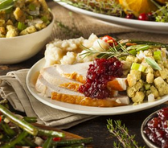
Cooking Class: Taco Tuesday
Do you love Mexican-inspired foods? If so, join us for this session in which we will create authentic and tasty Mexican dishes. We will also provide tips for enhancing the flavors of your meals. Best of all? We’ll sample all that we make!
MSU employees and eligible family members may attend.
Date & Time: Tuesday January 31, 5:15-6:40pm
Location: Kampeter Health Sciences Hall 426
Presenters: Gabrielle McGrath and Jack Simon, dietetics graduate students; Daniela Novotny, DHSc, RDN, LD, CHES
Please register through MyLearningConnection (search Cooking Talks) for this hands-on and informative session!

