Slide 1
Hello Omni CMS, goodbye Web Press!
MarCom Training Week 2023
Web strategy and development | MissouriState.edu/Web
Notes:
Introductions: Kai, Corey, Louis

Slide 2
Content
What we are covering
What's changed & basics
Design system
Access and support
Q&A
Notes:
Goals today:
Raise your skills to the next level if you're already doing basic editing.
Or, if you're new, get you comfortable doing the “little things” that only take a couple of steps.

Slide 3
What's changed & basics
Web Press -> Omni CMS
Notes:
Who used old system, Web Press?
Who’s only used Omni CMS? Never used in Omni?

Slide 4
What's changed?
Learn the basics of the new system
Good news. Omni CMS isn't as intimidating.
Key changes to know
Log-in
Editing
Navigation
Notes:
You'll find Omni CMS to be simplified and much more user-friendly for first-time users.
With a new system comes change.
Log-in: How do you get to the new system?
Editing: How do you change/publish stuff?
Navigation: How do you move through Omni CMS (and also update the nav bar?)

Slide 5
Change 1: How you login
Just go to the page
Web Press
Central log-in location.
Omni CMS
From your web browser, just go directly to the page you want to edit. Scroll to the bottom and select the little © symbol.
Let's do an example
Notes:
Web Press: Log-in, find the page or site you wanted to edit it. Every page had a unique Page ID number.
Omni CMS: Click the DirectEdit link at the bottom (copyright-looking symbol); Log-in with MSU credentials

Slide 6
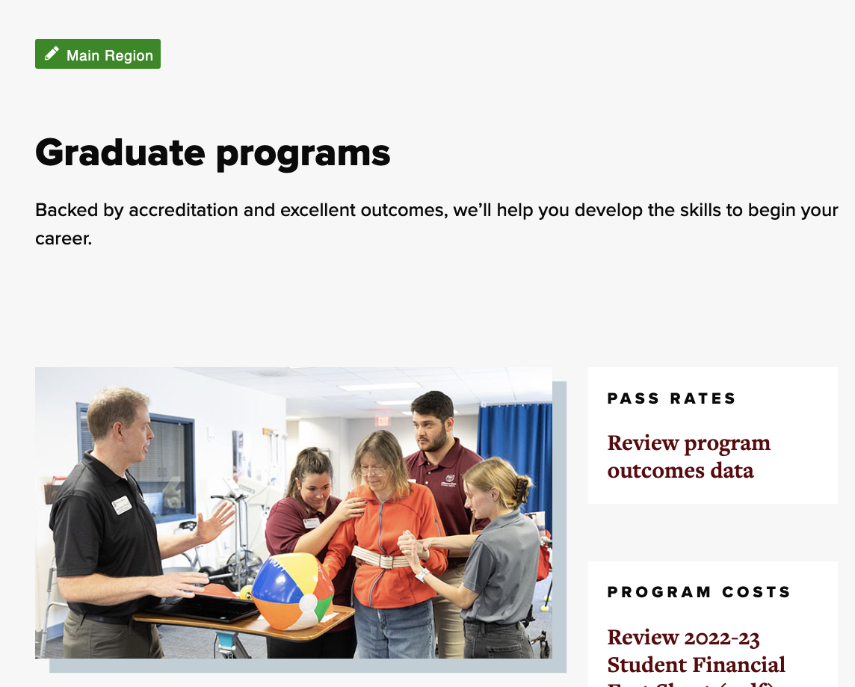

Change 2: How you edit content
Look for the green rectangle in the middle
Primary editing area: Main region. "Check out"
Basic text updates are very simple.
WYSIWYG toolbar – Where you edit or add content.
Notes:
Select Main Region to “Check out” your page. Yellow light comes on. It's yours to edit.
Basic text updates are very simple. Just point at the text you want to edit, change it, then save. Then hit publish
No more rich text block, submit/release, stuff like that.
WYSIWYG toolbar – where to modify/stylize your content. Snippets, Assets and Components.

Slide 7
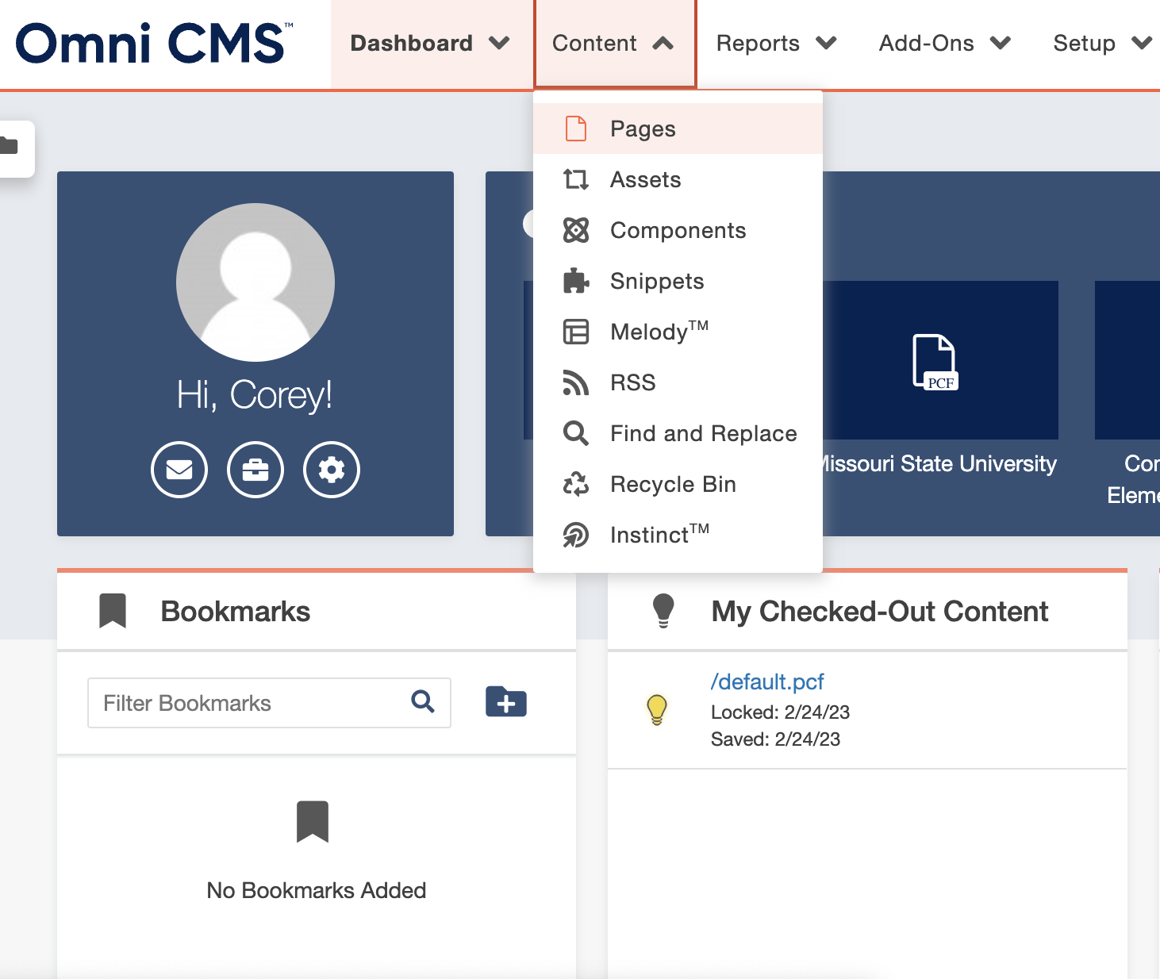
Change 3: Navigation
Part 1: for the editing system and your site
How you navigate between pages/sections
  Web Press vs. Omni CMS
In Omni, you go to Content->Pages.
  Pages are saved as .pcf files
Dashboard highlights
Notes:
Two parts to this.
In Web Press, everything was done via the left navigation bar. You could click any page you want to edit from there. Also build pages from there.
Not in Omni.
In Omni, you go to Content->Pages. That shows all the pages within your site or folder (section of your site). Or, open a new tab and go to the other page(s) you want to edit and log-in there.

Slide 8
Change 3: Navigation
Part 2: Updating your navigation bar
Global (site-wide)
  Not editable from page itself.
  Go to Content->Pages. Select _global-nav.pcf.
    Click the green Global Navigation Links rectangle.
    Edit and organize as needed.
Local (links within a specific page)
  Editable directly on the page (.pcf file).
  Select page (.pcf file) that the links are on.
  Edit on the page (.pcf file) in upper left. Save/publish.
Notes:
Navigation bar – What your site visitors see. That bar on the left side of your page with a list of links.
Site-wide = All pages within your site.

Slide 9
B. Design system
Snippets, components, assets
Use the design system as a guide when building pages. Design System

Slide 10

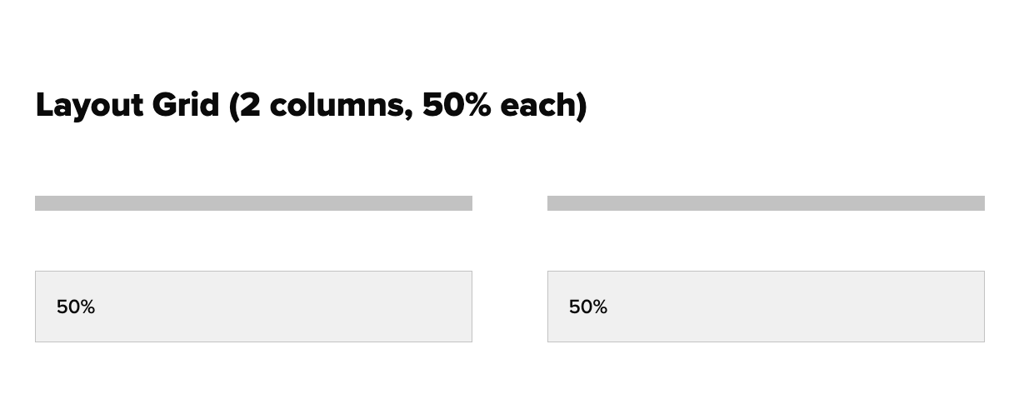
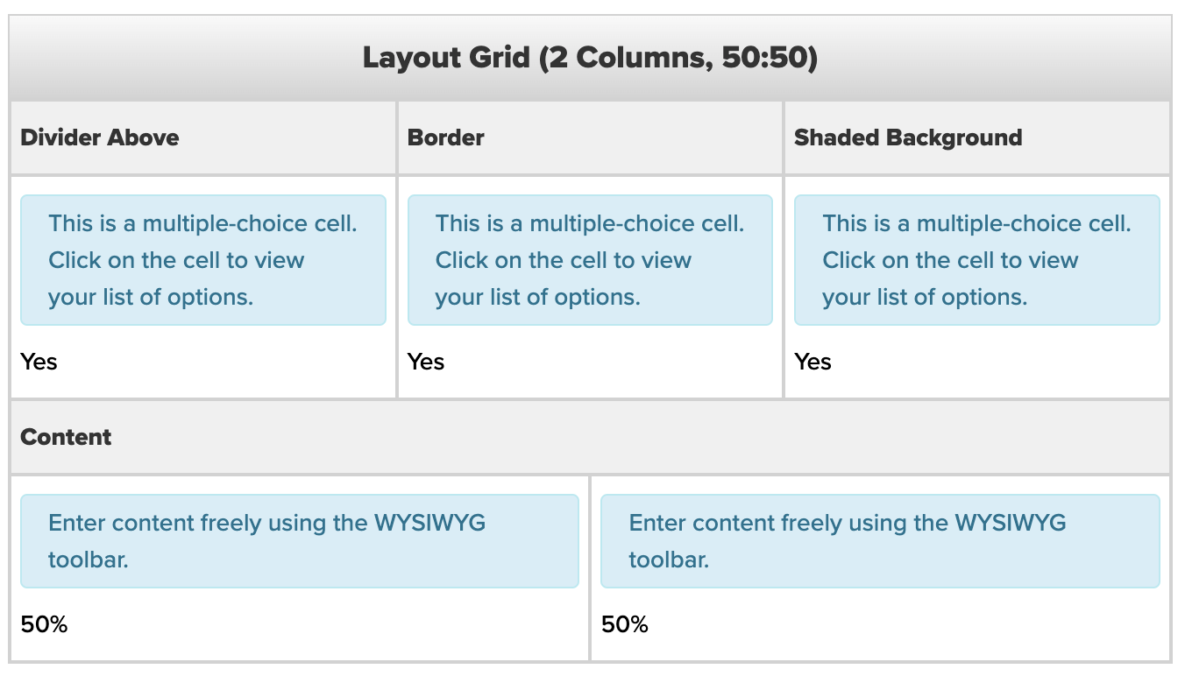
Snippets
Puzzle piece icon on menu Bar
The starting point for building
your page
Most common: Grids. Grids give your page structure.
Text and components (content) goes in grids.
Place in the editable region they appear as a table but display correctly when published.
Page Structure Template Guide
Notes:
Add examples

Slide 11

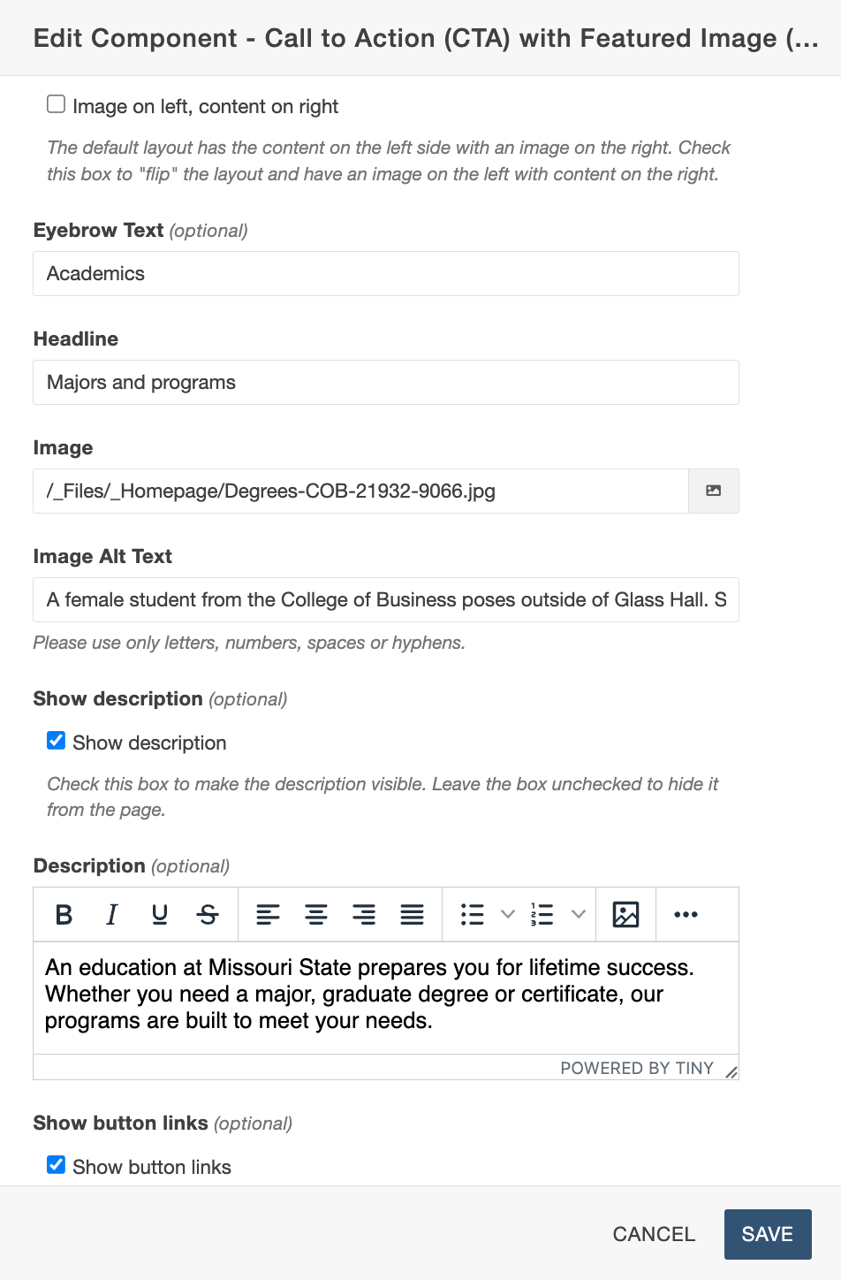

Components
Atom icon In the Menu Bar
Elements you use to design your content.
When placed on a page, they display as a form, and you simply fill out the fields with your content.
Examples: Touts (feature blocks), related content/important links, call to action.
Notes:
Now that you have structure
Add a component within the layout grid snippet
Examples
Walk through an example

Slide 12

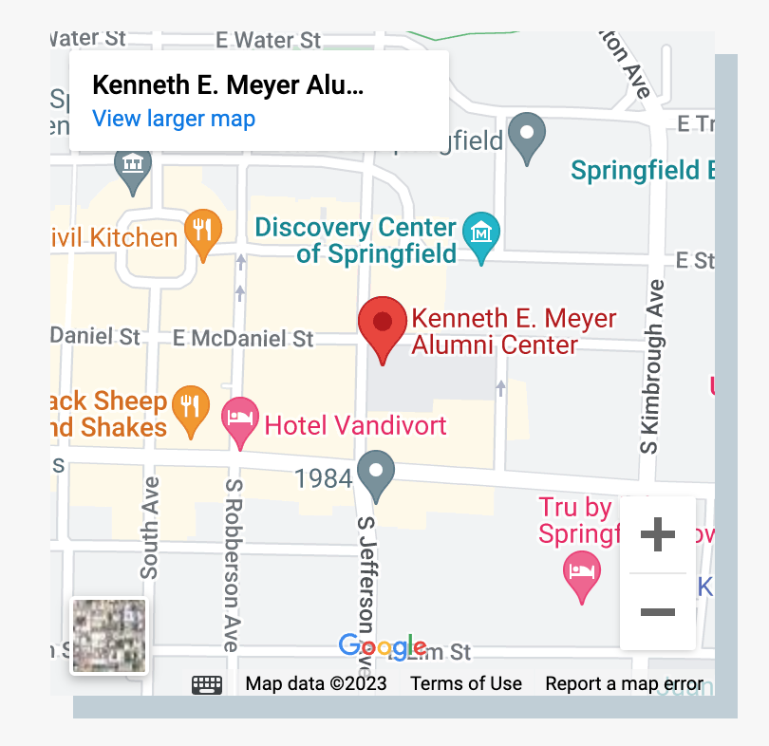
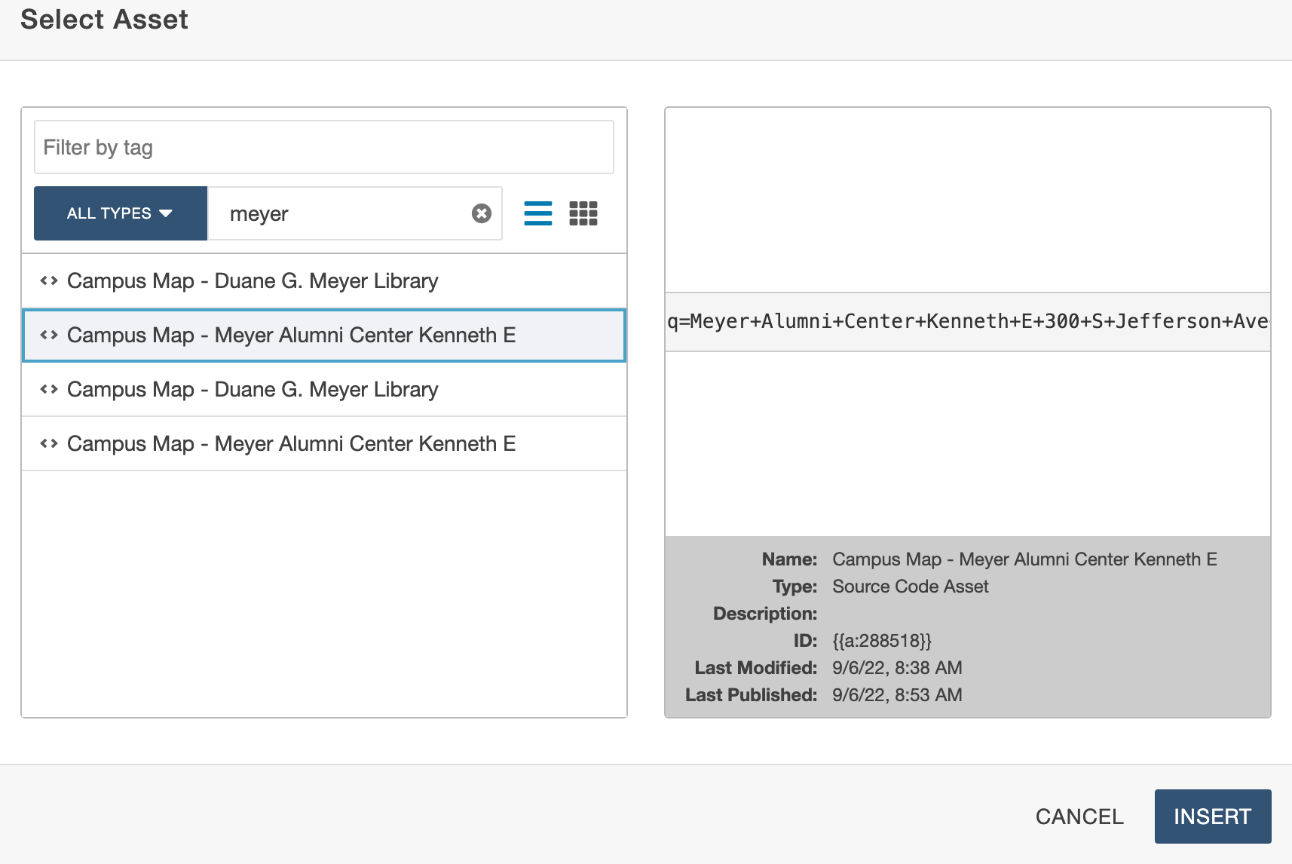
Assets
Majority are used by WSD. Displayed as a box with Arrows
Reusable content
If you use it one page, you can also use it one another on another and it'll be the same.
Examples: maps, catalog content (academics), policy library.
Notes:
Examples
Uneditable content we manage such as maps, policies , blog feeds and etc.
Forms the main one they will use

Slide 13
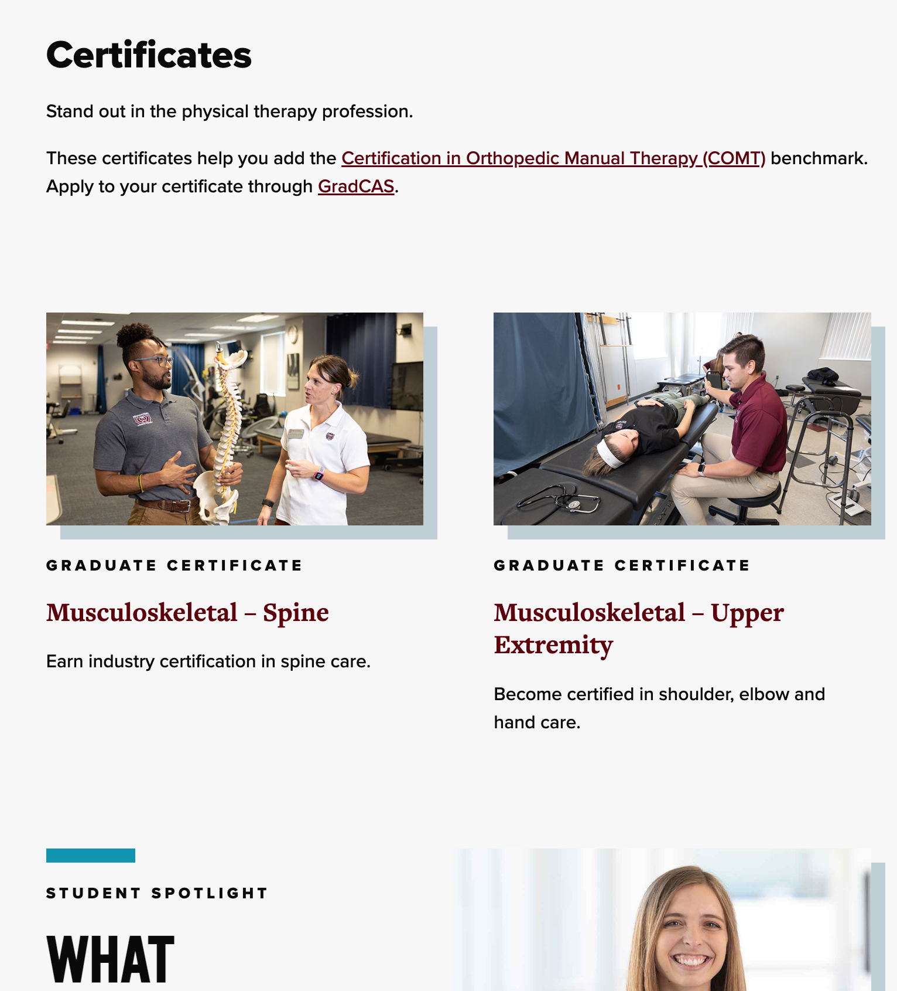
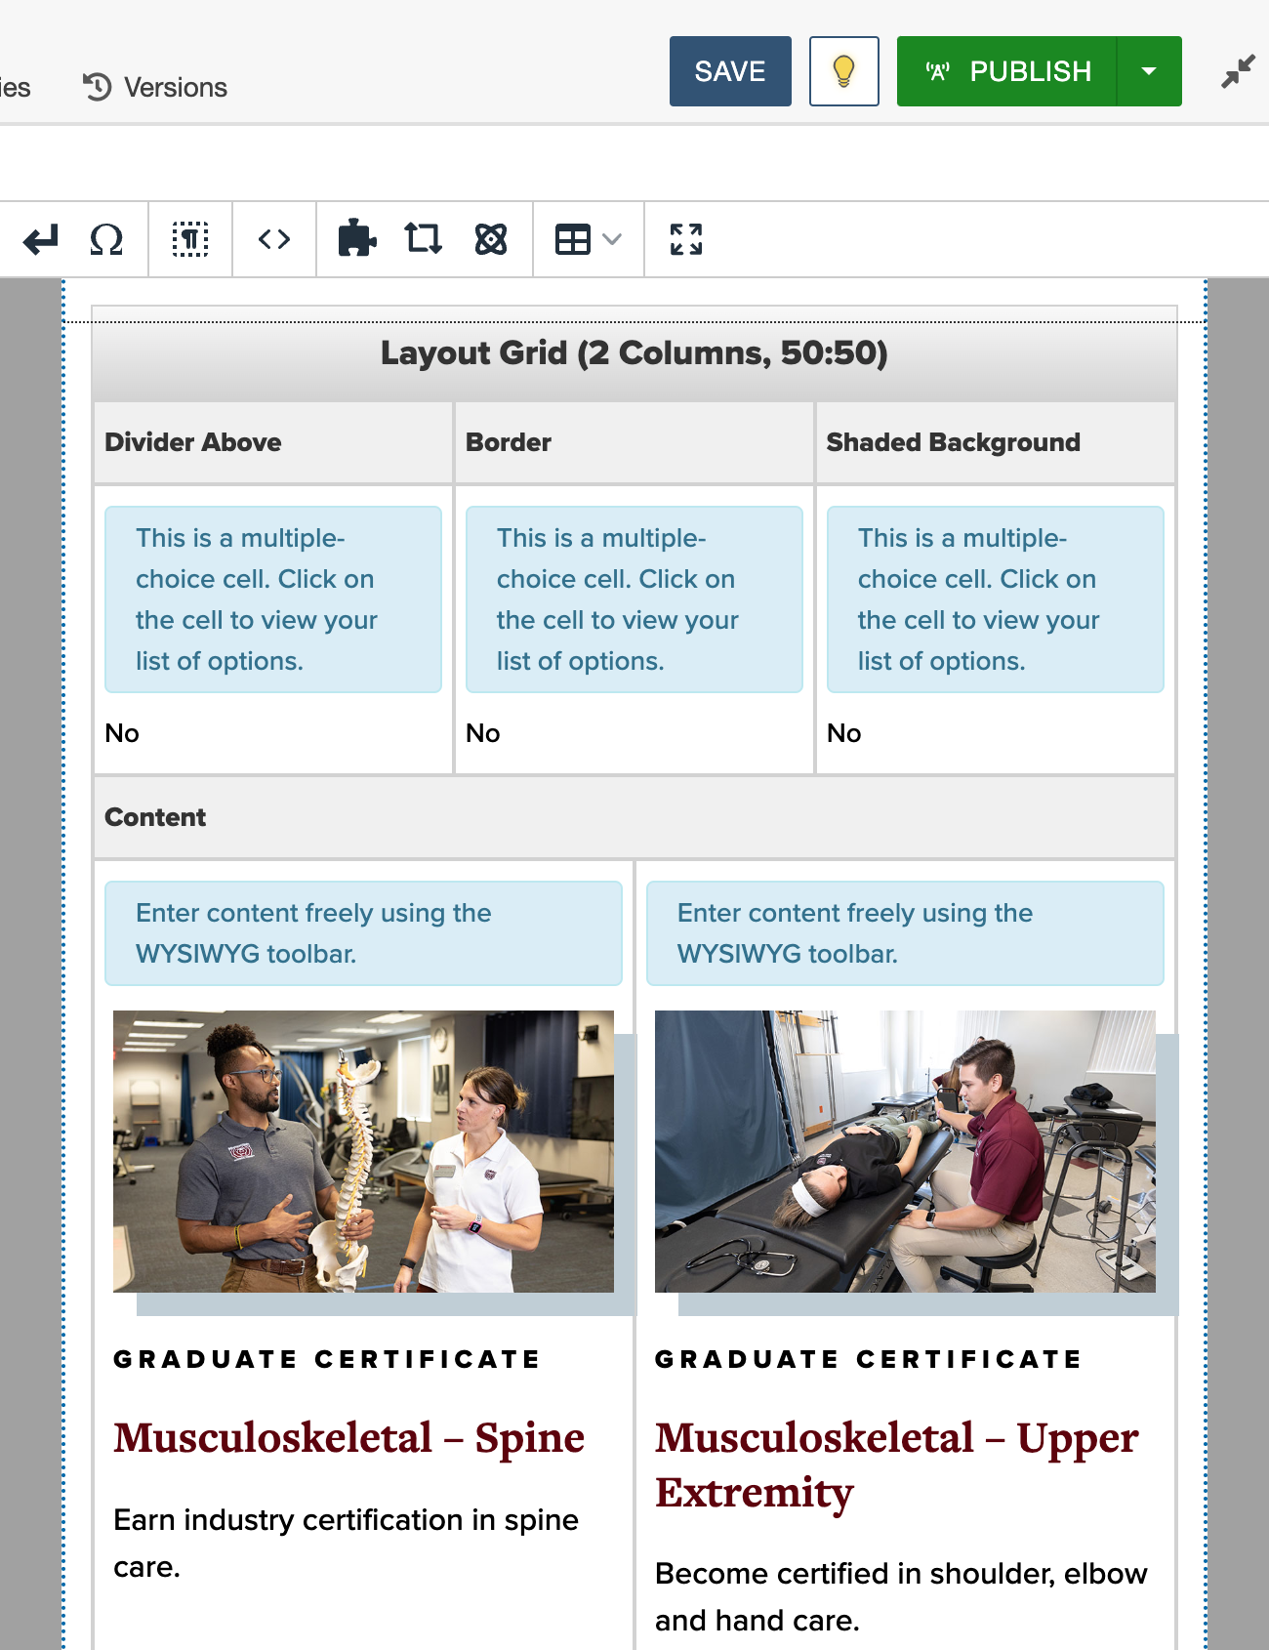
Building a page
putting it all together
Examples
www.missouristate.edu/physicaltherapy/
Reference Tools
Use the design system guide
when building pages.
Design System
Notes:
Open in Omni in Edit mode
Components
Examples

Slide 14
Tips
Make the most of the CMS to Showcase your Content
Use eyebrow text (if available in the component) to give clarity to the section, keep it short and category like.
Use clear heading hierarchy to break up content.
Use notice format for only short-term urgent changes.
Use the element guide for determining how components should be used.

Slide 15
Accessibility
<h1>Page Title
<h2>Section
<paragraph>Copy
<h3>Sub section
<paragraph>Copy
<h4>Sub sub section
<paragraph>Copy
<h5>Sub sub section
<paragraph>Copy
Content should be legible to all .
The Web Content Accessibility Guidelines (WCAG) provide specs to improve the accessibility of web content for people with a wide range of disabilities.
Screen readers, contrast, links.
Basic issues. Spelling, no image descriptions, broken links, adding copy to images, no content hierarchy.
Secondary benefits to organic search.
<h1> Dynamic page title only
Notes:
Spelling....wcag in the future possibly

Slide 16
C. Access & support
resources

Slide 17
Omni CMS
ETA start to approval: 4-5 days.
Access granted upon verification of training.​
The process to get access
Step 1​
Submit our request form to become a web editor.​
Or, email WebSupport@MissouriState.edu with the necessary request details.​
Step 2​
Complete the required trainings (in Blackboard)​.
  Website Accessibility and Content Editing​.
  Basic Omni CMS​.
Step 3​
Submit our request form to verify your trainings.

Slide 18
Support
Average completion time 2-4 days
Varies based on complexity of request.
Websupport@missouristate.edu
Web Support Desk​
  Email WebSupport@MissouriState.edu​
  Phone
  417-836-5271
Editor Support
WebSupport.MissouriState.edu
Resources
Web Design System
WebDS.MissouriState.edu
Elements/Components
Elements Guide
Documentation
WebSupport.MissouriState.edu/OmniCMS
New internal support tools were implemented 3 weeks ago making our response time more efficient.

Slide 19
FAQ
Common Omni CMS Support Questions
Directory & Profiles
Profile Photos: Participate in Photo Days.
  Or, submit a 500x600 headshot to web support for approval.
Office Location & Phone Number can be updated via Organizational Chart Profile.
Profile Details — Submit to Web Support.
HR must change: Contact information, name, email, job title.
Broken Images in Preview
  Preview uses the Production (live) version of files — unpublished images may not display.
  Publish unpublished photos to display.
Frozen Forms​
  Forms originally built in Web Press are currently frozen in Omni CMS.​
  Minor edits to frozen forms can be made by us.​
  Frozen forms should be rebuilt as an Omni Form (Asset) for future edits.
Notes:
2-3+ weeks from photo day to being uploaded

Slide 20
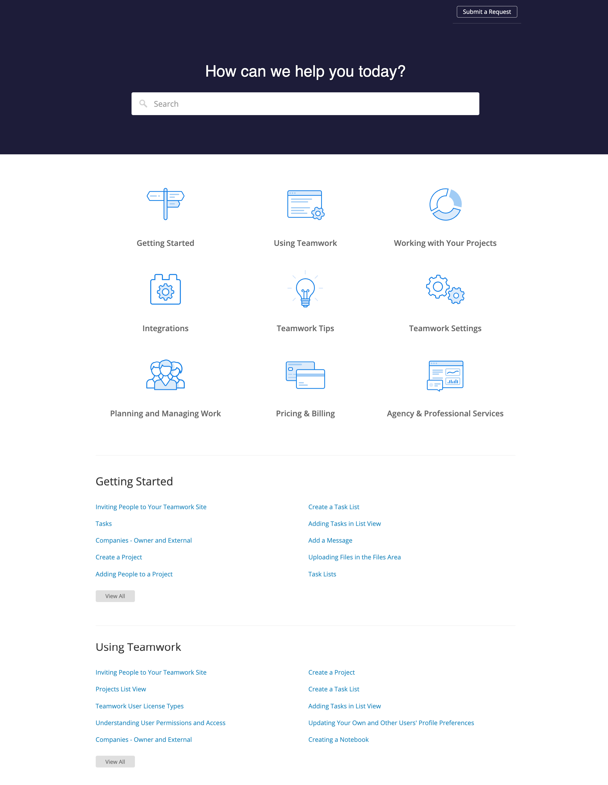
Coming soon
New support knowledge base
New Omni master calendar
Google Analytics 4 dashboards

Slide 21
Q&A

