Slide 1
Title IX –Investigator Specific Training
Required Training
https://www.missouristate.edu/Policy/Op1-02-11-title-ix-sexual-harassment-grievance-procedure.htm
Fall 2021

Slide 2
Title IX Required Training
Training will cover the following topics:
Review issues of relevance; and
Technology to be used to populate the Electronic Database utilized under this Policy.

Slide 3
Relevance
Relevant Evidence is evidence that is probative to the resolution of allegations included in the Formal Complaint.

Slide 4
Investigation Electronic Database
Op1-2-11 (8.4)
Evidence obtained by the Title IX Investigator will be uploaded to the Electronic Database. The Title IX Investigator will provide equal password protected access to both the Respondent and Complainant (including Advisors) allowing each party the opportunity to review the evidence obtained during the investigation of the Formal Complaint.
Notes:
The Complainant and Respondent shall each have the opportunity, but not the obligation, to review and provide a written response to the evidence collected in the Electronic Database.

Slide 5
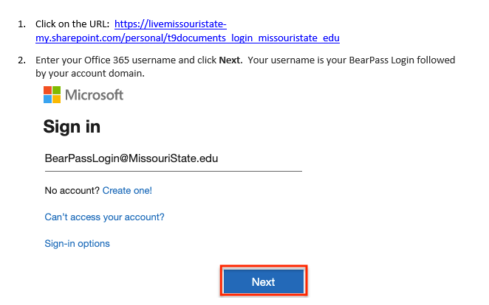
SharePoint – The University’s Electronic Database
Notes:
Once you enter your username, the page will automatically re-direct you to the Missouri State University Office 365 server. Enter your BearPass password. This is the same password you use to login to My Missouri State, Blackboard, and campus computers.
Click Sign in.

Slide 6
SharePoint – The University’s Electronic Database
Creating a Folder
Folders will be created in the University’s secured Clementine drive. Folders should be clearly labeled to avoid confusion in cataloging information.

Slide 7
SharePoint – The University’s Electronic Database
Uploading Relevant Evidence to a Folder
Throughout the process, the Title IX Investigator shall upload relevant evidence (including inculpatory and exculpatory relevant evidence) to the designated folder for each active Investigation.

Slide 8
SharePoint – The University’s Electronic Database
As described in the Policy, the Title IX Investigator shall make the investigation folder including the relevant evidence collected available for review by the parties and their advisors.

Slide 9
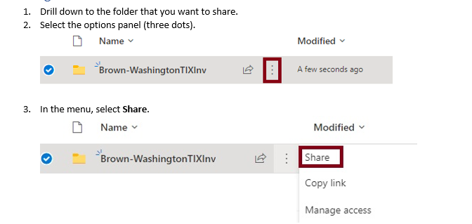
SharePoint – The University’s Electronic Database
In order to share a folder, the Title IX Investigator will:

Slide 10
SharePoint – The University’s Electronic Database
A drop down menu will be available. Select the option to provide a link to the shared folder.
The Title IX Investigator will then create a unique link and password for each Party and the Party’s designated advisor.

Slide 11
The Title IX Investigator will monitor access to the provided folder to minimize the impermissible sharing of information outside of the Party and designated advisor.

