Slide 1
Site Supervisor Orientation
Counseling Program
Department of Counseling, Leadership and Special Education
Missouri State University

Slide 2
Program Description
CACREP - accredited program.
School Counseling and Community Mental Health tracks lead to certification and/or licensure-eligible degrees.
All students complete 60 hours of coursework:
  Includes core curriculum with focus on national standards of professional and ethical practice.
  Practicum and internship placements including partnerships with area schools and community agencies which provide real-world, real-time experiences.

Slide 3
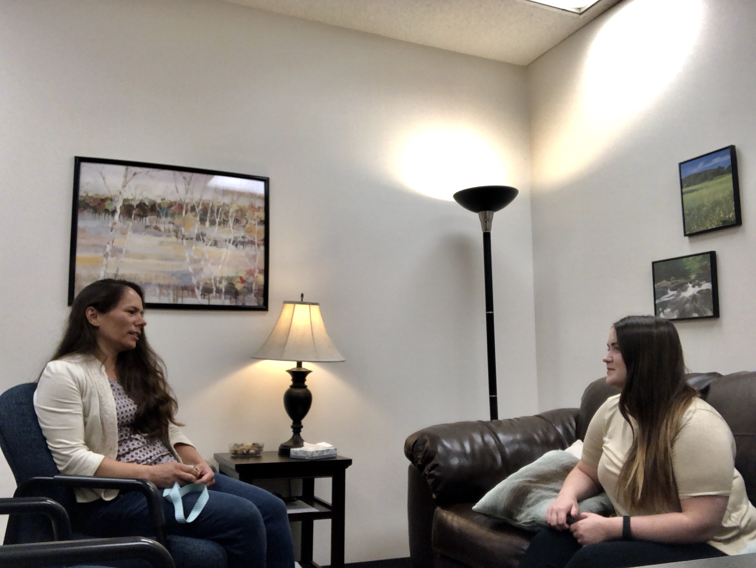
MSU Counseling Practicums
•Students work in a clinic and/or school setting for a total of 100 direct and indirect hours.
•Springfield students often begin at Center City Clinic, with 2nd semester placements off-site.
•West Plains students may begin with off site placements, supported by individual and group supervision at the university as well as on-site.

Slide 4
Compliance Documents
Must be completed before students are released to register for any Practicum or Internship:
Compliance Info found here: Compliance Documents
This includes:
  TB Test
  FBI Background check with fingerprinting (MOVECHS)
  Professional Liability Insurance (ASCA or ACA)

Slide 5
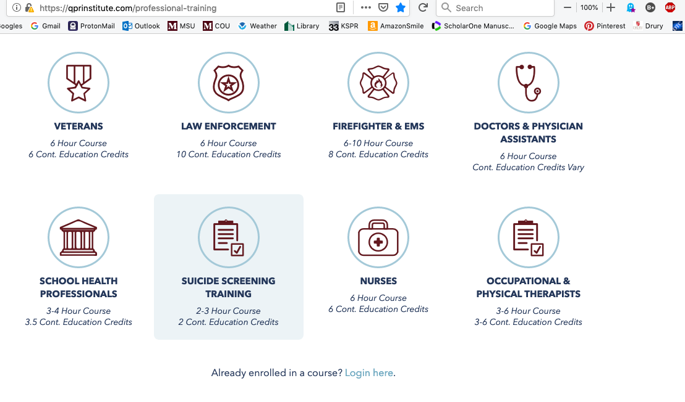
Required Training: Suicide Screening
All students complete:
Suicide Screening Training using the QPR Institute Model.
  QPR Suicide Screening Training

Slide 6

Required Training, Mandated Reporter
Mandated Reporter Training at
protectmokids.com : Go here: Mandated Reporter Training

Slide 7

Internship
Students complete 600 total hours of “supervised counseling…in roles and settings…relevant to their specialty area.” (2016 CACREP Standards)
240 clock hours of direct service
May be completed in at least two or more semesters as needed.

Slide 8
Mental Health Internships
Students may stay at the same site for more than one semester.
Students are encouraged to choose their own sites
MSU encourages the development of new sites.
Application process for students at MSU and sites (MSU process is online for students. Site application process varies by site.
Site supervisors may contact MSU Internship Coordinator for application suggestions if desired. (amelia302@missouristate.edu)

Slide 9
School Counseling Internships
*Certificate students may have different requirements
Students are encouraged to find their own sites.
Will have typically work a different site each semester—Elementary/Secondary
School systems may have their own application process:
Please inform MSU Internship Coordinator of your school site’s application process/requirements: (amelia302@missouristate.edu)

Slide 10
Site Supervisor Requirements
Agency/School must sign Memorandum of Understanding with College of Education at Missouri State University
Be fully licensed (CMHC) or certified (SC) in Missouri, with minimum of two years post-licensure experience.
Clinical supervision for Mental Health interns must be provided by LPC or Licensed Psychologists. (On-site work supervisors may include other clinical disciplines*)
Complete site supervisor training every three (3) years
Review online orientation annually, more often if needed.
Provide current copy of resume or CV to MSU Internship Coordinator, with:
  Contact Information •Credentials • Degrees •Relevant work experience.

Slide 11
Site Supervisor Requirements
Provide average of one hour per week of face-to-face clinical supervision throughout the student’s entire placement at your site.
Complete all required documentation.
Engage in professional and ethical supervision as outlined in the ASCA or ACA Guidelines.
Be fully engaged in the supervisory process throughout the experience.
Be accessible to the intern throughout the experience.
Contact the student’s university supervisor or the Counseling Program internship coordinator as soon as concerns are noted.

Slide 12
Supervising Counseling Students
A model for supervision is crucial to our development as counselors.
Developmental Models show the supervisee growing and changing over time, as a result of supervision.
Thompson (2004) identified 3 stages of supervision:
  Dependency
  Trial and turbulence
  Growth

Slide 13
Supervision for students, interns and professionals
An ”Integrated Developmental Model” (Stoltenberg, et al 1998) shows:
  Level One: Beginning Master’s Level supervisees may be seen as dependent and needing structure.
    The supervisor serves best as “teacher.”
  Level Two: Master’s Level Interns, are seen as experiencing conflict between dependence and their own autonomy.
    The supervisor serves best as “coach.”

Slide 14
Supervision for students, interns and professionals
An ”Integrated Developmental Model” (Stoltenberg, et al 1998) continued:
Level Three: Post-Master’s degree, doctoral level supervisees are described as more stable, desire mutual sharing, challenge and confrontations
Level Four: Master counselors, supervision is typically “collegial”

Slide 15
Supervising Counseling Students
Various models indicate core characteristics for effective supervision.
Consistent: Meet regularly with supervisee
Strengths-based: Supervisee should have a foundation of understanding, leave feeling stronger than when they came in.
Encouraging: Good listening skills, and the ability to validate the supervisee’s experiences while encouraging growth.
Accountable: Model accountability for their own actions and hold supervisee accountable for theirs.

Slide 16
Supervising Counseling Students
Core characteristics of effective supervision, continued:
  Provides constructive feedback: about job performance, strengths, areas for growth.
  Responsive: Is there when supervisee has questions, concerns; especially in times of client/student crisis.
  Strong ethics: Educates and models strong ethics.
  Clear boundaries: The supervisor is not a “friend” and understands how to share personal information appropriately.
  Provides practical answers: Has knowledge and experience to give meaningful directions or suggestions.

Slide 17
Supervising Counseling Students
Appropriate boundaries in counseling supervision are essential:
  For ethical counselor development.
  For effective therapeutic interventions and alliances.
Supervision may be therapeutic, but supervision is not therapy.
  MSU counselor trainees are encouraged to seek counseling as part of their developmental process .
  Contact MSU faculty for counseling referrals.

Slide 18
Supervisor Ethics and Boundaries
It is important to monitor boundaries in the supervisor/supervisee relationship and supervisee/client relationship.
Supervisors attend to appropriate boundaries and model them for supervisees.
Supervisors address boundaries and supervision areas using ACA or ASCA Code of Ethics
Supervisors have awareness that supervisees may need assistance establishing and maintaining boundaries.
Supervisors and supervisees demonstrate compliance with the ACA or ASCA Codes of Ethics.

Slide 19
Mandated Reporting
Counselor trainees are mandated reporters of suspected abuse and/or neglect.
  Suspicion, not proof, merits reporting.
  Counselor trainees are not investigators and should not engage in questioning that could impede and investigation.
Notifying a supervisor does not exempt a counselor trainee from reporting requirements.
Notifying a supervisor is NOT required under the law.

Slide 20
Practicum and Internship Documentation Information
Students, faculty and supervisors have access to the Practicum and Internship Handbook. (Updated in 2020!)
Information and most documents are in this handbook.
May be downloaded or viewed in .pdf format here:
  Practicum and Internship Handbook Link

Slide 21
Documentation of Services
Direct Services include: Indirect Services include:
Individual counseling
Couples and family counseling
Group counseling
Whole class counseling
Intakes
Other services as approved by course instructor and involving direct contact with clients.
Treatment planning, case notes, records
Lesson/small group planning
Individual and group supervision
Professional development
Observations
Team meetings, consultation, collaboration, etc.
Other services as approved by course instructor

Slide 22
When May Students Begin?
•Counseling interns may begin earning indirect hours prior to the start of the MSU semester with university and site approval.
•Document all “interim” hours the first Weekly Progress Report.
Students working before or after the MSU semester complete the Interim Agreement form.
Students who have completed their first internship may provide direct service during the interim period.

Slide 23
Special areas of consideration
Supervisors ensure counselor trainees are working within scope of training.
  Contact student’s instructor or Internship Coordinator if there are concerns or questions as soon as you notice them.
Counselor trainees are not to:
  transport clients
  engage in any activities off-site without approval of course instructor
If issues arise, supervisors should contact the course instructor immediately and follow up with the internship coordinator as needed.

Slide 24
Supervisor Emergencies
If an emergency arises that would:
  Prevent the on-site supervisor from being at the site for an extended period of time,
  Unable to meet with the counselor trainee for weekly supervision
  Notify the course instructor immediately.

Slide 25
Site Supervisor Stipend
To obtain your stipend for supervising an intern, download the Independent Contractor form:
https://apps.missouristate.edu/financialservices/Forms/IndependentContractorForm.pdf
•Complete form in black ink, mail to Judy Campbell, CLSE, MSU 901 S. National, Springfield, MO 65897
•Questions about the stipend or form? Email Mrs. Campbell: jcampbell@missouristate.edu or by phone: 417-836-5392
•Employed at MSU within the past 12 months? Contact Mrs. Campbell regarding alternative methods of payment.

Slide 26
Online Training Review and Documents
Site Supervisors who are reviewing these slides online:
  Send a copy of most current copy of the following documents via email to the MSU Internship Coordinator: amelia302@missouristate.edu
  When we receive these documents, we will send you verification by return email that you completed the training review and are approved for ongoing internship supervision.
    Resume
    License
    Liability Insurance

Slide 27
Thank you!
Thank you for your willingness to provide supervision and share your expertise with counselor trainees!
If you have additional questions or concerns, please email the Practicum and Internship Coordinator or call 417-836-4918.

