Slide 1
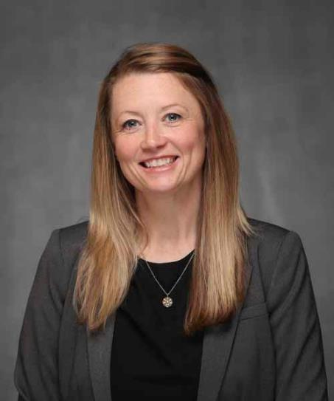
Missouri State University Career Center
To fulfill competency #4, contact:
Sherry Elkins
Career Resource Specialist
___________________________
Career Center can help fulfill Leadership/Professional Competency
Resume Support
Interview Practice

