Slide 1

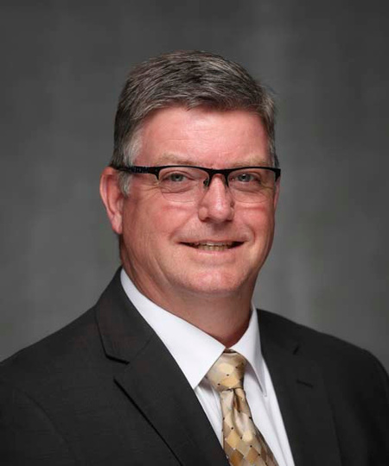


Dr. Andy Ward
Assistant Professor of Physical Therapy
Missouri State University
AndrewWard@MissouriState.edu
Philippines
Island of Panoan
1987-88
Sector: Agro-Forestry

