Slide 1
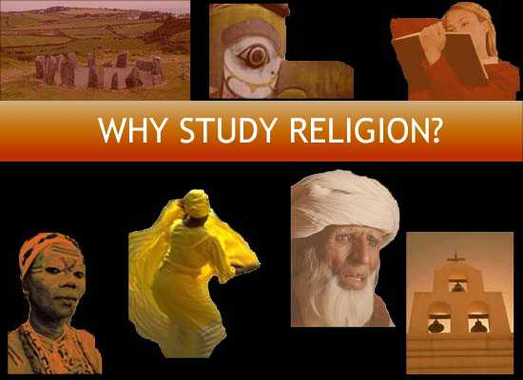
Image, above, from studyreligion.org (American Academy of Religion)

Slide 2
Why Is Religion Important?
“If there was ever any doubt, 9/11 proved that, as with our recent election, you can’t understand the world without understanding religion.”
-Gerald F. Powers
“You can't understand America without understanding religion.”
–David Stowe
“You cannot understand the human condition without understanding religion.”
-Stephen Jay Gould

Slide 3

Why Study Religion at MSU?
A Large, Diverse and Excellent Faculty
Amy Artman – American Religions
Leslie Baynes - New Testament
Stephen C. Berkwitz - Buddhism
Philippa Koch - American Religions
Mark Given - New Testament
Lora Hobbs - Religion and Society
Matthew Kuiper - Islam
J. E. Llewellyn - Hinduism
Victor H. Matthews - Hebrew Bible
Kathy J. Pulley - Religion & Society
Micki Pulleyking - Philosophy of Religion
Vadim Putzu – Judaism
Austra Reinis - History of Christianity
John Schmalzbauer - American Religions
John T. Strong - Hebrew Bible

Slide 4





Comparison Shopping for Religion Departments
Fifteen Faculty
Fifteen Faculty
Eight Professors
Program but
no department
Six internal
faculty
Program but
no department
Eight Faculty

Slide 5
Student Scholarships
Each spring the Department of Religious Studies at Missouri State University offers several scholarships for the following academic year. Currently, the total amount awarded each year is over $10,000. All scholarship application materials must be submitted by March 1 for the following academic year.
Rose Marie and Martin H. Boone, Jr. Religious Studies Scholarship
DeVries Family Religious Studies Scholarship
3) F.W.A. Bosch Scholarship
4) Kathy J. Pulley Religious Studies Scholarship (requires a focus on community service)
5) James P. Robinson Ecumenical Center Scholarship
6) William R. (Bill) Smith Baptist Student Union Memorial Scholarship
7) Schyler Elizabeth Strong Biblical Archaeology Award
8) *Moyer Family Scholarship
9) *Gerrit J. tenZythoff Religious Studies Scholarship
10) *Women in Religious Studies Scholarship

Slide 6
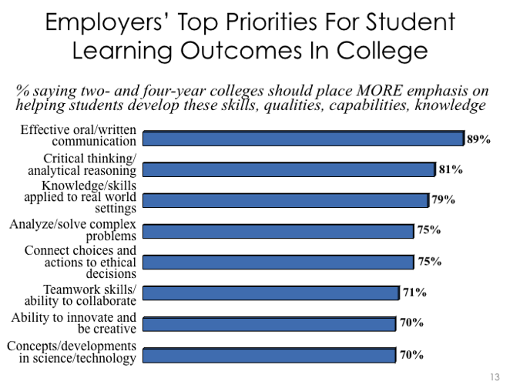
Don’t be afraid of the humanities
Notes:
https://www.aacu.org/leap/presidentstrust/compact/2013SurveySummary

Slide 7

Don’t be afraid of the humanities
Nearly all employers surveyed by the AACU (93 percent) say that “a demonstrated capacity to think critically, communicate clearly, and solve complex problems is more important than [a job candidate’s] undergraduate major.”
Notes:
https://www.aacu.org/leap/presidentstrust/compact/2013SurveySummary

Slide 8

“‘Studying philosophy taught me two things,’ says Butterfield, sitting in his office in San Francisco’s South of Market district, a neighborhood almost entirely dedicated to the cult of coding. ‘I learned how to write really clearly. I learned how to follow an argument all the way down, which is invaluable in running meetings.’”

Slide 9
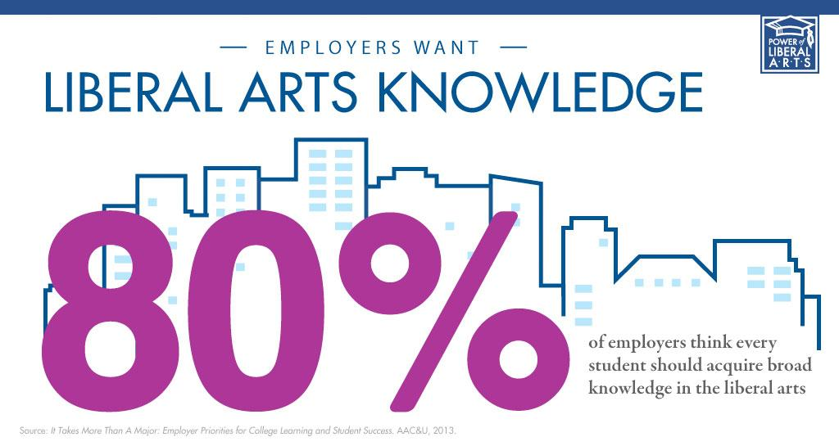
Humanities Majors are Marketable

Slide 10
Employers want colleges to focus on critical thinking, oral communication, writing, and evaluating information

Slide 11
Employers want students to know about ethics & cultural diversity

Slide 12

Humanities majors land good jobs
“Contrary to political rhetoric that became popular during last year’s political primary campaigns, philosophers do, in fact, make more than welders. . . . Unemployment rates for humanities graduates are also significantly lower than the national average.”
(SOURCE: Chronicle of Higher Education)

Slide 13


Median Mid-Career Salaries for Selected College Majors
Religious Studies | $62,100
Criminal Justice | $61,900
Kinesiology | $61,900
Medical Laboratory Science | $61,700
Graphic Design | $61,700
Foods and Nutrition | $61,500
Animal Science | $60,800
Education | $60,600
Exercise and Sports Science | $60,300
Clinical Psychology | $59,700
Banking | $59,400
Health and Exercise Science | $59,100
Speech-Language Pathology | $58,900
Recreation and Leisure Studies | $55,000
Exercise Science | $54,500
Social Work (SW) | $48,300
Early Childhood Education | $40,400

Slide 14

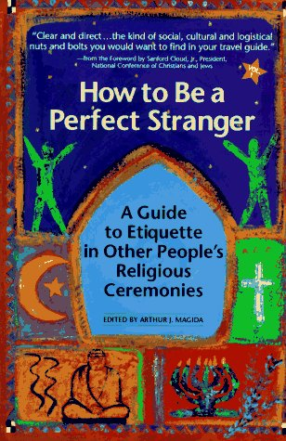
Globalization means that many occupations demand religious literacy

Slide 15
Career Preparation in Religious Studies
The study of religion provides many occasions for personal and intellectual growth, but it also transmits a set of very practical skills to students:
Gain a fundamental cultural literacy
Training in skills associated with data gathering and direct observation
Development of analytical skills and creative thought
An ability to empathize with other people and understand different perspectives
Religious Studies provides a useful academic foundation for many different careers.
Professional training in: Positions in:
Business (esp. international business) * Hospitality & Event Planning
Counseling and Social Work * Government & Foreign Service
Education * Management & Human Resources
Journalism * Museums & the Arts
Law * Non-Profits & NGOs
Medicine * Publishing

Slide 16
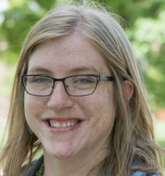
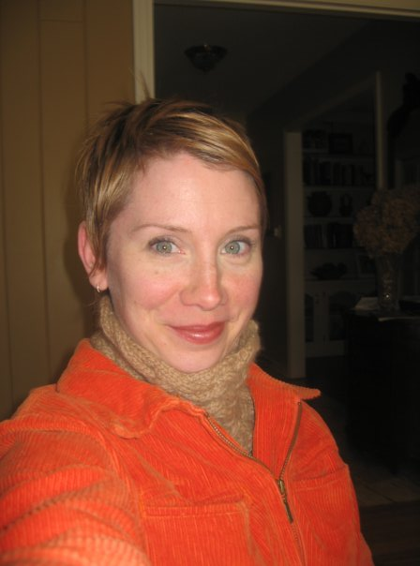







Alumni in the professoriate
Rachel McBride Lindsey
Leslie Dorrough Smith
Brian Doak (MA alum)

Slide 17

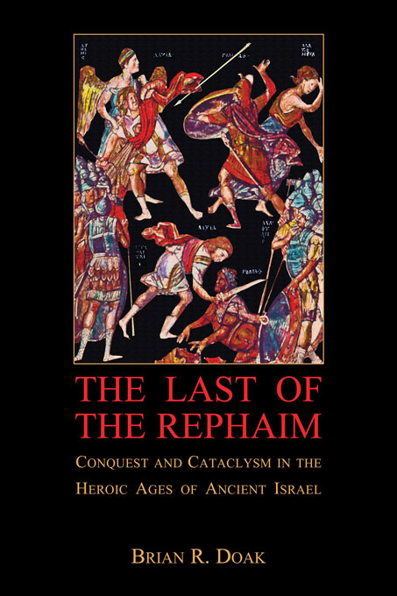
Recent Alumni Books
Oxford University Press
Harvard University Press

Slide 18
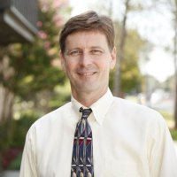
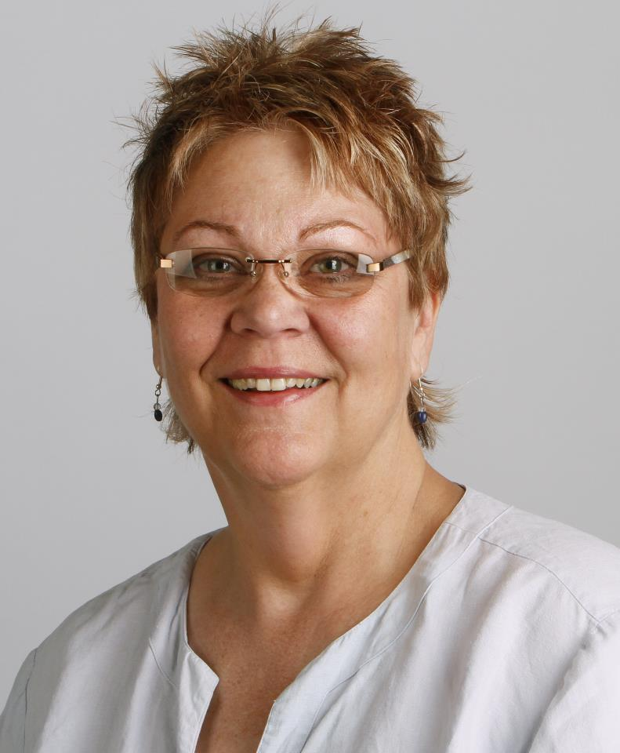


Alumni in the Professions
Joseph Pulleyking
BA Alum
MTS, Harvard Divinity School
Psy.D., Forest Institute
Psychologist, Mercy Clinic
Linda Leicht
BA Alum & MA Student
Former Editorial Page Editor,
Springfield News-Leader

Slide 19

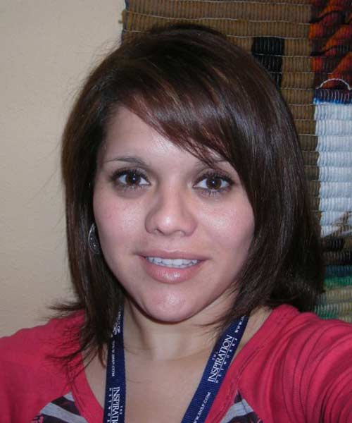


Alumni in the Professions
Phil Dieke
Student Discipleship Coordinator
Joanna Mendez
International Services

Slide 20

Consider an Accelerated Master’s in Religious Studies from Missouri State University

Slide 21

MSU has the oldest public university religion graduate program in Missouri
Accelerated Master’s students earn double credit for graduate courses while earning a bachelor’s degree!
Great preparation for many careers, including academia, psychology, seminary, and social work
Graduate assistants receive tuition waiver plus stipend of approximately $8,772 per academic year
Religious Studies students have won MSU’s thesis award three times in past twelve years

Slide 22

Consider a double major or minor in Religious Studies
Image, above, from sites.allegheny.edu/unusualcombinations/profiles (Allegheny College)

Slide 23






Fields that go well with Religious Studies

Slide 24


MSU Religious Studies received a $30,000 grant to develop courses on religion and health in 2016.

Slide 25

MSU Courses on Religion and Health
REL 338 – Death, Dying, and Afterlife
REL 347 – Suffering and Meaning
REL 348 – Religion, Spirituality, and Health
REL 358 – Yoga and Meditation
PSY 368 – Body and Health in American Religions
REL 378 – Religion and Healing in Modern America
REL 530 – Women, Violence, and Religion
PSY 533 – Psychological Issues in Religion

Slide 26
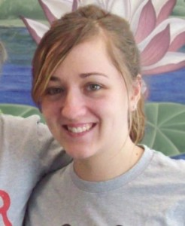
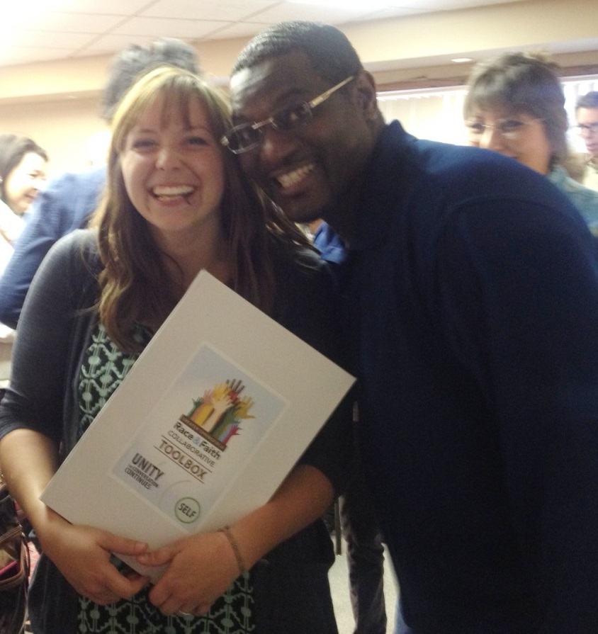
Religious Studies Internship Program
Samantha Nichols
KSMU/Ozarks Public Radio
Stacy Street
Race and Faith Collaborative Project
http://www.missouristate.edu/relst/Internship.htm

Slide 27
2018 Religious Studies Internships
Ambassadors for Children Internship
Missouri Health Care for All Internship
Veterans Holistic and Collaborative Care Internship
KSMU Radio "Religion Beat" Internship

Slide 28
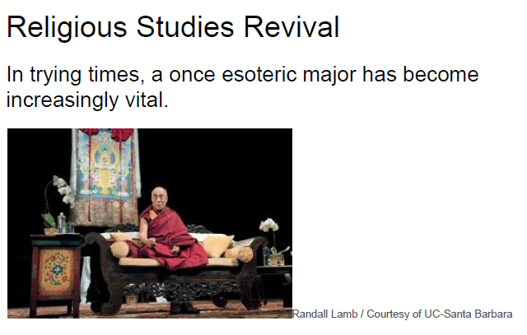

Nationally, Religious Studies has experienced a revival
“The number of bachelors degrees conferred upon graduates in philosophy or religious studies has doubled since the 1970s to nearly 12,000 a year, and has been rising steadily since 9/11.”

Slide 29

“If I went back to college today, I think I would probably major in comparative religion, because that’s how integrated it is in everything that we are working on and deciding and thinking about today.”
United States Secretary of State John Kerry, August 7, 2013

Slide 30
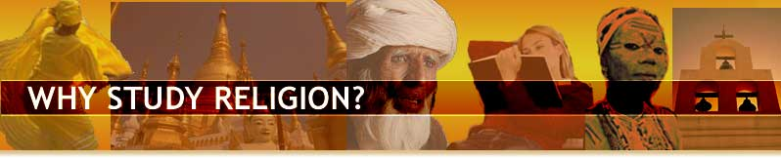
For more information on why you should consider a Religious Studies Major, Minor or Masters, visit
www.studyreligion.org
Image, above, from studyreligion.org (American Academy of Religion)

