Slide 1
All Faculty Recognition
May 2021

Slide 2
Table of Contents
Slides
University and Division Awards 3 – 35
Honoring Our Retiring Faculty 36 – 66
Faculty Service Awards 67 – 76
Grants Awarded 78 – 83

Slide 3
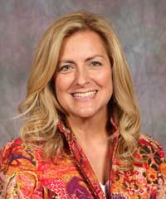
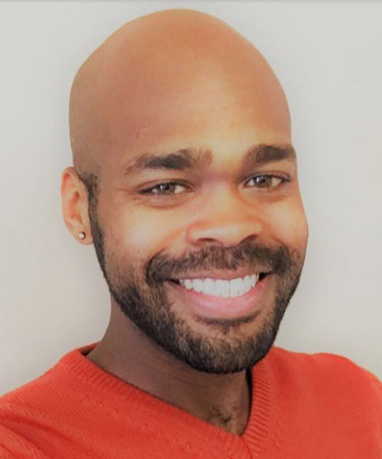
MSU Foundation Awards for Teaching
Margaret Weaver
English
Kyler Sherman-Wilkins
Sociology & Anthropology

Slide 4
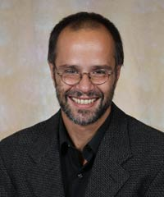
MSU Foundation Awards for Service
David Romano
Political Science

Slide 5
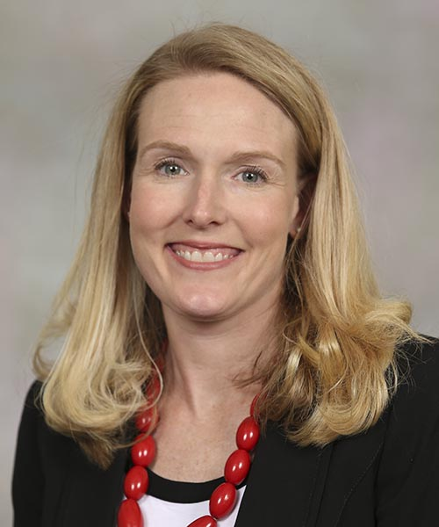
2020-21 Provost Fellows
Provost Fellow for Public Affairs
Amanda Brodeur
Biomedical Science
Dr. Brodeur is an Associate Professor of Cell & Molecular Biology. Amanda’s research involves understanding the biochemistry of human disease.
This year’s conference theme “the power of Voice” featured panels, plenaries and special events that focused on what effect do the myriad voices have on individuals, groups and society at large. How do people find their own voice and be heard?

Slide 6
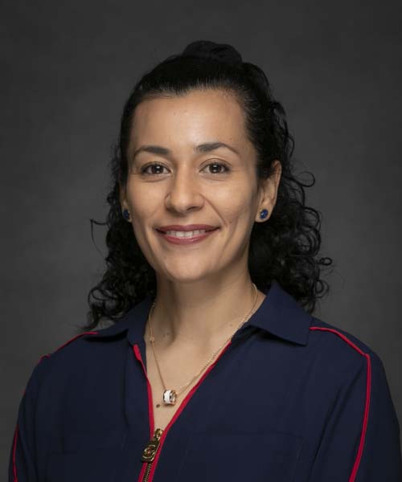
Provost Fellow for
Faculty Development
Judith Martinez
Modern & Classical Language
Judith is completing her 1st year as Provost Fellow for Faculty Development.
She works with the Provost Office to develop professional opportunities tied to diversity and other relevant topics for faculty. She managed the Bear Bridges mentoring program and worked in conjunction with the Office of Diversity & Inclusion to coordinate diversity initiatives impacting the university.

Slide 7
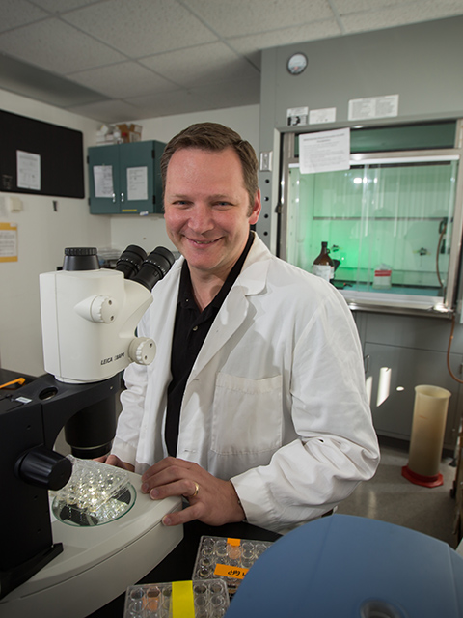
Provost Fellow for General Education Transition
Joshua Smith
Biomedical Science
Josh is completing his 6th year as Provost Fellow and will continue to serve in this capacity for the upcoming 2021-2022 academic year.

Slide 8
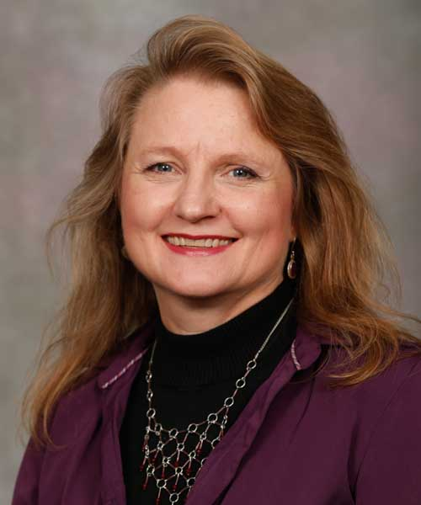
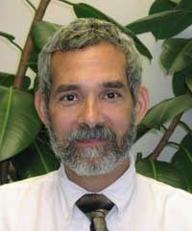
Eric Shade Memorial Award in Faculty Governance
Cynthia MacGregor
Counseling, Leadership & Special Education
Thomas Dicke
History

Slide 9
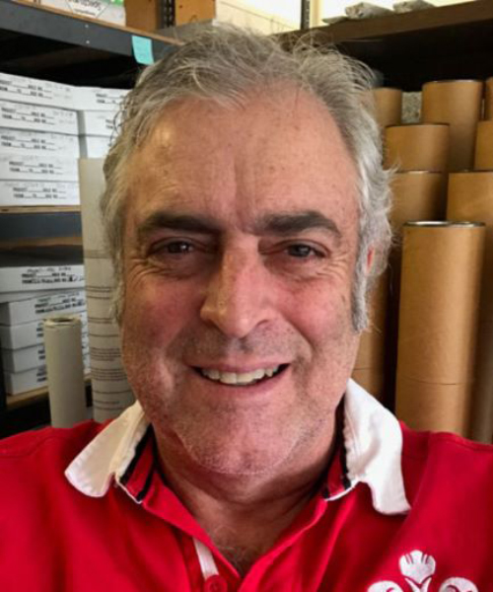
Excellence in Community Service Awards
Kevin Evans – Geography, Geology & Planning
Kevin lives life as a Citizen Bear both on and off campus. His passion to reignite a sense of unity began with a simple mission – to get his neighbors to know one another enough to “ask for a cup of sugar.” His vision and work became a reality as he and his neighbors ultimately formed the Delaware Neighborhood Association. In 2018 his work was recognized as a recipient of the City of Springfield’s NOVA award. As a scientist, Kevin also connects his geological passion with community through civic presentations and explorations. From children to seniors, he helps others understand our planet’s past and its implications on the present and future. His public outreach extends to helping the Boy Scouts, Science Olympiad, Ozarks Science & Engineering Fair and Habitat for Humanity among many others.

Slide 10
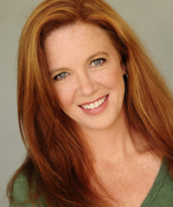
Excellence in Community Service Awards
Sarah Wiggin – Theatre and Dance
For over a decade, Sarah has devoted her heart and time to animal welfare in the Springfield area. Known by some as “the stray whisperer”, Sarah has fostered and rehabilitated numerous dogs to become healthy, trained and ready for forever homes. One such success story includes nursing an abandoned dog to health status that eventually led him to becoming a service dog with K9s for Camo. Sarah volunteers much of her time for Rescue One of Springfield and on any given Saturday you can find her providing transportation for one or more dogs to Rolla, St. Louis or Kansas City. An easy, but difficult volunteer duty to fill, transporting is a rewarding adventure needed to pair animals with a new foster or forever home, or other distant rescue organization one leg at a time.

Slide 11
Board of Governors
Faculty Excellence in Public Affairs
Kevin Evans – Geography, Geology & Planning
Kevin is a two-time Provost Fellow for Public Affairs. He has obtained external funding for studies ranging from investigations of terrestrial meteorite impacts to multiple geologic mapping projects. All of these ultimately help undergraduate and graduate students become better geologists. He’s continued these efforts with geologic studies in the Great Basin of Utah and Nevada, refining models for the timing of uplift in the Ozark, and most recently with tectonism in southwestern Jamaica. The Jamaica study has revealed that a natural disaster, such as an earthquake and possible tsunami, impacted a pre-Columbian culture, leading to a revolution in shelter and food resources. Dr. Evan’s research stands out in that he is truly interested in helping the public understand the applications of his findings to improve decisions that shape communities.

Slide 12
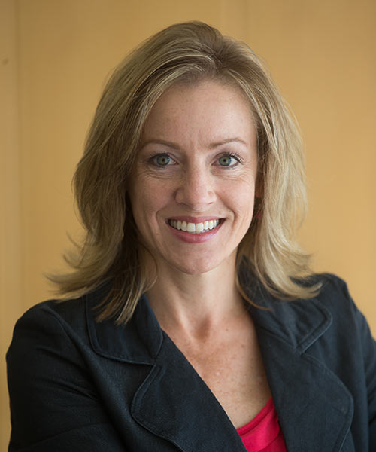
Board of Governors
Faculty Excellence in Public Affairs
Lisa Hall – Psychology & Gerontology Program Coordinator
Lisa’s research has developed into community-wide reports that have influenced policy in our community. Dr. Hall worked with the League of Women voters and then the Ozarks Mental Health Network to review and develop a report on the unmet needs for mental health in Southwest Missouri. This in turn led to the 2019 Community Mental Health and Substance Abuse Assessment report. Lisa worked in conjunction with the National Alliance on Mental Illness of SW Missouri and the Springfield-Greene County Health Dept. to develop and implement the Greene County Senior Peer Support Program. Lisa has been instrumental in shaping the Give 5 Program, a “civic-matchmaking” program that was created in our community. The origins of the Give 5 Program can be traced to MSU’s Public Affairs Mission.

Slide 13
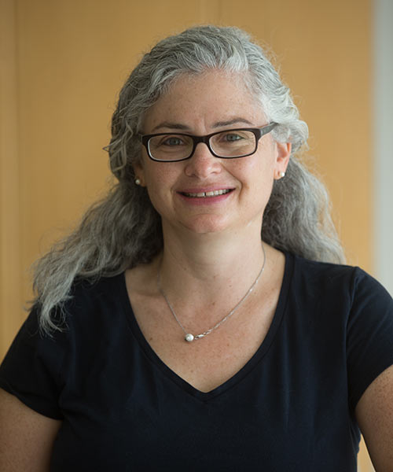
Board of Governors
Faculty Excellence in Public Affairs
Elizabeth Sobel – Sociology & Anthropology
Elizabeth’s work illuminates past injustices in the Ozarks and in other parts of the country. Her research explores cultural consequences of those injustices as she partners with cultural descendant groups and works to raise awareness through public education. She’s examined Chinookan Native American communities in the Pacific Northwest and how they changed with the arrival of European fur traders and settlers in the 18th – 20th centuries. In collaboration with MSU students and the local community, she uncovered the role of African American slaves associated with the Nathan Boone homestead. She has also documented the family names of those buried in the African-American section of the national cemetery on Seminole, and obtained grants that led to the creation of a “traveling truck” exhibit used in public schools.

Slide 14
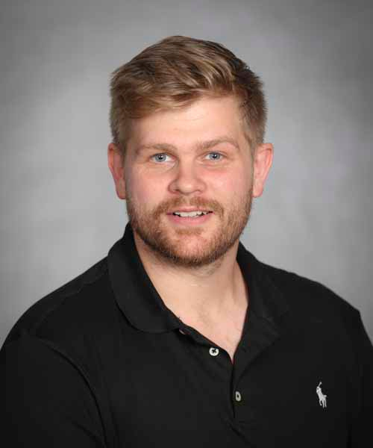
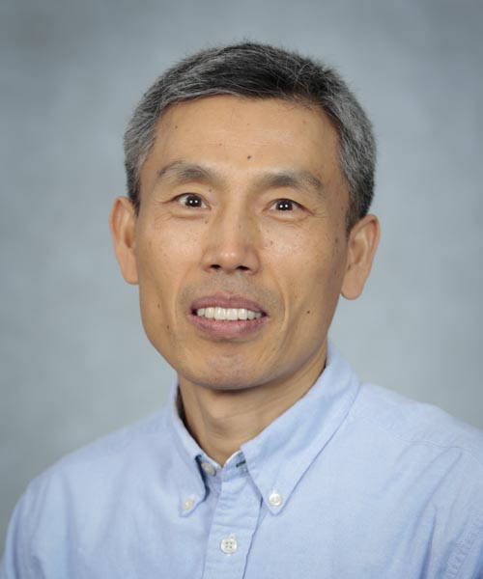
Outstanding Thesis Advisor 2021
Selected by the Graduate College staff based on quality of submitted theses.
Jordan Belisle
Psychology
Kyoungtae Kim
Biology

Slide 15
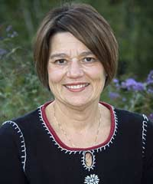
Honors College Awards
Curtis P. Lawrence Master Teacher Award
The Curtis P. Lawrence Master Teacher Award is offered to Honors College faculty members who are exclusively nominated by Honors College students and chosen by an Honors College student committee in collaboration with the Honors College administrative staff. The award was created in honor of the first Dean of MSU’s Honors College, Dr. Curtis P. Lawrence. This award is offered to recognize excellence in honors teaching and mentoring by a Missouri State University Honors College faculty member.
Carol Shoptaugh
Psychology

Slide 16
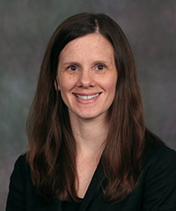
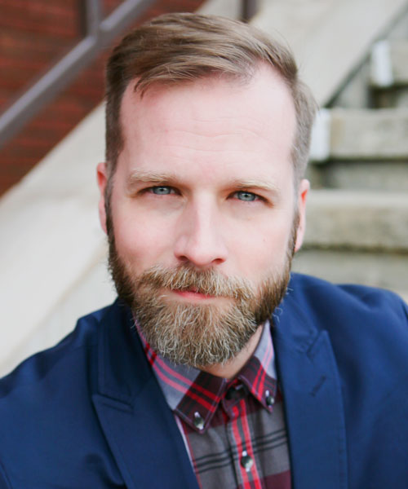
Honors College Awards
Director’s Award for Outstanding Faculty Research
The Director’s Award acknowledges the exceptional research accomplishments of MSU’s Honors college faculty. This award acknowledges those Honors College professors who serve as the best example of the ideal scholar/teacher who has not only made a significant contribution to their own field of research, but who have also helped to expand the growth and development of honors educ.
Sara Henary
Political Science
Kyle Thomas
Theatre & Dance

Slide 17
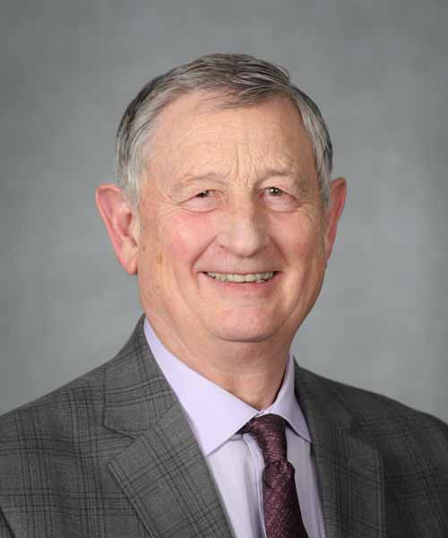
Honors College Awards
Marcia Morriset Award for Outstanding Service to Honors Education
The Marcia Morriset award for Outstanding Service to Honors Education recognizes the exceptional service, mentoring and advising accomplishments of MSU’s Honors College faculty and affiliated staff. The award was created in recognition of Marcia Morriset’s many years of service to the Honors College. The award is presented to a faculty or staff member who has contributed broadly to the advancement of honors education at Missouri State University.
Frank Einhellig
Provost

Slide 18
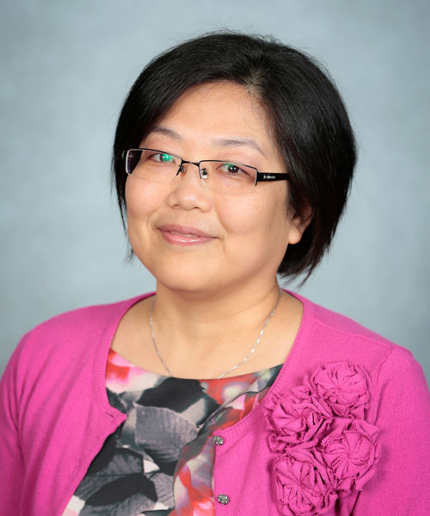
Faculty Center for Teaching & Learning Awards
Excellence in Teaching Award – Online Teaching
Ching-Wen Chang – Reading, Foundations & Technology
Ching-Wen is committed to the success of her students. During Spring 2020 one of her students shared that she “helped tremendously in my transition to online learning. When I felt lost, she guided me. Her course was interactive and engaging. I loved her class. My fear of online education was gone by the end of the semester.” Other students expressed that she was very approachable and always took time to quickly respond to their questions and emails. This speaks highly of Dr. Chang, particularly during a time when many students were experiencing uncertainty and additional anxiety.

Slide 19
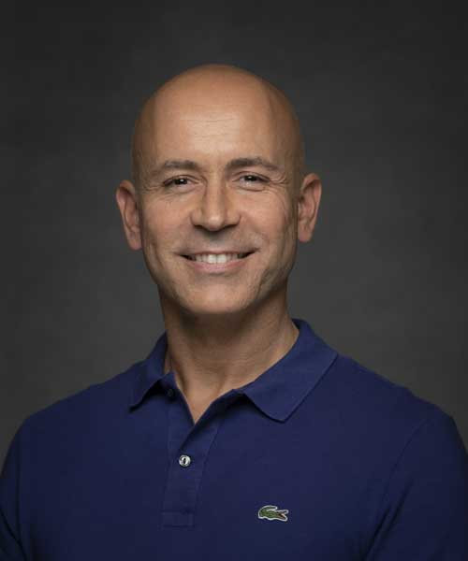
Faculty Center for Teaching & Learning Awards
Excellence in Teaching Award – Online Teaching
Luis Lombilla – Modern & Classical Language
Learning a new language can be very challenging. Luis makes this experience meaningful by having students interact with each other through Zoom to not only support learning Spanish but also share ideas about a different culture, expanding their sense of cultural competence. Students said this critical thinking and discussion “brough real meaning to learning another language.” Luis has also become the department resident expert in cutting-edge tools such as FlipGrid and VoiceThread and how to use them effectively for online assignments and assessments. His efforts have had a major impact on the ability of the department to serve more students.

Slide 20
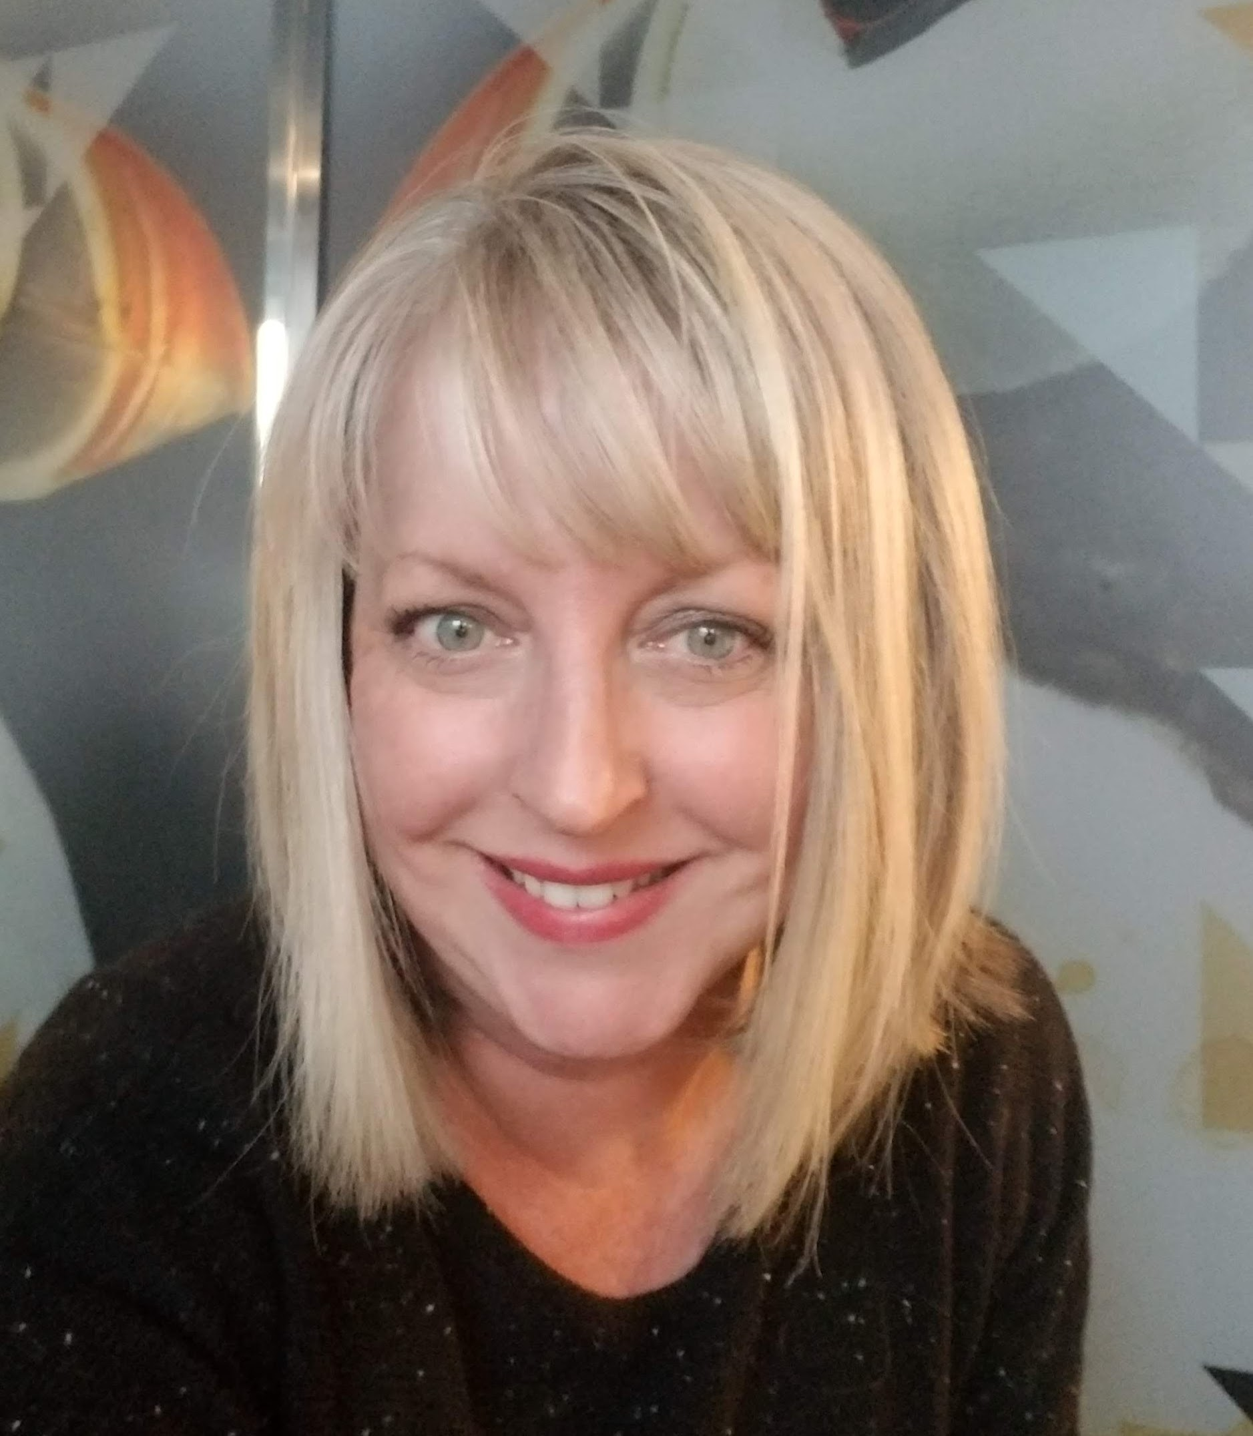
Faculty Center for Teaching & Learning Awards
Excellence in High-Impact Practices
Jennifer Pratt – Communication Sciences & Disorders
Jennifer leads by example supporting students and patients in the Speech-Language Hearing Clinic. Students say they have grown through her coaching and feedback which is designed to support and promote their curiosity of their chosen profession. A fellow MSU faculty who had the opportunity to co-teach with Jennifer said that in addition to integrating enhanced lectures, case studies, active learning, and clinical experience into the classroom, her approach to teaching was student-centered in a way that recognized the humanity of the students and made them a part of the collaborative process of learning.

Slide 21
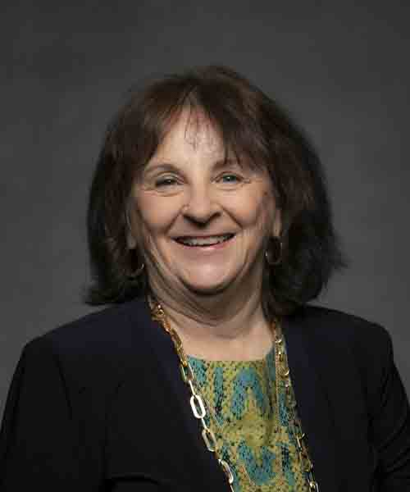
Faculty Center for Teaching & Learning Awards
High-Impact Learning Practices
Annice McLean – Reading, Foundations & Technology
With a vast experience of teaching in public schools, Annice knows what is needed to inspire her students. Her department head says that Annice knows “how to challenge her students constructively. She is a master teacher, and her students respect and adore her.” One of her students said, “She challenged my classmates and me to think outside the box to use technology to improve my teaching.” Another student said, “She cared so much about her students, and you could always tell.”

Slide 22
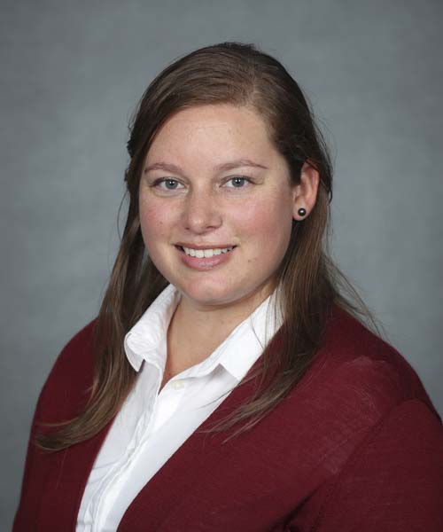
Faculty Center for Teaching & Learning Awards
Inclusive Teaching Practices
Julia Troche – History
Dr. Troche took a scholarly approach in revising the Egyptian History course she was teaching to make it more inclusive, equitable, and diverse in both its content and pedagogy. She wanted to escape the western bias of ancient history and include the voice of African, African American, and Latinx scholars in ancient history. Julia is committed to confronting systemic inequality and present ancient history in a way that supports students’ cultural competence and a more inclusive society.

Slide 23
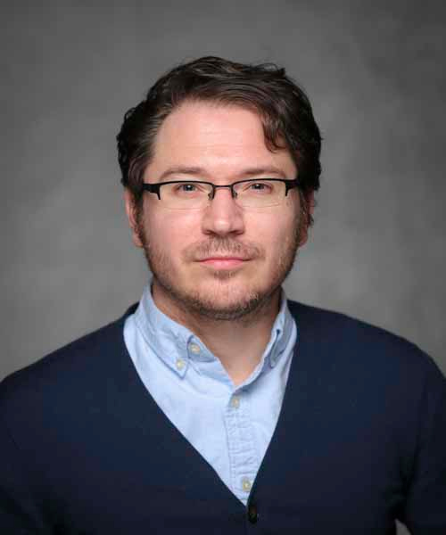
Faculty Center for Teaching & Learning Awards
Per-Course Teaching
Bryan Brinkman – Modern & Classical Language
Dr. Brinkman goes beyond what would be expected of a per course instructor. He regularly volunteers to judge at History Day, which is hosted by the History Department; he volunteered to assist in chaperoning a large class of students to the Nelson Atkins museum in Kansas City; he meets with students after class to review Latin, and he also meets with Master of Arts graduate students working on ancient history thesis topics. Bryan is an excellent example of an instructor who cares deeply about teaching and goes above and beyond for his students and the University.

Slide 24
FCTL Diversity Scholars
These faculty completed a series of Diversity Workshops facilitated by Faculty Diversity Fellow, Dr. Judith Martinez. Topics included recognizing microaggressions, respect and acceptance in the classroom, inclusive assessment, and difficult conversations in the classroom.
Albert A. Barreda (HL) Fatih Benzer (ART)
Juan Cabrera Hurtado (ELI) Kelly Cabrera Hurtado (ELI)
Maria Cerdas Cisneros (MCL) Daisy Collins (RFT)
Dennette Derezotes (SWK Jamie Grigsby (MKT)
Gordana Lazic (COM) Jeff Loughary (MCL)
Jody Lynn McCoy (ART) Zipporah Peddle (THE)
Katie Primrose (Athletic Training) Lori Rogers (ENG)
Dennis Rudnick (RFT) Diane Smith (NUR)
Suneeta Thomas (ENG) Randi Ulbricht (BMS)
Nicole West (CLSE) Carly Yadon (PSY)

Slide 25
FCTL Online Course Review Certificate
These faculty received an Exceptional Online Course Review Certificate meeting the Online Learning Consortium’s Quality Review of course design, accessibility, and online best practices.
Dollie Davis-Sneed (CEFS) Mark Ellickson (PLS)
Tiffany Havlin (SWK) Yoshimasa (Nancy) Kageyama (HL)
Albert Barreda (HL) Natalie Curry (SWK)
Eric Nelson (HST) Sarah Panzer (HST)
Kishor Shah (MTH) Siming Liu (CS)
Ryan Udan (BIO) Jung Choi (MUS)
Tammy Yoes (NUR) Qiang Chen (SWK)
Paul Moore (NUR) Daniela Novotny (BMS)
Yili Shi (ENG) Babur Mirza (BIO)
Matthew Kuiper (REL) Paula Kemp (MTH)
Jaime Bihlmeyer (MJF) Sarah Mellors (HST)
Bill Sandel (CRM) Damon Bassett (GGP)
Kerri Tassin (ACC)

Slide 26
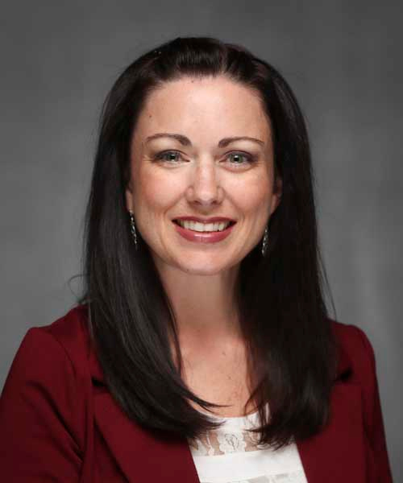
Master Online Course Recognition Awards
Best Overall
Kayla Lewis – Reading, Foundations & Technology
RDG 781/782 – Assessment and Remediation of Literacy Problems
This award spotlights excellence in transformative and innovative applications of pedagogy, learning strategies and educational technology in the virtual classroom.
Kayla has been chosen in the best overall in the five categories of Course Overview and Information, Course Technology and Tools, Design and Layout, Content and Activities, Interaction and Assessment and Feedback.

Slide 27
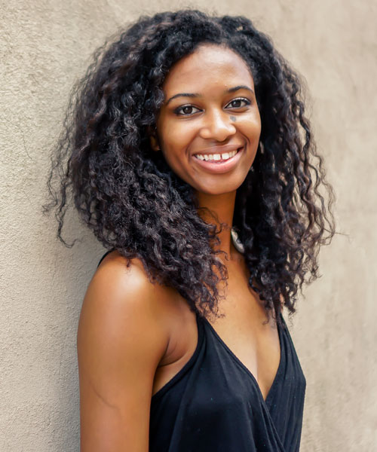
Master Online Course Recognition Awards
Best in Category – Course Technology & Tools
Azaria Hogans
Theatre & Dance
DAN 180 (Introduction to Dance)

Slide 28
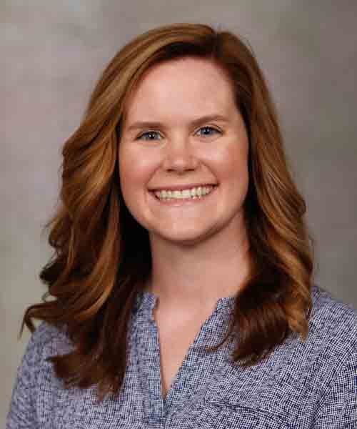
Master Online Course Recognition Awards
Best in Category – Assessment & Feedback
Julie Ravenscraft - Accountancy
ACC 300 (Professionalism in Accountancy)

Slide 29
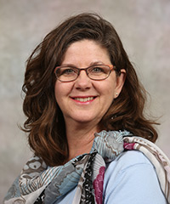
Master Online Course Recognition Awards
Best in Category – Design & Layout
Tracy Dalton – English
ENG 221 (Writing for the Professions)

Slide 30
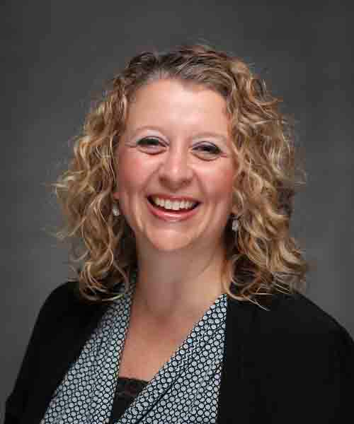
Master Online Course Recognition Awards
Best in Category – Best Interaction
Amanda Keys – Social Work
SWK 750 (Social Work Practice I: Advanced Generalist Practice with Individuals)

Slide 31
Certified Distance Educator
In order to recognize excellence in online and distance teaching and learning, Missouri State Online began the Certified Distance Educator Award in 2018. The following faculty have received recognition for completing three development activities during 2020.
Ismet Anistal (MKT) Jessica Bennett (LIBR)
Joanna Cemore Brigden (CEFS) Ching-Wen Chang (RFT)
Tracy Dalton (ENG) Luciane Maimone (MCL)
Judith Martinez (MCL) Annice McLean (RFT)
Jessica Nelson (CLSE) Jonathan Newman (ENG)
Jane Patterson (FGB) Cathy Pearman (RFT)
Ximena Uribe-Zarain (CLSE) Kimberly Van Ornum (MTH)
Erin Wehrman (COM) Xiuye Xie (KIN)

Slide 32
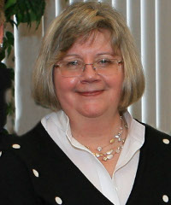
Excellence in Education Abroad Programs
Cultural Competence
Char Berquist -- Communication
Dr. Berquist designed and directed four education abroad programs (2015-2019) to offer students the opportunity to explore the dynamics of conflict and peacemaking at work in Northern Ireland. This was based on three goals: 1) immersion in a culture that had experienced both historic and contemporary conflict of major significance; 2) engagement with individuals who participated and experienced the Troubles, as well as emergent peace processes; and 3) awareness of nuanced differences and similarities between the United States and Northern Ireland.

Slide 33
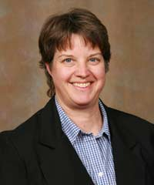
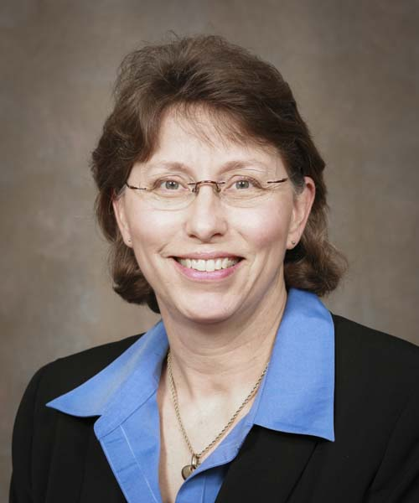
Excellence in Service Learning Award
Excellence in Service Learning
Patricia Cahoj & Jeanne Cook – Physical Therapy
For over 17 years Dr. Cahoj and Dr. Cook have integrated service-learning into their graduate level service-learning courses.

Slide 34
Milestones of Service-Learning Teaching
5 Year Recognition 10 Year Recognition
Heidi Backes (RCOAL) Joann Barnett (CNAS) Brian Greene (BIO)
Fatih Benzer (RCOAL) Sara Burge (RCOAL) Kurt Killion (CNAS)
Sherri Eldred (COE) Michael Frizell (RCOAL) Kathy Nordyke (COE)
Benjamin Goss (COB) Marcia Himes (MCHHS) Kimberly Roam (COE)
Holly Holladay (RCOAL) Colby Jennings (RCOAL) Joe Williams (MCHHS)
Jennifer Lowenthal-Hershey (COB) Ronald Malega (CNAS)
Katelyn McCoy (COAG) Misty Mitchell (MCHHS) 15 Year Recognition
Talena Morris (RCOAL) Carly Pierson (COB) Mary Newman (MCHHS)
Astrid Ruiz (RCOAL) Leslie Seawright (RCOAL)
Patrick Sullivan (CNAS) Tom Tomasi (CNAS) 20 Year Recognition
Cole Trent (RCOAL) Randi Ulbricht (MCHHS) Samuel Dyer (RCOAL)
Melody LaPreze (COB)
Phillip Rothschild (COB)

Slide 35

NACADA 2021 Certificate of Merit
NACADA 2021 Certificate of Merit
Outstanding Advising Award – Faculty Academic Advising
Kyler Sherman-Wilkins
Sociology & Anthropology

Slide 36
Honoring our Retiring Faculty

Slide 37
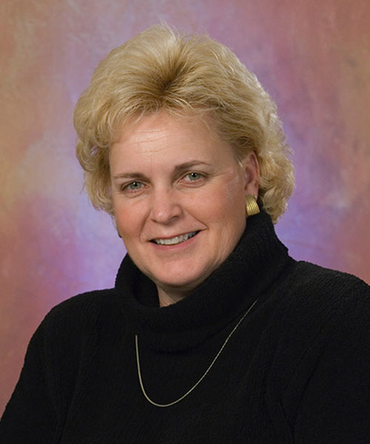
Retiring Faculty
Jodie Adams
Kinesiology
August 2016 - May 2021

Slide 38
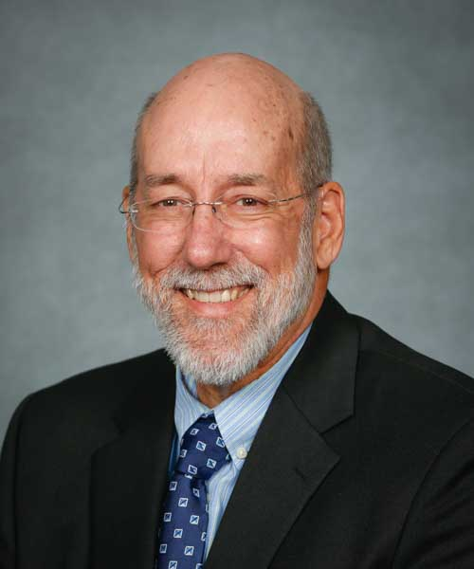
Retiring Faculty
M. Chris Barnhart
Biology
August 1991 – May 2021

Slide 39
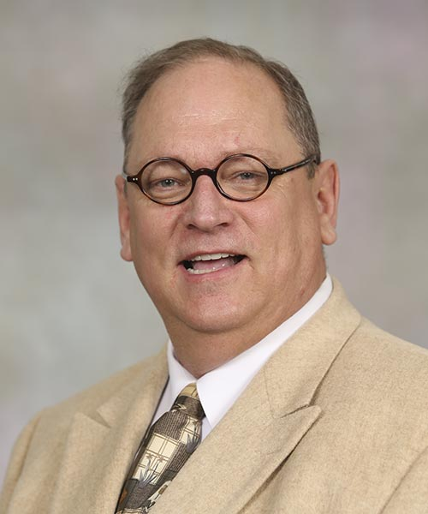
Retiring Faculty
John Bourhis
Communication
August 1988 – July 2021

Slide 40
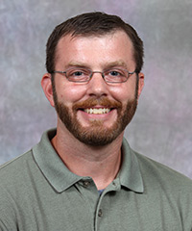
Retiring Faculty
Robert Brown
Mathematics
August 2011 – July 2020

Slide 41
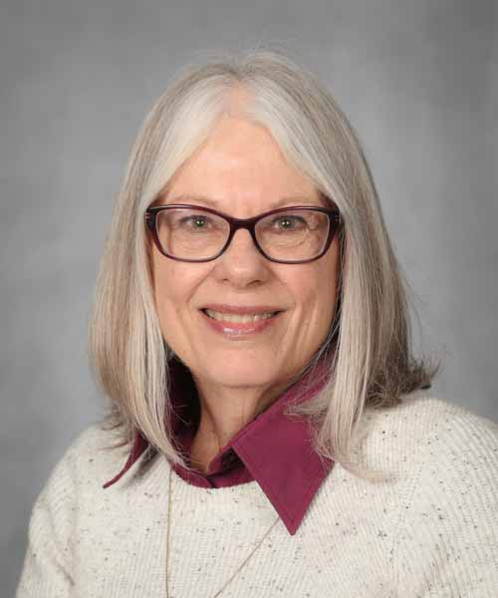
Retiring Faculty
Lanette Cadle
English
August 2005 – July 2021

Slide 42

Retiring Faculty
Paris DePaepe
Counseling, Leadership & Special Education
August 1996 – July 2020

Slide 43
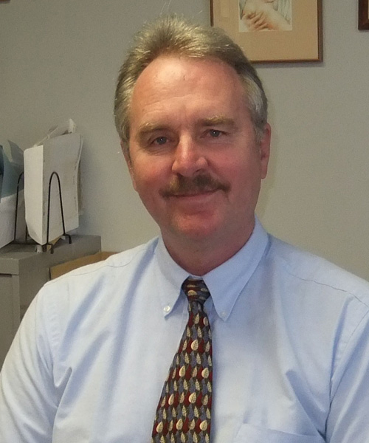
Retiring Faculty
Steven Dodge
Physician Assistant Studies
September 2004 – January 2020

Slide 44
Retiring Faculty
John Downing
Kinesiology
August 2001 – December 2020

Slide 45
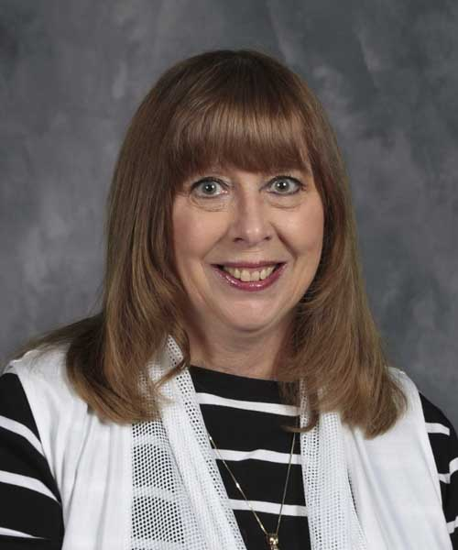
Retiring Faculty
Vicki Dunlop
Greenwood Lab School
August 1988 – May 2020

Slide 46
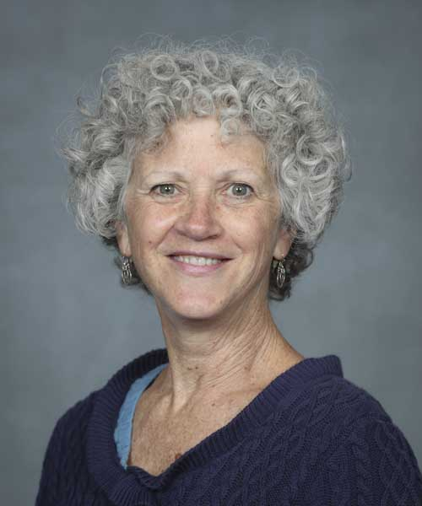
Retiring Faculty
Abigale Ehlers
Hospitality Leadership
August 2000 - May 2020

Slide 47
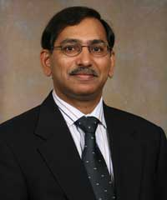
Retiring Faculty
Vinay Garg
Management
August 2000 - July 2021

Slide 48
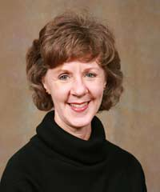
Retiring Faculty
Lyn Gattis
English
August 2006 – July 2021

Slide 49
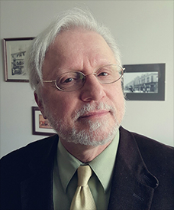
Retiring Faculty
David Gutzke
History
August 1985 – May 2021

Slide 50
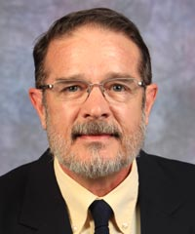
Retiring Faculty
John Harms
Sociology & Anthropology
August 1985 – December 2020

Slide 51
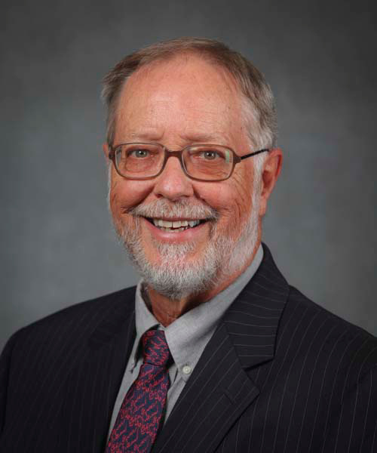
Retiring Faculty
Earl Holmer
English
August 2000 – July 2020

Slide 52
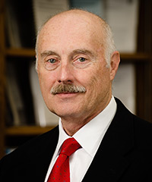
Retiring Faculty
David Hough
College of Education
August 1991 – January 2021

Slide 53
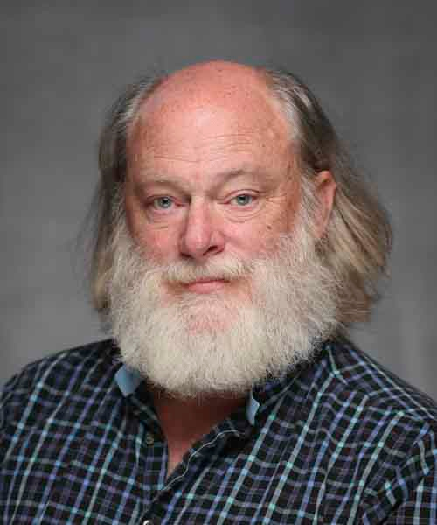
Retiring Faculty
Joseph Hughes
Modern & Classical Language
August 1987 - May 2021

Slide 54
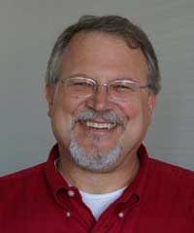
Retiring Faculty
Joseph Hulgus
Counseling, Leadership & Special Education
August 1987 - May 2021

Slide 55
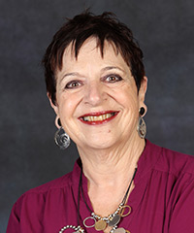
Retiring Faculty
Linnea Iantria
Geography, Geology & Planning
August 2008 – July 2021

Slide 56
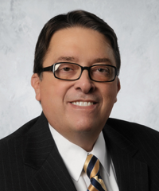
Retiring Faculty
Stanley Leasure
Finance & General Business
August 2005 - December 2020

Slide 57

Retiring Faculty
John (Jack) Llewellyn
Religious Studies
August 1989 - May 2021

Slide 58

Retiring Faculty
Neal Lopinot
Center for Archaeological Research
August 1993 – June 2021

Slide 59
Retiring Faculty
James Matthews
Counseling, Leadership & Special Education
July 2001 – July 2021

Slide 60

Retiring Faculty
Marilyn McCroskey
Library
August 1981 - November 2020

Slide 61

Retiring Faculty
Eric Pervukhin
Art & Design
August 1992 - May 2021

Slide 62

Retiring Faculty
Jack Ray
Center for Archaeological Research
November 1984 – June 2021

Slide 63
Retiring Faculty
Carol Shoptaugh
Psychology
August 1990 - May 2021

Slide 64

Retiring Faculty
Joan Test
Childhood Education & Family Studies
August 2007 – May 2021

Slide 65

Retiring Faculty
Thomas Tomasi
Biology
August 1986 – July 2021

Slide 66

Retiring Faculty
Iwona Zalewska-Duszek
Art & Design
August 2005 – July 2021

Slide 67

Faculty Service Awards

Slide 68
10 Years of Service
Li-Ling Chen (EPS) Timothy Daugherty (PSY)
Lisa Hall (PSY) Andrea Hellman (ENG)
Andrew Homburg (MUS) Angela Hornsby-Gutting (HST)
Kathleen Kennedy (HST) Judith Martinez (MCL)
Christine Sudbrock (AGB) Shurita Thomas-Tate (CSD)

Slide 69
15 Years of Service
Elizabeth Dudash-Buskirk (COM) Janelle Flanders (GRWD)
Michael Foster (THE) Lyn Gattis (ENG)
Richard Gebken (TCM) Aida Hass (CRM)
Daniel Hellman (MUS) Michael Hudson (PHSM)
Joshua Lambert (LIBR) Jun Luo (GGP)
Xin Miao (GGP) Eric Nelson (HST)
Maciej Pszczolkowski (EPS) Xiaomin Qiu (GGP)
George Schmelzle (ACC) Christina Simmers (MKT)
Elizabeth Sobel (SOC) Adam Wanekaya (CHM)

Slide 70
20 Years of Service
William Agnew (CLSE) Tamara Arthaud (CLSE) Clydette Alsup-Egbers (EPS)
Anne Baker (LIBR) Richard Callahan (TCM) Michele Day (SWK)
Susan Dollar (SWK) Paul Durham (BIO) Terrel Gallaway (ECO)
Richard Garrad (BMS) Nikolay Gerasimchuk (CHM) Martha Gholson (ENG)
Charles Hermans (MKT) Andrew Lokie (LIBR) Sean Newton (PT)
Gay Ragan (MTH) Michael Reed (PAMS) Erich Steinle (CHM)
Wei-Han Su (MUS) Gwen Walstrand (ART) Weiyan Wang (MJF)
Gary Webb (ANS)

Slide 71
25 Years of Service
Holly Baggett (HST) Steven Capps (PSY)
Deborah Cron (CSD) Dalen Duitsman (PHSM)
Steven Jones (RFT) Rajinder Jutla (GGP)
Thomas Kane (PSY) Stephen McIntyre (HST)
Grant Peters (MUS) Pamela Sailors (CHPA)

Slide 72


30 Years of Service
Chris Barnhart
Biology
Shyang Huang
Physics, Astronomy & Materials Science
Allan Liggett
Public Health & Sports Medicine

Slide 73



30 Years of Service
David Meinert
College of Business
Charles Rovey
Geography, Geology & Planning
Cameron Wickham
Mathematics

Slide 74



35 Years of Service
Dea Borneman
Library
Mark Ellickson
Political Science
Shelby Kilmer
Mathematics

Slide 75


35 Years of Service
John Prescott
Music
Thomas Tomasi
Biology
Karl Wilker
Environmental Plant Science & Nat’l Res

Slide 76


40 Years of Service
Marilyn Odneal
Environmental Plant Sciences & Nat’l Res
Kathy Pulley
Religious Studies

Slide 77
Grants
External and Internal

Slide 78
External Grants for 2020
108 Grants Applied for requesting $44,286,075
141 Grants Awarded for
$48,513,903

Slide 79
MSU Faculty Research Grants
These faculty were awarded grant money to enhance research and creative activities. The program supports new research, creative or scholarship activities that may enhance opportunities for external funding or high-quality projects not likely to receive external funding.
Fall 2019 Spring 2020
Paul Ajuwon (CLSE) Tiglet Besara (PAMS) Dana Paliliunas (PSY)
Kim Finch (CLSE) Patricia Cajoj (PT) Robert Pavlowsky (GGP)
Kartik Ghosh (PAMS) Natasha DeVore (CHM) Maciej Pszczolkowski (EPS)
Day Ligon (BIO) Kevin Evans (GGP) Tom Tomasi (BIO)
Jonathan Mabee (MJF) Michael Goerndt (EPS) Andrew Twibell (MJF)
Jennice McCafferty-Wright (CEFS) James Hackney (PT) Marnie Watson (SOC)
Jay McEntee (BIO) Kyoungtae Kim (BIO) Nicole West (CLSE)
Matthew McKay (GGP) Elizabeth King (CEFS)
Jonathan Newman (ENG) William McClain (EPS)
Jason Shaw (PT) Gary Meints (CHM)
Jeanie Skibiski (ANE) Jessica Nelson (CLSE)
Gary Webb (ANS)

Slide 80
Summer Faculty Fellowships
This Fellowship is to allow faculty members engaged in research or in creative activities to devote intense thought and activity to a single project. This Fellowship is different than the Summer Fellowship that is awarded by the Colleges to incoming faculty.
Deidre Argyle (ART) Djene Bajalan (HST)
Natasha DeVore (CHM) Ngoc Do (MTH)
Xin Miao (GGP) Saibal Mitra (PAMS)
Sascha Mowrey (CEFS)

Slide 81
FCTL Curriculum Innovation Grants
Damon Bassett (GGP)
Technological Solutions for Improved Inclusion and Online Experiences for Field Trips and Field Based Courses in Geoscience
Melissa Penkalski, Shelley Carter and Ronda Entlicher-Stewart (NUR)
Enhancing Students’ Classroom Experience with Innovative Technology
Kyler Sherman-Wilkins (SOC)
Incorporating Anti-racism into Undergraduate Methods and Statistics Courses in the Social Sciences
Lori Rogers and Judy Tarbox (ENG)
E-portfolios and Diversity Statements to Advance Diverse Perspectives and Encourage High Impact Practices in the Writing Classroom
Vanessa Rodriguez de la Vega (MCL)
Fostering Social Justice Practices in Spanish Upper-level Courses

Slide 82
FCTL Curriculum Innovation Mini-Grant Awards
Benjamin Goss (MGT) Paul Ajuwon (CLSE)
Joseph Williams (BMS) Subhasree Basu Roy (ECO)
Helena Metzker (CHM) Jeff Loughary (MCL)
Megan Rainville (FGB) Jamie Grigsby (MKT)
Annice McLean (RFT) Jennice McCafferty-Wright (CEFS)
Rhonda Bishop (CEFS) Damon Bassett (GGP)
Amanda Smith (ART) Kayla Lewis (RFT)
Julie Gallaway (ECO) Natasha DeVore (CHM)
Wayne Anderson (FGB) Gwen Walstrand (ART)
Paria Akbar Akhgari (PHI) Holly Holladay (MJF)
Muhammad Raza (CEFS) Ching-Wen Chang (RFT)
Luis Lombilla (MCL) Keiichi Yoshimatsu (CHM)
Deidre Argyle (ART) Tara Oetting (CSD)
Natalie Curry (SWK) Marijana Kotlaja (CRM)
Lisa Langston (SWK) Georgianna Saunders (BIO)
Brian High (CHM) Weiyan Wang (MJF)
Suzanne Walker Pacheco (SOC) Kristin Harper (MCL)
Mahua Mitra (ECO) Richard Biagioni (CHM)

Slide 83
20-21 Assessment Grant Awardees
Xiuye Xie
Developing Knowledge and Pedagogical Skills Through Online Professional Communities in Teaching School Health Education
Ching-Wen Chang
Program Assessment through on Educational Technology Graduate Program Advisory Board
Natalie Curry
Student Engagement Strategies in an Asynchronous Online Course
Junyoung Kim
Research Skill Seminar: A pilot study for a manuscript
Bernard Kitheka
Research Skill Seminar
Yating Ling
Research Skill Seminar: A pilot study through collaborative efforts
Suneeta Thomas
Course Evaluations for Spring 2020

Slide 84
Retiring Faculty
“Alone we can do so little;
together we can do so much!”
Helen Keller

Slide 85

Missouri State sign

