Slide 1
State and Federal OER Policy
Katie Steen, Open Education Policy Manager, SPARC

Slide 2
Why OER policy?
Notes:
Brady

Slide 3
Policy Landscape

Slide 4
Federal
The Affordable College Textbook Act (H.R. 3840/S. 1864)
The Higher Education Act
Price Disclosure Provision
FY18 and FY19 appropriations
SPARC leads OER coalition in DC on federal policy

Slide 5
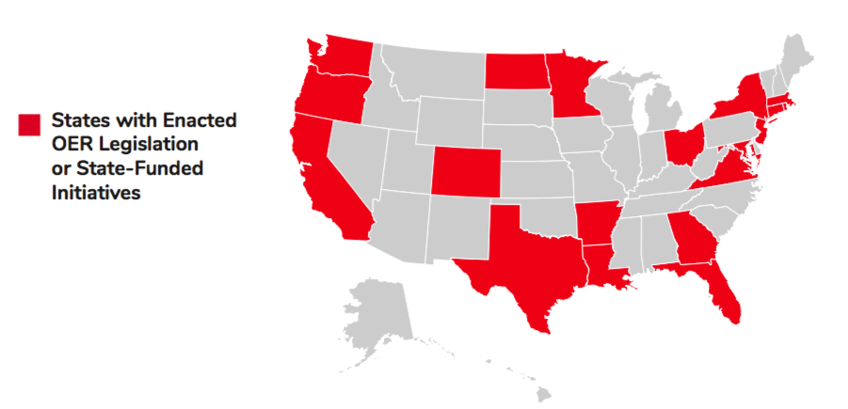
State

Slide 6
State
Nearly half of all states have considered OER legislation in recent years
27 active higher education OER bills in 2018
35 bills total including K-12
SPARC OER State Policy Tracker: https://sparcopen.org/our-work/state-policy-tracking/
SPARC OER State Policy Playbook: https://sparcopen.org/our-work/oer-state-policy-playbook/

Slide 7
Trends in OER State Policy
Notes:
Katie

Slide 8
Positive Trends

Slide 9
OER Grant Programs
Maryland 2017: SB 424 (passed)
Notes:
Katie and Brady

Slide 10
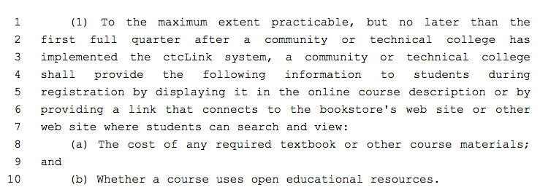
Course Catalog Marking
Washington 2017:
HB 1375 (passed)

Slide 11
Iowa 2018: SF 2362

Slide 12
2017 Texas: SB810 (passed)
Sec. 61.0668. OPEN EDUCATIONAL RESOURCES GRANT PROGRAM. (a) In this section, "open educational resource" has the meaning assigned by Section 51.451.
(b) The board shall establish and administer a grant program to encourage faculty at institutions of higher education to adopt, modify, redesign, or develop courses that use only open educational resources.
Notes:
Texas SB 810

Slide 13
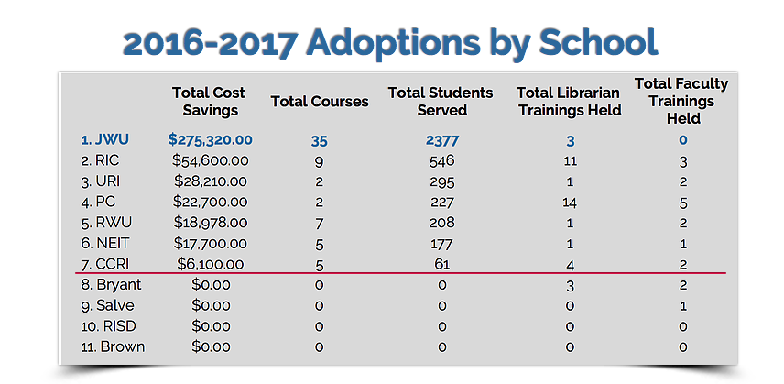
Savings Challenge
Rhode Island 2016
Governor’s Challenge
Notes:
Rhode Island governor issued a savings challenge to the state’s higher ed institutions
More than half of the institutions joined the effort right at the start - from Community College of Rhode Island to Brown University
One year later they’ve reached nearly a tenth of the goal, which is significant considering many of the campuses were starting from square one

Slide 14
OER Task Forces
Connecticut 2015: HB 6117 (passed)
**This legislation does establish a grant pilot program

Slide 15
Concerning Legislation

Slide 16
Digital Discounts
Innovative Pricing Models
Inclusive Access
Access Codes
Arkansas Publisher Packet
2015 Department of Education Regulation

Slide 17
Virginia 2018: HB 454
5. Provisions address the availability of required textbooks to students otherwise unable to afford the cost.
E. The governing board of each public institution of higher education shall implement [ policies, procedures, and ] guidelines [ that encourage for ] the adoption and use of low-cost and no-cost open educational resources [ and low-cost commercially published materials ] in courses offered at such institution.

Slide 18
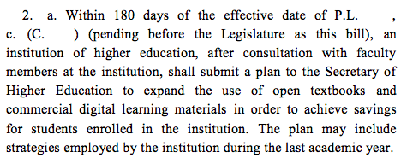
New Jersey 2018: S 768/A 3254

Slide 19
Connecticut 2017: SB 948 (passed)
Section 1. (NEW) (Effective January 1, 2018) The Office of Higher Education and the constituent units of the state system of higher education, as defined in section 10a-1 of the general statutes, may each establish guidelines that encourage institutions of higher education in this state to implement programs that reduce the cost of textbooks and other educational resources for students.

Slide 20
Massachusetts 2017: HB 4200 (passed)

Slide 21
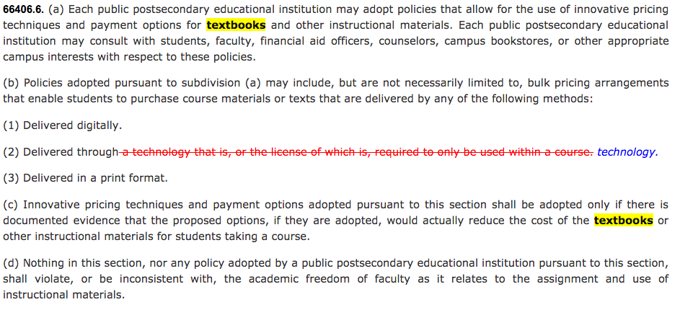
California 2017: SB 727

Slide 22
Recommendations and Discussion

Slide 23
Meet with librarian(s)
Brief government relations office on OER
Stay connected to other institutions
Start relationship with legislator on OER
Activity: Pitch to legislators on OER

Slide 24
Resources
SPARC OER State Policy Tracker: https://sparcopen.org/our-work/state-policy-tracking/
SPARC OER State Policy Playbook: https://sparcopen.org/our-work/oer-state-policy-playbook/
Creative Commons USA OER State Legslative Guide: https://creativecommonsusa.org/index.php/2018/01/16/new-state-legislative-resources/
SPARC Open Education staff: https://sparcopen.org/people/

Slide 25
Questions?

Slide 26
Katie Steen, Open Education Policy Manager
katie@sparcopen.org
@katiesteen627

