Slide 1
Statewide A&OER Efforts of Libraries
Grace Atkins Outreach & Open Education Librarian University of Missouri Libraries

Slide 2
Why Libraries?
The Original Affordability Model: Cost Reduction Through Shared Content

Slide 3
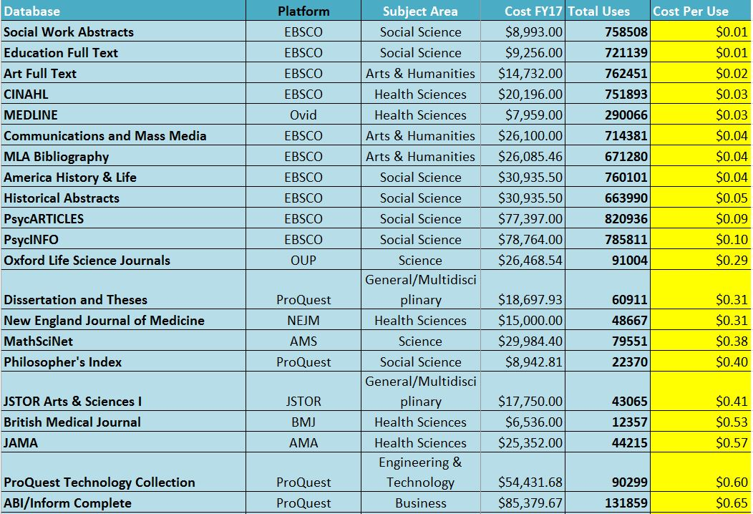

Slide 4
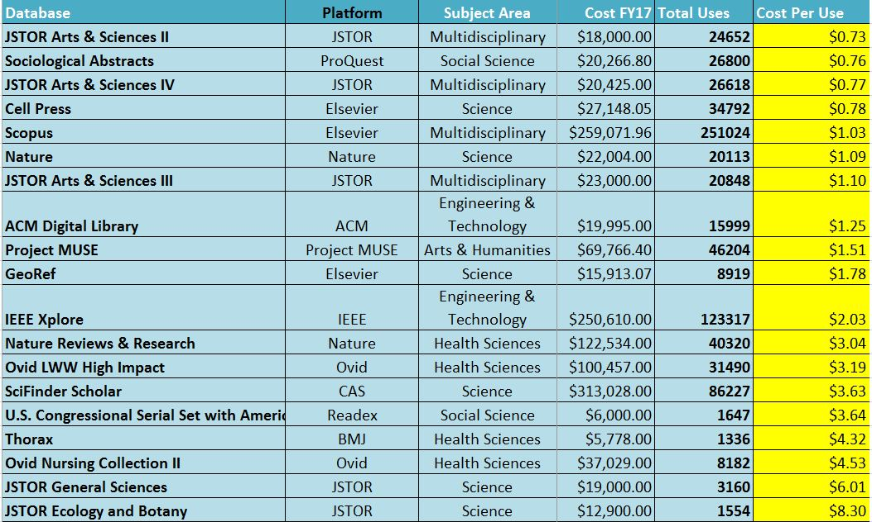

Slide 5
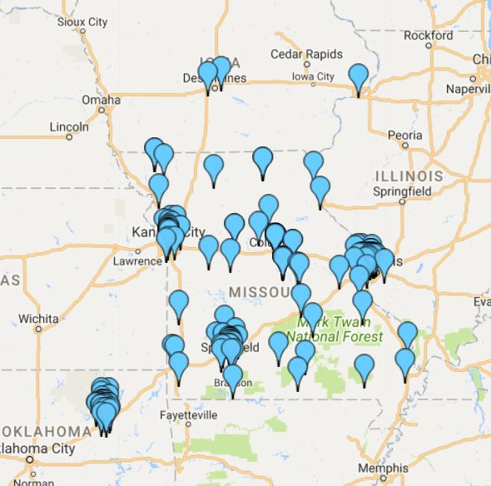
MOBIUS mobiusconsortium.org
192 Branches
share
Resources
Services
Expertise
Notes:
Missouri Bibliographic Information User System 62 full members from colleges, universities, the Missouri State Library, and 2 public libraries (cooperating partners)
MOBIUS is a vibrant, collaborative partnership of libraries providing access to shared information resources, services and expertise.
Guiding Principles
We foster a culture of collaboration and community
We support cooperative collection development and resource sharing
We provide professional development, training and networking opportunities
We adopt those technologies and services which enhance the user experience
We practice fiscally responsible stewardship of member resources
We engage all member libraries and respect their diversity
Share our Downloadable Flyer with your stakeholders to highlight the benefits of MOBIUS membership
More About MOBIUS
Since its founding in July 1998, MOBIUS has transformed library services for the citizens of Missouri. Formerly a part of the University of Missouri System, on July 1, 2010 MOBIUS became a Missouri not-for-profit corporation with 501 (C)(3) tax-exempt status. Thanks to the hard work and dedication of its members, the organization has grown from 50 founding charter members to 76 members which include 66 academic libraries, 6 public libraries, 3 special libraries, and the Missouri State Library, serving a total of 192 physical branches. Tulsa City-County Library became our first out-of-state member library in 2014. MOBIUS manages InnReach, a union catalog and resource sharing tool from Innovative Interfaces as well as their Sierra platform, a local integrated library system for our member libraries.
The consortium’s purpose is to share library materials, information, and services using accessible, cost effective methods. Today, the MOBIUS Union Catalog has expanded to include more than 29 million items, serving users in Missouri and into Oklahoma, Iowa, Kansas and Texas. A courier service delivers library materials to member libraries once per day, 5 days per week.

Slide 6
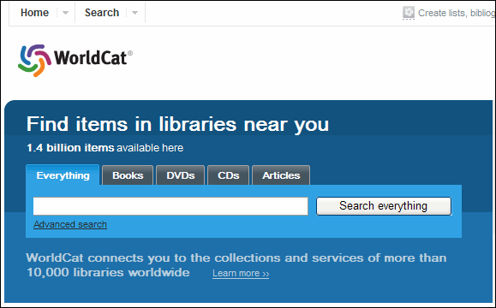
Interlibrary Loan (ILL)

Slide 7
A&OER: Affordable
course reserves
library-owned course materials especially e-books and textbooks
well-funded collections budgets

Slide 8
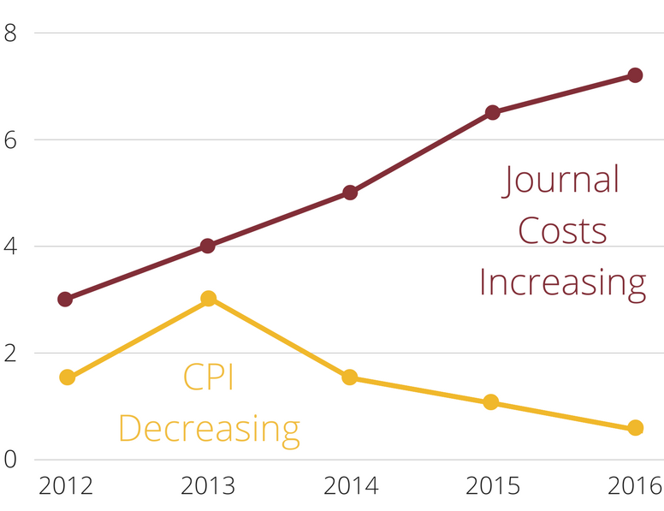
Open Access & Publisher/Vendor Negotiations

Slide 9
A&OER: Open
Include OER materials in catalogs and on research guides
Add campus-created OER content to Institutional Repositories

Slide 10
Statewide Referatories

Slide 11
A&OER: Librarians
Facilitators of A&OER
Curate lists of A&OER materials library.missouri.edu/OER
Provide A&OER trainings / consultations
Collaborate on campus & system A&OER initiatives oer.missouri.edu

Slide 12
A good librarian is good to have around… Internal - UM System A&OER Working Group member - MU Campus A&OER Committee co-chair - MU Campus Operations Team, organizer - University Libraries, A&OER project leader External - SPARC Open Educational Leadership Fellow, national - Open Textbook Network System Lead for MOBIUS, state
Takeaway: librarians are well-connected to people and resources at a variety of levels

Slide 13
Moving Forward
Making the Most of Your Libraries

Slide 14
Working with Libraries on A&OER
Evaluate resources, services, and expertise
+ Empower librarians to work on A&OER
Align library projects with A&OER initiative goals
Collaborate with A&OER support networks

Slide 15
University Libraries: A&OER Initiative Support
Projects
Provide OER trainings and consultations for faculty interested in using or creating OER
Curate a list of recommended OER platforms, hubs, collections, organizations, etc. for faculty
libraryguides.missouri.edu/oer
Promote and/or rebrand current A&OER support services
Build awareness of how libraries are the original affordability model of cost reduction through shared content.
Promote course reserves and library-owned course materials, especially e-books and textbooks
Increase MU-faculty-created OER submissions to University Libraries’ Institutional Repositories
Curate an OER collection within the repository for faculty works created through A&OER grants
Recruit faculty to submit their pre-A&OER-grant-created OER content to the repository’s OER collection
Include library-created OER materials in the repository’s OER collection
Continue to advocate for well-funded collections budgets
Goal/Project Alignment

Slide 16
MOBIUS Annual Conference June 4-6, 2018 Independence, MO
OER Training Session! 2018conf.mobiusconsortium.org/

Slide 18
Thank you!
Questions?
Contact me: Grace Atkins, atkinsge@missouri.edu
Credit to Katie Steen, Open Education Policy Manager for providing the CC-BY-4.0 License that allowed me to duplicate her “State and Federal OER Policy” PPT slide design

