Slide 1

Prices change, freedom is forever
Nicole Finkbeiner
@nfinkbeiner @openstax
Associate Director, Institutional Relations
Notes:
e

Slide 2
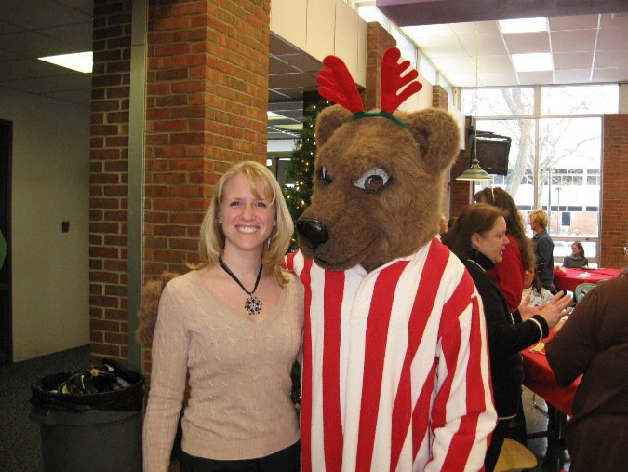
MY STORY

Slide 3
Open Educational Resources are teaching, learning, and research resources that reside in the public domain or have been released under an intellectual property license that permits their free use and repurposing by others. OER include full courses, course materials, modules, textbooks, streaming videos, tests, software, and any other tools, materials, or techniques used to support access to knowledge.
- Hewlett Foundation

Slide 4
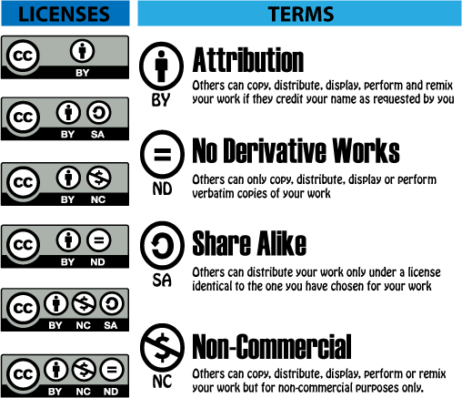
LICENSING

Slide 5
Rice University’s Story

Slide 6
So what have we learned?

Slide 7
QUALITY CONTENT IS A MUST
Quality comparable to commercial texts
Standard scope and sequence
Expert-written
Extensively reviewed by peers and industry
Rigorous editorial process
Regular errata and industry updates
Notes:
[Tell the Rice story….]
Rice University began working in OER in 1999
Originally called Connextions.
OER repository where faculty could upload and share content
We now call it cnx.org and it has over 40,000 pieces of content
So we thought “no one will ever have to pay for content again”
Except that isn’t what happened
In most cases, only the faculty member who uploaded the content was using it
So we had to go back and find out why
And what we found is that faculty weren’t willing to adopt content where they were unsure of the quality and it didn’t meet standard scope and sequence [this is a REALLY important point to make because it shows why creating OER locally will never scale. We’ve been there and done that]
So we formed OpenStax in 2012 and started with content that...[read bullet points]

Slide 8







DEVELOPMENT FOUNDATION SUPPORT
Notes:
So how do we fund all of this?
The development of the textbooks is very expensive because we following a similar process to that of the publishers to ensure quality
These generous foundations provided the nonprofit startup funding as well as continue to provide the funding for our books

Slide 9

OPENSTAX BOOKS
Math
Prealgebra
Elementary Algebra
Intermedia Algebra
College Algebra
Algebra & Trigonometry
Precalculus
Calculus
Introductory Statistics
Business Statistics
Science
Anatomy & Physiology
Astronomy
Biology (for majors)*
Concepts of Biology
Microbiology
Chemistry
Chemistry: Atoms First
College Physics*
University Physics I, II, III
Social Sciences
American Government
Principles of Economics 2e
Macroeconomics 2e*
Microeconomics 2e*
Psychology
Introduction to Sociology 2e
Humanities
U.S. History
*Advanced Placement® versions also available
Notes:
Here are our books thus far
Everyone wants to know how we are choosing which books to publish
Since our mission is to drive down costs and increase access, there are two main criteria:
How many students take the course nationwide. There are 1 million students per year taking Psychology and US History
How expensive are the textbooks currently in the market. For example, it’s not uncommon for a Physics book to be above $300, it’s not uncommon to find a Statistics book above $300. I find it ironic but Economics books are some of the most expensive books in the market.

Slide 10
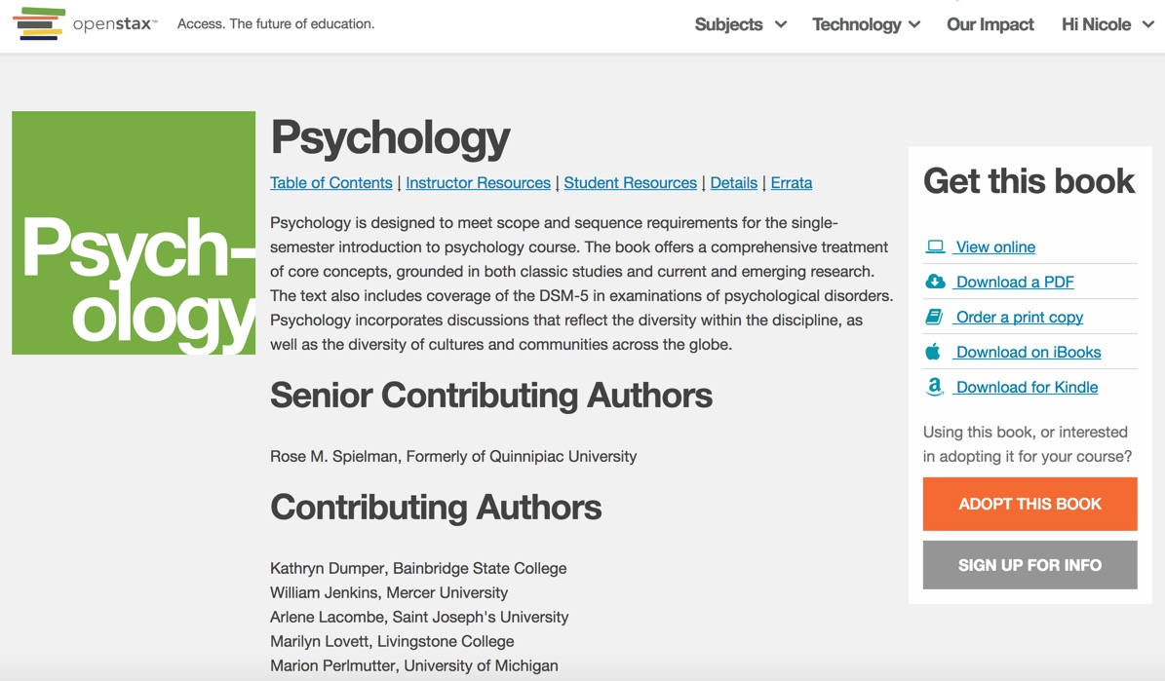
ACCESS & FORMATS STUDENTS USE
Notes:
So how do students get access to the book?
[demo the website in a browser you don’t use for normal work]
[go to the homepage and show them that you are not logged-in to the website]
You can see I’m not logged in to this website
So this is as if I was a student in your class, you told me about my free book, and I cracked-open my laptop
[Go to subjects and go to all….talk through what you are doing with them...click on Physics]
[talk aobut how you can see the senior contributing authors but they can go to the preface of the book to see the full list of authors and reviewers]
[Go through the various formats and prices. Click and open both the .pdf and webview and navigate around them to show how easy it is]
[click the print copy so they can see the bookstore link, the Amazon link, and tell them about why we post the price]
[highlight Adopt this book button]
[scroll down and talk about the instructor resources and our faculty verification process and explain that process]
[talk about Community Hubs next and how faculty like to donate resources back, but how we don’t have funding to peer-review them, so they are on Community Hubs, click on the Hub to demo it]
[scroll down and talk about the student resources, ISBN, errata links, etc.]
[back to powerpoint]

Slide 11
FACULTY NEED MORE THAN A BOOK
Online homework (from partners)
Online labs (from partners)
PowerPoint slides
Pronunciation guides
Solution Manuals
Test banks
And more (via community resources)
Notes:
And again, we have additional faculty resources for our books, depending on the subject area and grant funding.
These include…[read bullet points]

Slide 12
And it’s working…

Slide 13
5,000+ SCHOOLS USING OPENSTAX
  University of Maryland University College
  Austin Community College
  Harvard
  California State University System
  Houston Community College
  Stanford University
  Baylor College of Medicine
  Rice University
  Ivy Tech Community College System
  State University of New York
Notes:
[highlight the variety of schools on this list]

Slide 14
16% of introductory courses in the U.S. are using at least one OpenStax book
Babson College Survey,
July 2017

Slide 15
$332 million saved
OpenStax internal statistics based on faculty reporting

Slide 16
Students now have the freedom to access their content wherever they are, whenever they want, however they learn
Notes:
But beyond cost savings and persistence….

Slide 17
STUDENT CONTENT FREEDOM
Wherever they want
Different formats for different devices and situations
Share on social networks and public forums
Share in blended learning environments
Whenever they want
Instant, unlimited access
Permanent access, they own the content forever
However they learn
Use content in their work legally
Make videos/class assignments legally
Put into a format that meets their study habits
Notes:
Different formats for different devices and situations – They can study from their phone on the bus, use their tablet in labs, etc.
Use content in their work legally – Use our charts and graphs in research papers
Put into a format that meets their study habits – UTSA student created study guides from the .pdf

Slide 18
Faculty now have the freedom to use the content to match their teaching
Notes:
From the faculty perspective….

Slide 19
ADOPTION
Every student has immediate & unlimited access
Standard scope & sequence makes it easy to adopt
Variety of technology partners allow choice
Permission free use, editing & adaptation
Variety of formats/partners eliminates one size fits all
Ownership of the content. Forever
Moving to a new edition is optional
Notes:
Every student has immediate & unlimited access – which means you can begin your teaching right away

Slide 20


ADAPTATION
Notes:
This freedom allow you and everyone else to adapt the content to make it perfect for your specific course.
UCONN example.
UConn teaches Chemistry Atom’s First
So one of their faculty wanted to modify our book to meet this format
Uconn Undergraduate Student Government, working with the Uconn library, funded the professor to modify the book and then have it peer-reveiwed
Donated the book back to OpenStax, so now we have two Chemistry books

Slide 21
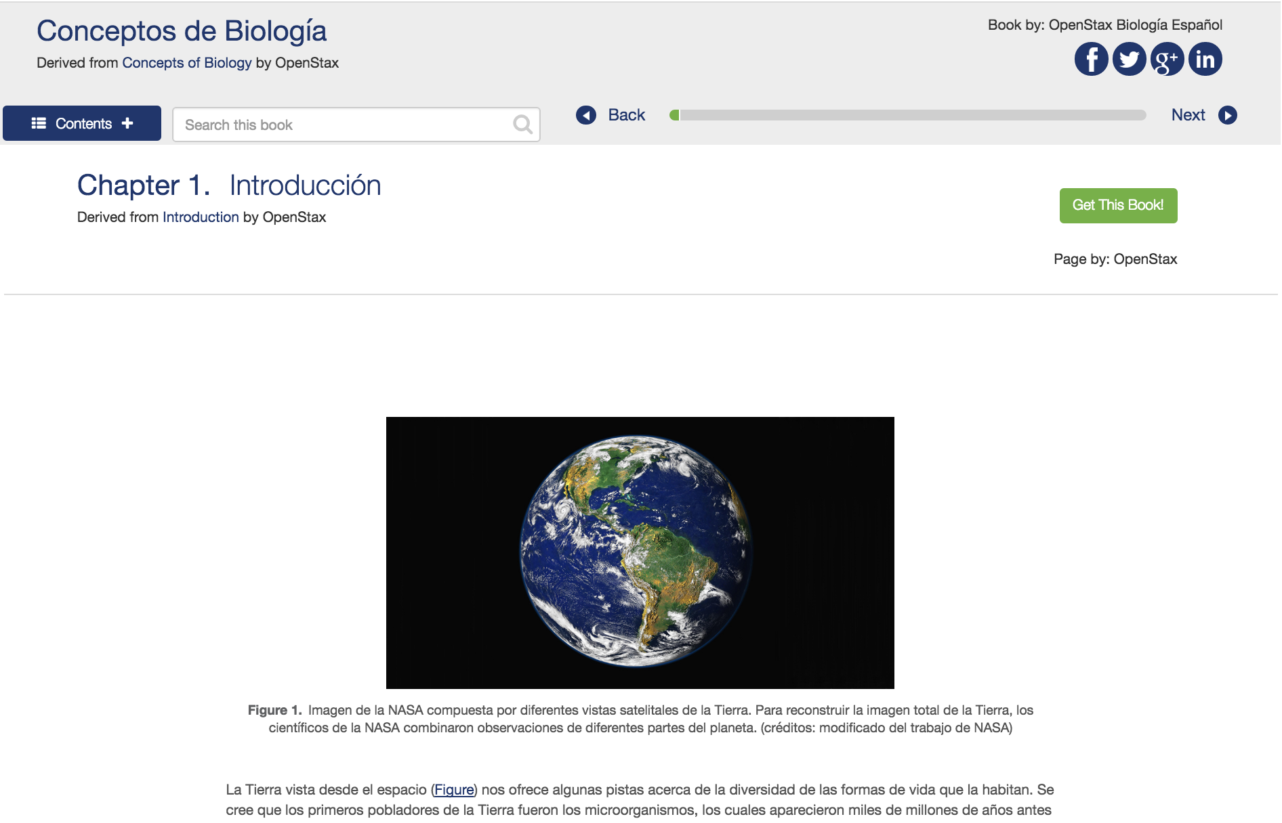
LOCALIZATION

Slide 22
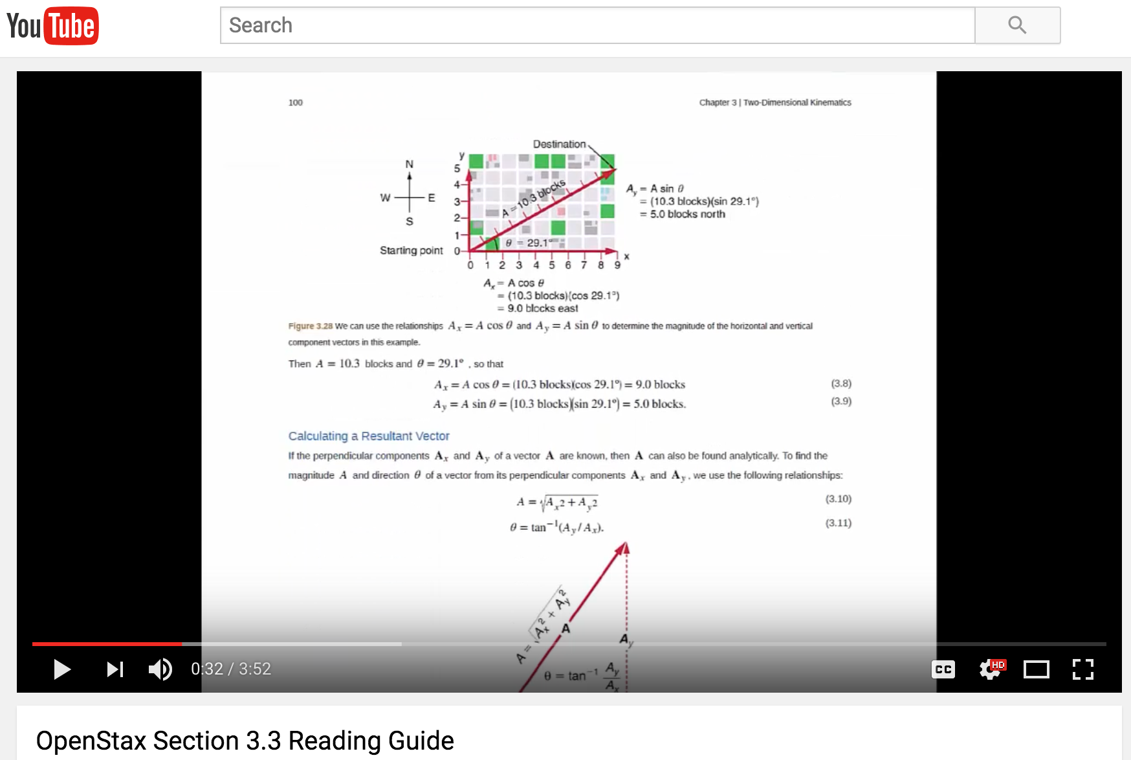
BEYOND THE TEXTBOOK
Notes:
UMASS Physics flipped classroom on YouTube.
This wouldn’t be legal with publisher content

Slide 23
Publisher and market responses

Slide 24
OER PLATFORMS
Wrap-around services related to the OER content, such as additional content, ancillaries, LMS integration, quizzing and homework.
Offered by publishers and other for-profit companies:
Cengage OpenNOW
Macmillian’s Intellus Learning
PanOpen
Lumen Learning
And many more…

Slide 25
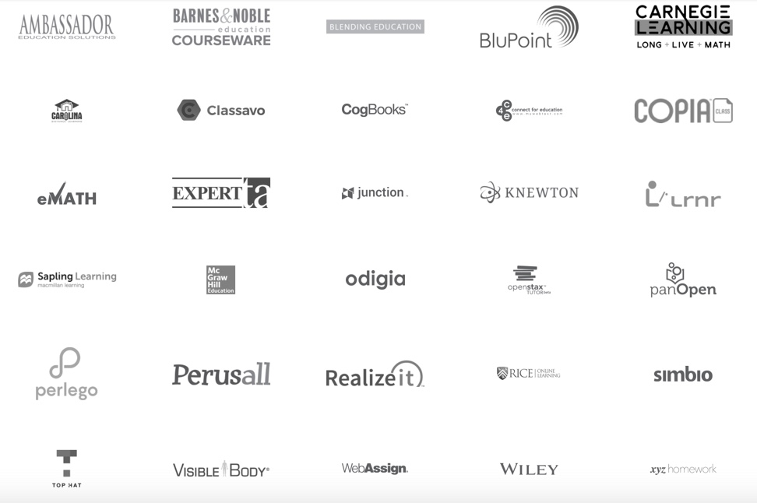
PARTNERSHIPS WITH OER
Notes:
As we hear a lot about rentals and subscriptions for content, I also want to highlight why post-course access TO CORE CONTENT matters….

Slide 26
INCLUSIVE ACCESS/AUTOMATIC PURCHASING PROGRAMS
Faculty/institution decide to participate
Administered by the bookstore
Students opt in/out when paying course fees*
Digital access through LMS – no print
Works for eBooks and courseware platforms
Access ends when class is over
*Publishers are willing to discount substantially (up to 80% off print and up to 25% for online courseware, i.e. MyMathLab)

Slide 27
ACCESS CODES
Faculty decide to participate
Students purchase access codes from bookstore or direct from the publisher*
Digital access only – no print, typically only one format available
Works for eBooks and courseware platforms
Access ends when class is over
*Publishers are willing to discount substantially (up to 80% off print)

Slide 28
POST-COURSE ACCESS TO CORE CONTENT MATTERS
Courses that span multiple semesters
Retaking the course
Reference for advanced courses
Studying for higher education entrance exams & certification exams
Changing careers
Lifelong learning
Any of the above could mean a student needs to purchase another access code or rent the content again
Notes:
As we hear a lot about rentals and subscriptions for content, I also want to highlight why post-course access TO CORE CONTENT matters….

Slide 29
CARE FRAMEWORK
by Lisa Petrides, Douglas Levin, C. Edward Watson
Contribute: OER stewards actively contribute to efforts, whether financially or via in-kind contributions, to advance the awareness, improvement, and distribution of OER; and
Attribute: OER stewards practice conspicuous attribution, ensuring that all who create or remix OER are properly and clearly credited for their contributions; and
Release: OER stewards ensure OER can be released and used beyond the course and platform in which it was created or delivered; and
Empower: OER stewards are inclusive and strive to meet the diverse needs of all learners, including by supporting the participation of new and non-traditional voices in OER creation and adoption.
“CARE Framework” graphic and definitions, by Petrides, Levin and Watson, is licensed under CC-BY-SA 4.0.
Notes:
As we hear a lot about rentals and subscriptions for content, I also want to highlight why post-course access TO CORE CONTENT matters….

Slide 30
Effective strategies for encouraging OER
  from working with over 177 colleges and universities on their OER initiatives

Slide 31
DESIGNATE A LEADER
Someone who is:
  Respected by faculty
  Viewed as a peer by faculty
  Can dedicate 10+ hours per week

Slide 32
Effective strategy:
Be proactive and persistent

Slide 33
DIRECT VS. INDIRECT TACTICS
      Direct tactics
      Should result in one or more faculty members saying:
        Yes
        No
        I’m interested, tell me more

Slide 34
DIRECT VS. INDIRECT TACTICS
      Direct tactics
      You should be able to track, for each direct strategy:
      Faculty who expressed interest (aka “leads”)
      Faculty who adopted
      New students impacted

Slide 35
DIRECT VS. INDIRECT TACTICS
      Indirect tactics
      “If you build it, they might find it”
      Does not result in you getting a yes, no, or I’m interested from faculty
      Helpful, but should not be your main focus

Slide 36
PARTNER SCHOOLS: WHAT WORKS
Direct Tactic | What makes it “direct”
One-on-one meetings with faculty. Take physical OER with you. | Faculty agreeing to the meeting shows interest
Presentations during department meetings with a “carrot” (incentive) | Follow-up with individual faculty for one-on-one meetings. If they agree to the meeting, they are interested
Adoption grants | Faculty apply for grants

Slide 37
PARTNER SCHOOLS: WHAT WORKS
Direct Tactic | What makes it “direct”
Presentations during faculty convocation/orientations | Pass-around a sign-up sheet for faculty to express interest
Email from a respected senior leader expressing support & asking faculty to consider OER | Include ONE call to action: For more information, please email Mary at….
OER review workshops | Faculty who attend are interested

Slide 38
PARTNER SCHOOLS: WHAT DOESN’T WORK
Tactics that didn’t increase interest/adoptions
  Stand-alone OER workshops/presentations
  Department meeting presentations without a “carrot”
  OER website on the college/university site
  Student-driven activities
  Presentations/booths at other faculty events (not including orientations)
  Display of books

Slide 39

Do 8 direct tactics in one academic year
"8 Ball" by Jarno, via OpenClipArt.org

Slide 40
“Zone of Adoption”
Student Success conf.
OER Workshops
Dept. presentations
OER Workshops
OER Petting Zoo
Faculty office visits
Senior admin email
Faculty office visits
Faculty inservices
Open Ed Week
Faculty inservices
OER Grant Program
Bookstore deadline
OER Textbook Display, LibGuides, Website, Committee Meetings, Course Schedule Listings, Library Reserves, On-Campus Advertisements

Slide 41
Student Success conf.
OER Workshops
OER Textbook Display, LibGuides, Website, Committee Meetings, Course Schedule Listings, Library Reserves, On-Campus Advertisements

Slide 42
OER Textbook Display, LibGuides, Website, Committee Meetings, Course Schedule Listings, Library Reserves, On-Campus Advertisements

Slide 43
Effective strategy:
“An effective goal focuses on results, not activity”
Stephen R. Covey
7 Habits of Highly Effective People

Slide 44
MEASURE OUTCOMES, NOT ACTIONS
Outcomes. Measure success by these!
  # of faculty using OER
  # of students impacted by OER
  $ amount of savings to students ($98.57 average)
  Student success (grades, completion, etc.)
Actions that contribute to, but don’t equal success
  Holding a meeting
  Having a workshop
  # of people who attended meeting/workshop
  Having a display
Notes:
PIRG= $100
OSC= $98.57

Slide 45
MEASURE OUTCOMES, NOT ACTIONS
“We presented at 10 department meetings (185 faculty total) and 8 faculty expressed interest right away. From those 8, so far, 2 have agreed to adopt OER for their courses, a total of 500 students per year impacted.”
  Action: Present at department meetings
  Goal: 25 interested faculty from presentations
  Interest/leads so far from action: 8 (out of 185)
  Adoptions so far from action: 2
  Students so far from action: 500 per year

Slide 46
If a direct action isn’t resulting in new interest or adoptions, stop and refocus on actions that are working

Slide 47
Effective strategy:
It’s going to be a lot of work

Slide 48
“You will be pushed further than you thought possible, but in a nurturing and highly supportive way.”
Erik Christensen
South Florida State College
Re: OpenStax Institutional Partner Program

Slide 49
It’s everyone’s initiative

Slide 50
INSTITUTION-WIDE INITATIVE
  Faculty
  Administrators
  Librarians
  Instructional Support
  At least one Senior Administrator who is willing to regularly promote the initiative
  Bookstore
  Disability Services
  Students

Slide 51
Market early & often.
Think beyond emails.

Slide 52
Effective strategy:
Start with momentum and scale

Slide 53
Focus on scale
What are your top 25 highest-enrolled courses?
Who teaches those full-time?

Slide 54
1. Adopt
2. Adapt
3. Create

Slide 55
MEASURE OUTCOMES, NOT ACTIONS
2016-2017 Partner Program Results
  Average of 150% increase in students impacted
    50,000 additional students impacted
    $4.9 million in additional savings

Slide 56
Prices change, freedom is forever
Questions? nicolef@rice.edu
Notes:
So here’s our final thought that I’d like to leave you with….

