Slide 1

Enterprise Holdings, Inc.
Missouri State University
August, 2018

Slide 2
Agenda
Introductions
Program Impact
Rental vs. Mileage Reimbursement
Method of Payment
One-Ways & Specialty Vehicles
Personal Use Rentals
Walk Through Items
Q&A

Slide 3
Account Managers: Service and Contractual
Administrative Support:
Example Tasks:
Billing and Invoicing Inquiries
Refund Requests
Do Not Rent customers
Method of Payment Changes
Claims Inquiries
Rate Verification
Account-Development Representative (ADR)
ADROldSouthwest@ehi.com
Contractual Support
Primary Contact:
Josh Lambert Joshua.M.Lambert@ehi.com
PH#: 417-868-8855
FAX#: 855-237-0893
Secondary Contact:
Matt Madura
Matthew.M.Madura@ehi.com
PH#: 417-866-8355
FAX#: 866-346-2511

Slide 4
Local Operations and Locations
Tamie May, Area Manager
417-869-6282 office 417-392-1032 cell Tamara.N.May@ehi.com
Springfield Branches
1046 W Sunshine St
3220 S Campbell Ave *
207 E Kearney
1308 E Republic Rd
2300 N Airport BLVD *
Ozark Branch
1501 W State Highway J
Enterprise Reservation Line
1-800-736-8222
*Branches open 7 days per week

Slide 5
Program Impact
588,593 miles driven from Springfield area
Average cost per mile $.20
Add $.07 per mile for fuel
Total cost to MSU $159,463.39
Total cost if reimbursed at $.37 per mile = $217,779.41
MSU Saving over the last 12 months
$58,316.02

Slide 6
Mileage Reimbursement Alternative
MSU recognizes that renting is a cost effective option offered to personnel for business travel
Operating Policies recognize 3 Methods of Transportation for Travel
University owned (Departmental or Motor Pool) vehicles
Commercial transportation (airlines, rental services, etc.)
Personal vehicle (reimbursement)
Trip Optimizer (tripoptimizer.mo.gov)

Slide 7
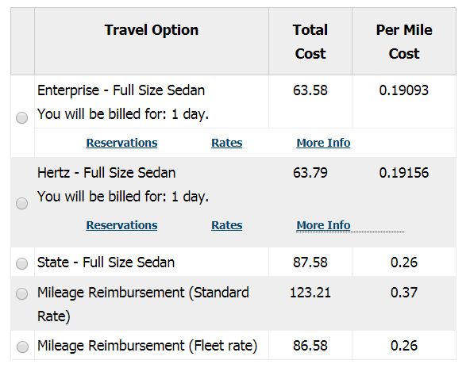
Example Trip
One day trip to
KC and back in a
Full size car.

Slide 8

Method of Payment
Customer Pay Rentals
Provide Missouri State University’s account number and a credit card (XZ51W99)
Procurement Card on file
Account/Billing Number required
If you do not know your department billing number-Office of Procurement Services

Slide 9
Method of Payment:
Department Billing Numbers-Office of Procurement Services:
Create new billing number
Updates to billing numbers
Change in cardholder
Change in P-Card information
Setup to receive emails from Enterprise-Office of Procurement Services
Email Isaac!
Emailed receipts are available for up to 5 people

Slide 10
Do not post Billing numbers.
Billing numbers are to be treated as Credit Card numbers.
Any rental utilizing a billing number will charge the MSU Procurement Card attached to it.

Slide 11
Delayed Billing Process
Enterprise now has the ability to Audit Tickets for Sales Tax and VLF Charges
All accounts will be on a weekly billing cycle
Direct Billing accounts will send invoices once a week
Procurement Card Billing Accounts will be charged once a week and receipts emailed at that time.
88% of MSU Billing numbers are Delayed CC
12% of CC Immediate

Slide 12
EHI auditing team cannot review customer pay rentals.

Slide 13
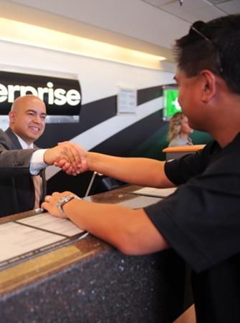
Additional Fees
Taxes and Fees that are not exempt in some locations
Airport/concessionary taxes
Midfield Fees
Arena Fees
Sales tax on rentals occurring in other states
Mandatory municipal fees

Slide 14
Optional Product Blockage
Completely Blocked
PAI/PEC
Upgrades
Billing Block
Roadside Protection
GPS
Fuel Policy:
If rentals are returned with less fuel than when rented, EHI will charge regional pump price for the difference.

Slide 15
Enterprise One-Way Option
One-Way rental terms:
One-way rentals must be reserved as such
Rentals with a radius of less then 500 miles incur no additional fee
Trips 501 miles or more incur an additional $125.00 fee
How to reserve:
Enterprise Rentals
Reserve at enterprise.com
Enter account number
Change return location to final destination
All one-way’s are subject to availability

Slide 16
Specialty Vehicles Not Included Under NASPO
(Examples: 15 Passenger Van, Premium/Luxury SUV, Exotics, Motorcycles, etc…)
15 Passenger Vans
A special account has been created for 15 Passenger vans (MSU15PK)
Damage waiver and liability insurance must be purchased
These vehicles can be reserved locally through our Regional Van Coordinator:
Amanda LaBarge
Amanda.D.Labarge@ehi.com
PH#: 417-832-1494
Premium/Luxury SUV’s (Suburban/Yukon XL)
Contact local branch for availability
Damage waiver and liability insurance must be purchased

Slide 17
Personal Use & Alumni Rentals
MSU Employees, Students, and Alumni receive discounts on personal use rentals.
Personal Use: XZ51MPU
Alumni Rentals: MSUALUM
Charged tax.
Insurance is not included but can be purchased at a discounted price.
Enterprise - 5% Discount
National Car Rental - 10% Discount

Slide 18
Walk Through Items
Online Reservations
Emerald Club Enrollment

Slide 19
Q&A
Thank you

