Slide 1
Bridging the Gap:
Teaching for Tomorrow’s Accounting Careers
Wayne Thomas
University of Oklahoma

Slide 2
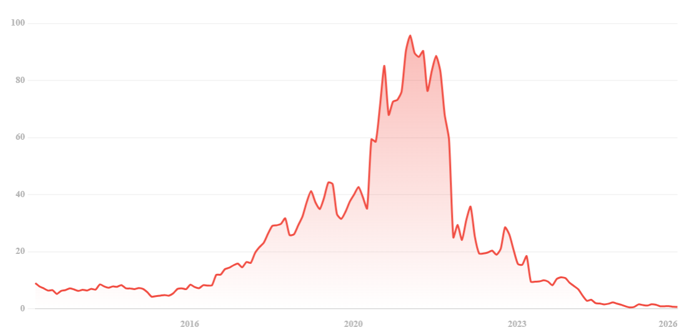
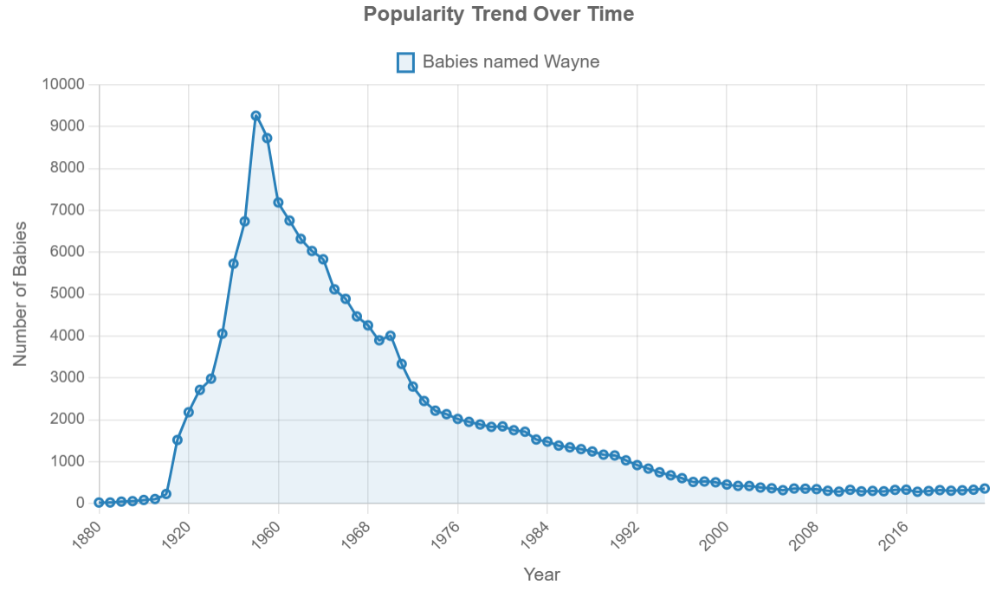

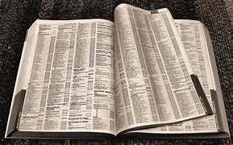
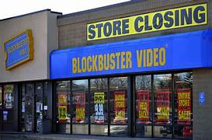
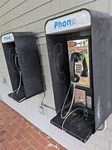

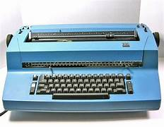
We Still Do It…But in a Different Way
Chegg’s
Stock Price
$113.51
$0.64
Babies Named
“Wayne”

Slide 3

Today’s Agenda
Headwinds Facing College Education
Ideas for a Meaningful Course
Introducing Real-World Perspectives
EDGAR Cases, AI Assignments
Ethics and Earnings Management Assignments
Data Analytics – Visuals and Dashboards

Slide 4
Headwinds Facing College Education
Demographic Cliff

Slide 5
Headwinds Facing College Education
Declining Confidence

Slide 6
Headwinds Facing College Education
Fewer High School Students Opting for College
Many opting for non-degree vocations and paths

Slide 7
Headwinds Facing College Education
Rising Costs of College
“Materials” may include computers
If inflation only
If inflation only

Slide 8

Headwinds Facing College Education
Declining Employer Perceptions of Graduates (skills gap)
Not able to deal with uncertainties/messiness of the real world
Not prepared to use common tools (Excel, AI)
Insufficient experiential learning (theory versus practice)
Lack of communication skills
Lack of professional behavior
Grade inflation and lack of rigor (which student is better?)

Slide 9

Headwinds Facing Accounting Education – Misperceptions
Accounting is…
A math class (not business, boring)
Too difficult (foreign language)
Static (never changes)
Cut-and-dried (little thought needed)
Not a driver of business value (just a bunch of rules to follow)
Bookkeeping (only staff-level support)
Historical only (backwards looking)
Only for accounting majors (not relevant to other business functions)
For people who work alone (not part of management group)
For people who don’t need communication skills (no clients or teams)
Incorrect
All of these are __________________!

Slide 10

But Wait…Reasons for Optimism!
Headwinds ≠ Collapse → Time of transition (it’s happened before)
Student value remains → Lower unemployment and higher wages
Employers value degrees → Business disciplines in particular
Expanding opportunities → Online education, corporate partnerships
Innovative programs → Certificates, credentials, specialty programs
Advances in technology → Innovations at relatively lower cost
Institutional norms → Parents want kids in college classes (and married)
Accounting matters → Decision making and accountability always needed
Instructors (we) matter → Course design and delivery make a difference
Generate interest
Build knowledge
Develop skills

Slide 11

My Classroom
275 students × 2

Slide 12


My Other “Classrooms”
Synchronous
Asynchronous

Slide 13




Create a Meaningful Course
“Big Picture”: Organize students’ perception of accounting
Real-world: Make the course seem relevant to students
Useful business tool: Show them decisions and analysis
Career readiness: Give them the tools and skills they’ll need
$140 Million
My daughter’s
My Goal: Make the course meaningful, without making it more complex.

Slide 14



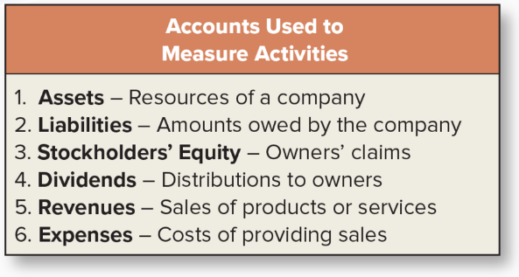
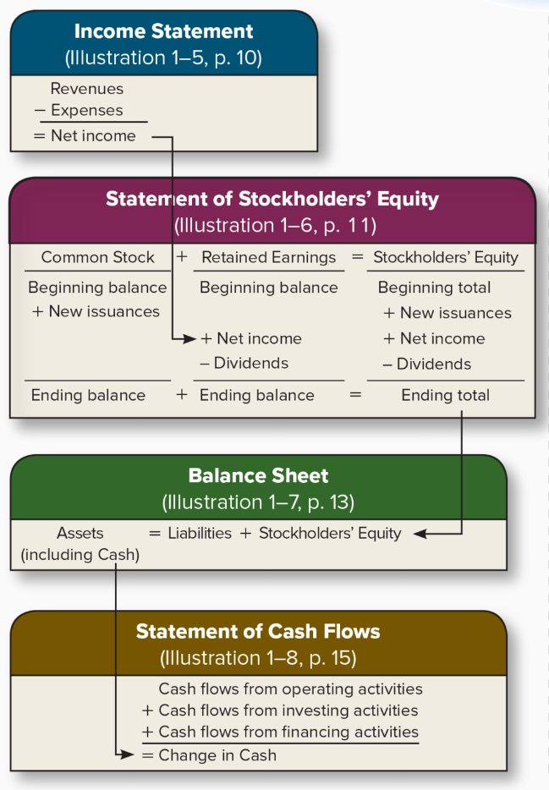

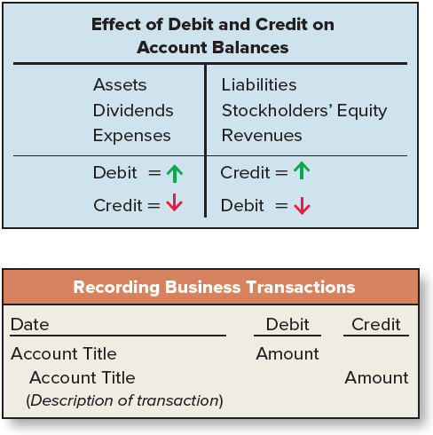
Framework for Financial Accounting
Make Decisions About
Companies
Investors, creditors,
managers, etc.
Activities
Measured by
Organize Their Perception
Build a framework
Accounting ≠ counting
Accounting = telling a story
Dynamic social science
Motivate majors
Appreciated by non-majors
Information
Communicated to
Financial
Accountants

Slide 15
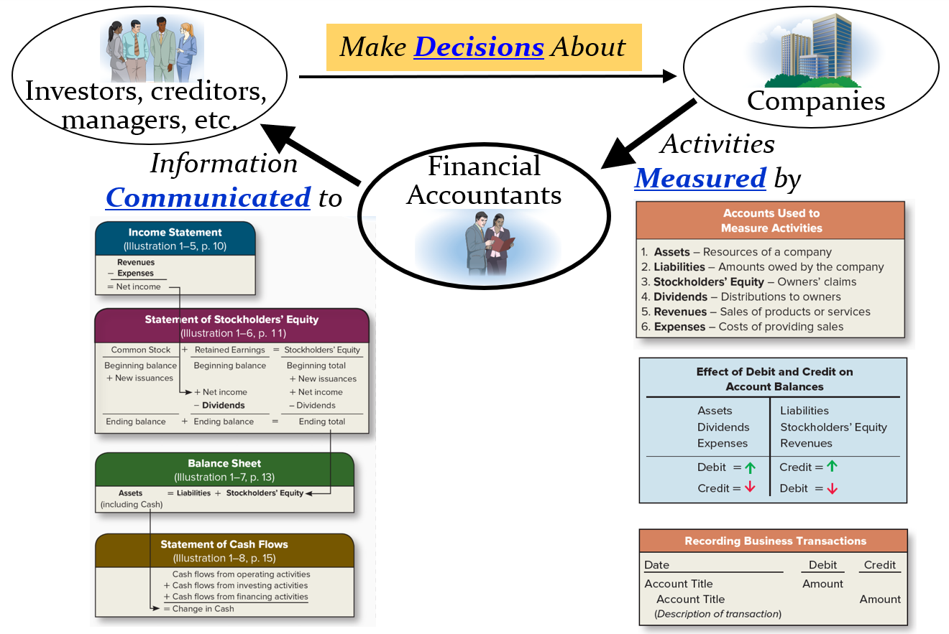
Framework for Financial Accounting
Organize Their Perception
Build a framework
Accounting ≠ counting
Accounting = telling a story
Dynamic social science
Motivate majors
Appreciated by non-majors

Slide 16
Framework for Financial Accounting
Organize Their Perception
Build a framework
Accounting ≠ counting
Accounting = telling a story
Dynamic social science
Motivate majors
Appreciated by non-majors

Slide 17
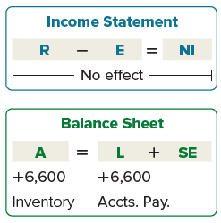
Journal Entries and Financial Statements
(Measurement and Communication)
Measurement → Communication
Journal Entry → Financial Statements
Example. On October 19, purchase inventory for $6,600 on account.
Journal Entry
Debit Credit
Financial Statement Effects
Inventory
Accounts Payable
6,600
6,600

Slide 18
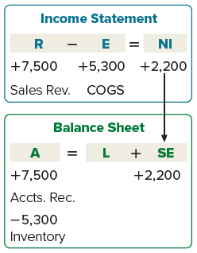
Journal Entries and Financial Statements
(Measurement and Communication)
Example. On December 15, sold inventory for $7,500 on account with a cost of $5,300.
Journal Entry
Debit Credit
Financial Statement Effects
Accounts Receivable
Sales Revenue
7,500
7,500
Cost of Goods Sold
Inventory
5,300
5,300

Slide 19
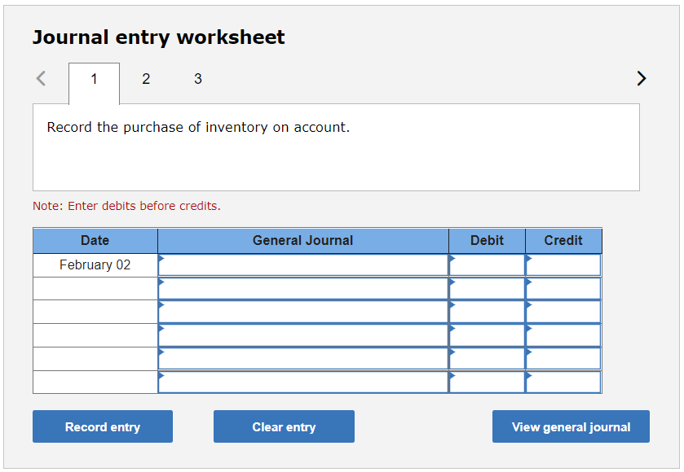
Journal Entries and Financial Statements
(Measurement and Communication)
A company purchases inventory on account on February 2 for $40,000 and then sells this inventory on account on March 17 for $60,000.
Record the purchase of inventory on account.
Record the sale of inventory on account.
Record the purchase of inventory on account for $40,000.
Inventory
40,000
Accounts Payable
40,000

Slide 20
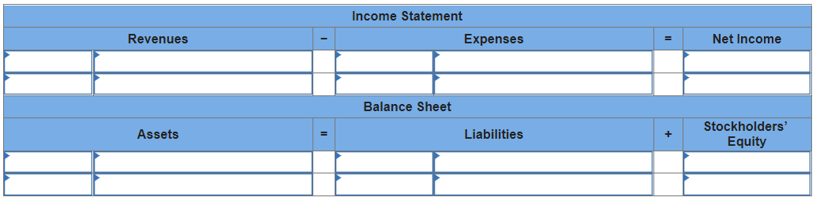
Journal Entries and Financial Statements
(Measurement and Communication)
A company purchases inventory on account on February 2 for $40,000 and then sells this inventory on account on March 17 for $60,000.
(a) Determine the financial statement effects for the purchase of inventory on account.
40,000
Inventory
40,000
Accounts Payable

Slide 21
Journal Entries and Financial Statements
(Measurement and Communication)
A company purchases inventory on account on February 2 for $40,000 and then sells this inventory on account on March 17 for $60,000.
(b) Record the sale of inventory on account.
60,000
Sales Revenue
40,000
Cost of Goods Sold
20,000
60,000
Accounts Receivable
20,000
(40,000)
Inventory

Slide 22
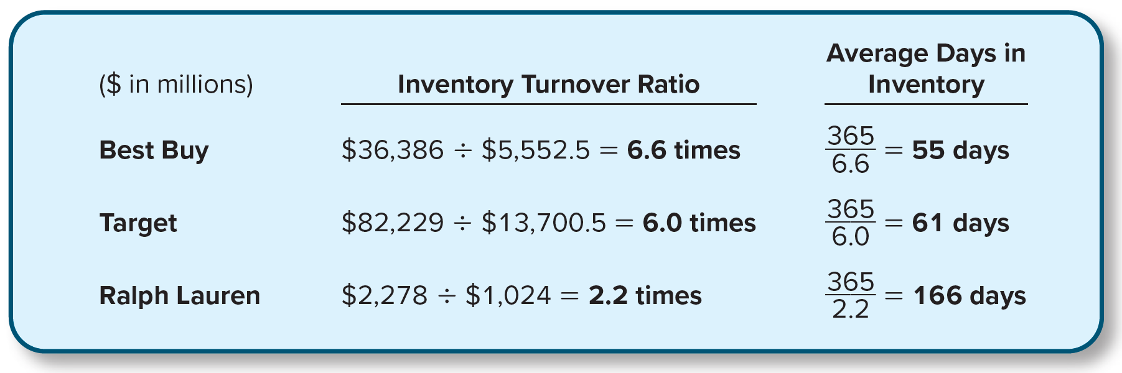
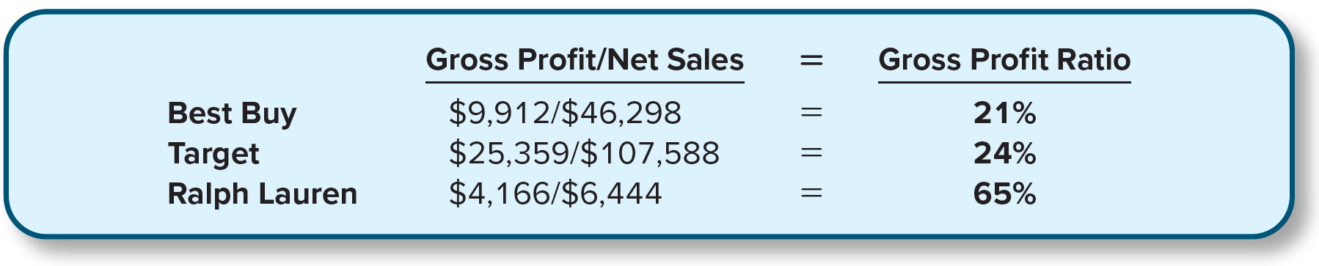
Ratio Analysis
(Decision Making)
Real-World analysis
Inventory analysis: Best Buy vs. Target vs. Ralph Lauren

Slide 23
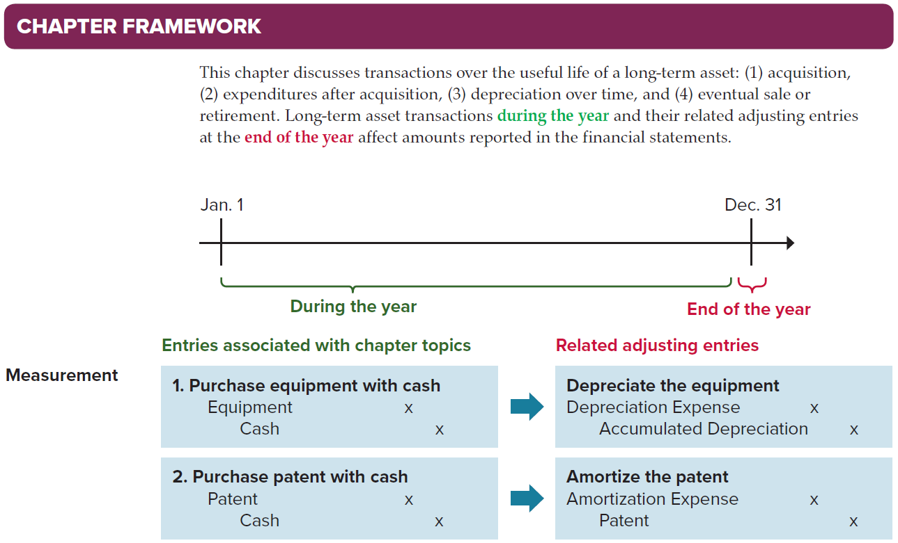
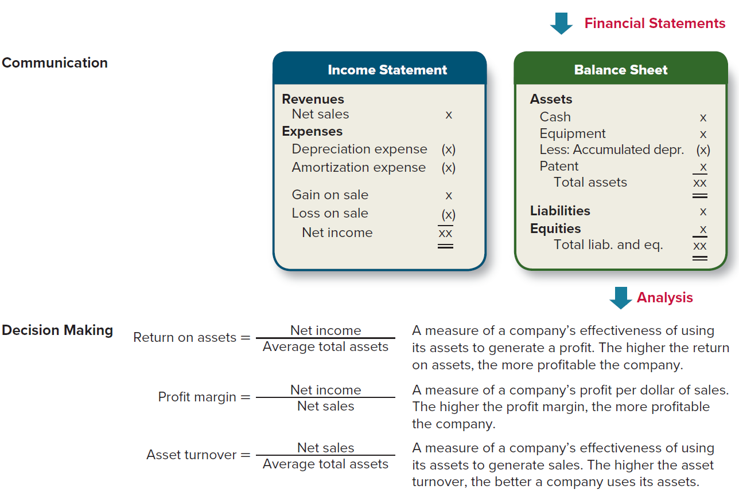

Chapter Framework
Every chapter
One-page illustration
Summarize for major topics:
Measurement (during vs. end)
Communication (I/S & B/S)
Decision Making (Ratios & interp.)
Also:
Video walk-through (2-4 min.)
10 MC Questions

Slide 24
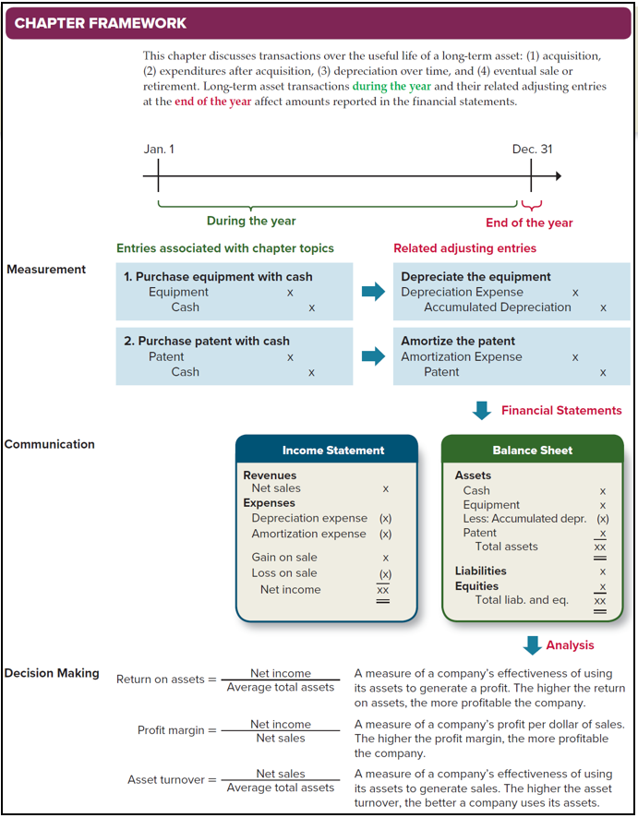
Chapter
Framework
1. Measurement (during the year): During the year, a company purchases equipment that is expected to be used for several years. The company records
a. Debit Equipment; credit Cash.
b. Debit Equipment Expense; credit Cash.
c. Debit Cash; credit Equipment.
d. Debit Cash; credit Equipment Expense.
2. Measurement (end of the year): At the end of the year, the adjusting entry to depreciate equipment involves
a. Debit Accumulated Depreciation; credit Equipment.
b. Debit Depreciation Expense; credit Accumulated Depreciation.
c. Debit Depreciation Expense; credit Equipment.
d. Debit Accumulated Depreciation; credit Depreciation Expense.
3. Communication (income statement): Depreciation of equipment each year has what effect on the income statement?
a. Decrease expenses for the amount of depreciation for the current year only.
b. Decrease expenses for the amount of depreciation since the asset was purchased.
c. Increase expenses for the amount of depreciation for the current year only.
d. Increase expenses for the amount of depreciation since the asset was purchased.
4. Communication (balance sheet): Which of the following is true about Accumulated Depreciation reported in the balance sheet related to equipment?
a. An asset account that maintains a record of the equipment’s original cost.
b. A contra (or negative) asset account that represents depreciation of the equipment for the current year only.
c. A liability account that represents total depreciation since the equipment was purchased.
d. A contra (or negative) asset account that represents total depreciation since the equipment was purchased.
5. Decision Making (ratio analysis): A company that is less effective at using its assets to generate sales would have a __________ asset turnover ratio.
a. Higher.
b. Lower.
Purposeful order:
Measurement (during the year)
↓
Measurement (end of the year)
↓
Communication (income statement)
↓
Communication (balance sheet)
↓
Decision Making (ratio analysis)

Slide 25
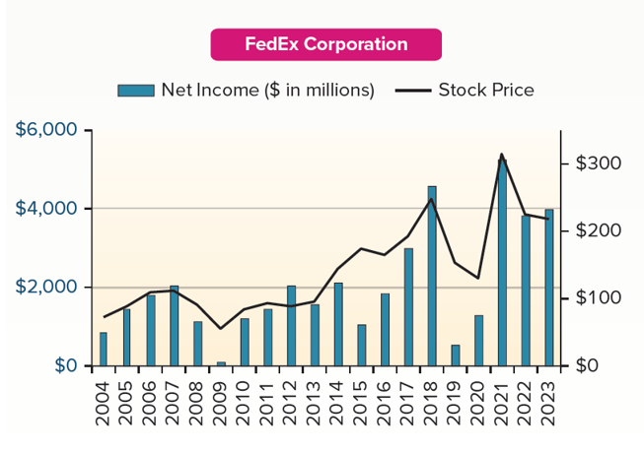
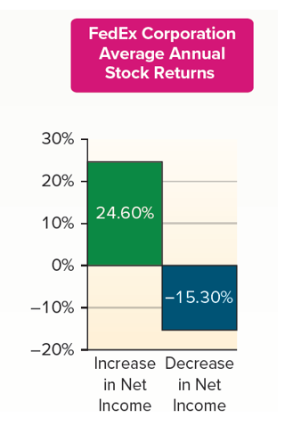
Real-World Visuals

Slide 26
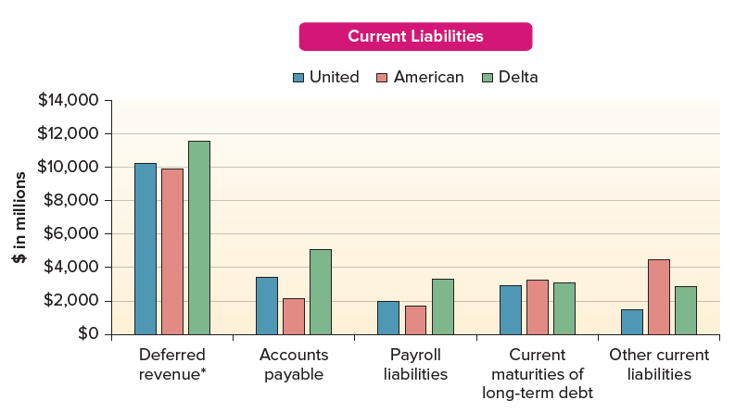
Real-World Visuals
What are some of the current liabilities reported by companies in the airline industry?
* Deferred revenue includes advanced ticket sales to customers and rewards earned through customer loyalty programs.

Slide 27
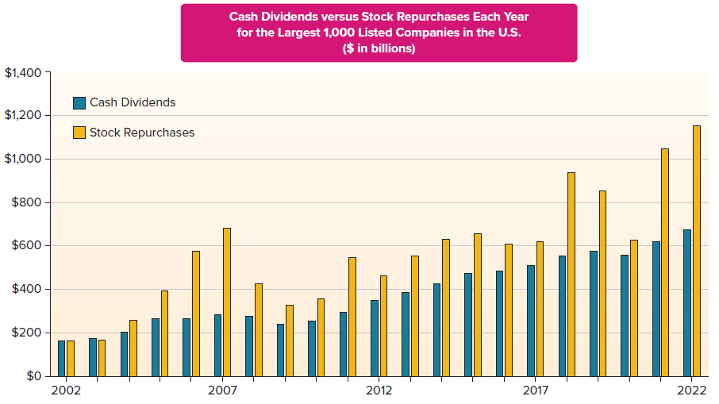
Real-World Visuals

Slide 28
Customize Your Course: Content and Skills
Goal: Generate Interest → Build Knowledge → Develop Skills
Exercises
(w/ Hint videos)
Real-World
(EDGAR Cases)
Live
Dashboards
AI
Assignments
Data
Visualizations
Engage/Prepare Students
Without adding more topics or complexity
Chapter Framework
Excel
Earnings
Management
GL/Acct Software
Ethics
Cases
Fin. Stmt. Effects
SmartBook

Slide 29

My Assignment Variety – Old vs. New
Chapter 7 – Long-Term Assets | Old | New
Brief Exercises, Exercises (all topics)
Chapter 7 – Long-Term Assets
Brief Exercises, Exercises (all topics)
F/S Effects (BEs: Depreciation & Sale)
Data Visuals (Acquisition, Depreciation)
Dashboard (Depreciation)
EDGAR Case (Meta)
Earnings Management Case (Depreciation estimates)
General Ledger Software (Accounting cycle)
AI Case (Depreciation schedule)
Chapter Framework video/questions
SmartBook
(many)
(fewer)
Assignments in other chapters:
Ethics Cases, Financial Analysis Cases, Integrated Excel

Slide 30
EDGAR Cases
Unique for each chapter
Visit SEC website (www.sec.gov)
Search for 10-K
  Financial statements
  Financial statements + disclosures
  Comparative analysis (analyze two companies)

Slide 31
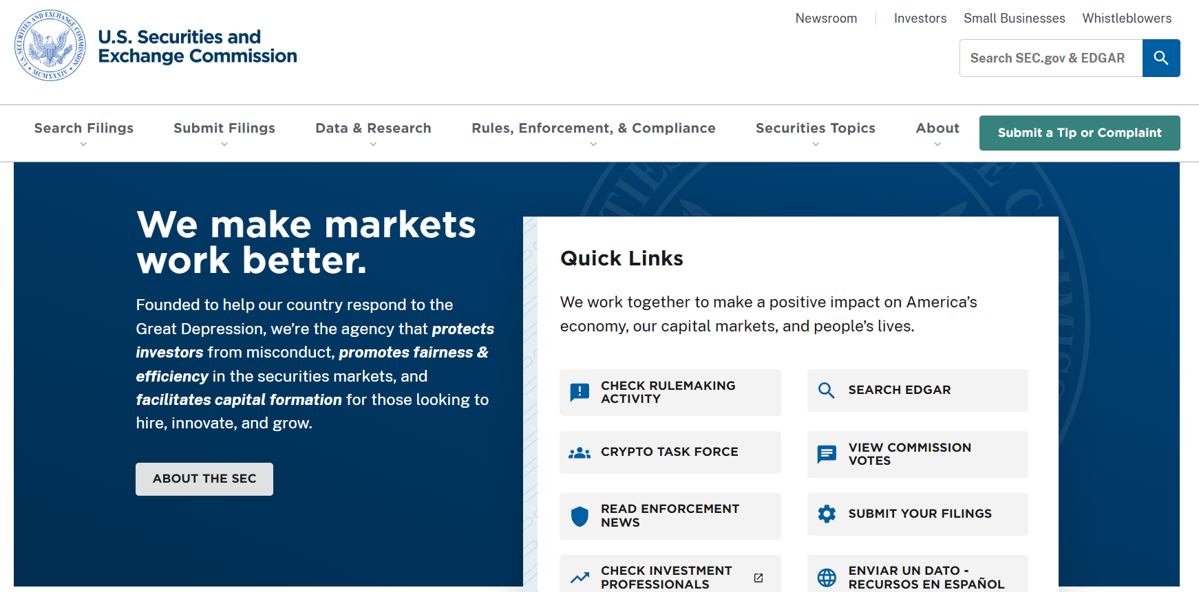
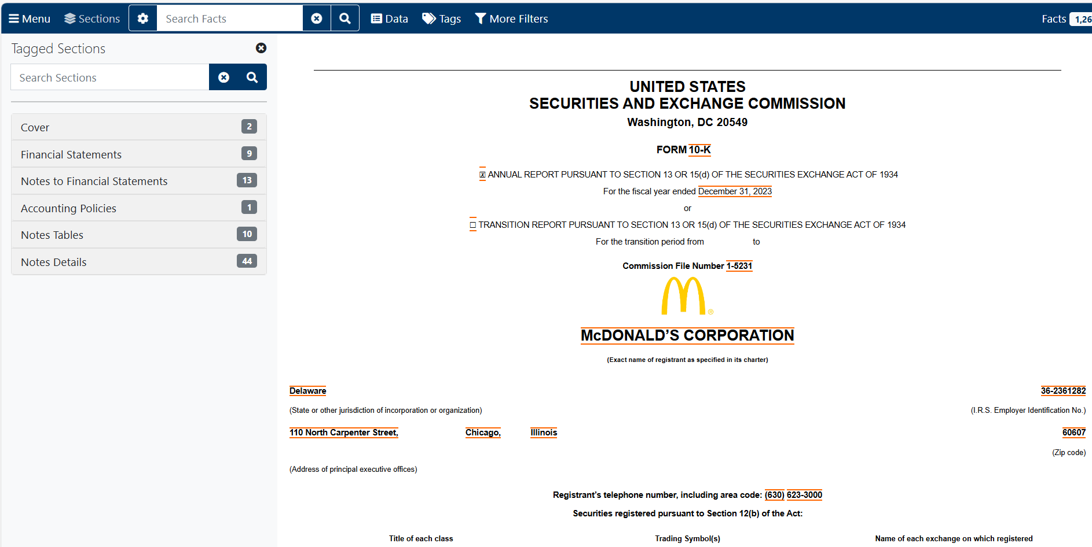
EDGAR Cases
Visit www.sec.gov and use EDGAR to search for the McDonald’s (ticker: MCD) annual report (10-K) for the year ended December 31, 2023. Locate the “Consolidated Statement of Income” (income statement) and “Consolidated Balance Sheets.”

Slide 32
EDGAR Case
Example: Financial Statements Only
Visit www.sec.gov and use EDGAR to search for the McDonald’s (ticker: MCD) annual report (10-K) for the year ended December 31, 2023. Locate the “Consolidated Statement of Income” (income statement) and “Consolidated Balance Sheets.”
1. Do the company’s revenues exceed expenses in the most recent year shown? What is the amount of net income?
2. Did net income increase in the most recent year compared to the previous year?
3. What amounts are reported for current assets and total assets in the most recent year shown?
4. What amount is reported for current liabilities in the most recent year shown? Does the company have any long-term liabilities?
5. By how much did retained earnings increase/decrease in the most recent year compared to the previous year?
6. What is the amount of dividends paid to common stockholders in the most recent year shown? This information can be found in the statement of shareholders’ equity or the statement of cash flows.
7. Does the change in retained earnings equal net income minus dividends?

Slide 33
EDGAR Case
Example: Financial Statements and Disclosure
Visit www.sec.gov and use EDGAR to search for the Meta (ticker: META) annual report (10-K) for the year ended December 31, 2023. Locate the “Consolidated Statements of Income” (income statement) and “Consolidated Balance Sheet.”
1. What is the net balance in property and equipment in the most recent year shown?
2. What are the amounts reported for (a) goodwill and (b) intangible assets net in the most recent year shown?
3. What are the balances of (a) gross property and equipment and (b) accumulated depreciation? (Hint: Locate Note 7 on Property and Equipment.)
4. Which depreciation method is used? (Hint: Locate Note 1 on the Summary of Significant Accounting Policies and find the section on Property and Equipment.)
5. Calculate the profit margin ratio in the most recent year shown and the previous year. Is the company’s profitability increasing or decreasing?

Slide 34
EDGAR Case
Example: Comparative Analysis
Visit www.sec.gov and use EDGAR to search for the Coca-Cola (ticker: KO) and Pepsico (ticker: PEP) annual reports (10-K) for the year ended December 31, 2023, and December 30, 2023, respectively. Locate the "Consolidated Statements of Income" (income statement) and "Consolidated Balance Sheets."
1. For each company, calculate the gross profit ratio, inventory turnover ratio, and average days in inventory in the most recent year shown.
2. Compare the management of each company’s investment in inventory. Which company is more profitable and which company sells its inventory more quickly based on the ratios calculated in requirement 1?

Slide 35

Recent Email from Student

Slide 36
AI Assignments
AI as a Tool
Transaction analysis and recording | Error detection/ correction | Data sorting and retrieval (sched prep) | Financial statement prep | Analysis and decision | Visualization creation and interpretation | Self learning and assessment
Acct Cycle
Receivables
Inventory
LT Assets
Liabilities
Equity
Cash Flows

Slide 37
AI Assignment:
Example – Allowance for Uncollectible Accounts
What do we typically assign?
A company has the following balances, before any adjustment: Accounts Receivable = $103,000; Allowance for Uncollectible Accounts = $3,300 (debit). The company estimates:
Required:
Estimate the amount of uncollectible receivables.
Record the adjusting entry for uncollectible accounts.
Calculate net accounts receivable reported in the balance sheet.
Age Group | Amount Receivable | Estimated Percentage Uncollectible
Not yet due | $53,000 | 5%
0 to 60 days past due | 25,300 | 10%
61 to 120 days past due | 15,300 | 20%
More than 120 days past due | 9,400 | 80%
Total | $103,000

Slide 38
AI Assignment:
Example – Allowance for Uncollectible Accounts
Copy the following instructions and table of customer information as an AI prompt:
Prompt: At the end of the year (12/31/2024), a company has the following customer account balances outstanding. All amounts are due from the customer within 30 days of the invoice date.
Customer # | Account Balance | Invoice Date
350 | $3,520 | 12/23/2024
125 | $4,424 | 11/1/2024
854 | $6,582 | 12/18/2024
204 | $6,811 | 12/14/2024
214 | $11,935 | 10/20/2024
754 | $14,087 | 10/17/2024
328 | $3,488 | 12/21/2024
381 | $9,912 | 11/7/2024
242 | $4,535 | 12/23/2024
859 | $12,674 | 11/18/2024
Group customer invoices into three groups: 1) not yet due, 2) past due by 1 to 30 days, 3) over 30 days past due. The company estimates the following uncollectible accounts: Group 1) = 5%, Group 2) = 10%, and Group 3) = 40%.
Determine the amount of total accounts receivable in each group, the amount estimated to be uncollectible in each group, and total estimated uncollectible accounts. Round estimates of uncollectible accounts to the nearest whole dollar.

Slide 39
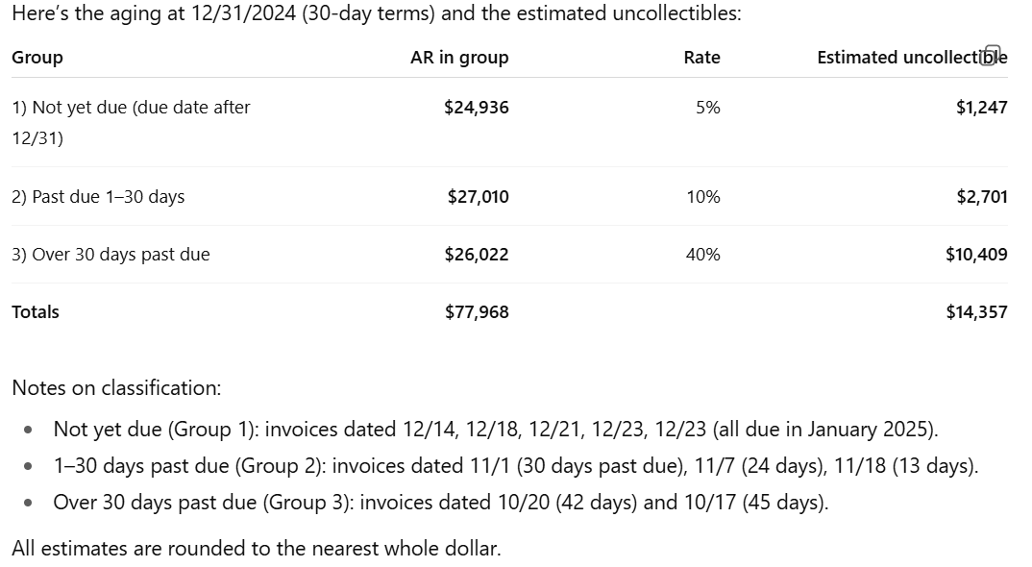
AI Assignment:
Example – Allowance for Uncollectible Accounts
ChatGPT
Output:

Slide 40
AI Assignment:
Example – Allowance for Uncollectible Accounts
Using only the output from the AI prompt, answer the following:
1. What are the amounts of accounts receivable and estimated uncollectible accounts for each age group?
2. Record the year-end adjusting entry for uncollectible accounts. Assume the balance of Allowance for Uncollectible Accounts prior to adjustment is $1,200 (credit).
3. What amount would be reported in the year-end financial statements for (a) net accounts receivable and (b) bad debt expense?
4. Now assume the balance of Allowance for Uncollectible Accounts prior to adjustment is $1,200 (debit). (a) Record the year-end adjusting entry for uncollectible accounts. What amount would be reported in the year-end financial statements for (b) net accounts receivable and (c) bad debt expense?

Slide 41
AI Assignment:
Example – Depreciation Methods
On January 1, North Fork Manufacturing purchased a CNC milling machine for $88,000. The machine has an estimated residual value of $4,000 and an estimated service life of seven years. The machine was used 1,600 hours in Year 1 and 2,500 hours in Year 2, and total expected usage over its life is 14,000 hours.
1. Without using AI, calculate depreciation expense for the first year under each of the following methods:
a. Straight-line method
b. Double-declining-balance method
c. Activity-based method

Slide 42
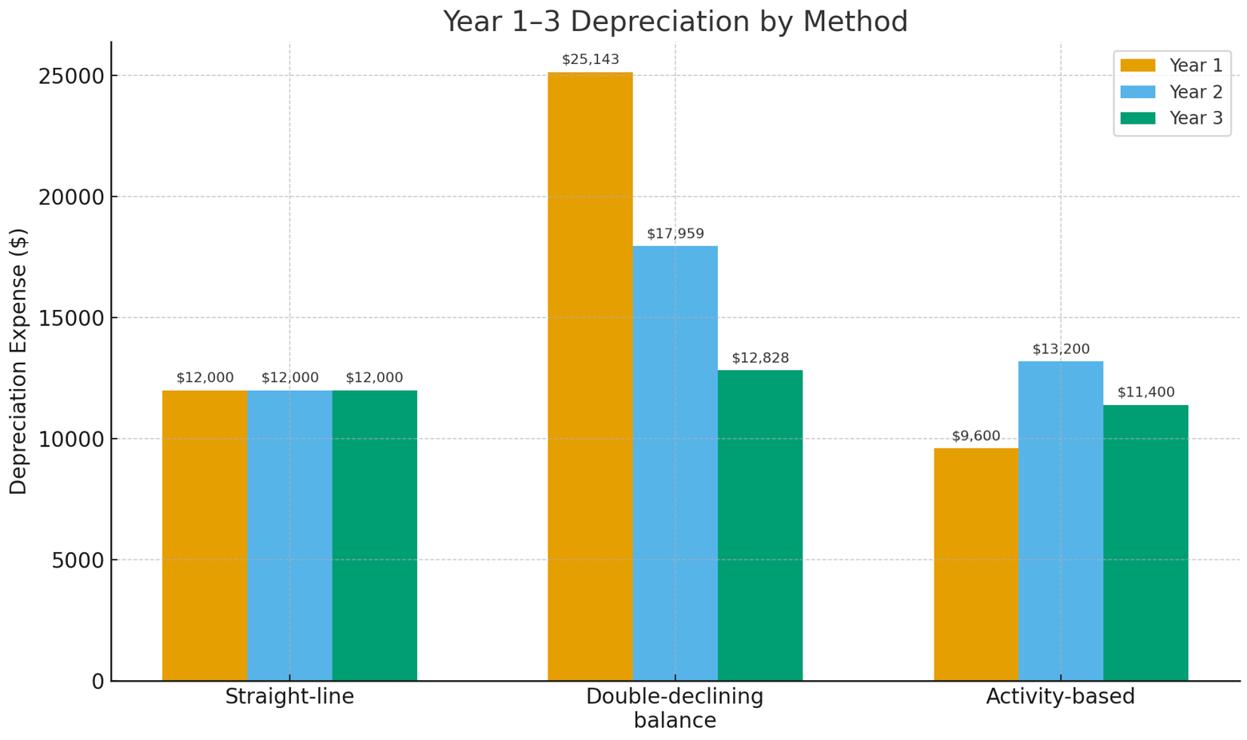
AI Assignment:
Example – Depreciation Methods
2. Copying the given information for North Fork Manufacturing, along with the following AI prompt:
Prompt: Using a single illustration, create a side-by-side bar chart by grouping depreciation expense in Year 1, Year 2, and Year 3 within depreciation method: 1) straight-line, 2) double-declining-balance, and 3) activity-based. The machine was used for 2,200 hours in Year 2, and 1,900 hours in Year 3. Include the depreciation amount with each bar.
Using only the graphs that were generated, answer the following questions.
  For which method does depreciation expense stay the same each year?
  For which method does depreciation expense vary with the level of activity?
  For which method does depreciation expense decrease each year?
ChatGPT
Output:

Slide 43
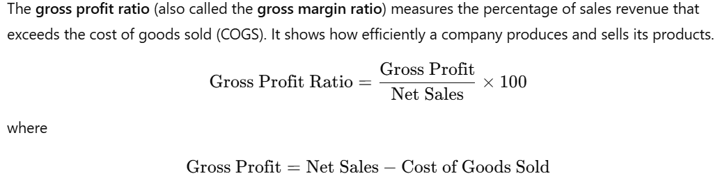
AI Assignment:
Example – Gross Profit Ratio and Inventory Turnover
1. Answer the following questions by using each question as a separate AI prompt:
a. Prompt: How is the gross profit ratio computed?
b. Prompt: How is the gross profit ratio interpreted?
2. Answer the following questions by using each question as a separate AI prompt:
a. Prompt: How is the inventory turnover ratio computed?
b. Prompt: How is the inventory turnover ratio interpreted?
ChatGPT
Output:

Slide 44
AI Assignment:
Example – Gross Profit Ratio and Inventory Turnover
3. Copy the instructions and table of information as an AI prompt to answer the questions for Required 3.
Prompt: Use the following data for 10 companies to create a scatter plot. The Y axis is for the gross profit ratio, and the X axis is for the inventory turnover ratio. For each of the 10 data points, show in the scatter plot the company name, the amount of the gross profit ratio as a percentage rounded to one decimal, and the amount of inventory turnover ratio rounded to one decimal.
Company | Sales Revenue | Cost of Goods Sold | Beginning Inventory | Ending Inventory
Alpha Co. | $714,080 | $498,004 | $67,436 | $68,654
Bravo Inc. | 153,528 | 111,546 | 11,208 | 13,906
Cascade LLC | 298,380 | 189,516 | 27,443 | 26,753
Delta Partners | 271,998 | 201,426 | 20,159 | 21,217
Epsilon Group | 258,380 | 168,388 | 21,682 | 20,820
Frontier Corp | 830,823 | 559,984 | 97,149 | 82,671
Grove Holdings | 930,926 | 572,071 | 88,599 | 97,500
Harbor Ltd. | 348,962 | 262,984 | 25,870 | 23,524
Ionix Works | 837,715 | 536,284 | 69,947 | 65,471
Juniper & Co. | 900,825 | 627,305 | 69,500 | 79,208

Slide 45
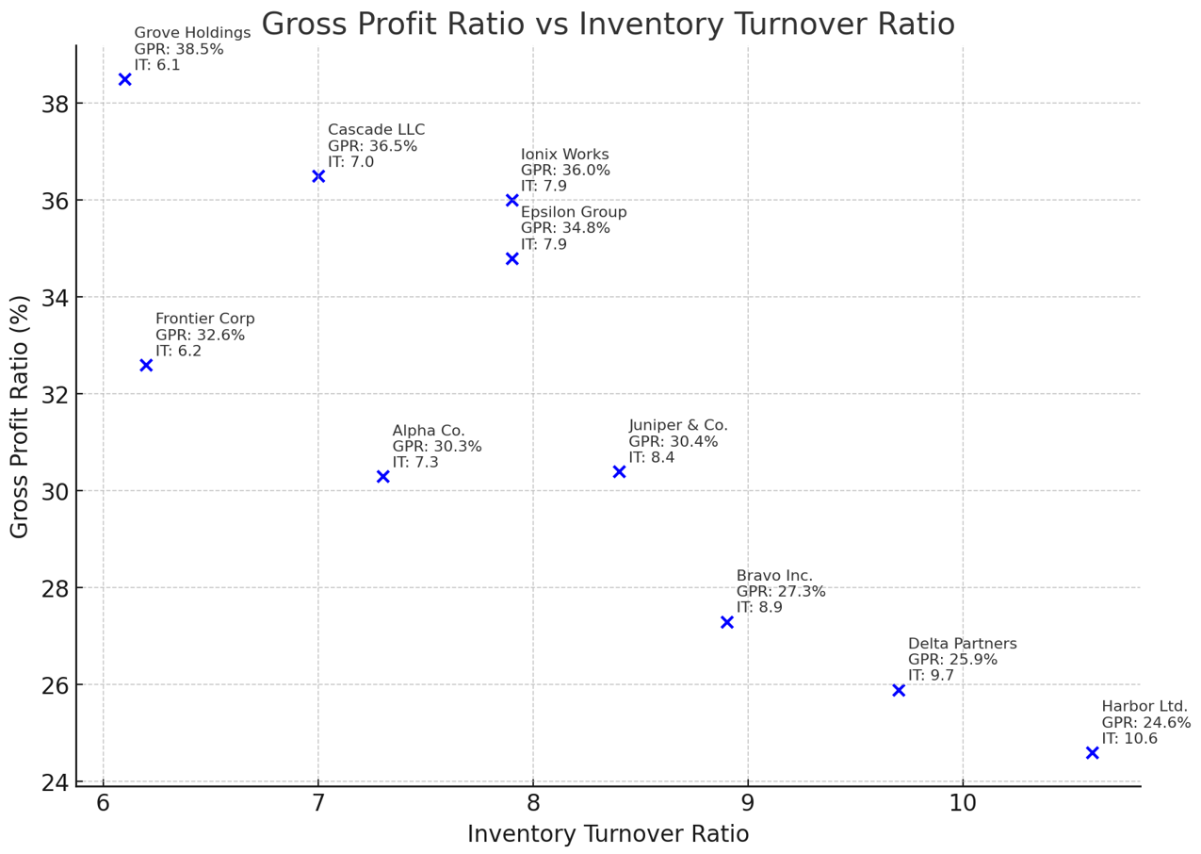
AI Assignment:
Example – Gross Profit Ratio and Inventory Turnover
ChatGPT
Output:
a. Without using AI, calculate the gross profit ratio for Epsilon Group (check your calculation using the scatter plot).
b. Without using AI, calculate the inventory turnover ratio for Epsilon Group (check your calculation using the scatter plot).
c. Using the scatter plot, which of the 10 companies shows the most favorable profitability?
d. Using the scatter plot, which of the 10 companies sells its inventory the most often?
e. What general relationship between the two ratios is shown in the scatter plot? As the gross profit ratio increases, the inventory turnover ratio ____________.

Slide 46
AI Assignment:
Examples – Current Assets and Current Liabilities (Real-World)
Use the following text as three separate AI prompts (run each prompt separately):
Prompt: Using the annual report (10-K) as of February 1, 2025, list Best Buy's current assets, dollar amounts, and percentage of total current assets.
[You can verify the output by using EDGAR (sec.gov) to find each company’s balance sheet in the annual report (10-K).]
Prompt: Generate a pie chart showing these amounts and percentages, with the amount of total current assets listed at the bottom.
Prompt: Provide similar amounts for currents assets of Amazon as of December 31, 2024, and generate a pie chart with the amount of current assets listed at the bottom.

Slide 47
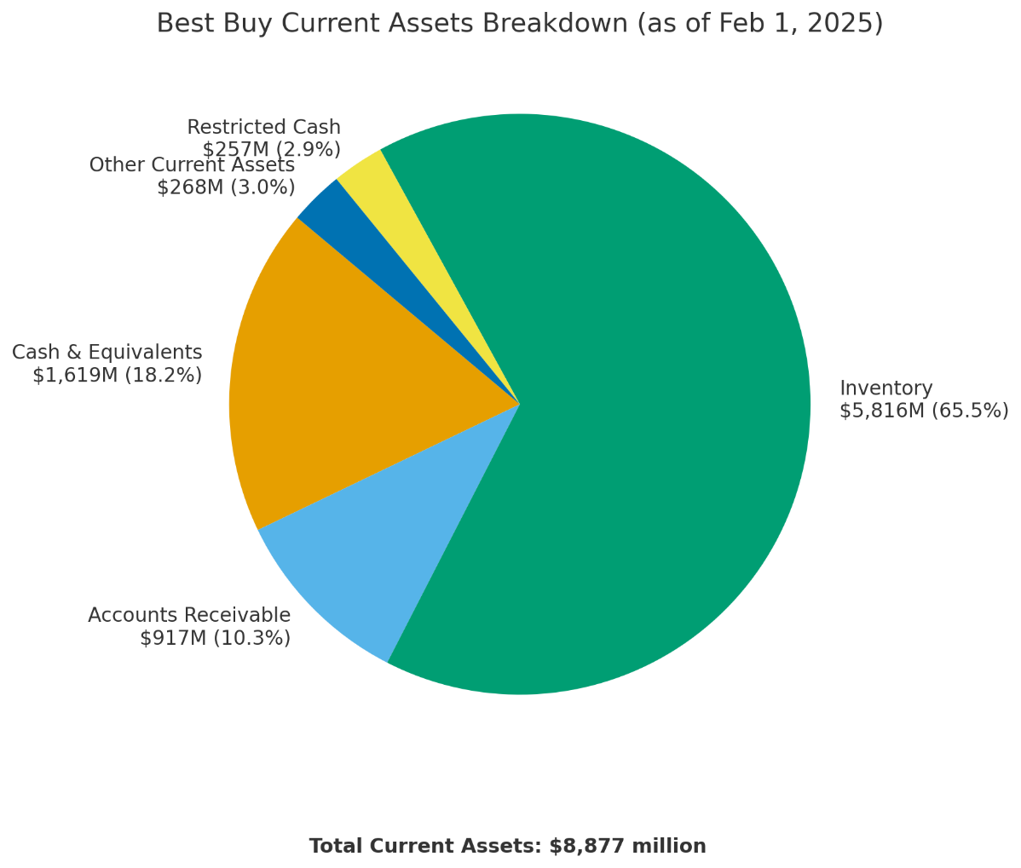
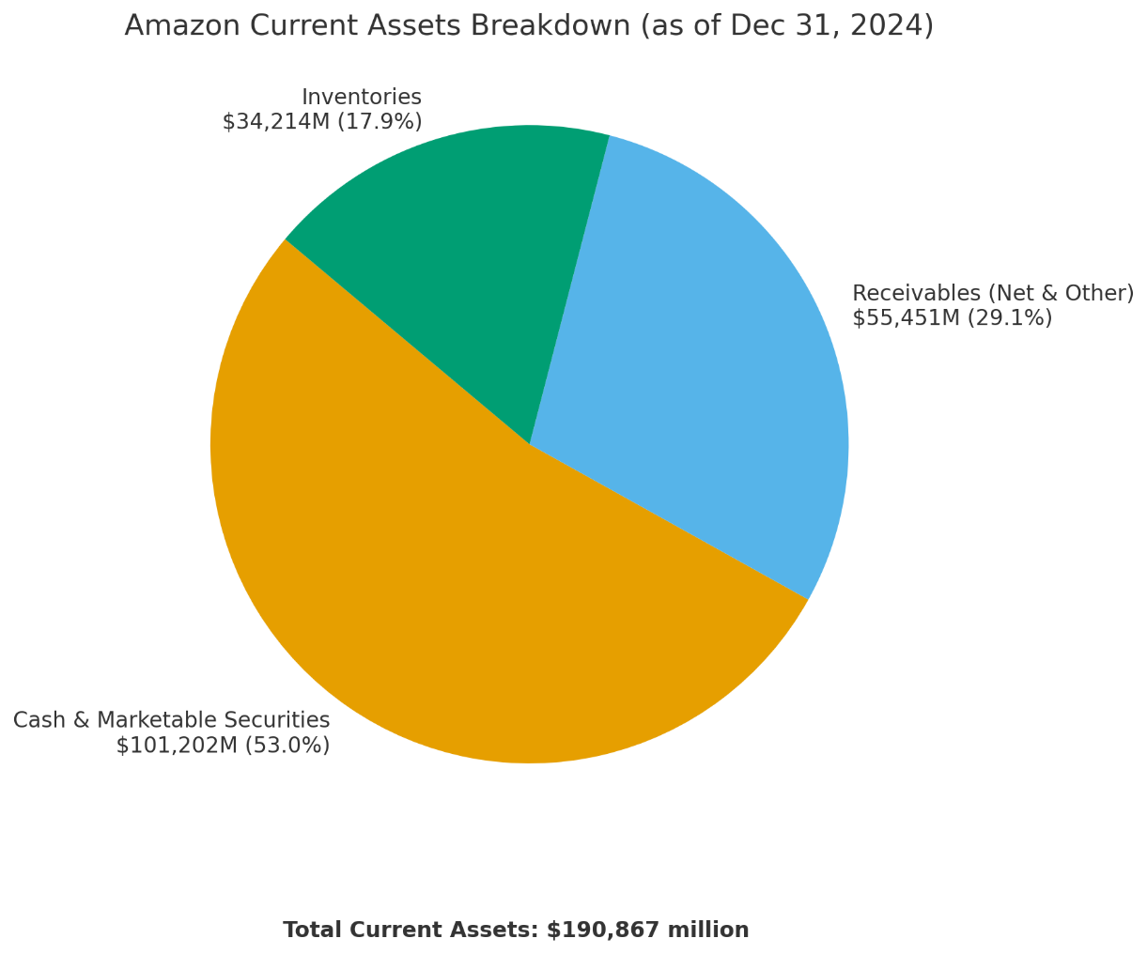
AI Assignment:
Examples – Current Assets and Current Liabilities (Real-World)
Which company has a greater percentage of its current assets in the form of cash? Which company has a greater percentage of its current assets in the form of inventory?
ChatGPT
Output:

Slide 48
AI Assignment:
Examples – Current Assets and Current Liabilities (Real-World)
Use the following text as three separate AI prompts (run each prompt separately):
Prompt: Using the annual report (10-K) as of February 1, 2025, list Best Buy's current liabilities, dollar amounts, and percentage of total current liabilities.
Prompt: Generate a pie chart showing these amounts and percentages, with the amount of total current liabilities listed at the bottom.
Prompt: Provide similar amounts for currents liabilities of Amazon as of December 31, 2024, and generate a pie chart with the amount of current liabilities listed at the bottom.

Slide 49
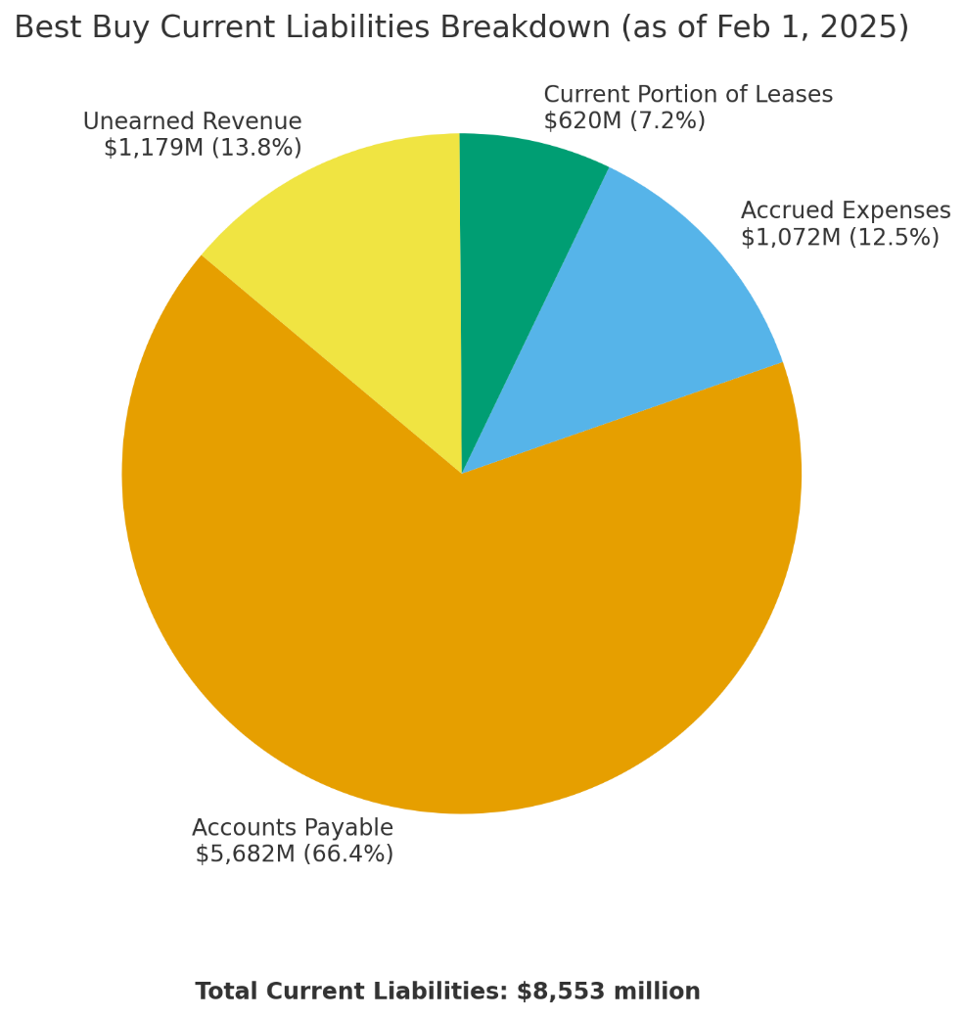
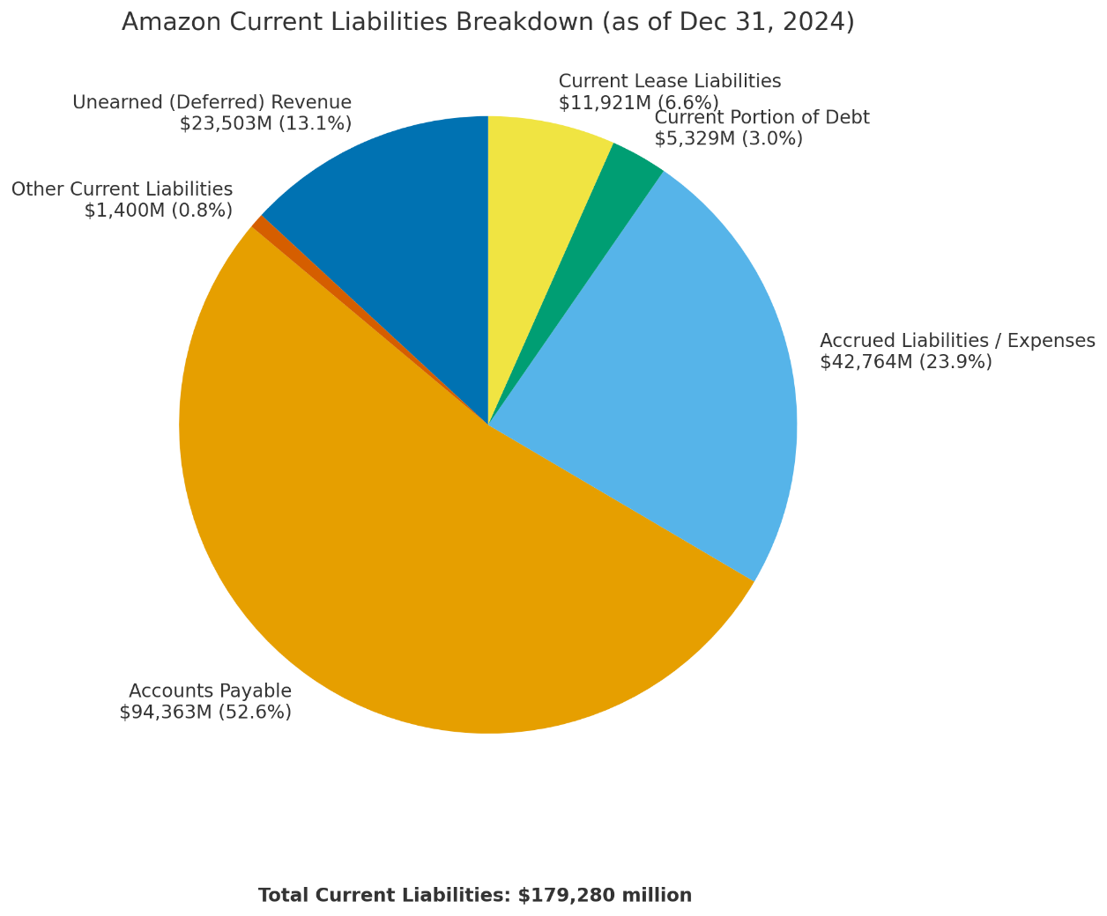
AI Assignment:
Examples – Current Assets and Current Liabilities (Real-World)
2. What current liability has the greatest percentage for both companies?
3. What percentage of current liabilities does Amazon report as Deferred Revenue (also known as Unearned Revenue)?
ChatGPT
Output:
4. Calculate each company’s current ratio. Which company has greater liquidity? [For your own additional understanding, ask AI to compare the two ratios and explain the difference.]

Slide 50
AI Assignment:
Self Quiz—Account Classifications
Use the following text as an AI prompt:
Prompt: Create a five-question interactive quiz using html code with dropdown menu selections to help me practice. The five questions should be classification of common account titles. The first dropdown menu should have six classifications: asset, liability, equity, revenue, expense, and dividend. The second dropdown menu should have two reporting choices: balance sheet and income statement. Indicate correct answers in green and incorrect answers in red.
1. Complete the practice quiz with all answers correct by following these instructions:
Open a text editor (such as Notepad).
Paste the AI-generated code into the text editor.
Save the file as quiz.html into your preferred folder.
Double-click the file and it will open in a browser (Edge, Chrome, etc.).
Complete the quiz and check your answers.

Slide 51
AI Assignment:
Self Quiz—Account Classifications
<!DOCTYPE html>
<html lang="en">
<head>
<meta charset="UTF-8">
<meta name="viewport" content="width=device-width, initial-scale=1.0">
<title>Account Classification Quiz</title>
<style>
body { font-family: Arial, sans-serif; margin: 40px; background-color: #f9f9f9; }
h2 { color: #333; }
.question { margin-bottom: 20px; padding: 15px; background-color: #fff; border-radius: 10px; box-shadow: 0 0 5px rgba(0,0,0,0.1); }
select { margin: 5px; padding: 5px; }
.correct { color: green; font-weight: bold; }
.incorrect { color: red; font-weight: bold; }
</style>
</head>
<body>
<h2>Classify Each Account</h2>
<div class="question" data-type="asset" data-statement="balance sheet">
<p><strong>1. Accounts Receivable</strong></p>
<label>Classification:
<select class="type">
<option value="">--Select--</option>
<option>asset</option>
<option>liability</option>
<option>equity</option>
<option>revenue</option>
<option>expense</option>
<option>dividend</option>
</select>
</label>
<label>Statement:
<select class="statement">
<option value="">--Select--</option>
<option>balance sheet</option>
<option>income statement</option>
</select>
</label>
<span class="feedback"></span>
</div>
<div class="question" data-type="liability" data-statement="balance sheet">
<p><strong>2. Accounts Payable</strong></p>
<label>Classification:
<select class="type">
<option value="">--Select--</option>
<option>asset</option>
<option>liability</option>
<option>equity</option>
<option>revenue</option>
<option>expense</option>
<option>dividend</option>
</select>
</label>
<label>Statement:
<select class="statement">
<option value="">--Select--</option>
<option>balance sheet</option>
<option>income statement</option>
</select>
</label>
<span class="feedback"></span>
</div>
<div class="question" data-type="equity" data-statement="balance sheet">
<p><strong>3. Common Stock</strong></p>
<label>Classification:
<select class="type">
<option value="">--Select--</option>
<option>asset</option>
<option>liability</option>
<option>equity</option>
<option>revenue</option>
<option>expense</option>
<option>dividend</option>
</select>
</label>
<label>Statement:
<select class="statement">
<option value="">--Select--</option>
<option>balance sheet</option>
<option>income statement</option>
</select>
</label>
<span class="feedback"></span>
</div>
<div class="question" data-type="revenue" data-statement="income statement">
<p><strong>4. Service Revenue</strong></p>
<label>Classification:
<select class="type">
<option value="">--Select--</option>
<option>asset</option>
<option>liability</option>
<option>equity</option>
<option>revenue</option>
<option>expense</option>
<option>dividend</option>
</select>
</label>
<label>Statement:
<select class="statement">
<option value="">--Select--</option>
<option>balance sheet</option>
<option>income statement</option>
</select>
</label>
<span class="feedback"></span>
</div>
<div class="question" data-type="expense" data-statement="income statement">
<p><strong>5. Rent Expense</strong></p>
<label>Classification:
<select class="type">
<option value="">--Select--</option>
<option>asset</option>
<option>liability</option>
<option>equity</option>
<option>revenue</option>
<option>expense</option>
<option>dividend</option>
</select>
</label>
<label>Statement:
<select class="statement">
<option value="">--Select--</option>
<option>balance sheet</option>
<option>income statement</option>
</select>
</label>
<span class="feedback"></span>
</div>
<button onclick="checkAnswers()">Check Answers</button>
<script>
function checkAnswers() {
document.querySelectorAll('.question').forEach(q => {
const type = q.querySelector('.type').value;
const stmt = q.querySelector('.statement').value;
const correctType = q.dataset.type;
const correctStmt = q.dataset.statement;
const feedback = q.querySelector('.feedback');
if (type === correctType && stmt === correctStmt) {
feedback.textContent = '✓ Correct!';
feedback.className = 'feedback correct';
} else {
feedback.textContent = '✗ Incorrect';
feedback.className = 'feedback incorrect';
}
});
}
</script>
</body>
</html>
ChatGPT
Output:

Slide 52
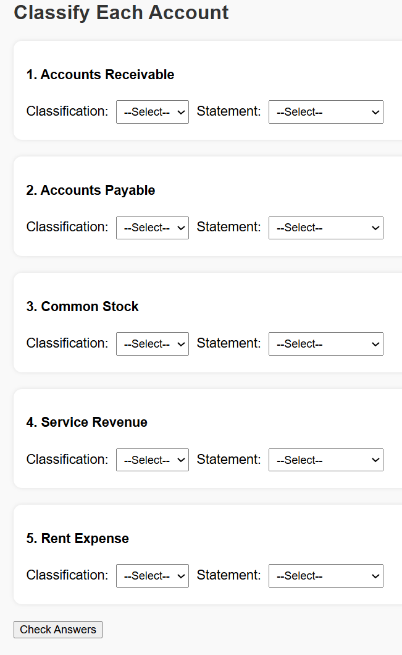
AI Assignment:
Self Quiz—Account Classifications
Did you complete the quiz with all correct answers?

Slide 53
AI Assignment:
Self Quiz—Account Classifications
2. Without using AI, determine how each of the following accounts would be classified and on which financial statement they would be reported:
Classification Statement
  Prepaid Insurance
  Salaries Payable
  Interest Revenue
  Utilities Expense
  Retained Earnings

Slide 54
AI Assignment:
Self Quiz—CVP Analysis
Use the following text as an AI prompt:
Prompt: Write an html code to create an interactive chart that allows me to do CVP analysis. The sales price per unit is $90, variable cost per unit is $50, and fixed costs are $20,000. Allow the volume of units to vary, and calculate the profit based on the volume selected.
Using the chart created, answer the following.
What is the breakeven number of units?
How many units must be sold if target profits are $32,000?
What is the breakeven number of units if fixed costs increase to $22,000?

Slide 55
AI Assignment:
Errors
1. Copy the following text as an AI prompt:
Prompt: Briefly describe the revenue recognition principle and explain “when” revenue should be recognized.
Based on the AI output from the prompt, when should revenue be recognized?
A. When the customer pays cash for the goods or services.
B. When the company signs a contract with the customer.
C. When the company provides goods or services to the customer.
D. When production of the goods or services is complete.
Ans: C

Slide 56
AI Assignment:
Errors
2. Use the following text as an AI prompt:
Prompt: A company provides services to customers on account in Year 1 for $50,000. The company receives cash of $30,000 from those customers in Year 1, and the remaining cash of $20,000 is received in Year 2. Therefore, $30,000 of revenue is recognized in Year 1, and $20,000 of revenue is recognized in Year 2. Is this correct?
Based on the AI output, is the statement correct? [Yes/No]
Without using AI, answer the following questions:
3. Prepare the journal entry in Year 1 for $50,000 of services provided to customers on account.
4. Prepare the journal entry in Year 1 for $30,000 cash collected from customers on account.
5. Prepare the journal entry in Year 2 for $20,000 cash collected from customers on account.

Slide 57
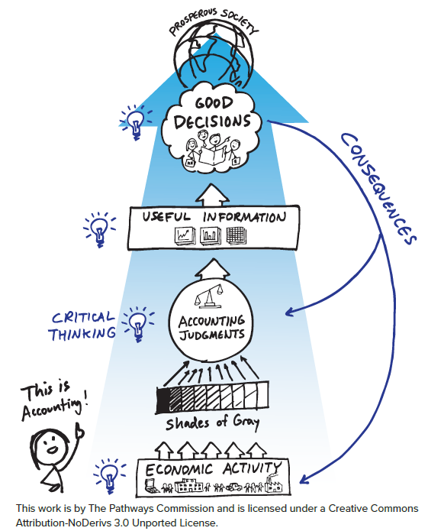
Dynamic/Discretionary Nature of Financial Accounting
←Standard setters
We are the
storytellers
Managers→
Outcomes
Investors→
Decision Making
←Auditors
Creditors→
←Regulators
Communication
Financial
Accounting
←Analysts
Measurement
Competitors→
←Preparers
Economic activity
←Lawyers
Politicians→
Optimization
=
Social welfare
“To engage and retain the strongest possible community of students”

Slide 58

Ethics Cases
Example: Uncollectible Accounts
What do we typically teach? How can we enhance the dynamic nature?
GAAP:
Estimate amount of future uncollectible accounts
Aging:
Old accounts less collectible
$180,000
Net income is too low…Let’s change that estimate to $135,000
Compare estimate to current balance of Allowance
$20,000 (credit)
Ethics
Case
Reporting effects:
I/S – Decrease net income
B/S – Decrease total assets
Recording:
Bad Debt Exp 160,000
Allowance 160,000

Slide 59
Ethics Cases
Example: Uncollectible Accounts
You have recently been hired as the assistant controller for Stanton Industries. Your immediate superior is the controller who, in turn, reports to the vice president of finance.
The controller has assigned you the task of preparing the year-end adjusting entries. For receivables, you have prepared an aging of accounts receivable and have applied historical percentages to the balances of each of the age categories. The analysis indicates that an appropriate balance for Allowance for Uncollectible Accounts is $180,000. The existing balance in the allowance account prior to any adjustment is a $20,000 credit balance.
After showing your analysis to the controller, he tells you to change the aging category of a large account from over 120 days to current status and to prepare a new invoice to the customer with a revised date that agrees with the new aging category. This will change the required allowance for uncollectible accounts from $180,000 to $135,000. Tactfully, you ask the controller for an explanation for the change and he tells you, “We need the extra income; the bottom line is too low.”

Slide 60
Ethics Cases
Example: Uncollectible Accounts
1. Understand the reporting effect:
What is the effect on income before taxes of lowering the allowance estimate from $180,000 to $135,000, as requested by the controller?
2. Specify the options:
If you do not make the change, how would the additional $45,000 of Allowance for Uncollectible Accounts affect total assets?
3. Identify the impact:
Are investors and creditors potentially harmed by the controller’s suggestion?
4. Make a decision:
Should you follow the controller’s suggestion?

Slide 61
Earnings Management Cases
Example: Depreciation
How well do students full understand that assumptions, estimates, and judgements are embedded in accrual accounting?
For example:
What if a manager wanted to lower net income?
Option 1: 12 years to 6 years
Option 2: Residual $600K to $0
Option 3: Both
Straight-line
Depreciation = ?
Standard Problem
Equipment purchased = 4,200,000
Estimated service life = 12 years
Estimated residual = $600,000
Straight-line
Depreciation = $300,000

Slide 62
Earnings Management Cases
Example: Depreciation
Edward L. Vincent is CFO of Energy Resources, Inc. The company specializes in the exploration and development of natural gas. It’s near year-end, and Edward is feeling terrific. Natural gas prices have risen throughout the year, and Energy Resources is set to report record-breaking performance that will greatly exceed analysts’ expectations. However, during an executive meeting this morning, management agreed to “tone down” profits due to concerns that reporting excess profits could encourage additional government regulations in the industry, hindering future profitability.
At the beginning of the current year, the company purchased equipment for $4,200,000. The company’s standard practice for equipment like this is to use straight-line depreciation over 12 years using an estimated residual value of $600,000. To address the issue discussed in the meeting, Edward is considering three options.
Option 1: Adjust the estimated service life of the equipment from 12 years to 6 years.
Option 2: Adjust estimated residual values on the equipment from $600,000 to $0.
Option 3: Make both adjustments.

Slide 63
Earnings Management Cases
Example: Depreciation
1. Calculate annual depreciation using the company’s standard practice.
$300,000
2. Calculate annual depreciation for each of the three options and state whether the option would increase or decrease net income.
Option 1: $600,000 Decrease net income
Option 2: $350,000 Decrease net income
Option 3: $700,000 Decrease net income
3. Which option has the biggest effect on net income?
Option 3

Slide 64
Data Visualizations
Graphic representation of data
Can we use visuals to help understand concepts?
Topic: Balance of the Retained Earnings account
Text description: “Cumulative amount of net income minus dividends over the life of the company.”
Numerical example in Illustration/Exercise:
 | Year 1 | Year 2 | Year 3
Net Income | 100 | 120 | 150
Dividends | 20 | 30 | 40
Retained Earnings | ?? | ?? | ??
Visual representation of the same concept?

Slide 65
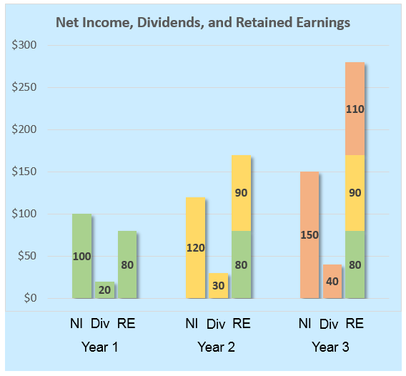
Data Visualizations

Slide 66
Data Visualizations
1. What is the amount of Retained Earnings at the end of Year 1?
2a. At the end of Year 2, the company reports Net Income of $120. This amount includes:
$80
Revenues minus expenses in Year 2 only
2b. What amount of dividends did the company declare in Year 2?
2c. What is the ending balance of Retained Earnings in Year 2?
2d. The ending balance of Retained Earnings in Year 2 includes:
3a. What amount of Net Income did the company report in Year 3? $150
3b. What amount of dividends did the company declare in Year 3? $40
3c. What is the ending balance of Retained Earnings in Year 3? $280
3d. The ending balance of Retained Earnings in Year 3 includes:
$30
$170
Net Income minus dividends from Year 1 and Year 2
Net Income minus dividends from Year 1, Year 2, and Year 3

Slide 67
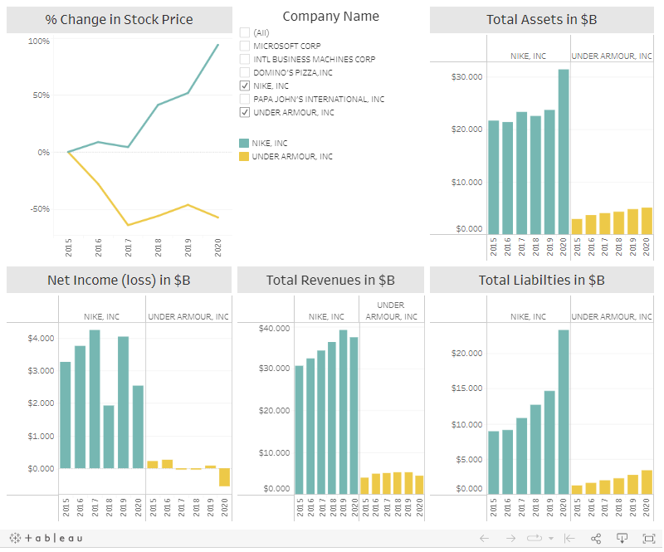
Dashboard Activities
Look at the comparison between Nike and Under Armour and answer the following questions:
1a. Which company has the greater increase in stock price over the period?
1b. Which company shows a more favorable profitability over the period?
1c. What could explain Under Armour’s net income in 2020?
Look at the comparison between Domino’s Pizza and Papa John’s Pizza and answer the following questions (You can un-select Nike and Under Armour and then select Domino’s and Papa John’s):
2a. Which company has the greater increase in stock price over the period?
2b. Which company’s sales of products and services to customers shows a more favorable trend over the period?
2c. What is the total amount of sales of products and services of Domino’s in 2020?
Look at the comparison between Microsoft and IBM.
3a. Which company has the greater increase in stock price over the period?
3b. Which company’s total resources have increased by the greater dollar amount over the period?
3c. Which company reports greater stockholders’ equity in 2020?

Slide 68
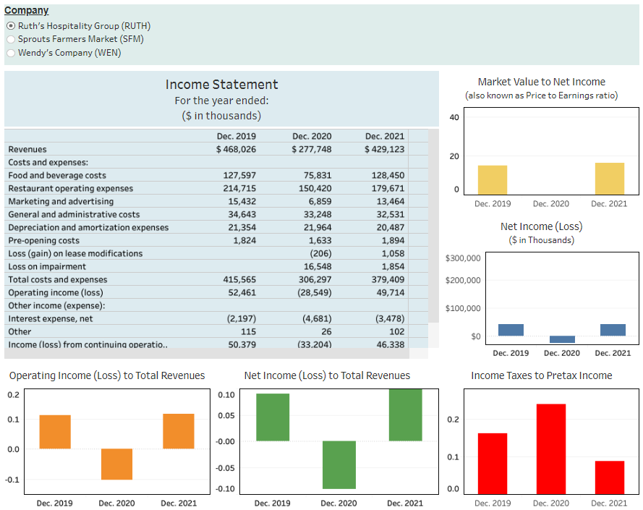
Dashboard Activities
The COVID-19 pandemic affected companies in the food industry in unique ways, particularly during 2020. Ruth’s Hospitality Group (Ticker: RUTH) develops and operates fine dining restaurants under the trade name Ruth’s Chris Steak. Sprouts Farmers Market (Ticker: SFM) offers a healthy grocery store experience. Wendy’s Company (Ticker: WEN) is primarily engaged in the business of operating, developing and franchising a system of distinctive quick-service restaurants. In answering the following questions, consider the impact that the COVID-19 pandemic would have on each company’s business model.
1. Which company experienced a significant increase in revenue in 2020?
2. Which company’s revenue was most negatively affected by the
COVID-19 pandemic in 2020?
3. Which company has the highest ratio of operating income to total
revenues in 2021?
4. What is the ratio of net income to total revenues for Sprouts in 2021?
5. What nonoperating item has the largest magnitude for Wendy’s in 2021?
6. Which company tends to have lowest ratio of income tax expense to pretax income (effective tax rate) over 2019-2021?
7. Determine the following amounts for Sprouts in 2021: (a) Gross profit, (b) Operating income, (c) Pretax income, and (d) Net income (Sprouts uses a slightly different naming convention for some of these amounts.)
8. Based on the ratio of market value to net income in 2021 (also known as the Price to Earnings ratio), which company do investors value relatively more based on 2021 net income?

Slide 69
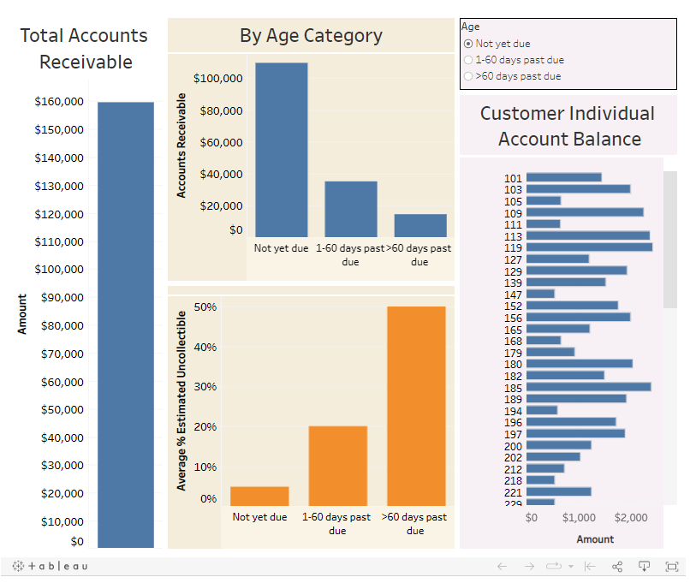
Dashboard Activities
1. Estimate the amount of uncollectible receivables.
2. Record the adjusting entry for uncollectible accounts. Assume the balance of Allowance for Uncollectible Accounts prior to the adjusting entry is $2,173 (credit).
3. Calculate net accounts receivable reported in the balance sheet.
4. What amount of bad debt expense is reported in the income statement.
5. For accounts over 60 days past due, what customer owes the most and how much is owed by that customer?

Slide 70
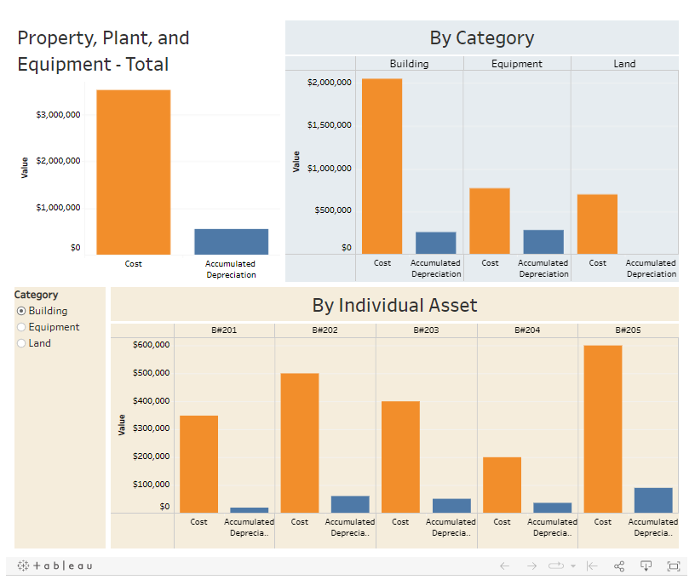
Dashboard Activities
1. What is the net amount of property, plant, and equipment reported in the balance sheet?
2. What is the net amount reported separately for buildings, equipment, and land?
3. Suppose the company decides to sell Building #203 for $425,000. What is the gain or loss on the sale reported in the income statement?
4. What is the gain or loss on the sale if the company sells Equipment #303 for $30,000?
5. Which piece of equipment is most likely to need replaced because it’s nearest the end of its service life?

Slide 71


Questions?
“What did he say?”

Slide 72
Customize Your Course: Content and Skills
Goal: Generate Interest → Build Knowledge → Develop Skills
Exercises
(w/ Hint videos)
Real-World
(EDGAR Cases)
Live
Dashboards
AI
Assignments
Data
Visualizations
Engage/Prepare Students
Without adding more topics or complexity
Chapter Framework
Excel
Earnings
Management
GL/Acct Software
Ethics
Cases
Fin. Stmt. Effects
SmartBook

Slide 73


The Goal
At the end of every class…
I want to learn!!
Accounting is my new major!!
Accounting is awesome!!
Tell me more!!

Slide 74
Thank you!
Please feel free to contact me for more questions or discussion
Wayne Thomas
wthomas@ou.edu

