Slide 1
Risk Management Student Organization Training
November 14, 2018

Slide 2
Goal for session:
Awareness of risk management strategies for Student Organization advisors
Awareness of risk management protections currently in place applicable to Student Organization advisors
Question and Answer period for Student Organization advisors

Slide 3
What this session will not cover
Emergency Management / Emergency Preparedness
Legalese / Legal Citations

Slide 4
Where are we?
Evolution of student / institution relationship
  In Loco Parentis
    Institution of Higher Education operates “in place of parents”
Individual Rights / Responsibilities / Duty of Care
  Students maintain individual rights, responsibilities, and obligations as actors in their own right
Missouri State, as a public institution of higher education has some additional protections / additional obligations related to SO risk management.

Slide 5
What are the risks?
Not an exhaustive list:
  Alcohol and Illegal Drug use
  Hazing
  Sexual Misconduct
  Event Management / Safety
  Nondiscrimination and Accessibility

Slide 6
Role of a Student Organization Advisor
Roles of a Student Organization Advisor:
  Mentor
  Collaborator
  Educator
  Supervisor / Administrator
Important policy decision requiring all registered Student Organizations to have faculty/staff advisor
Advisors serve as an connection between our Student Organizations and the Office of Student Engagement
“First line of defense” in the operation of Student Organization related to risk management and other areas of the Student Organization.

Slide 7
Defining Risk Management
Risk management is the process of identifying the potential / perceived risks involved in activities and advising and/or responding to eliminate or minimize the risks associated with those activities.
Risk management relating to Student Organization is more than simply protecting against injury/liability. It should also be focused on student development and student education.
Methods of Risk Management:
  Risk Avoidance
  Risk Mitigation
  Risk Transfer
  Risk Acceptance

Slide 8
Risk Management and SO Advisors
Risk Avoidance:
Be aware of and follow University policies relating to Student Organizations, Students, and other aspects of University operations.
Be aware of and follow procedures of the Office of Student Engagement
“See Something, Say Something.”
Communicate with the Office of Student Engagement if you question the actions / decisions / events of your Student Organization.
The Advisor’s Supplement to the Student Organization Handbook (2018-2019), Risk Management Matrix (pg. 33 -35)

Slide 9
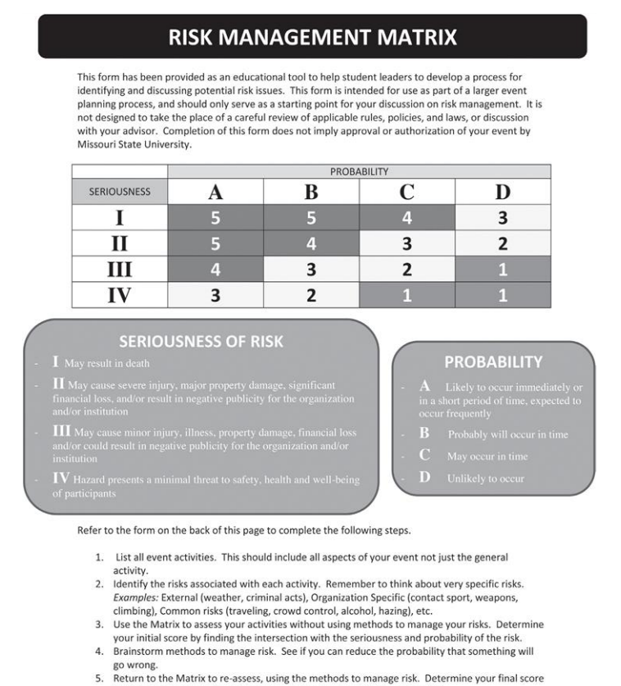
Risk Management Matrix

Slide 10
University Policies/Procedures and Student Organizations
Risk Avoidance / Risk Mitigation:
  Social Event Risk Management Policy (Op5.15)
  Non-Discrimination Policy Statement (G1.05) / Accessibility Policy (G1.05-1)
  Student Code of Rights and Responsibilities (G5.01)
  Expressive Activity Policy (G.5.02)
  Commercial Advertising, Sales, Solicitation, and Facilities Usage Policy (Op1.01)

Slide 11
Social Event Risk Management Policy
Op5.15 Social Event Risk Management Policy
This Student Organization Event Risk Management Policy applies to all Missouri State University (University) student organization (recognized, registered and/or university sponsored), and their events, and activities; including events at which alcohol may be present. University student organizations are expected to abide by the following list of responsibilities in connection with the scheduling of organizational activities, and specifically those activities that involve alcohol. Failure to comply could result in individuals and/or organizational conduct charges under the university’s Code of Student Rights and Responsibilities (Code). . . .

Slide 12
Non-Discrimination Policy Statement
G1.05 Non-Discrimination Policy Statement
Missouri State University is a community of people with respect for diversity. The University emphasizes the dignity and equality common to all persons and adheres to a strict non-discrimination policy regarding the treatment of individual faculty, staff, and students. In accord with federal law and applicable Missouri statutes, the University does not discriminate on the basis of race, color, national origin (including ancestry, or any other subcategory of national origin recognized by applicable law), religion, sex (including marital status, family status, pregnancy, sexual orientation, gender identity, gender expression, or any other subcategory of sex recognized by applicable law), age, disability, veteran status, genetic information, or any other basis protected by applicable law in employment or in any program or activity offered or sponsored by the University. Sex discrimination encompasses sexual harassment, which includes sexual violence, and is strictly prohibited by Title IX of the Education Amendments of 1972. . . .

Slide 13
Accessibility Policy
G1.05-1 Accessibility Policy
Missouri State University is a community of people with respect for diversity. Consistent with its public affairs mission and its commitment of non-discrimination, the university emphasizes the fundamental dignity and equality common to all persons and is committed to maintaining an environment that is accessible to all individuals. To this end, the university will continue to support a physical and digital campus that is accessible to all individuals, including individuals with disabilities. The university will continue to develop policies and procedures designed to eliminate barriers to access and to provide equal and inclusive access for all members of the university community. These efforts support the university’s commitment to establish equal opportunity on campus, provide an inclusive learning environment and maintain compliance with federal and state law.

Slide 14
Student Code of Rights and Responsibilities
4.5
Hazing, an act that endangers the mental or physical health or safety of a student, or which destroys or removes public or private property, for the purpose of initiation or admission into, affiliation with or as a condition of continued membership in a group or organization. The express or implied consent of the student will not be a defense to a violation of hazing. The willing participation or acquiescence of the student subject to the hazing activity is no defense and is still a violation of this policy.

Slide 15
Expressive Activity Policy
G5.02 Expressive Activity Policy
Missouri State University is committed to providing an environment where issues can be openly discussed and explored. The freedom to exchange views is essential to the mission of the University. This policy is in place to provide a community environment in which open discussion can occur without disrupting the academic mission or daily University functions, subject to constitutional time, place, and manner limitations and without unconstitutionally interfering with the rights of others.
All individuals may exercise the right of assembly, free speech, and expression throughout the outdoor areas of campus, when doing so does not disrupt the academic mission or daily University functions, and is consistent with University policy regarding time, place, and manner limitations. Expressive activities will not be limited to any specific outdoor areas on the University campus. However, the right of assembly and expression does not include unlawful activity that endangers the safety of the campus community or that destroys University property. Expressive activities are not to unduly disrupt traffic, either vehicular or pedestrian, or violate other time, place, and manner parameters specified in this policy.

Slide 16
Commercial Advertising, Sales, Solicitation and Facilities Usage Policy
2. Commercial Sales and Solicitations
A. No prohibition for registered student organizations and university departments
The university’s prohibition on solicitation does not apply to registered student organizations, university organization, and university colleges and departments. Registered student organizations, university organization, and university colleges and departments may solicit on campus. All solicitation activities on campus of registered student organizations, university organization, and university colleges and departments must comply with the procedures outlined in this policy. . . .

Slide 17
Risk Management and Advisors
Risk Mitigation / Risk Transfer
Follow the procedures outlined by the University (policies / department)
  Forms available on the Student Engagement website.
Follow the policies / procedures outlined in Student Organization’s national chapter (if any)
Waiver, Releases, and Hold Harmless agreements

Slide 18
Risk Management and Advisors
Risk Transfer
Insurance is the primary means of risk transfer
The University is self-insured through the State of Missouri’s Legal Expense Fund (established by Mo. Rev. Stat. § 105.711, and administered by the Office of the Missouri Attorney General)
The “State Legal Expense Fund” covers:
  Employees (Faculty / Staff)
  Student-Employees
The State Legal Expense Fund does not cover students or student organizations

Slide 19
Risk Management and Advisors
Student Organizations are often times require to maintain insurance for certain activities / events (e.g. facility rentals).
  Student Organizations can contact Mike Wills, Director, Procurement Services
    MikeWills@MissouriState.edu
    417-836-7635
  Procurement Services can facilitate the independent procurement of insurance on behalf of the Student Organization.

Slide 20
Risk Management and Advisors
Risk Acceptance
Generally, Student Organization advisors are considered to be acting within the course and scope of their employment when serving in their role of advisors
  Covered by State Legal Expense Fund
  Does not prevent personal suit by third-parties
The question is not “Can I be sued?”. The question should be “Can I be liable?”.

Slide 21
Risk Management and SO Advisors
When in doubt, communicate:
When you have concerns regarding a proposed activity or proposed course of action contact the Office of Student Engagement.
If you can help, do:
If you see gaps in Student Organization processes / procedures, or are struggling to explain same: contact the Office of Student Engagement.
Communication is Key
Communication is a two-way street

Slide 22
Questions

Slide 23
Follow-up
Contact Information
Jeff Mitchell – jmitchell@missouristate.edu
Carrington 205
836-8507

