Slide 1
Crowdfunding @ Missouri State
#thegrassrootscampaign
Alison Harper, Director of Annual Funds
November 2018

Slide 2
Background Information
Crowdfunding is the practice of funding a project or venture by raising small amounts of money from a large number of people, typically via the Internet
Benefits
Donor centric
Offline gifts
Sense of community
No additional costs
Time sensitive promotes urgency
Utilizes your network &
the people who support you

Slide 3
http://www.missouristatecrowdfunding.org/

Slide 4
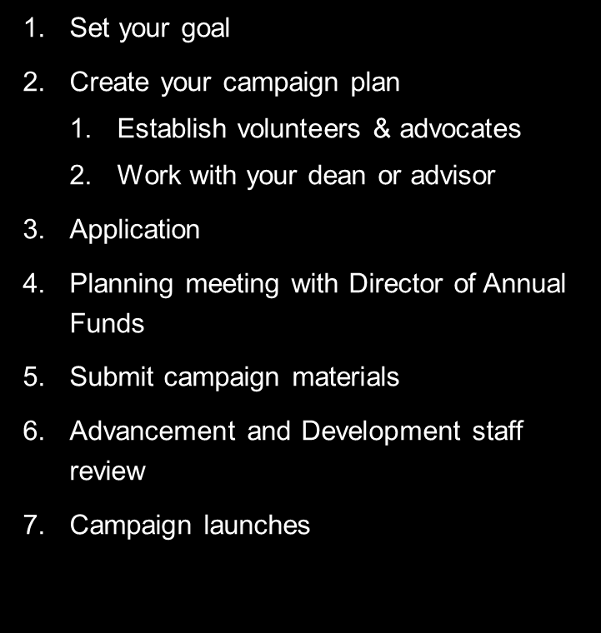
Steps to a Campaign
Share
Update
Share
Update
Share
Update
Share again
Celebrate

Slide 5
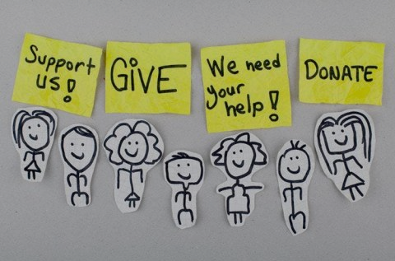
Basics
Know how to obtain your funds
Work with cost center
Have support from your advisor or approval from your department
Have a marketing plan
Utilize unique links and hashtag
Set a realistic goal
Raise 10%-20% of funds before
you go live – soft launch

Slide 6
Tell a story & show impact in your video
Likeness release forms are required for any person whose face you can see
Transcripts are needed for accessibility
Copyright permissions/ music
Landscape
Upload to GiveCampus and share
Update frequently
Offer incentives and have a match
Thank your donors

Slide 7
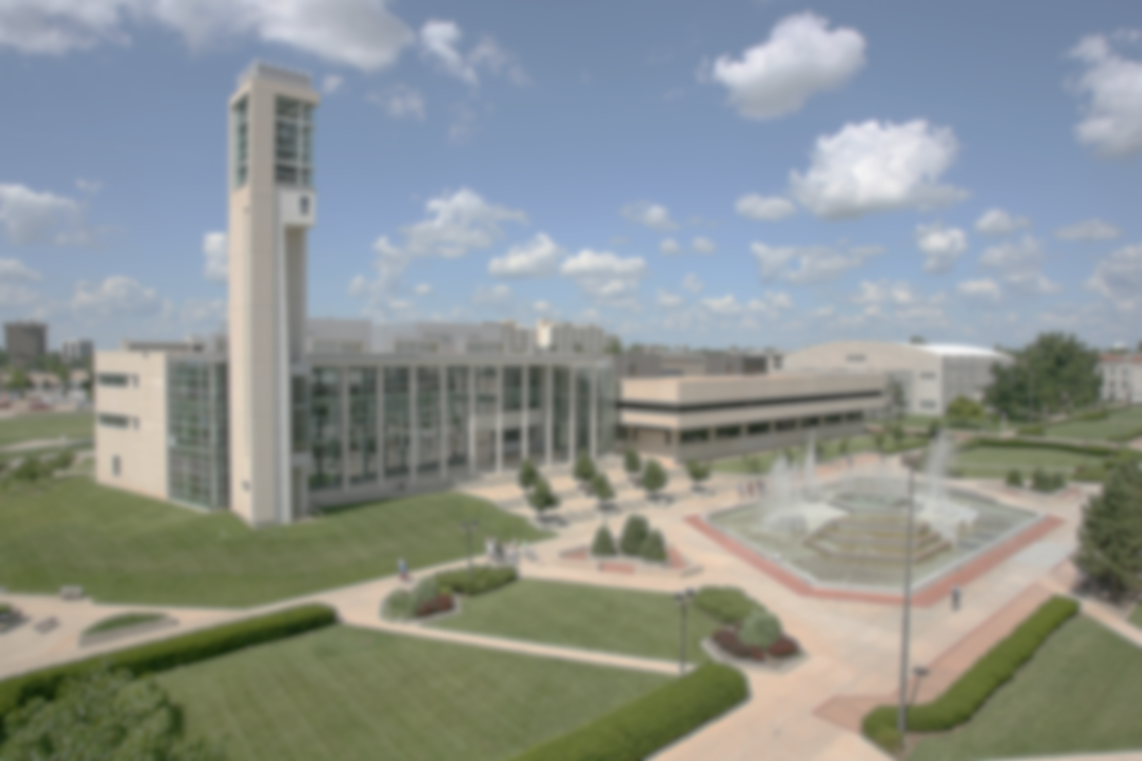
MSU Choral Endowment
Rural Programs
Winter Guards
Grizzly Welcome

Slide 8
Resources
Getting started document
Video tips/ editing
Planning session
Playbook
Advocate training
Fund assistance
Tracking & Reporting
Foundation social media
Additional promoting
5 Things
Check-ins

Slide 9
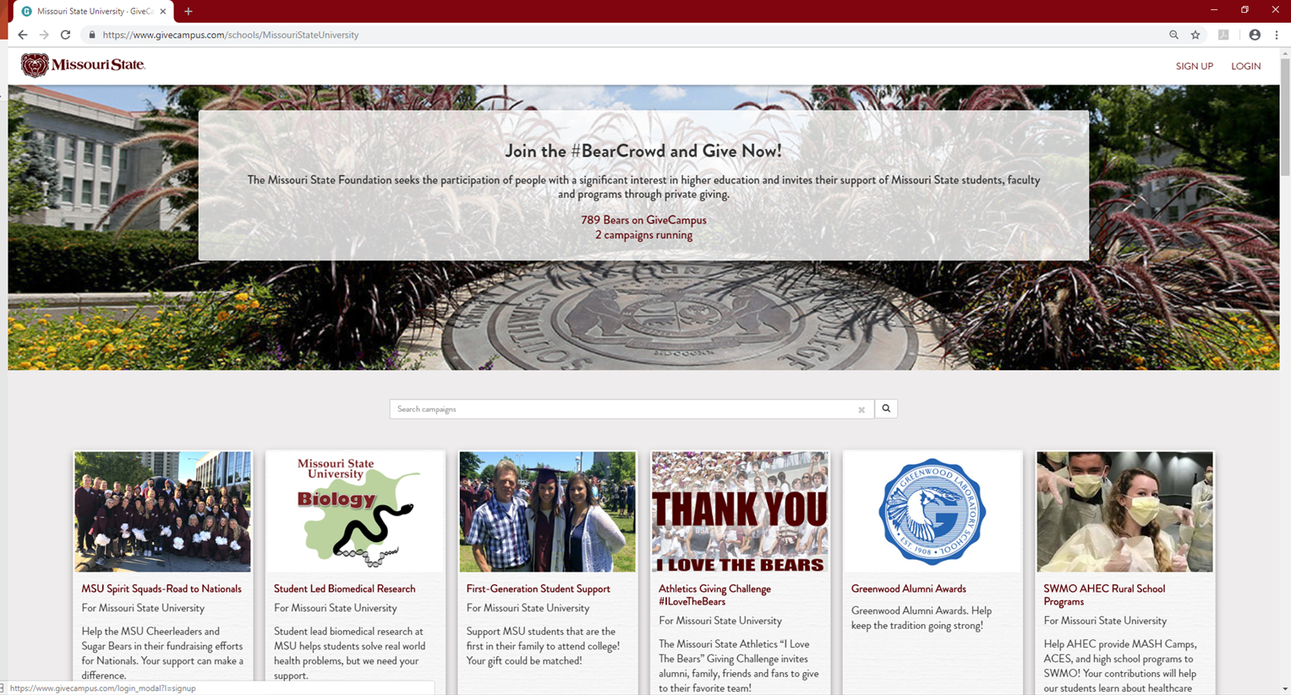
http://givecampus.com
Getting Started

Slide 10
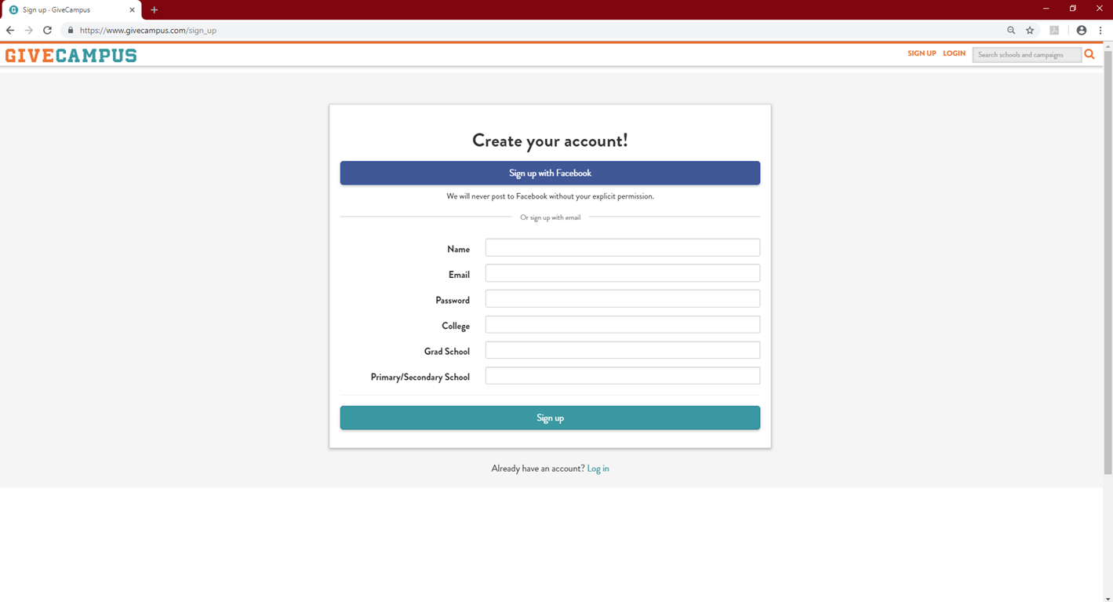
Activate your account via the e-mail link

Slide 11
How to Apply
http://www.missouristatecrowdfunding.org/

Slide 12
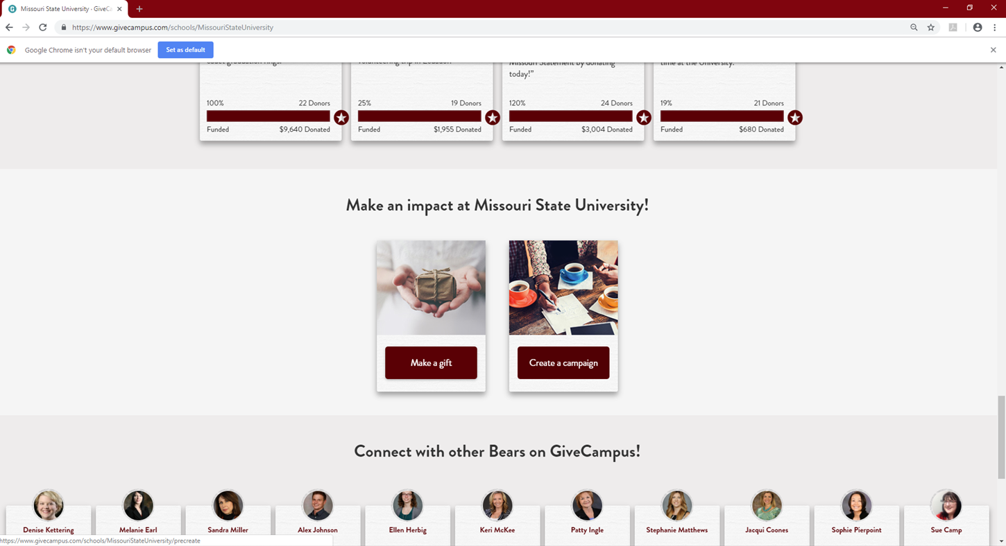

Slide 13
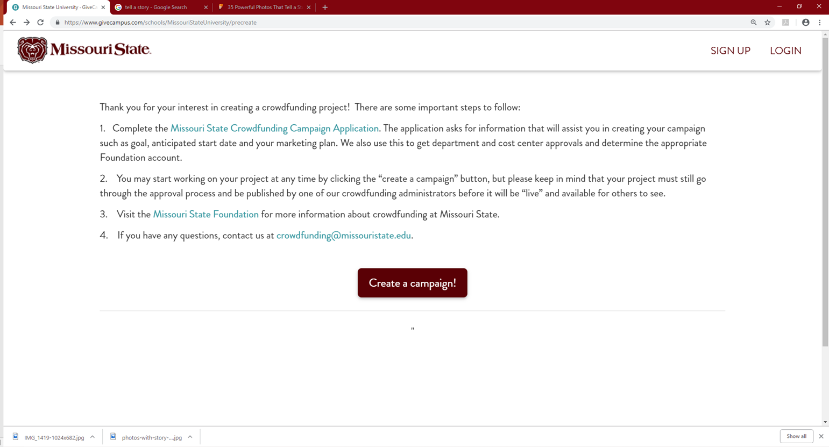

Slide 14
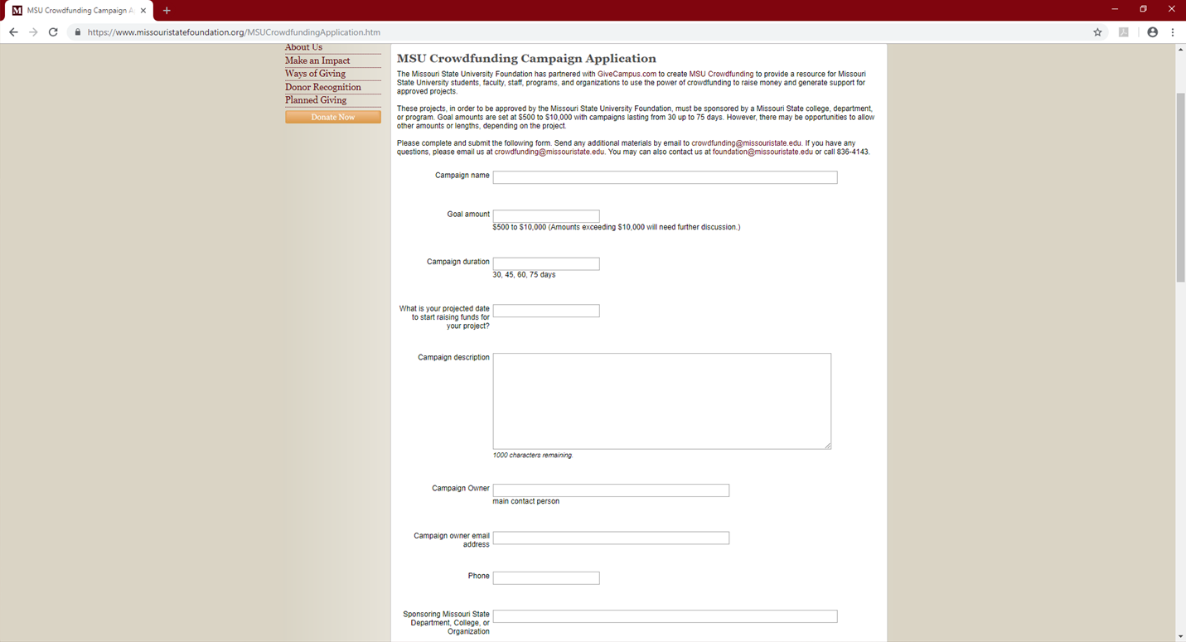
Application

Slide 15
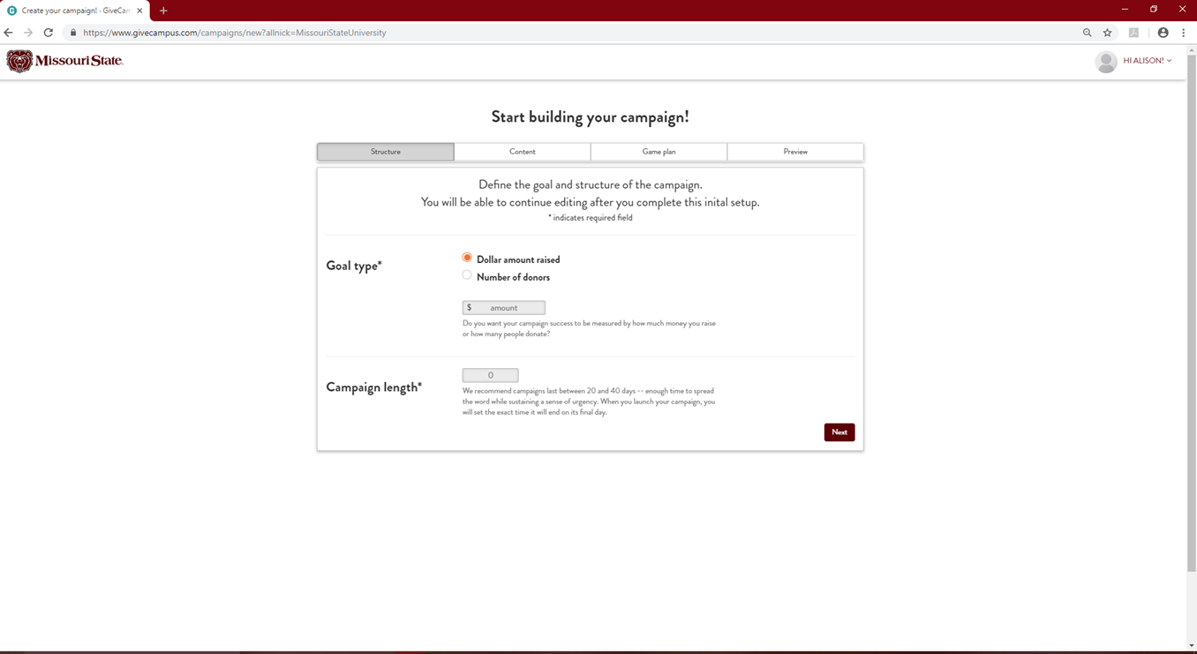

Slide 16
The only time you’re encouraged to overshare
Questions?

