Slide 1
General Demographics
Missouri and Its Southwest Region in perspective

Slide 2
Total Population for the U.S. and the States, 2010-2040
Observed and Projected with Rankings
Missouri and Neighboring States
Rank among 50 States and D.C.
Notes:
Missouri is projected to lose its proportional share of the U.S. population, as are many other Midwestern states.

Slide 3
Total Population for the U.S. and the States, 2010-2040
Projected Growth Rate
Missouri and Neighboring States
Updated August 2013 by the Weldon Cooper Center for Public Service, Demographics & Workforce Group, www.coopercenter.org/demographics
Notes:
Missouri is growing, but not as rapidly as the nation as a whole or some of its neighboring states.

Slide 4
Percent of the Population Age 65 Plus, 2010-2040
Observed and Projected
Missouri and Neighboring States
Notes:
The percentage of persons over age 65 in the US is projected to peak around 2030, with approximately one in five being in this age group. Missouri is projected to maintain its additional percentage point of seniors compared to the nation.

Slide 5
The Distribution of Population in the Show-Me State

Slide 6
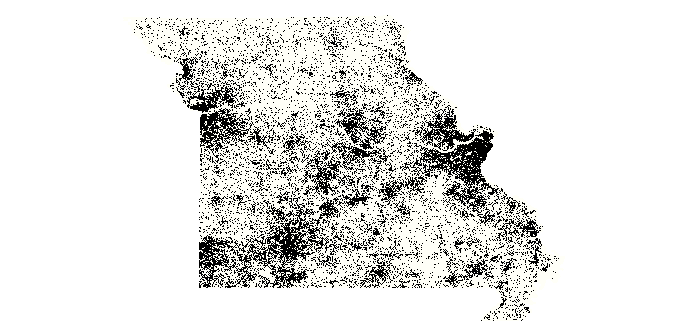
2010 Population by Block
One Dot = Five Persons
Notes:
Where are Missouri’s residents located? This dot density map shows clearly that residents are not evenly distributed within the state, county, city, or nearly any other geographical boundary that could be used to aggregate data. These data come from the 2010 Census.

Slide 7
Population Change 2000 to 2010
Missouri and Neighboring States
Notes:
Missouri ranked 20th in numeric growth during the 2000’s with and increase of 393,716 persons but ranked only 29th when growth was looked at as a percentage of total population. Missouri grew seven percent over the course of the decade compared to a national growth rate of 9.7 percent. These figures come from the 2010 Census.

Slide 8
Population Change - Numeric
2000 to 2010
-240578 to -10,000
-9,999 to 0
1 to 10,000
10,001 to 100,000
100,001 to 744,968
Notes:
These figures come from the 2000 and 2010 Censuses.

Slide 9
Population Change - Percent
2000 to 2010
-46.6% to -5.0%
-4.9% to 0%
0.1% to 15.0%
15.1% to 35.0%
35.1% to 100.4%
Notes:
These figures come from the 2000 and 2010 Censuses.

Slide 10
Percent Minority Population
Missouri and Neighboring States
Notes:
These figures come from the 2010 Census.

Slide 11
Percent Minority Population
2010
Total Population minus White Non-Hispanic
0.8% to 12.3%
12.4 %to 26.9%
27.0% to 44.5%
44.6% to 65.9%
66.0% to 97.3%
Notes:
These figures come from the 2010 Census.

Slide 12
Change in Minority Population 2000 to 2010
Missouri and Neighboring States
Notes:
These figures come from the 2000 and 2010 Censuses.

Slide 13
Percent Change in Minority Population
2000 to 2010
Total Population minus White Non-Hispanic
-78.6% to 0.0%
0.1 %to 25.0%
25.1% to 50.0%
50.1% to 100.0%
100.1% to 746.0%
Notes:
These figures come from the 2000 and 2010 Censuses.

Slide 14
Median Age
Missouri and Neighboring States
Notes:
These figures come from the 2010 Census.

Slide 15
Median Age
2010
21.9 to 33.0
33.1 to 37.8
37.9 to 41.7
41.8 to 46.1
46.2 to 62.7
Notes:
These figures come from the 2010 Census.

Slide 16
Percent of the Population with a Bachelor’s Degree or Above
2000 SF3 to 2009-2013 ACS
Missouri and Neighboring States
Notes:
These figures come from the 2000 Census and the 2013 American Community Survey 5-year period estimates.

Slide 17
Percent of the Population with a Bachelor's Degree or Above
2013 Five-year Period Estimates
3.0% to 15.0%
15.1% to 22.0%
22.1% to 31.0%
31.1% to 42.0%
42.1% to 74.0%
Notes:
These figures come from the 2013 American Community Survey 5-year period estimates.

Slide 18
Per Capita Income in the Past 12 Months
Missouri and Neighboring States
Notes:
These figures come from the 2013 American Community Survey 5-year period estimates.

Slide 19
Per Capita Income in the Past 12 Months
2013 Adjusted Dollars
$8,768 to $19,939
$19,940 to $24,357
$24,358 to $29,905
$29,906 to $39,600
$39,601 to $62,498
Notes:
These figures come from the 2013 American Community Survey 5-year period estimates.

Slide 20
Persons Below Poverty in the Past 12 Months
Missouri and Neighboring States
Notes:
These figures come from the 2013 American Community Survey 5-year period estimates.

Slide 21
Persons Below Poverty in the Past 12 Months
2013 Five-year Period Estimates
0.9% to 11.4%
11.5% to 16.3%
16.4% to 21.7%
21.8% to 29.4%
29.4% to 53.2%
Notes:
These figures come from the 2013 American Community Survey 5-year period estimates.

Slide 22
Population Age 65 and Over in 2010
Missouri and Neighboring States
Notes:
These figures come from the 2010 Census.

Slide 23
Population Age 65 and Over in 2010
3.5% to 11.7%
11.8% to 15.1%
15.2% to 18.5%
18.6% to 22.9%
23.0% to 43.4%
Notes:
These figures come from the 2010 Census.

