Slide 1
HR Live: Goal Management for Performance the Review Process
MSU Performance Review (ADP) Process
Paula Wilhelm
HR Employee Relations Office of Human Resources

Slide 2
New System – Updated Process with 2025
Goal Management Process

Slide 3
Overview for Goal Setting & Plans
Supervisors will be tasked with ensuring that their employees’ Annual and Probationary Planning documents are completed.
This process includes setting goals and meeting with their employees at the start of the Annual rating year or the employee’s Probationary cycle.
Annual Cycle: Completed July 1 – August 31 of the year.
Probationary Cycle: Completed 2 weeks after last hire date

Slide 4
Initial Goal Setting
Supervisors can submit the goals for their employees on the Performance Review Planning document. OR
Supervisors can instruct their employees to submit their goals online for approval.
Supervisors will need to approve the goals in the Performance Review Planning document, electronically sign off, and submit for completion with either scenario.

Slide 5
Performance Review Annual Cycle
Jul1-Aug 31 - Goal Setting
Track & Manage Goals
Mid-Year
Check-in
April 1 - Review Period Opens
June 30 - All Reviews Due
2025 Goal Setting Sep 1- Nov 30, 2025
Goals from Feb 1, 2025, forward can be entered

Slide 6
Performance Review Probationary Cycle
First two weeks – Initial Goal Setting
3-month Check-In Feedback and Goal Updates
6-month Performance Review and set goals for Annual cycle
New Process starts with employees who have a New Hire date of October 1, 2025

Slide 7
Updating Goals
Supervisor access path: Performance (ADP)>Goals >select My Team option> Scroll to select employee
Employee access path: Performance (ADP) >Goals>select My Goals option
If there is a need to update goals for the Performance Review Process, both the supervisor and employee will access their goals under Performance (ADP) >Goals
Note: Supervisor will need to approve any changes.

Slide 8
Overview of the 2025 Process Timeline
Performance Review Process cycles:
Annual process starts July 1 through June 30
Initial Planning: February 1 - November 30, 2025
Goals can be brought forward into the plan going back to February 1, 2025, and forward
All FT employees with a last hire date of September 30, 2025, or earlier
Academic Administrators whose names and positions have been identified by the Provost to be include in the process
Review: April 1 – June 30, 2026
Probationary starts with New Hire date
Initial Planning is completed within the first 2 weeks of hire for the 6-month Probationary Period
3-month Check-In is completed to provide interim update to new employee
6-month Performance Review is completed at the 6 month of employment
New employee rolls into the Annual process
New process starts effective with employees with an October 1, 2025, New Hire date

Slide 9
Supervisor Actions
Communicate to your Department :
Internal goal setting process with guidance to your team.
Schedule for updating goal progress and starting the review process.
Self-Evaluation process – required, not required, or optional Review employee list to ensure all your employees are listed for the 2025 cycle.
Schedule a meeting or provide email communication to your team before starting the review process that starts on April 1 thru June 30, 2026.

Slide 10
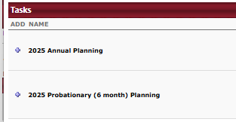
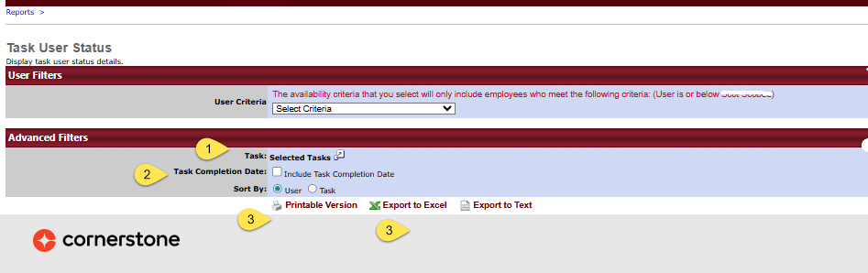
Supervisor Standard Report - Task User Status Report
Navigate to your “Standard Report” tab:
Reports>Standard Reports>Performance
Select Task User Status Report
Click to open options and select the task:
Check to include completion date and select to sort by task or users.
Select output to view the information for your unit the status of their Plans.

Slide 11
Employee Actions
Employee Actions:
Review provided goals for understanding.
Provide comments or feedback if appropriate.
Submit any supporting documents for the individual goal.
Update goal progress through the online tracking tool.
Submit recommended goals to your supervisor if requested by them through the Goal Setting process in the online system for approval.
Follow your supervisor’s guidance on updating goal progress and self-evaluations.

Slide 12
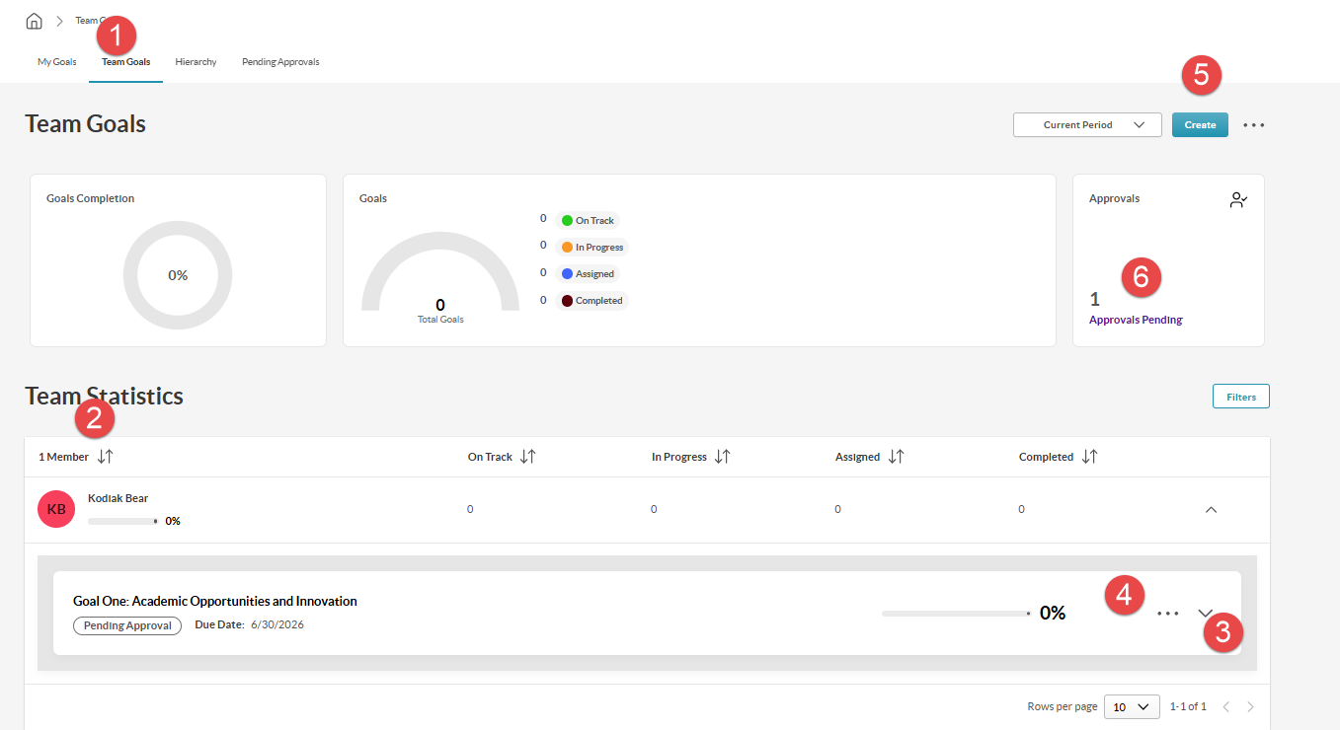
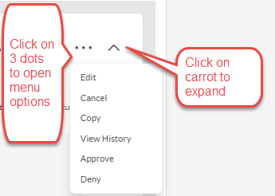
Team Goals: Supervisor Actions
Select “Team Goals”.
Locate the employee in the list.
Click on the “Carrot” to expand goal for access.
Click on “3 Dots” to open Option menu:
Click on the “Create” button to add a new goal.
Click on “Approvals Pending” to access goals needing approval by the supervisor.

Slide 13
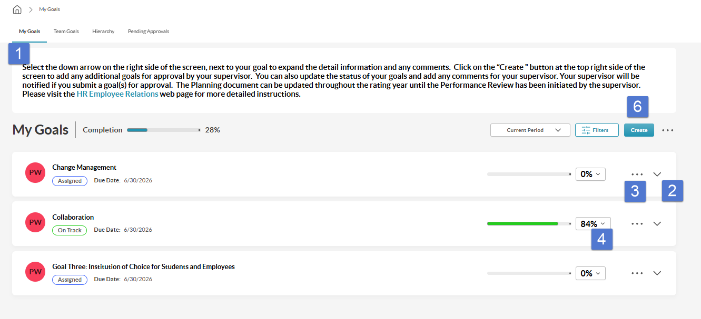
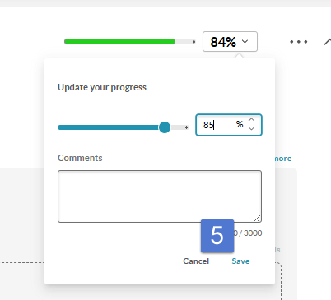

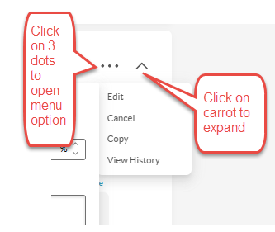
My Goals: Employee Actions
Select “My Goals”.
Click on the “Carrot” to expand goal for access.
Click on “3 Dots” to open Option menu.
Click on the “Carrot ” to open a window for updating progress.
Update goal status by % and include any comments. Click “Save” to finalize update of goal.
Click on the “Create” button to add a new goal.

Slide 14
Resources
HR Employee Relations website
HR Live Training Sessions
Job Descriptions
Goal Development tools in the online system
MSU Igniting Opportunity 2025 – 2030 Strategic Plan
HR Performance Management
HRPerformance@MissouriState.edu
417.836.4592

Slide 15
Thank You!
Office of Human Resources
Paula Wilhelm

