Slide 1
HR Live:
Performance Review Evaluation Process
MSU Performance Review (ADP) Process
Paula Wilhelm
HR Employee Relations
Office of Human Resources

Slide 2
Performance Review - 2025
Evaluation Process

Slide 3
Performance Review Annual Cycle
Jul1-Aug 31 - Goal Setting
Track & Manage Goals
Mid-Year
Check-in
April 15 - Review Period Opens
June 30 - All Reviews Due

Slide 4
Annual Performance Review Period
Optional Indirect Manager Review
coordinated by the leadership team
Optional Employee
Self-Review
Starts Apr 15
open for 35 days
Manager Completes Review
Starts April 15
open for 70 days
Manager Meets with Employees
Employee Sign Off
Open for 7 days after manager submits evaluation
2025 Performance Review Completed
Due by June 30

Slide 5
Scenario 1 Workflow:
Manager Completes Review
Employee
Completes Optional
Self-Review
Submits to Manager
April 20
Manager
Views Self-Review and completes Manager Review
Submits for Employee Sign Off
April 22
Manager Meets with Employee
April 22
Employee Sign Off
Open for 7 days after manager submits evaluation
April 29
2025 Performance Review Completed
On April 29
Employee completes Self-Review within the 35-day window.
Online document moves forward to the manager after submission.
Manager can view the Self-Review and complete their Manager Review at that time or within the 70 days it is open.
Employee will receive an email notification and be able to access the Employee Sign Off.
Employee can access the completed Manager Review after submission and have 7 days to sign off upon receipt.

Slide 6
Scenario 2 Workflow:
Manager Completes Review
Manager
Completes Manager Review
Submits for Employee Sign Off
April 15
Manager Meets with Employee
April 22
Employee Receives Notification for Sign Off
(After 35-day Self-Review window closes)
May 20
Employee Sign Off
Open for 7 days after notification for sign off
May 21
2025 Performance Review Completed
May 21
Employee does not complete a Self-Review and Manager starts completing their Manager Review on April 15.
Manager can access and complete the Manager Review.
Employee will not receive an email notification or be able to access the Employee Sign Off until after the 35-day Self-Review window closes.
After the 35-day Self-Review Window closes, the employee will receive notification to sign off on the Manager Review immediately after submission.
  The employee will have 7 days to complete the sign off.

Slide 7
Updating Goals
Supervisor access path: Performance (ADP)>Goals >select Team Goals option> Scroll to select employee under Team Statistics dashboard.
Employee access path: Performance (ADP) >Goals>select My Goals option
If there is a need to update goals for the Performance Review Process, both the supervisor and employee will access their goals under Performance (ADP) >Goals
Note: Supervisor will need to approve any changes.

Slide 8
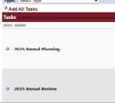
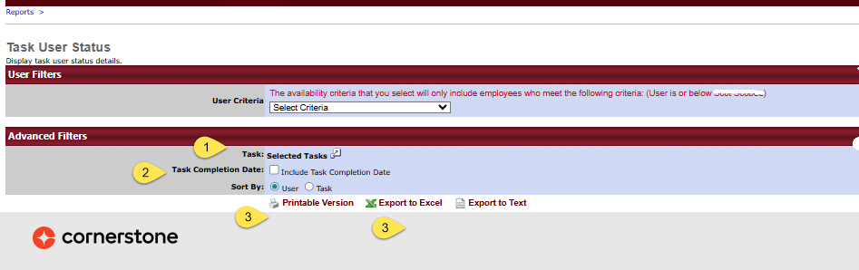
Supervisor Standard Report - Task User Status Report
Click to open options and select the task:
Check to include completion date and select to sort by task or users.
Select the desired output to view and save the information on your unit.
Navigate to your “Standard Report” tab:
Reports>Standard Reports>Performance
  Select Task User Status Report

Slide 9
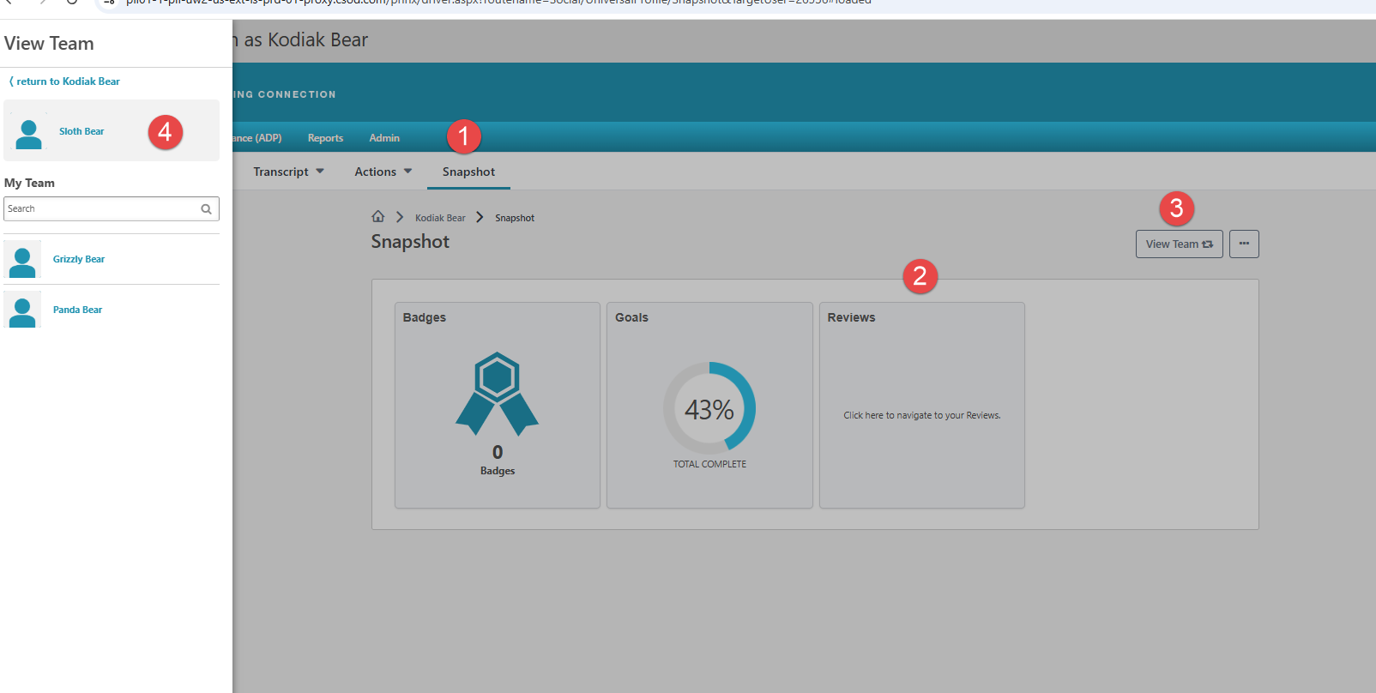
Manager / Indirect Manager Tools
Navigate to Snapshot Dashboard:
Home>Universal Profile>Snapshot
Navigate to Snapshot.
Select Reviews Widget.
Select View Team to open Left Navigation panel.
Select or search for Team Member to access their documents.

Slide 10
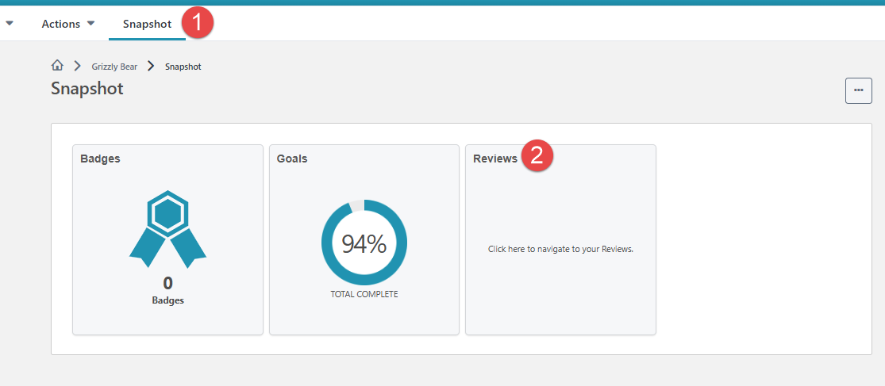
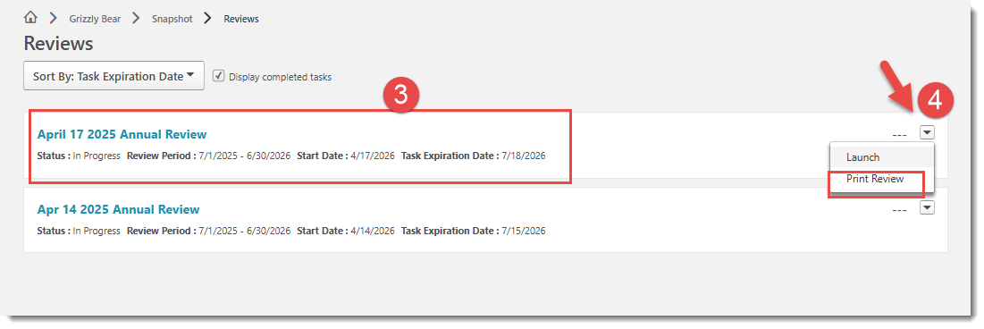
Employee Tools
Navigate to Snapshot.
Select Reviews Widget to open document list.
Select the document you want to view.
Select Print Review to save as a PDF file.
Navigate to Snapshot Dashboard:
Home>Universal Profile>Snapshot

Slide 11
Resources
HR Employee Relations website
HR Live Training Sessions
Job Descriptions
Goal Development tools in the online system
MSU Igniting Opportunity 2025 – 2030 Strategic Plan
HR Performance Management
  HRPerformance@MissouriState.edu
  417.836.4592

Slide 12
Thank You!
Office of Human Resources
Paula Wilhelm

