Slide 1

Honors College
SOAR Session
Welcome To the Honors College!
Dr. John Chuchiak, Director
Scott Handley, Assistant Director

Slide 2
Honors College: Advantage of a Small College with the Opportunity of a Large University
The Honors College fosters a community of academic excellence, connects students with premier faculty, and promotes civic engagement and leadership opportunities.
As a member of the Honors College, you will be a part of a community of exceptional students who engage in academic endeavors starting in the classroom and extending beyond the campus.
The Honors College will provide you with a nurturing and collaborative educational environment to explore issues in-depth through special projects and small enrollment honors classes.

Slide 3
What is Honors Education & How is it Important?

Slide 4
What is Honors Education?
The essence of Honors education is:
Personal attention
Access to top faculty
Small class sizes
Study Abroad experiences
Research opportunities
Internship opportunities

Slide 5
What is Honors Education?
Honors Education is not designed to be about more/harder work:
Student-centered education focused on:
  Student’s personal interests and professional goals
  Open discussion and critical thinking on various contemporary topics in a comfortable atmosphere of open exchange
  Encouraging creativity and innovation
  Emphasizing diverse perspectives and interdisciplinary coursework
  Establishing closer connections to peers and professors

Slide 6
Benefits of Honors College Membership

Slide 7
Benefits of Honors College Membership
Priority Registration
Honors courses with small class sizes
Mentoring from Honors Faculty
Individualized Honors College advising
Honors Living-Learning Community
Scholarship and Fellowship Opportunities
LOGOS: A Journal of Undergraduate Research
Experiential Learning Opportunities – Study Abroad, Research, Independent Study, Internships, and Service-Learning

Slide 8

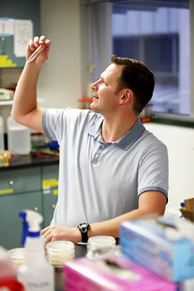
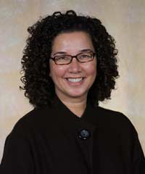
Membership Benefits
Outstanding Faculty
Outstanding records of research, scholarship, and publication
Nominated to teach honors courses
Annually evaluated by honors students
Major advisors to honors students

Slide 9
Membership Benefits
Outstanding faculty in UHC 110 and General Honors courses
[Dyer] was very laid back, approachable, and just felt more like a friend and mentor than a professor.
[Francka] By allowing group led discussions, I think it helped develop my communication skills because the pressure of saying the ‘perfect’ or ‘right’ thing wasn’t there. I could just talk freely if I wanted to without fear of a grade decrease.
[Gillam] is very chill and recognizes that life and other classes happen, and flexibility was granted accordingly (in reasonable small amounts).
[Murvin] allowed us to take risks without worrying that we would get a bad grade.
[Harwood] Very interesting and cool presentations. I actually wanted to pay attention.
[Walker] is always willing to drop what she is doing to help a struggling student understand or do whatever it takes to help that student succeed.
[Breyfogle] was fair and he helped us in a more 1 on 1 setting instead of in a big lecture hall. It helped me feel more connected to the class.
[Smith] provided us with resources and office hours but it was ultimately up to us to take advantage of these chances.
[Kaf] is an amazing professor and cares about her students very much.
[Boyle] is already pretty funny, but maybe he could be funnier?

Slide 10

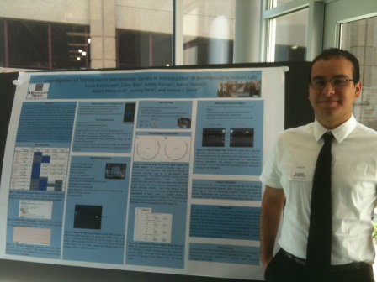
Membership Benefits
Research Opportunities
Senior Honors Projects
Opportunities to design research course components alongside faculty members
Sponsorship for undergraduate research conferences
Research funding grants
Publication opportunities through LOGOS: A Journal of Undergraduate Research
Senior Honors Projects have included:
Academic research papers
Laboratory experiments
Dramatic productions
Musical compositions & performances
Production & publication of illustrated books
Development of computer programs & applications

Slide 11

Membership Benefits
Scholars House
Honors Learning-Living Community
Suite-style living with large common space
Study & recreational facilities
Special programming

Slide 12



Membership Benefits
Logos: a journal of undergraduate research
Undergraduate research publication opportunity
  Submissions are accepted from all academic disciplines
  Honors students serve as peer reviewers and associate editors

Slide 13
Membership Benefits
Individualized Honors Advising
Chance to build one on one relationships with both Honors faculty advisors/career mentors and Honors College professional advising staff
Highly accessible advisors
Review of mid-term grades and final grades
Scheduling assistance and course/career planning

Slide 14
A Closer Look at the Honors Program

Slide 15
Mission of the Honors College
Goals
Distinctive multidisciplinary curriculum provided by leading faculty researchers.
Immersion into Springfield and Regional Community for exploration, research, and internship.
Early access to leading professionals, scholars, artists, and local policy-makers.
Setting students apart from their peers

Slide 16
How does Honors College do this?
Small Class Sizes
Faculty Collaboration in Creating Innovative Interdisciplinary Courses
Rigorous But Worthwhile Coursework
Growth in Writing and Research Skills
Immersion Into local Springfield Community Resources
Experiential Learning Opportunities

Slide 17
Structure of General Honors Program
Freshman and Sophomore Years
UHC 110: Honors Freshman Seminar
Research based special topics seminar/introductory to university life
3 General Education Honors Courses
Class options from every box required for completion of general education requirements
1 Experiential Learning Experience
Takes the form of Study Abroad, Service-Learning, Independent Study, Independent Research, and Internship/Apprenticeship
***Can be taken any time

Slide 18
Structure of General Honors Program
Junior and Senior Years
UHC 397: Honors Colloquia
Special topics course focused on Public Affairs
Project Driven
UHC 410: Senior Honors Seminar
Special Topics Course
Research Driven

Slide 19
Departmental Distinction Option
Work on a senior capstone project directed and mentored by a faculty expert in your major and graduate with Distinction in [Your Major] on your diploma and transcript
The requirements:
12 Credit Hours of Honors Coursework in Major
UHC 396
Honors Independent Study
UHC 398
Honors Undergraduate Study
***Can be component added to existing major course
Major course (3 credits) + UHC396/398 (1 credit) = 4 credits toward your requirement
UHC 499
Honors Distinction Project
*required to take UHC499, but it counts as part of the 12-credit total

Slide 20
Accelerated Honors Program
For students with more than 30 college credits through AP or dual credit/enrollment, the Accelerated Program has a different set of requirements to better fit their needs.
  More focused on major course work over general education requirements
Students will be formally notified of their placement prior to the beginning of classes; differing tracks have no impact on fall course selection.

Slide 21
Honors College Soar Registration

Slide 22
UHC 110 Requirement
UHC 110: Honors Freshman Seminar
Every Honors College student must take UHC 110 in the fall.
UHC 110 is:
  Special topics course
  Taught by some of the best instructors at MSU
  Not an intro to your major, but you can connect topic of course to your interests in creative, thought-provoking ways

Slide 23
General Honors Course
Optional
You can take the opportunity to grab a general honors class that fits within your general education needs
  Great way to be proactive on your honors requirements
Do not register for more than 2 honors courses
  Ex: UHC 110 + 1 general education honors course

Slide 24
Soar Scheduling
You can change your schedule later if you need to
Registration starts at SOAR where the initial goal is to build a complete class scheduling meeting all your needs
Post SOAR:
  You have until the end of the first week of classes to edit your schedule
  Feel free to schedule an advising appointment with your Honors College advisor, Scott Handley, to have a second look at your schedule

Slide 25
Adjusting to University Life
What to Expect in your first semester as an Honors student
Performance expectation and stress
  Every honors student had a 3.9+ GPA in high school
  70% of our students will graduate from university with a GPA below 3.9 GPA
  THIS IS OK! Great students do not need to be perfect.
  Explore your options and take risks!

Slide 26
Keep the Following in Mind
Average Freshman GPA at MSU is 2.99
Average Honors College Freshman GPA is 3.78
Honors College Minimum GPA is 3.25
Most scholarships require 3.25 GPA
96% of students finished last year in good standing with Honors College

Slide 27
Contact Us
honorscollege@missouristate.edu
417.836.6370
University Hall 212
Missouri State University
https://www.missouristate.edu/honors/
https://www.missouristate.edu/logos/default.htm
Honors College at Missouri State University
Missouri State University Honors College

