Slide 1

Budget Reporting for Administrators
The Office of Financial Services

Slide 2

Welcome To Budget Reporting for Administrators
In order to provide you a better understanding of your budget and the financial information you have been authorized to oversee, we will be discussing the following:
Our Chart of Accounts structure and what it means in terms of processing reports.
Management reports made easily accessible from the Bear Finance reporting page.
Other budget query capabilities available through Self- Service Banner (SSB).

Slide 3
Our Chart of Accounts
All budget, revenue, expense, and transfer transactions are recorded by Fund, Organization, Account, and Program.
Funds identify a set of self-balancing accounts and include hierarchical ownership by Cost Center.
Organizations identify a unit of responsibility and are also hierarchical by Cost Center.
Accounts classify the type of transaction.
Programs classify the function or purpose of the transaction. These elements make up what is often called a FOAP.

Slide 4
Our Funds
For reporting purposes, we have four general categories of University funds.
Operating (A02000 - Springfield & A92000 - West Plains)
  Contain the primary operating funds of the University.
  Departments are allocated a share of these funds in the form of an annual budget.
  Remaining balances from these annual budgets are allocated to the department’s Cost Center as CarryForward.
Non-Operating Unbudgeted (most B, E, and F funds)
  Contain designated funding for a specific purpose or activity and often are revenue generating.
  Any revenue over/under expenses & transfers is available to each individual fund as Net Asset Carryover.

Slide 5
Our Funds
Non-Operating Budgeted (D, H and some designated funds)
  Contain designated funding for a specific purpose or activity and often are revenue generating.
  Include annual “projected” budgets that will not result in CarryForward to the Cost Center in the case of a remaining balance.
  Any actual revenue over/under expenses & transfers will become part of each individual fund’s Net Asset Balance.
  For some budgeted designated funds, any remaining Net Asset Balance may be made available as Net Asset Carryover.
Grants and Projects (I, K, M, O and X funds)
  Externally funded or include funding designated for a project.
  Budget is based on expenditures outlined in a contract or bid.
  Budgets and associated expenditures may span more than one fiscal year and are cumulative in nature.

Slide 6
Our Funds
We have three general categories of Foundation funds.
Unrestricted (FA2000)
  Contains the unrestricted funds of the Foundation.
  Limited areas are allocated a share of these funds in the form of an annual budget.
Restricted (FN funds)
  Revenue generating in terms of gifts, interest, etc.
  Restricted by specifications of the related donor agreements.
Endowed (FS funds)
  Revenue generating in terms of gifts, interest, etc.
  Non-spendable funds that generate interest revenue for associated restricted funds.
  Authorized access to FS funds is limited.

Slide 7
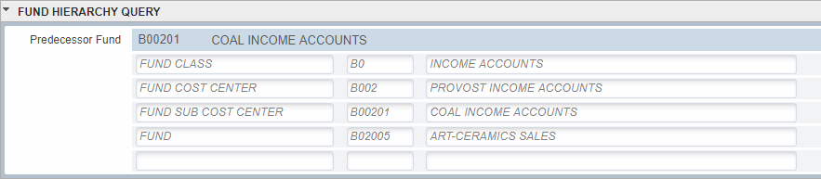
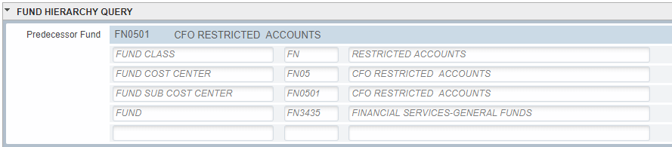
Our Funds
Example of UNIVERSITY Academic B-Fund Hierarchy
Example of FOUNDATION Non-Academic FN-Fund Hierarchy
Note: All funds have a consistent number of hierarchical levels, resulting in duplicate levels in some non-academic areas.

Slide 8
Our Organizations
We have three general categories of University organizations.
Operating
  Paired with the Operating fund.
Non-Operating
  Paired with Non-operating funds.
Auxiliary
  Paired with Non-Operating Budgeted Auxiliary funds.
We typically have only one general organization code for each University department in the Foundation.

Slide 9
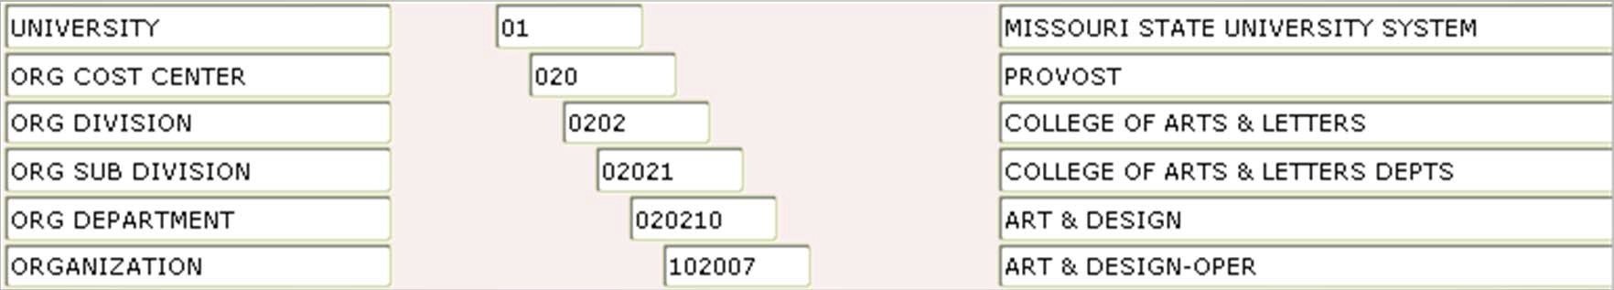
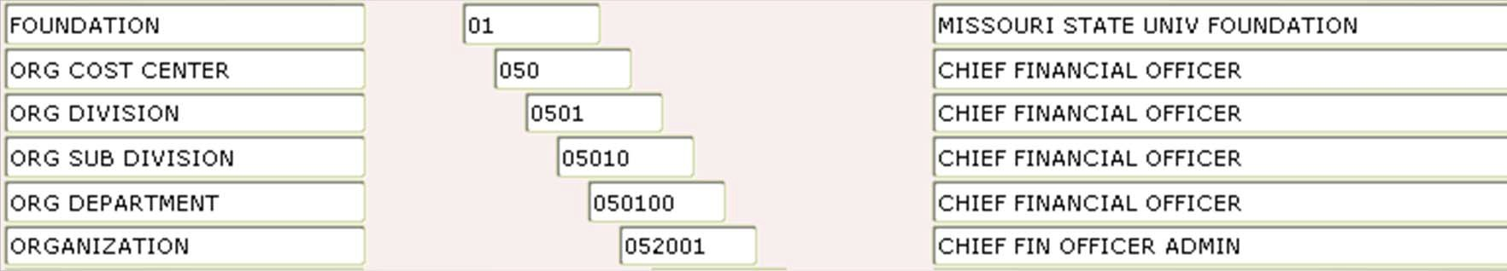
Our Organizations
Example of University Academic Organization Hierarchy
Example of Foundation Non-Academic Organization Hierarchy
Note: All organizations have a consistent number of hierarchical levels, resulting in duplicate levels in some non-academic areas.

Slide 10
Welcome & Over-View
Chart Review
Bear Finance Budget Reports Self-Service Banner
Our Accounts
There are four general types of accounts that will be reflected in your budget reports.
Revenue (5xxxx)
Salaries and Benefits (6xxxx)
Expenses (7xxxx)
Transfers (8xxxx)
These account codes are also hierarchical in nature and are grouped into categories that reflect the general activities of the University or the Foundation.
Note: Some 5xxxx revenue accounts are considered “contra” accounts which result in a reduction in revenue and thus “act” as an expense. Examples of “contra” revenue accounts include the 519 scholarship account codes.

Slide 11
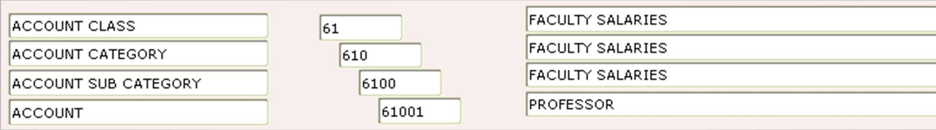
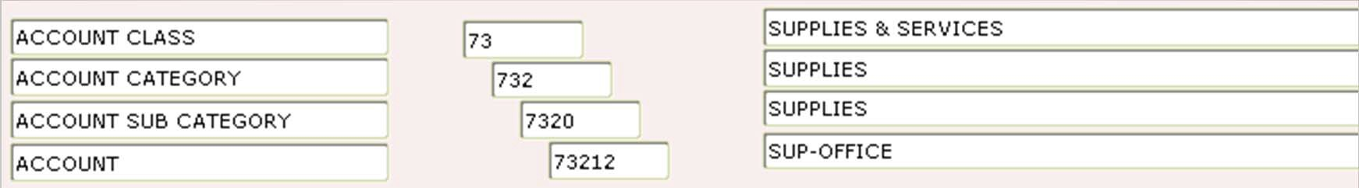
Welcome & Over-View
Chart Review
Bear Finance Budget Reports Self-Service Banner
Our Accounts
Example of Salary Account Hierarchy
Example of Expense Account Hierarchy
Note: All accounts have a consistent number of hierarchical levels, resulting in duplicate levels in some areas. Revenue, Salaries & Benefits, and Transfers are budgeted at the account level while most Expenses are budgeted at the account category level.

Slide 12
Welcome & Over-View
Chart Review
Bear Finance Budget Reports Self-Service Banner
Our Programs
We have three general categories of program codes.
Expense Function (011, 022, etc.)
  Reflects the purpose of the expense as it relates to general University functions.
Revenue (001)
  Used to record all Non-Auxiliary Revenue.
  Note that Service Centers (D-funds) will use their expense function program code to record revenue.
Auxiliary (201)
  Used to record all Auxiliary transactions.
Example of Expense Function Program Hierarchy

Slide 13
Welcome & Over-View
Chart Review
Bear Finance Budget Reports Self-Service Banner
FOAP Structure and Your Budget
Understanding our “FOAP” structure will help you in both accessing and reviewing the various budgets you administer.
What type of fund do you want to review?
  Is it an operating fund (A02000 or A92000)?
  If it is a non-operating type fund, does it contain a budget?
  Or, is it a grant or project type fund for which you want cumulative balances from the point of inception?
Are you reviewing a single budget or multiple budgets within an hierarchical group?
  If reviewing a group of budgets, what “roll-up” organization code contains the organizational budgets you oversee?
  If reviewing a group of funds, what “roll-up” Cost Center or Division fund code contains the funds you oversee?

Slide 14
Welcome & Over-View
Chart Review
Bear Finance Budget Reports Self-Service Banner
FOAP Structure and Your Budget
At what level of account detail do you wish to review your budget?
  Do you want to review balances in total by organization?
  Do you want to review those balances at the account category level at which the University typically budgets?
  Do you want to review balances for each individual account?
  Do you want to review the individual transactions that make up those account balances?
In what form do you wish to review your budget?
  Do you want to generate a report designed to reflect activity based on the type of Fund and level of detail you wish to review?
  Do you want to perform an online budget query with the option to “drill down” to more specific detail?

Slide 15
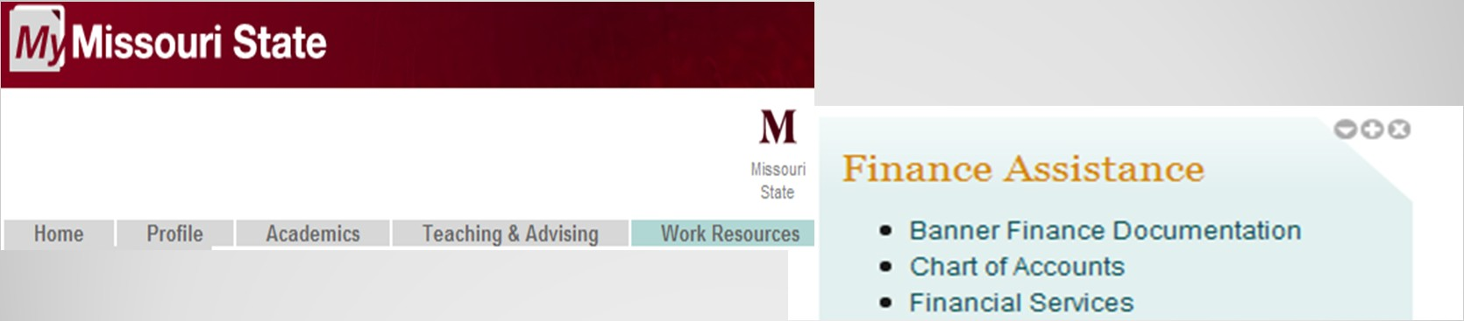
Welcome & Over-View
Chart Review
Bear Finance Budget Reports Self-Service Banner
FOAP Structure and Your Budget
The ability to review transactions and balances within your budget, either from a report or from an online budget query, will be based on your Fund/Organization authorization.
Access is obtained by completing and submitting a signed FOAP Authorization form to the Office of Financial Services.
  Online form link is available on the Banner Finance Documentation page which may be accessed from the Work Resources tab of My.Missouristate.edu in the Finance Assistance section.

Slide 16
Welcome & Over-View Chart Review
Bear Finance Budget Reports
Self-Service Banner
Budget Information on Bear Finance
If you choose to review your budget within a report, a variety of report formats are available on the Bear Finance reporting page.
University Departmental Reports
  Reports designed to reflect departmental budget and actual activity based on the type of University fund category being reported.
  Three levels of reporting are included for each of the general University fund categories.
    Organization Summary reports provide revenue, expense and transfer information in total by organization.
    Account Category Summary reports provide information based on the account level at which budgets are recorded.
    Account Summary reports provide information at each individual account level with subtotals by account category.
    Transaction Summary reports provide the transactional information that makes up each account balance.

Slide 17
Welcome & Over-View Chart Review
Bear Finance Budget Reports
Self-Service Banner
Budget Information on Bear Finance
Foundation Reports
  Reports designed to reflect budget and actual activity based on the type of Foundation fund category being reported.
  There are three levels of reporting (by Category, Account, and Transaction) for the Foundation Unrestricted fund.
  There are two levels of reporting for the Foundation Restricted and Endowed fund categories.
    Account Type Summary reports provide information by the general type of account (Revenue, Expenses, Transfers).
    Transaction Summary reports provide the transactional information that makes up each account balance.
Note: Foundation reports generated through Bear Finance will also reflect the Fund Net Assets (account code 41000) Balance Forward amount.

Slide 18
Welcome & Over-View Chart Review
Bear Finance Budget Reports
Self-Service Banner
Budget Information on Bear Finance
University Overview Reports
  Reports available to University Administration only designed to reflect high- level financial information for various fund and account categories.
Chart of Account Reports
  Reports reflecting the hierarchical structure of the Funds, Organizations, Accounts and Programs for both the University and the Foundation.
  These reports are provided for reference and to aid in determining the appropriate individual or roll-up Fund or Organization code to be selected for reporting purposes.
Fund and Organization Authorization Reports
  Designed to provide fund and organization access and approver information for both University and Foundation charts to authorized individuals who help manage this access, such as your Cost Center’s Budget Officer.

Slide 19
Welcome & Over-View Chart Review
Bear Finance Budget Reports
Self-Service Banner
Accessing Bear Finance
Bear Finance reports are generated with the Argos Reporting Solution.
  Access to Argos and the Bear Finance reports is obtained by sending an email request to the Query Developer User Group at: QDUG@missouristate.edu.
  Once you’ve logged in to Argos, you will also need to enter your ODSPROD Userid and Password in order to verify your Fund/Organization authorization.
    Your ODSPROD Userid is usually the same as your Banner ID and is most often the first letter of your first name followed by your last name.
    Your ODSPROD Password may be set (or reset) via the Change Your Password option at: https://cams.missouristate.edu/.

Slide 20
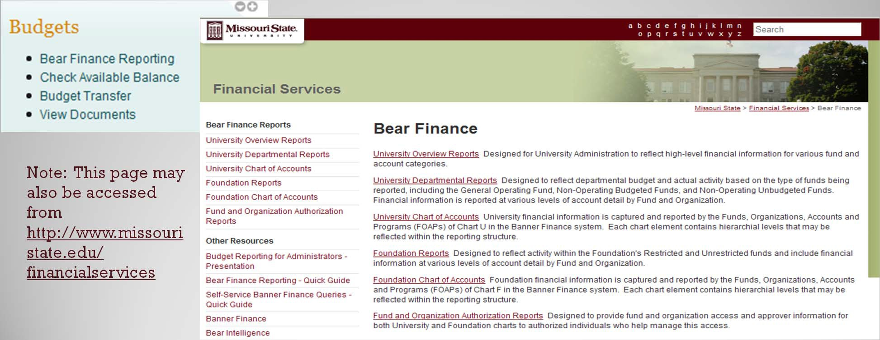
Welcome & Over-View Chart Review
Bear Finance Budget Reports
Self-Service Banner
Accessing Bear Finance
The Bear Finance reporting page may be accessed directly from the Work Resources tab of My.Missouristate.edu under the Budgets section.
Note: This page may also be accessed from http://www.missouri state.edu/ financialservices

Slide 21
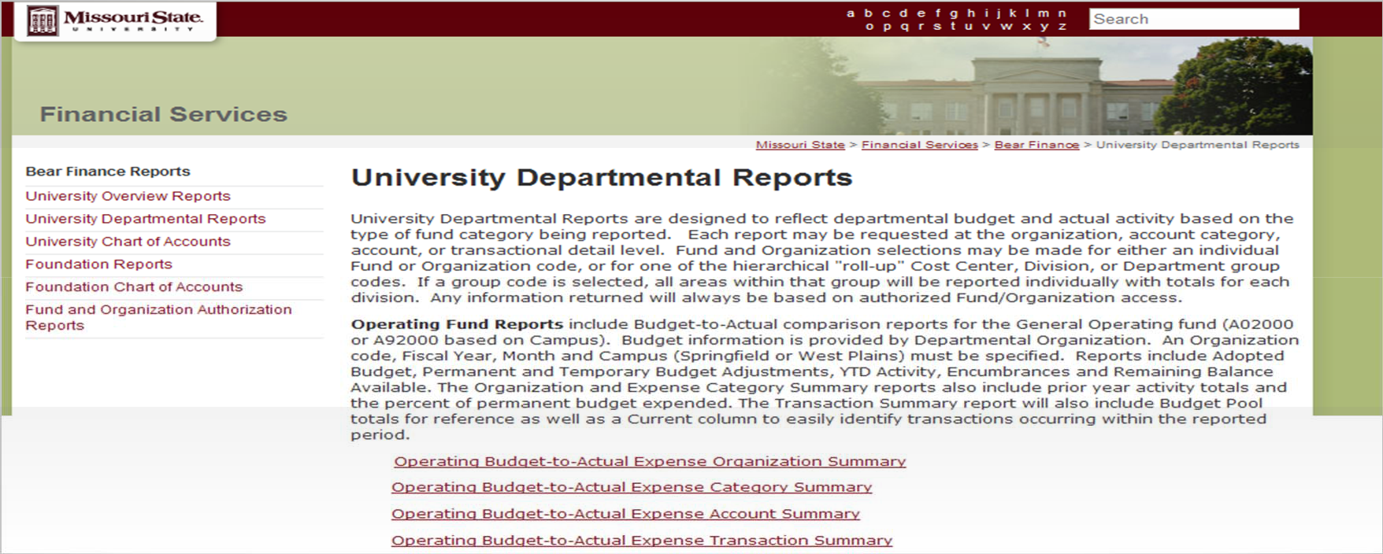
Welcome & Over-View Chart Review
Bear Finance Budget Reports
Self-Service Banner
Running Budget Reports from Bear Finance
From either the University Departmental Reports page or the Foundation Reports page, determine which report is appropriate based on the general fund category and the level of detail you wish to view, and click on the desired report link.

Slide 22
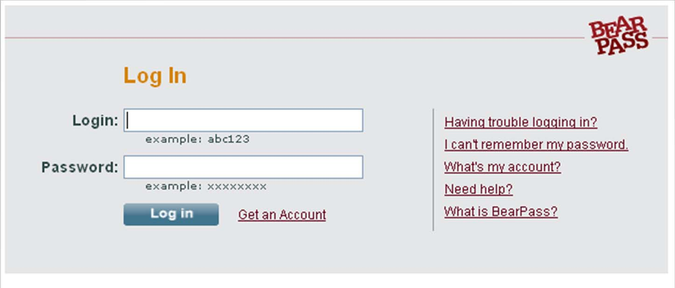
Welcome & Over-View Chart Review
Bear Finance Budget Reports
Self-Service Banner
Running Budget Reports from Bear Finance
The BearPass Log In page will be displayed in a separate page.
Enter your BearPass Userid and Password to log into the Argos Reporting Solution.

Slide 23
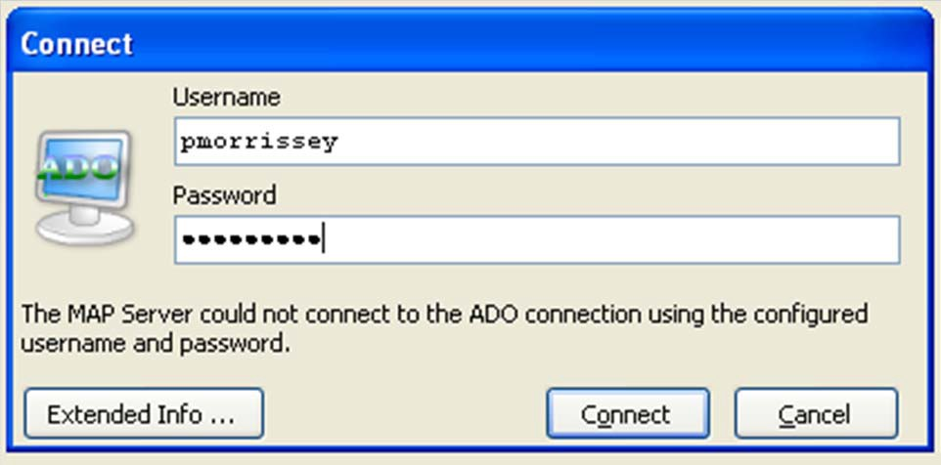
Welcome & Over-View Chart Review
Bear Finance Budget Reports
Self-Service Banner
Running Budget Reports from Bear Finance
Once Argos is invoked, a Connect window will be displayed where you will need to enter your ODSPROD Userid and Password in order to validate your Fund/Organization access.
Enter your ODSPROD Userid and Password and click Connect to continue.

Slide 24
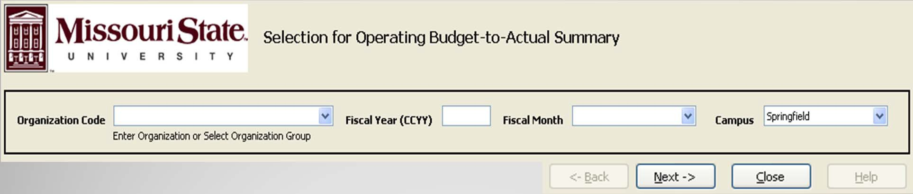
Welcome & Over-View Chart Review
Bear Finance Budget Reports
Self-Service Banner
Running Budget Reports from Bear Finance
Enter required report criteria and click Next.
Fund and Organization selections may be made for either an individual Fund or Organization code or for one of the hierarchical “roll-up” Cost Center, Division, or Department group codes listed in the dropdown list.
  If a group code is selected, all areas within that group will be reported individually with totals for each division. Any information returned will always be based on authorized Fund/Organization access.

Slide 25
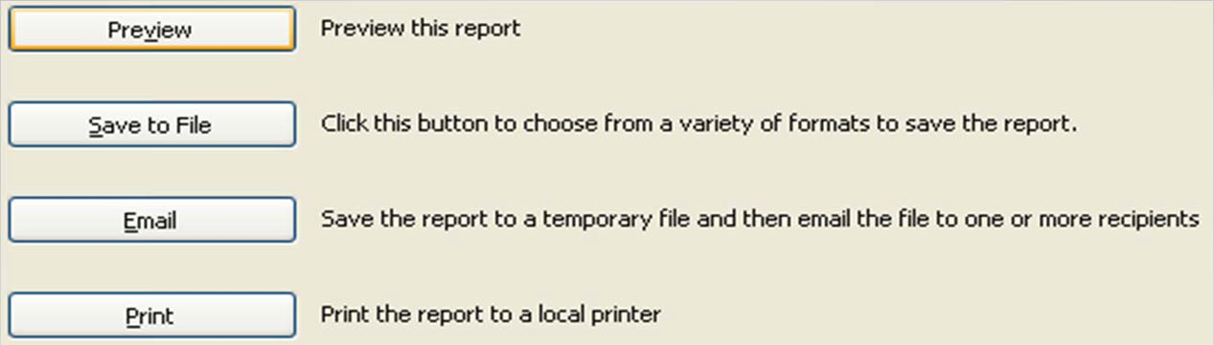
Welcome & Over-View Chart Review
Bear Finance Budget Reports
Self-Service Banner
Running Budget Reports from Bear Finance
Select to either Preview the report, Save the report (as a pdf or csv file to Excel), Email the report, or Print the report.
It is recommended that you preview your reports before selecting other options. You will also have the option to Save or Print directly from the Report Preview page.
Close the Report Preview page and select one of the options listed above, or click Back to enter new criteria for this report or Close to quit.
Note: Once you have Closed the Argos selection page, click the back arrow of your web browser to return to Bear Finance and select another report for processing.

Slide 26
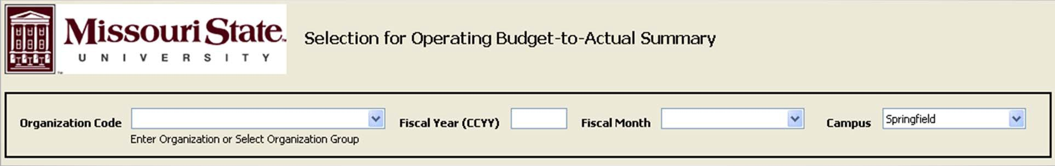
Welcome & Over-View Chart Review
Bear Finance Budget Reports
Self-Service Banner
University Operating Fund Reports in Bear Finance
Budget-to-Actual comparison reports for the Operating fund (A02000 or A92000 based on Campus).
Budget information is provided by Departmental Organization.
Organization, Fiscal Year, Month, and Campus (Springfield or West Plains) must be specified.
Reports include Adopted Budget, Permanent and Temporary Budget Adjustments,YTD Activity, Encumbrances (including POs and Requisitions) and Remaining Balance Available.

Slide 27
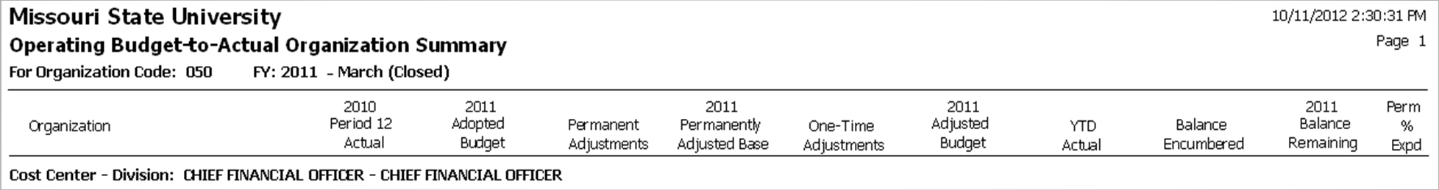
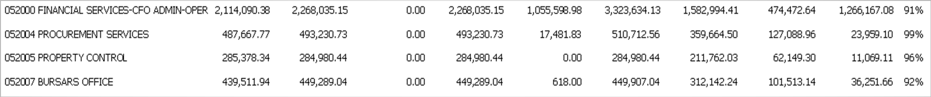
Welcome & Over-View Chart Review
Bear Finance Budget Reports
Self-Service Banner
University Operating Fund Reports in Bear Finance
Example Operating Budget-to-Actual Organization Summary
Note: A Division “roll-up” organization was specified in this example, resulting in a single report line for each organization within that area.

Slide 28
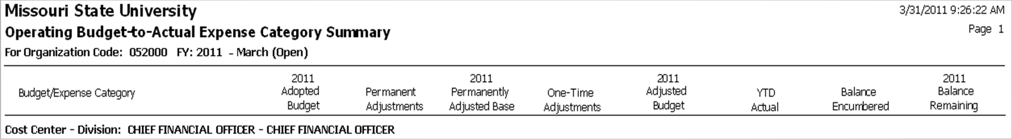
Welcome & Over-View Chart Review
Bear Finance Budget Reports
Self-Service Banner
University Operating Fund Reports in Bear Finance
Example Operating Budget-to-Actual Expense Category Summary
Note: Only one organization was specified in this example, so Orgn Totals and Division Totals are the same.
If a “roll-up” organization had been specified, each organization within it would be reported with separate totals, and the Division total would reflect all organizations reported within that Division. Also note that any scholarship balances (519xx accounts) will be reported as expenses rather than as a reduction to revenue,

Slide 29

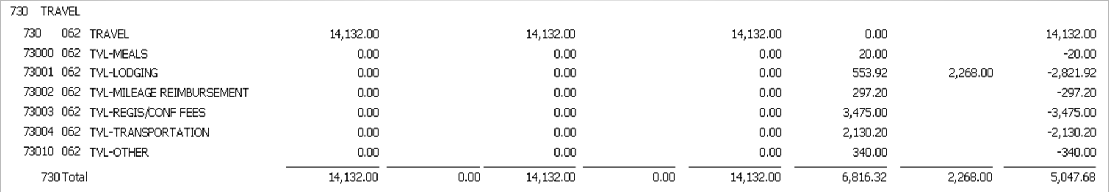
Welcome & Over-View Chart Review
Bear Finance Budget Reports
Self-Service Banner
University Operating Fund Reports in Bear Finance
Example Operating Budget-to-Actual Expense Account Summary
Note: Individual account balances are reflected with totals by account category.

Slide 30
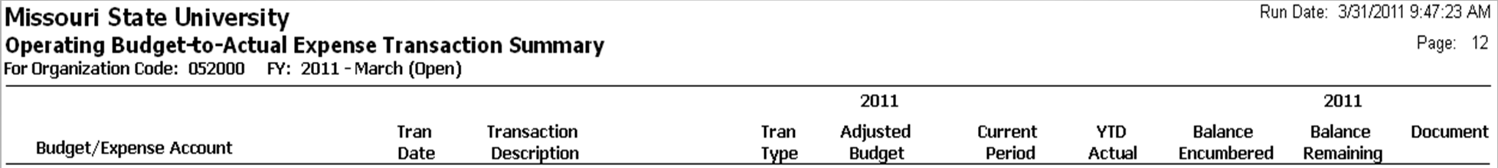
Welcome & Over-View Chart Review
Bear Finance Budget Reports
Self-Service Banner
University Operating Fund Reports in Bear Finance
Example Operating Budget-to-Actual Expense Transaction Summary
Note: Transaction Summary reports include Budget Pool Totals in addition to account category totals. The reports also include a “Current” column to easily identify transactions occurring within the reported period.

Slide 31
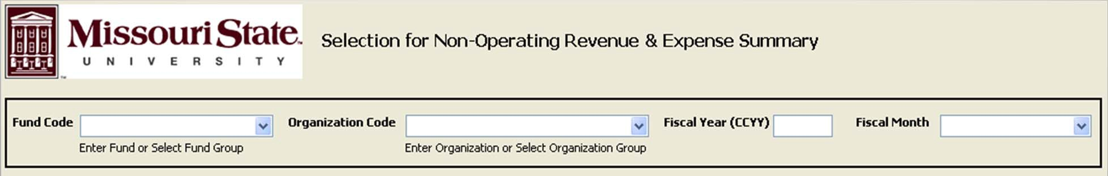
Welcome & Over-View Chart Review
Bear Finance Budget Reports
Self-Service Banner
University Non-Operating Unbudgeted Fund Reports in Bear Finance
Revenue and Expense reports for Non-Operating revenue generating funds that do not receive an annual budget.
Activity and balance amounts are provided by departmental organization for each fund reported.
Fund, Organization, Fiscal Year and Month must be specified.
Reports include Net Asset Carryover, YTD Activity, Balance Encumbered, and resulting Projected Remaining Net Assets.

Slide 32
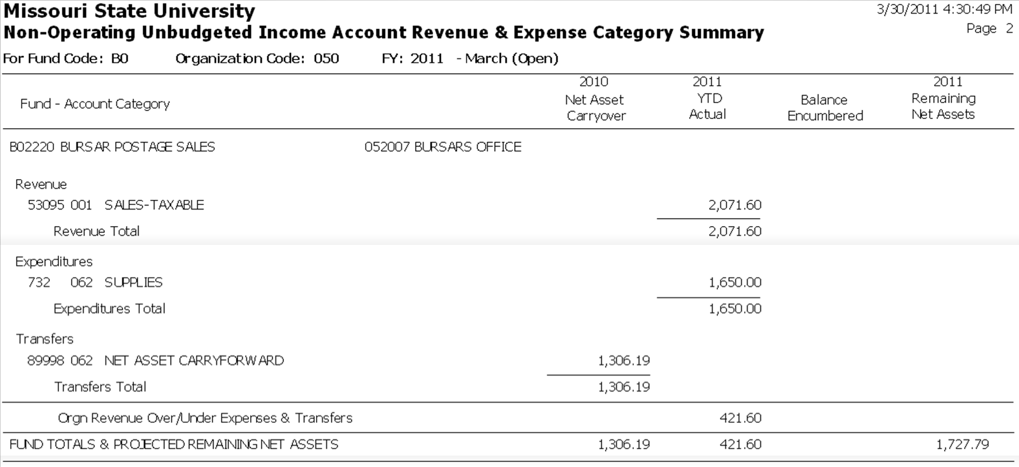
Welcome & Over-View Chart Review
Bear Finance Budget Reports
Self-Service Banner
University Non-Operating Unbudgeted Fund Reports in Bear Finance
Example Income Account (B-Fund) Revenue & Expense Category Summary

Slide 33
Welcome & Over-View Chart Review
Bear Finance Budget Reports
Self-Service Banner
University Non-Operating Budgeted Fund Reports in Bear Finance
Budget-to-Actual comparison reports for Non-Operating funds revenue generating funds that also receive an annual budget.
Budgeted and actual revenue, expense and transfer information is provided by Departmental Organization for each fund reported.
Fund, Organization, Fiscal Year and Month must be specified.
Reports include Adopted Budget, Permanent and Temporary Budget Adjustments,YTD Activity, Encumbrances (including POs and Requisitions) and Remaining Balance Available. Budgeted and actual revenue over/under expenses and transfers along with a resulting projected change to Net Assets after Encumbrances is also provided for each fund.
Note: Selection input for Non-Operating Budgeted Fund reports is the same as that for and Non- Operating Unbudgeted Fund reports.

Slide 34
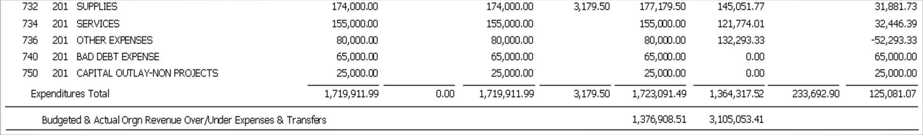
Welcome & Over-View Chart Review
Bear Finance Budget Reports
Self-Service Banner
University Non-Operating Budgeted Fund Reports in Bear Finance
Example Auxiliary (H-Fund) Revenue & Expense Category Summary

Slide 35
Welcome & Over-View Chart Review
Bear Finance Budget Reports
Self-Service Banner
University Grant and Project Fund Reports in Bear Finance
Budget-to-Actual comparison reports for Grant and Project type funds that require cumulative “inception-to-date” balances.
Reports will include balances for the life of the grant or project and may span fiscal years.
May be generated for all funds associated with a particular grant or project (as in the case of a grant with a match fund), or optionally for a specified fund or group of grant/project funds.
Reports will include Adopted Budget, Permanent and Temporary Budget Adjustments,“Inception-to-Date” Activity, Encumbrances (including POs and Requisitions) and Remaining Balance Available for the grant or project.

Slide 36
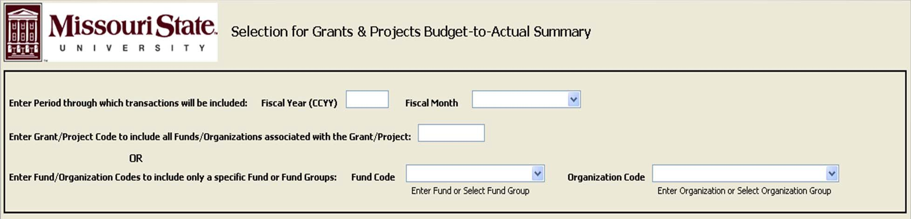
Welcome & Over-View Chart Review
Bear Finance Budget Reports
Self-Service Banner
University Grant & Project Fund Reports in Bear Finance
Enter either the Grant/Project ID to see activity for all associated funds with totals for the Grant/Project . .
-- OR –
Enter the Fund and Organization Code to see activity for a single fund within the Grant/Project and totals for the Cost Center – Division responsible for the fund(s) . .
----- DO NOT ENTER BOTH -----

Slide 37
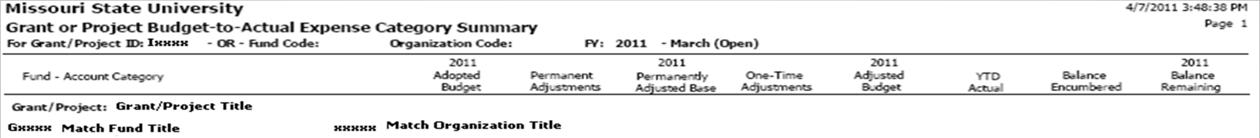
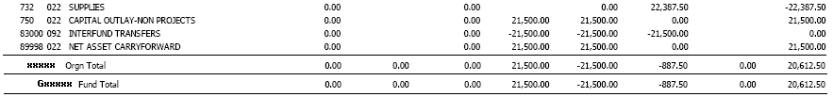
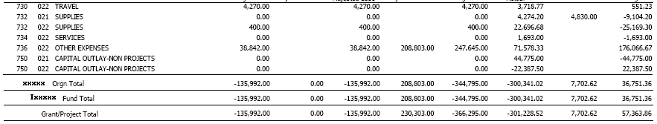
Welcome & Over-View Chart Review
Bear Finance Budget Reports
Self-Service Banner
University Grant & Project Fund Reports in Bear Finance
Example Grant Budget-to-Actual Expense Category Summary

Slide 38
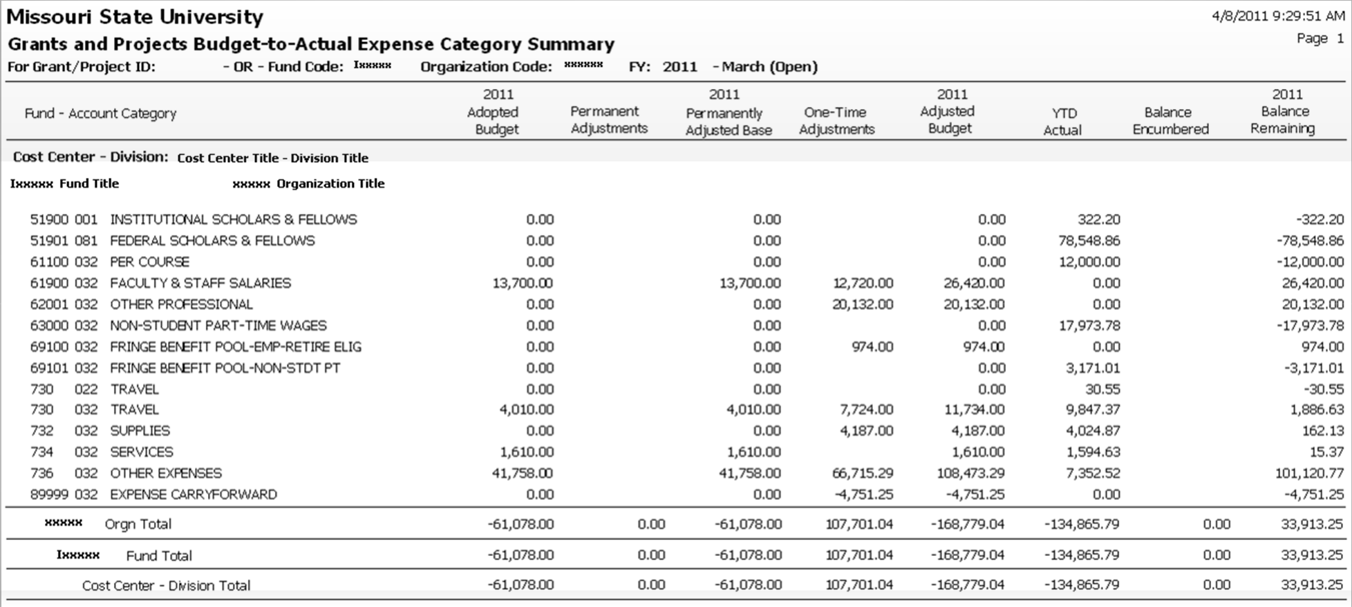
Welcome & Over-View Chart Review
Bear Finance Budget Reports
Self-Service Banner
University Grant & Project Fund Reports in Bear Finance
Example Grant Fund Budget-to-Actual Expense Category Summary

Slide 39
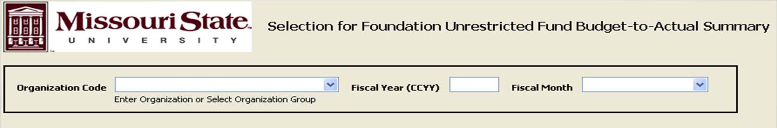
Welcome & Over-View Chart Review
Bear Finance Budget Reports
Self-Service Banner
Foundation Unrestricted Fund Reports in Bear Finance
Budget-to-Actual comparison reports for the Foundation’s Unrestricted fund (FA2000).
Budget information is provided by Departmental Organization.
Organization code, Fiscal Year and Month must be specified.
Reports include Adopted Budget, Permanent and Temporary Budget Adjustments,YTD Activity, Encumbrances (including POs and Requisitions) and Remaining Balance Available.

Slide 40
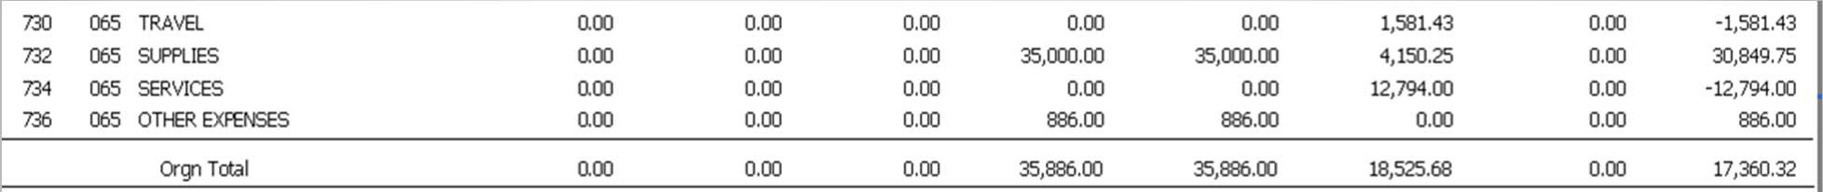
Welcome & Over-View Chart Review
Bear Finance Budget Reports
Self-Service Banner
Foundation Unrestricted Fund Reports in Bear Finance
Example Unrestricted Fund Budget-to-Actual Expense Category Summary

Slide 41
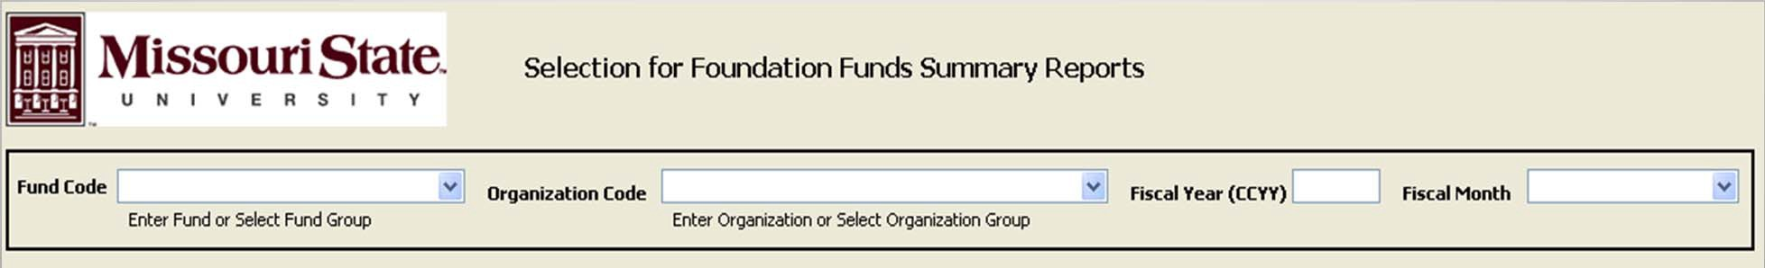
Welcome & Over-View Chart Review
Bear Finance Budget Reports
Self-Service Banner
Foundation Restricted and Endowed Fund Reports in Bear Finance
Activity and Balance reports for the Foundation’s Restricted (FN) and Endowed (FS) funds.
Information includes revenue, expense, transfer and resulting fund balance amounts for each fund reported.
Fund, Organization, Fiscal Year and Month must be specified.
Reports include Fund Balance Forward, Revenue, Expense and Transfer Activity, Balance Encumbered, and resulting Fund Net Assets Balance.

Slide 42
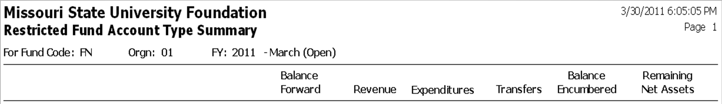
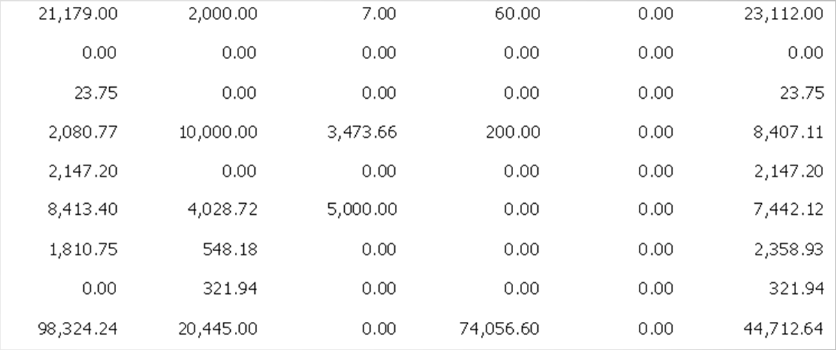
Welcome & Over-View Chart Review
Bear Finance Budget Reports
Self-Service Banner
Foundation Restricted and Endowed Fund Reports in Bear Finance
Example Restricted Fund Account Type Summary
Note: Fund Net Asset Balance Forward amounts are reflected in the Foundation Restricted and Endowment reports.
Balance Forward amounts are not available through SSB.

Slide 43
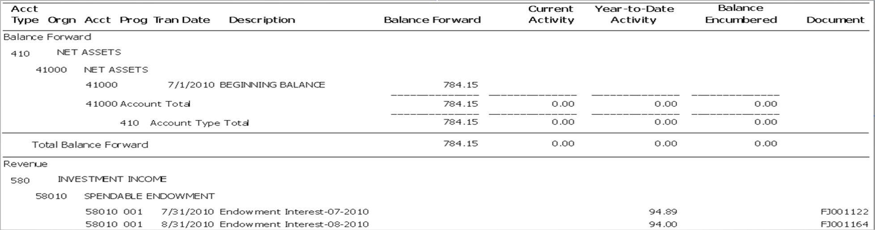
Welcome & Over-View Chart Review
Bear Finance Budget Reports
Self-Service Banner
Foundation Restricted and Endowed Fund Reports in Bear Finance
Example Restricted Fund Transaction Summary

Slide 44
Welcome & Over-View Chart Review
Bear Finance Budget Reports
Self-Service Banner
Budget Information in Self-Service Banner (SSB)
If you choose to review your budget with an online budget query, a variety of options are available through Self-Service Banner (SSB).
Queries may be performed against both University and Foundation FOAPs, and include budget information based on selection criteria specified.
  Three basic query types may be performed through SSB.
    Budget Status by Account.
    Budget Status by Organizational Hierarchy.
    Budget Quick Query.

Slide 45
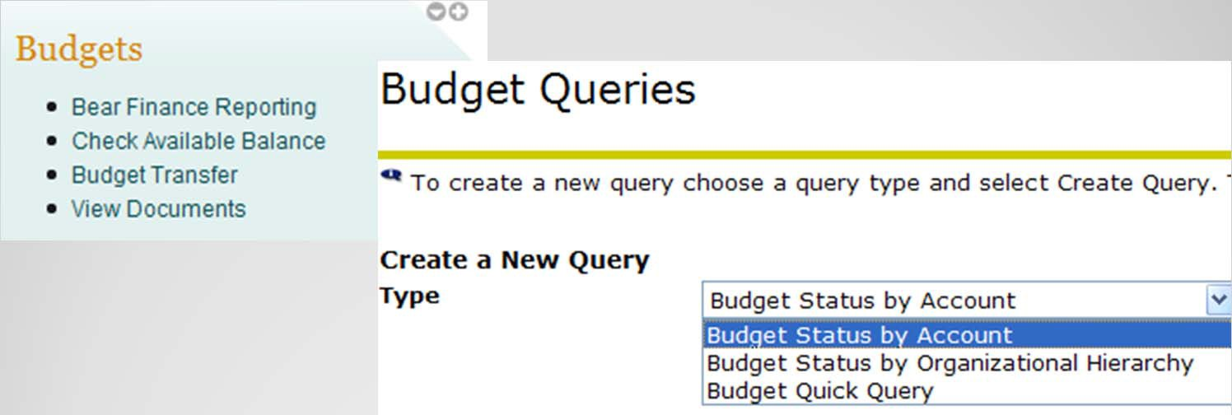
Welcome & Over-View Chart Review
Bear Finance Budget Reports
Self-Service Banner
Accessing Self-Service Banner (SSB)
Authorization to run SSB Budget Queries is granted as part of the FOAP Authorization process.
SSB Budget Queries may be accessed directly from the Work Resources tab of My.Missouristate.edu in the Budgets section by clicking on the Check Available Balance link.

Slide 46
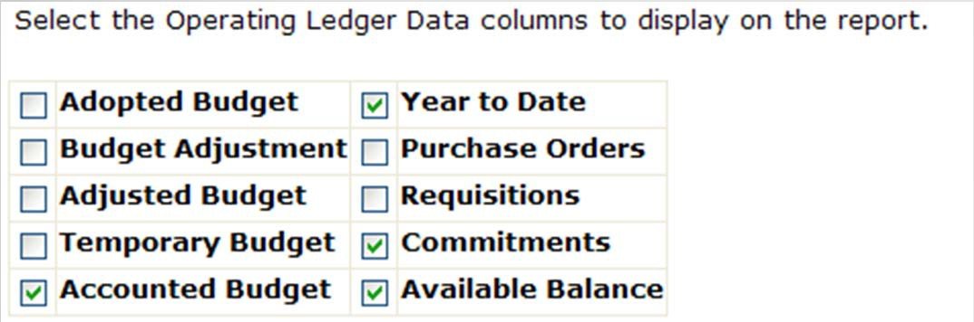

Welcome & Over-View Chart Review
Bear Finance Budget Reports
Self-Service Banner
Performing Budget Queries in Self-Service Banner (SSB)
Budget Status by Account
Select columns to be included on your report based on the type of fund to be reported and click to Continue.
  Does the fund have an Original Adopted Budget?
  Do you want to see Adjustments or just Accounted Budget?
  Do you want to see POs and Requisitions or just Commitments?
  Is Budget Balance Available applicable for this fund?
These might be typical columns included for a University Operating Fund (A02000) query.

Slide 47

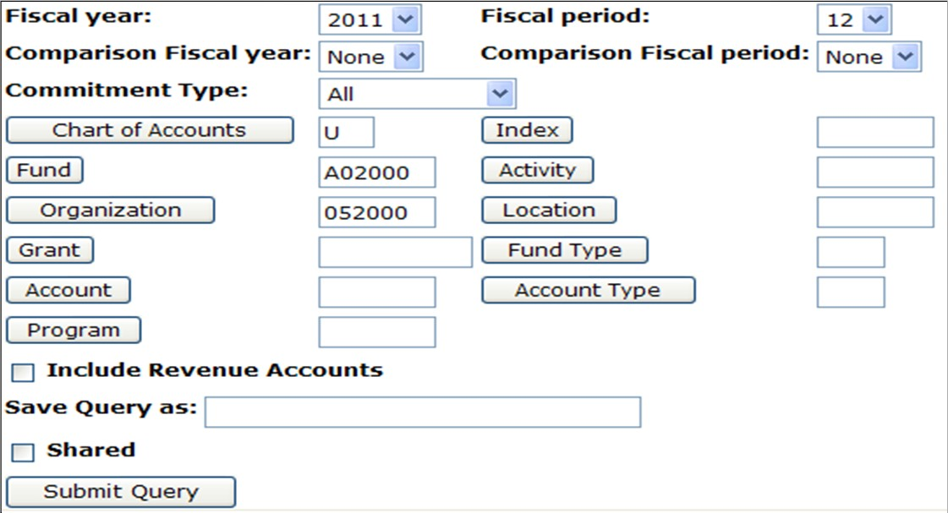
Welcome & Over-View Chart Review
Bear Finance Budget Reports
Self-Service Banner
Performing Budget Queries in Self-Service Banner (SSB)
Enter Fiscal Year, Period and FOAP and click to Submit Query.
  Do you want comparison information?
  Is this a Grant or Project that requires cumulative totals?
  Do you want to view only specific accounts or account type?
  Is this a revenue generating fund?
This might be typical selection criteria for a University Operating Fund (A02000) query.
Note: If you wish to review total Expense Budget Balance Available for a budgeted fund, Revenue accounts should NOT be included, but may be queried separately.
This image cannot currently be display ed.

Slide 48
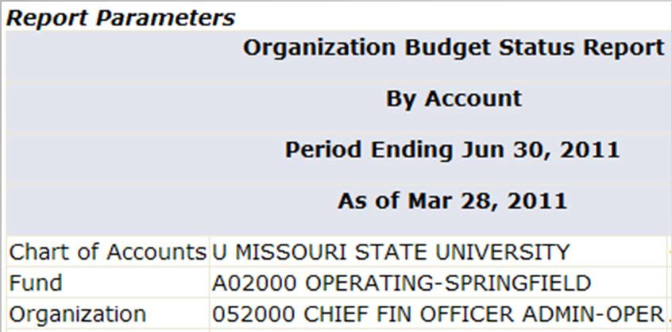

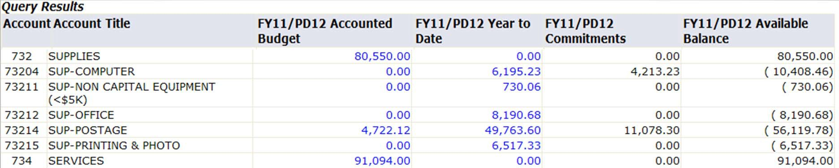
Welcome & Over-View Chart Review
Bear Finance Budget Reports
Self-Service Banner
Performing Budget Queries in Self-Service Banner (SSB)
View your Query Results.
Click on “linked” totals to view details of reported amounts, including posting documents and associated scanned invoice and check images where applicable. Note that Screen, Running, and Report totals are included on each page displayed and that computed columns may be added.

Slide 49
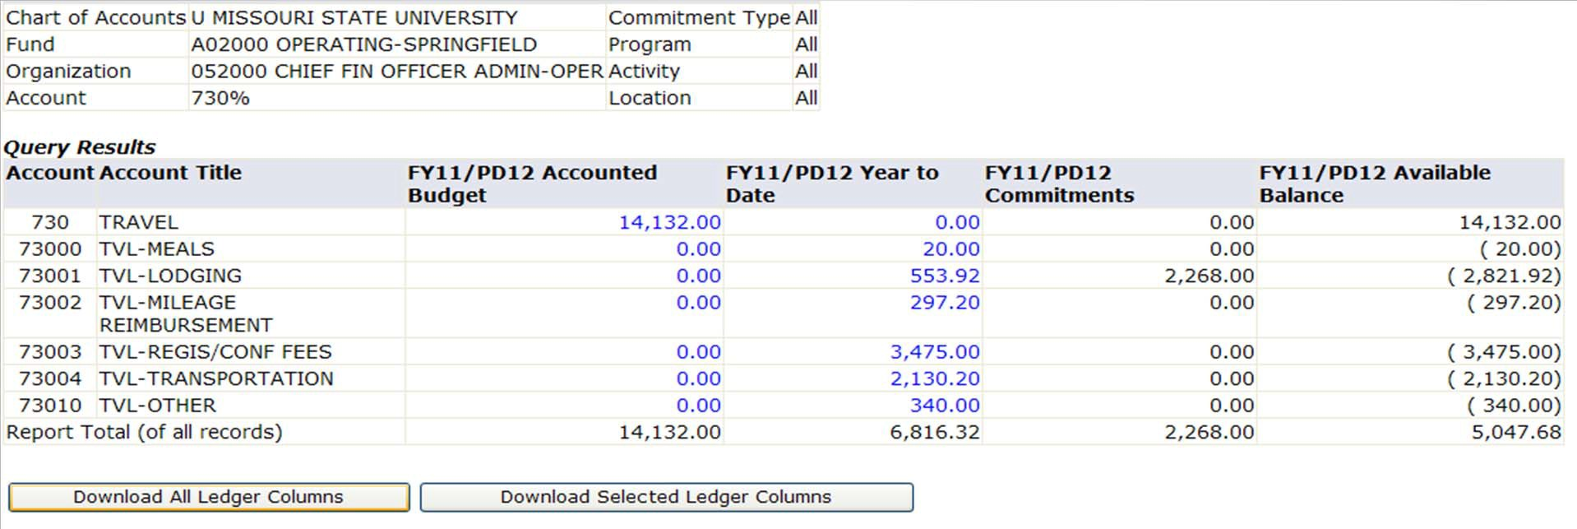
Welcome & Over-View Chart Review
Bear Finance Budget Reports
Self-Service Banner
Budget Query Considerations
Things to consider when querying University funds.
Operating Fund queries should reflect the Balance Available in your Expense budget, so do not include Revenue accounts unless you also have budgeted scholarship amounts (519 accounts).
Note: SSB Query results may be downloaded into Excel if desired.

Slide 50
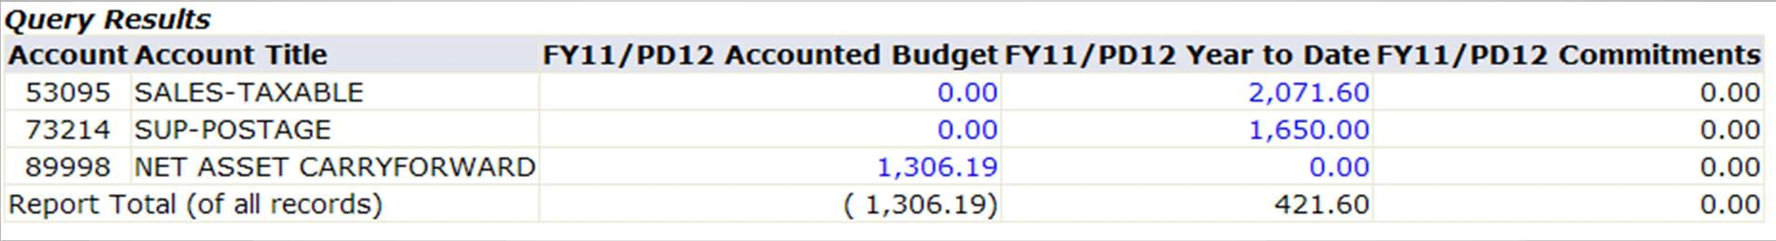
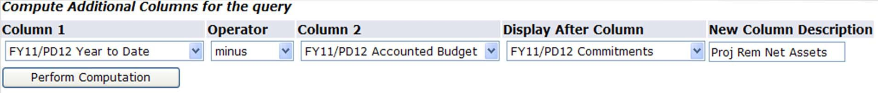
Welcome & Over-View Chart Review
Bear Finance Budget Reports
Self-Service Banner
Budget Query Considerations
Non-Operating Unbudgeted Fund queries should reflect a YTD total of revenue over/under expenses and transfers, so select to include Revenue accounts in your query. Any Net Asset Carryover available to you will be reflected as Accounted Budget in account 89998.
Note: A computation may be performed to compute an additional column amount.

Slide 51
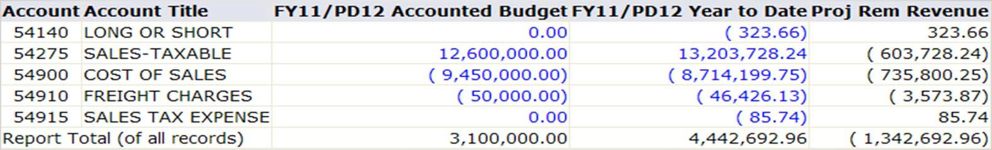
Welcome & Over-View Chart Review
Bear Finance Budget Reports
Self-Service Banner
Budget Query Considerations
Non-Operating Budgeted Fund queries should also reflect a YTD total of revenue over/under expenses and transfers, so select to include Revenue accounts in your query.
A review of Budget to actual YTD activity is also relevant.
  To view a Budgeted Expense to YTD comparison, perform a query similar to an Operating Fund query, excluding Revenue accounts and selecting Balance Available in your query.
  To view a Projected Revenue to YTD comparison, include Revenue accounts and specify a revenue Account Type (such as 5D – Sales & Services – Auxiliaries) to limit results to a specific revenue type only. Do not select Balance Available – Compute Remaining = Budget – YTD.

Slide 52
Welcome & Over-View Chart Review
Bear Finance Budget Reports
Self-Service Banner
Budget Query Considerations
Grants & Project Fund queries should reflect the Balance Available in your contracted Expense budget, so a similar query to that performed for a University Operating Fund budget may be performed, excluding Revenue accounts and specifying a Balance Available column in your query results.
To view cumulative “inception-to-date” totals for your grant, enter the associated Grant code (which is usually the same as the Fund code).
If your grant includes multiple funds (grant, match, etc), enter the Grant code only, excluding the Fund code, to view cumulative totals for all funds associated with the project.
To view “inception-to-date” totals for just the grant fund or just the match fund, enter the Grant code and the desired Fund code.

Slide 53
Welcome & Over-View Chart Review
Bear Finance Budget Reports
Self-Service Banner
Budget Query Considerations
Things to consider when querying Foundation Funds.
Unrestricted Fund queries should reflect the Balance Available in your Foundation Unrestricted Expense budget.
  Create a similar query to one performed for a University Operating budget.
  Exclude Revenue accounts and specify a Balance Available column.
Restricted and Endowment Fund queries should reflect a YTD total of revenue over/under expenses and transfers.
  Create a similar query to one performed for University Non-Operating Unbudgeted funds.
  Include Revenue accounts and do not include Balance Available.
Note: A Foundation Fund Net Assets Balance Forward amount is not available for querying through SSB.

Slide 54
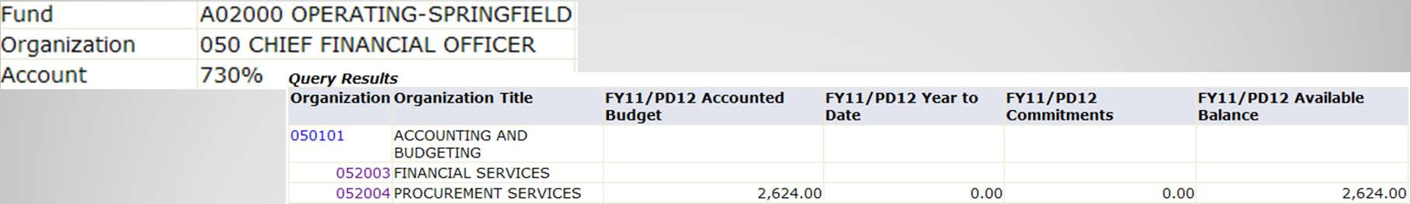
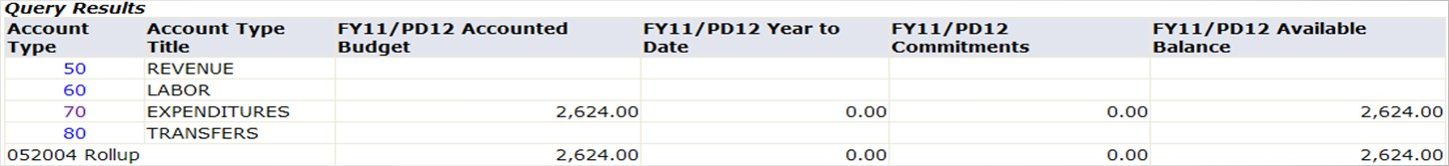
Welcome & Over-View Chart Review
Bear Finance Budget Reports
Self-Service Banner
Additional Budget Queries in Self-Service Banner (SSB)
Budget Status by Organization Hierarchy
The same types of fund queries may be performed for an entire college or division by specifying one of the “roll-ups” in the organizational hierarchy (division, cost center, etc.).
  Results will be displayed in total at the highest level requested.
  Click on “linked” organizations and then on “linked” account totals to view more detail in each area or type of account.
Note: Results will only include Org codes for which you have been authorized.

Slide 55
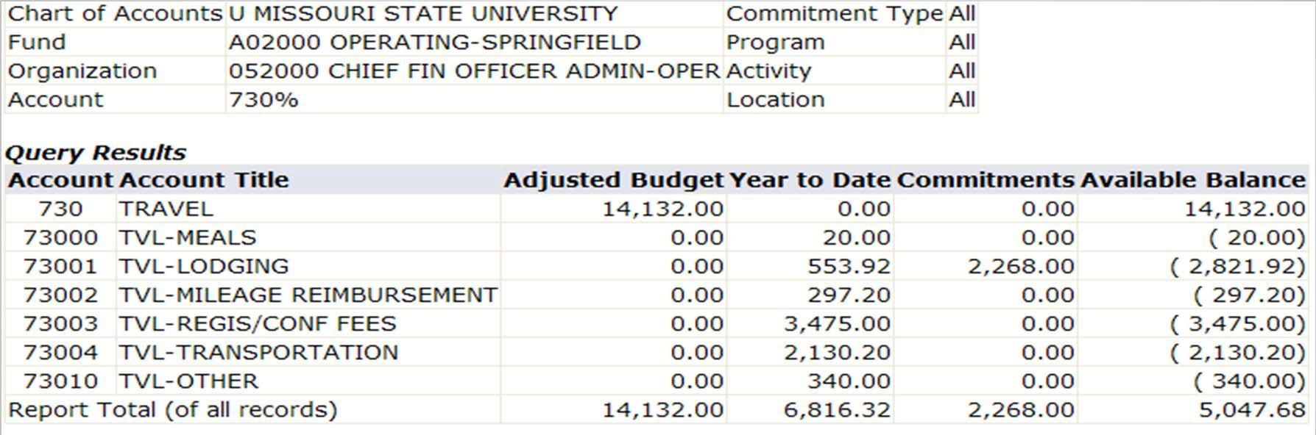
Welcome & Over-View Chart Review
Bear Finance Budget Reports
Self-Service Banner
Additional Budget Queries in Self-Service Banner (SSB)
Budget Quick Query
The same types of fund queries may also be performed as a summary report.
  Only total amounts by account code are included with no “links” for further transaction detail.

Slide 56
Welcome & Over-View Chart Review
Bear Finance Budget Reports Self-Service Banner
Questions?
Additional reporting questions may be forwarded to:
BannerFinance@missouristate.edu
Additional Argos access questions may be forwarded to:
QDUG@missouristate.edu
Contact Information:
Clement Balasundaram
Office of Financial Services Carrington 113
417-836-4350
ClementBalasundaram@MissouriState.edu
Pamela Morrissey
836-5632
pammorrissey@missouristate.edu

