Slide 1
Financial Aid for Advisors

Slide 2
Office of Student Financial Aid
Federal, State, Institutional, and Third-Party student financial assistance.
Eligibility determinations, award calculations, fund disbursements, annual reporting.
Financial aid counseling, financial literacy education, smart borrowing, and gap funding.

Slide 3
FAFSA Process and Terminology

Slide 4
Financial Aid Life-Cycle
Complete the FAFSA every year (December ‘23)
FAFSA determines aid eligibility
Scholarship eligibility calculated
Students notified of award package
Aid disbursed the second week of classes
Refunds paid around the third week of classes

Slide 5
Important Financial Aid Dates
December 2023: The FAFSA opens for the 2024-2025 academic year
November 1 – March 1: The MSU Annual Scholarship Application is available for completion
February 1: Missouri & MSU priority FAFSA submission deadline
New

Slide 6
Free Application for Federal Student Aid
FAFSA
Federal aid application completed annually. Used to determine federal, state, and some institutional/third-party eligibility.
Undergoing significant changes for 2024-2025.
Used to determine student’s financial need.

Slide 7
Financial Need
Financial need in a financial aid context is not the same as financial need as traditionally understood
  Does not require SNAP, TANF, WIC, Free and Reduced Lunch, etc.
  FNA Financial Need is purely a numbers game
Financial Need = Cost of Attendance – Expected Family Contribution or Student Aid Index
  Need = COA - EFC or SAI
NEW

Slide 8
Cost of Attendance
The Cost of Attendance (COA) is the cornerstone of establishing a student’s financial need, as it sets a limit on the total aid that a student may receive
Allowable Costs include:
  Tuition & Fees
  Housing & Meals
  Books & Supplies
  Transportation
  Personal Expenses
  Loan fees
  Professional License, Credential, or Certification
New

Slide 9
Eligibility Review

Slide 10
Student Issue: Verification
The U.S. Department of Education (ED) requires financial aid offices to conduct various reviews of student information provided (or not provided) on the Free Application for Federal Student Aid (FAFSA)
The most common review is known as Verification which entails a detailed review of family and income data reported on the FAFSA
Students cannot receive any Title IV funds until verification has been completed

Slide 11





Special Circumstance Review
If a student or their family experienced a change in finances, they can apply for a process called Special Circumstance Review.
Submitting a Special Circumstance application does not guarantee any change of your financial aid award.
Common circumstances include:
  Change in household income
  Loss or change in employment
  Receiving public assistance
  Divorce or separation of parents
  Parent deceased
  Medical expenses
  Parent’s post-secondary expenses

Slide 12
Satisfactory Academic Progress
Situation: Student is not meeting SAP and thus cannot receive aid
Three components to the SAP policy
  GPA
  Pace
  Max Hours
Solution: Submit a SAP appeal if the student has a documented extenuating circumstance. Fall deadline is October 27, 2023
SAP appeals go to FinancialAidAppeals@missouristate.edu

Slide 13
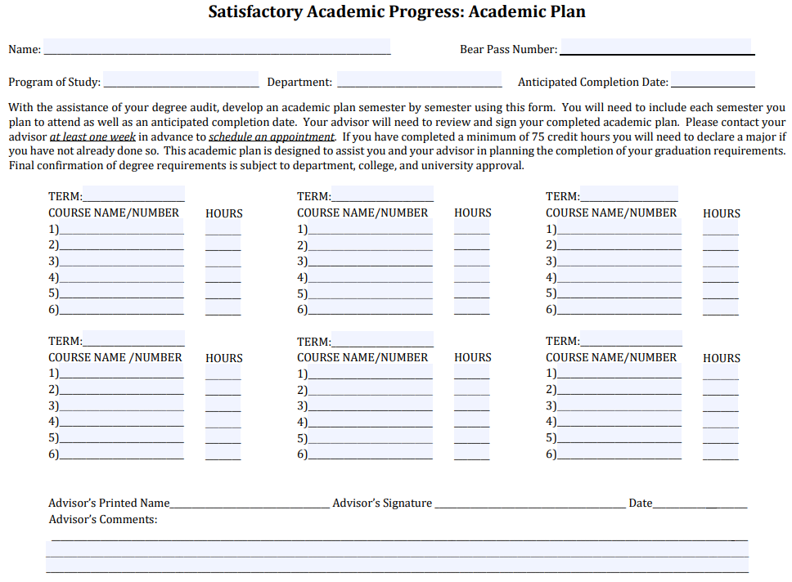
Satisfactory Academic Progress (SAP)
Students not meeting SAP are notified and placed on a “warning period”, during which time they have 1 semester to bring themselves back within compliance
  If a student is still not in compliance after the warning period, financial aid is terminated.
Regaining Aid Eligibility:
  Self-pay until back within minimum standards
  SAP Appeal due to extenuating circumstances
    Academic Plan required for all appeals
New

Slide 14
Scholarship Appeal
Situation: Student did not renew scholarship due to extenuating Circ.
Scholarship Appeal Form
  Extenuating circumstances include but are not limited to illness or injury, death of a family member, and work-related problems.
  Inability to perform academically is not an extenuating circumstance.
  Must be documented.
Appeal link available on the scholarship page and submitted via Dynamic Forms.

Slide 15
Completion & Emergency Funds

Slide 16
Completion Grants
Situation: Student has exhausted funds
Senior Degree Completion Grant – Up to $3,000
  One-time award; 2.00 GPA; meeting SAP; submitted FAFSA; used all aid; UG only; within 1 year of graduation.
Degree Completion Assistance Fund – Up to $1,500
  One-time award; 2.00 GPA; meeting SAP; submitted FAFSA; used all aid; UG and GR.
Applications go to Office of Student Financial Aid in Carrington Hall, Room 101

Slide 17
Financial Emergencies
Situation: Student is facing an urgent financial emergency
Director’s Choice Grant – Up to $1,500
  Must be full-time and meeting SAP; must be Missouri resident; must meet with a staff member who will write a letter of support; approved by Director.
Emergency Scholarship – Up to $2,000
  One-time award; 2.50 GPA and meeting SAP; full-time; FAFSA if possible; used other funds; documented unplanned and life-altering situation.
Applications go to Office of Student Financial Aid in Carrington Hall, Room 101

Slide 18




Contact Information
Office
Phone
Website
Appointments
Carrington Hall,
Room 101
(417) 836-5262
https://www.missouristate.edu/FinancialAid/
https://www.missouristate.edu/FinancialAid/schedule-a-meting.htm

