Slide 1
Dealing with Student Emergencies and Appeals
September 14, 2021

Slide 2

Financial Aid for Proactive Advisors

Slide 3
Presentation goal:
To orient you as academic advisors within the world of Student Financial Assistance programs, policies, and practices. Provide detailed information and develop a more nuanced understanding of financial aid concepts, jargon, and student challenges

Slide 4
Presentation goal:
To orient you as academic advisors within the world of Student Financial Assistance programs, policies, and practices. Provide detailed information and develop a more nuanced understanding of financial aid concepts, jargon, and student challenges

Slide 5
Financial Aid Life-Cycle
Complete the FAFSA every year (October 1)
FAFSA determines aid eligibility
Scholarship eligibility calculated
Students notified of award package
Aid disbursed the second week of classes
Refunds paid around the third week of classes

Slide 6
Financial Need
Financial need in a financial aid context is not the same as financial need as traditionally understood
  Does not require SNAP, TANF, WIC, Free and Reduced Lunch, etc.
  FNA Financial Need is purely a numbers game
Financial Need = Cost of Attendance – Expected Family Contribution

Slide 7
Cost of Attendance
The Cost of Attendance (COA) is the cornerstone of establishing a student’s financial need, as it sets a limit on the total aid that a student may receive
Allowable Costs include:
  Tuition and fees
  Books, supplies, transportation, personal miscellaneous.
  Room and board
  Dependent Care
  Study-abroad expenses
  Disability expenses
  Employment expenses for co-op study
  Loan fees

Slide 8
Cost of Attendance
For the 2021-2022 Academic Year the Full-Time Undergraduate Cost of Attendance for a Missouri Resident Student is $22,168
  Important to note that most students will not actually pay this much
  Average cost for this type of student is closer to $16,000
This inflation is due to including both direct and indirect costs
Higher COAs actually benefit the students when determining need and awarding funds

Slide 9
Expected Family Contribution (EFC)
Expected Family Contribution (EFC) is an index number that colleges use to determine how much financial aid you're eligible to receive. Your EFC is calculated according to a formula established by law and the information from your Free Application for Federal Student Aid (FAFSA)
EFC is not necessarily how much a student/family can expect to pay for school
  It serves as an indicator of the family’s financial strength and ability to pay

Slide 10
Important Financial Aid Dates
October 1: The FAFSA opens for the next academic year
  E.g.: On October 1, 2021 the FAFSA for the 2022-2023 Academic Year is available for completion
November 1 – March 1: The MSU Annual Scholarship Application is available for completion
February 1: Missouri & MSU priority FAFSA submission deadline

Slide 11
Major Take-Away:
Most students at MSU have some degree of financial need. This means they should ALWAYS apply for need-based aid regardless if they think they’ll get it.

Slide 12
Student Issue: Verification
The U.S. Department of Education (ED) requires financial aid offices to conduct various reviews of student information provided (or not provided) on the Free Application for Federal Student Aid (FAFSA)
The most common review is known as Verification which entails a detailed review of family and income data reported on the FAFSA
  Verifications can be classified based on the degree of review required: V1 (Standard), V4 (Identity & Educational Purpose), V5 (The Works)
Students cannot receive any Title IV funds until verification has been completed
WAIVED

Slide 13
Satisfactory Academic Progress
Situation: Student is not meeting SAP and thus cannot receive aid
Three components to the SAP policy
  GPA
  Pace
  Max Hours
Solution: Submit a SAP appeal if the student has a documented extenuating circumstance. Fall deadline is October 29, 2021.
SAP appeals go to Mari (FinancialAidAppeals@missouristate.edu)

Slide 14
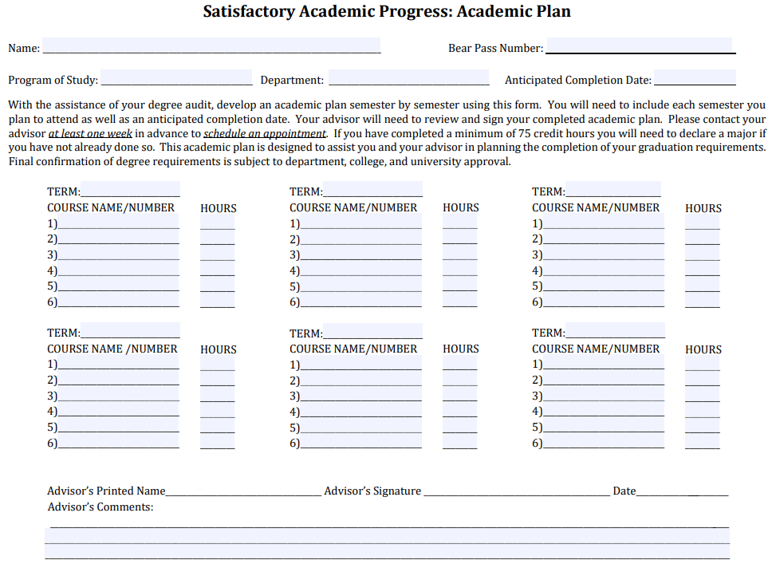
Satisfactory Academic Progress (SAP)
Students not meeting SAP minimums are notified and are placed on a “warning period”, during which time they have 1 semester to bring themselves back within compliance
  If a student is still not incompliance after the warning period, financial aid is terminated.
Regaining Aid Eligibility:
  Self-pay until back within minimum standards
  SAP Appeal due to extenuating circumstances
    Academic Plan required for all appeals

Slide 15
Scholarship Appeal
Situation: Student did not renew scholarship due to extenuating Circ.
Scholarship Appeal Form
  Extenuating circumstances include but are not limited to illness or injury, death of a family member, and work-related problems.
  Inability to perform academically is not an extenuating circumstance.
  Must be documented.
Appeal link available on the scholarship page and submitted via Dynamic Forms.

Slide 16
Not Attending Immediately
Situation: Student will not attend immediately and is receiving a scholarship
Some students may wish to place their institutional scholarship on hold in order to participate in internships, for life-enriching experiences, or due to extenuating circumstances beyond their ability to control.
To request a hold be placed on their institutional scholarships students should complete the scholarship hold request form.
Available as a link on the scholarship page.

Slide 17
Completion Grants
Situation: Student has exhausted funds
Senior Degree Completion Grant – Up to $3,000
  One-time award; 2.00 GPA; meeting SAP; submitted FAFSA; used all aid; UG only; within 1 year of graduation.
Degree Completion Assistance Fund – Up to $1,500
  One-time award; 2.00 GPA; meeting SAP; submitted FAFSA; used all aid; UG and GR.
Applications go to Rob

Slide 18
Financial Emergencies
Situation: Student is facing an urgent financial emergency
Director’s Choice Grant – Up to $1,500
  Must be full-time and meeting SAP; must be Missouri resident; must meet with a staff member who will write a letter of support; approved by Director.
Emergency Scholarship – Up to $2,000
  One-time award; 2.50 GPA and meeting SAP; full-time; FAFSA if possible; used other funds; documented unplanned and life-altering situation.
Applications go to Rob

Slide 19
Student Issue: Emergency Situation
Senior Degree Completion Grant (up to $3,000)
  One-time grant designed to assist students who are approaching graduation but whose circumstances have resulted in an outstanding balance within the University that prevents them from registering for a future semester and/or graduating.
Degree Completion Assistance Fund (up to $1,500)
  A one-time grant designed to assist undergraduate or graduate students who are experiencing circumstances resulting in an outstanding balance with the university that prevents them from either continuing their enrollment, registering for a future semester, or graduating from MSU.
Director’s Choice Grant (up to $1,500)
  Third-party grant designed to assist Missouri undergraduate students who have an urgent financial need that may prevent the student from continuing his/her degree or program.
Emergency Scholarship Fund
  One-time award intended to assist students who are confronted with an unforeseen personal crisis that has caused them to become unable to meet their college financial obligations.

Slide 20
Insufficient Funds – Gap Fillers
Situation: Student is not facing emergency, but funds are insufficient
Parent PLUS Loan
Credit-Based Educational Loans
  Missouri Family Education Loan Program - $5,000 per year
Applications made online and Loan Team contacted as appropriate

Slide 21
Emergency COVID Response Funds
The U.S. Department of Education has provided MSU students with over $33 million in emergency assistance grant funding
  The Coronavirus Aid, Relief, and Economic Security (CARES) Act
  The Coronavirus Response and Relief Supplemental Appropriations (CRRSA) Act
  The American Rescue Plan (ARP) Act

Slide 22
Fall 2021 Emergency Disbursements
Higher Education Emergency Relief Fund (HEERF)
Almost all degree-seeking students will qualify for something.
Must be enrolled in at least 1 fall 2021 credit hour by September 27
Students with exceptional need are prioritized
International students with financial need can apply
Tiers:
  ~$1,500 - $1,600
  ~$1,000
  ~$750

Slide 23
Other Initiatives of Interest
Finish Line Degree Completion Grant
  Partnering with MSLF to re-enroll students who have left MSU and owe an unpaid balance (up to $3,000 can be forgiven as a 50/50 match between MSLF and MSU)
Fast Track Workforce Incentive Grant
  The Fast Track Workforce Incentive Grant is a new financial aid program that addresses workforce needs by encouraging adults to pursue a certificate, degree, or industry-recognized credential in an area designated as high need.
Texting Initiative
  OSFA now texts students!
Online, Dynamic Form Submission
Online Appointment Scheduling – MissouriState.edu/FinAidMeeting

Slide 24
Student Employment
Types of Student Employment
  Regular Part-Time Budget
  Federal Work-Study
  Leaders in Community Service (LCS)
  Job Location & Development (JLD) Program

Slide 25
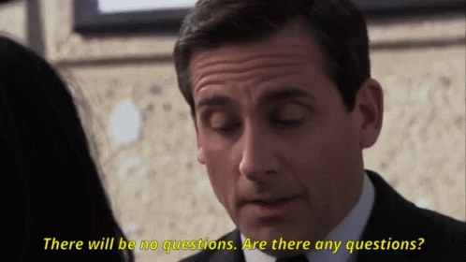
Questions?

