Slide 1

Financial Aid Overview
Special Programs
Presenter: Breanna Scanlon

Slide 2

Cost of Attendance
(COA or Budget)
All students receive a standard budget. This serves as the cap on the amount of aid a student can receive.
COA (Max Amount of funding you are able to get in your current program).
Includes
  Scholarships
  Federal Loans
    Unsubsidized Loans
    Grad PLUS Loan
  Alternative Loans
    Bank Loan
    MSU Preferred Lender List

Slide 3
How will I pay for it?
Scholarships
Out of Pocket
FAFSA
  Automatic $20,500 per year
  Split between Fall/Spring
    $10,250 per semester
    Second summer may require alternative funding
Alternative Funding
  Graduate PLUS loan
  Alternative Loans
FYI
  Loan LIFETIME Limit
  For federal loans only
    $138,500
Which FAFSA to fill out?
  Current year (2019-2020)
  Upcoming year
    Upcoming Year- October 1st 2020

Slide 4
Graduate PLUS Loan
Credit-based graduate loan provided by the Department of Education
  Amount varies but may not exceed the student’s COA/budget
  Interest is fixed every year by DOE
  Origination fee
Apply online at www.StudentAid.gov as well as with MSU Office of Student Financial Aid
  Credit check good for 180 days
  Credit Check cannot be renewed before 180 days is up
Interest Rates for 2019-2020
  Unsubsidised Loans: 6.08% Fixed Rate
  Grad PLUS loans: 7.08% Fixed Rate

Slide 5
Alternative Loans
Private loans from a third-party designed to help students with educational expenses.
  (i.e. Sallie Mae, Discover, Commerce Bank, etc.)
Amount varies depending on budget space available and amount requested.
  Interest rates vary depending on credit history as well as by loan provider.
  Application is online.
FASTChoice online.

Slide 6

Increasing Standard Budget
Under specific circumstances the standard budget can be increased:
  Cost of transportation to/from clinical
  Child care expenses
  One-time cost of laptop for program use
  Additional housing
Budget cannot be increased for things like:
  Credit card bills
  Mortgage payments
  Optional activities not required for program completion

Slide 7
How to Increase Budget
Determine what your costs are and that they qualify as an additional expense not already covered.
Collect all appropriate documentation (i.e. receipts, invoices, reservation confirmation, etc.)
Submit Budget Increase Request Form
  If you have already received Graduate Unsubsidized Loans up-to $20,500 you will need to determine alternative funding source.

Slide 8
Forms
MSU Website- Financial Aid- Forms
Adjustment to Direct Loan
  Adjust loan amount after initial Acceptance/ Declined from FA Offer
Budget Increase Form
  Increase COA for your program
Release of Information
  Allows FA to talk about finances with someone other than the student
Direct Deposit of Aid
  Refund amount direct deposited, or
  Check in mail
Graduate PLUS loan Application
  Apply for the PLUS loan via StudentAid.gov
  Submit MSU paper form

Slide 9
FAQ
Financial Services vs Financial Aid
  FS- Billing, Direct Deposit, Refunds, Payment Plans
  FA- Loans, COA, adjustments
FA processes
  All forms can take up to 2 weeks to process
  Priority Deadlines
  No appointments the first two weeks of semester
  ALL refunds disburse roughly the third week of the undergraduate semester.
    Gap between semesters?

Slide 10
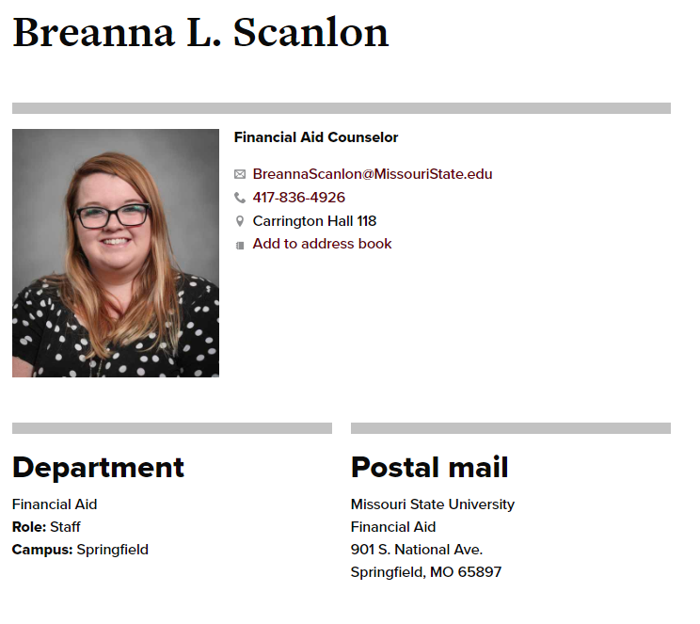
Contact Information
Phone
  417-836-4926
Email
  BreannaScanlon@missouristate.edu
Location
  Carrington Hall 118
Appointments
  https://msubreannascanlon.youcanbook.me/

