Slide 1
Financial Aid Overview
Special Programs

Slide 2

How will I pay for it?
Savings
Payment Plan (3 monthly payments)
Scholarships / Waivers
FAFSA
  Fall / Spring / Summer
  Award Offer: $20,500 per academic year
  Split between Fall / Spring
  Up to $10,250 per semester
  1st year is unique
Alternative Funding
  Federal Graduate PLUS loan
  Alternative (private) Loans
FYI
Federal loans must be equally split
Lifetime limit of $138,500
Which FAFSA to fill out?
Current year (2023 - 2024)
December 2024
  FAFSA opens
MSU Scholarships
November 1st application opens
Higher Interest Rate
Lowest Interest Rate
Payment Plan
Free Money
Savings

Slide 3

Cost of Attendance
(COA or Budget)
All students receive a standard budget. This serves as the cap on the amount of aid a student can receive.
COA (Max Amount of funding you are able to get in your current program).
Includes
  Grants and Scholarship
  Federal Loans
    Unsubsidized Loans
    Grad PLUS Loan
  Alternative Loans
    Bank Loan
    Loan from trusted lender

Slide 4
Estimates: What it might look like
22-23 (Spring/Summer)
**20,500 per FAFSA**
  Spring
    18,983
      18,983 Unsub loan
  Summer
    10,071
      1,517 Unsub loan
      8,554 Max Grad PLUS loan
  Fall/Spring
    37,965
23-24 (Fall/Spring/Summer)
**20,500 per FAFSA**
  Fall/Spring
    37,965
      20,500 Unsub Loan
      17,465 Max Grad PLUS loan
  Summer
    10,071
      10,071 Max amount in Grad PLUS loan

Slide 5

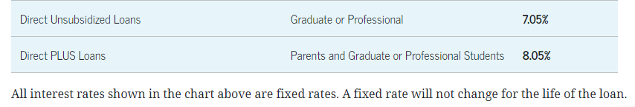
Graduate PLUS Loan
Credit-based graduate loan provided by the Department of Education
  Amount varies but may not exceed the student’s COA/budget
  Interest is fixed every year by DOE
  Origination fee
Apply online at Studentaid.gov as well as with MSU Office of Student Financial Aid
  Credit check good for 180 days
  Credit Check cannot be renewed before 180 days is up

Slide 6
Alternative Loans
Private loans from a third-party designed to help students with educational expenses.
  (i.e. Sallie Mae, Discover, Commerce Bank, etc.)
Amount varies depending on budget space available and amount requested.
  Interest rates vary depending on credit history as well as by loan provider.
  Application is online.
FASTChoice online.

Slide 7
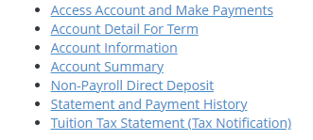
Billing
Direct Costs
  Tuition and Fees
  Bill is considered estimated until second week of UG classes.
  Student Financial Services Office.
    Billing questions
My Missouri State Portal >
Student Tab > My Finances
Notes:
Financial Services: https://www.missouristate.edu/FinancialServices/contact-information.aspx
Tuition and Fees: https://www.missouristate.edu/Registrar/detailed-tuition-and-fees.htm

Slide 8

Increasing Standard Budget
Only do this if the initial COA is not enough
Under specific circumstances the standard budget can be increased:
  Cost of transportation to/from clinical
  Child care expenses
  One-time cost of laptop for program use
  Program expenses not already allocated in standard budget
Budget cannot be increased for things like:
  Credit card bills
  Mortgage payments
  Optional activities not required for program completion
Must meet with Vicki Jacobson before submitting form to make sure you are eligible.
Notes:
Vicki Jacobson
VictoriaJacobson@MissouriState.edu
417-836-3301
Carrington Hall 419D

Slide 9
January:
Semester Begins. Grad PLUS loan forms for Spring. Funds Requested: second Monday of undergraduate classes. Refunds: third Monday of classes.
December:
Term ends. Offices are closed for two weeks for the winter break.
November:
Third Payment: November 10th Registration begins. Last month to request any additional loans for the Fall ONLY.
February:
First Payment is due on February 10th
October:
Second Payment is due: October 10th. New FAFSA comes out for the next academic year.
March:
Second Payment is due on March 10th
September:
First Payment is due on September 10th.
Academic Year
April:
Third Payment due: September 10th. Registration begins. Last month to request any additional loans for the spring semester.
August:
Semester Begins. Grad PLUS loan forms. Funds Requested: second Monday of undergraduate classes. Refunds: third Monday of classes
May:
COA (Summer) comes out. Financial Aid Packages for summer. Grad PLUS loan forms for summer. NEW STUDENTS ONLY: MPN and EC are needed.
July:
Payment due: July 10th. COA for Fall/Spring comes out. Packages for Fall/Spring come out. Forms for Fall/Spring will come out.
June:
Summer aid requested: second Monday of undergraduate classes. Refunds: third Monday. FAFSA for the upcoming year should be completed.
Notes:
January: Spring Semester Begins. Grad PLUS loan forms for the Spring only semester needs to be sent in (if needed). Funds start getting requested the second Monday of undergraduate classes. Refunds begin the third Monday of classes (sometimes the second Friday of classes depending on volume for the Billing office).
February: First Payment is due on February 10th (if bill has not been paid off before then).
March: Second Payment is due on March 10th (if bill has not been paid off before then).
April: Third Payment is due on September 10th (if bill has not been paid off before then). Registration for Fall/Summer classes begin. Last month to request any additional loans for the spring semester (like if you need additional funds to tide you over until summer refunds go out mid-June).
May: Cost of Attendance for Summer comes out. Financial Aid Packages for the summer semester go out. Grad PLUS loan forms for the Summer only semester need be sent in (if needed). Summer only forms will come out. NEW STUDENTS STARTING IN MAY: Master Promissory Note and Entrance Counseling are needed for any federal loans (Unsubsidized loans) to pay out. Summer goes off the FAFSA of the previous academic year.
June: Summer aid first requested the second Monday of undergraduate classes. Refunds begin the following Monday. FAFSA for the upcoming year should be completed.
July: Payment is due for summer on July 10th. Cost of Attendance for Fall/Spring comes out. Packages for Fall/Spring will start to come out. Forms for Fall/Spring will come out.
August: : Fall Semester Begins. Grad PLUS loan forms for the Fall/Spring as well as Fall only semester needs to be sent in (if needed). Funds start getting requested the second Monday of undergraduate classes. Refunds begin the third Monday of classes (sometimes the second Friday of classes depending on volume for the Billing office).
September: First Payment is due on September 10th (if bill has not been paid off before then).
October: Second Payment is due on October 10th (if bill has not been paid off before then). New FAFSA comes out for the next academic year.
November: Third and final payment is due on November 10th (if bill has not been paid off before then). Registration for Spring classes begin. Last month to request any additional loans for the Fall ONLY semester (like if you need additional funds to tide you over until Spring refunds go out mid-January).
December: Term ends. Offices are closed for two weeks for the winter break.

Slide 10
Forms
MSU Website- Financial Aid- Forms
Adjustment to Direct Loan
  Adjust loan amount after initial Acceptance/ Declined from FA Offer
Budget Increase Form
  Increase COA for your program
Release of Information
  Allows FA to talk about finances with someone other than the student
Direct Deposit of Aid
  Refund amount direct deposited
  Check in mail
Graduate PLUS loan Application
  Apply for the PLUS loan
  MUST fill this out along with the application via studentloans.gov
Notes:
Forms can be found: https://www.missouristate.edu/FinancialAid/forms.htm
Special Program Specific Forms can be found: https://www.missouristate.edu/FinancialAid/special-programs.htm

Slide 11
FAQ
Financial Services
  FS- Billing, Direct Deposit, Refunds, Payment Plans
VS Financial Aid
  FA- Loans, COA, Scholarships
Offices Closed during Winter Break
FA processes
  All forms can take up to 1.5 weeks to process
  Priority Deadlines
  No appointments the first two weeks of semester
  ALL refunds disburse roughly the third week of the undergraduate semester.
    Gap between semesters?

Slide 12
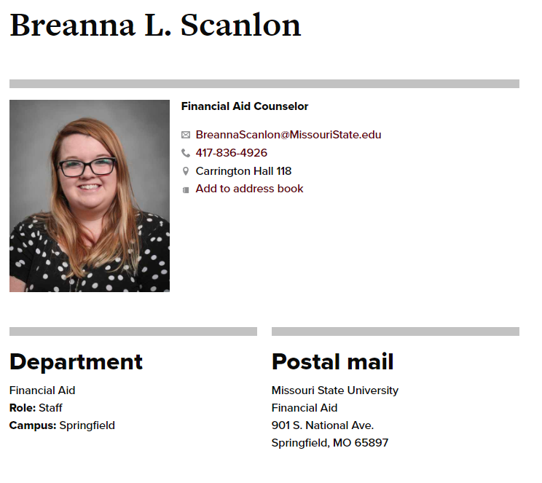
Contact Information
Phone
  417-836-4926
Email
  BreannaScanlon@missouristate.edu
  ALL EMAILS MUST CONTAIN M#
Location
  Carrington Hall 118

Slide 13
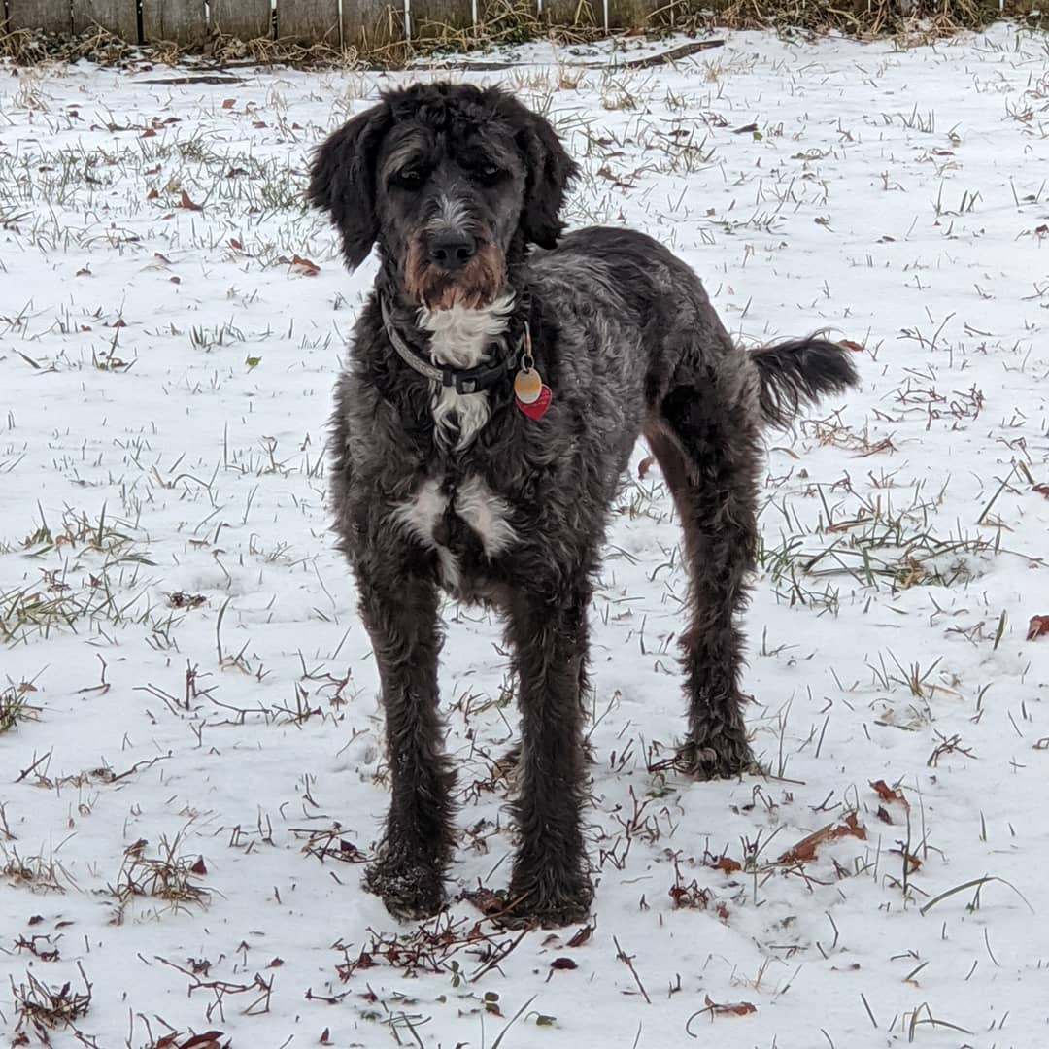
My Role
Help students figure out how to pay for college
Include M# in emails (or have it in the email thread).
Pester me!
  Don’t suffer in silence
Monthly Emails
In person between classes (coming soon).
Zoom and Phone Appointments
Notes:
Book an Appointment with me: https://www.missouristate.edu/FinancialAid/schedule-a-meeting.aspx

