Slide 1
Financial Aid Overview
Special Programs

Slide 2

How will I pay for it?
Savings
Payment Plan (3 monthly payments)
Scholarships / Waivers
FAFSA
  Fall / Spring / Summer
  Award Offer: $20,500 per academic year
  Split between Fall / Spring
  Up to $10,250 per semester
Alternative Funding
  Federal Graduate PLUS loan
  Alternative (private) Loans
FYI
Federal loans must be equally split
Lifetime limit of $138,500
Which FAFSA to fill out?
Current year (2023 - 2024)
2024-2025 Date: TBD
MSU Scholarships (for next academic year)
November 1st application opens
March 1st Application Closes
Savings
Free Money
Payment Plan
Cheapest to most expensive
Lowest Interest Rate
Higher Interest Rate

Slide 3

Cost of Attendance or Budget
Maximum amount in financial assistance (that is considered educational based, including loans) you may receive for the award year / semester.
Dept of Ed only considers the student (not family members or child expenses) in the budget.
Includes:
Scholarships
Waivers
Federal Loans:
  Unsubsidized Loan
  Graduate PLUS Loan
Alternative (private) Loans
*NOTE: Grad PLUS loans and Private loans that are approved for a large amount, still must fit within the COA. We will only disburse the loan up to your COA, despite what you are approved for.

Slide 4
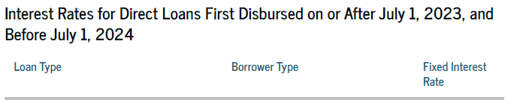
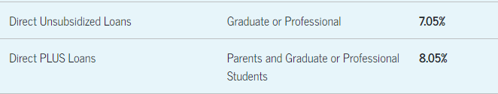
Graduate PLUS Loan
Credit-based graduate loan provided through the U.S. Department of Education
  Cannot exceed the student’s COA/budget, including all other forms of financial assistance
  Interest rate is fixed for the life of the loan
  Origination fee (4.2% withheld by ED)
Apply online at StudentAid.gov + MSU online form
  Credit check valid for 180 days
  Credit Check cannot be renewed before 180 days expires
Calculating MAX amount in Grad PLUS loan
COA for the semester
– Financial Aid (All forms of aid)
= MAX Grad PLUS Loan Allowed

Slide 5
Alternative (private) Loans
Private student loans designed to help students with educational expenses.
  (i.e. bank, credit union, Citizens, Commerce, Discover, Earnest, Sallie Mae, SoFi)
Amount varies depending on budget space available in combination with other financial aid awarded.
  Interest rates vary depending on credit score, fixed and variable interest rates, different repayment options compared with federal loans.
  Application is online.
Private loans funds must also fit within your cost of attendance/budget
MSU will be asked to certify this loan before funds are sent to the school
FASTChoice online.

Slide 6
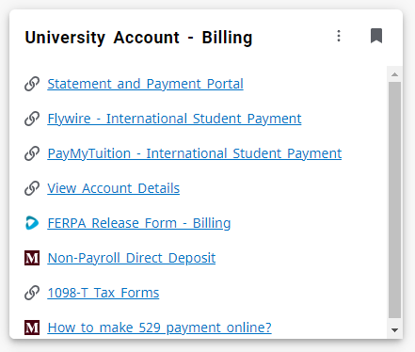
Billing (Financial Services)
Direct Costs
  Tuition and Fees
  Books and supplies
  Account is considered an estimate until second week of UG semester.
  Financial Services Office (a.k.a. billing)
  Bursar (a.k.a. cashier) 8:30 – 3:59 pm))
  Does NOT mail out statements
  Statement vs account balance
  Have their own FERPA
  Non-Payroll Direct Deposit (for refunds)
My.MissouriState.edu
University Account – Billing Card
Notes:
Financial Services: https://www.missouristate.edu/FinancialServices/contact-information.aspx
Tuition and Fees: https://www.missouristate.edu/Registrar/detailed-tuition-and-fees.htm

Slide 7
January:
Semester Begins. Grad PLUS loan forms for Spring. Funds Requested: second Monday of undergraduate classes. Refunds: third Monday of classes.
December:
Term ends. Offices are closed for two weeks for the winter break.
November:
Third Payment: November 10th Registration begins. Last month to request any additional loans for the Fall ONLY.
February:
First Payment is due on February 10th
October:
Second Payment is due: October 10th. New FAFSA comes out for the next academic year.
March:
Second Payment is due on March 10th
September:
First Payment is due on September 10th.
Academic Year
April:
Third Payment due: September 10th. Registration begins. Last month to request any additional loans for the spring semester.
August:
Semester Begins. Grad PLUS loan forms. Funds Requested: second Monday of undergraduate classes. Refunds: third Monday of classes
May:
COA (Summer) comes out. Financial Aid Packages for summer. Grad PLUS loan forms for summer. NEW STUDENTS ONLY: MPN and EC are needed.
July:
Payment due: July 10th. COA for Fall/Spring comes out. Packages for Fall/Spring come out. Forms for Fall/Spring will come out.
June:
Summer aid requested: second Monday of undergraduate classes. Refunds: third Monday. FAFSA for the upcoming year should be completed.
Notes:
January: Spring Semester Begins. Grad PLUS loan forms for the Spring only semester needs to be sent in (if needed). Funds start getting requested the second Monday of undergraduate classes. Refunds begin the third Monday of classes (sometimes the second Friday of classes depending on volume for the Billing office).
February: First Payment is due on February 10th (if bill has not been paid off before then).
March: Second Payment is due on March 10th (if bill has not been paid off before then).
April: Third Payment is due on September 10th (if bill has not been paid off before then). Registration for Fall/Summer classes begin. Last month to request any additional loans for the spring semester (like if you need additional funds to tide you over until summer refunds go out mid-June).
May: Cost of Attendance for Summer comes out. Financial Aid Packages for the summer semester go out. Grad PLUS loan forms for the Summer only semester need be sent in (if needed). Summer only forms will come out. NEW STUDENTS STARTING IN MAY: Master Promissory Note and Entrance Counseling are needed for any federal loans (Unsubsidized loans) to pay out. Summer goes off the FAFSA of the previous academic year.
June: Summer aid first requested the second Monday of undergraduate classes. Refunds begin the following Monday. FAFSA for the upcoming year should be completed.
July: Payment is due for summer on July 10th. Cost of Attendance for Fall/Spring comes out. Packages for Fall/Spring will start to come out. Forms for Fall/Spring will come out.
August: : Fall Semester Begins. Grad PLUS loan forms for the Fall/Spring as well as Fall only semester needs to be sent in (if needed). Funds start getting requested the second Monday of undergraduate classes. Refunds begin the third Monday of classes (sometimes the second Friday of classes depending on volume for the Billing office).
September: First Payment is due on September 10th (if bill has not been paid off before then).
October: Second Payment is due on October 10th (if bill has not been paid off before then). New FAFSA comes out for the next academic year.
November: Third and final payment is due on November 10th (if bill has not been paid off before then). Registration for Spring classes begin. Last month to request any additional loans for the Fall ONLY semester (like if you need additional funds to tide you over until Spring refunds go out mid-January).
December: Term ends. Offices are closed for two weeks for the winter break.

Slide 8
Forms
MSU Website -Financial Aid- Forms
Adjustment to Direct Loan
  Adjust loan amount after initial Acceptance/ Declined from FA Offer
Budget Increase Request
  Increase COA for your program
FERPA Release of Information
  Allows financial aid staff to discuss your financial aid with someone other than the student
Graduate PLUS loan Application
  Apply for the PLUS loan
  MUST fill this out along with the application via StudentAid.gov
Aid Cancellation Form
  Cancel “Send Back” all or partial of a loan you have taken out within that semester.
Notes:
Forms can be found: https://www.missouristate.edu/FinancialAid/forms.htm
Special Program Specific Forms can be found: https://www.missouristate.edu/FinancialAid/special-programs.htm

Slide 9
FAQ
Financial Aid
  FAFSA
  Develops COA (Financial Aid Budget)
  MSU Foundation Scholarships
  Waivers
  Federal and private loans
Financial Services
  Billing
  Payment Plan
  Direct Deposit
  Refunds
Financial Aid process
  Allow up to 2 weeks for processing additional loan request (PLUS, private)
  Deadlines are listed on forms forms
  Schedule an appointment online
    1st week of semester: COSP
    2nd week of semester: aid disburses
    3rd week of semester: refunds
  Gap between semesters

Slide 10
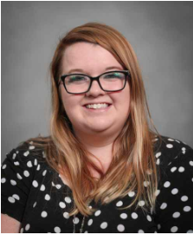
Contact Information
Phone
  417-836-4926
Email
  BreannaScanlon@MissouriState.edu
  Send from MSU email account
  Include student ID
Location
  Carrington Hall 118
Website
  https://www.missouristate.edu/FinancialAid/special-programs.htm

Slide 11

Increasing Standard Budget
Only do this if the initial COA is not enough
Under specific circumstances the standard budget can be increased:
  Cost of transportation to/from clinical
  Child-care expenses while in class/clinicals
  One-time cost of laptop for program use
  Program expenses not already allocated in standard budget
Budget cannot be increased for:
  Credit card bills
  Mortgage payments
  Optional activities not required for program completion
  Additional family expenses
Must meet with Vicki Jacobson before submitting form to make sure you are eligible.
Notes:
Vicki Jacobson
VictoriaJacobson@MissouriState.edu
417-836-3301
Carrington Hall 419D

