Slide 1
Master Advisor Workshop
Financial aid Topics Overview
Rob Moore
2024-05-10

Slide 2
Presentation Agenda
What we’ll attempt to cover
Financial Aid Office Quick Overview
The advisor’s role in the SAP process
Emergency assistance funds
Student scholarships (programs, deadline, renewal criteria, etc.)
Details and FAFSA changes

Slide 3
Office Overivew

Slide 4
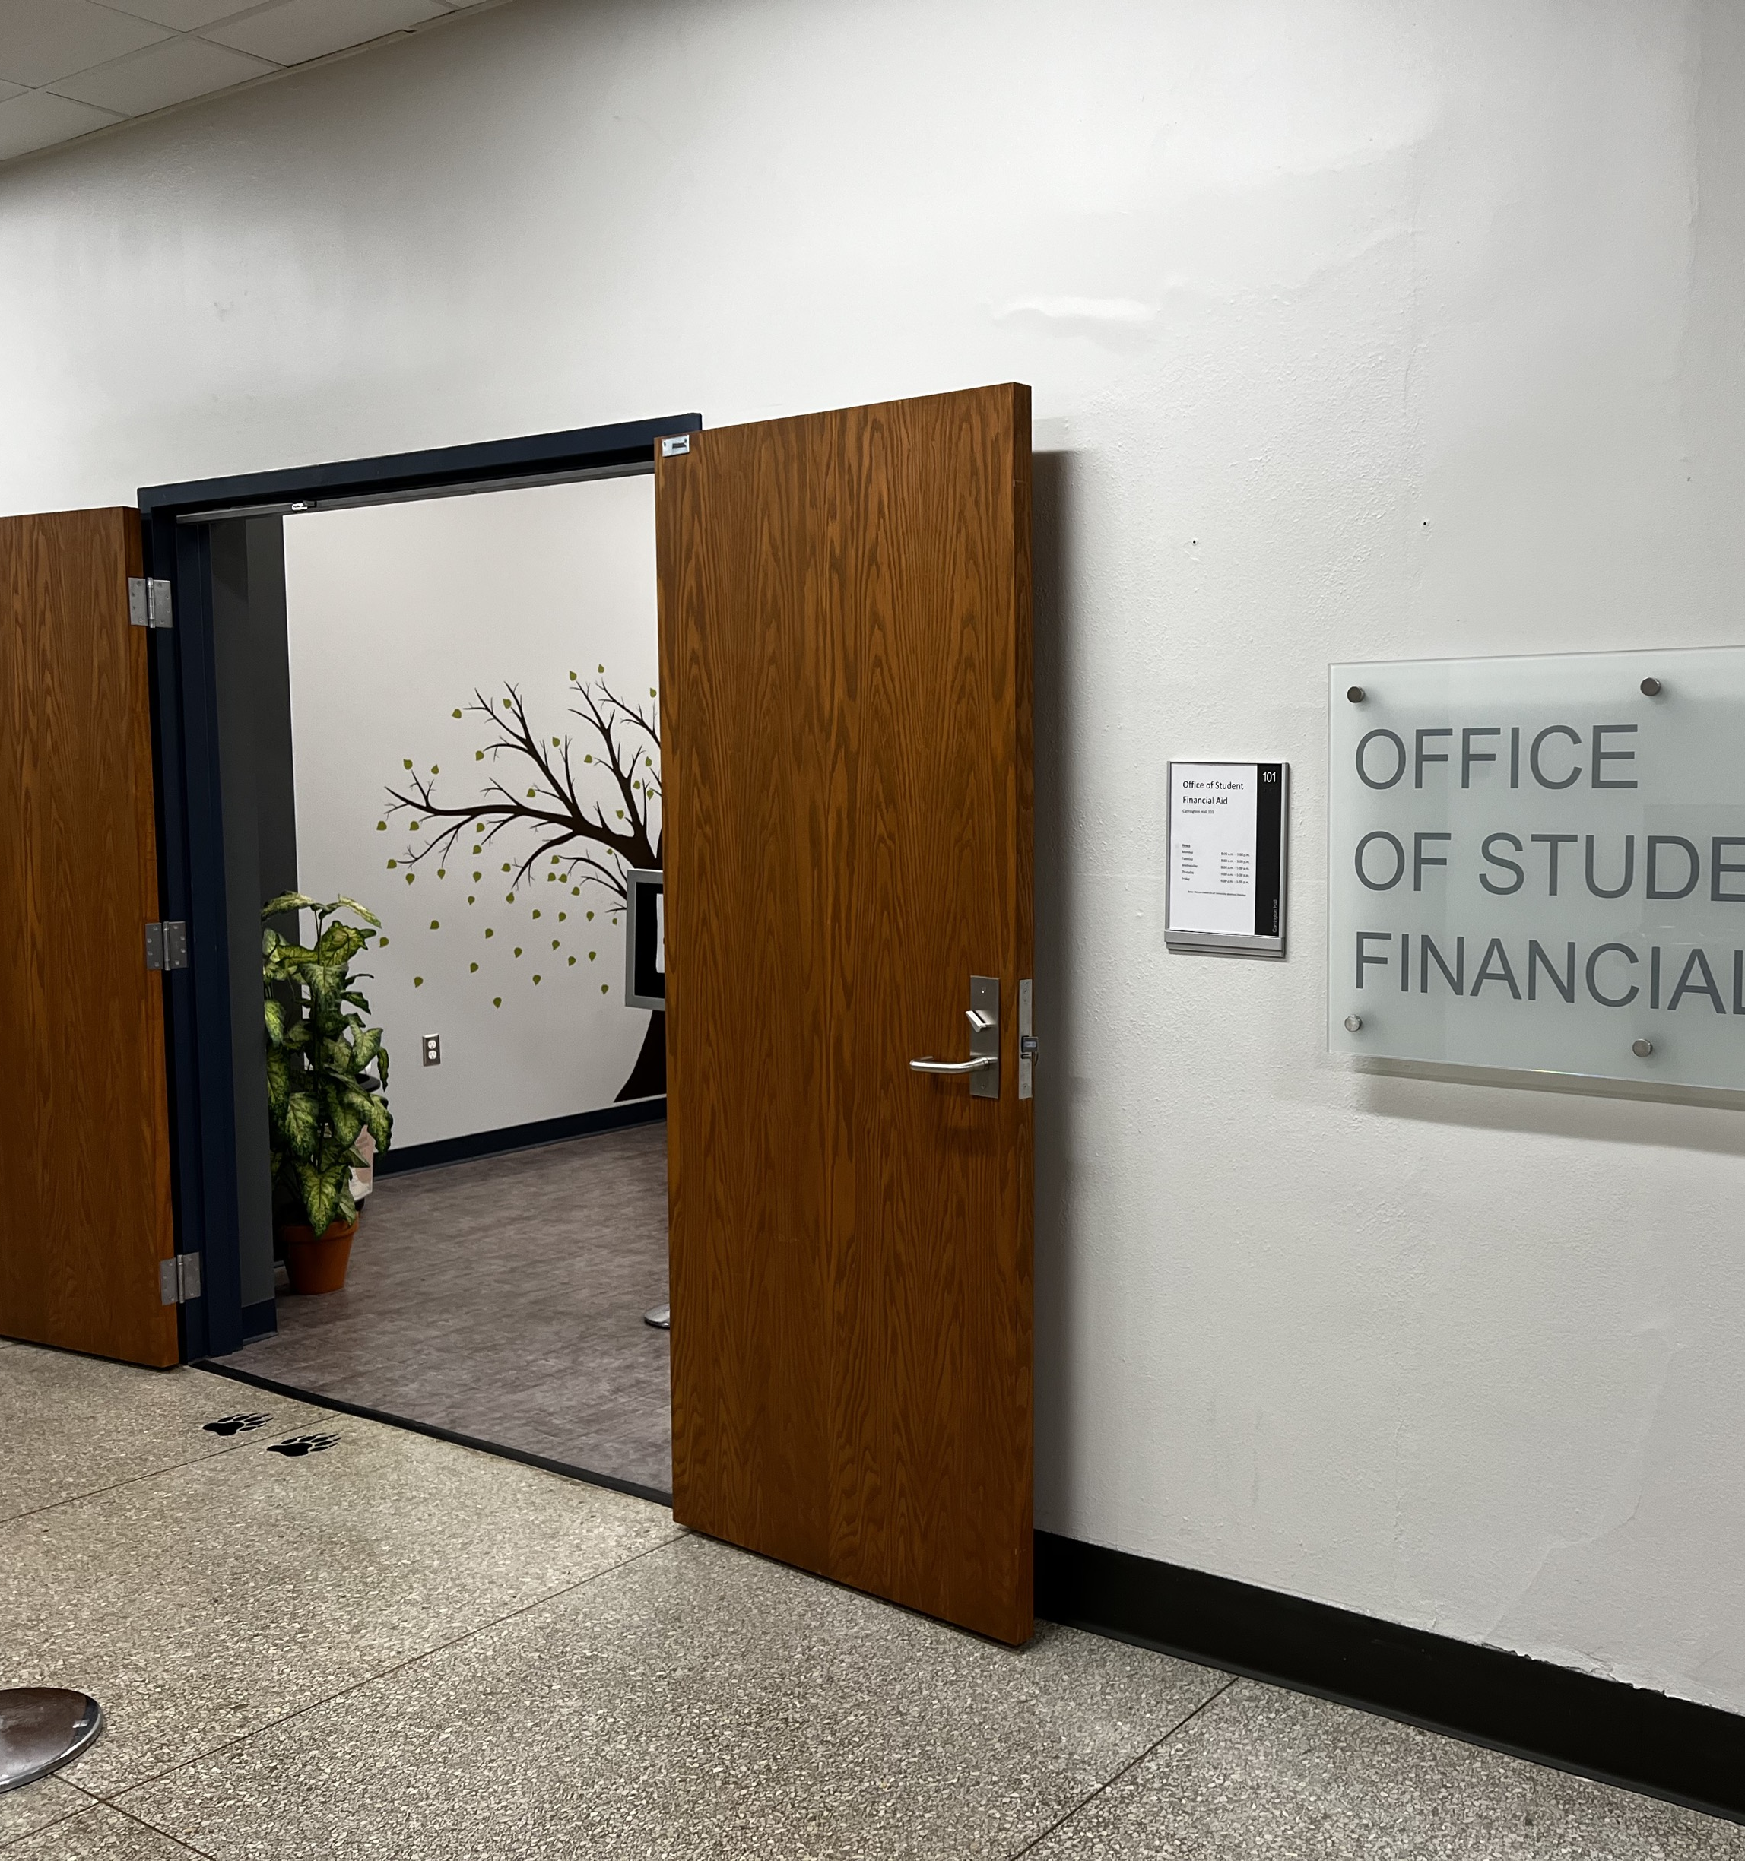
OSFA Overview
Location: Carrington Hall, Room 101
Phone: (417) 836-5262
Email: FinancialAid@MissouriState.edu
Appointments: missouristate.edu/FinancialAid/schedule-a-meeting.htm
Director: Rob Moore (RobMoore@MissouriState.edu)
Associate Director: Kelly Evans (KellyEvans@MissouriState.edu)

Slide 5
Overview Cont.
Areas of Responsibility
Directly Administer
  Title IV Aid
    Student Loans, Federal Pell Grant, Federal Work Study, TEACH, etc.
  State Aid
    Access Missouri Grant, Bright Flight Scholarship, Fast Track Workforce Incentive Grant, etc.
  Institutional Aid
    Scholarships, fee waivers, etc.
  Outside Aid
    Scholarships, Voc-Rehab,
Assist in Administration
  Military benefits
  Contract programs
  Resident Assistantships
  Graduate Assistantships
  Contract payments (tuition reimbursement, WIOA, etc.)
  Foundation scholarships

Slide 6
Satisfactory Academic Progress (SAP)
Federal regulations require Missouri State University to establish a satisfactory academic progress (SAP) policy to ensure all students receiving financial aid are making reasonable progress towards completing their degree.

Slide 7

SAP Policy
What are the standards?
GPA
  Undergraduate students must have an overall GPA of 2.00 after 24 attempted credit hours.
  Graduate students must have an overall GPA of 3.00 after 9 attempted credit hours.
Pace
  Pace is calculated by dividing the cumulative number of credit hours completed by the cumulative number of credit hours attempted.
  In order to graduate within the maximum timeframe allowed, all students must maintain a pace equal to 67% of their cumulative hours attempted.
  Only courses for which the student receives credit count toward completed hours. Courses in which students receive “I” or “Z” grades do not count toward completed hours.
Maximum Timeframe
  Students are no longer eligible to receive financial aid once they have attempted more than 150% of the credits required for the major in which they are currently enrolled.
  For example, if the typical bachelor’s degree requires 120 credit hours, the limit for maximum attempted hours would be 180.

Slide 8
Failure to Meet Standards
Financial Aid Warning Period
A financial aid warning period will be granted for students who do not meet pace or GPA requirements. The financial aid warning period will extend through the end of the semester for which it is granted. If students are not in compliance at the end of their financial aid warning period, financial aid eligibility will be terminated.
A financial aid warning period is not granted to students who do not meet maximum timeframe requirements. Financial aid eligibility for students exceeding 150% of the credits required for the major in which they are currently enrolled will be immediately terminated.

Slide 9
Termination of Aid Eligibility
Students who fail to meet SAP pace or GPA conditions after a warning period or exceed the 150% of allowable credits provisioned under the maximum timeframe provisions will have their financial aid eligibility terminated until such point as they bring themselves back into compliance or are granted an exception to the SAP policy through a Financial Aid Appeal.

Slide 10
Appeal Process
If academic deficiencies are the result of extenuating circumstances, a student may appeal to the Financial Aid Appeal Committee.
Appeals for the current semester must be submitted no later than the tenth week of classes.
Appeals must be accompanied by an academic plan completed by the student and signed by the student’s advisor.
The appeal must include a statement as to why the student did not meet SAP and an explanation of what has changed to allow the student to meet SAP standards at the end of the next evaluation period.
Students who have reached the maximum timeframe due to switching majors, second majors or additional degrees will be evaluated on a case-by-case basis through the appeal process.

Slide 11
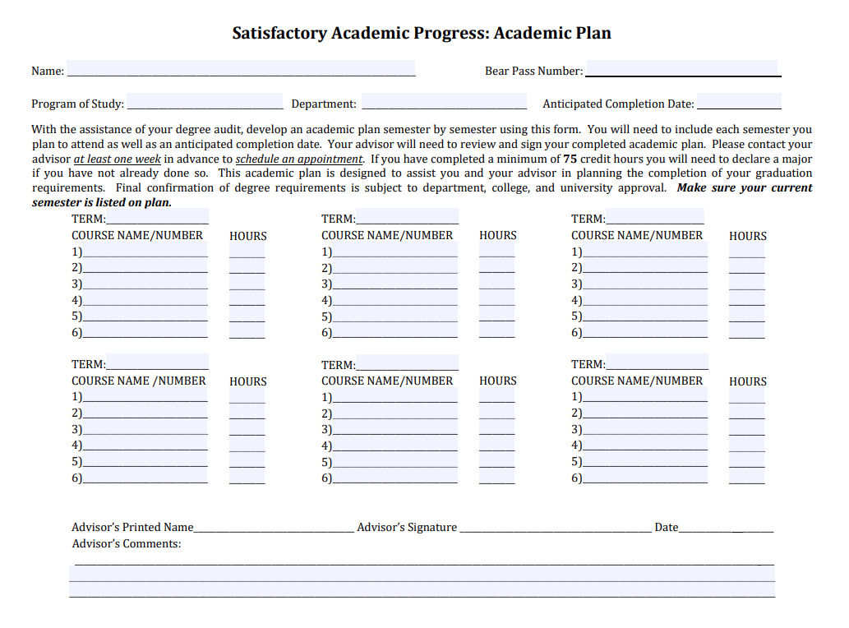

Slide 12
Emergency Assistance Funds

Slide 13




Types of Emergency Funds Available
Senior Degree Completion Grant
Emergency Loan
Emergency Scholarship
Director’s Choice Grant
One-time grant for students within 1 year of graduating and have exhausted fund availability.
Up-to $3,000 for outstanding MSU charges.
UG applicants only.
Short-term loan to assist with unforeseen financial emergencies.
Count against student’s account balance, which can pose issues.
Up-to $250 in most cases.
One-time award to help with unforeseen, life changing crises that result in an inability to pay charges.
Up-to $2,000 without additional approval.
Domestic and Intl students are eligible.
One-time, third-party grant for MO resident UGs.
Up-to $1,500 with approval from office and third-party.
Requires a meeting with a financial aid counselor.

Slide 14
Emergency Assistance Cont.
Applications are typically found online, but some may require an appointment with a counselor in order to submit.
  https://www.missouristate.edu/FinancialAid/emergency-funding.htm
Funds are extremely limited and are first-come, first-serve. We try to reserve some funding for subsequent terms, but that’s not always possible.
If funds aren’t available or appropriate, we may have other ways to assist students (e.g., helping to get registration holds lifted, special circumstance reviews, directing to other campus partners and community resources, etc.).

Slide 15
Emergency Assistance Best Practices
We encourage students to meet with a member of our counseling team. Bookings can be made at missouristate.edu/FinancialAid/schedule-a-meeting.htm.
  Counselors can look for other issues we may be able to mitigate.
Most funds focus first and foremost on outstanding MSU balances. Few are intended for off-campus expenses.
Documentation is typically required to verify situation as described by the student. Confidentiality is observed.
We are not always able to meet the students’ expectation in terms of awards or amounts provided.

Slide 16
Institutional Scholarships

Slide 17
Scholarship Renewal
To renew institutional scholarship, students must meet established academic progress standards. Typically, these include:
  Earning at least 27 MSU credit hours per year (transfer credits do not count)
  Completing MSU courses with a minimum GPA (typically a 3.25 but varies)
Summer counts as the end of the academic year so those courses are included in scholarship renewal considerations.

Slide 18
Failure to Meet Renewal Requirements
Students who fail to meet scholarship renewal criteria will not receive the scholarship for the following academic year (and will lose one year of scholarship eligibility) but may regain the scholarship for the second following year by completing the required annual MSU credits during that year and having the required cumulative MSU GPA (including all MSU courses) at the end of that year.
  This is not an automatic process; instead, students must complete and submit the Request to Reinstate Scholarship form and return it to the Office of Student Financial Aid no later than the first day of classes for the academic year for which they are requesting reinstatement.

Slide 19
Scholarship Non-Renewal Appeals
If a student does not meet the renewal criteria due to some extenuating circumstance or medical emergency, students may appeal to the Scholarship Appeal Committee with a letter explaining the situation, along with supporting documentation. Appeals are granted only in extreme circumstances beyond the student's control.
  If a student experiences other challenges throughout the year, such as difficulty with classes, time management, work or family responsibilities, or other co-curricular commitments, be aware that these are not considered extenuating circumstances.

Slide 20
Potpourri
If we have time

