Slide 1

Financial Aid for Proactive Advisors

Slide 2
Presentation goal:
To orient you as academic advisors within the world of Student Financial Assistance programs, policies, and practices. Provide detailed information and develop a more nuanced understanding of financial aid concepts, jargon, and student challenges

Slide 3
Financial Aid Life-Cycle
Complete the FAFSA every year (October 1)
FAFSA determines aid eligibility
Scholarship eligibility calculated
Students notified of award package
Aid disbursed the second week of classes
Refunds paid around the third week of classes

Slide 4
Financial Need
Financial need in a financial aid context is not the same as financial need as traditionally understood
  Does not require SNAP, TANF, WIC, Free and Reduced Lunch, etc.
  FNA Financial Need is purely a numbers game
Financial Need = Cost of Attendance – Expected Family Contribution

Slide 5
Cost of Attendance
The Cost of Attendance (COA) is the cornerstone of establishing a student’s financial need, as it sets a limit on the total aid that a student may receive
Allowable Costs include:
  Tuition and fees
  Books, supplies, transportation, personal miscellaneous.
  Room and board
  Dependent Care
  Study-abroad expenses
  Disability expenses
  Employment expenses for co-op study
  Loan fees

Slide 6
Cost of Attendance
For 2022-2023, our various COA budgets include:
Student Category | Tuition & Fees | Housing & Meals | Books & Supplies | Transportation | Personal Expenses | Loan Fees | Total
UG, Resident, On-Campus | $8,604 | $10,010 | $1,200 | $1,424 | $3,012 | $64 | $24,314
UG, Resident, Off-Campus | $8,604 | $8,768 | $1,200 | $3,240 | $3,012 | $64 | $24,888
UG, Resident, with Relative | $8,604 | $4,208 | $1,200 | $3,240 | $3,012 | $64 | $20,328
UG, Non-Resident, On-Campus | $17,144 | $10,010 | $1,200 | $1,424 | $3,012 | $64 | $32,854
UG, Non-Resident, Off-Campus | $17,144 | $8,768 | $1,200 | $3,240 | $3,012 | $64 | $33,428
GR, Resident, On-Campus | $7,122 | $10,010 | $800 | $1,424 | $3,012 | $156 | $22,524
GR, Resident, Off-Campus | $7,122 | $8,768 | $800 | $3,240 | $3,012 | $156 | $23,098
GR, Non-Resident, On-Campus | $13,098 | $10,010 | $800 | $1,424 | $3,012 | $156 | $28,500
GR, Non-Resident, Off-Campus | $13,098 | $8,768 | $800 | $3,240 | $3,012 | $156 | $29,074

Slide 7
Expected Family Contribution (EFC)
Expected Family Contribution (EFC) is an index number that colleges use to determine how much financial aid you're eligible to receive
EFC is calculated according to a formula established by law and the information from your Free Application for Federal Student Aid (FAFSA)
EFC is not necessarily how much a student/family can expect to pay for school
  It serves as an indicator of the family’s financial strength and ability to pay in comparison to other FSA applicants

Slide 8
Important Financial Aid Dates
October 1: The FAFSA opens for the next academic year
  E.g.: On October 1, 2022 the FAFSA for the 2023-2024 Academic Year is available for completion
November 1 – March 1: The MSU Annual Scholarship Application is available for completion
February 1: Missouri & MSU priority FAFSA submission deadline

Slide 9
Major Take-Away:
Most students at MSU have some degree of financial need. This means they should ALWAYS apply for need-based aid regardless if they think they’ll get it.

Slide 10
Student Issue: Verification
The U.S. Department of Education (ED) requires financial aid offices to conduct various reviews of student information provided (or not provided) on the Free Application for Federal Student Aid (FAFSA)
The most common review is known as Verification which entails a detailed review of family and income data reported on the FAFSA
  Verifications can be classified based on the degree of review required: V1 (Standard), V4 (Identity & Educational Purpose), V5 (The Works)
Students cannot receive any Title IV funds until verification has been completed
WAIVED

Slide 11





Special Circumstance Review
If a student or their family experienced a change in finances, they can apply for a process called Special Circumstance Review.
Submitting a Special Circumstance application does not guarantee any change of your financial aid award.
Common circumstances include:
  Change in household income
  Loss or change in employment
  Receiving public assistance
  Divorce or separation of parents
  Parent deceased
  Medical expenses
  Parent’s post-secondary expenses

Slide 12
Satisfactory Academic Progress
Situation: Student is not meeting SAP and thus cannot receive aid
Three components to the SAP policy
  GPA
  Pace
  Max Hours
Solution: Submit a SAP appeal if the student has a documented extenuating circumstance. Fall deadline is October 29, 2021.
SAP appeals go to Mari (FinancialAidAppeals@missouristate.edu)

Slide 13
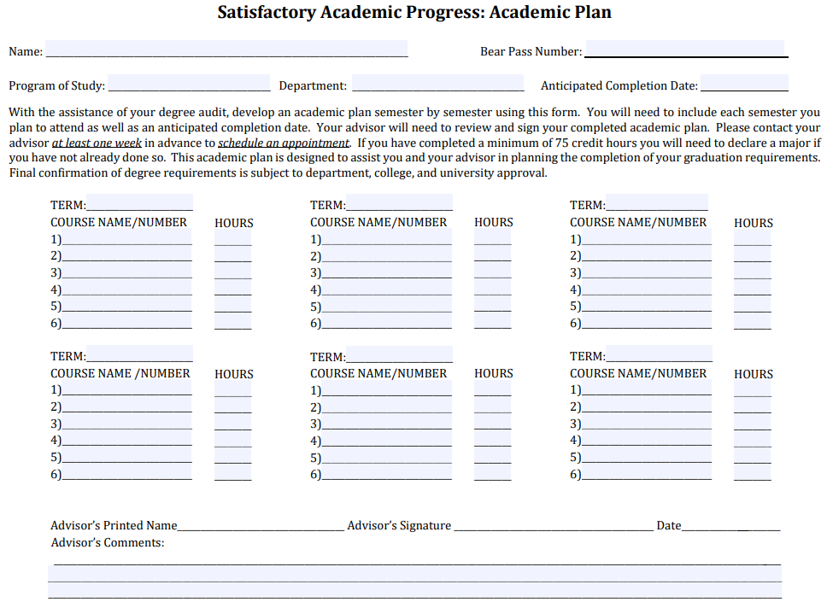
Satisfactory Academic Progress (SAP)
Students not meeting SAP minimums are notified and are placed on a “warning period”, during which time they have 1 semester to bring themselves back within compliance
  If a student is still not incompliance after the warning period, financial aid is terminated.
Regaining Aid Eligibility:
  Self-pay until back within minimum standards
  SAP Appeal due to extenuating circumstances
    Academic Plan required for all appeals

Slide 14
Scholarship Appeal
Situation: Student did not renew scholarship due to extenuating Circ.
Scholarship Appeal Form
  Extenuating circumstances include but are not limited to illness or injury, death of a family member, and work-related problems.
  Inability to perform academically is not an extenuating circumstance.
  Must be documented.
Appeal link available on the scholarship page and submitted via Dynamic Forms.

Slide 15
Not Attending Immediately
Situation: Student will not attend immediately and is receiving a scholarship
Some students may wish to place their institutional scholarship on hold in order to participate in internships, for life-enriching experiences, or due to extenuating circumstances beyond their ability to control.
To request a hold be placed on their institutional scholarships students should complete the scholarship hold request form.
Available as a link on the scholarship page.

Slide 16
Completion Grants
Situation: Student has exhausted funds
Senior Degree Completion Grant – Up to $3,000
  One-time award; 2.00 GPA; meeting SAP; submitted FAFSA; used all aid; UG only; within 1 year of graduation.
Degree Completion Assistance Fund – Up to $1,500
  One-time award; 2.00 GPA; meeting SAP; submitted FAFSA; used all aid; UG and GR.
Applications go to Office of Student Financial Aid in Carrington Hall, Room 101

Slide 17
Financial Emergencies
Situation: Student is facing an urgent financial emergency
Director’s Choice Grant – Up to $1,500
  Must be full-time and meeting SAP; must be Missouri resident; must meet with a staff member who will write a letter of support; approved by Director.
Emergency Scholarship – Up to $2,000
  One-time award; 2.50 GPA and meeting SAP; full-time; FAFSA if possible; used other funds; documented unplanned and life-altering situation.
Applications go to Office of Student Financial Aid in Carrington Hall, Room 101

Slide 18
Insufficient Funds – Gap Fillers
Situation: Student is not facing emergency, but funds are insufficient
Parent PLUS Loan
Credit-Based Educational Loans
  Missouri Family Education Loan Program - $5,000 per year
Applications made online and Loan Team contacted as appropriate

Slide 19
Other Initiatives of Interest
Finish Line Degree Completion Grant
  Partnering with MSLF to re-enroll students who have left MSU and owe an unpaid balance. MSLF pays up-to $3,000 in back balance.
Fast Track Workforce Incentive Grant
  The Fast Track Workforce Incentive Grant is a financial aid program that addresses workforce needs by encouraging adults to pursue a certificate, degree, or industry-recognized credential in an area designated as high need.
Online, Dynamic Form Submission
Online Appointment Scheduling – MissouriState.edu/FinAidMeeting

Slide 20
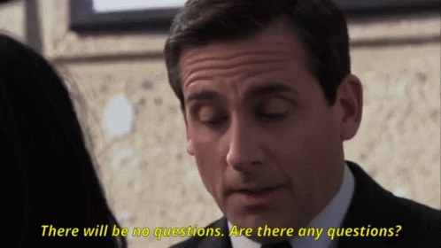
Questions?

