Slide 1
Graduate Student Financial Aid: Special Programs
Breanna Scanlon
Financial Aid Counselor

Slide 2
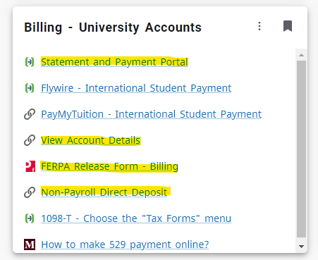
Your Bill- What am I being charged?
Make payment and see overall total
View statement with more in-depth charges listed
FERPA for billing office ONLY
How you set up your direct deposit for your refund
Notes:
The Billing Office (also known at MSU as Financial Services or Accounts Receivable) handles all charges on your MSU account. They also take care and issue any refunds you may need during your program.

Slide 3
MY PAYMENT PLAN
Charges incurred for and during…
Fall semester may be paid in three monthly installments.
September 10th
October 10th
November 10th
Spring semester may be paid in three monthly installments
February 10th
March 10th
April 10th
Summer Semester is paid with one payment deadline
July 10th
All students are automatically enrolled in the payment plan
This does not mean you have to utilize it, but it gives you the ability to if you choose to.
Statement Balance (Full Semester) / # of Payments Remaining = Monthly Minimum Payment
Finance Charges are incurred monthly on any unpaid statement balance even when using the payment plan.
If all charges for the semester are not paid by the statement due date, a Finance Charge will be applied at a monthly periodic rate of 1% to the remaining balance.
All accounts must be paid in full by the end of that semester's plan
Past due amounts will prevent a student from registering for the next semester
Notes:
The Payment Plan goes into effect if you still have a balance on your account during the third week of classes, after your financial aid has paid.

Slide 4
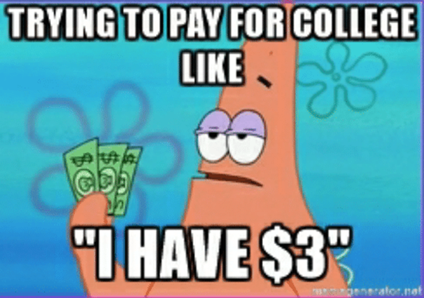
How to Make Payments
In Person at the Bursar’s Office
  Cash or Check
Over the WEB
  E-Check (Free)
  529 Plan Payments
  Credit Card/Debit Card (2.75% Service Fee)
    Visa, Master Card, Discover, American Express
Through Mail Missouri State University
    Include Student Name Attn: Bursar
    Include Student M# 901 S National Ave
    MOST or 529 Plans Springfield MO 65897

Slide 5
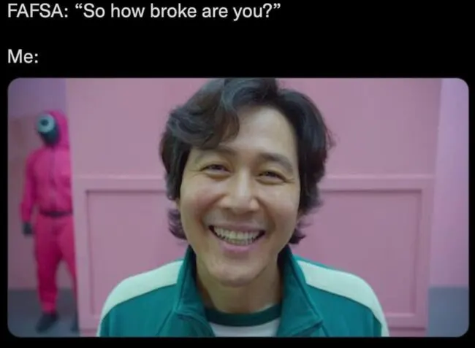
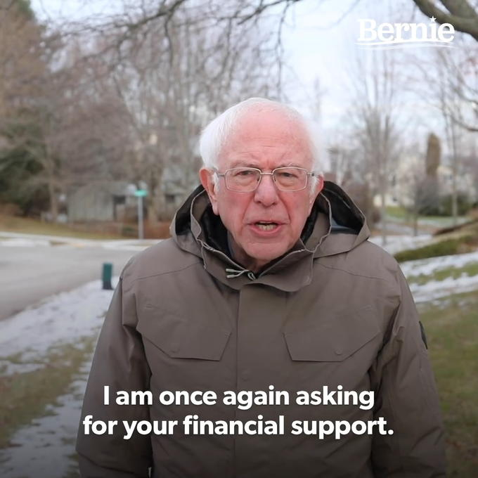
Financial Aid
Scholarships/ Out of State Waivers
  Office of the Registrar handles all residency requirements
  Questions with Scholarships: FAScholarships@missouristate.edu
Out of Pocket
FAFSA
  Automatic $20,500 per year
  Split between Fall/Spring
    $10,250 per semester
    FA/SP/SU
      Whatever you don’t use in FA/SP will be reoffered in the summer up to your COA
      If starting in summer, all 20,500 remaining eligibility from that FAFSA year will be offered fully in the summer.
    Fixed Interest Rate: 7.05% (until June 30th 2024)
      July 1st 2024 – June 30th 2025 Interest Rate: 8.08% Fixed
Alternative Funding
  Graduate PLUS loan: Fixed Interest Rate 8.05% (until June 30th 2024)
    July 1st 2024 – June 30th 2025 Interest Rate: 9.08% Fixed
  Alternative Loans: Interest Rates Vary
    FASTChoice online: Preferred Lender List

Slide 6
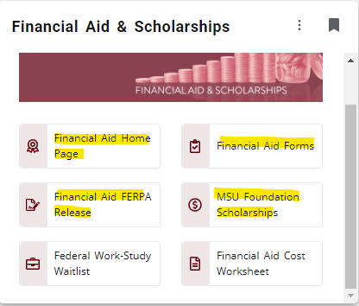
Financial Aid
Where you can see all of YOUR financial aid information
Any Forms you may need to fill out
FERPA for FA ONLY
Foundation Application open November 1st to March 1st for the following academic year

Slide 7
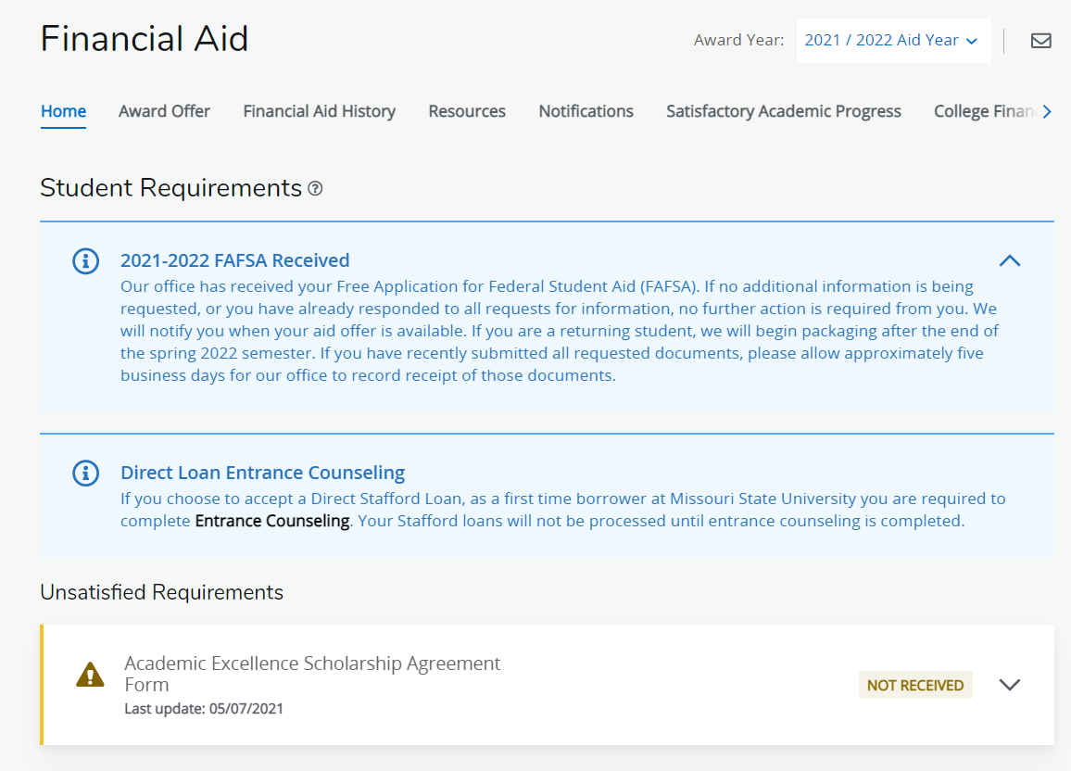

Slide 8
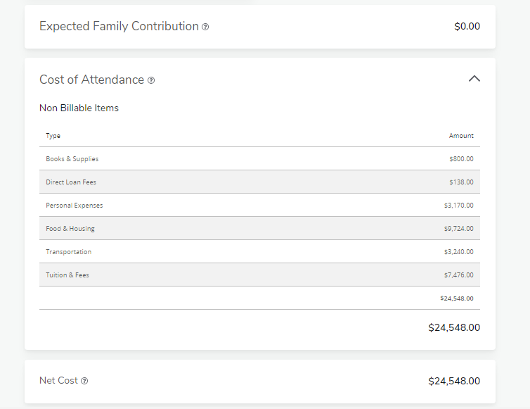

Slide 9
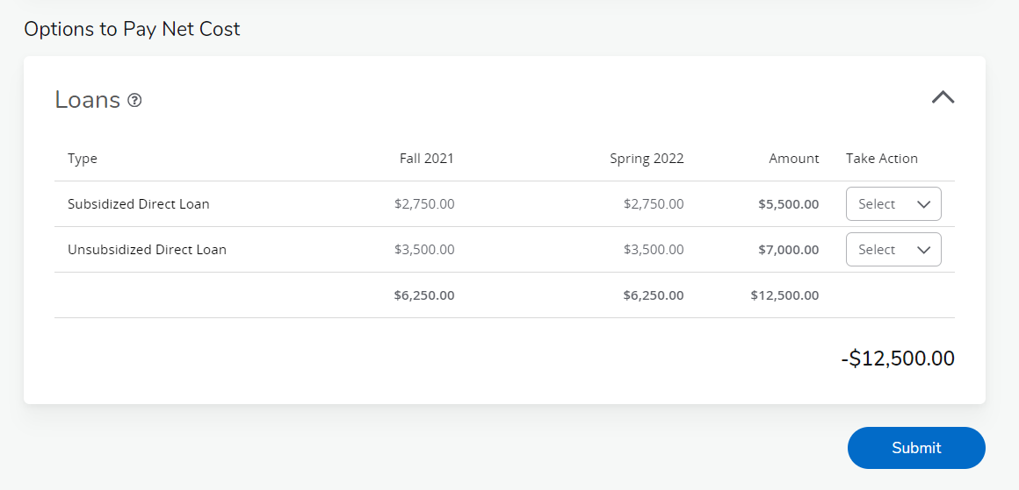
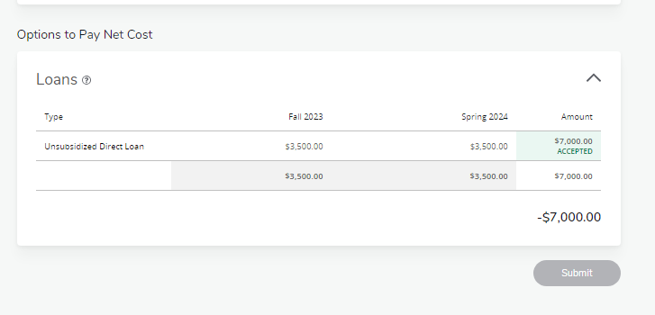
*Graduate Students are not eligible for Subsidized Direct Loans. Example from UG student
*

Slide 10
Forms
Adjustment to Direct Loan
  Adjust loan amount after initial Acceptance/ Modify Down from FA Offer
Budget Increase Form
  Increase COA for your program
Graduate PLUS loan Application
  Apply for the PLUS loan
  MUST fill this out along with the application via studentloans.gov
  Complete PLUS Counseling
Aid Reduction and Cancellation
  Cancel/reduce existing loans (for the current semester)

Slide 11
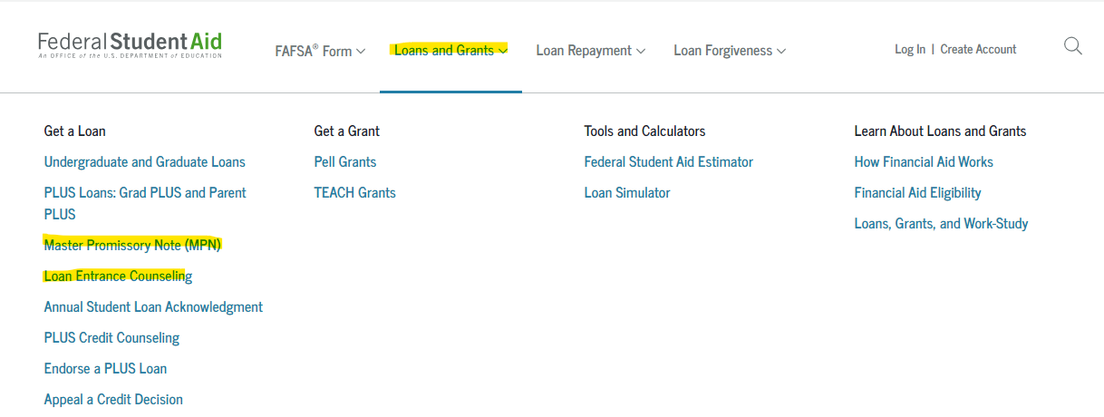
I accepted my loans, now what?
Studentaid.gov
Notes:
Students who are first time borrowers (or/and are taking out their first loan for their program) will have to go to studentaid.gov and complete the Master Promissory Note and Loan Entrance Counseling. This just has to be done ONCE during your program BEFORE your FIRST DISBURSEMENT OF LOANS here at MSU. They both take around 30-45 minutes to complete (each).

Slide 12
Timing is EVERYTHING
University Scholarships, Fee waivers and Stafford Loans will apply to students’ accounts after the first week of school (for Undergraduates)
Scholarships from private sources pay to student accounts when funds are received by Missouri State (but no sooner than the second week of school)
Refunds start paying out the third week of the undergraduate classes.
We pay out financial aid as soon as possible, making it to where if you have enough FA to cover your bill (and even get a refund) you don’t have to worry about the payment plan.
We can pay out aid until the second to last week of Undergraduate Classes
Gap between semesters:
  May-June
  End of July to September
  Winter Break

Slide 13
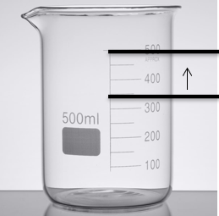
Increasing Standard Budget
Only do this if the initial COA is not enough
Under specific circumstances the standard budget can be increased:
  Cost of transportation to/from clinical
  Childcare expenses
  One-time cost of laptop for program use
  Program expenses not already allocated in standard budget
Budget cannot be increased for things like:
  Credit card bills
  Mortgage payments
  Optional activities not required for program completion
Encouraged to meet with Vicki Jacobson before submitting form to make sure you are eligible.

Slide 14
January:
Semester Begins. Grad PLUS loan forms for Spring. Funds Requested: second Monday of undergraduate classes. Refunds: third Monday of classes.
December:
Term ends. Offices are closed for two weeks for the winter break.
November:
Third Payment: November 10th Registration begins. Last month to request any additional loans for the Fall ONLY.
February:
First Payment is due on February 10th
October:
Second Payment is due: October 10th. New FAFSA comes out for the next academic year.
March:
Second Payment is due on March 10th
September:
First Payment is due on September 10th.
Academic Year
April:
Third Payment due: September 10th. Registration begins. Last month to request any additional loans for the spring semester.
August:
Semester Begins. Grad PLUS loan forms. Funds Requested: second Monday of undergraduate classes. Refunds: third Monday of classes
May:
COA (Summer) comes out. Financial Aid Packages for summer. Grad PLUS loan forms for summer. NEW STUDENTS ONLY: MPN and EC are needed.
July:
Payment due: July 10th. COA for Fall/Spring comes out. Packages for Fall/Spring come out. Forms for Fall/Spring will come out.
June:
Summer aid requested: second Monday of undergraduate classes. Refunds: third Monday. FAFSA for the upcoming year should be completed.
Notes:
As you are preparing to start your program, take some time to read through our suggested timeframe of applying for aid, registering for classes and making on time payments.
Months listed in green allow for advanced planning and the year gets busier for months in blue. Red indicates peak processing for the financial aid office.
January: Spring Semester Begins. Grad PLUS loan forms for the Spring only semester needs to be sent in (if needed). Funds start getting requested the second Monday of undergraduate classes. Refunds begin the third Monday of classes (sometimes the second Friday of classes depending on volume for the Billing office).
February: First Payment is due on February 10th (if bill has not been paid off before then).
March: Second Payment is due on March 10th (if bill has not been paid off before then).
April: Third Payment is due on September 10th (if bill has not been paid off before then). Registration for Fall/Summer classes begin. Last month to request any additional loans for the spring semester (like if you need additional funds to tide you over until summer refunds go out mid-June).
May: Cost of Attendance for Summer comes out. Financial Aid Packages for the summer semester go out. Grad PLUS loan forms for the Summer only semester need be sent in (if needed). Summer only forms will come out. NEW STUDENTS STARTING IN MAY: Master Promissory Note and Entrance Counseling are needed for any federal loans (Unsubsidized loans) to pay out. Summer goes off the FAFSA of the previous academic year.
June: Summer aid first requested the second Monday of undergraduate classes. Refunds begin the following Monday. FAFSA for the upcoming year should be completed.
July: Payment is due for summer on July 10th. Cost of Attendance for Fall/Spring comes out. Packages for Fall/Spring will start to come out. Forms for Fall/Spring will come out.
August: : Fall Semester Begins. Grad PLUS loan forms for the Fall/Spring as well as Fall only semester needs to be sent in (if needed). Funds start getting requested the second Monday of undergraduate classes. Refunds begin the third Monday of classes (sometimes the second Friday of classes depending on volume for the Billing office).
September: First Payment is due on September 10th (if bill has not been paid off before then).
October: Second Payment is due on October 10th (if bill has not been paid off before then). New FAFSA comes out for the next academic year.
November: Third and final payment is due on November 10th (if bill has not been paid off before then). Registration for Spring classes begin. Last month to request any additional loans for the Fall ONLY semester (like if you need additional funds to tide you over until Spring refunds go out mid-January).
December: Term ends. Offices are closed for two weeks for the winter break.

Slide 15
FAQ
24/25 FAFSA
  Fall 2024-Summer 2025
Allow up to 2 weeks for processing additional loan request (PLUS, private)
Deadlines are listed on forms
Office of the Registrar
  Residency Status Reclassification
Questions with Scholarships
  FAScholarships@missouristate.edu
Billing Questions: Financial Services

Slide 16
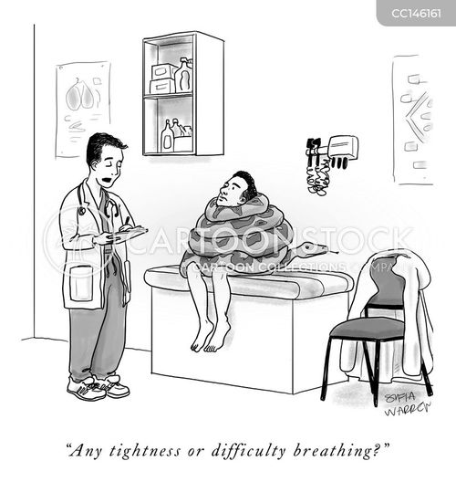
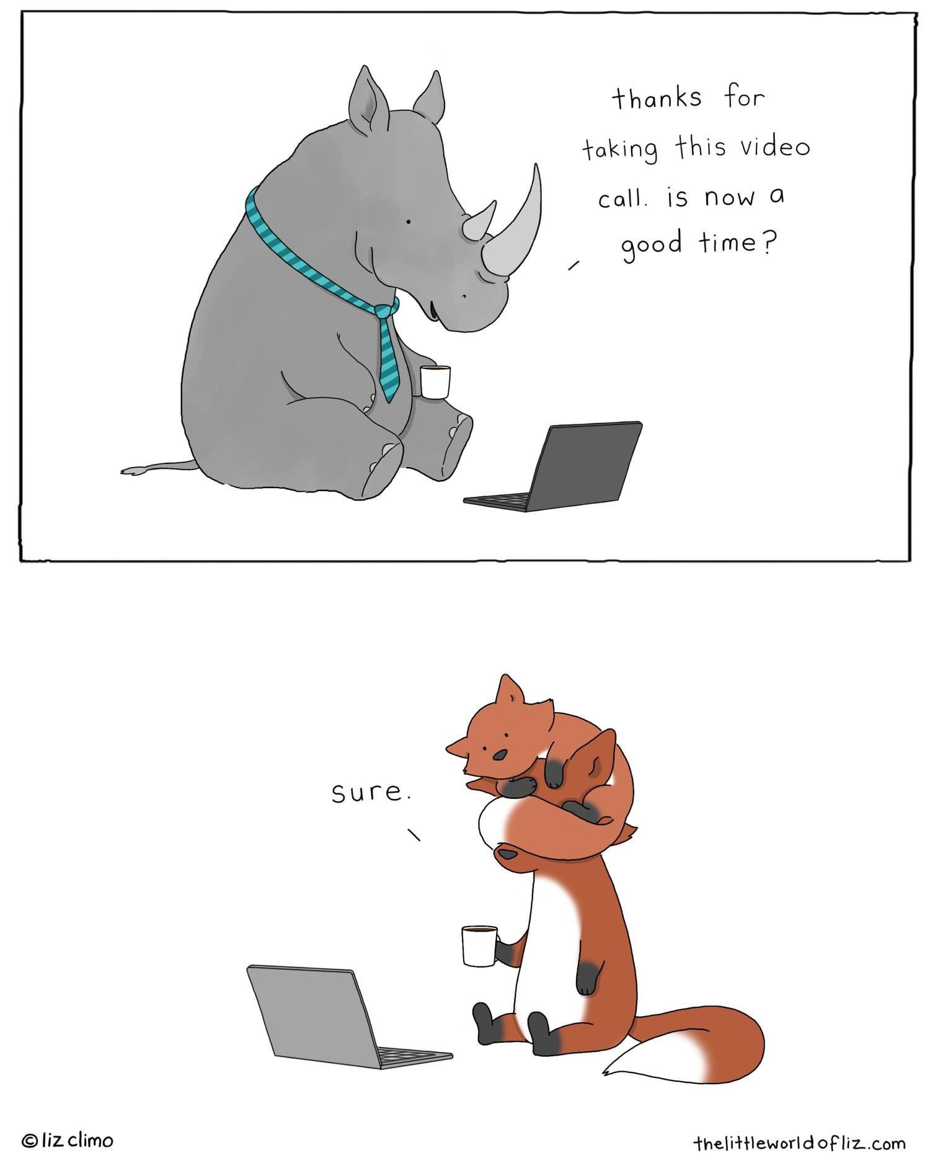
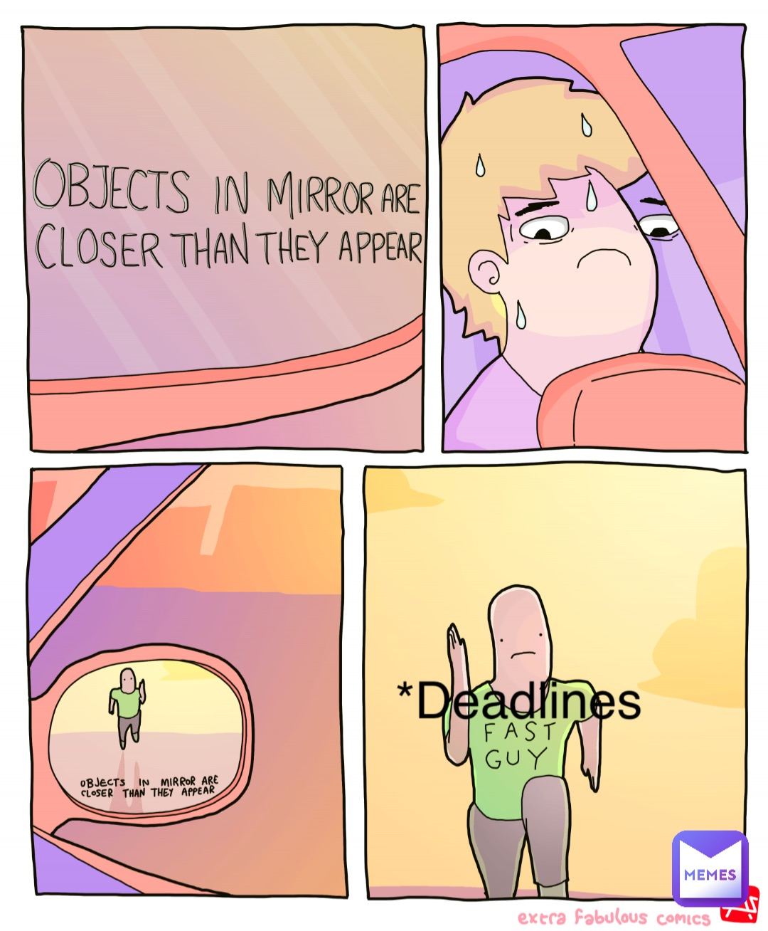
Last thing….
Email me, email me twice!
Transparency/ Email Updates and Deadlines
There is no such thing as stupid questions….
Notes:
College students cannot afford to not understand their financial aid. Don’t feel like any questions that you have are stupid. If you must ask it more than twice, then I am not doing a good job at explaining it. Keep asking questions until you feel comfortable with the answer. It doesn’t bother me one bit. No one should feel stupid for asking questions, Especially in the medical field.
Pester me! I am here to help you navigate your financial aid. If you reach out to me and you cant get ahold of me, contact me again! Its not personal! The best (and fastest) way to get ahold of me is via email.
I am a great resource for you during your time in the program. I try to be as transparent about all information and deadlines that may be coming up. I try and send out semesterly emails regarding important information.

Slide 17
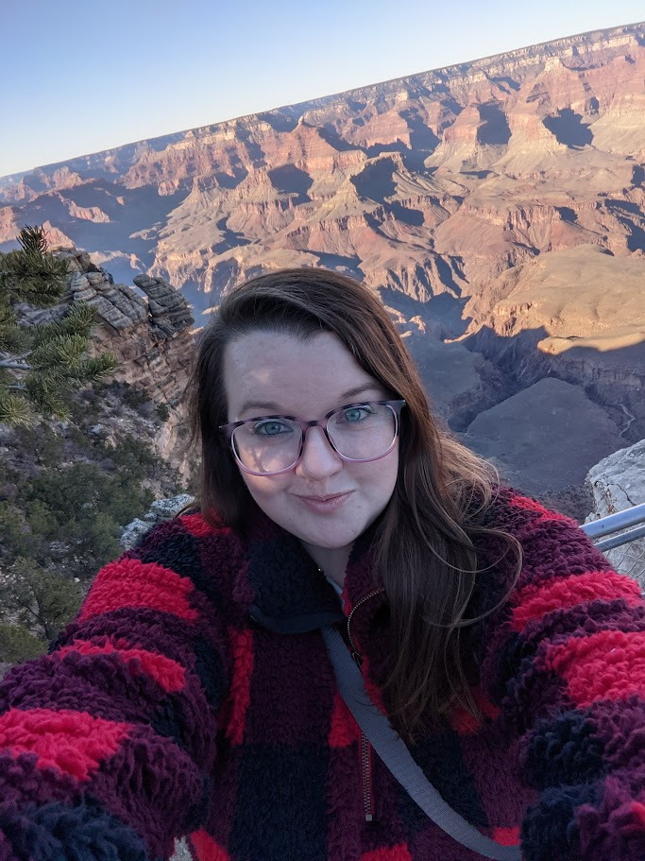
Contact Information
Phone
  417-836-4926
Email
  BreannaScanlon@Missouristate.edu
  Send from MSU email account
  Include student ID
    Its okay to pester me ☺
Location
  Carrington Hall 101
Website
  https://www.missouristate.edu/FinancialAid/special-programs.htm
You can Book Me
  https://msubreannascanlon.youcanbook.me/

