Slide 1
ModernThink
Missouri State Springfield Results 2026
2026 ModernThink “Great Colleges to Work For”
Faculty Senate

Slide 2
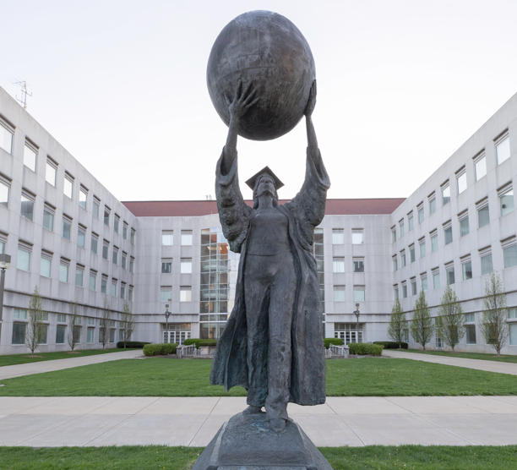
Agenda
01 | Survey Recap
02 | University Results
03 | Faculty Results
04 | Q&A

Slide 3
Missouri State University
Overall and benchmark results 2026

Slide 4
Survey Overview
55
Survey statements on a 5-point agreement scale
5
Survey Timeline
March 2, 2026 – April 3, 2026
Faculty Experience Statements on a five-point agreement scale.
20
Benefit satisfaction questions on a 5-point satisfaction scale
Response Rates
MSU-Springfield: 38% (734/1957)
2
Open-ended Questions
Benchmarks
2026 MSU – Research College and Universities
8
Demographic Questions

Slide 5
Core Dimensions
Job Satisfaction & Support
Professional Development
Faculty & Staff Well-being
Performance Management
Supervisor/ Department Chair Effectiveness
Communication
Collaboration
Inclusion, Belonging & Community
Mission & Pride
Confidence in Senior Leadership

Slide 6
Dimensions

Slide 7
Dimensions

Slide 8






Q1
What do you appreciate most about working at this institution?
Six dominant themes emerged from faculty, administrator, and staff responses (n = 585 comments)
n = 194
n = 174
n = 139
Students, Mission & Community
Benefits, PTO & Job Stability
Colleagues & Family-Like Culture
Employees find deep purpose in supporting student success and carrying out the university's public affairs mission in the community.
Health, retirement, tuition waivers, and generous paid time off are consistently cited as meaningful, stabilizing advantages.
Across every group, employees describe close-knit, caring relationships with coworkers and a genuine sense of belonging.
“ I appreciate our focus on students. ”
“ The tuition waiver, earned time off and healthcare are all incredible benefits. ”
“ My coworkers, they are like family. ”
n = 90
n = 63
n = 18
Work-Life Balance & Flexibility
Supportive Supervisors & Leadership
Autonomy & Freedom from Micromanagement
Flexible schedules, remote-work options, and trust to manage one's own time are valued across faculty, administrator, and staff roles.
Many credit their immediate supervisor or department head with fairness, compassion, and real investment in their success.
Employees appreciate being trusted to do their jobs — from academic freedom in the classroom to independence in daily work.
“ Flexibility is key! I very much appreciate the flexibility I have in my work. ”
“ My supervisor is smart, has compassion, and works hard to make us successful. ”
“ Ability to do your job without being micromanaged. ”

Slide 9






Q2
What would make this institution a better place to work?
Employees identified six priority areas for improvement — compensation being the most prevalent (n = 580 comments)
n = 228
n = 156
n = 101
Competitive & Equitable Pay
Leadership Communication & Transparency
Budget & Athletics Priorities
By far the most frequently cited concern across every group — employees feel pay lags peer institutions, merit, and the rising cost of living.
Employees want clearer, more consistent communication from senior administration and greater transparency around decisions and budgets.
Many feel spending favors athletics and new construction over classrooms, salaries, and the academic mission.
“ Yearly raises that at least cover cost of living increases. ”
“ Genuine communication from leadership. ”
“ Less emphasis on athletics, and more focus and emphasis on what we do well. ”
n = 95
n = 59
n = 30
Facilities, Maintenance & Parking
Recognition & Advancement
Workload & Staffing Support
Employees cite aging buildings, deferred maintenance, and costly, limited parking as daily frustrations that affect morale.
Faculty and staff call for clearer promotion pathways and evaluation standards applied consistently across departments.
Heavy workloads and chronic understaffing are wearing on faculty and staff alike, who are asking for realistic expectations and more help.
“ Facility updates to ensure faculty, staff, and students are working in safe conditions. ”
“ More recognition and promotion opportunities for instructors. ”
“ The workload. There is much to do! We rarely have sufficient folks to get the work done. ”

Slide 10
Faculty Results
All faculty

Slide 11
Dimensions

Slide 12
Dimensions

Slide 13
Color Legend
Throughout the presentation color coding is used to indicate additional information about various data elements.
 | Indicates a statement is also in the top or bottom list of the university overall.
 | Indicates a positive response is above 75% or a negative response is below 10%.
 | Indicates a positive response is below 45% or a negative response is above 30%.

Slide 14
University Strengths
Job Satisfaction/Fit, Autonomy & Meaningful Work
Mission & Pride
Faculty & Staff Well-being
Supervisor/Department Chair Effectiveness

Slide 15
Top Ten Statements – All Faculty and Adjunct Faculty (N=166)
 | Survey Statement | All Faculty and Adjunct Faculty
 |  | Overall Positive | Overall Negative
1 | 24. The work I do is meaningful to me. | 89 | 3
2 | 29. In my department, we welcome people of all backgrounds. | 87 | 6
3 | 05. I understand how my job contributes to the institution’s mission. | 86 | 8
4 | 49. This institution actively contributes to the community. | 82 | 6
5 | 02. I am given the responsibility and freedom to do my job. | 76 | 10
6 | 10. I understand the necessary requirements to advance my career. | 74 | 11
7 | 01. My job makes good use of my skills and abilities. | 72 | 13
8 | 15. My supervisor/department chair shows genuine interest in my well-being. | 70 | 16
9 | 47. My supervisor/department chair supports my efforts to balance my work and personal life. | 70 | 19
10 | 25. Overall, my department is a good place to work. | 68 | 13

Slide 16
University Opportunities
Resource Constraints
Professional Development
Performance Management
Communication
Collaboration
Confidence in Senior Leadership
Faculty Experience

Slide 17
Bottom Ten Statements – All Faculty and Adjunct Faculty (N=166)
 | Survey Statement | All Faculty and Adjunct Faculty
 |  | Overall Positive | Overall Negative
1 | 11. I am paid fairly for my work. | 26 | 50
2 | 41. Senior leadership communicates openly about important matters. | 32 | 40
3 | 53. There’s a sense that we’re all on the same team at this institution. | 36 | 40
4 | 45. I believe what I am told by senior leadership. | 34 | 39
5 | 52. This institution is well run. | 37 | 39
6 | 54. This institution’s culture is special – something you don’t find just anywhere. | 39 | 39
7 | 27. Senior leadership provides a clear direction for this institution’s future. | 33 | 38
8 | 37. Senior leadership shows genuine interest in the well-being of faculty, administrators and staff. | 38 | 37
9 | 18. Issues of low performance are addressed in my department. | 37 | 33
10 | 32. Senior leadership has the knowledge, skills and experience necessary for institutional success. | 39 | 33

Slide 18
Job Satisfaction & Support
Question | All Faculty and Adjunct Faculty (N=166) |  | University (N=734)
 | Overall Positive | Overall Negative | Overall Positive | Overall Negative
1. My job makes good use of my skills and abilities. | 72 | 13 | 73 | 10
2. I am given the responsibility and freedom to do my job. | 76 | 10 | 78 | 7
4. I am provided the resources I need to be effective in my job. | 45 | 31 | 55 | 21
11. I am paid fairly for my work. | 26 | 50 | 28 | 47
24. The work I do is meaningful to me. | 89 | 3 | 81 | 4
31. The facilities (e.g., classrooms, offices, laboratories) adequately meet my needs. | 43 | 31 | 56 | 19
34. This institution’s benefits meet my needs. | 66 | 18 | 75 | 8
Job Satisfaction & Support - Average | 60 | 22 | 64 | 17

Slide 19
Professional Development
Question | All Faculty and Adjunct Faculty (N=166) |  | University (N=734)
 | Overall Positive | Overall Negative | Overall Positive | Overall Negative
6. I am given the opportunity to develop my skills at this institution. | 64 | 19 | 67 | 12
10. I understand the necessary requirements to advance my career. | 74 | 11 | 61 | 19
28. I have access to training I need to do my job well. | 59 | 18 | 62 | 11
30. Our onboarding processes prepare new faculty and staff to be effective. | 49 | 31 | 47 | 25
Professional Development - Average | 62 | 20 | 59 | 17

Slide 20
Faculty & Staff Well-being
Question | All Faculty and Adjunct Faculty (N=166) |  | University (N=734)
 | Overall Positive | Overall Negative | Overall Positive | Overall Negative
15. My supervisor/department chair shows genuine interest in my well-being. | 70 | 16 | 75 | 11
33. This institution’s policies and practices give me the flexibility to manage my work and personal life. | 67 | 17 | 68 | 14
39. The institution takes appropriate steps to protect the health and safety of faculty, staff, and students. | 52 | 28 | 62 | 14
44. At work, I know where to go for help with my mental or emotional well-being. | 59 | 20 | 76 | 11
47. My supervisor/department chair supports my efforts to balance my work and personal life. | 70 | 19 | 79 | 11
Faculty & Staff Well-being - Average | 64 | 20 | 72 | 12

Slide 21
Performance Management
Question | All Faculty and Adjunct Faculty (N=166) |  | University (N=734)
 | Overall Positive | Overall Negative | Overall Positive | Overall Negative
9. I am regularly recognized for my contributions. | 46 | 30 | 50 | 25
16. Promotions in my department are based on a person’s performance. | 61 | 21 | 42 | 35
17. Our review process accurately measures my job performance. | 61 | 20 | 44 | 27
18. Issues of low performance are addressed in my department. | 37 | 33 | 40 | 32
35. Our recognition and awards programs are meaningful to me. | 46 | 31 | 44 | 29
Performance Management - Average | 50 | 27 | 44 | 30

Slide 22
Supervisor/Department Chair Effectiveness
Question | All Faculty and Adjunct Faculty (N=166) |  | University (N=734)
 | Overall Positive | Overall Negative | Overall Positive | Overall Negative
3. My supervisor/department chair makes their expectations clear. | 62 | 25 | 65 | 16
7. I receive feedback from my supervisor/department chair that helps me. | 58 | 26 | 60 | 17
12. I believe what I am told by my supervisor/department chair. | 60 | 24 | 67 | 14
19. My supervisor/department chair is consistent and fair. | 60 | 23 | 65 | 16
20. My supervisor/department chair actively solicits my suggestions and ideas. | 59 | 19 | 64 | 14
Supervisor/Department Chair Effectiveness - Average | 60 | 23 | 64 | 15

Slide 23
Communication
Question | All Faculty and Adjunct Faculty (N=166) |  | University (N=734)
 | Overall Positive | Overall Negative | Overall Positive | Overall Negative
8. When I offer a new idea, I believe it will be fully considered. | 51 | 28 | 55 | 19
14. I can speak up to challenge a traditional way of doing something without fear of harming my career. | 52 | 24 | 58 | 19
21. I my department, we communicate openly about issues that impact each other’s work. | 55 | 21 | 60 | 14
22. Changes that affect me are discussed prior to being implemented. | 44 | 29 | 41 | 26
43. At this institution, we discuss and debate issues respectfully to get better results. | 41 | 31 | 44 | 23
Communication - Average | 49 | 27 | 52 | 21

Slide 24
Collaboration
Question | All Faculty and Adjunct Faculty (N=166) |  | University (N=734)
 | Overall Positive | Overall Negative | Overall Positive | Overall Negative
13. We have opportunities to contribute to important decisions in my department. | 58 | 21 | 59 | 17
23. People in my department work well together. | 61 | 14 | 69 | 10
26. I can count on people to cooperate across departments. | 43 | 24 | 46 | 18
42. There are sufficient opportunities to participate in institutional planning. | 51 | 26 | 58 | 16
53. There’s a sense that we’re all on the same team at this institution. | 36 | 40 | 38 | 31
Collaboration - Average | 50 | 25 | 54 | 18

Slide 25
Inclusion, Belonging & Community
Question | All Faculty and Adjunct Faculty (N=166) |  | University (N=734)
 | Overall Positive | Overall Negative | Overall Positive | Overall Negative
29 In my department, we welcome people of all backgrounds. | 87 | 6 | 90 | 4
38. This institution has clear and effective procedures for dealing with discrimination. | 52 | 24 | 60 | 15
40. At this institution, we value people of all backgrounds. | 65 | 15 | 74 | 8
46. We are making progress towards becoming an institution where everyone feels included. | 56 | 25 | 58 | 15
48. I feel a sense of belonging at this institution. | 60 | 21 | 65 | 13
50 This institution places sufficient emphasis on having faculty, administrators, and staff of all backgrounds. | 57 | 20 | 64 | 11
Inclusion, Belonging & Community - Average | 63 | 19 | 69 | 11

Slide 26
Mission & Pride
Question | All Faculty and Adjunct Faculty (N=166) |  | University (N=734)
 | Overall Positive | Overall Negative | Overall Positive | Overall Negative
5. I understand how my job contributes to this institution’s mission. | 86 | 8 | 90 | 3
25. Overall, my department is a good place to work. | 68 | 13 | 74 | 9
36. I am proud to be part of this institution. | 66 | 17 | 73 | 7
49. This institution actively contributes to the community. | 82 | 6 | 82 | 4
51. I would recommend working here to my family and/or friends. | 59 | 25 | 66 | 15
54. This institution’s culture is special – something you don’t find just anywhere. | 39 | 39 | 46 | 26
55. All things considered, this is a great place to work. | 54 | 23 | 64 | 12
Mission & Pride - Average | 65 | 19 | 71 | 11

Slide 27
Confidence in Senior Leadership
Question | All Faculty and Adjunct Faculty (N=166) |  | University (N=734)
 | Overall Positive | Overall Negative | Overall Positive | Overall Negative
27. Senior leadership provides a clear direction for this institution’s future. | 33 | 38 | 39 | 30
32. Senior leadership has the knowledge, skills and experience necessary for institutional success. | 39 | 33 | 49 | 21
37. Senior leadership shows genuine interest in the well-being of faculty, administrators and staff. | 38 | 37 | 43 | 28
41. Senior leadership communicates openly about important matters. | 32 | 40 | 40 | 29
45. I believe what I am told by senior leadership. | 34 | 39 | 42 | 25
52. This institution is well run. | 37 | 39 | 37 | 27
Confidence in Senior Leadership - Average | 36 | 38 | 42 | 27

Slide 28
Faculty Experience
Question | All Faculty and Adjunct Faculty (N=166) |  | University (N=734)
 | Overall Positive | Overall Negative | Overall Positive | Overall Negative
56. The role of faculty in shared governance is clearly stated and publicized. | 55 | 22 | 55 | 22
57. Faculty are appropriately involved in decisions related to the education program (e.g., curriculum development, evaluation). | 56 | 23 | 56 | 23
58. There is apriority recognition of innovative and high-quality teaching. | 48 | 29 | 48 | 29
59. Advancement and promotion processes are clear. | 67 | 14 | 67 | 14
60. There is a good balance of teaching, service and research at this institution. | 54 | 29 | 54 | 29
Faculty Experience- Average | 56 | 23 | 56 | 23

Slide 29
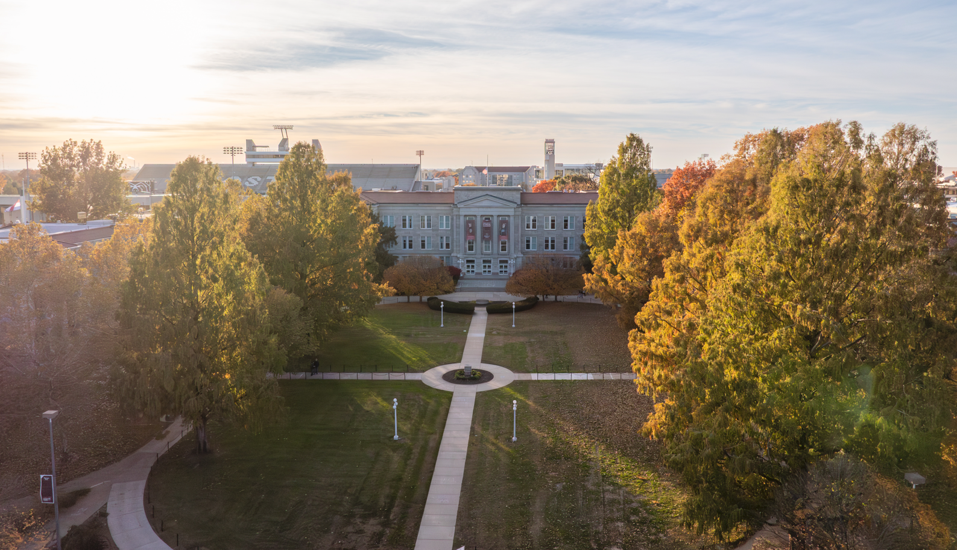
Q&A

