Slide 1
BEHAVIORAL INTERVENTION TEAM
“BIT” | Ellen Currie

Slide 2

Hi!
I’M ELLEN CURRIE!
Coordinator, Student Care and Support

Slide 3

ABOUT
BIT
BIT is composed of a group of MSU employees who provide an organized and coordinated method of assessment of the severity of an incident, situation, or behavior affecting a student or the University community.

Slide 4
WHAT IS BEING REPORTED TO BIT?
01
general mental health concerns
02
academic difficulties
BIT works with students facing various situational stressors. Student concerns include anxiety, depression, eating/body image concerns, family stressors, financial concerns, hardened thoughts, suicidal ideation/attempts, traumatic events, all of these among many other barriers students might face.
03
medical concerns
04
grief from loss

Slide 5
OTHER REPORTED BIT CONCERNS
fear for safety
substance abuse concerns
suicidal ideation or attempts
financial concern
hygiene concern
housing insecurity
self harm
traumatic event
harassment
+ MANY MORE

Slide 6
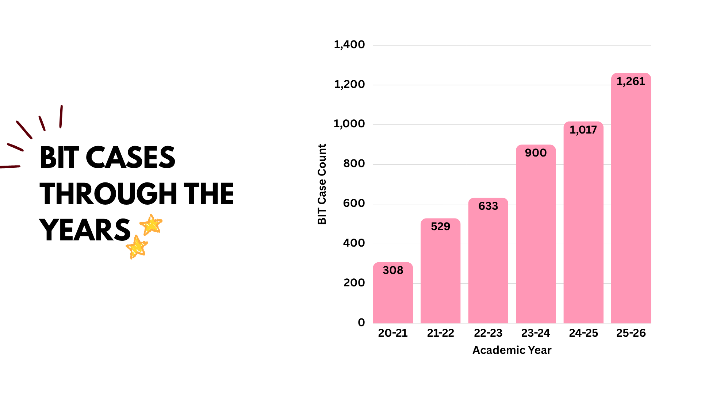
BIT CASES THROUGH THE YEARS

Slide 7
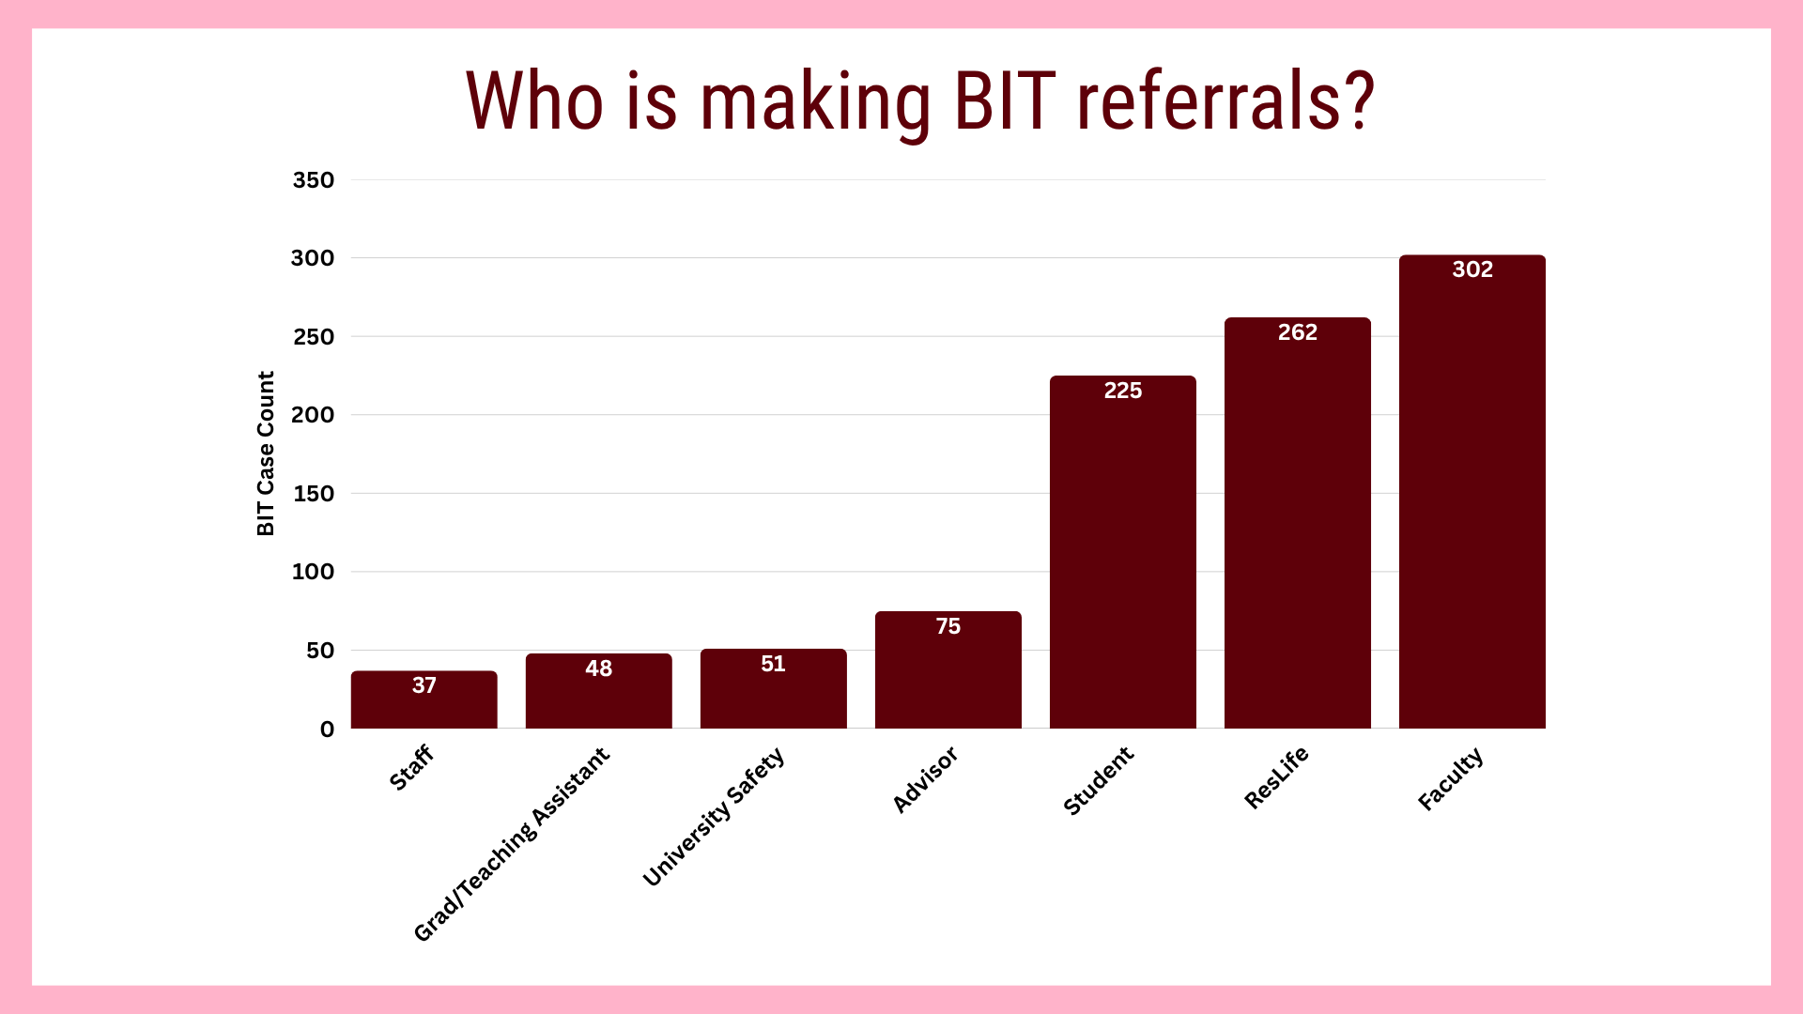

Slide 8
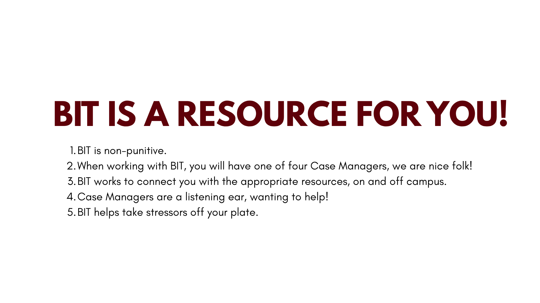

Slide 9

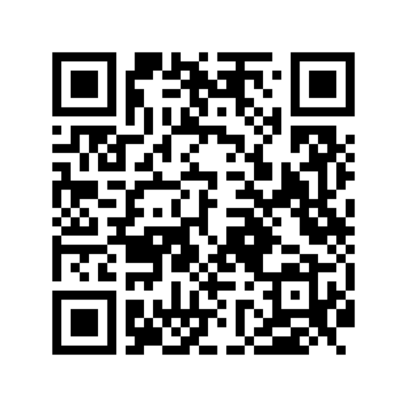
LET’S NOTE:
HOW TO REFER TO BIT
low-medium risk
If there is not an immediate concern for safety or response, make a referral by:
Online Referral Form
Emailing the Dean of Students
deanofstudentsoffice@missouristate.edu​
Calling the Dean of Students Office
missouristate.edu/DOS/BIT
417-836-5527

Slide 10
LET’S NOTE:
HOW TO REFER TO BIT
HIGH RISK
If there is a concern for safety (themes or direct statement of, self-harm, suicide, or harm to others, seems out of touch with reality, displays delusional or aggressive behavior, etc.)
Get immediate help by:
1. Calling 911
2. Calling Campus Safety
at 417-836-5509 ​
After getting immediate help, then submit your referral!
GET IMMEDIATE HELP!

Slide 11
your bit referral
gather data
Once the BIT receives the referral, we will begin collecting any additional information to put together the pieces of the puzzle.
HOW WE PROCESS BIT REFERRALS
assess concern
deploy interventions
In order to determine how to best intervene and support the student, the BIT reviews the data collected to assess the level of concern, risk, or threat.
Based on the level of concern, risk or threat, the BIT will deploy interventions such as a meeting with the individual, case management services and offering various resources.​

Slide 12
your bit referral
Student tells soar leader that they recently had a parent pass away.
Student has a melt down in financial aid office because they "have to do everything on their own." Student storms off and leaves.
Student tells roommate that they have been drinking a lot more recently.

Slide 13
your bit referral
Student tells soar leader that they recently had a parent pass away.
Student has a melt down in financial aid office because they "have to do everything on their own." Student storms off and leaves.
Student tells roommate that they have been drinking a lot more recently.

Slide 14
your bit referral
Student tells soar leader that they recently had a parent pass away.
Student has a melt down in financial aid office because they "have to do everything on their own." Student storms off and leaves.
Student tells roommate that they have been drinking a lot more recently.

Slide 15
your bit referral
Student tells soar leader that they recently had a parent pass away.
Student has a melt down in financial aid office because they "have to do everything on their own." Student storms off and leaves.
Student tells roommate that they have been drinking a lot more recently.

Slide 16
THANK YOU
QUESTIONS?
417-836-5527
ellencurrie@missouristate.edu

