Slide 1
Enrollment Steering Team Update
Presented to the
Missouri State University
Faculty Senate
October 20, 2022
Zora Mulligan

Slide 2
Steering Team Membership
Brad Bodenhausen
Tim Flannery
Teresa Haney
Algerian Hart
Rob Hornberger
Tammy Jahnke
John Jasinski
Julie Masterson
Zora Mulligan
Joye Norris
Suzanne Shaw
Mark Smith
Kelly Wood

Slide 3
Consulted:
Student Success Committee
Kelly Wood, Chair
Associate Provost for Student Success
Kelly Hayes
Coordinator International Leadership and Training Center
Brian Edmond
Coordinator of Management Info Systems
Hannah Evans
Student Representative
Chelsey Giles
Business Process and Reporting Analyst
Tracey Glaessgen
Associate Director, Center for Academic Success and Transition/Director of First Year Programs
Gary Meints
Associate Professor
Andrea Mostyn
Director of Strategic Communication
Ross Hawkins
Director
Michael Hudson
Faculty Senate Chair
Kelly Rapp
Director of Career Center
Jorge Rebaza-Vasquez
Associate Dean
Jon Turner
Associate Professor
Andrea Weber
Assistant Vice President for Student Affairs/Dean of Students
Angela Young
Registrar

Slide 4
Initial Focus:
Admissions

Slide 5
2022-2023 Strategic Enrollment Initiatives
VISION
To drive growth across the university using strategic thinking and bold execution.
THEMES
ADMISSIONS AND ENROLLMENT
STUDENT SUCCESS
INITIATIVES
FTNICs -- Overall
Develop best-in-class campus tours, strengthen relationships with high school counselors and communication with parents, increase market share in Springfield and the surrounding areas, engage consultants.
Overall goal: 5% increase in headcount enrollment.
Stretch goal: 2,500 FTNICs.
Dual Credit
Create VIP activities for dual credit students at November 12 Showcase.
International
Expand partnerships with additional countries, implement case manager approach.
Goals are 10% increase in FTNIC and FT-transfer and maintain current level of graduate enrollment.
First Gen
Increase communication with first gen students, including letters/email and a video.
Goal is to increase first gen enrollment by 5%.
Adults
Increase the number of all online programs from 17 to 20 by Fall 2023. Build out annual plan to promote Fast Track.
Racially Inclusive
Visit access programs, train admissions staff, present at schools, host IES Showcase, host meet ups with a focus on the most diverse schools, meet one on one with students, host groups on campus.
Goal is to increase applications and deposits for BILPOC, First Gen , and Pell-eligible students by 10%.
Pell-Eligible
Establish and promote scholarship.
Employer-Connected Adults
Expand access to financial support and new programs. Targets to be identified by March 31, 2023.
Transfer
Establish/resume/ strengthen communication and relationship-building with community colleges, launch new degree plan guide, host VIP events.
Goal is to increase transfer student enrollment by 10%.
Graduate
Increase prospects, develop accelerated programs, implement inclusive practices, continue to build out partnerships, and reduce barriers to student success.
Increase the effectiveness of the Undergraduate Recruitment Committee.
College and program activities.
5

Slide 6
Shifting Gears:
Retention

Slide 7
Retention is the Single Biggest Driver of Overall Enrollment

Slide 8
Observations:
Overall Freshman Retention
First to second year retention rates appear to have rebounded slightly this year but are down 3.6% since their pre-COVID high in 2019-2020.
Our rates are generally +/- one percent from the Coalition of Urban and Metropolitan Universities median FS retention rate, which is represented by the grey squares on the chart. The CUMU isn’t a perfect or official peer group, but it was selected for purposes of state performance funding in 2017. We don’t have data on those institutions’ experience during and after COVID yet. Those data will come out this year. UMKC and UMSL are the other public Missouri institutions in the CUMU and they are both selective institutions (like MSU); their 2019-2020 FS retention rates were 75% and 82%, respectively.
The gap between our current numbers and our goal has grown since the goal was set in 2019-2020. We will need to increase retention rates by 2.1% every year for the next four years to achieve our 2026 goal.
Coalition of Urban and Metropolitan Universities Median

Slide 9
Observations:
Retention Rates by Group
Retention rates vary significantly by group. Pell-Eligible, First Gen, and Black African American retention rates have not returned to pre-COVID levels.
Students admitted through the test-optional admissions policy in Fall of 2020 had a 55% retention rate. Students admitted through exceptions had retention rates ranging from 67% in 2017-2018 to 58.4% in 2019-2020.

Slide 10
What’s Next:
Advising

Slide 11
What’s Next?
October
Identify short-, intermediate-, and long-term plans to increase retention
Examine opportunities to improve transfer
Track success on recruitment initiatives
November
Begin discussion of advising models
Review data on advising models currently in place at Missouri State
Learn from comparable institutions with exceptional retention and graduation rates
Continue monitoring data on impact of recruitment and retention initiatives; adjust strategy if needed
Spring
Determine whether we should consider changes to our advising model; if so, develop recommendation, discuss with campus community, make a decision, and move toward implementation
Continue monitoring data on impact of recruitment and retention initiatives; adjust strategy if needed

Slide 12
Academic Disruptor Steering Team Update
Presented to the
Missouri State University
Faculty Senate
October 20, 2022
John Jasinski

Slide 13
Steering Team Membership
Doug Gouzie
Algerian Hart
John Jasinski
Kathleen Kennedy
Julie Masterson
Dave Meinert
Zora Mulligan
Greg Rainwater (implementation leader)
Barri Tinkler
Shawn Wahl
Beth Walker

Slide 14
Academic Affairs CAP
Work Streams for 2022-23
Programs and Enrollment
Budget and Realignment
Performance Measurement
Inclusive Excellence
Processes and Approaches
CAP: Continuous Agility Process
Culture
Culture
Culture
Culture
Culture

Slide 15
Work Stream 1: Programs and Enrollment
Output 1: Academic Program Mix
Output 2: Enrollment Growth
Work Stream 2: Budget and Alignment
Output 1: Academic Affairs Budget
Output 2: Academic Affairs Realignment
Work Stream 3: Performance Measurement
Output 1: Academic Department Annual Review Metrics
Output 2: Academic Performance System (APS)
CAP Work Streams
and
Outputs
for 2022-23

Slide 16
Work Stream 4: Inclusive Excellence
Output 1: Inclusive Excellence Scorecard
Work Stream 5: Processes and Approaches
Output 1: Selected Academic Affairs Processes
Output 2: Academic Affairs Committee System
Output 3: Academic Affairs Policy Library
Output 4: Provost’s Office Rhythm of the Year
CAP Work Streams
and
Outputs
for 2022-23
(Initially: Curricular Workflow Process, Academic Hiring Process, Faculty Equity Adjustment Process, Online Definitions and Coding Process, Academic Awards and Events Model

Slide 17
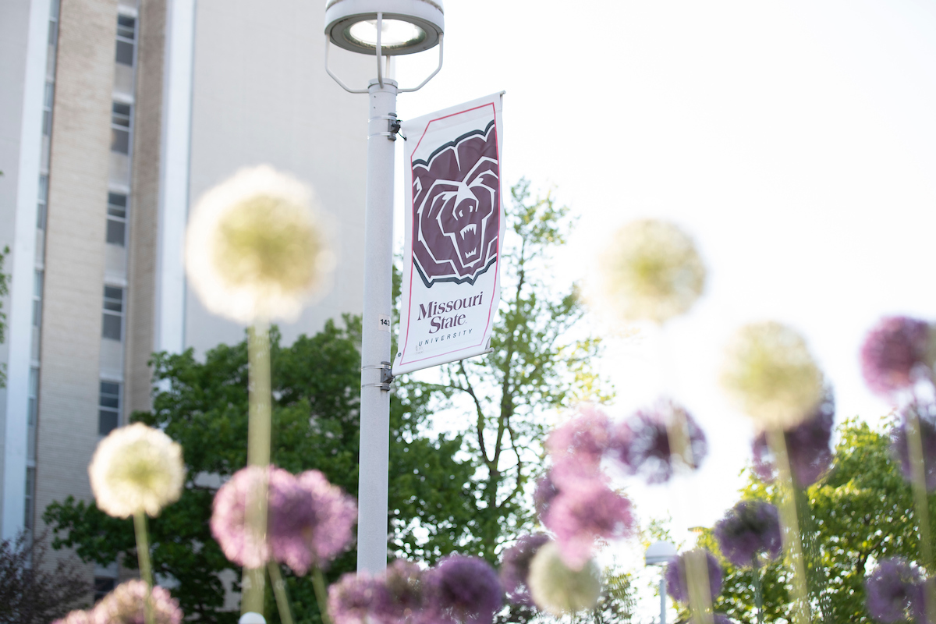
Other
Q and A
Upcoming meetings
Tenure and Promotion Report
Salary Report
Faculty Concerns Committee
And Faculty Equity Process, Performance Measurement

