Slide 1
Missouri State University Faculty Senate
Committee on University Budget & Priorities
Salary Report Card Fall 2023
K. Stephen Haggard
Professor of Finance
College of Business

Slide 2
Charge
College and University Professional Association for Human Resources (CUPA) Report Card: How well are MSU faculty compensated compared to benchmark means and medians?
How is the equity adjustment process working at MSU?

Slide 3
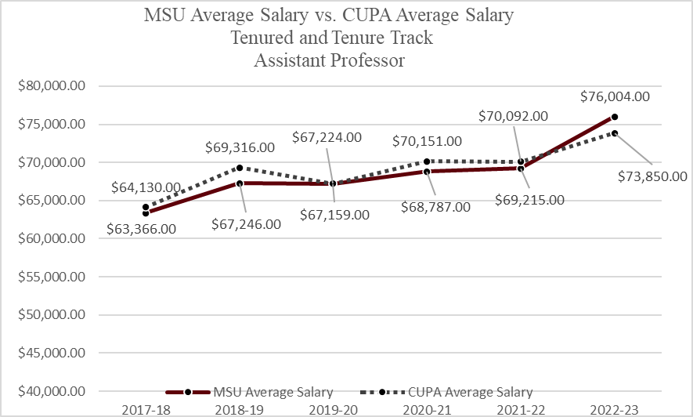

Slide 4
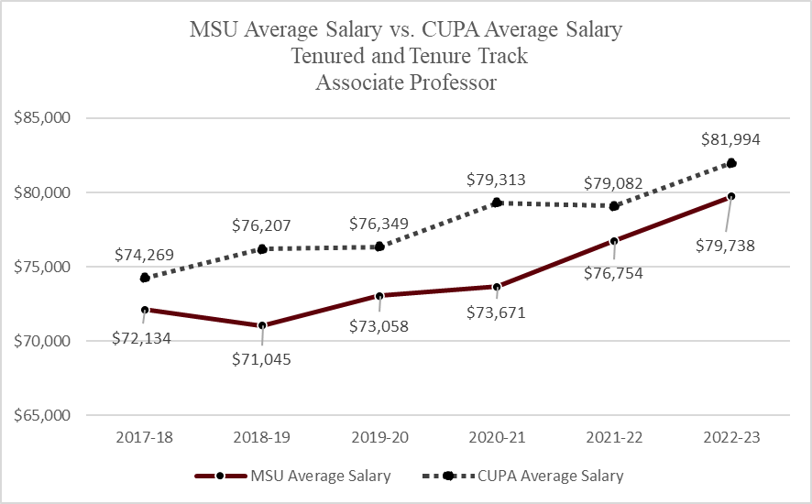

Slide 5
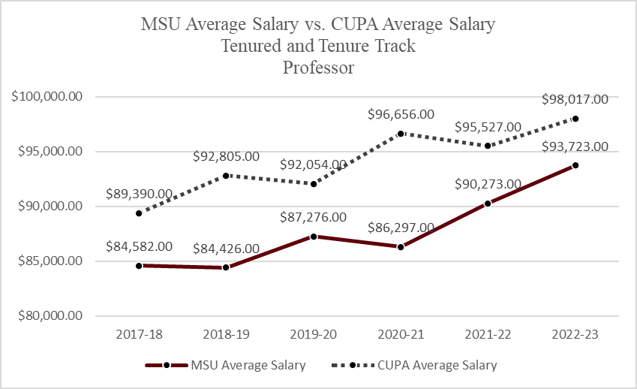

Slide 6
Tenure and Tenure-track Summary
MSU must pay near-market rates to attract new Assistant Professors. Anomalous above CUPA average likely due to changing CUPA benchmark and New Assistant Professor cohort discipline composition.
The pay gap grows larger for Associate Professors and is the largest for Full Professors.
New Assistant Professors dedicating their careers to MSU can look forward to greater magnitudes of underpayment as they progress in their careers.

Slide 7
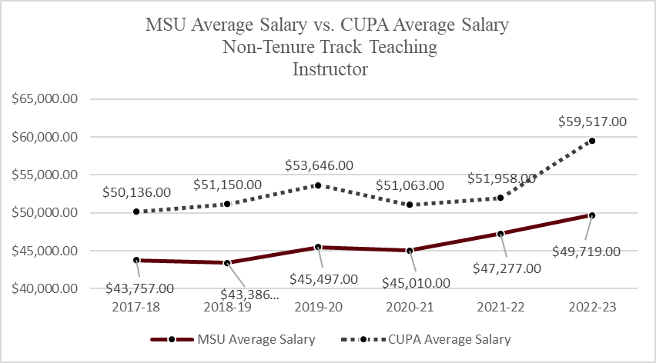

Slide 8
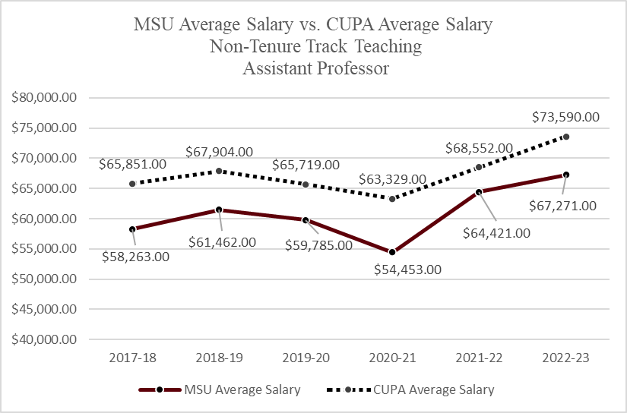

Slide 9
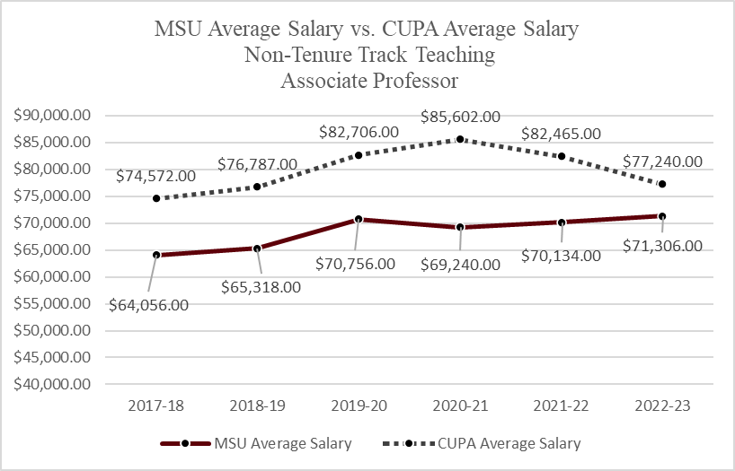

Slide 10
Non-tenure-track Summary
MSU underpays non-tenure-track faculty
The pay gap is worst for Instructors, who are underpaid $10k (16.5%)

Slide 11
Forthcoming CUPA Improvements
Excluding department heads and school directors from the submission since they do not meet the CUPA criteria for inclusion.
Ensuring that faculty ranks, classification of instructional programs (CIP) codes, degrees held, and other submission data are accurate.
Ensuring salary data complies with CUPA guidelines (e.g., adjusting for 9/10 month salary equivalent, full-year sabbatical pay, and ignoring supplemental pay)
Benchmark group expanding to Doctoral/Professional schools and the Masters: Large Programs schools.
https://blogs.missouristate.edu/president/2024/03/05/clifs-notes-for-march-5-2024/

Slide 12
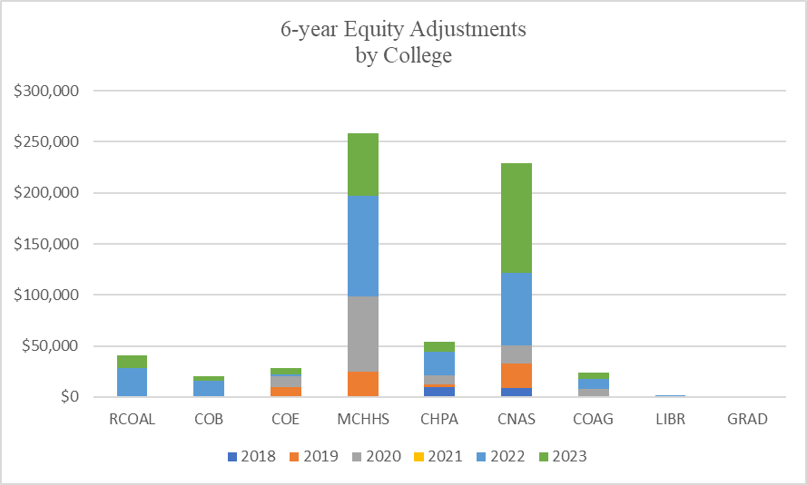
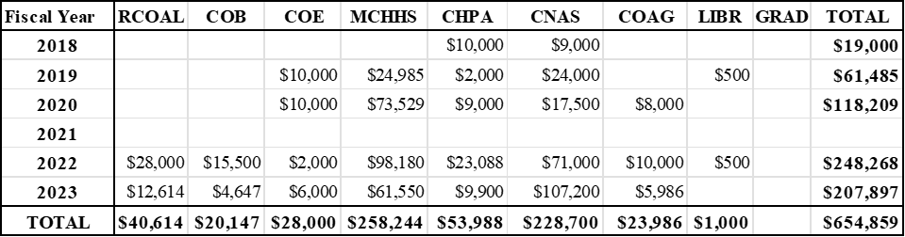

Slide 13
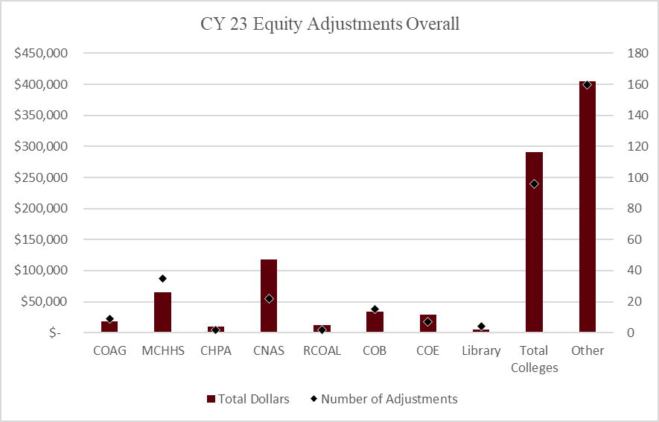

Slide 14
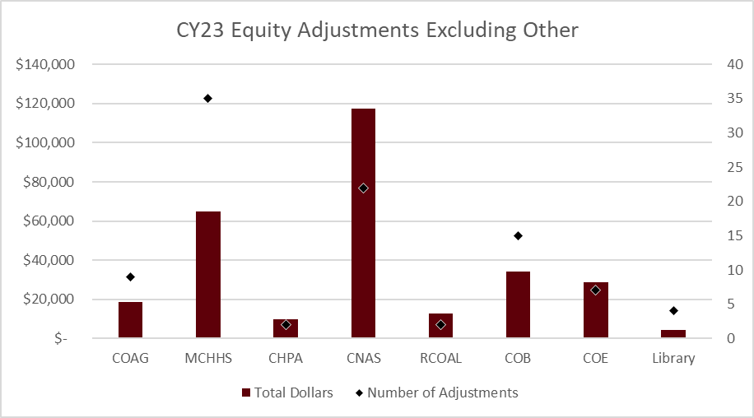

Slide 15
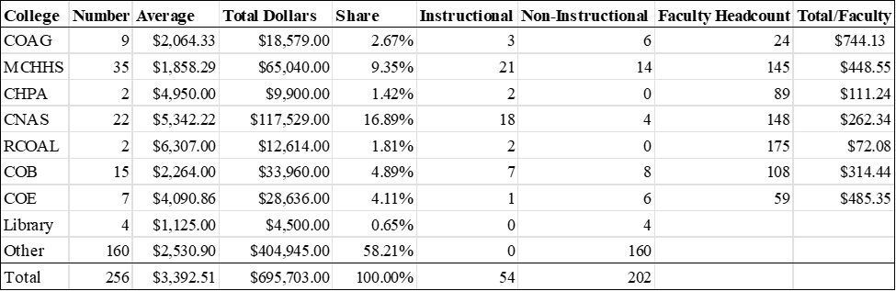
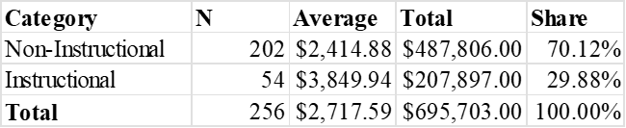
Distribution of Equity Adjustments

Slide 16

Diverse Funding Sources
Issue: MCHHS has additional funding sources not available to other Colleges.
Faculty are concerned about paycheck earnings, not funding sources.
Carrington Hall has always done a great job of vacuuming up the revenue of the Colleges and redistributing it as they see fit. (e.g., operating transfers to the athletics money pit)
Solution: Reduce redistribution to MCHHS and increase redistribution to other Colleges. Example: Recent central funding of equity.

Slide 17

Hearts and Minds
For where your treasure is, there your heart will be also. – J. Christ, Matthew 6:21, NIV
With my mind on my money and my money on my mind. – S. Dogg, “Gin and Juice”

Slide 18
Conclusions and Recommendations
Vast majority of MSU faculty are underpaid.
Underpayment gets worse the longer we stay at MSU.
Equity adjustments are concentrated in a few areas and favor non-instructional personnel.
Equity processes vary widely across Colleges.
No University-wide equity process appears to exist.
Recommendation: Adopt a procedure to rationally distribute equity funds based on the severity of underpayment and the employee’s contribution to the mission of the University.

Slide 19

Questions, Comments, and Rants

