Slide 1
Behavioral Intervention Team
Dr. Thomas Lane
Associate Vice President for Student Affairs & Dean of Students

Slide 2
Some BIT History…
BIT was founded in Fall 2003.
Mission: To identify students who exhibit behaviors that may be detrimental to their success or to the success of other members of our community and provide resources that improve the opportunity to experience student success.
Goal is to serve as a central collection point for information and reduce important student behavioral information from residing in campus silos.
Team is focused on assessing and taking action while behaviors are at the lower end of escalation, shifting the path away from violence.
Team meets every Wednesday at 10:00am during the academic year.

Slide 3
Who serves on BIT?
Associate Vice President for Student Affairs & Dean of Students (Chair)
Director, Student Conduct
Director, Taylor Health and Wellness Center
Director, Counseling Center
Care Consultant, Dean of Students Office

Slide 4
Who serves on BIT?
Associate Director, Residence Life, Housing, and Dining Services
Patrol Lieutenant, Safety and Transportation
Title IX Coordinator
General Counsel
Deputy Provost
Two faculty members (appointed by Faculty Senate)

Slide 5
How does BIT work?
The BIT provides an organized and coordinated method of assessment of the severity of an incident or situation affecting an individual and/or the University community.
The BIT determines the need for intervention, identification and activation of appropriate resources and responses, ongoing monitoring, and evaluation of responses and outcomes.
Any member of University community can contact a BIT member with a concern. Most reports come from Residence Life staff and faculty members.
Incident reports can be received on-line through the Dean of Students Office website. http://www.missouristate.edu/dos/131965.htm
Team may use NaBITA Threat Assessment Tool “D-Scale” to assess risk and determine appropriate intervention.

Slide 6
Examples of Discomforting or Annoying Behaviors
Staring
Not picking up on social cues
Talking loudly
Asking lots of questions
Talking about things not related to class
Standing within personal space boundaries
Wanting to speak to your supervisor/chair
Disrespectful/rude behavior
Threatening to sue
Monopolizing your time
Crying
Not listening to you
Not doing homework
Not engaging in class
Answering phone, talking, texting, on computer in class
Emailing incessantly

Slide 7
Examples of Concerning Behaviors and Indicators
Acts of physical aggression
Threats of violence
Articulating depression, hopelessness, or self-harm
Mention of weapons or violence to solve problems
Expressions of anger/agitation/inability to cope with stress
Reports of abuse

Slide 8
Examples of Disruptive Behaviors and Indicators
Yelling or being excessively loud
Excessive hygiene concerns
Under the influence of alcohol or other substances
Refusing to leave or cooperate
Destruction of property
Not complying with instructions
Escalating low-level behaviors

Slide 9
Examples of Interventions
One-to-one meeting between student and Dean of Students or DoS Care Consultant.
Referral to Counseling Center or other appropriate campus or community resources.
Consultation with faculty member regarding classroom management strategies.
Monitoring of student by Residence Life staff members.

Slide 10
Keeping BIT Records
BIT uses Maxient Conduct Database to keep track of all cases.
Dean and/or Care Consultant documents behavioral concern, meetings, communication, interventions, observations, and follow-up steps regarding student of concern.
Track individual’s patterns or behavioral trends over time.
BIT Team Members have access to case information when needed.

Slide 11
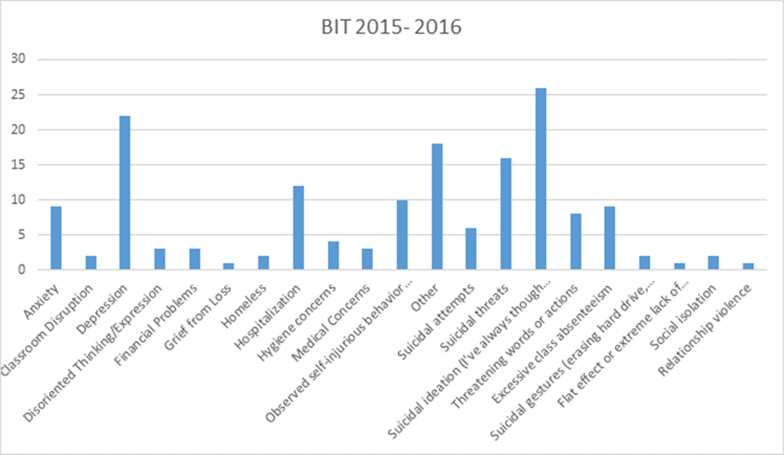
2015-16 BIT Incident Types

Slide 12
Creating a Culture of Reporting
BIT
  Resource for Missouri State community when having concerns about a student’s behavior.
  Guide campus interventions prior to a crisis.
  Use the Incident Reporting Form at http://www.missouristate.edu/dos/ or contact Dean of Students at ThomasLane@missouristate.edu, 417-836-5527, PSU 405

Slide 13
Creating a Culture of Reporting
Student Conduct
  Office of Student Conduct: Ms. Andrea Weber, Director, PSU 405.
  File formal complaints of Code of Student Rights and Responsibilities violations. Be familiar with Code at www.missouristate.edu/dos/
  Should be based on actual behavior, not speculation.

Slide 14
Creating a Culture of Reporting
Office of Safety and Transportation
  Radio Communications Center is open 24/7/365. To report a crime or to request service, please call (417) 836-5509. If you have an emergency, or immediate safety concern, dial 911.

Slide 15
For more information about BIT
http://www.missouristate.edu/dos/72223.htm
Thank You!

