Slide 1
Budget & Priorities Spring report 2026 Presented by. Dr. Beth Walker, Chair
Data compiled by B&P Committee and Guests: William Agnew, Heidi Backes, Rachel Besara, Phil Bridges, Michele Brown, Natasha DeVore, Chelsey Giles, Monika Islam Khan, Matthew Morris, Quinton Phelps, Michael Suttmoeller, Gabriel Ondetti

Slide 2
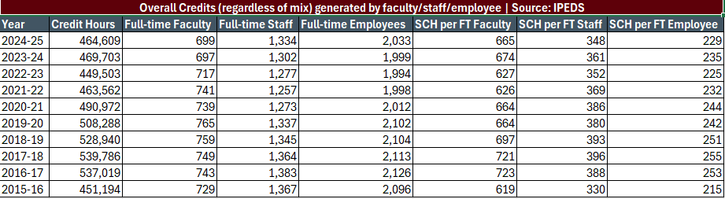
Real Data
$302 * 665 = $200,803
464,609 *302 = $140,311,918 in student derived revenue
Per Exec Budget Committee – Thanks Phil Bridges

Slide 3
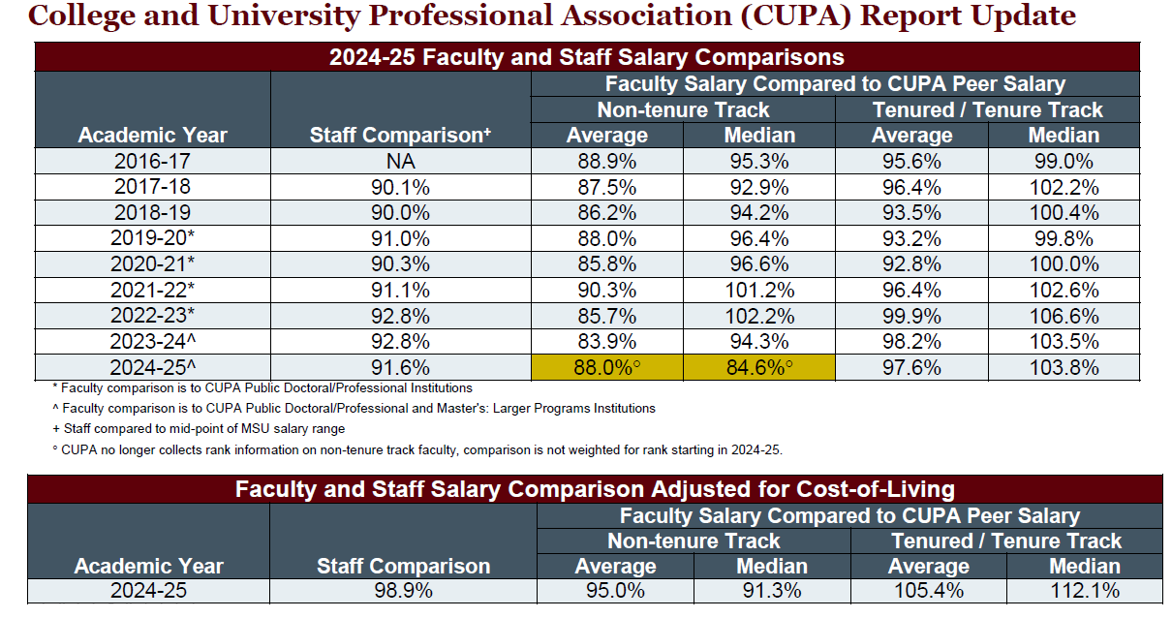

Slide 4
Thanks to Dr. Ken Brown….

Slide 5
HOT OFF the PRESS HigherEd.com
All higher ed employee groups continued to be paid less in 2025-26 than they were in 2019-20 when adjusting to 2025-26 dollars.
Staff received the highest median percentage increases in comparison to other workforce areas (3.0%).
Staff increases were also higher than pre-pandemic levels, though lower than recent historical highs.
The largest gap between pre-pandemic inflation-adjusted salaries and current salaries is for tenure-track faculty (who are paid 11.7% less), followed by non-tenure-track teaching faculty (paid 6.8% less).
For the fourth consecutive year, tenure-track faculty received the lowest median salary increase of all employee categories (1.8%).
Across the 10 years of data analyzed, tenure-track faculty salary increases have never exceeded the rate of inflation.
Tenure-track faculty have not received salary increases in real dollars for the past decade

Slide 6
