Slide 1

Energy Program - 2014

Slide 2

Program Goals
Practice good stewardship of public resources
Avoid wasting energy… Energy is money
Apply savings to fund improvements for more savings
Public Affairs is our mission … Set the example!

Slide 3
Utilities Data
Electricity
  Provider: City Utilities
Steam
  Provider: MSU Steam Generation Plant
  Uses: Heating: 24 buildings & Rec Ctr pool
Showers: Res Life, Athletics, Rec Ctr
Steam lines: Dining Halls
Hot water: Restrooms
Water
  Provider: City Utilities
Chilled Water Loop
  Provider: MSU Utilities
  Capacity: 5,930 tons
Utilities Distribution Tunnel
  1.75 miles underground tunnel system

Slide 5
History of Energy Initiatives
1996-2014

Slide 6
History of Energy Initiatives
1996-2014
1996 Energy Project

Slide 7
High Energy Usage (1994)
BTU/Sq Ft/Year
80% Above Regional
33% Above National
171,610
129,075
95,167
Missouri
State
University
Regional
Avg
National
Avg

Slide 8
1996 Energy Review
Feasibility Study Revealed
  No centralized control of occupied buildings
  Inefficient lighting
  No sub-metering to manage high energy use
  Energy waste: $60K-$80K/mo

Slide 9
Solution Option: “Energy Performance Contract”
  MSU borrows funds
  Install energy improvements
  Debt service paid with generated savings
  If “guarantee” not met, contractor must pay
Energy Performance Contract” Executed
  $5.5M of energy improvements
  Scope of work:
  15,000 Lighting retrofits
  Variable speed drive motors
  Electric Meters in all major buldings
  Central Energy Management System

Slide 10
Central Energy Management System
Saves energy when buildings are unoccupied
  Occupied Mode 70-75 degrees
  Unoccupied Mode
    Drifts to 80 degrees (summer)
    60 degrees (winter)
    Buildings systems are not shut off

Slide 11
1996 Energy Project
Energy Project Executed
  $5.5M of energy improvements
  Scope of work:
  15,000 Lighting retrofits
  Variable speed drive motors
  Electrical meters for all major facilities
  Central Energy Management System
  Energy savings: approx. $1M/yr
  Paid off in October 2005 (7.3 years)

Slide 12
History of Energy Initiatives
1996-2014
1996 Energy Project – $5.5M Energy Improvements
1998 Electrical Distributions System Testing
1999 Utility Master Plan

Slide 13
1999 Utility Master Plan
Recommendations:
  Upgrade the electrical spine for the future
  Combine building chillers to “satellite plants”
  Phase out inefficient steam-absorption chillers

Slide 14
History of Energy Initiatives
1996-2014
1996 Energy Project – $5.5M Energy Improvements
1998 Electrical Distributions System Testing
1999 Utility Master Plan
2000 Utility Tunnel Repairs
  - $5M Capital Appropriation

Slide 15
Utility Distribution Tunnel
Hammons
Garst
Hutchens
Hammons Stu Ctr
JQH Arena
Greenwood
Lab
Woods
Rec Center
BLSH
Morris
Hall
King St. Annx
Freudenberger
Forsythe
Athl.Ctr
Student Union
Wells
Meyer Library
McDonald Arena
Siceluff
Cheek
Strong
CARR
Temple
Pummill
Hill
Ellis
PH
Kemper Hall
Karls
Craig
Art Annex

Slide 16
Utility Distribution Tunnel
Hammons
Garst
Hutchens
Hammons Stu Ctr
JQH Arena
Greenwood
Lab
Woods
Rec Center
BLSH
Morris
Hall
King St. Annx
Freudenberger
Forsythe
Athl.Ctr
Student Union
Wells
Meyer Library
McDonald Arena
Siceluff
Cheek
Strong
CARR
Temple
Pummill
Hill
Ellis
PH
Kemper Hall
Karls
Craig
Art Annex

Slide 17
2000 Utility Tunnel Repairs
  Upgraded electrical systems
  Reduced line loss
  Corrected structural deficiencies
  Set us up for the next phase

Slide 18
History of Energy Initiatives
1996-2014
1996 Energy Project – $5.5M Energy Improvements
1998 Electrical Distributions System Testing
1999 Utility Master Plan
2000 Utility Tunnel Repairs
2002 Mechanical Upgrade to Hammons Student Center
2004 Energy Project - $10.9M Chilled Water Loop

Slide 19
2004 Energy Contract
Scope
  Chilled Water Loop
  Services 20 buildings
  Replaces 16 old and inefficient chillers
  Charged by large, efficient chillers
    5 new
    4 existing
Cost:
  $10.8M of energy improvements
  To pay back within 15 years

Slide 20
Chilled Water Distribution
1,000T
Garst
Hammons
Hutchens
320T
Woods
Total Design Capacity= 4,130 T
Morris
720T
Freudenberger
Student Union
Wells
750T
500T
Cheek
Siceluff
Strong
Carrington
Temple
Pummill
Hill
Powerhouse
Craig
Karls
840T
Art Annex

Slide 21
2004 Project - Impact on
Natural Gas Consumption

Slide 22
City Utilities
Top 10 Natural Gas Customers
Missouri State University
St. Johns Regional Health Center
#1 –
#2 –
#3 –
#4 –
#5 –
Cox Health
Kraft, Inc.
Regal-Beloit Electric Motors
Dairy Farmers of America
Springfield Board of Education
Clariant LSM-Missouri
U.S. Medical Center
Willow Brook Foods, Inc.

Slide 23
2004 City Utilities
Top 10 Natural Gas Customers
2006 City Utilities
Top 10 Natural Gas Customers
Customer # 1
Missouri State University
Customer # 2
Customer # 3
Customer # 4
Customer # 2
Customer # 3
Customer # 4
Customer # 5
Customer # 6
Customer # 7
Customer # 8
Customer # 9
Customer # 10

Slide 24
History of Energy Initiatives
1996-2014
1996 Energy Project – $5.5M Energy Improvements
1998 Electrical Distributions System Testing
1999 Utility Master Plan
2000 Utility Tunnel Repairs
2002 Mechanical Upgrade to Hammons Student Center
2004 Energy Project - $10.9M Chilled Water Loop
2006 Utility Study

Slide 25
Rationale for a Study
Last Utility Master Plan 1999
Landscape had changed
    Utility spine upgrades 2000-03
    Chilled Water Loop Installation 2006
    Energy costs skyrocketed
      Natural Gas rates increased 185%
      Electricity rates increased 47%

Slide 26
Scope
Evaluate:
    Boiler House and Steam Distribution System
    Chiller Water System
      Building Systems

Slide 27
2006 Utility Study Recommendations
Chilled Water Loop Expansion
Develop Sound Steam Distribution PM Program
Cost-Center Accounting of Utilities
Alternative Energy Options

Slide 28
Action Taken
  Chilled Water Loop Expansion

Slide 29
Chilled Water Distribution
Garst
900T
Hammons
Hutchens
Greenwood
Lab
Hammons Stu Ctr
JQH Arena
Woods
Total Design Capacity= 5,030 T
Blair Shannon
Freudenberger
Student Union
Wells
Cheek
Siceluff
Strong
Carrington
Temple
Pummill
Hill
Powerhouse
Ellis
Kemper
Karls
Craig

Slide 30
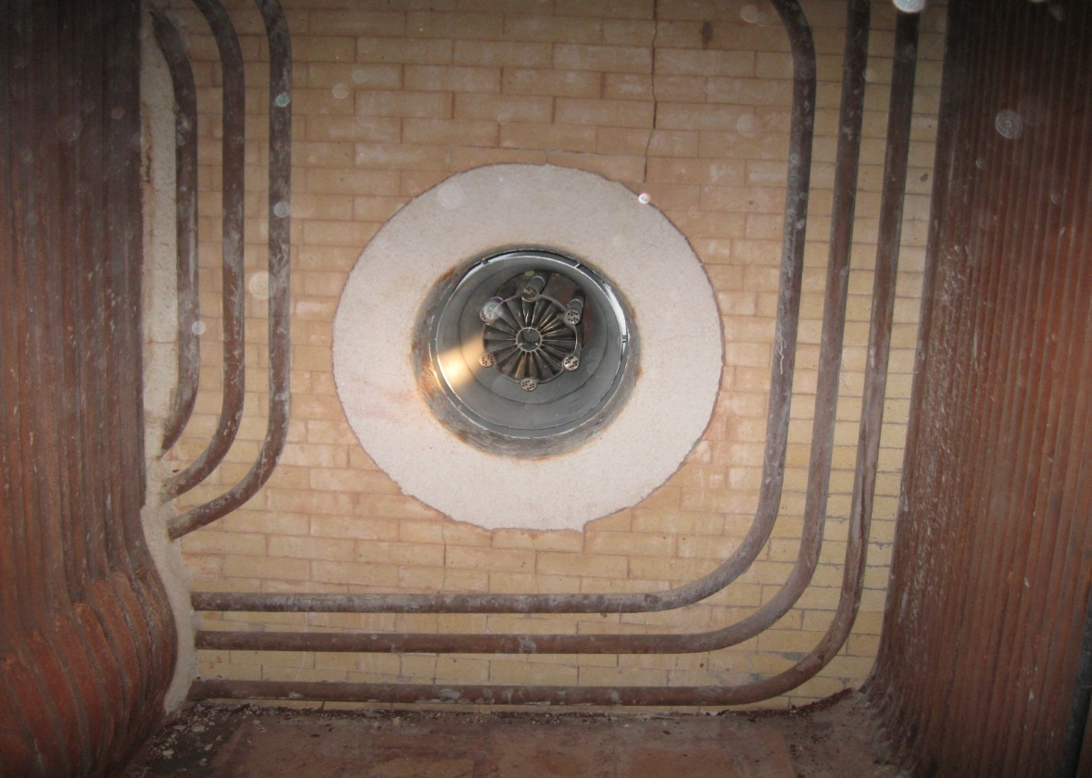
Action Taken
  Chilled Water Loop Expansion
  Boiler House Modernization Project
    Upgraded two boilers
      Tubes, refractory, burners, skin
    Supervisory Controls and Data Acquisition (SCADA)
Boiler Interior

Slide 31
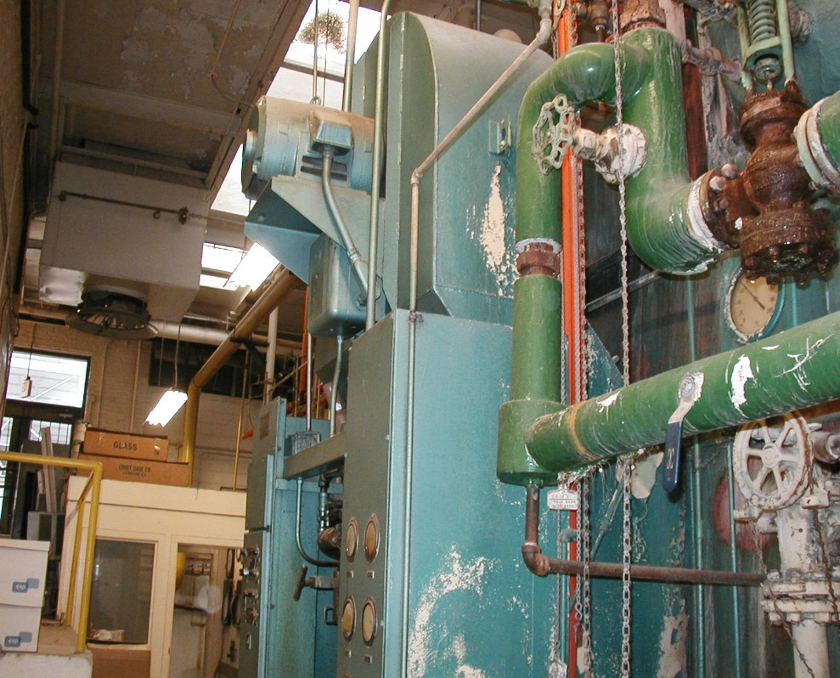
Boiler House

Slide 32
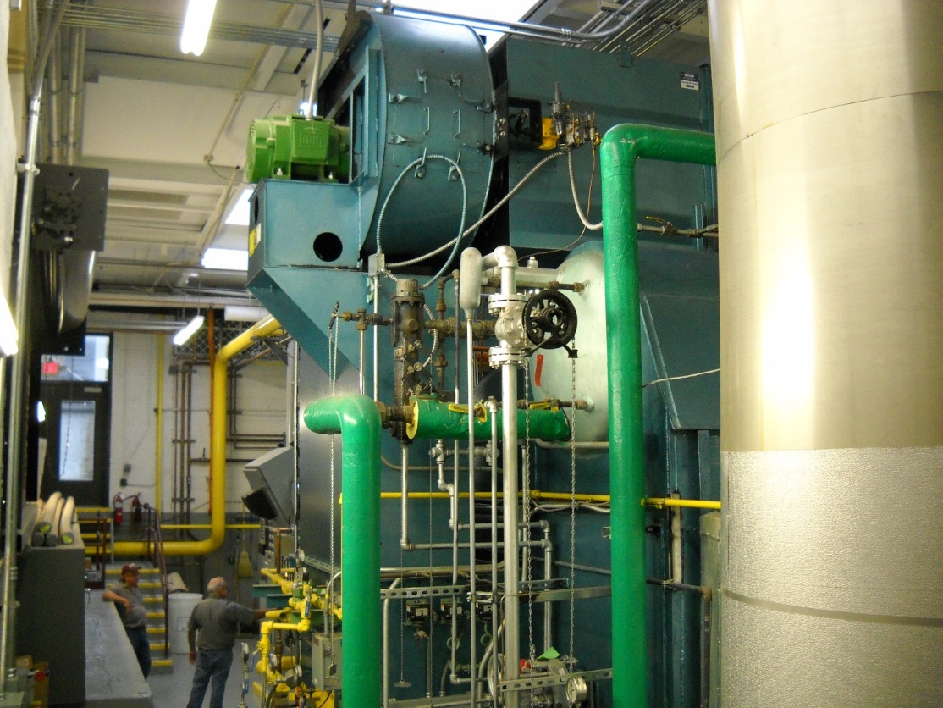
New Boiler

Slide 33
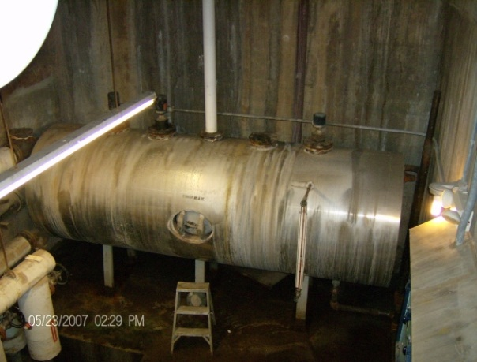
Power House Condensate Tank

Slide 34
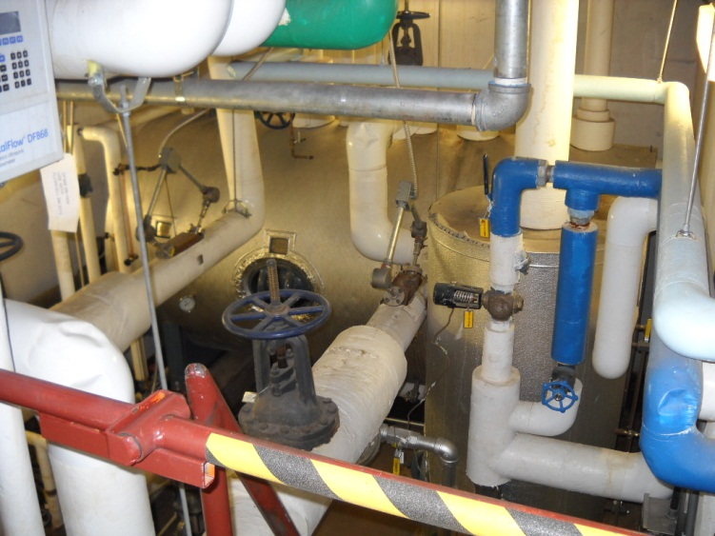
New Condensate Pit

Slide 35
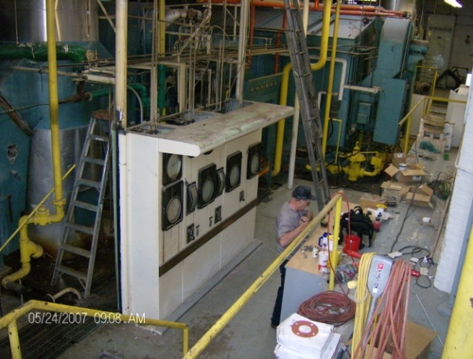
Controls - 2007

Slide 36
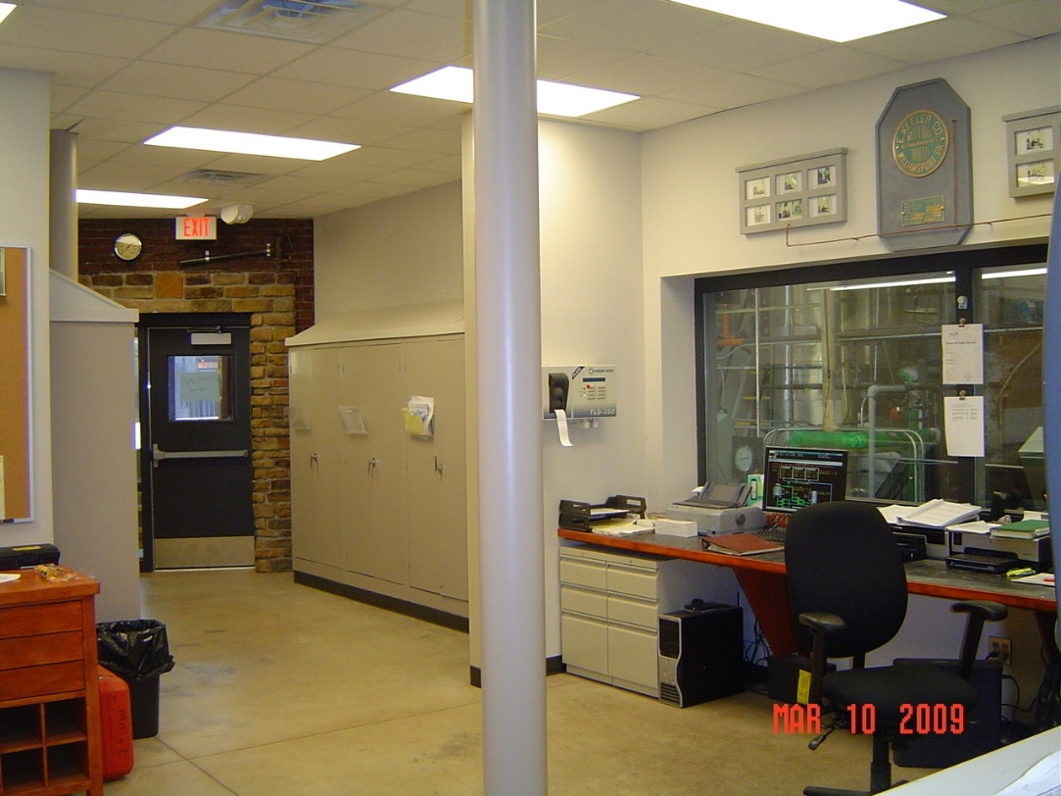
New Control Room

Slide 37
Action Taken
  Chilled Water Loop Expansion
  Boiler House Modernization Project
  Replacement of Insulation and Steam Traps
    Potentially $250,000/yr savings

Slide 38
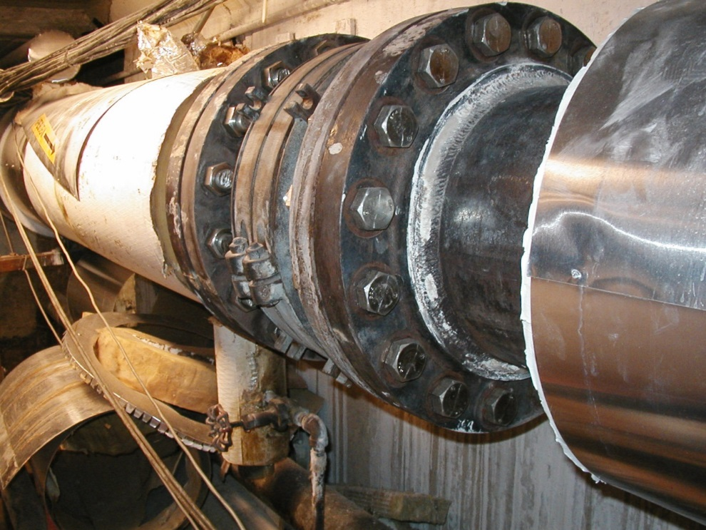
Insulation Issues

Slide 39
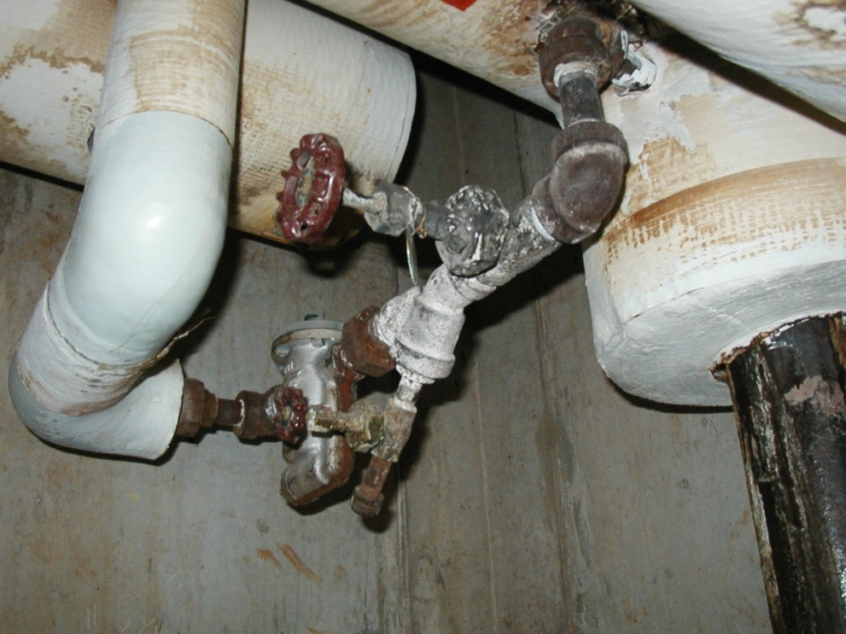
SteamTrap Issues

Slide 40
Action Taken
  Chilled Water Loop Expansion
  Boiler House Modernization Project
  Replacement of Insulation and Steam Traps
    Potentially $250,000/yr savings
Chilled Water System Enhancements
    Install Pressure Independent Valves

Slide 41
Building Pressure Independent Valves
… restore capacity
Chilled
Water Loop

Slide 42
Pressure Independent Valve Installation
Garst
Hammons
Hutchens
Greenwood
Lab
Hammons Stu Ctr
Freudenberger
Installations since 2009
Union
Cheek
Carrington
Temple
Pummill
Strong
Ellis
Kemper
Plaster Sports Complex
Craig

Slide 43
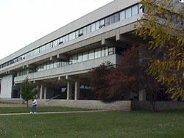
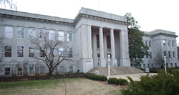
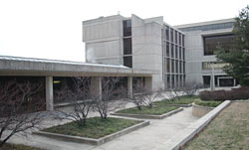
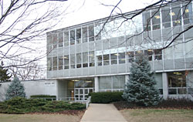

PIV Installation Benefits
Craig
Hill
Temple
#Valves 10
Ton A/C Saved 50T
#Valves 6
Ton A/C Saved 50T
#Valves 17
Ton A/C Saved 300T
Ellis
Loop Capacity Recaptured
450 T
=
Therefore, no chiller required for the
Foster Family Recreation Center!
#Valves 7
Ton A/C Saved 50T
40 Valves
450T

Slide 44
Pressure Independent Valve Installation
Garst
Hammons
Hutchens
Greenwood
Lab
Hammons Stu Ctr
Recently Installed
Freudenberger
Proposed Installations
Union
Cheek
Carrington
Temple
Pummill
Strong
Ellis
Kemper
Plaster Sports Complex
Craig

Slide 45
Action Taken
  Chilled Water Loop Expansion
  Boiler House Modernization Project
  Replacement of Insulation and Steam Traps
    Potentially $250,000/yr savings
Chilled Water System Enhancements
    Install Pressure Independent Valves
    Air & Dirt Separators

Slide 46
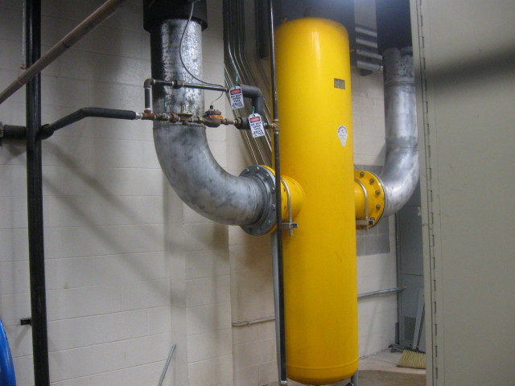
Air & Dirt Separator

Slide 47


Air-Dirt Separator
AIR
Pipeline
DIRT
Dirt Removed
Eliminates Contaminants
Air Removed
Makes Denser Water
This means…
cleaner coils
…better heat transfer
Coil
…less chilled water
…less costly chiller run time
…more savings and less
maintenance

Slide 48
Air-Dirt Separator
AIR
Pipeline
DIRT
Dirt Removed
Eliminates Contaminants
Air Removed
Makes Denser Water
This means…
cleaner coils =
…better heat transfer
Coil
…less chilled water
…less costly chiller run time
…more savings and less
maintenance

Slide 49
Air/Dirt Separators
Garst
Hammons
Hutchens
Greenwood
Lab
Hammons Stu Ctr
JQH Arena
Woods
Installation since 2009
BLSH
Morris
Freudenberger
Student Union
Wells
Cheek
Siceluff
Strong
Carrington
Temple
Pummill
Hill
Powerhouse
Ellis
Kemp
Karls
Craig
Art Annex

Slide 50
History of Energy Initiatives
1996 Energy Project – $5.5M Energy Improvements
1998 Electrical Distributions System Testing
1999 Utility Master Plan
2000 Utility Tunnel Repairs
2002 Mechanical Upgrade to Hammons Student Ctr
2004 Energy Project - $10.9M Chilled Water Loop
2006 Utility Master Plan
2007 – 2013 Add’l Energy Conservation Measures

Slide 51
Add’l Energy Conservation Measures
  Occupancy Sensors & Relamping via DNR
    2009 Campus-wide Occupancy Sensors
    2010 Campus-wide Relamping

Slide 52
Add’l Energy Conservation Measures
  Occupancy Sensors & Relamping via DNR
    Sensors paid off in one year
  Moved Electrical Feed to reduce demand rates

Slide 53
Add’l Energy Conservation Measures
  Occupancy Sensors & Relamping via DNR
    Sensors paid off in one year
  Moved Electrical Feed to reduce demand rates
  Boiler replacement to match summer load

Slide 54
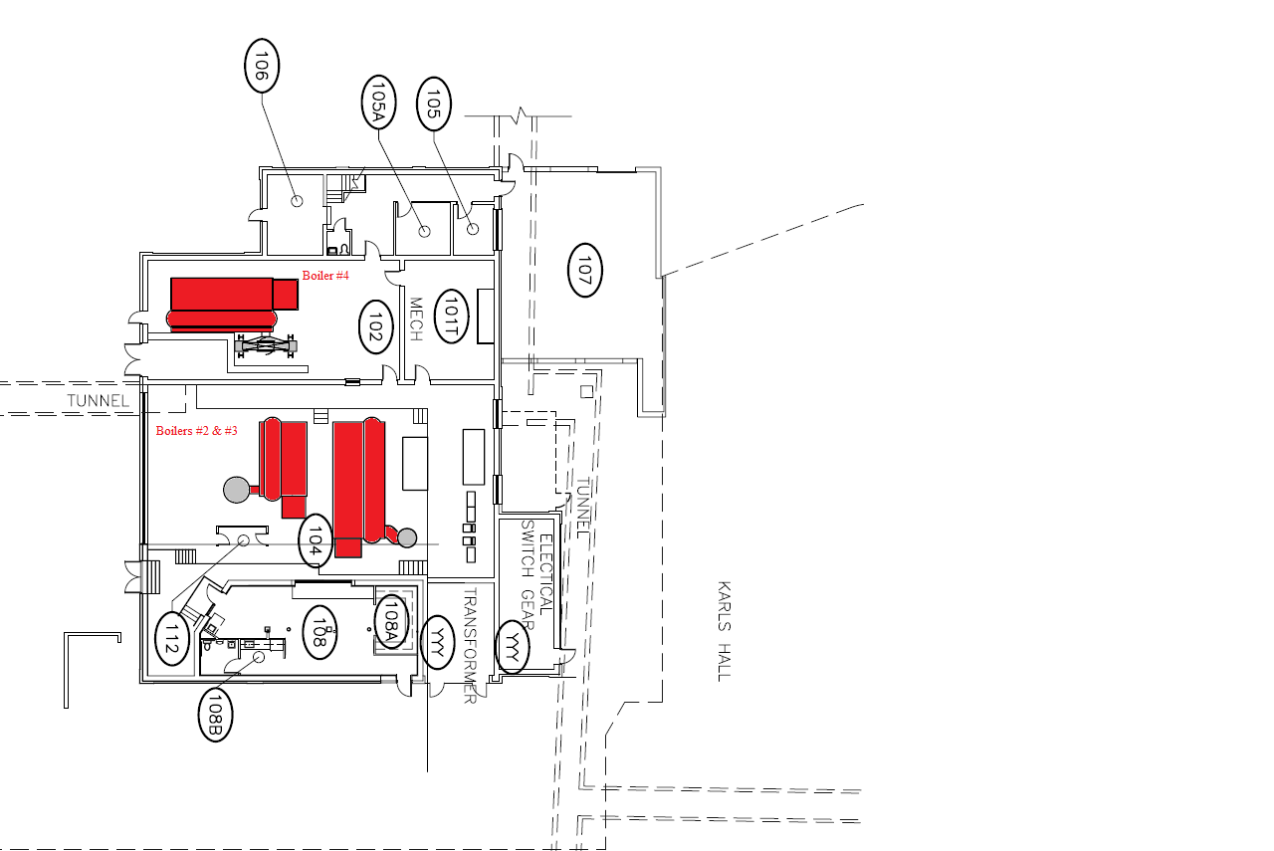

Slide 55
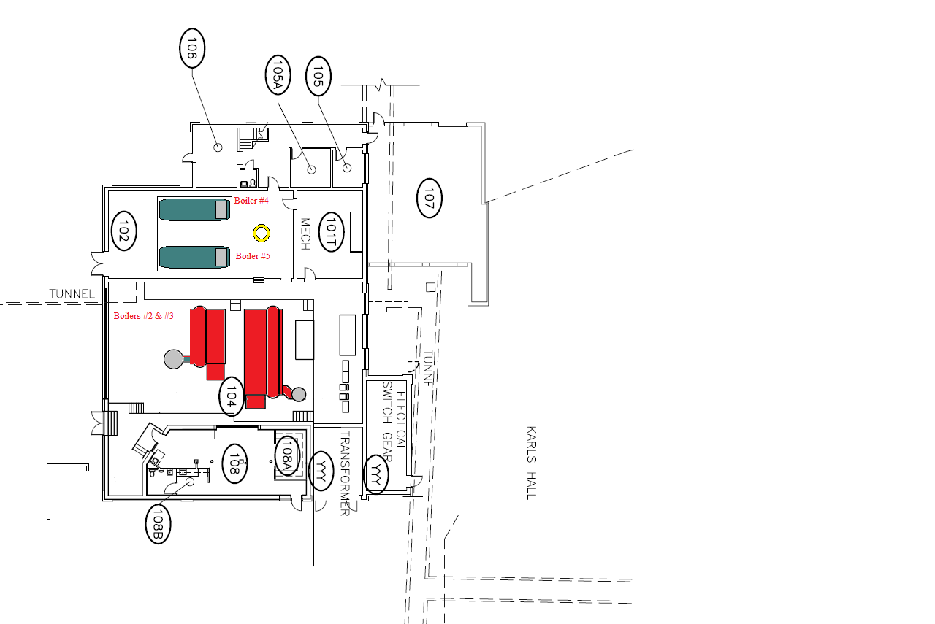

Slide 56
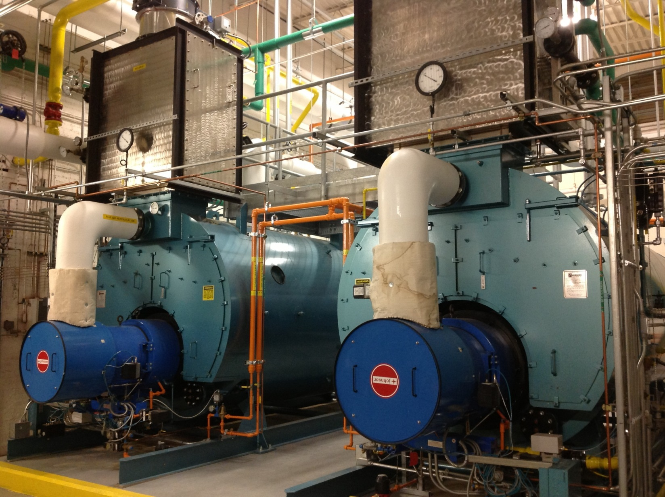

Slide 57
Add’l Energy Conservation Measures
  Occupancy Sensors & Relamping via DNR Loan
    Sensors paid off in one year
  Moved Electrical Feed to reduce demand rates
  Boiler replacement to match summer load
  CW Loop Improvements

Slide 58
Chilled Water Distribution
North-South CW Leg
Garst
Hammons
Hutchens
JQH Arena
Greenwood
Lab
Hammons Stu Ctr
Woods
BLSH
Rec Center
Freudenberger
Student Union
Wells
Cheek
Siceluff
Strong
Temple
Carrington
Pummill
Hill
Powerhouse
Ellis
Kemp
Karls
Craig

Slide 59
Chilled Water Distribution
Forsythe
Connects to CW Loop
Garst
900T
Hammons
Hutchens
Greenwood
Lab
Hammons
Stu Ctr
JQH Arena
Woods
Total Design Capacity= 5,030 T
Blair Shannon
Rec Center
Freudenberger
Forsythe
Student Union
Wells
Cheek
Siceluff
Strong
Carrington
Temple
Pummill
Hill
Powerhouse
Ellis
Kemper
Karls
Craig

Slide 60
Chilled Water Distribution
HHPA & Wehr Band Hall
Sunvilla
HHPA
Wehr
Garst
900T
Hammons
Hutchens
Greenwood
Lab
Hammons
Stu Ctr
JQH Arena
Woods
Total Design Capacity= 5,030 T
Blair Shannon
Rec Center
Freudenberger
Forsythe
Student Union
Wells
Cheek
Siceluff
Strong
Carrington
Temple
Pummill
Hill
Powerhouse
Ellis
Kemper
Karls
Craig

Slide 61
Chilled Water Distribution
Meyer Library
Connects to CW Loop
Sunvilla
HHPA
Wehr
Garst
900T
Hammons
Hutchens
Greenwood
Lab
Hammons
Stu Ctr
JQH Arena
Woods
Total Design Capacity= 5,930 T
Blair Shannon
Rec Center
Freudenberger
Forsythe
Student Union
Wells
Cheek
Meyer Library
Siceluff
Strong
Carrington
Temple
Pummill
Hill
Powerhouse
Ellis
Kemper
Karls
Craig

Slide 62
Completed Initiatives
  Occupancy Sensors & Relamping via DNR Loan
    Sensors paid off in one year
  Moved Electrical Feed to reduce demand rates
  Boiler replacement to match summer load
  CW Loop additional leg
  Continued Replacement of PIVs
  Outdoor LED Lighting

Slide 63
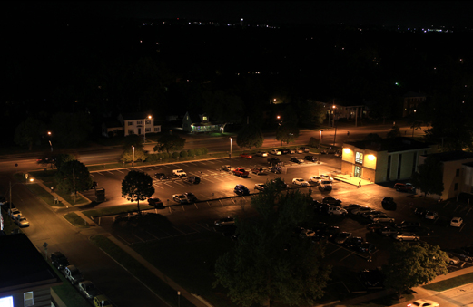

Installation of
LED Lights in
Visitor
Parking Lot
Before
After

Slide 64
History of Energy Initiatives
1996 Energy Project – $5.5M Energy Improvements
1998 Electrical Distributions System Testing
1999 Utility Master Plan
2000 Utility Tunnel Repairs
2002 Mechanical Upgrade to Hammons Student Center
2004 Energy Project - $10.9M Chilled Water Loop
2006 Utility Master Plan
2007 – 2013 Add’l Energy Conservation Measures
2009 - 2014 Heating & Cooling Efficiencies

Slide 65
Heating & Cooling Efficiencies
At the Power House
    Policy & PM Enforcement
  Matching Equipment to the Campus Demand
  A New Synergy in Energy Conservation

Slide 66
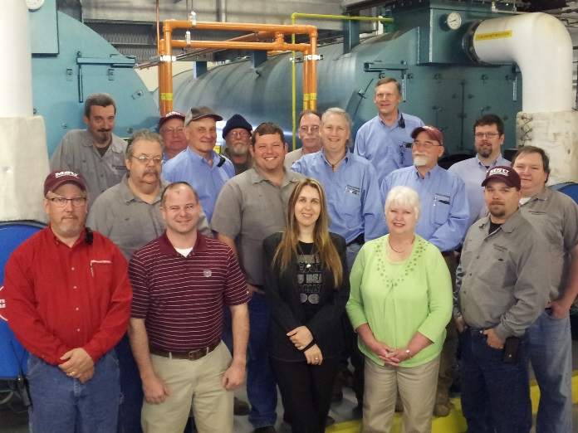

Slide 67
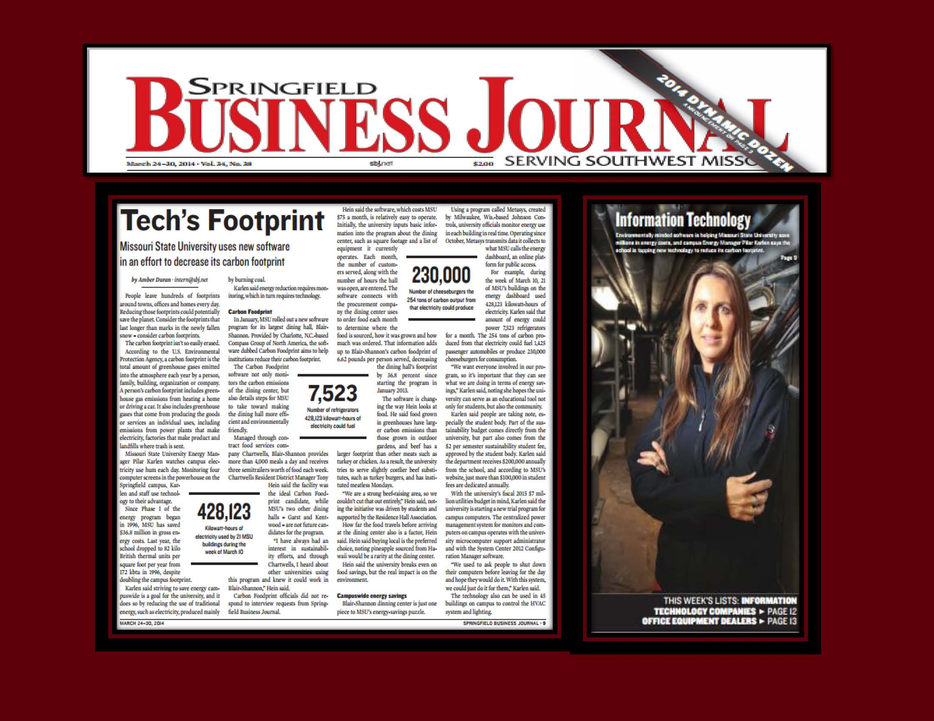

Slide 68
Heating & Cooling Efficiencies
At the Power House
  Policy & PM Enforcement
  Matching Equipment to the Campus Demand
  A New Synergy in Energy Conservation
Utility Distribution through the Tunnels
  Cleaning up Past Sins

Slide 69
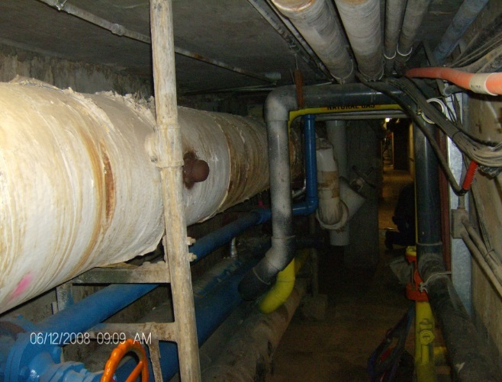
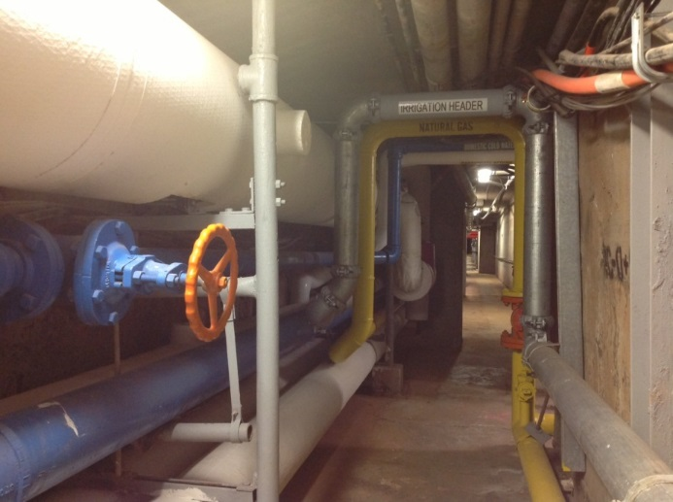
Carrington
Tunnel
2008-Present
2008
Present

Slide 70
Heating & Cooling Efficiencies
At the Power House
  Policy & PM Enforcement
  Matching Equipment to the Campus Demand
  A New Synergy in Energy Conservation
Utility Distribution through the Tunnels
  Cleaning up Past Sins
At the Building
  Improving Heat Transfer & Reducing Flow

Slide 71
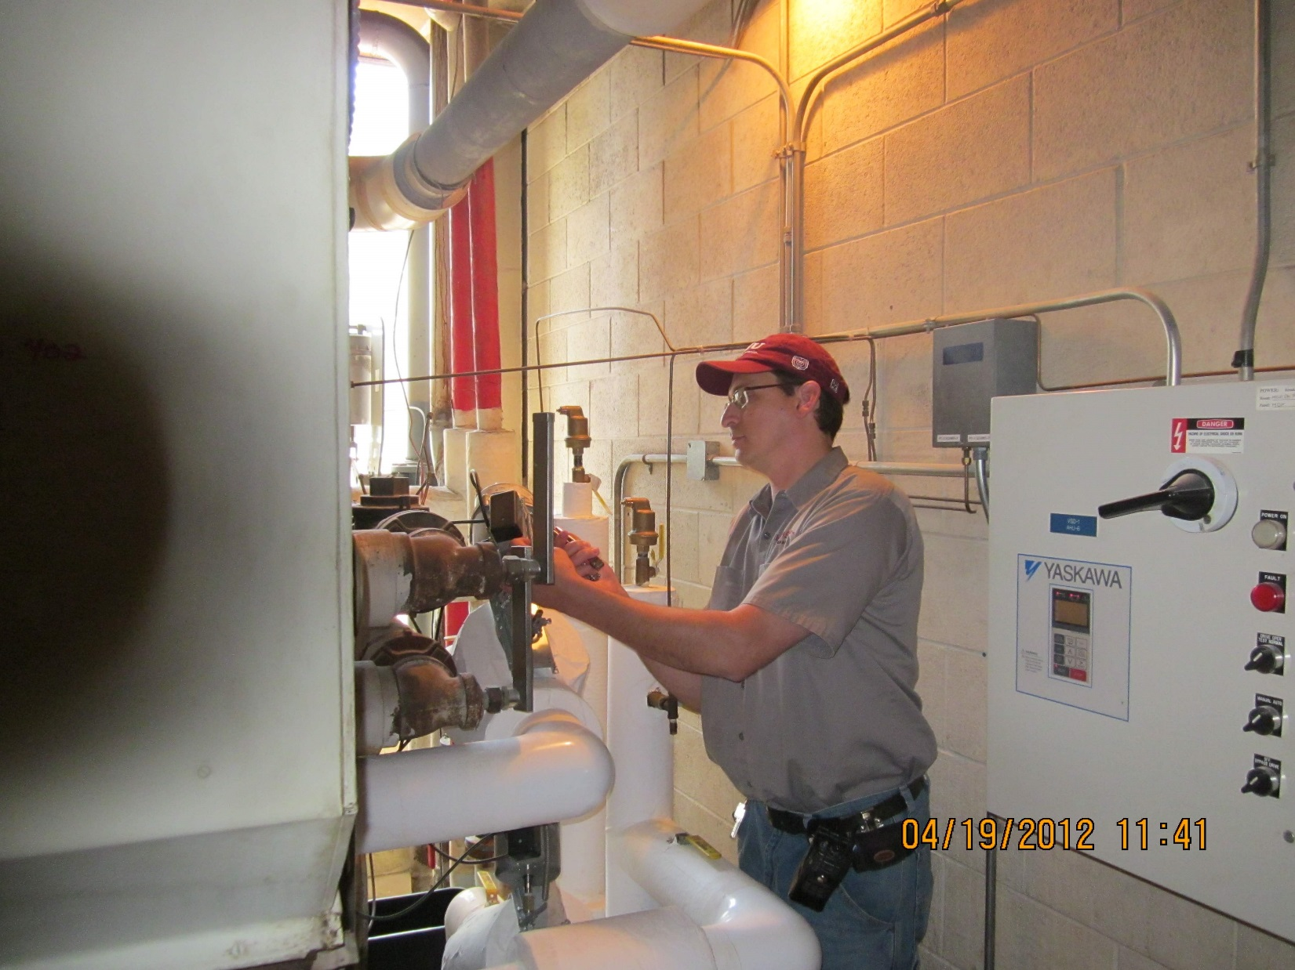

Slide 72
Benefits of Energy Improvements
1997-2014

Slide 73
Electrical Consumption
Would have been
Energy

Slide 74
Natural Gas Consumption
Would have been
Actual

Slide 75
Total Energy Savings
Would have been
Actual
Baseline Year

Slide 76
Utility (Energy) Expenditures

Slide 77
Academic Building Growth
Gross Square Footage, Springfield Campus
95% Increase From 1994
Wehr Band Hall, Taylor Health Addition, Forsythe
Physical Therapy, CDL, Student Union
Bear Park North, J.D. Morris
Strong Hall, Karls Addition
Meyer Library Addition
Willow Brook
McQueary, Greenwood
Bear Park South
Bond Ctr
Plaster Ctr
JVIC
Notes:
Waiting on pic from Photographic services

Slide 80
Increases Since 1994
Building Growth since 1994: 95% 1,710,127 sf
Utility Rate increases:
Natural Gas 91%
Electric 46%
“Plug Growth”… increase in:
              Computers
              Refrigerators
              Copiers
              Microwaves
              Vending Machines
              Cell phones
Campus population increase: 20%
  Additional heat load
  Increases in exterior door openings

Slide 81
Energy Efficiencies
kbtu/sf/year
Campus Growth
Notes:
Waiting on pic from Photographic services

Slide 82
Utility Bill Savings
Actual

Slide 83
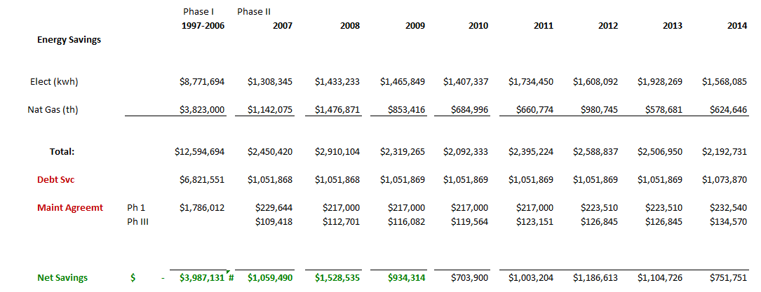
Net Energy Savings
From 1997-2014:
Energy Costs Avoided: $ 32M
Net Savings: $ 12.3M !

Slide 84
Impact of
Energy Initiatives
BTU/Sq Ft/Year
171,610
129,075
126,043
105,037
97,800
95,167
94,480
Missouri
State
University
87,000
Regional
Avg
National
Avg
‘98
’07(est)
1994
1998
2007
2014
1994
2014
1994
2014

Slide 85
Benefits Beyond Savings
University & Community Involvement
  The Sustainability Movement
    Board Initiatives
      Energy Sub-Committee

Slide 86
Energy Sub-Committee
to the Presidentially-Appointed Sustainability Committee
      Members:
        Associate Director Fac Mgmt (Chair)
        Energy Manager
        Associate VP of AIS
        Sustainability Coordinator
        Students
          Sustainability Committee members
        Faculty
        City Public Works
        City Utilities

Slide 87
Benefits Beyond Savings
University & Community Involvement
  The Sustainability Movement
    Board Initiatives
      Energy Sub-Committee
      Revolving Fund for new Energy Projects
    Environmentally-Friendly

Slide 88
Environmental Impact
(1997 - 2014)
POLLUTION REDUCTION:
The volume could fill:
21,765
Goodyear Blimps
Carbon Dioxide: 293,827 Tons
Nitrous Oxide (Acid Rain): 784 Tons
Sulfur Dioxide: 667 Tons
58
Goodyear Blimps
49
Goodyear Blimps

Slide 89
Benefits Beyond Savings
University & Community Involvement
  The Sustainability Movement
    Board Initiatives
      Energy Sub-Committee
      Revolving Fund for new Energy Projects
      Energy Audit
    Concern for the Environment
    Energy Awareness

Slide 90
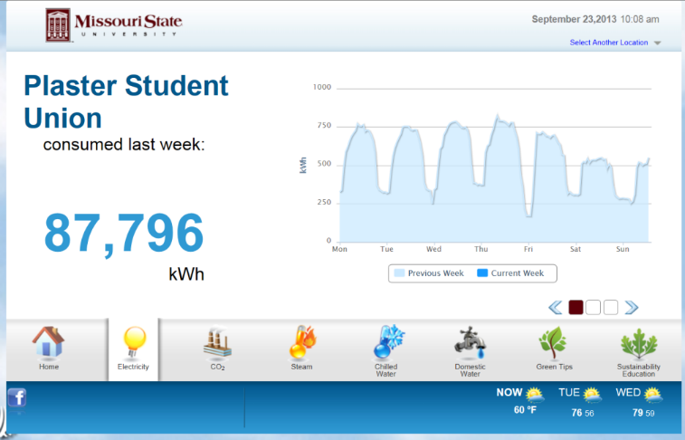
Energy Green Kiosk
TIPS TO SAVE:
Turn out the lights when departing
Adjust thermostat
Close windows during hot/cold seasons
Turn off computer when not in use
Space heaters off when unattended
Notes:
Insert dashboard pic

Slide 91
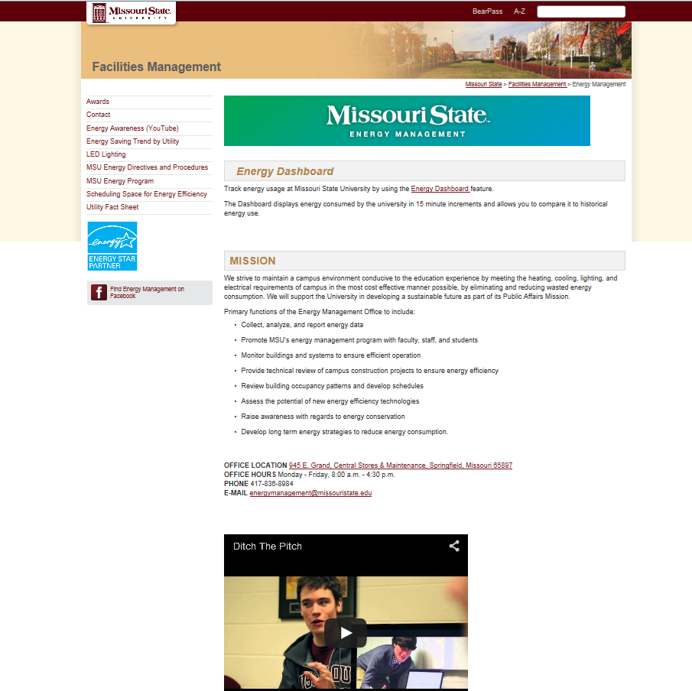

Slide 92
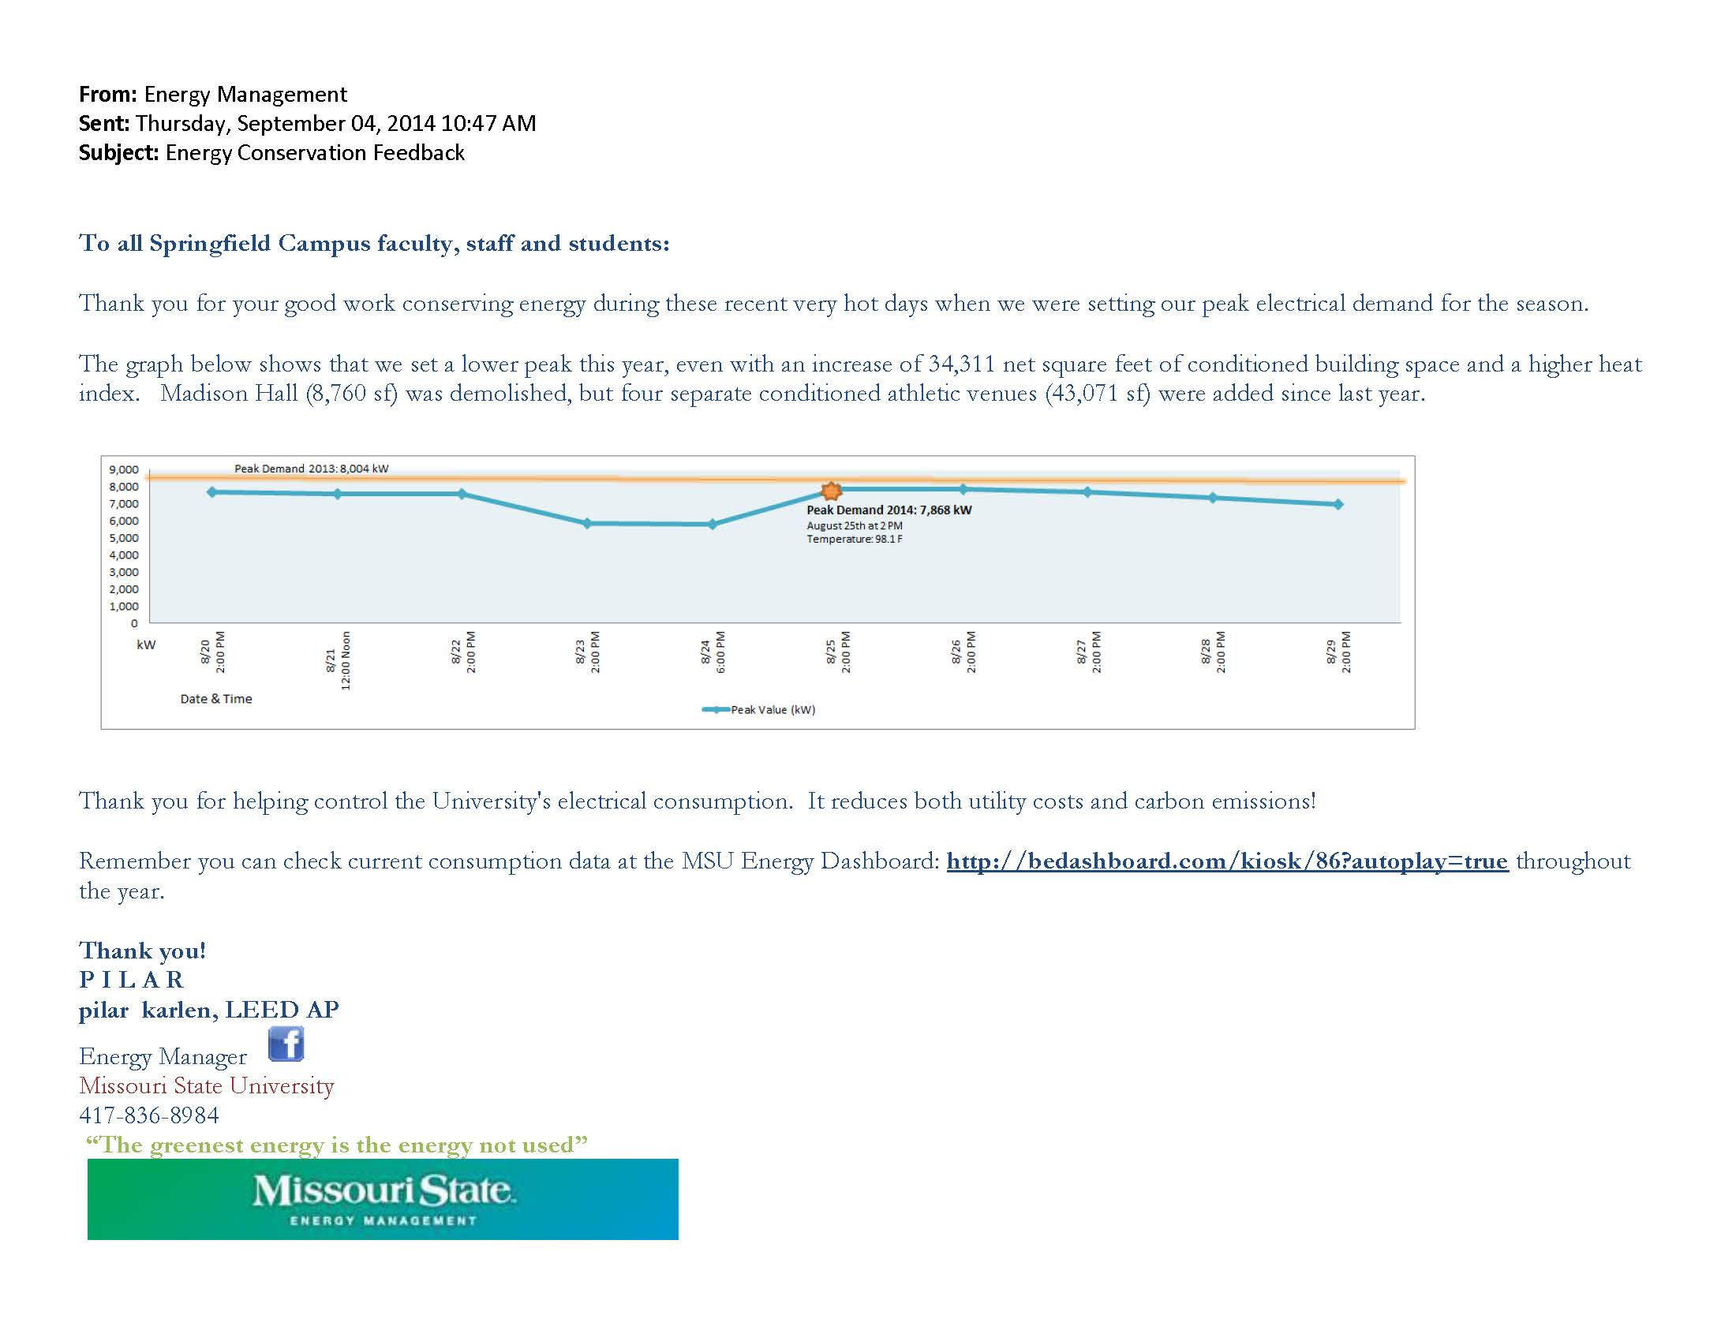
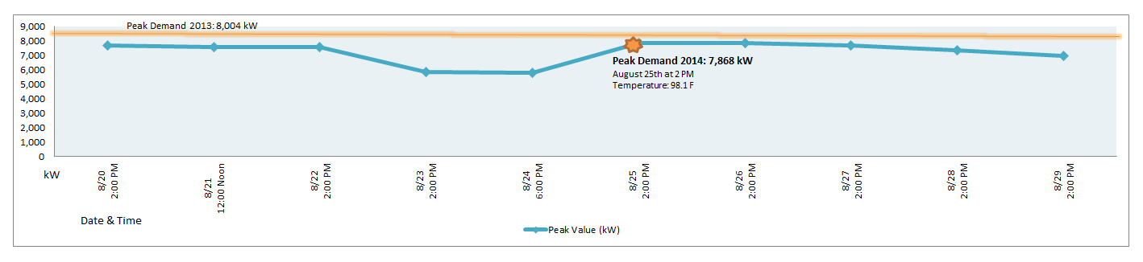

Slide 93
Building Efficiencies Forward
    LEED Buildings

Slide 94
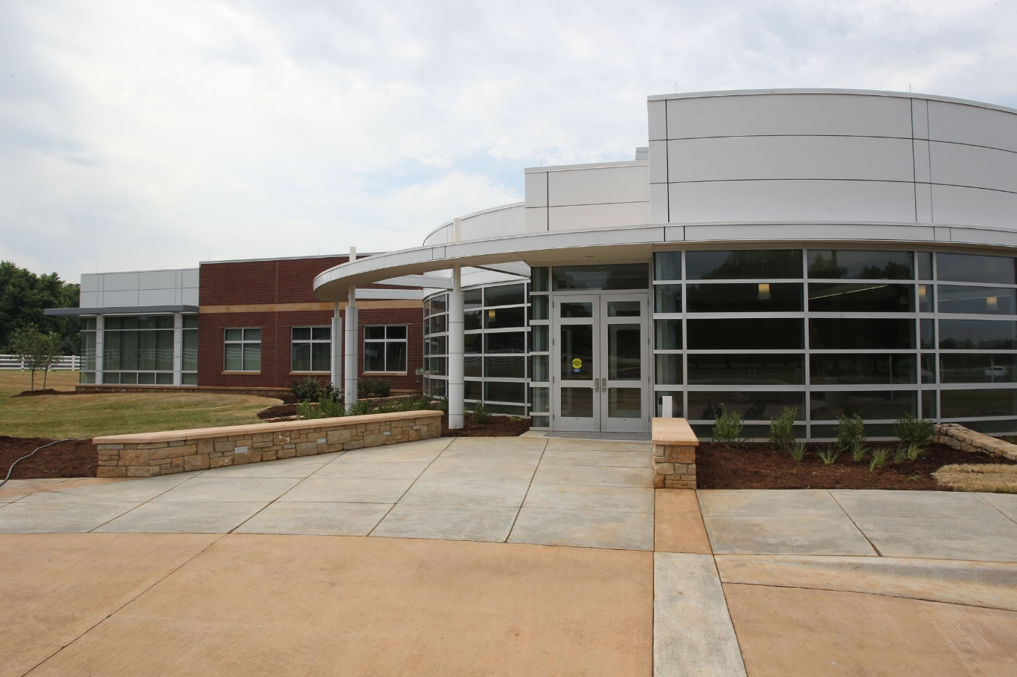
Darr Ag Learning Center

Slide 95
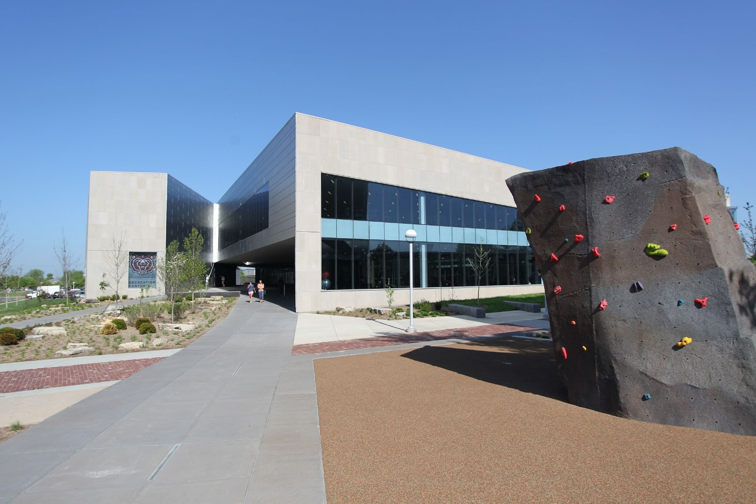
University Recreation Center

Slide 96
Building Efficiencies Forward
    LEED Buildings
    Class Consolidation

Slide 97
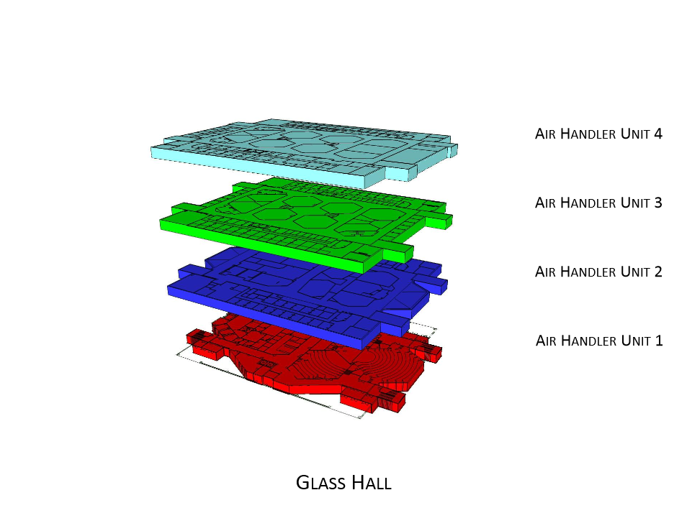

Slide 98
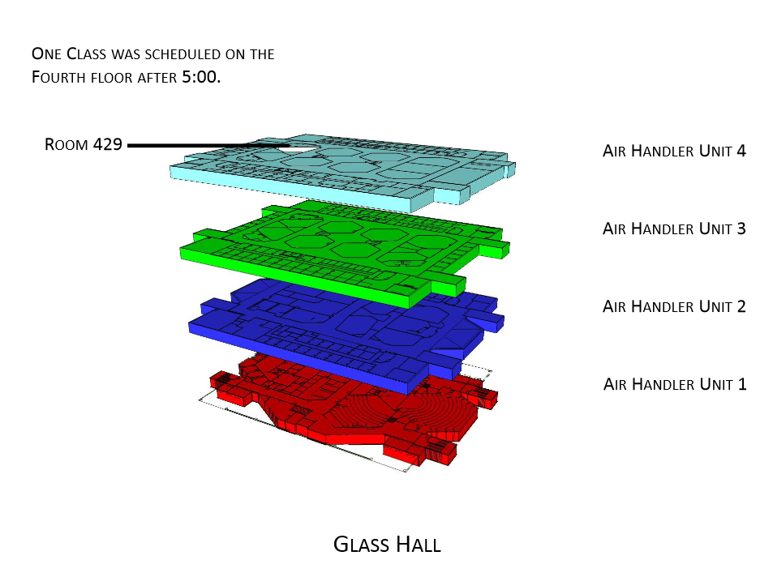

Slide 99
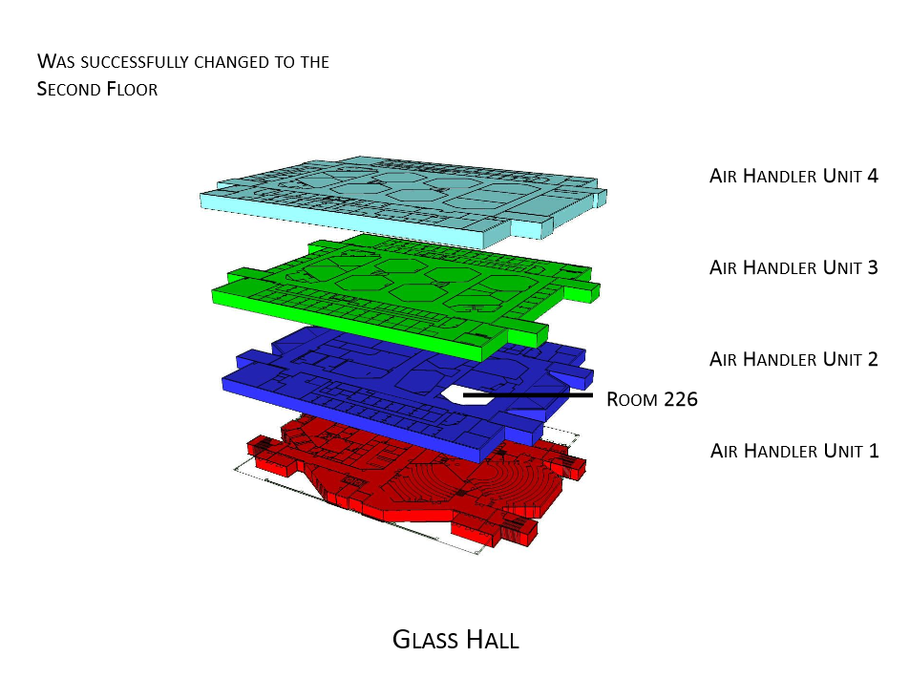

Slide 100
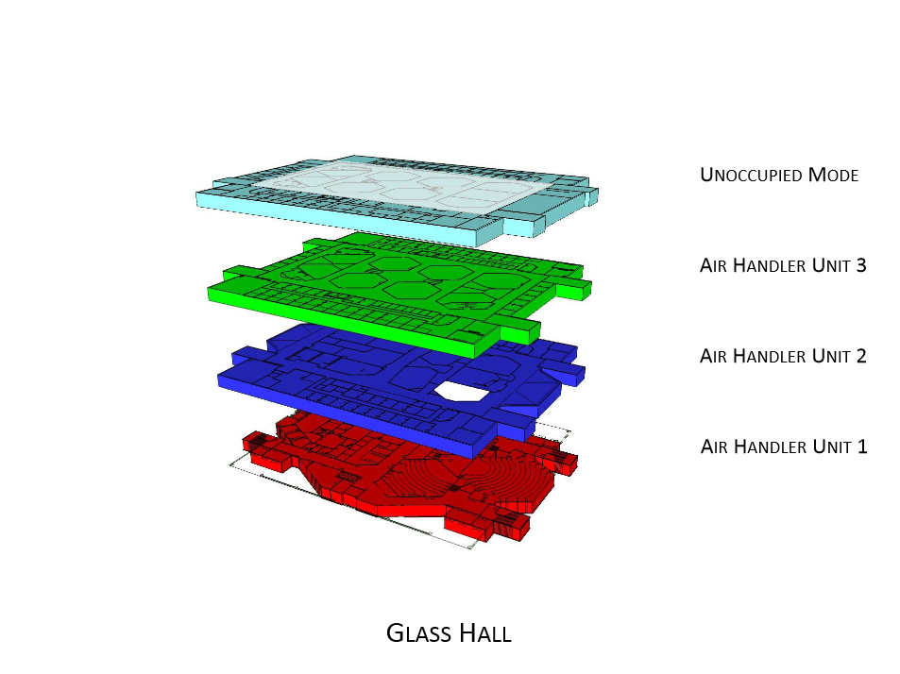

Slide 101
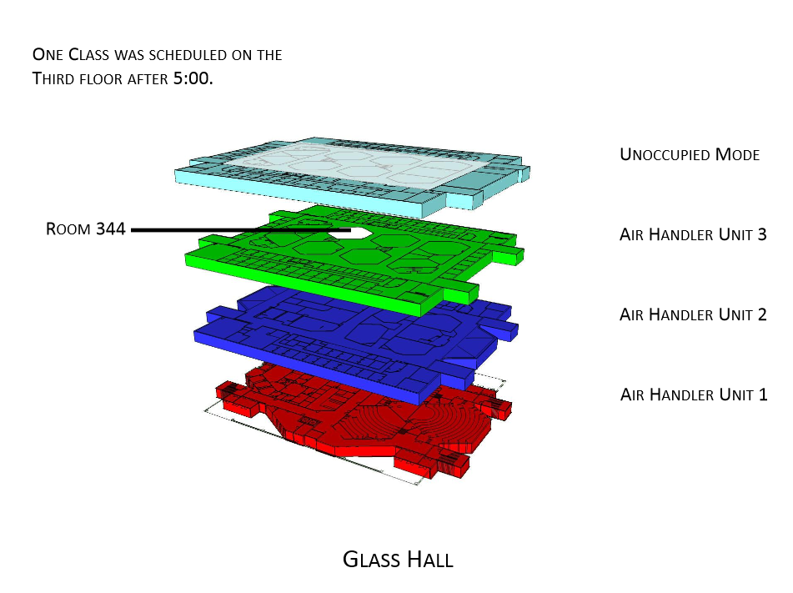

Slide 102
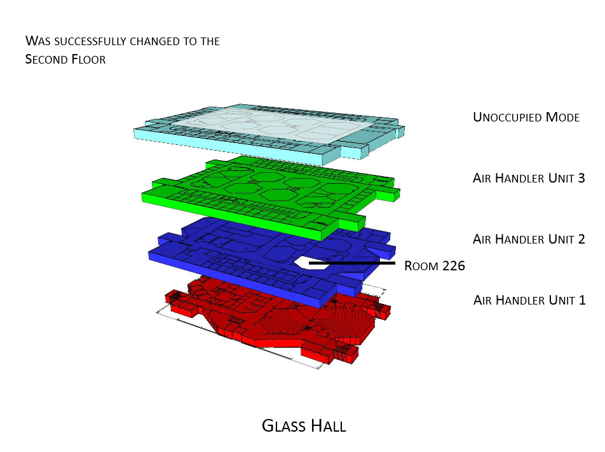

Slide 103
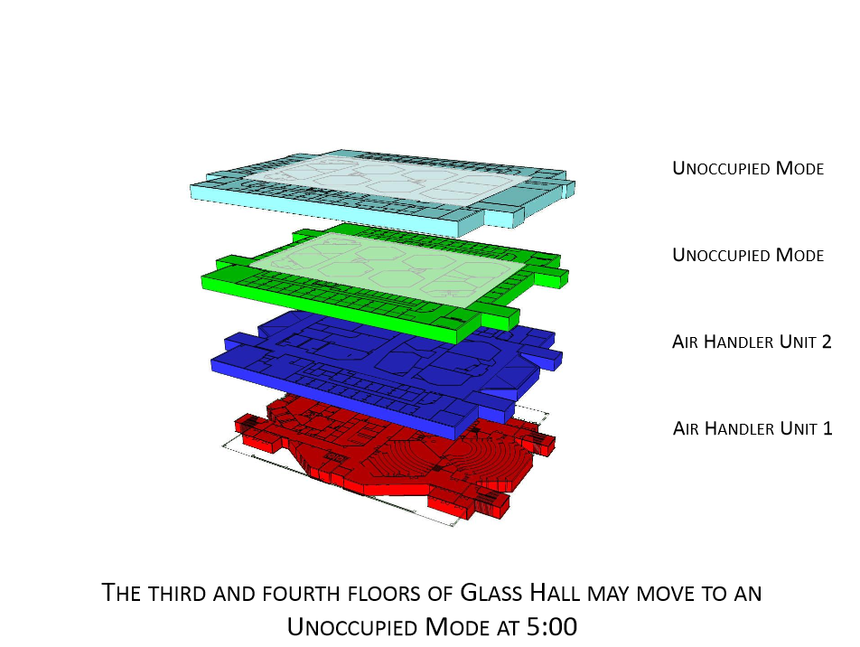

Slide 104
Class Consolidation Project
Phase I: Summer 2013
  4 partially unoccupied buildings (evenings & weekends)
  Savings of $15,939
  Reduction of 161 metric tons of carbon dioxide equivalent
Phase II: Summer 2014
  9 totally or partially unoccupied buildings (evenings & weekends)
  Savings of $38,976 (Accumulated)
  Reduction of 384 metric tons of carbon dioxide equivalent
Phase III: All year, starting Fall 2015

Slide 105
Future Opportunities
  Chilled Water Reset

Slide 106
Chilled
Water Loop
42°

Slide 107
44°
Chilled
Water Loop
42°

Slide 108
46°
Chilled
Water Loop
44°

Slide 109
48°
Chilled
Water Loop
46°

Slide 110
50°
Chilled
Water Loop
48°

Slide 111
52°
Chilled
Water Loop
50°

Slide 112
52°
Chilled
Water Loop
42°

Slide 113
Chilled
Water Loop
42°

Slide 114
Future Opportunities
  Chilled Water Reset
  Additional PIV’s to 6 buildings
  Addition Air/Dirt Separators – 10 locations
  Chilled Water Study
    Connections to CW Loop
      Sunvilla Tower
      Occupational Therapy
      Welcome Center

Slide 115
Chilled Water Distribution
Sunvilla
HHPA
Occup. Therapy
1000T
LaCrosse/
Field Hockey
Garst
Wehr
Hammons
Hutchens
900T
Greenwood Lab
Hammons
Stu Ctr
JQH Arena
320T
V.Ball
Woods
Rec Center
Blair Shannon
Welcome Center
Total Design Capacity
5,930 T
Track/Soccer
Freudenberger
Wells
Forsythe
Student Union
840T
Cheek
Glass
Meyer Library
900T
500T
Siceluff
Strong
Carrington
Existing
750T
Temple
Pummill
Hill
Funded Work
Ellis
Future
Power
house
840T
Kemper
Karls
Craig
Art Annex

Slide 116
Future Opportunities
  Chilled Water Reset
  Addition PIV’s to 6 buildings
  Addition Air/Dirt Separators – 10 locations
  Chilled Water Study
    Connections to CW Loop
      Sunvilla Tower, Occupational Therapy, Welcome Center
  More re-lamping parking lots with LEDs

Slide 117
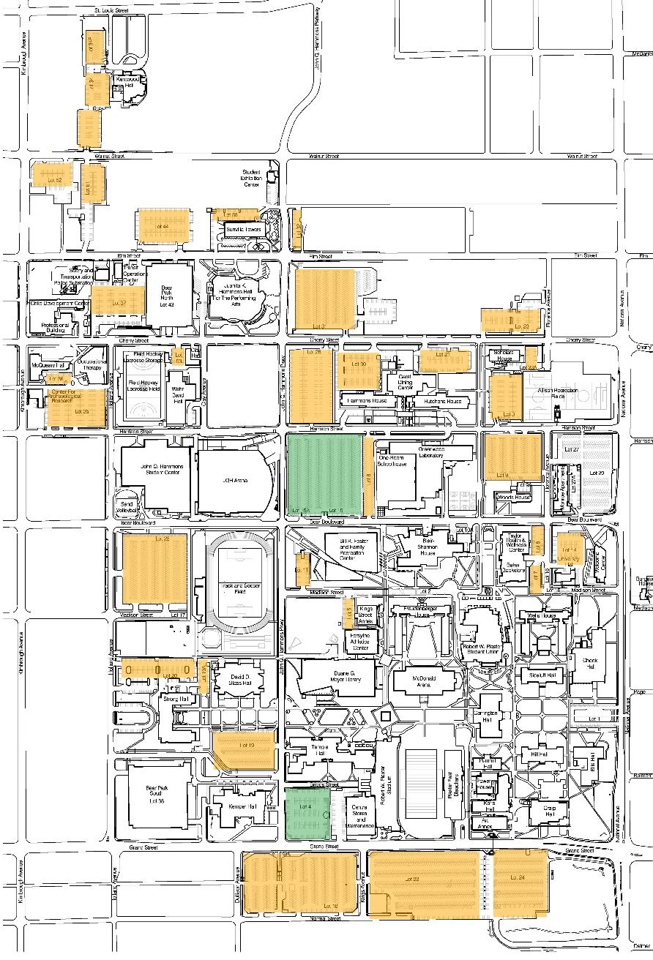
Outdoor LED Installations map

Slide 118
Future Opportunities
  Chilled Water Reset
  Addition PIV’s to 6 buildings
  Addition Air/Dirt Separators – 10 locations
  Chilled Water Study
    Connections to CW Loop
      Sunvilla Twr, Occup Therapy & Welcome Ctr
  More re-lamping parking lots with LEDs
  Virtual Servers
    Collaboration with Computer Services
  LEED EB (existing building)
  Photo-voltaics
  Solar heating
  Wireless Thermostats
  Continue to educate the campus community

Slide 119
Class Consolidation-
Emissions Reductions
81 cars/year
53 Home’s electricity use/year
315 acres of forests/year
384 metric tons of Carbon Dioxide Equivalent is similar to:

Slide 120
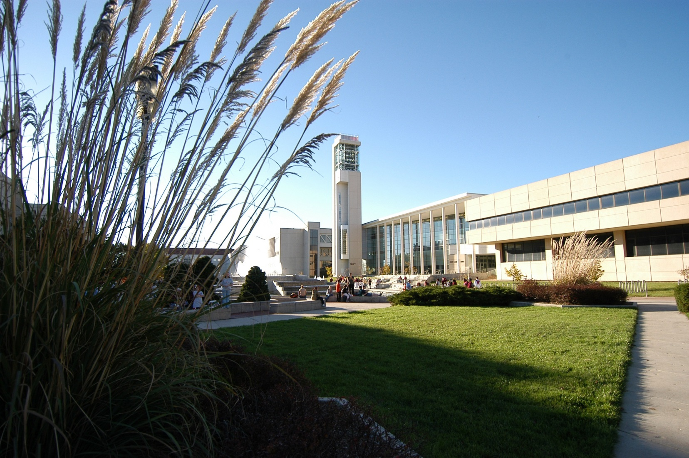
Executing its
Public Affairs Mission
through Energy Conservation
Questions?

