Slide 1
Enrollment Management and Services
Presentation to
USA Class of 2014
November 1, 2013

Slide 2
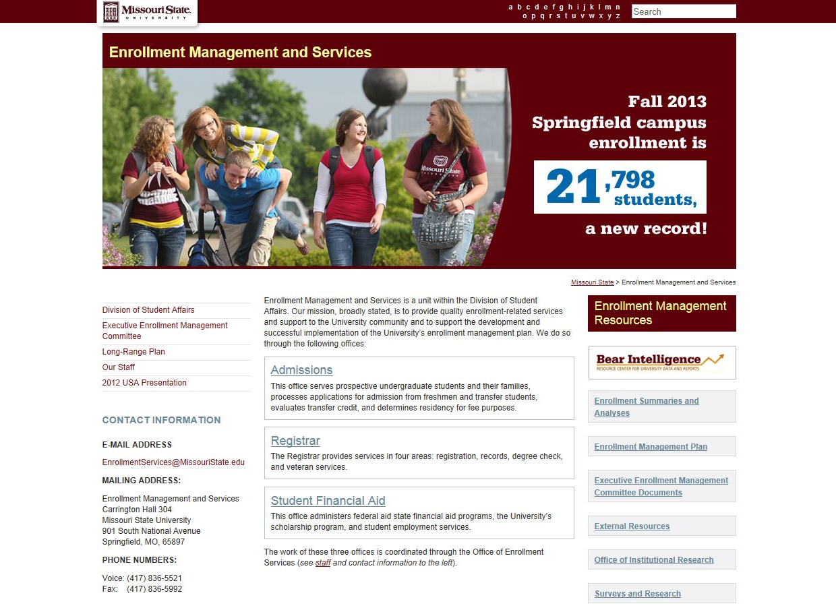

Slide 3
Access to Success Objectives
Maintain modest growth/increase diversity
Increase alternative pathway programs and enrollments
Ensure course availability
Maintain competitive cost of attendance
Increase retention and graduation rates
Increase degrees in fields aligned to workforce needs
Increase STEM degrees awarded

Slide 4
Overview of Enrollment
Fall 2013 enrollment at census: 21,798 (Q1 D)
15,947degree-seeking undergraduate students
3,334 graduate and postbaccalaureate students
2,057 precollege students
460 non-degree undergraduates

Slide 5
Overview of Enrollment (Continued)
Students from every Missouri county, every other state, and 85 other countries (Q2: D)
57.5 percent of our students are female
22.3 percent (over one-fifth) are 25 years of age or older

Slide 6
Overview of Enrollment (Continued)
By dominance of enrollment
16,348 campus-based day
1,722 campus-based evening
2,352 off campus
1,276 online
100 China campus
Total other than campus-based day: 5,450 (Q3: B)

Slide 7
Who Are Our Freshmen?
60.6 percent are female
70.1 percent come from outside of the 24 county southwest Missouri region (Q4: C)
Average ACT is 24.0 (MO high school graduate average is 21.6)
85.2 percent of ranked students were in the top half of their class
22.8 percent have not declared a major
Notes:
Mention growth from Illinois (for trivia quiz at end). Also catalog done by registrar

Slide 8
Admissions
Carrington 204
Carrington 425

Slide 9
Office of Admissions
Office operations
Undergraduate recruitment
Freshmen
Transfer
Diversity outreach and recruitment

Slide 10
Recruitment
High school and community college relations
School visits
Publications
Communications plan (mailings and email)
Campus visit program/special events
Telecounseling
Web

Slide 11
Brand Statement Follow Your Passion, Find Your Place
Marketing Message
Distinctive Mission, Remarkable Education
Affordable Choice, Unbeatable Value
Memorable Experiences, Lifetime Success

Slide 12
Challenges to recruitment
Competition
Demographics (fewer high school grads)
Economy
Higher admission standards
Location

Slide 13
Research
Survey of entering freshmen for the Fall 2013 semester -
Main competition is University of Missouri
88% said quality of major was very important in choice of college
99% used our website to obtain information

Slide 14
Admission Operations
Processing applications – over 16,000 from freshmen, transfers, and undergraduate readmits
Transfer credit evaluations
Residency for fee purposes (Q5: A)

Slide 15
Transfer Student Services
Community college visits
Development of articulation agreements
Maintenance of transfer equivalencies
Special programs and services for transfers
Transfer credit re-evaluation and preapproval system

Slide 16
Did you know?
This calendar year, 46.6 percent of our total (Q6:D) enrollment of degree-seeking undergraduate students started as transfer students.
That percentage has increased from 34.2 in 2006.
Notes:
Fall 13 enrollment was an all-time record (1,754)

Slide 17
Diversity Outreach and Recruitment
Traditional recruitment
Community outreach
Special programming
Enrollment of underrepresented students has grown by 818 (51.3%) since the fall 2009 semester

Slide 18
Student Financial Aid
Carrington 101
Carrington 401
Carrington 419
Blair-Shannon 113

Slide 19
What is the cost of attending Missouri State?
Missouri resident
Fees $ 6,908
Books $ 1,000
Room/Board (Avg.) $ 7,544
TOTAL (Q7: C) $15,452
Non-Missouri resident
Fees $ 13,388
Books $ 1,000
Room/Board $ 7,544
TOTAL $21,932

Slide 20
How do students finance those costs?
Scholarships – $19m
Grants – $29m (federal, state, institutional)
Loans – $80m
the average undergraduate with loans graduates with about $25,000 in student loan debt
On-campus employment - $5M
Total awarded in 2012-13: $133M

Slide 21
Student Financial Aid is divided into five functional areas:
Application Processing
Loan Origination
Student Employment (Shannon, Room 113 Q8:A)
Scholarships
Information

Slide 22
Financial Aid Concerns
Enrollment status—full time vs. part time
Satisfactory Academic Progress (SAP) requirements
Eligible programs (i.e., post-baccalaureate)
Repeat classes and financial aid eligibility
Dropping/Withdrawing from classes after financial aid has disbursed
Limits on maximum Pell Grant

Slide 23
Most days are good, some not so much…….

Slide 24
Office of the Registrar
Carrington 320

Slide 25
The Office of the Registrar consists of four major areas:
Degree Check
Records
Registration
Veteran Student Services (Q9: D) )

Slide 26
Primary Degree Check functions
Maintain the degree audit system
Review eligibility of graduation candidates
Produce the commencement program
Process major/minor changes and admission to degree programs
Process intent to graduate submissions
Maintain the commencement website

Slide 27
Primary Records functions
Maintain student academic records
Process grades/grade changes
Provide transcripts
Provide degree/enrollment verifications
Process name and address changes

Slide 28
Primary Registration functions
Coordinate campus-wide registration services
Process adds and drops
Coordinate development of the class schedule
Assess tuition and fees
Apply the refund schedule and process appeals
Publish important dates on the academic calendar

Slide 29
Primary Veteran Student Services functions
Currently serve 650 students
Counsel students regarding use of veteran educational assistance programs
Certify enrollment to the Dept. of Veterans Affairs
Monitor student progress toward degree completion
Facilitate withdrawal of students called to active duty
Administer Veterans Incentive Program grant

Slide 30
Cross-functional roles
Enforce and recommend academic policies
Enforce state/federal laws, including FERPA (Q10: B)
Publish undergraduate catalog (online only)
Provide training ( e.g., FERPA, class schedule building)
Implement and maintain student systems
Provide data reports to constituents on campus
Provide student directory for print and Sunshine Law requests

Slide 31
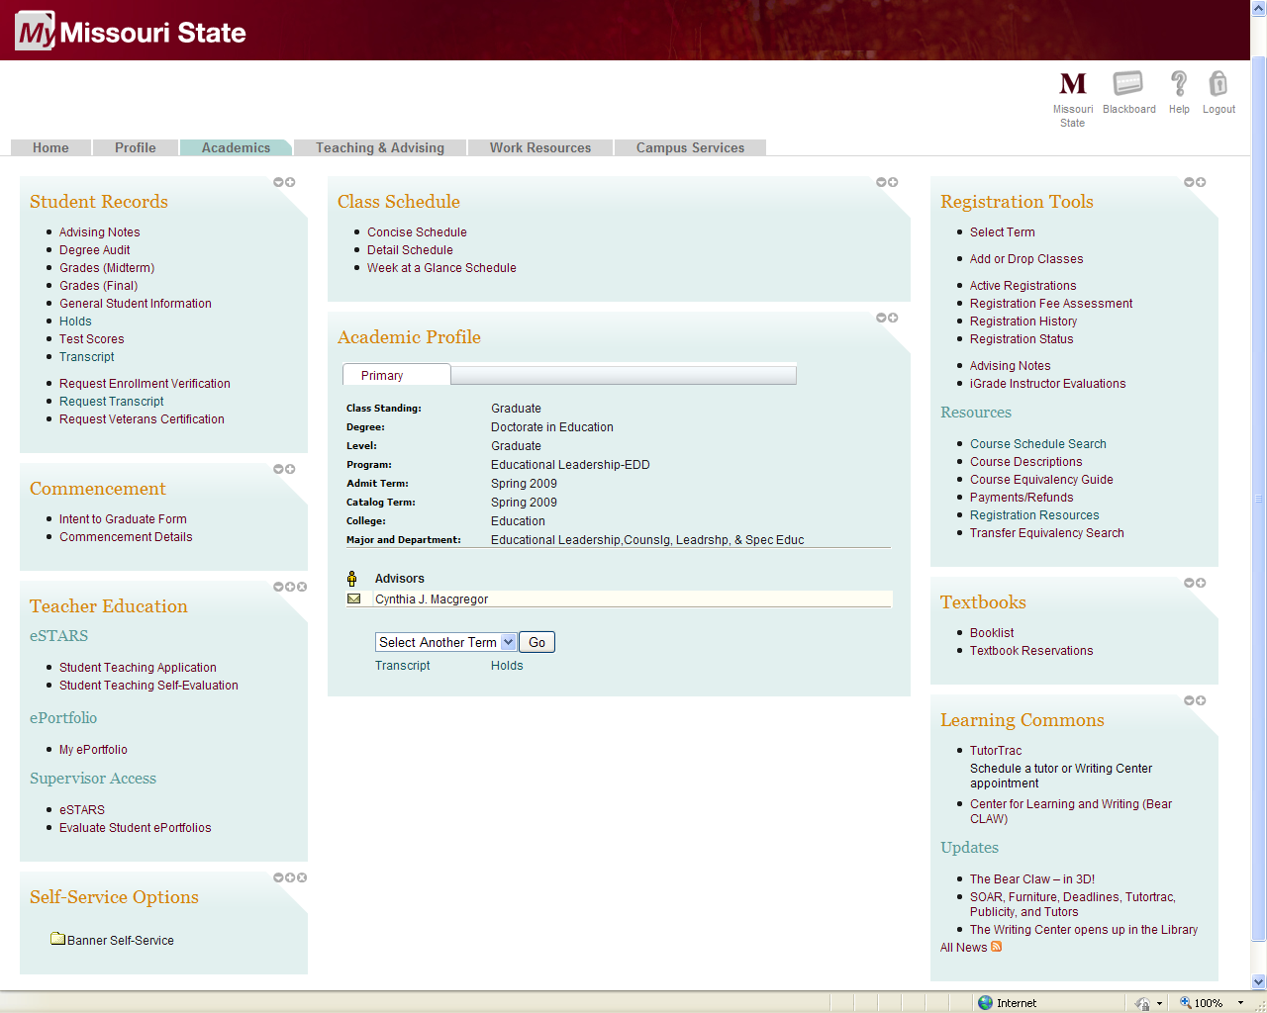
Office of the Registrar Functions on My Missouri State
Academics tab (for students)
Student records
Class schedule
Registration tools
Academic profile
Commencement
Textbooks
More

Slide 32
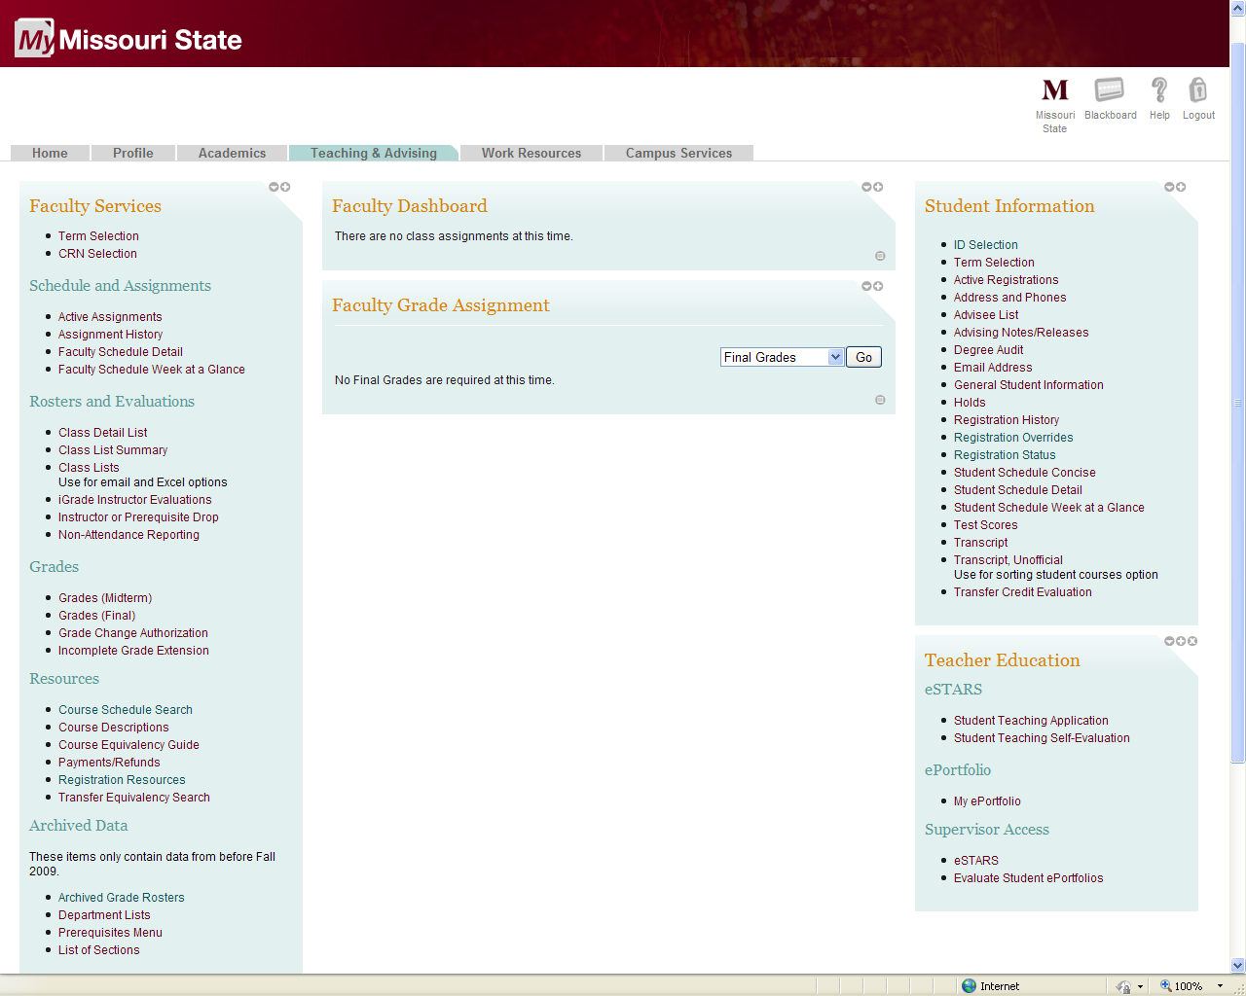
Office of the Registrar Functions on My Missouri State
Teaching and Advising tab
(for faculty, staff, advisors)*
Faculty services
Faculty dashboard
Faculty grade assignment
Student information
Teacher education

Slide 33
Conclusion
How did you do on the quiz?
Questions?
Thank you!

Slide 34
Organizational Structure for Office of the Registrar
REGISTRAR
Robert S. Hornberger, Ed.D
ASSISTANT TO REGISTRAR
Linda M. Johnson (part-time)
SYSTEMS ANALYST
Natalie Seever (part-time)
ADMINISTRATIVE ASSISTANT II
Vacant
ASSOCIATE REGISTRAR –
OPERATIONS
Rebecca H. Harbaugh
ASSOCIATE REGISTRAR –
DEGREE PROGRAMS & ADVISEMENT SUPPORT
Nathan E. Hoff
ASSISTANT REGISTRAR –
RECORDS & REGISTRATION
Diana K. Jolly
ASSISTANT REGISTRAR –
VETERAN STUDENT SERVICES
Jenifer M. Kautzman
ACADEMIC RECORDS SPECIALIST
Katie M. Anderson
ADMINISTRATIVE SPECIALIST II
Sherry Bailey
SR. ACADEMIC RECORDS SPECIALIST
Shannon Holt
VETERANS INCENTIVE PROGRAM PROJECT COORD.
Audri Hileman
(Grant Funded)
ACADEMIC RECORDS SPECIALIST
Marceda (Marty) W. Harris
ACADEMIC RECORDS SPECIALIST
Vacant
SR. ACADEMIC RECORDS SPECIALIST
Misty L. Bowen
ADMINISTRATIVE ASSISTANT II
Joyce Eddy
ACADEMIC RECORDS SPECIALIST
Dorothy A. Morton
(part-time)
ACADEMIC RECORDS SPECIALIST
Galen D. Hope
ACADEMIC RECORDS SPECIALIST
Kathleen James
ACADEMIC RECORDS SPECIALIST
Judith (Judy) K. Procter
(part-time)
Revised November 9, 2012

Slide 35
Executive Enrollment Management Committee Charge
To develop and periodically revise enrollment objectives for the University that are consistent with the institutional mission, resources, facilities, demographics, legislative mandates, and other factors that influence optimum enrollment levels.
The committee will also coordinate campus-wide efforts to achieve enrollment objectives, with emphasis on recruitment, retention, marketing, program and service offerings and resource allocation.

