Slide 1
Enrollment Management and Services
Presentation to
USA Class of 2013
November 15, 2012

Slide 2
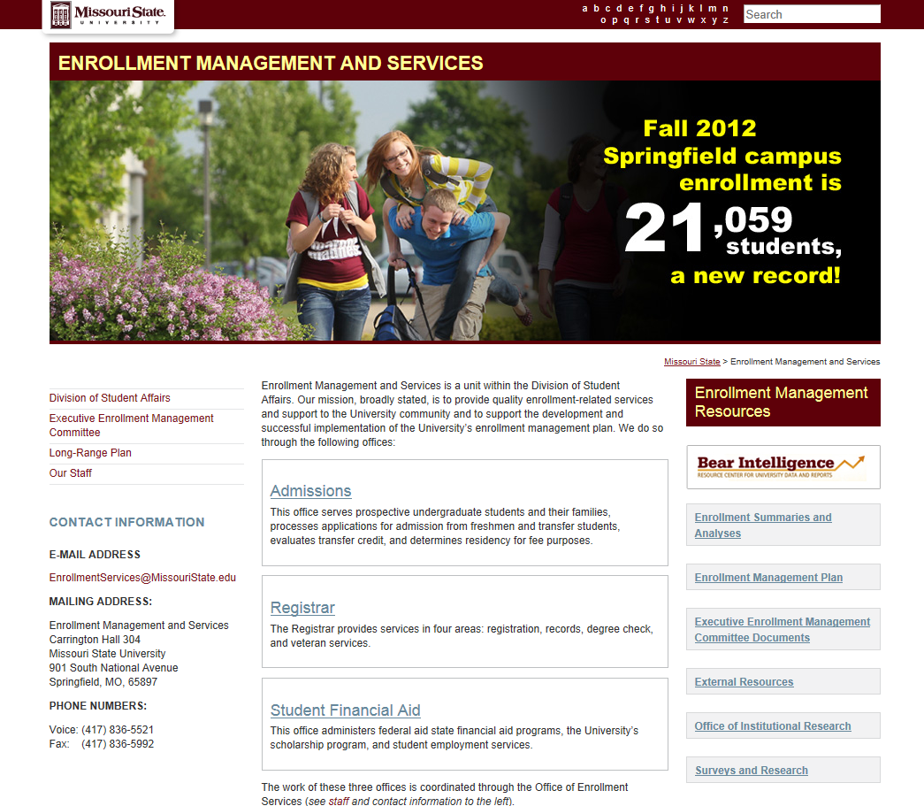

Slide 3
Overview of Enrollment
Fall 2012 enrollment at fourth week: 21,059 (Q1)
15,539 degree-seeking undergraduate students
3,295 graduate and postbaccalaureate students
1,960 precollege students
265 non-degree undergraduates

Slide 4
Overview of Enrollment
(Continued)
Students from every Missouri county, 48 other states, and 86 other countries (Q2)
56.8 percent of our students are female
22.6 percent (over one-fifth) are 25 years of age or older

Slide 5
Overview of Enrollment
(Continued)
By dominance of enrollment
  15,737 campus-based day
  1,989 campus-based evening
  2,376 off campus
  862 online
  95 China campus
  Total other than campus-based day: 5,322 (Q3)

Slide 6
Who Are Our Freshmen?
62 percent are female
69 percent come from outside of the 24 county southwest Missouri region (Q4)
Average ACT is 23.9 (MO high school graduate average is 21.6)
84 percent of ranked students were in the top half of their class
24 percent have not declared a major

Slide 8
Admissions
Carrington 204
Carrington 425

Slide 9
Office of Admissions
Undergraduate recruitment
Office operations
Transfer coordinator
Diversity outreach and recruitment

Slide 10
Recruitment
High school and community college relations
School visits
Publications
Recruitment mailings
Campus visit program/special events
Telecounseling
Web

Slide 11
Brand Statement
Follow Your Passion, Find Your Place
Marketing Message
Distinctive Mission, Remarkable Education
Affordable Choice, Unbeatable Value
Memorable Experiences, Lifetime Success

Slide 12
Challenges to recruitment
Competition
Demographics (fewer high school grads)
Economy
Higher admission standards
Location

Slide 13
Research
Survey of entering freshmen for the Fall 2012 semester -
    Main competition is University of Missouri
    87.7% said quality of major was very important in choice of college
    99.1% used our website to obtain information

Slide 14
Admission Operations
Processing applications – over 16,000 from freshmen, transfers, and undergraduate readmits
Transfer credit evaluations
Residency for fee purposes (Q5)

Slide 15
Transfer Student Services
Community college visits
Development of articulation agreements
Maintenance of transfer equivalencies
Special programs and services for transfers
Transfer credit re-evaluation and preapproval system

Slide 16
Did you know?
This calendar year, 47 percent of our total enrollment of degree-seeking undergraduate students started as transfer students.
That percentage has increased from 34 in 2006.

Slide 17
Diversity Outreach and Recruitment
Traditional recruitment
Community outreach
Special programming
Enrollment of underrepresented freshmen increased by 33% this year.

Slide 18
Student Financial Aid
Carrington 101
Carrington 401
Carrington 419
Blair-Shannon 113

Slide 19
What is the cost of attending Missouri State?
Missouri residents
Fees $ 6,793
Books $ 1,000
Room/Board (Avg.) $ 7,475
TOTAL $15,268 (Q8)
Out of state
Fees $ 13,138
Books $ 1,000
Room/Board $ 7,475
TOTAL $21,613

Slide 20

How do students finance those costs?
Scholarships – $24m
Grants – $30m (federal, state, institutional)
Loans – $80m
    the average undergraduate with loans graduates with over $23,000 * in student loan debt
On-campus employment - $5M
Total awarded in 2011-12: $133M *

Slide 21

Student Financial Aid is divided into five functional areas:
    Application Processing
    Loan Origination
    Student Employment (Shannon, Room 113 Q7)
    Scholarships
    Information

Slide 22
Financial Aid Concerns
Enrollment status—full time vs. part time
Satisfactory Academic Progress (SAP) requirements
Eligible programs (i.e., post-baccalaureate)
Repeat classes and financial aid eligibility
Dropping/Withdrawing from classes after financial aid has disbursed
Limits on maximum Pell Grant

Slide 23

Most days are good, some not so much…….

Slide 24
Office of the Registrar
Carrington 320

Slide 25
Organizational Structure for Office of the Registrar
REGISTRAR
Robert S. Hornberger, Ed.D
ASSISTANT TO REGISTRAR
Linda M. Johnson (part-time)
SYSTEMS ANALYST
Natalie Seever (part-time)
ADMINISTRATIVE ASSISTANT II
Vacant
ASSOCIATE REGISTRAR –
OPERATIONS
Rebecca H. Harbaugh
ASSOCIATE REGISTRAR –
DEGREE PROGRAMS & ADVISEMENT SUPPORT
Nathan E. Hoff
ASSISTANT REGISTRAR –
RECORDS & REGISTRATION
Diana K. Jolly
ASSISTANT REGISTRAR –
VETERAN STUDENT SERVICES
Jenifer M. Kautzman
ACADEMIC RECORDS SPECIALIST
Katie M. Anderson
ADMINISTRATIVE SPECIALIST II
Sherry Bailey
SR. ACADEMIC RECORDS SPECIALIST
Shannon Holt
VETERANS INCENTIVE PROGRAM PROJECT COORD.
Audri Hileman
(Grant Funded)
ACADEMIC RECORDS SPECIALIST
Marceda (Marty) W. Harris
ACADEMIC RECORDS SPECIALIST
Vacant
SR. ACADEMIC RECORDS SPECIALIST
Misty L. Bowen
ADMINISTRATIVE ASSISTANT II
Joyce Eddy
ACADEMIC RECORDS SPECIALIST
Dorothy A. Morton
(part-time)
ACADEMIC RECORDS SPECIALIST
Galen D. Hope
ACADEMIC RECORDS SPECIALIST
Kathleen James
ACADEMIC RECORDS SPECIALIST
Judith (Judy) K. Procter
(part-time)
Revised November 9, 2012

Slide 26




The Office of the Registrar consists of four specialty areas:
Degree Check
Records
Registration
Veteran Student Services (Q9) )

Slide 27

Primary Degree Check functions
Maintain the degree audit system
Review eligibility of graduation candidates
Produce the commencement program
Process major/minor changes and admission to degree programs
Process intent to graduate submissions
Maintain the commencement website

Slide 28

Primary Records functions
Maintain student academic records
Process grades/grade changes
Provide transcripts
Provide degree/enrollment verifications
Process name and address changes

Slide 29

Primary Registration functions
Coordinate campus-wide registration services
Process adds and drops
Coordinate development of the class schedule
Assess tuition and fees
Apply the refund schedule and process appeals
Publish important dates on the academic calendar

Slide 30
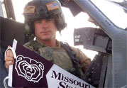
Primary Veteran Student Services functions
Currently serve 650 students
Counsel students regarding use of veteran educational assistance programs
Certify enrollment to the Dept. of Veterans Affairs
Monitor student progress toward degree completion
Facilitate withdrawal of students called to active duty
Administer Veterans Incentive Program grant

Slide 31

Cross-functional roles
Enforce and recommend academic policies
Enforce state/federal laws, including FERPA
Publish undergraduate catalog (online only)
Provide training ( e.g., FERPA, class schedule building)
Implement and maintain student systems
Provide data reports to constituents on campus
Provide student directory for print and Sunshine Law requests

Slide 32
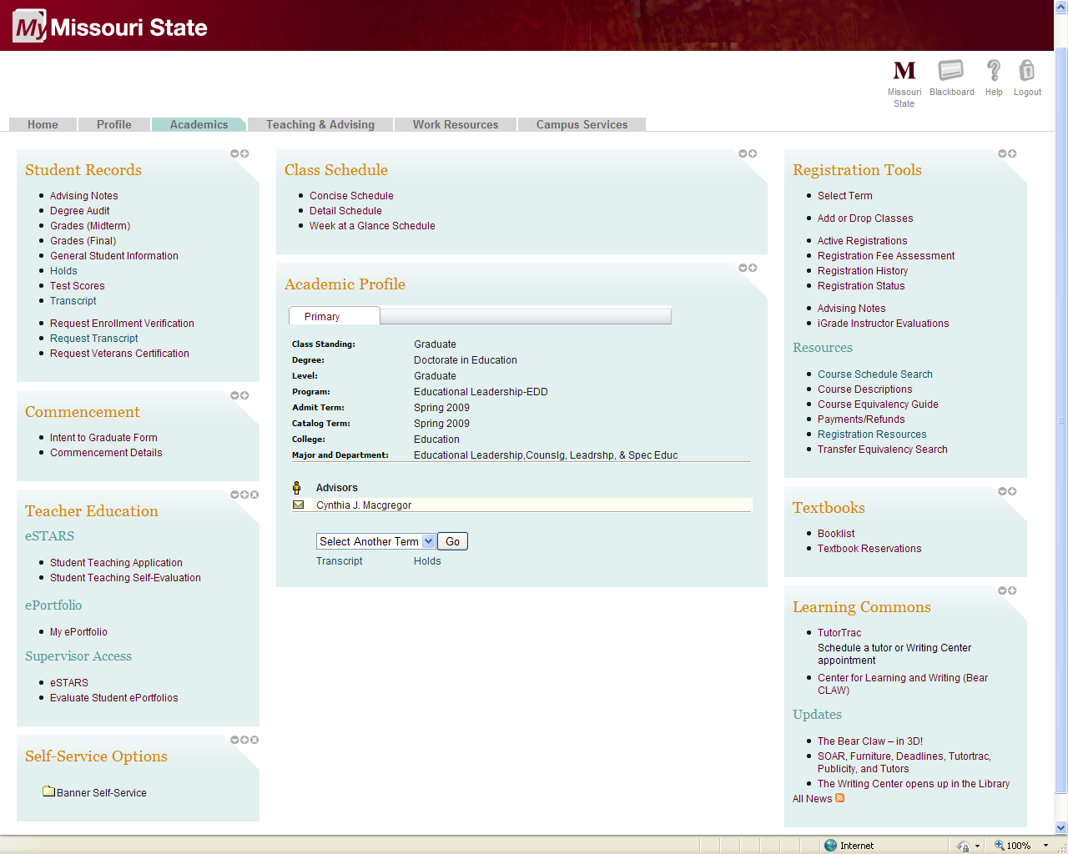
Office of the Registrar Functions on My Missouri State
Academics tab
(for students)
    Student records
    Class schedule
    Registration tools
    Academic profile
    Commencement
    Textbooks
    More

Slide 33
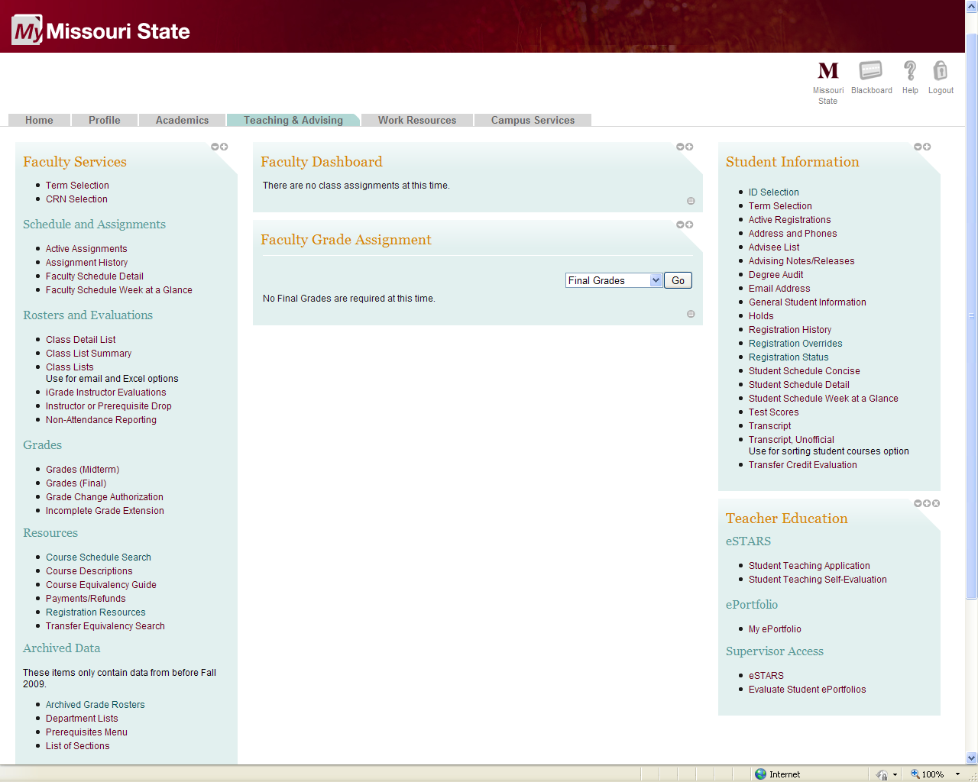
Office of the Registrar Functions on My Missouri State
Teaching and
Advising tab
(for faculty, staff,
advisors)*
    Faculty services
    Faculty dashboard
    Faculty grade
    assignment
    Student information
    Teacher education

Slide 34
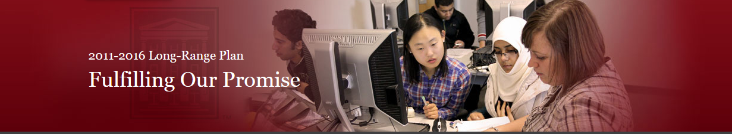
Access to Success Objectives
Maintain modest growth/increase diversity
Increase alternative pathway programs and enrollments
Ensure course availability
Maintain competitive cost of attendance
Increase retention and graduation rates
Increase degrees in fields aligned to workforce needs
Increase STEM degrees awarded

Slide 35
Executive Enrollment Management Committee Charge
To develop and periodically revise enrollment objectives for the University that are consistent with the institutional mission, resources, facilities, demographics, legislative mandates, and other factors that influence optimum enrollment levels.
The committee will also coordinate campus-wide efforts to achieve enrollment objectives, with emphasis on recruitment, retention, marketing, program and service offerings and resource allocation.

Slide 36
Conclusion
How did you do on the quiz?
Questions?
Thank you!

