Slide 1
SEM Plan Update
Board of Governors Meeting
Dr. Rob Hornberger, Associate Vice President of Enrollment Management & Services
Dr. Tammy Jahnke, Dean of the College of Natural and Applied Sciences
October 16, 2020

Slide 2
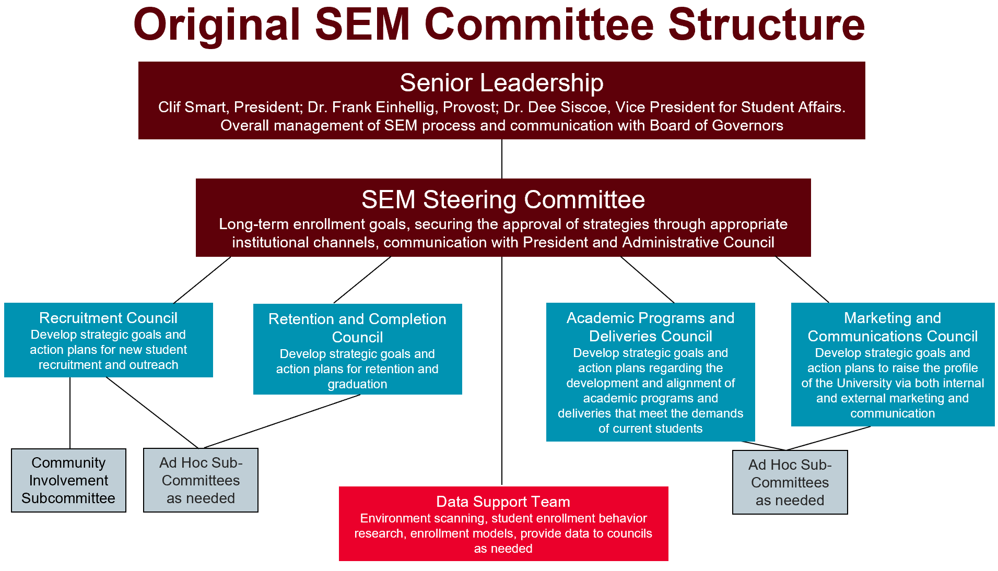
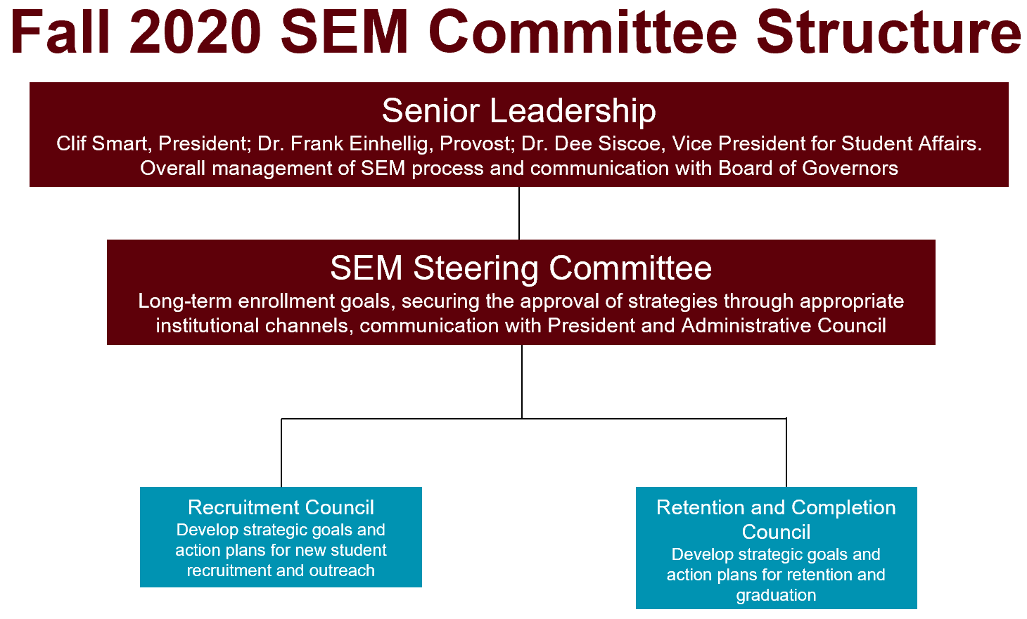
SEM Committee Structure

Slide 3
SEM Goals
Overview of Update
Narrowed the scope
Transition some of the SEM plan objectives to the new long-range plan
Reassessed the remaining goals
  Moved climate (#4) and raising the profile (#7) goals to LRP
  Collapsed goal #3 (Student Success/Underserved Populations) to be addressed in goals #1 (Outreach and Recruitment) and #2 (Retention and Student Success).
Created introductory language to address the
  baseline that will be used for the goals
  ability to have flexibility and reassess the goals and strategies throughout the life of the plan

Slide 4
SEM Goals
Goal #1 | Fa2020 Baseline | Fa2026 Goal
Overall Headcount | 24,163 | 25,371
FTE Enrollment | 18,027 | 18,568
Updated draft
Outreach and Recruitment
By 2026, with particular focus on targeted student populations, increase overall headcount enrollment by 5% and increase FTE enrollment by 3%.
Retention and Student Success
By 2026, increase the first to second year undergraduate student retention rate by 5%, with a focus on improving retention by 5% for each of these sub-groups: African American, Hispanic/Latino/Latinx, first-generation and Pell eligible students; and improve persistence at other critical transition points.
Successful Graduation and/or Completion
By 2026 increase the number of credentials (e.g., degrees and certificates) awarded to 5,800 per year.
Financial Preparedness
By 2026, decrease the average loan debt of undergraduate degree recipients by 5% after inflation.
Goal #2 | Fa2020 Baseline | Fa2026 Goal
Overall Retention @ 5% | 79.2% | 84.2%
Overall Retention @ 3% | 79.2% | 82.2%
African American @ 5% | 71.3% | 76.3%
Hispanic/Latino/Latinx @ 5% | 75.8% | 80.8%
First Generation @ 5% | 73.9% | 78.9%
Pell Eligible @ 5% | 71.7% | 76.7%
Goal #3 | FY20 Baseline | FY25 Goal
Overall Headcount | 5,696 | 5,800
Goal #4 | AY 2019-20Baseline | AY 2025-26 Goal
Avg UG loan debt | $24,893 | * $23,648
* Assuming CPI remains the same.

Slide 5
Strategies
3-5 broad strategies will be created for each goal
Many action items (tactics) will be developed to meet these strategies
The SEM plan will include goals and strategies
Recruitment manuals, operational plans, etc. will include tactics

Slide 6
Measuring Success
Combine with existing key performance indicators (KPI) goals
KPI goals for overall retention and graduation rates exist.
Will recommend adding KPI’s and/or goal labels for:
  Enrollment (headcount and FTE)
  Retention by subgroups
  Credentials awarded
  Financial preparedness (average loan debt)
Ensures consistency with our goals and how they are measured

Slide 7
Timeline
Date | Item
October 19 | Steering Committee
End of October | SEM plan draft submitted by consultant
Month of November | Internal review of plan
November 6 | Steering Committee
November 9 | Senior Leadership
November 20 | Steering Committee
December 7 | Senior Leadership
December 10 | Final version presented to BOG

