Slide 1

Online Reservation Systems
Training

Slide 2
EMS Online Reservation Training
URL: Events.Missouristate.edu/EMSWebApp

Slide 3
PSU Terminology
Banner Space
  The Area above the staircase between 1st and 2nd flr.
  Can be booked 2 days out
Contact Tables:
  4 tables under the staircase on 2nd flr of PSU
  3 tables outside across from Siceluff
  Can book 2 days out
Boardrooms
  309/310/311
  Otherwise known as fishbowl rooms ☺
  Can be booked anytime
Breakout Rooms:
  308/312/314/315/317
  Can be booked 2 days out
Large Event Space:
  Grand Ballroom
  Ballroom East/Ballroom West
  PSU Theater
  Traywick Parliamentary Rm
  PSU Union Club
  PSU Food Court
  Can only be booked 10 days out
Outdoor Space:
  North Mall
  North Patio
  Bear Paw Stage
  Can only be booked 10 days out

Slide 4
PSU Terminology Continued
Web Confirmed
  Reservation space is confirmed
  Spaces automatically confirmed – Banner, Contact Tables, Boardroom
Web Request
  Space is held but not confirmed
  You will be contacted by EMS office to get more information if needed in order to confirm your space
Web Conflict
  The space you requested is not available on that date and time. You need to pick another space, date, or time. This occurs when making a reoccurring reservation
Web Canceled
  You have canceled your reservation through the web app
Services
    Audio/Visual
    (PSU Spaces & Specialty Event spaces have costs, Academic spaces are free but must be used as is)
    Food & Beverages

Slide 5
Academic Space Terminology
The scheduling templates for academic spaces are
  Academic Fall (Spaces holds 10-34ppl)
  Academic Fall (Spaces holds 35-49ppl)
  Academic Fall (Spaces holds 50-74ppl)
  Academic Fall (Spaces holds 75 - 370ppl)
Academic space timeline for submitting requests*:
  Spring – starting November 1st
  Summer** & Fall – starting April 1st
  *Event/meeting requests cannot be confirmed until after Event & Meeting Services is given permission to do so (i.e. after classes are loaded, classroom conflicts resolved, and Room Scheduling has given permission to do so.
  **Summer can only be confirmed after academic schedules have been loaded, conflicts resolved, and MSU Summer Camps have been scheduled.

Slide 6
Lets Book Space for a Large Event
With Services!

Slide 7
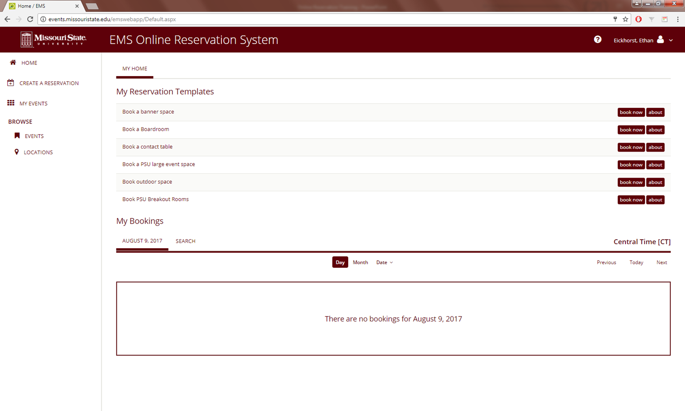
Large Event Reservation Example
Book a PSU large event space

Slide 8
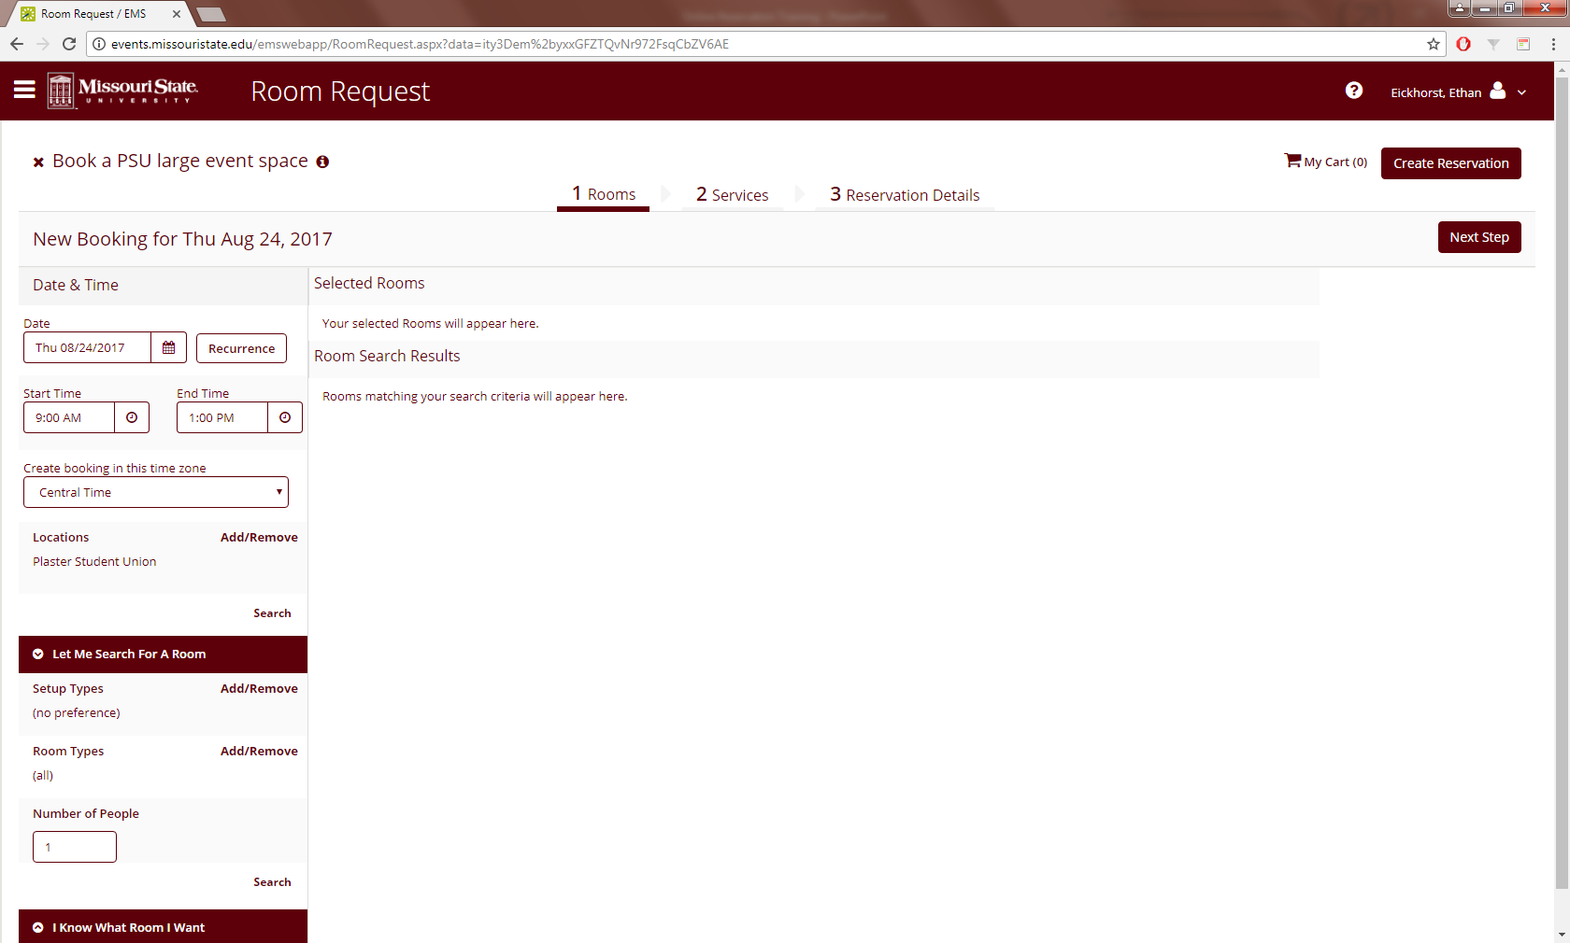
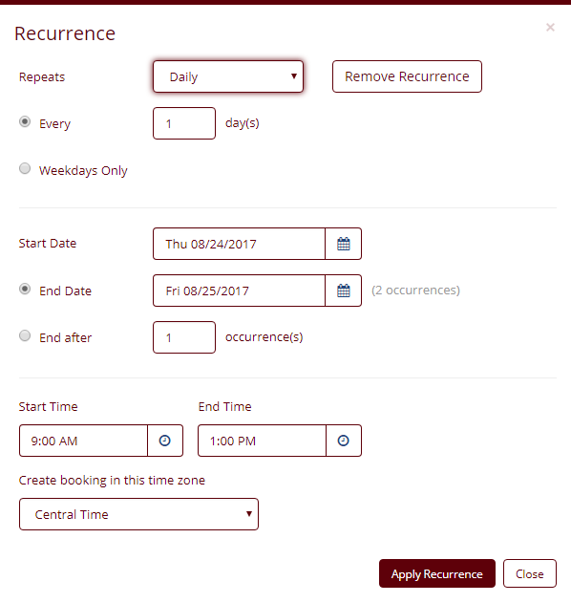
Large Event Reservation cont.
Select Date if it occurs on a single day
Enter the start and end time directly underneath
Select (Recurrence) if it occurs on multiple days
A separate window will pop up with the date and time options

Slide 9

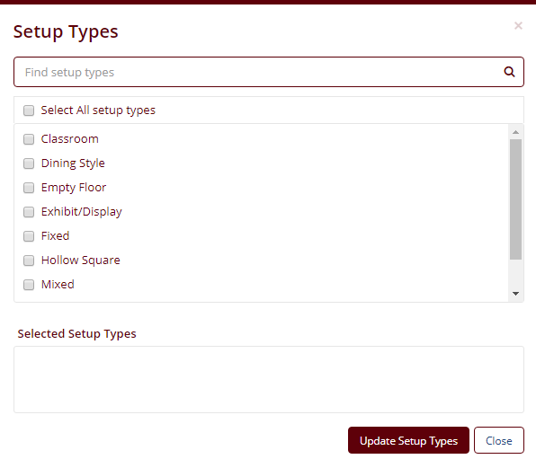
Large Event Reservation cont.
Make sure (Let Me Search For A Room) is selected
Select Setup Types (Add/Remove)
  Popup window gives options for how to set the room
Enter amount of guests in (Number of People)
Note: As selections are being made, the search results will auto update in the middle of the screen

Slide 10
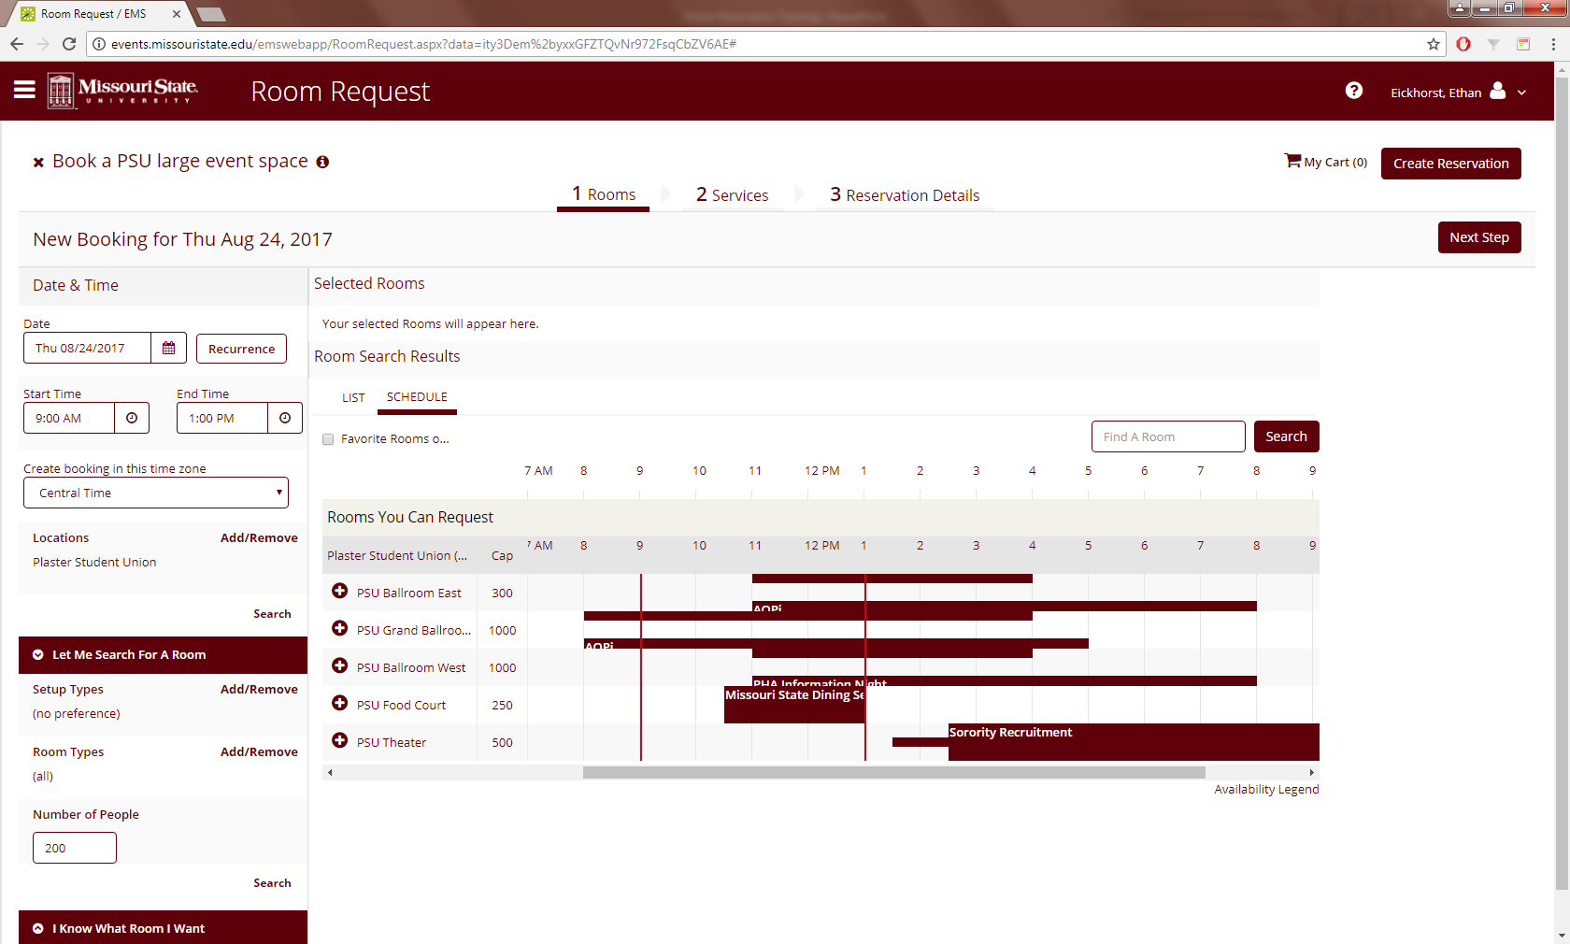
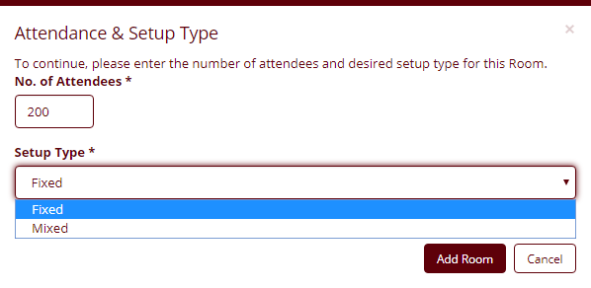
Large Event Reservation cont.
Select the room that is appropriate and available by clicking on the + button
Popup window will give the (Setup Type) options the theater has two types (Fixed) and (Mixed)
Fixed is installed seating
Mixed is installed and portable chairs together
Click on (Add Room)

Slide 11

Large Event Reservation cont.
After clicking (Add Room) your selection will show up under Selected Rooms with a – button
The – button will cancel the room. Then you can change the dates, times, space
Once everything is correct click on (Next Step)

Slide 12
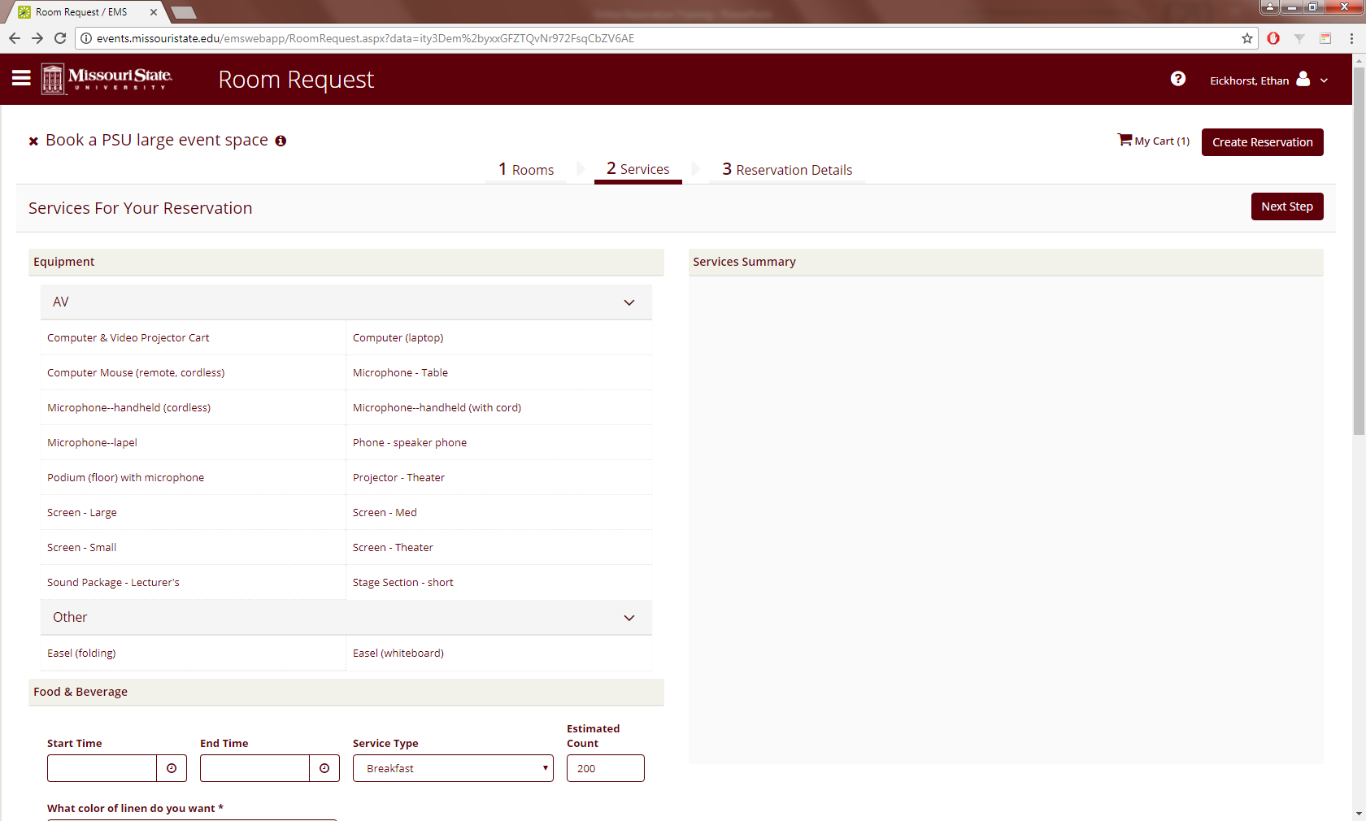
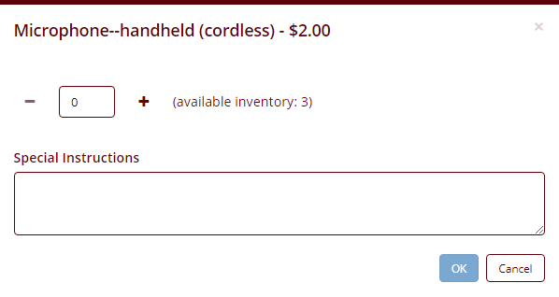
Large Event Reservation cont.
The (Services) tab gives you the ability to select A/V equipment and catering
Click on equipment that is needed for the event
Popup window will display how many are available and allow up to that many to be chosen
It also shows you how much the equipment costs
Click the + sign to add the equipment

Slide 13
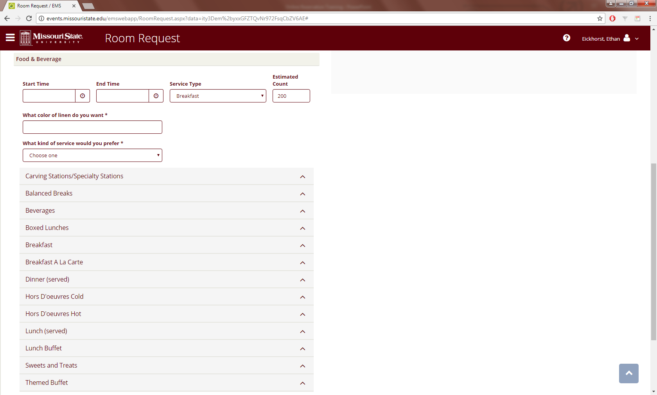
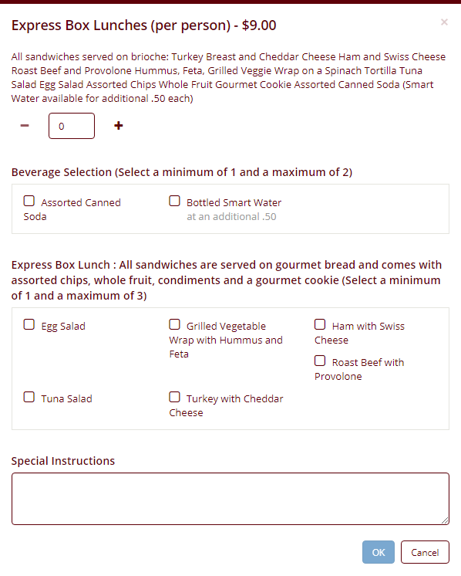
Large Event Reservation cont.
Many catering options are available under the Food and Beverage section
Fill in the Start and End times for when the catering is to be served
Select what type of meal is to be served
Select color of linen
Select what type of dishware the meal is to be served on
Once a catering option has been selected a popup window will display item specific options

Slide 14
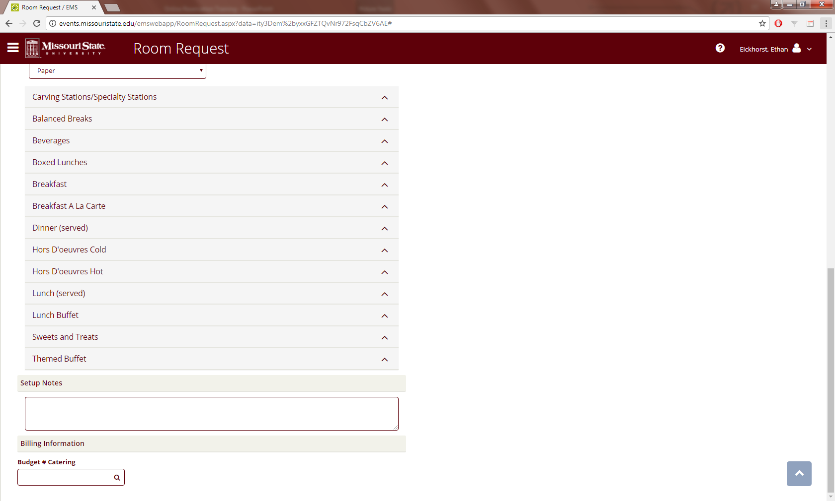
Large Event Reservation cont.
Any additional catering setup notes can be added in the (Setup Notes)
The budget number to be used for catering can be entered in the (Budget # Catering) text box

Slide 15
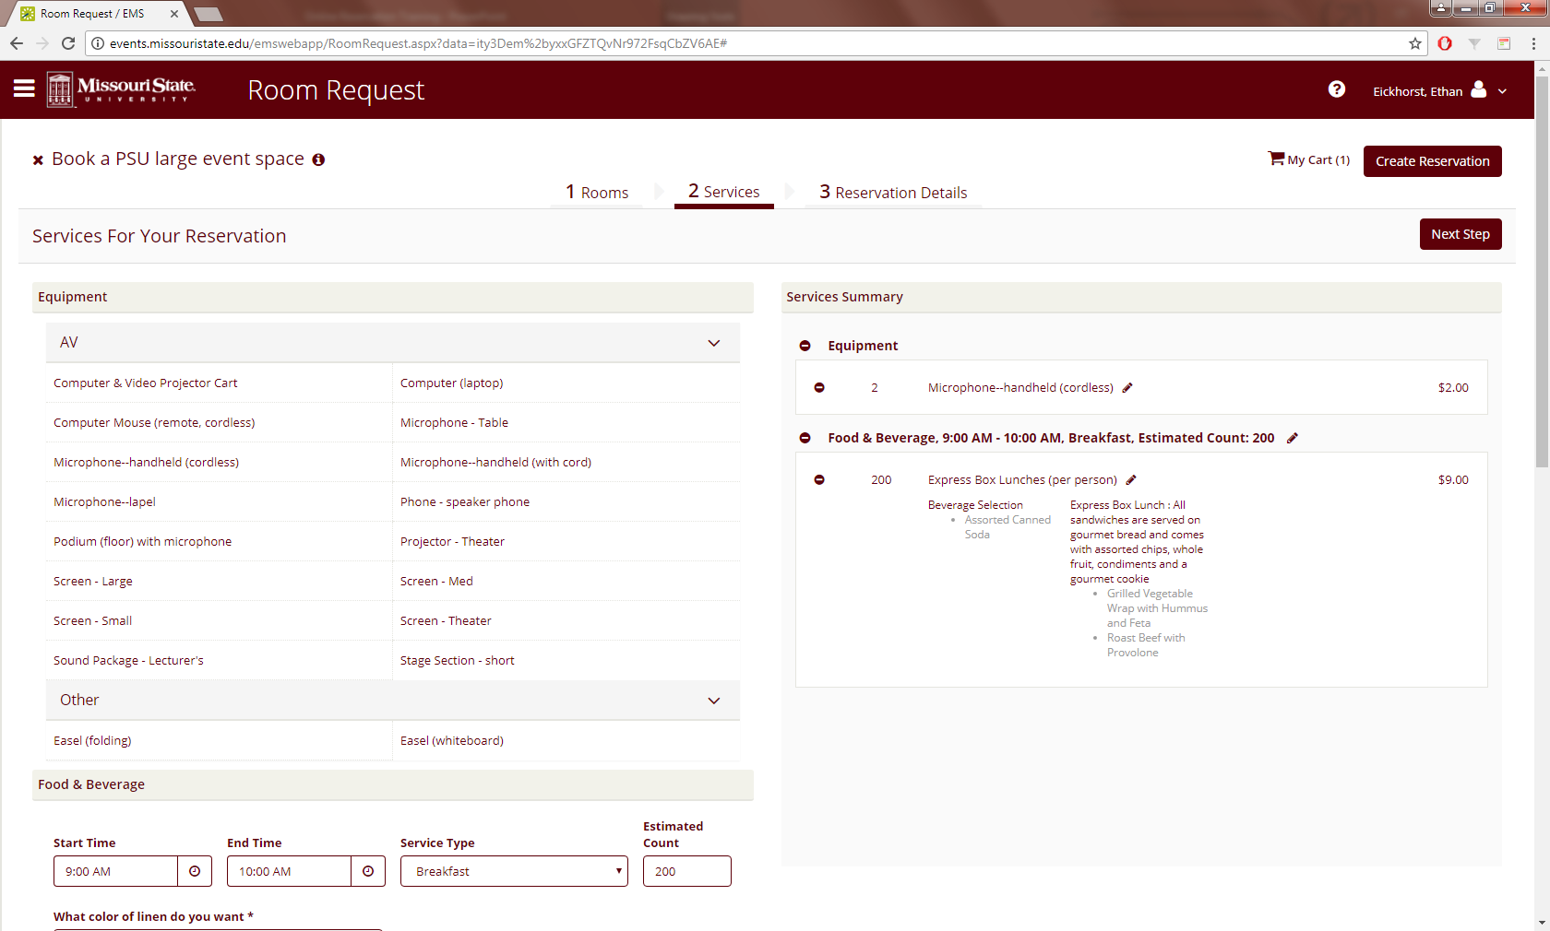
Large Event Reservation cont.
All equipment and catering that have been selected will show up in the (Services Summary) area
Once everything is correct click on (Next Step)

Slide 16
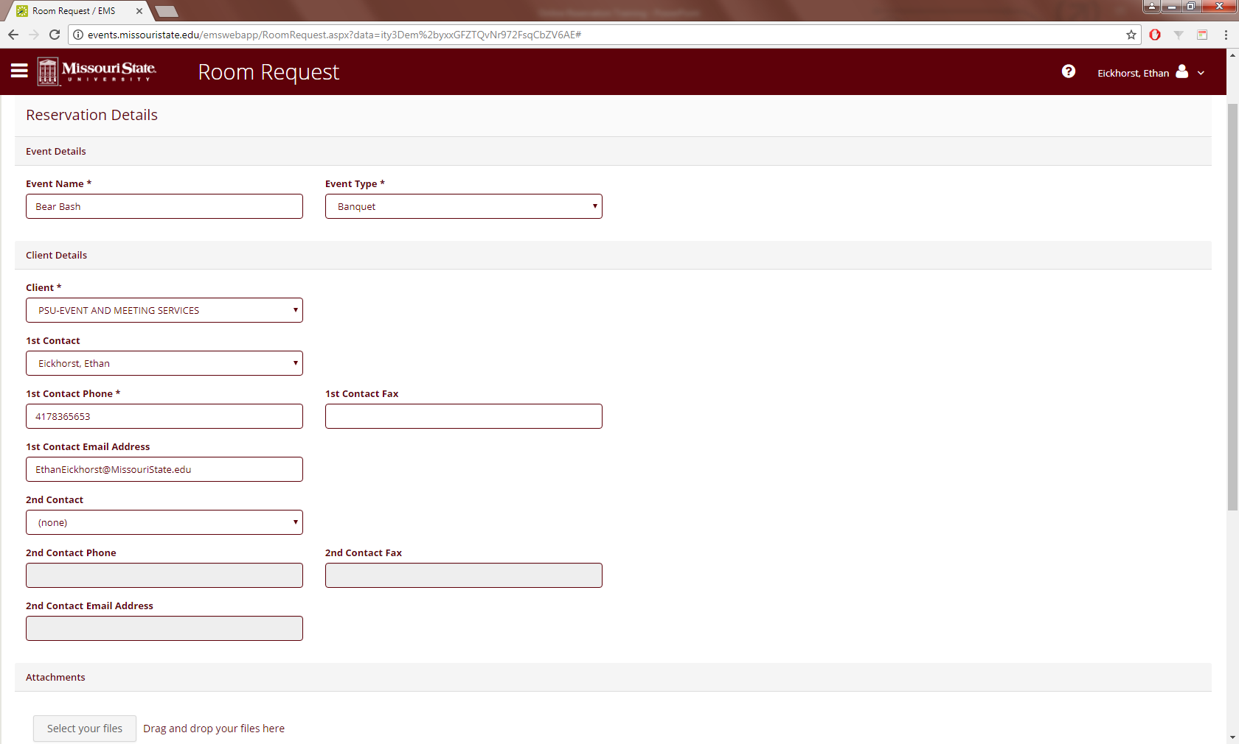
Large Event Reservation cont.
Fill in the appropriate text and drop down boxes
Fields that must be filled in will be denoted with an *

Slide 17
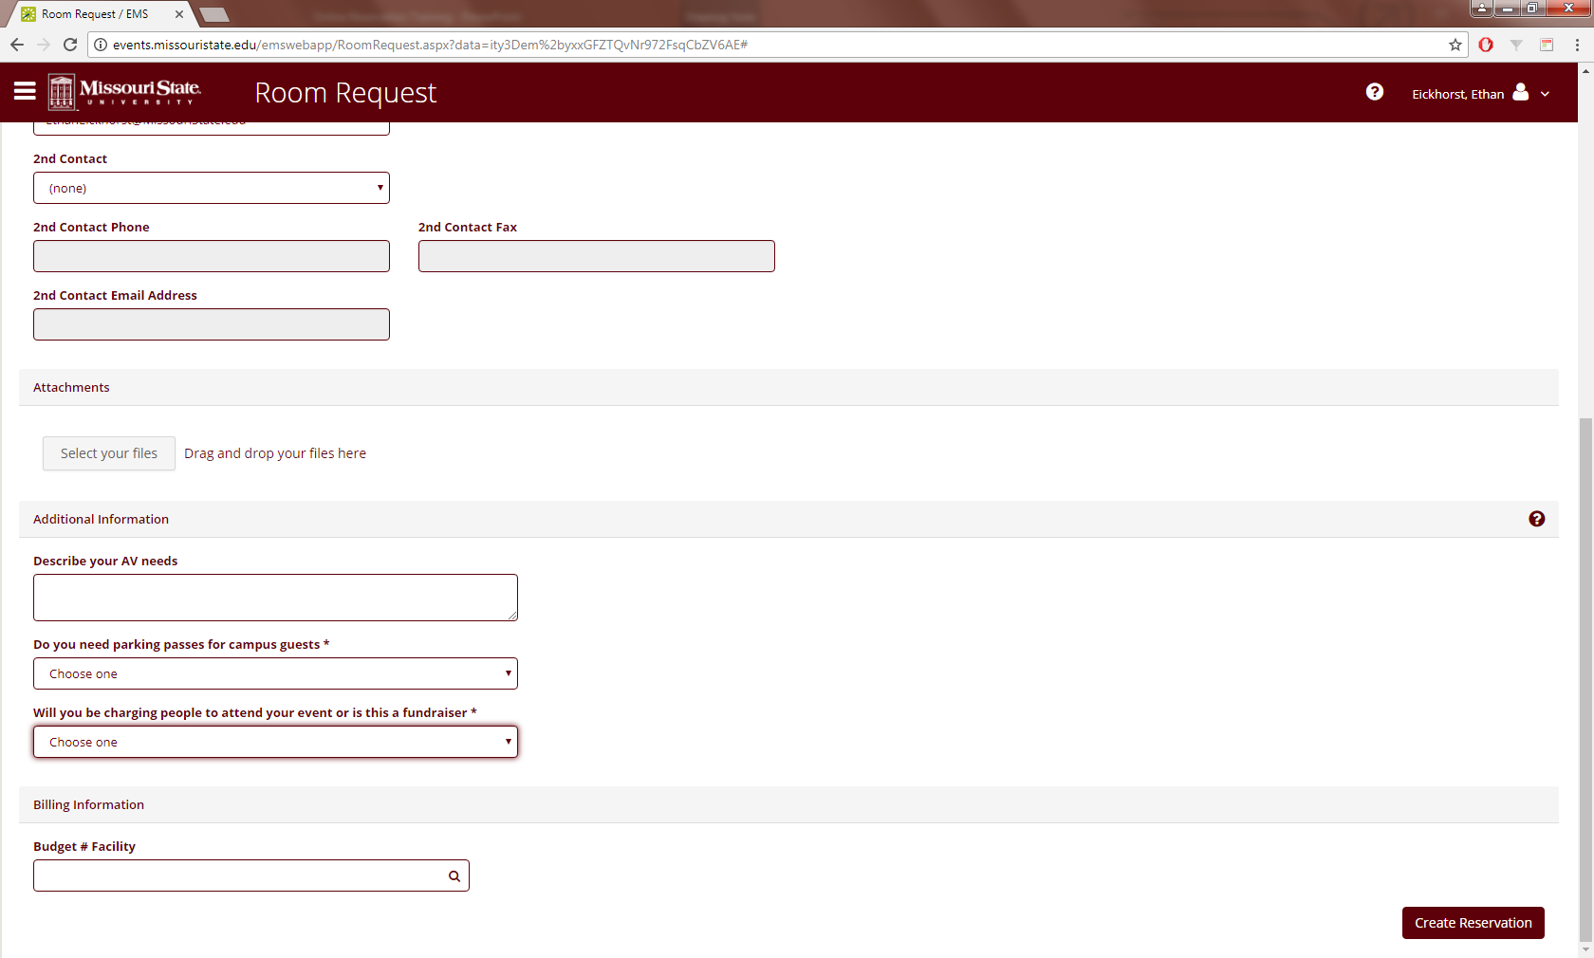
Large Event Reservation cont.
If you have specific A/V needs in addition to the equipment added under (Services), enter that information in the (Describe your AV needs) text box
If parking passes are needed for guests then select (Yes)
If the event is a fundraiser then select (Yes)
The budget number to be used for everything except catering can be entered in the (Budget # Facility) text box
Once everything is complete click (Create Reservation)

Slide 18
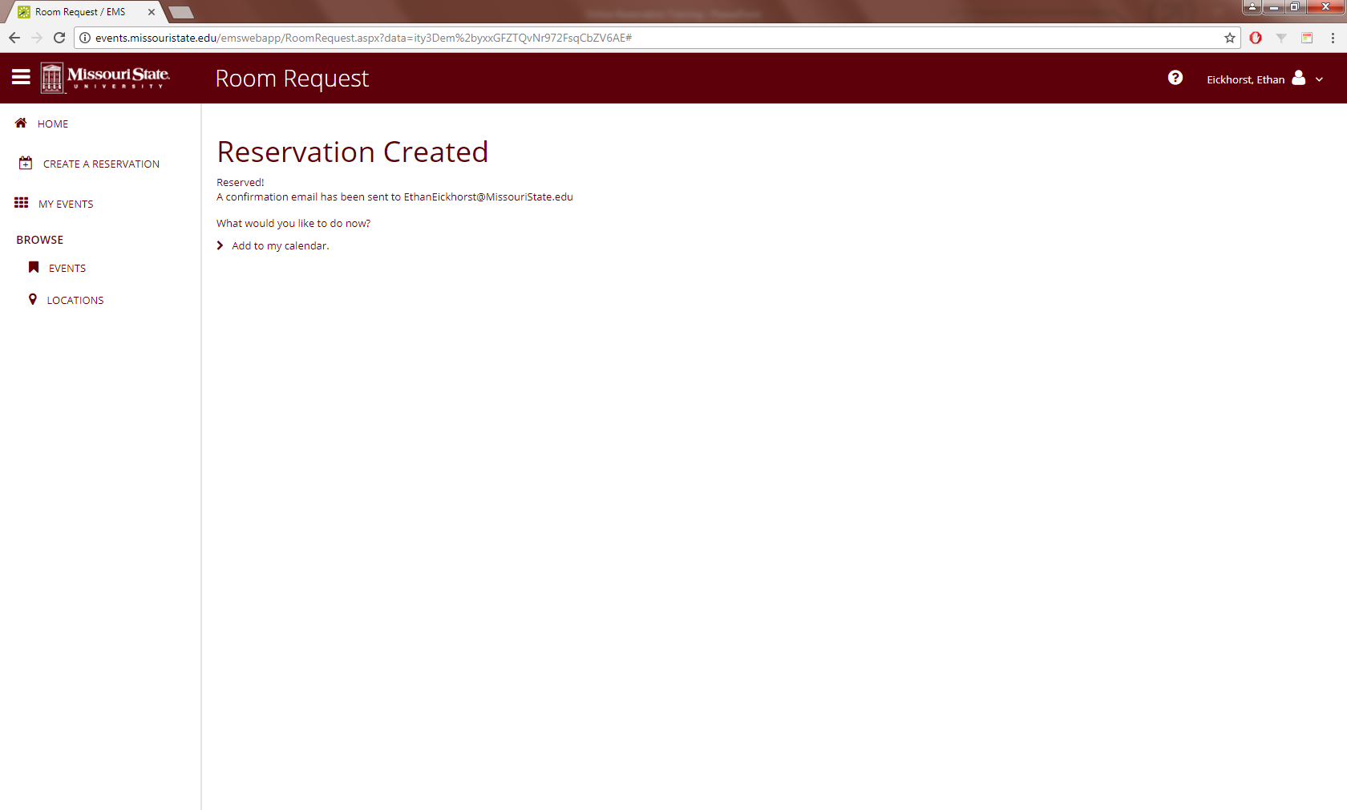
Large Event Reservation cont.
Congratulations, your event has been submitted!
You will receive an email with a summary of what was ordered. This summary is NOT a final total. It is only an estimate.
An Event Coordinator will email you within 2 business days to finalize all of the details for your event.

Slide 19
Edit My Events
Change your date/time
Add A/V to your single meeting
Cancel your large event

Slide 20
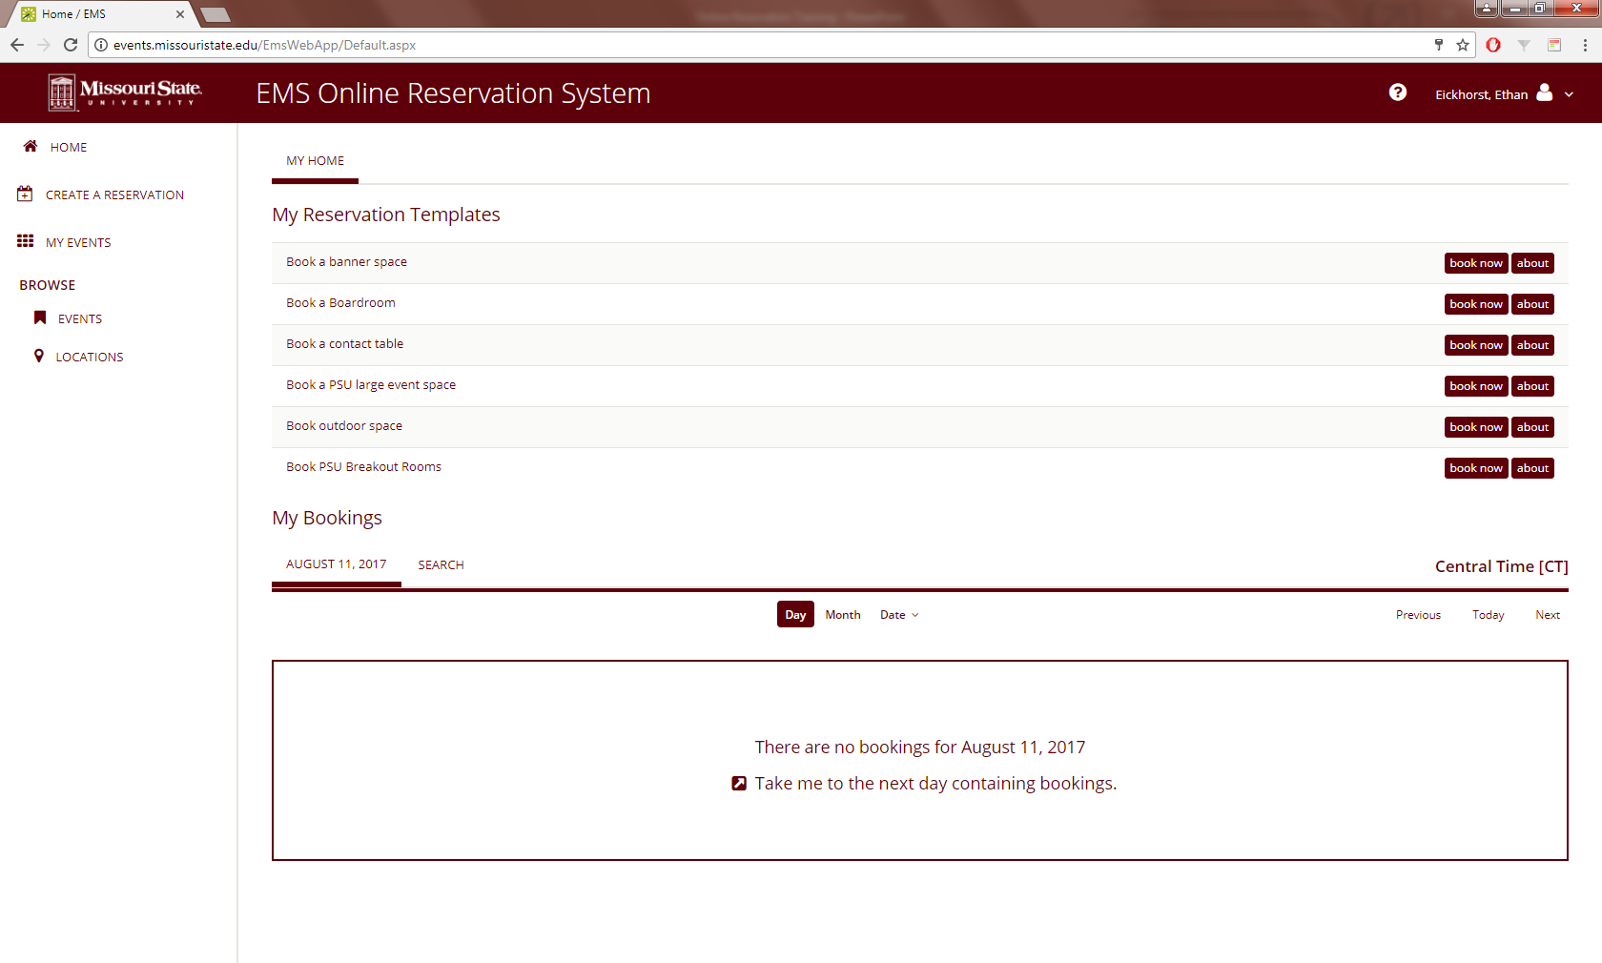
Edit Events Example
To edit your event click on (MY EVENTS)

Slide 21
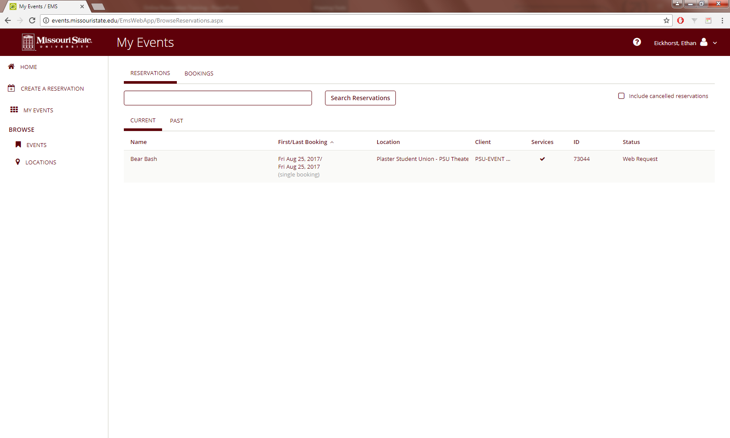
Edit Events cont.
Click on the event to be edited

Slide 22
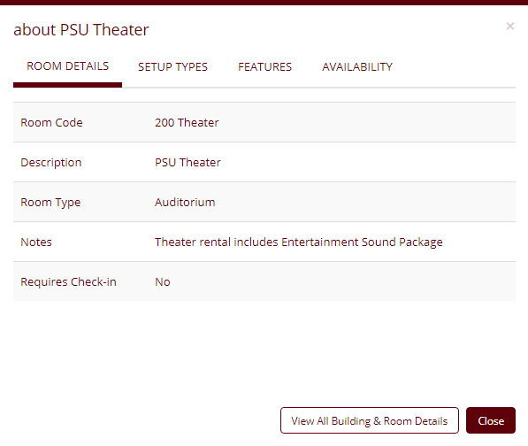
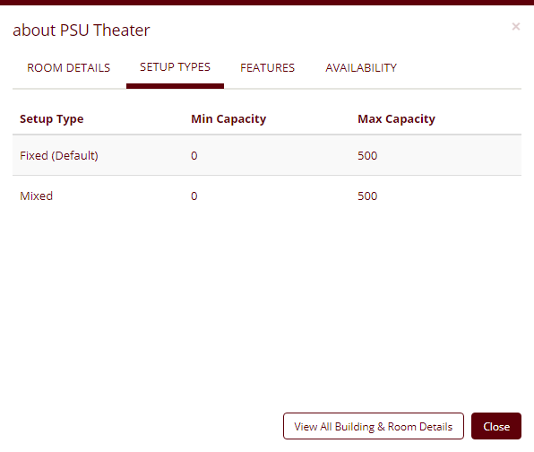
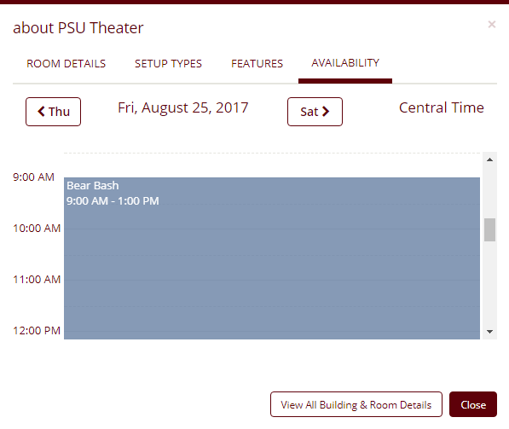
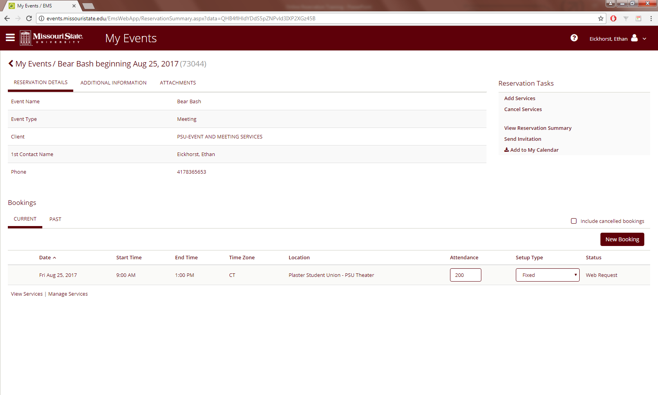
Edit Events cont.
This page displays all of the booking information for your event
From here the attendance numbers can be edited
The parking pass and fundraiser designations can be found under (ADDITIONAL INFORMATION)
Information about the events location can be found here

Slide 23
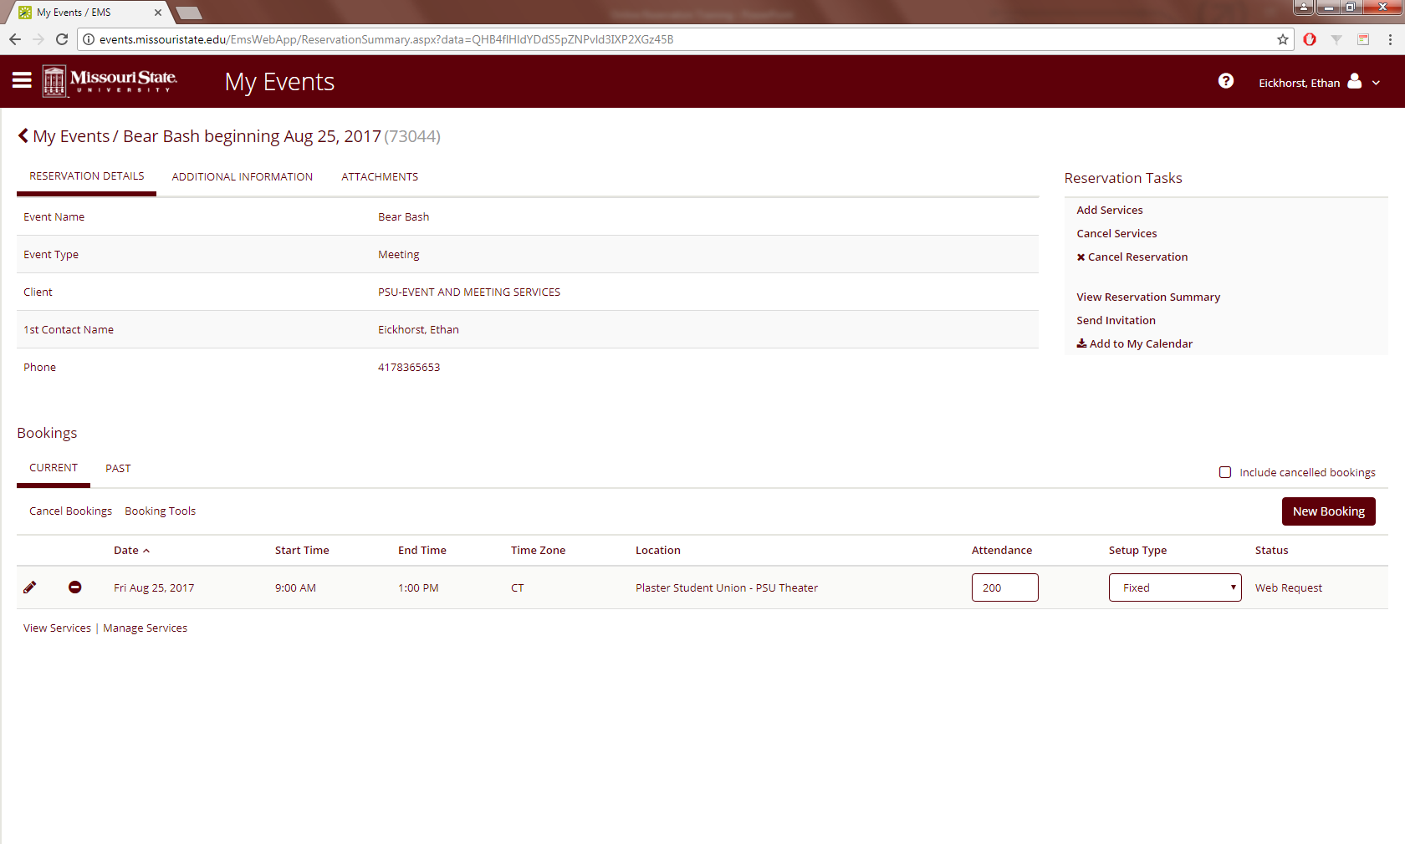
Edit Events cont.
To see what services are already applied to the event click (View Services)
To make a change to services click on (Manage Services)

Slide 24
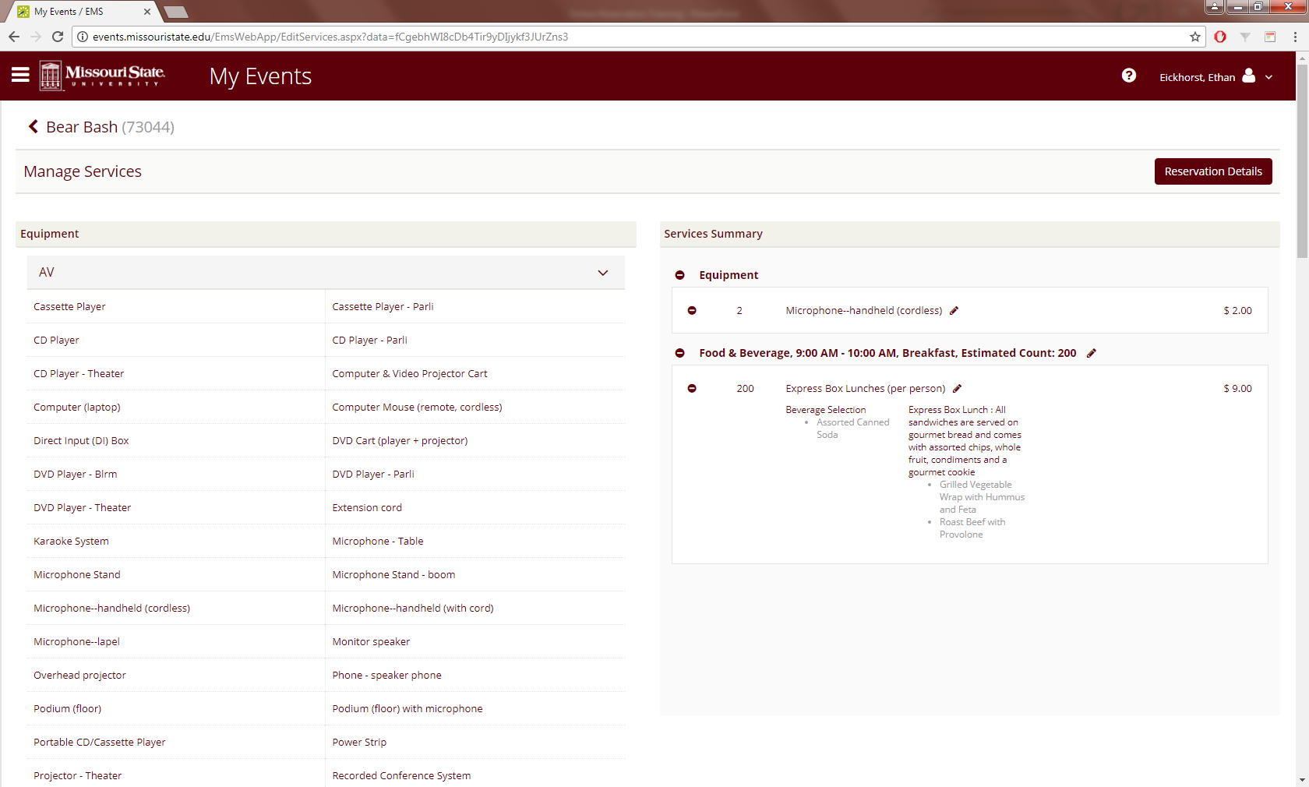
Edit Events cont.
To edit item specific equipment or catering click on the pencil icon next to the item to be edited
Popup windows will allow changes to be made
Note: these popups are the same as adding in new equipment or catering

Slide 25

Edit Events cont.
If specific items need to be deleted, they can be deleted by clicking the – button next to the item to be deleted
If all equipment or catering needs to be deleted, click the – button next to Equipment or Food and Beverage

Slide 26

Edit Events cont.
To make sure everything is correct click on (View Reservation Summary)

Slide 27
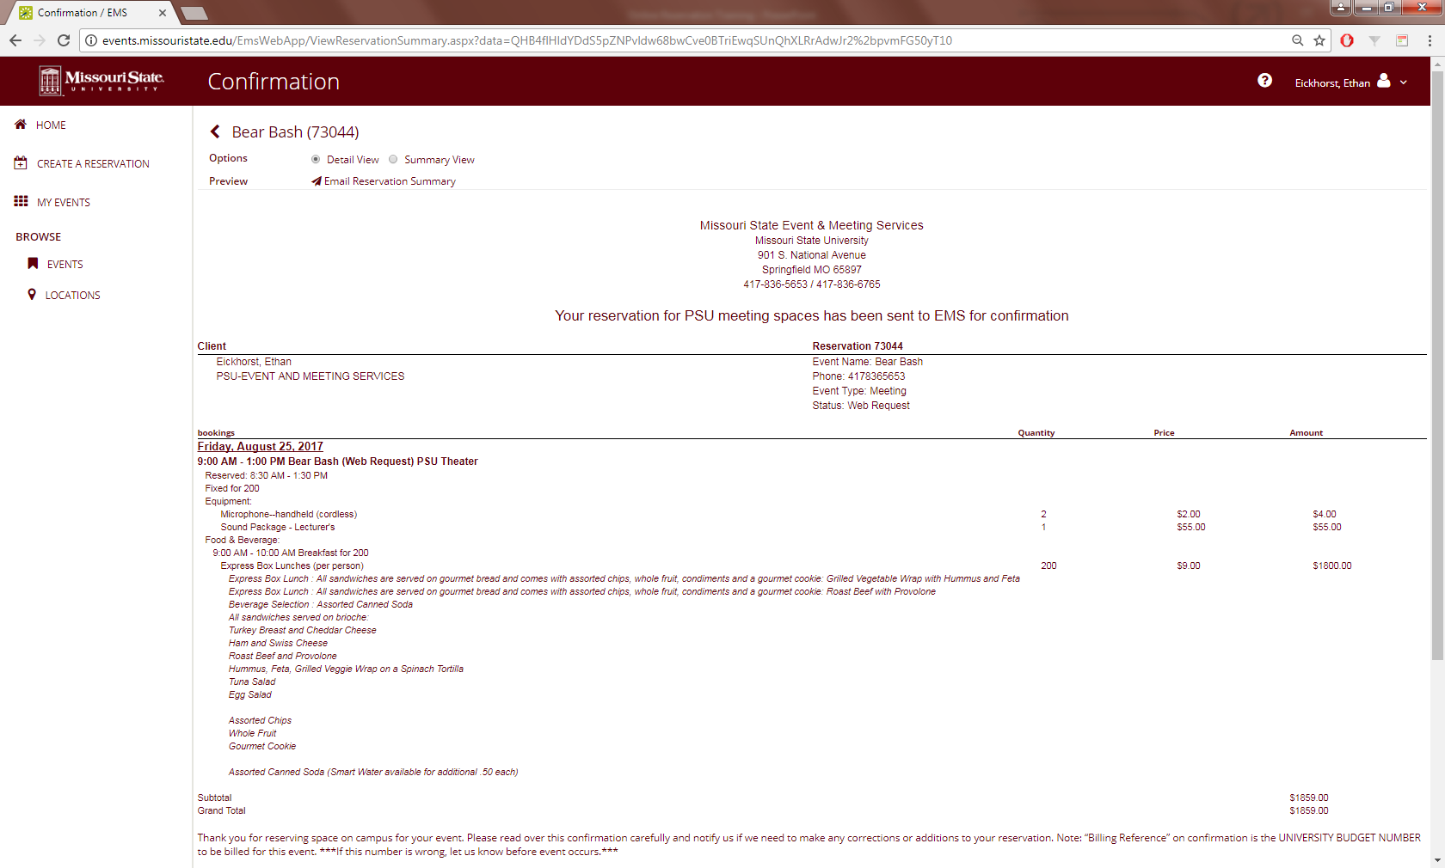
Edit Events cont.
The Reservation Summary will give you an estimated cost of the event along with a detailed list of the services requested

Slide 28
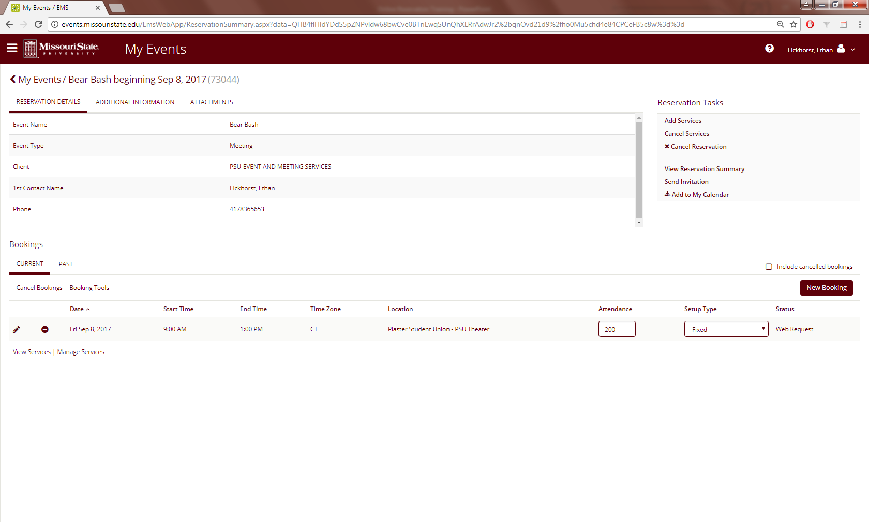
Edit Events cont.
- If the name, event type, time and date, or location need to be edited for a particular event click on the pencil icon on the event

Slide 29
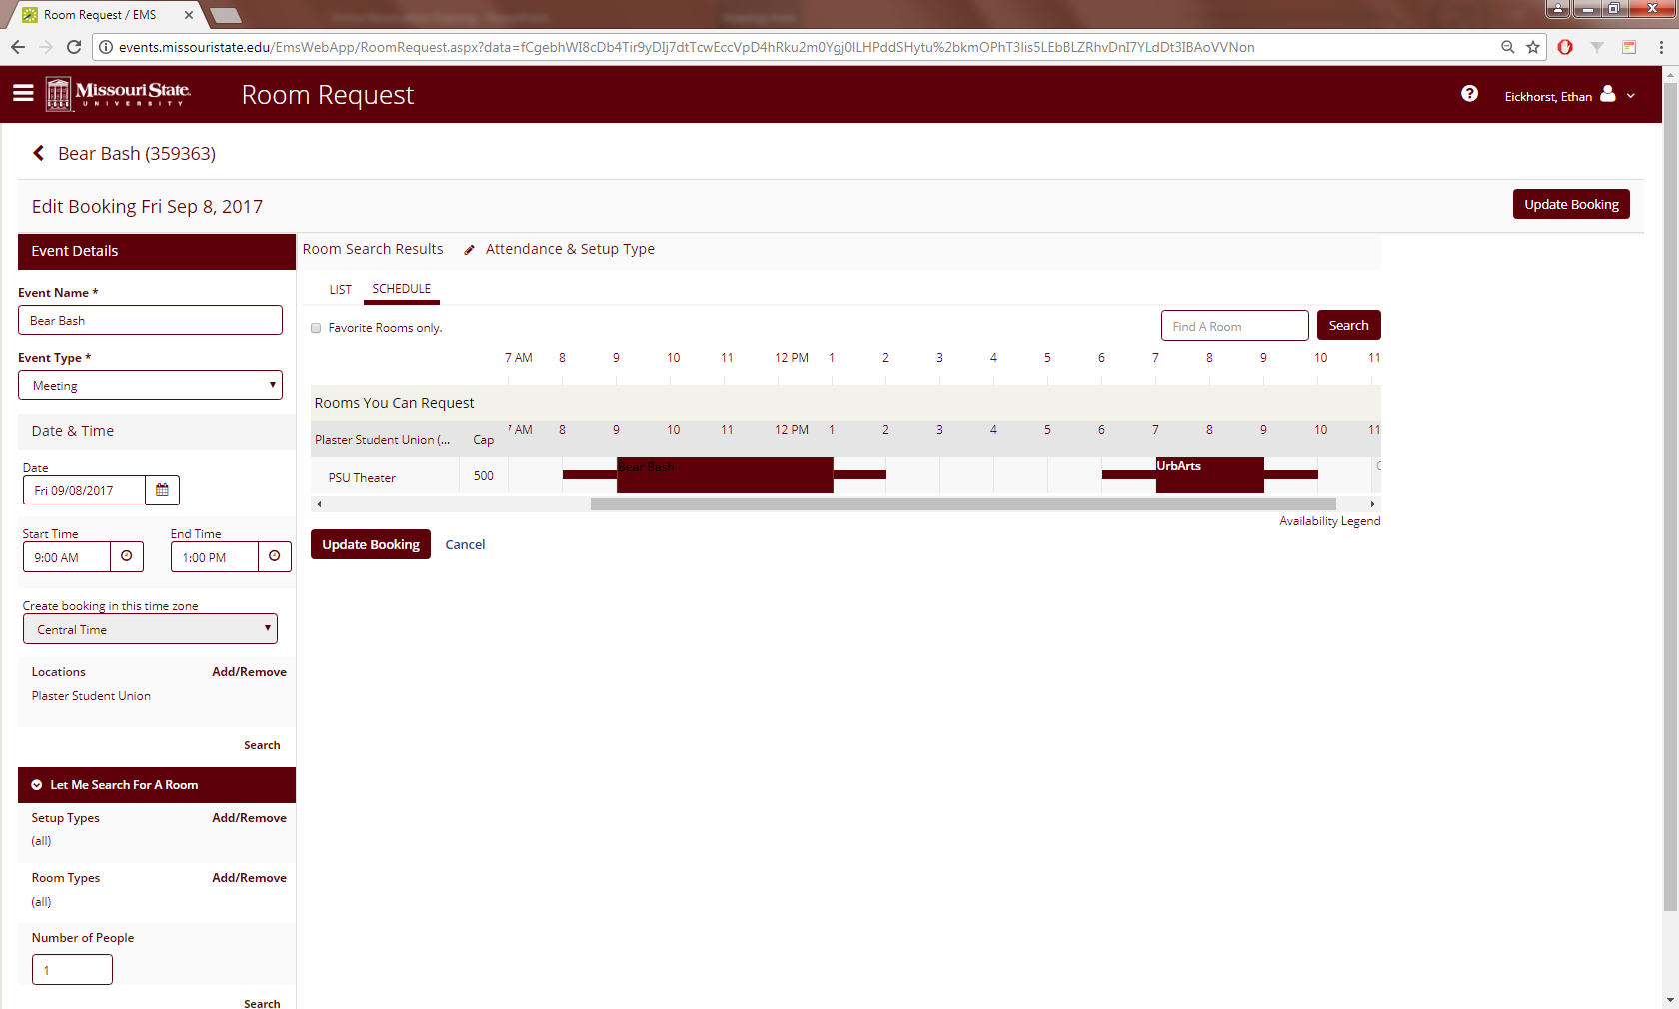
Edit Events cont.
The name of the event can be edited in (Event Name)
The event type can be changed in (Event Type)
The date and time can be adjusted under (Date & Time)
If the room needs to be changed, or is not available for the new date and time, the (Setup Type), (Room Type), and (Number of People) can be adjusted under (Let Me Search For A Room) to help you find a space that is available

Slide 30
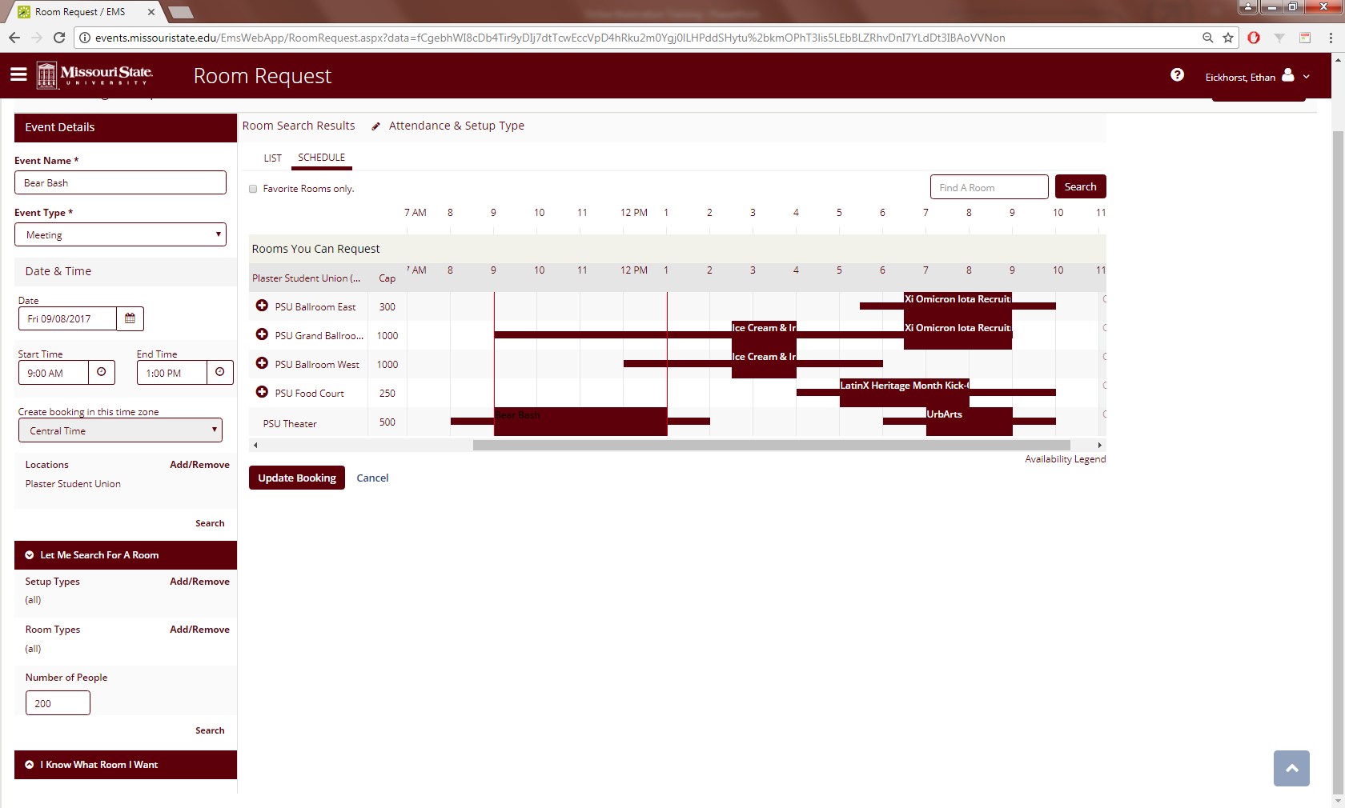
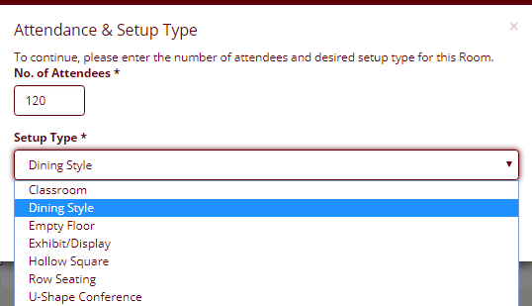
Edit Events cont.
(SCHEDULE) will show all rooms that seat the number of people that you have entered
An available room can be selected by clicking on the + button
A popup window will give you the option to update the number of guests and the desired setup of the room

Slide 31
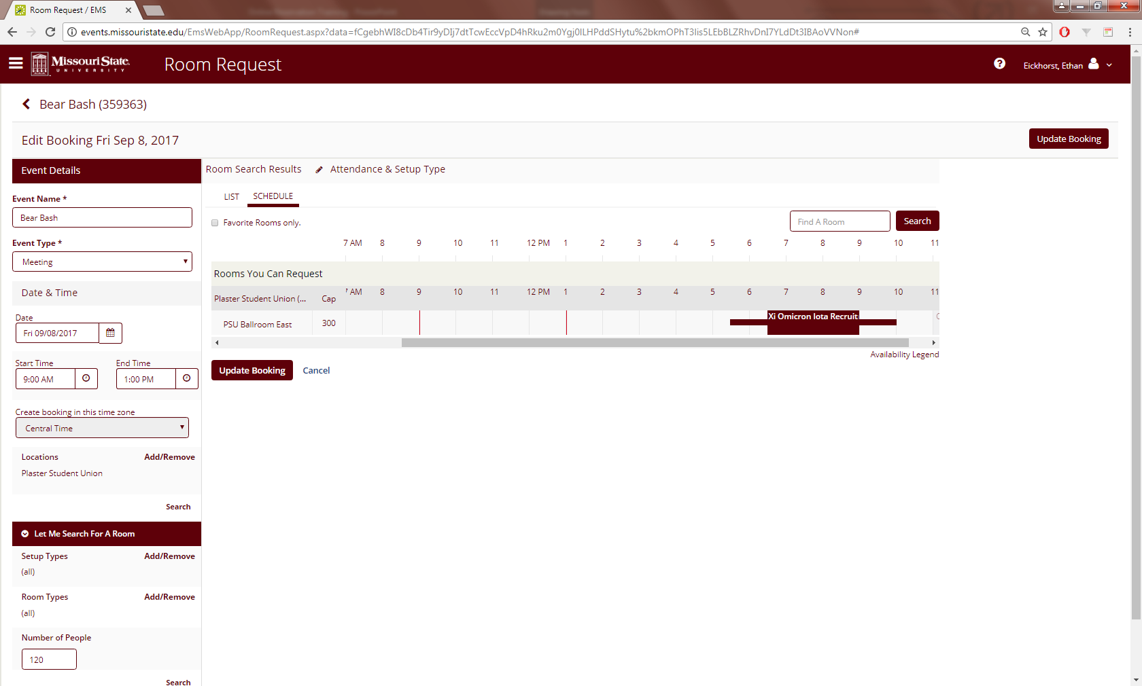
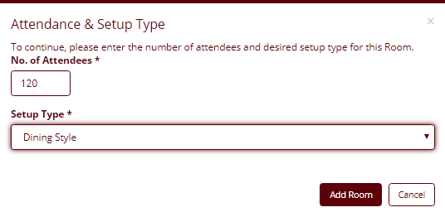
Edit Events cont.
When the details look correct click on (Add Room)
Next click on Update Booking

Slide 32
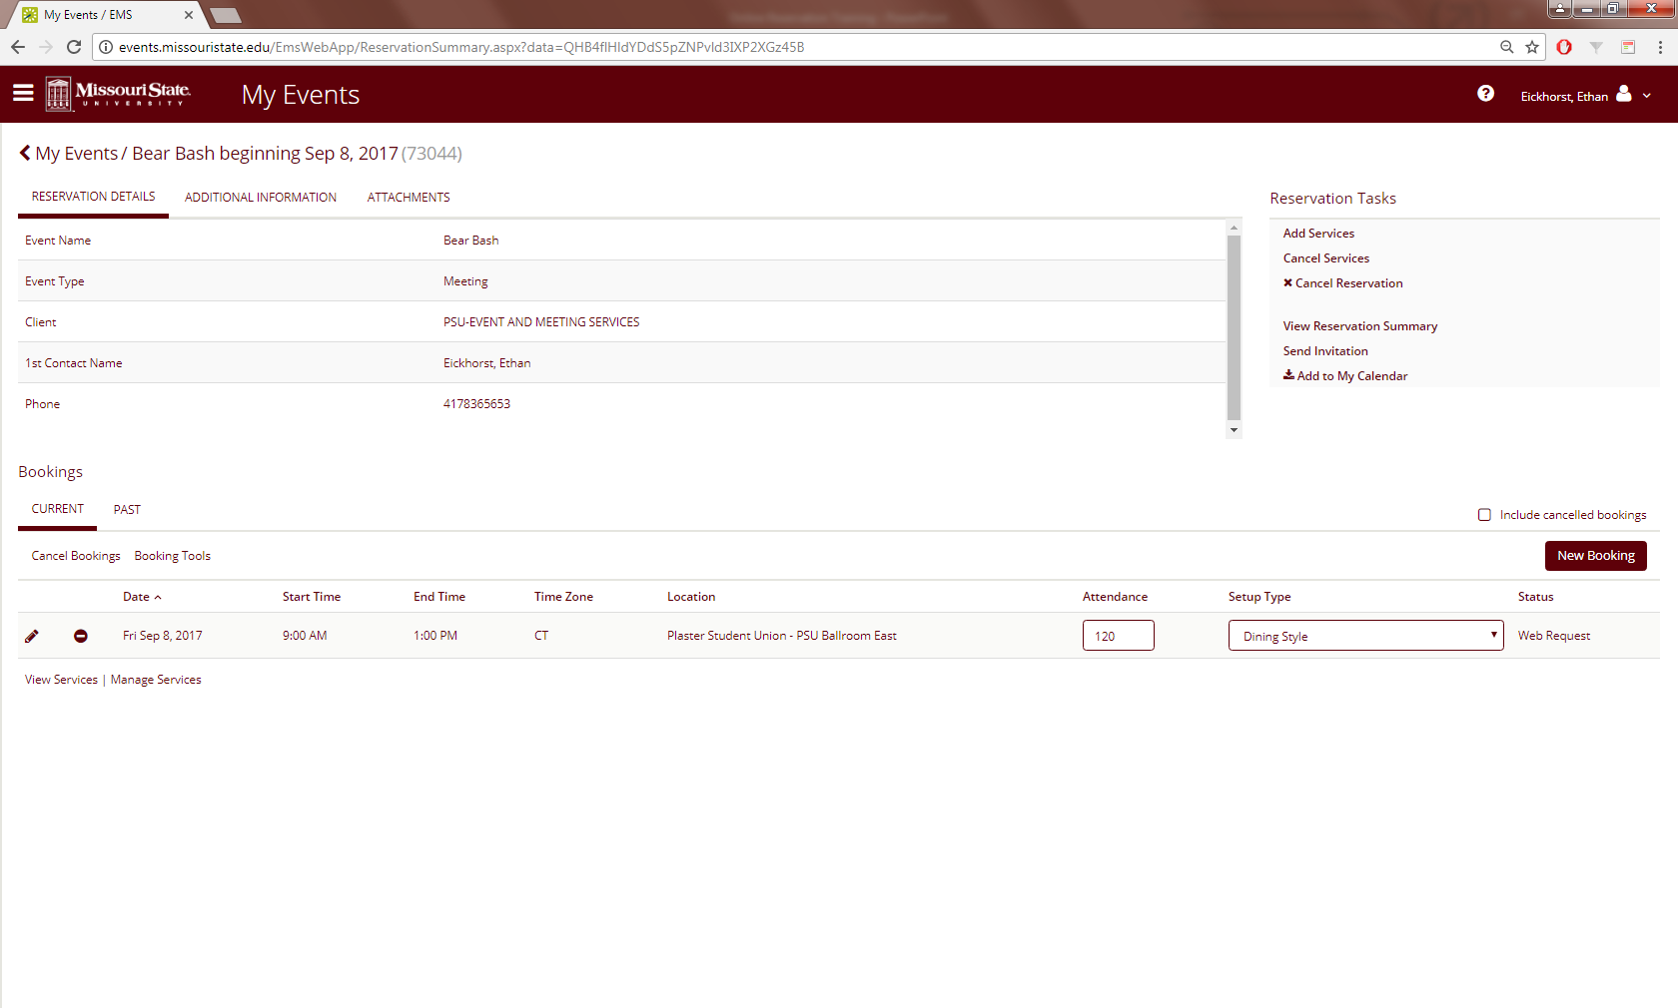
Edit Events cont.
If a new booking needs to be added to the reservation click on (New Booking)
Note: The steps for setting up a New Booking are identical to editing a booking

Slide 33

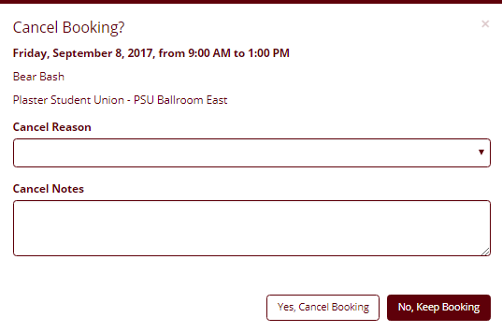
Edit Events cont.
If a particular booking needs to be canceled click on the – button next to the event space to be canceled
A popup window will ask for the cancellation reason and some additional notes can be added in the (Cancel Notes) section
Click (Yes, Cancel Booking) and that particular booking will be canceled

Slide 34
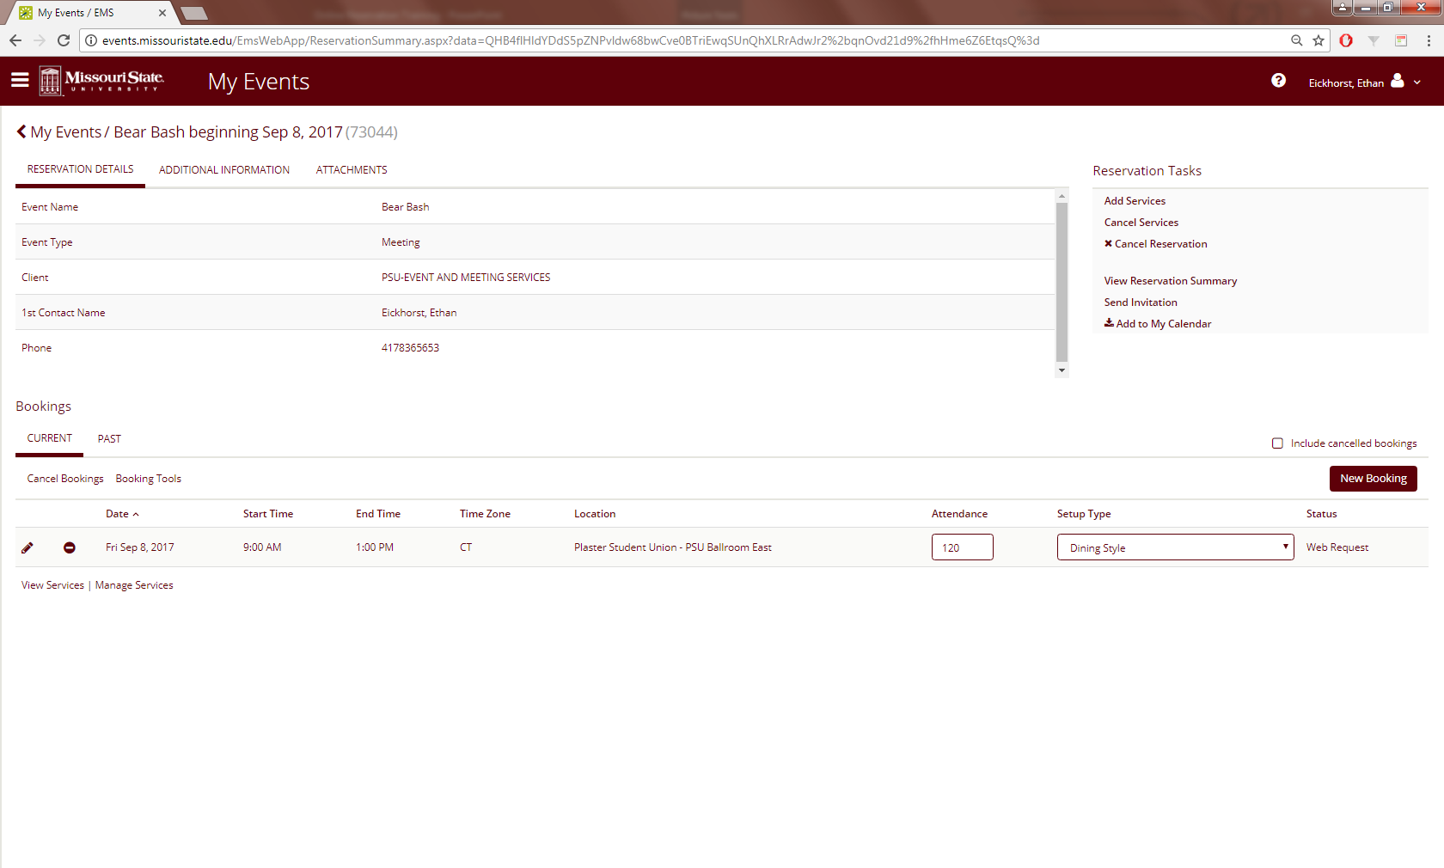
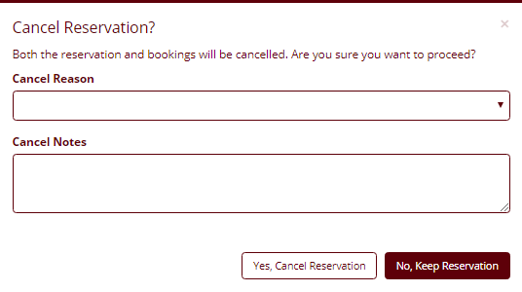
Edit Events cont.
To cancel a reservation click on (x Cancel Reservation)
A popup window will ask for the reason for cancelling
Click (Yes, Cancel Reservation) to cancel the reservation
Note: This will cancel everything, including all room bookings, equipment, catering requests, etc. ONLY do this if the ENTIRE event is cancelled
This will open up the rooms for other groups to request, and it may not be possible to get them back

