Slide 1

The Intersection between Service-Learning and Intercultural Competence
GREAT Conference – November 10, 2022
Missouri State University
Panel Host – Katherine Nordyke
Panel Presenters: Jennifer Lowenthal-Hersey, Professor (COB); Lori Rogers, Professor (COAL); Malie Auterson, Executive Director & Founder – Springfield Community Gardens; Shannon Porter, Chief Executive Office – Empower: Abilities; Agamyrat Bayramgeldiyev - Student; Audrey Bian - Student

Slide 2
Brief Introductions
A little about the high-impact practice of Service-Learning
What is Intercultural Competence / Research
Hear from our Panelists about how service-learning and intercultural competence intersects within their organization, course, or experience
Questions and Answers
Next Steps
Format for Today’s Panel Session

Slide 3
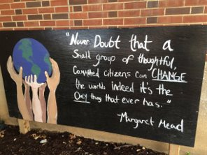
High-Impact Teaching Method/Pedagogy
Often referred to as Experiential Learning, Project-based Learning
Occurs when students learn by actively engaging in an experience(s) direct or indirect, in-person or virtually, that benefits both the student and the community partner (reciprocity) and includes reflection
Meets a need in a community – local, national, or global
Creates a bridge between the community, the University, and the world around it.
What is Service-Learning

Slide 4
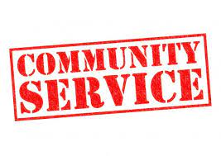
Volunteerism/Volunteering
School Activities; Make up Work or Extra Credit
Community Service
  Might look similar to service-learning:
    No connection to coursework/reflective assignment
    Often incorporated into a defendant’s sentencing - https://doc.mo.gov/programs/community-service
What is NOT Service-Learning

Slide 5
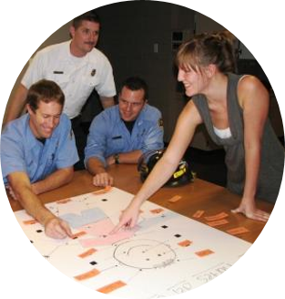
Shown to have an impact on
  Student Success & Retention
  Career Readiness and Major Exploration
  Building Social Capital in communities long-term
  Fostering Intercultural Competence between Students & Community
Benefits of Service-Learning

Slide 6
"Intercultural competence can no longer be viewed as a 'nice to have' skill in our world. It is a 'must have.' Tara Harvey, PhD is the Founder of True North Intercultural
  Develop a better understanding and appreciation of complex differences that exist
  Engage effectively and appropriately across these differences
  Foster intercultural development within our educational institutions
Intercultural competence is never an endpoint but a continual process of development that examines our attitudes, awareness, knowledge, and skills.
What is Intercultural Competence

Slide 7
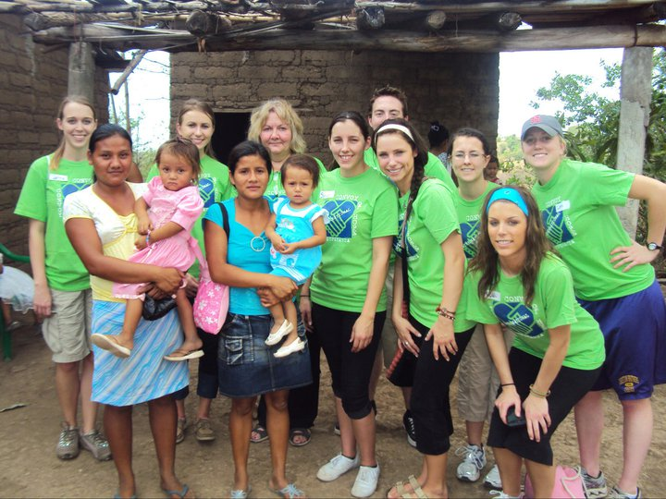
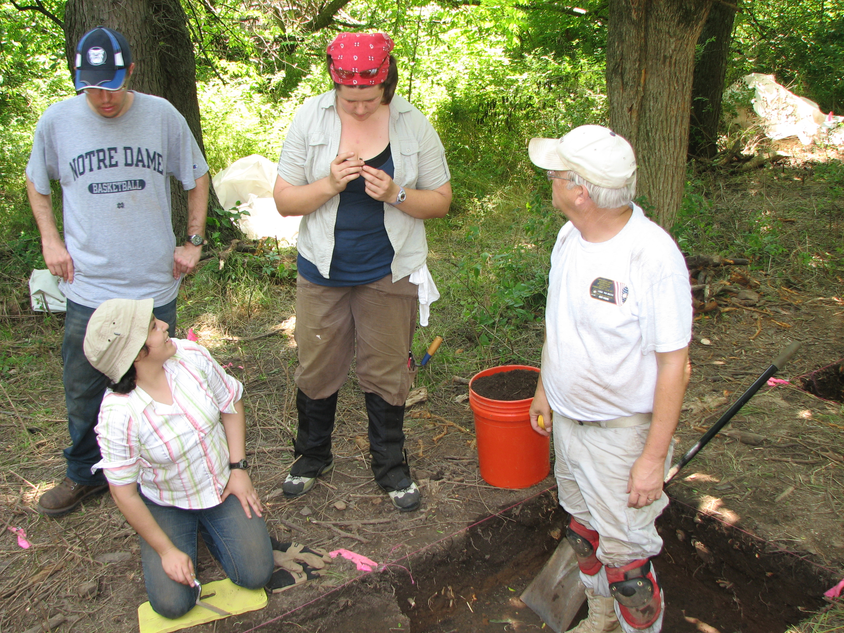
Cultural Awareness – Awareness of one's own cultural world view
Cultural Knowledge – Knowledge of Different Views
Cultural Sensitivity – Attitudes toward cultural differences
Cultural Competence – Skills in interacting with people across cultures
What is Intercultural Competence

Slide 8
Study conducted by Nadia De Leon at Stanford University
  Article - Developing Intercultural Competence by Participating in Intensive Intercultural Service-Learning
    Quasi-experimental – 170 Undergraduate Students; 6 sections; 6 different faculty; 3 sections with service-learning / 3 sections without service-learning
      Two Scales: Cultural Intelligence Scale & Intercultural Sensitivity Scale
      Pre / Post Reflections
      $100 Solution Model working with immigrant and refugee families https://the100dollarsolution.org/mission/
  Statistical Analysis confirmed that service-learning had a "significant positive effect on students' intercultural competence" compared to courses with no service-learning.
    Michigan Journal of Community Service Learning (2014, pp 17-30)
What Does the Research Say ?

Slide 9
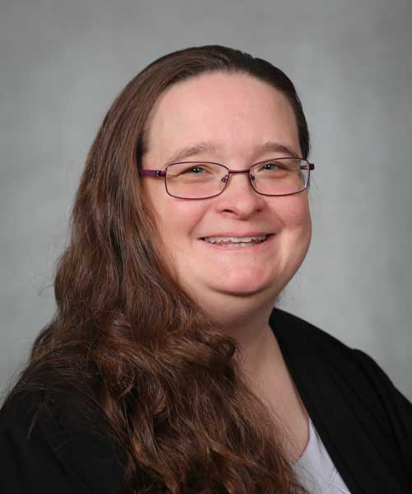
College of Business
ITC 200 - Critical and Creative Thinking Using Information Technology
Integrated Service-Learning Course
Required by all Business Majors
Jennifer Lowenthal-Hershey, Instructor, Information Technology and Cybersecurity Department

Slide 10
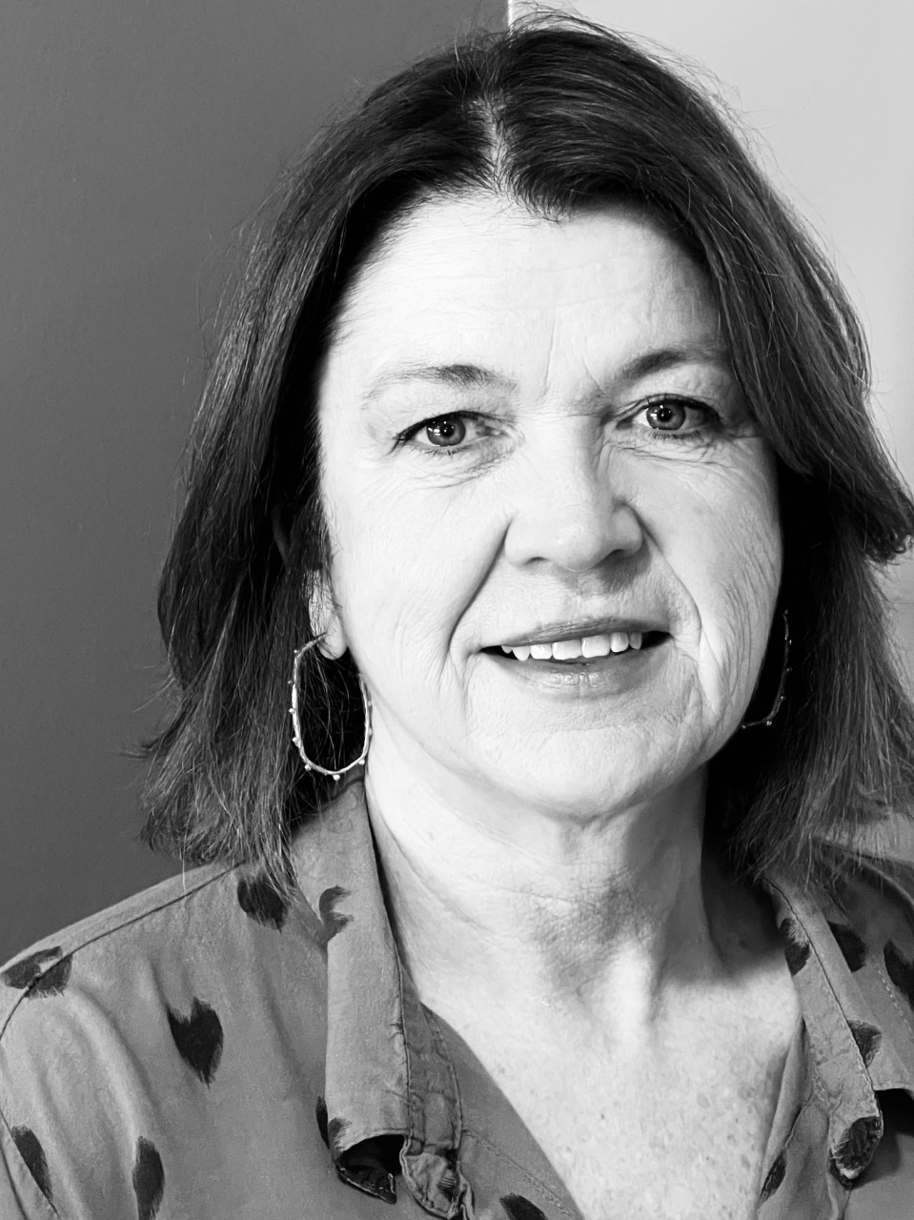
College of Arts & Leaders
ENG 310 – Writing II: Writing for Graduate and professional Schools
Integrated Service-Learning Course
Bonner Faculty Stipend Award
Lori E. Rogers, Senior Instructor & Co-Director of the Ozarks Writing Project

Slide 11
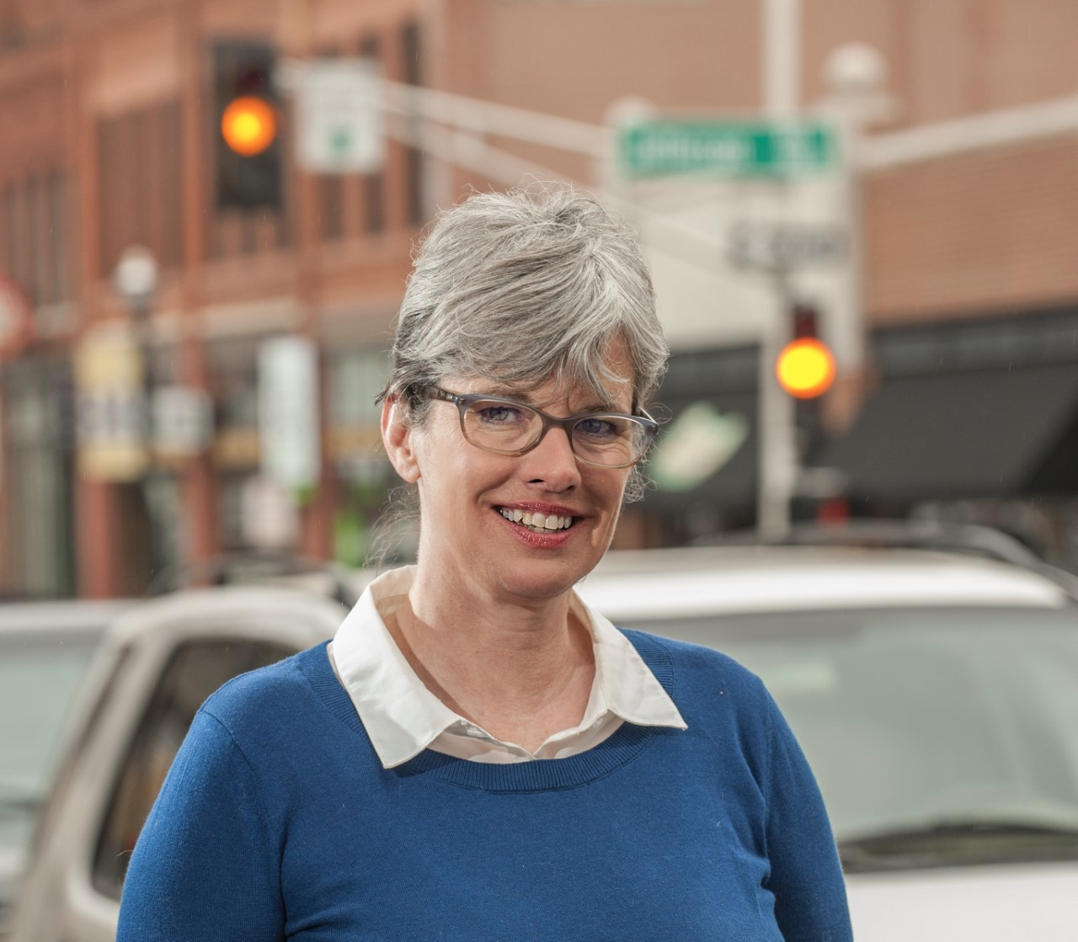
Service-Learning Community Partner
Springfield Community Gardens
16 community gardens
3 urban farms
  Amanda Belle’s Farm/Cox Health
1 test kitchen – Cox North
Maile Auterson, Founder & Executive Director

Slide 12
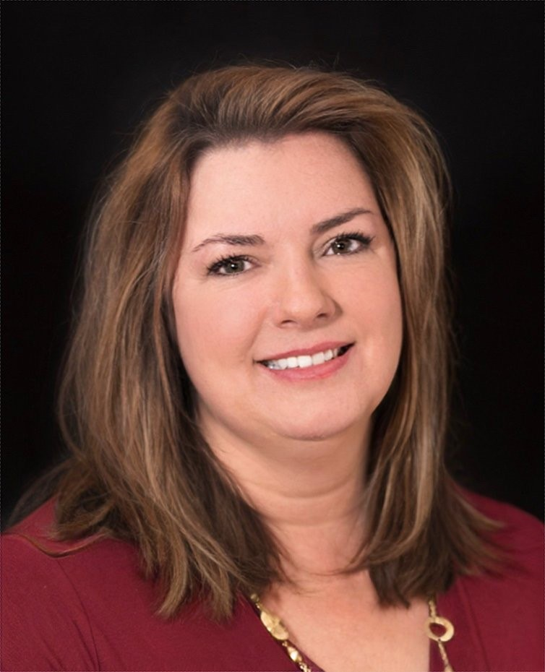
Service-Learning Community Partner
Empower: Abilities
Attendant Care Services
Advocacy
Independent Living Skills Training
Transition Service
Education & Outreach
Shannon Porter, Chief Executive Officer

Slide 13
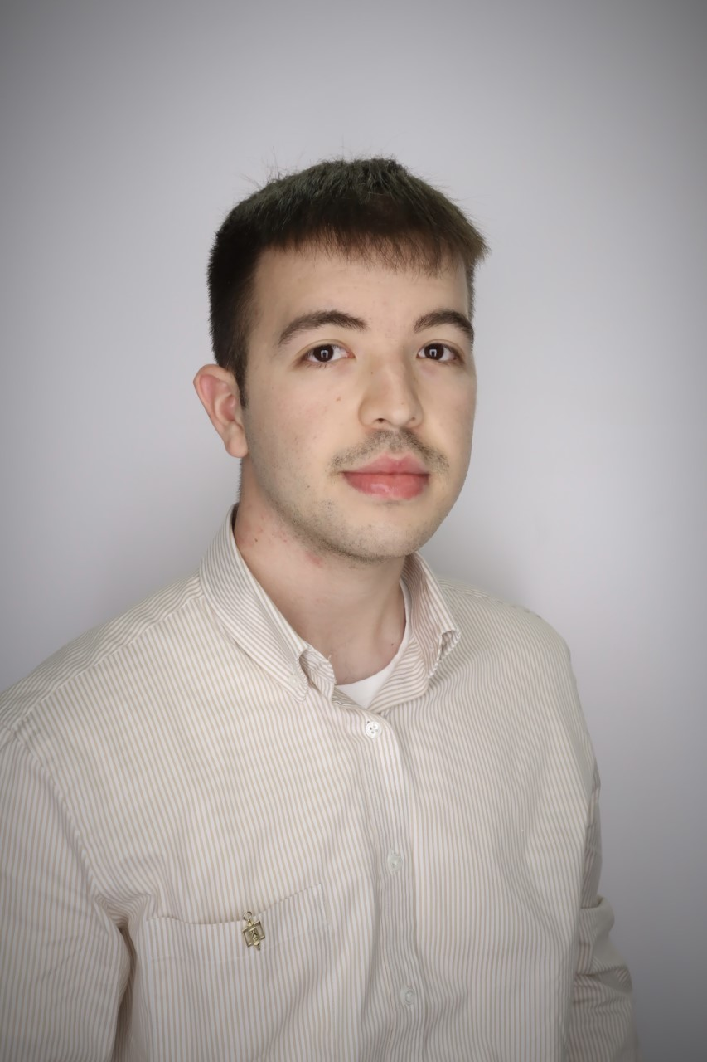
International Service-Learning Student
FRN 300: Service-Learning in French
Student Visa from Turkmenistan located in Central Asia
Major: Global Studies & French
Fluent in both Turkmen & Russian languages
Plans to attend Graduate School at MSU – Fall 2023 in International Affairs
Agamyrat Bayramgeldiyev

Slide 14
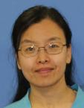
International Service-Learning Student
PTE 747: Service-Learning Clinical
Student Visa from China
Native Language: Chinese (Mandarin)
Major: Doctoral in Physical Therapy
Holds a Graduate Certificate in Public Health and a Master’s Degree in Public Administration (both from MSU)
Huiying (Audrey) Bian

Slide 15
Bernard Kitheka, PhD – KIN 500 – Global Community Service-Learning
The goal of this program is to cultivate globally-minded citizens and provides students the opportunity to extend learning beyond the walls of the classroom. This is a structured academic experience where students with areas of service that may involve teaching, health education and outreach, community development, sustainable tourism, environmental project, building entrepreneurial skills, or a variety of socio-economic activities that contribute to the well-being of individuals, households and communities based on the Global Sustainable Development Goals (SDGs). Students will develop analytical and critical thinking skills, active listening skills, and empathy towards others. Students will get an opportunity to serve, virtually or in person, a community of their interest to address a societal problem. Enrollment is limited to first-come-first-serve.
Upcoming Service-Learning Course – Spring 2023

Slide 16
Jennice McCafferty-Wright, PhD
This education abroad course bridges locally and globally integrated service learning. It begins in Springfield with an introduction to local services for families who are refugees and a children's activity. We’ll then depart for a two-and-a-half-week trip to Morocco to learn with and from children who are refugees in the capital city of Rabat, where we’ll help facilitate an English immersion day camp and coordinate a children’s vision clinic in partnership with the UN High Commissioner for Refugees in Morocco. Along the way, we’ll visit with educators and students to gain an inside look at the Moroccan education system. Excursions will include schools, the markets of Marrakech, the Hassan II mosque in Casablanca, and the Royal Traditional Arts Academy in Tetouan. Finally, we’ll return to Missouri with a better understanding of how global education systems drive cultural continuity and change as they respond to humanitarian needs.
Upcoming Educational Abroad Service-Learning Course- late Spring or early summer 2023

Slide 17

Opportunity for Q & A

Slide 18
Making your course service-learning
Enrolling in a service-learning course
Becoming a service-learning Community Partner
Next Steps:
Visit our Website at: www.missouristate.edu/CASL
Stop by our office – PSU 131 and meet with our Staff
Call our office – 417-836-5774 to find out more
For Faculty, Staff, or Community Partners

