Slide 1
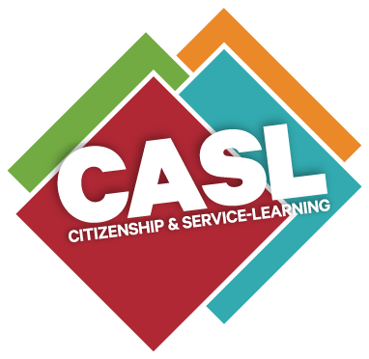
CASL Presentation for Success Coach Meeting
Presented by Katherine Nordyke, Ph.D. – Director / Adjunct Faculty
The Office of Citizenship and Service-Learning (CASL)
Missouri State University
February 2025

Slide 2
What brings us here today…
Overview of what Service-Learning is and why it is important in the realm of Student Success
Understand how Service-Learning aligns with our Public Affairs mission
Gain an understanding of how Service-Learning is defined in terms of our Carnegie Classification as a Community-engaged University
Consider the types of Service-Learning
How do we partner to ensure students have opportunities to engage in Service-Learning

Slide 3
Defining Community-engaged Learning
Understand how community engagement (community-engaged learning) is defined by Carnegie
  The Carnegie Foundation defines community engagement (community-engaged learning) as the collaboration between institutions of higher education and their larger communities for the mutually beneficial exchange of knowledge and resources in a context of partnership and reciprocity.
  Community-engaged Learning = Service-Learning

Slide 4
What is Reciprocity?
Reciprocity is what defines and distinguishes engagement from outreach or service, defining relationships between those in the University and those outside the University that are grounded in mutual respect, shared authority, and co-creation of goals and outcomes.

Slide 5
Missouri State University’s Public Affairs Mission
The vehicle that moves Community Engagement forward
  Increase Cultural Competence
  Increase Ethical Leadership

Slide 6
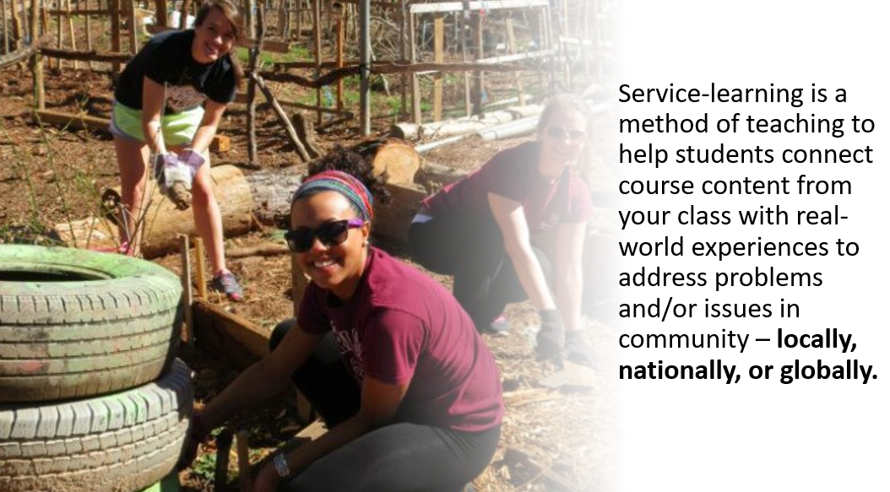
What is Service-Learning…
Notes:
A little context and background about what service-learning is:
Service-learning is considered a high-impact teaching method that connects classroom learning with real-world experiences to address identified problems and issues in communities. The final activity is a reflective activity in which the students think critically and demonstrate how their experience connected to their course learning.
Bringle and Hatcher (1996) defined service-learning as a credit-bearing educational experience in which students participate in an organized service activity that meets identified community needs [and] reflects on the service activity in such a way as to gain further understanding of course content, a broader appreciation of the discipline, and an enhanced sense of civic responsibility. (Klentzin and Wierzbowski-Kwiatkowaki, 2013, p. 46).
Why is Service-Learning important?
At Missouri State, service-learning really serves as the vehicle that moves our Public Affairs mission forward
Further, with more from than three decades of research in the field of service-learning data shows positive outcomes and benefits for students who complete courses where the teaching method of service-learning is applied. These benefits and outcomes include: 1) increased student academic success, 2) increased student retention rates, 3) increased demonstration of civic responsibility by the student, 4) increased ability to identify college majors and career choices, and 5) increased student commitment to engage in service to community post-graduation .
As noted by Kilgo, Sheets and Pascarella (2015), the high-impact practice of service-learning serves as “pathways to student success” (p. 509) for higher education students when service-learning is used as the primary teaching method in curriculum development and course delivery.
(Next Slide)

Slide 7

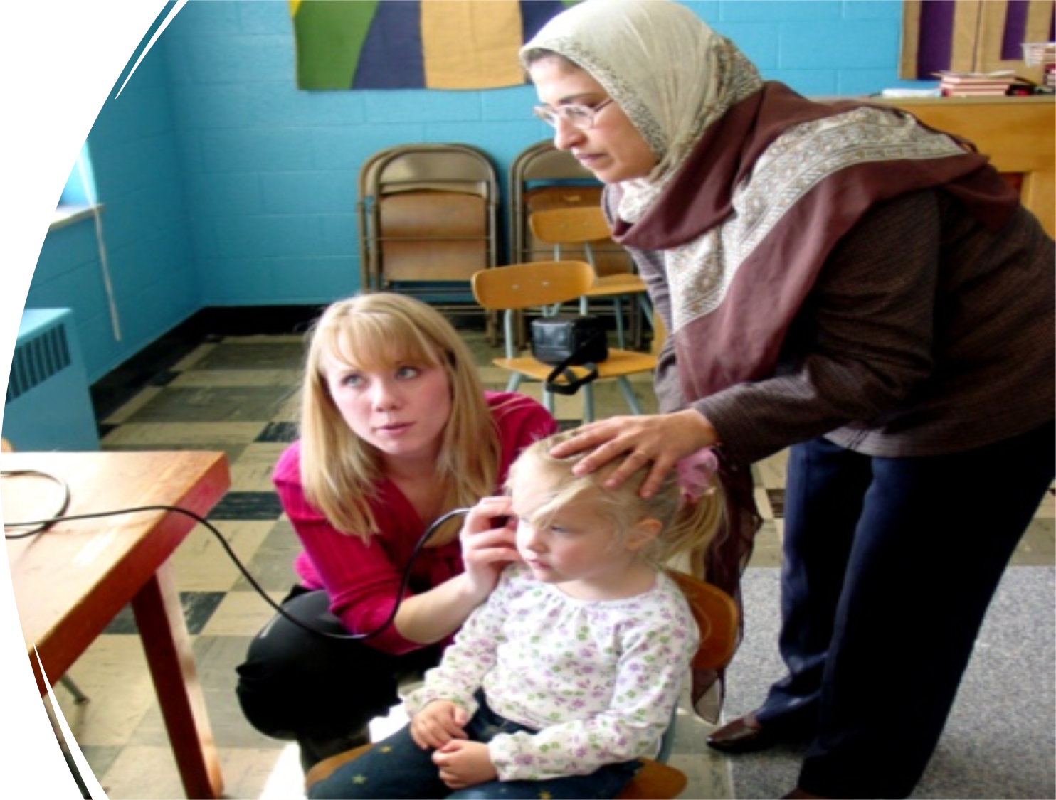
What is Service-Learning …
Service-Learning = Experiential Learning:
Occurs when students learn by actively engaging in experiences that have benefits and consequences and includes focused reflection.
State of Missouri Learning Standards (2010)

Slide 8
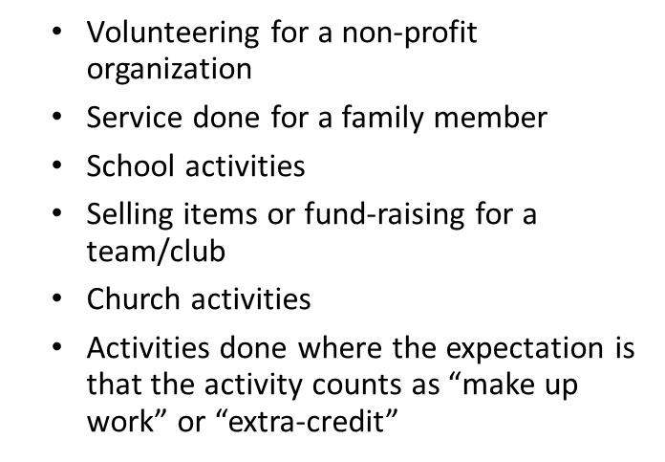
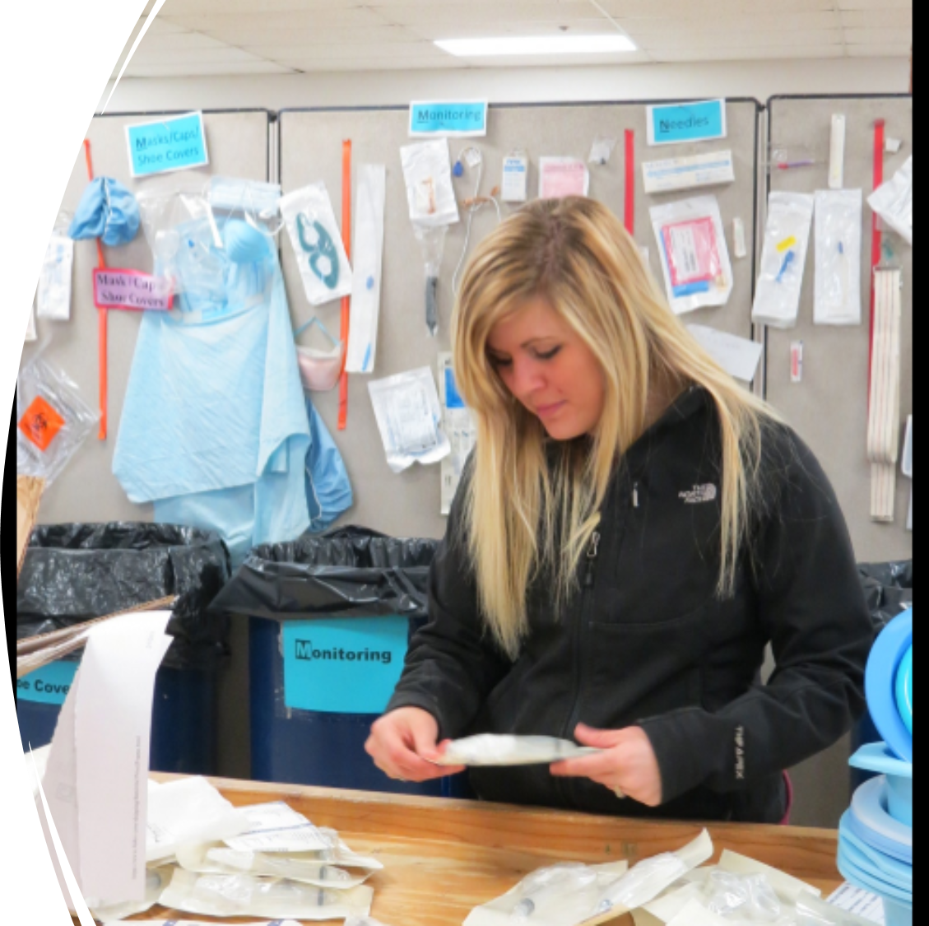
Service-Learning – What it’s NOT…

Slide 9
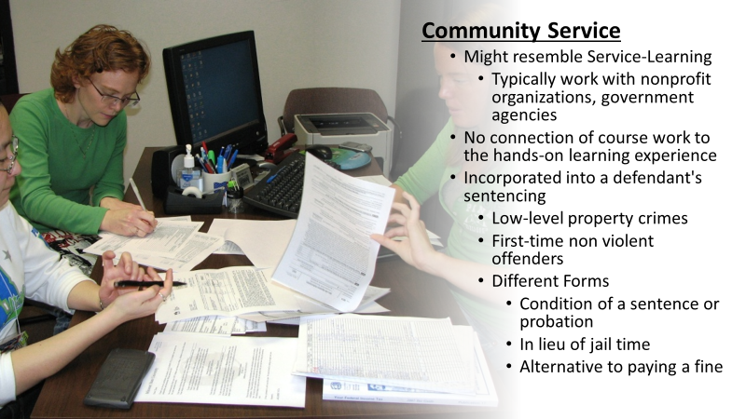
Service-Learning – What it’s NOT…

Slide 10
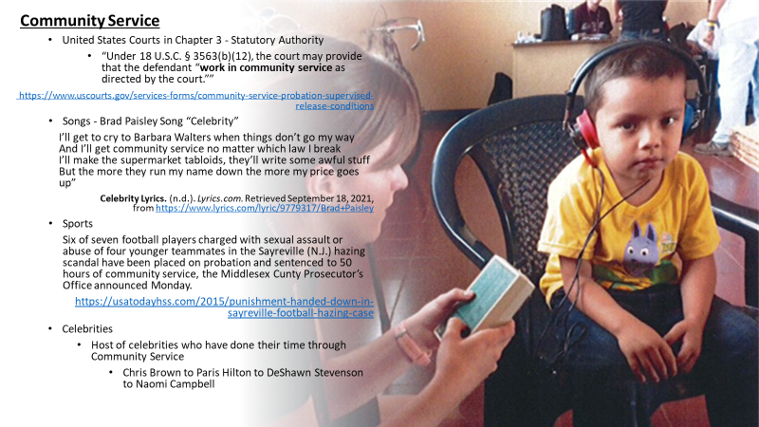
Service-Learning – What it’s NOT…

Slide 11
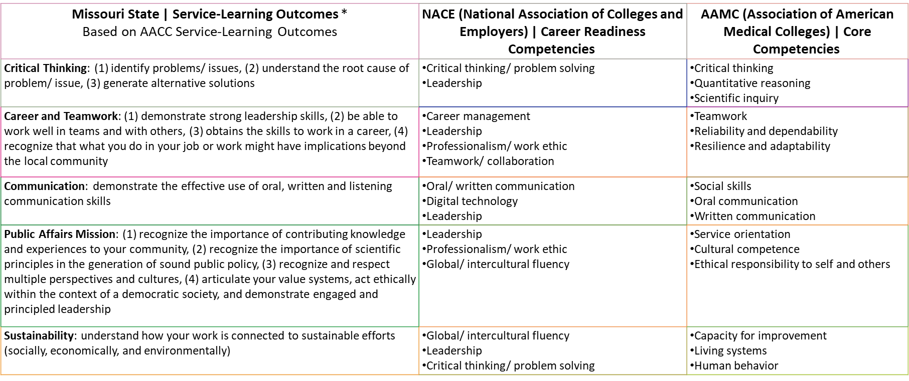
Why Service-Learning?
Examples of Other Association Core Competencies: American Bar Association; American Counseling Association; American Dental Education Association; American Psychological Association; American Physical Therapy Association, American Speech-Language-Hearing Association; American Society of Health System Pharmacists; Council on Education for Public Health; General Optical Council; Department of Elementary and Secondary Education; National Association of Social Workers

Slide 12
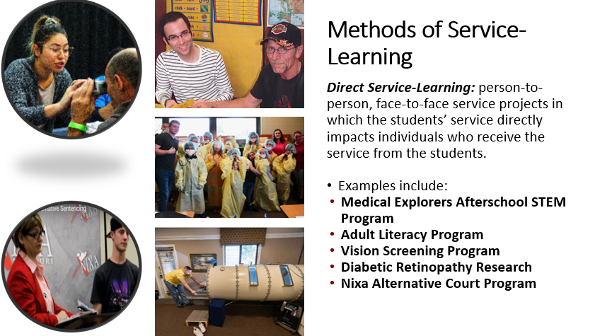
What Does Service-Learning Look Like?
Notes:
(Next Slide)

Slide 13
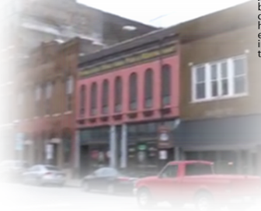
What Does Service-Learning Look Like?
Methods of Service-Learning
Capacity-building Service-Learning: working on broad issues, environmental project, community development projects that have clear benefits to the community or environment, but not necessarily to individual identified people with whom the students are working.
Compiling a town history; working to restore historic structures or building low-income housing
Removing exotic plants and restoring ecosystems
Writing grants for non-profit organizations or to fund services/programs
Writing a guide on available services in a community and translating it into Spanish or other languages for new residents
Notes:
(Next Slide)

Slide 14
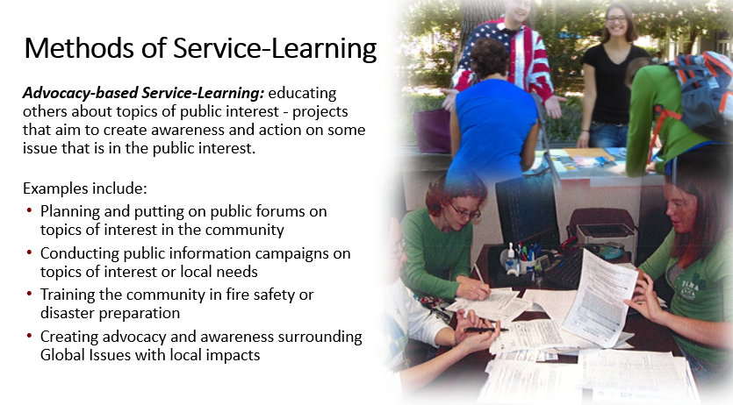
What Does Service-Learning Look Like?
Notes:
(Next Slide)

Slide 15
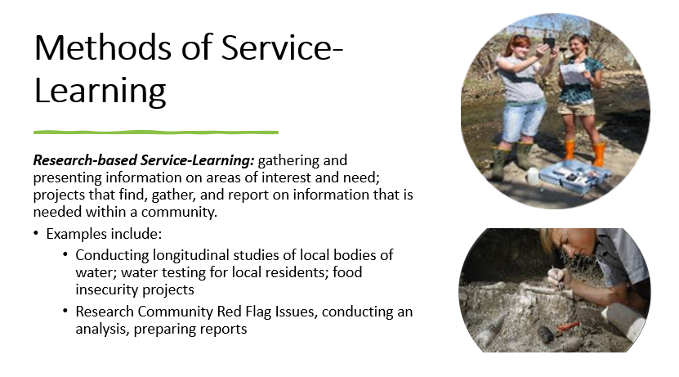
What Does Service-Learning Look Like?
Notes:
(Next Slide)

Slide 16
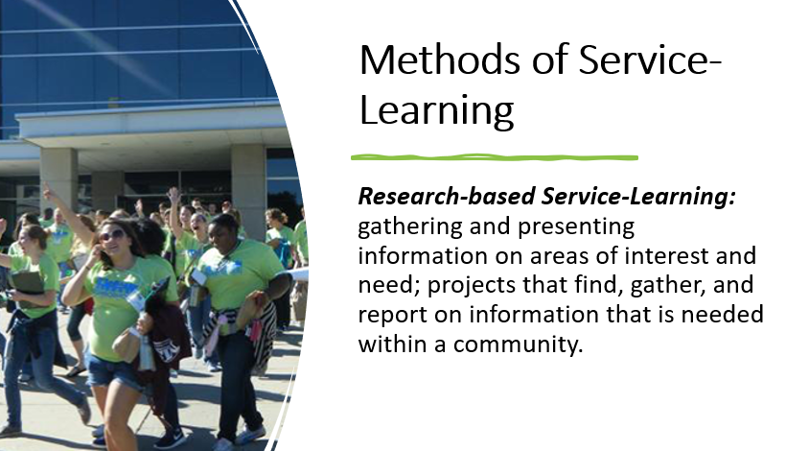
What Does Service-Learning Look Like?
Walkable Springfield: https://youtu.be/TLOUyvPbU2c?list=PL-cV8SvlX_qJYZXIYBXgVrre2NYm2rJko
Notes:
(Next Slide)

Slide 17
Key Stakeholders – Community-engaged learning
Campus
Connects the Institution to the Community
Supports our work for accreditation (HLC; Carnegie)
Faculty
Helps student connect their classroom learning in an applied way
Supports their work in tenure, promotion, research and service
Students
Gain “real-world” experience
Skills, Sensitivities, and Commitment
Community
Provides a wealth of resources to work with community to address problems and issues
Platform for faculty & students to engage in research
Connects the Community to the Institution
Strengthens Majors / Career Choices
IPEDS – High Impact Practices
Fosters and promotes student success/retention
Builds Resume’
Provides for Networking
Aligns with the NACE Career Core Competencies
Aligns with Professional Core Competencies
Vehicle that moves our Public Affairs Mission Forward
Notes:
A little context and background about what service-learning is:
Service-learning is considered a high-impact teaching method that connects classroom learning with real-world experiences to address identified problems and issues in communities. The final activity is a reflective activity in which the students think critically and demonstrate how their experience connected to their course learning.
Bringle and Hatcher (1996) defined service-learning as a credit-bearing educational experience in which students participate in an organized service activity that meets identified community needs [and] reflects on the service activity in such a way as to gain further understanding of course content, a broader appreciation of the discipline, and an enhanced sense of civic responsibility. (Klentzin and Wierzbowski-Kwiatkowaki, 2013, p. 46).
Why is Service-Learning important?
At Missouri State, service-learning really serves as the vehicle that moves our Public Affairs mission forward
Further, with more from than three decades of research in the field of service-learning data shows positive outcomes and benefits for students who complete courses where the teaching method of service-learning is applied. These benefits and outcomes include: 1) increased student academic success, 2) increased student retention rates, 3) increased demonstration of civic responsibility by the student, 4) increased ability to identify college majors and career choices, and 5) increased student commitment to engage in service to community post-graduation .
As noted by Kilgo, Sheets and Pascarella (2015), the high-impact practice of service-learning serves as “pathways to student success” (p. 509) for higher education students when service-learning is used as the primary teaching method in curriculum development and course delivery.
(Next Slide)

Slide 18
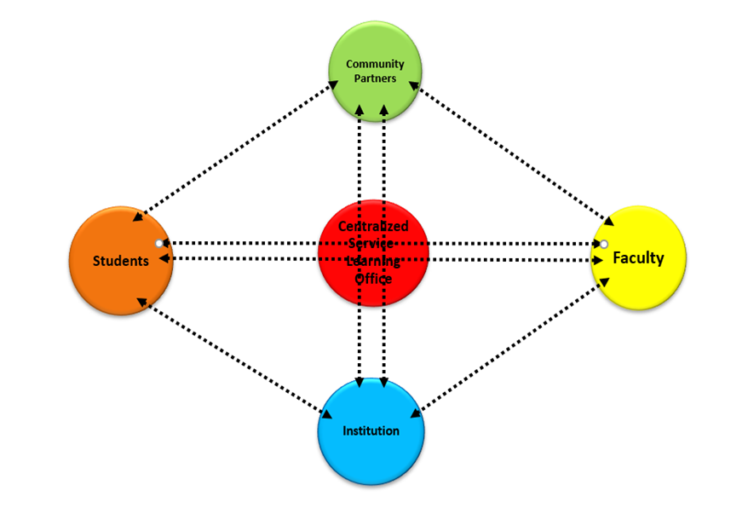
Making It Happen – Connecting the Dots…
All of the Dots must be Connected for Community-engaged Learning or Service-Learning to happen
Who's the Dot Connector
  CASL
Stakeholders
  Institution
  Faculty
  Students
  Community
Notes:
(Next Slide)

Slide 19

Questions
Q & A: What questions do you have?
Links for additional information:
Carnegie: https://carnegieclassifications.acenet.edu/elective-classifications/community-engagement/
CASL: https://www.missouristate.edu/CASL/default.htm
Contact Information:
Dr. Katherine Nordyke, Director
Citizenship & Service-Learning
Missouri State University
Direct Line: 417-836-6060
Email: katherinenordyke@missouristate.edu

