Slide 1
New Faculty Orientation
Office of the Provost
2012-13

Slide 2
Welcome to MSU Dr. Julie Masterson Provost Fellow Faculty Development

Slide 3
Breakfast is sponsored by Commerce Bank
Getting to Know You Questionnaire
Have your photo taken August 27 or 28; Plaster Student Union 312, 9:00-4:00
Getting to Know MSU

Slide 4
Welcome to MSU Dr. Frank Einhellig Provost

Slide 5
MSU’s Special Mission in Public Affairs Dr. Chris Craig Associate Provost

Slide 6
‘Tis a Priviledge to be a Bear…..

Slide 7
Video Overview

Slide 8
Quiz
Table to Table Competition
Customary Academia Rewards

Slide 9
The current president of Missouri State University is
Bluff Clever- although semantically related, it’s wrong, so you get 0 points
Clif Smart- correct… 2 points

Slide 10
The out-of-pocket cost for a basic office visit at Taylor Health and Wellness for a faculty member on MSU insurance is
$7.80 – correct! Can you believe it? They waive the deductable and cover 20% of the costs. Of course, this is only for a basic visit for colds, sore throat, etc. If you want something complicated like botox, that’s a different story. If this isn’t reward enough, give yourself a point.
$78.00- No.. you’re at MSU now. No points.

Slide 11
At MSU, CHPA stands for
a museum dedicated to Erik Estrada memorabilia- wrong, 0 points, and some of you are too young to know why this is funny
College of Humanities and Public Affairs- correct… 2 points

Slide 12
MSU is an extension of the University of Missouri
True- wrong, deduct 2 points from your total score and may God have mercy on your souls
False- correct… 2 points

Slide 13
The Bear CLAW provides
academic support for students- correct… 2 points. It stands for Center for Learning and Writing
free drinks during Happy Hour on Wednesdays-no; 0 points for wishful thinking

Slide 14
At MSU, CASL stands for
an exclusive club for tenured full professors– HAHAHAHAHAHA.. 0 points..
Citizenship and Service Learning -correct… 2 points. They can help when you’re ready to plan service learning experiences for your students

Slide 15
It is possible to get an examination for hearing aids at MSU.
True- correct… 2 points. Faculty and their can get a variety of services at the MSU Speech-Language-Hearing Clinic in the Professional Building.
False- incorrect..you don’t get any points, but it’s not surprising that you didn’t know what awesome services are available on campus….

Slide 16
Greenwood is MSU’s
center for research on renewable energy- sorry, wrong, 0 points.
laboratory K-12 school- correct… 2 points. The faculty and staff are terrific about supporting research projects. Greenwood is a tremendous resource.

Slide 17
MSU’s mascot is the
bear- correct… 2 points
tiger- wrong, deduct 2 points from your total score and may God have mercy on your souls

Slide 18
The woman who leads the NCAA Division 1 in career basketball scoring played for
MSU-correct… 2 points. Jackie Stiles, who lead our women’s team to the NCAA Final Four in 2002.
Ole Miss- No, but they do have a strong tradition in women’s basketball, so you don’t have to deduct any points. You just can’t add any.

Slide 19
The MSU PRIDE Band has marched in
Macy’s Thanksgiving Day Parade- correct… 1 point
Tournament of Roses Parade- also correct… 1 point.. They are amazing!

Slide 20
At MSU, Tent Theatre is
a festival that highlights INDY films about the experiences of extreme camping- wrong, 0 points, but that might be a cool thing to do
an outdoor theatre that has been in existence since 1963 and offers special summer productions for the southwest Missouri region-correct… 2 points. Look for this next summer!

Slide 21
Dependents of faculty and staff at MSU are eligible for
tuition/fee waivers for MSU coursework-correct… 2 points. My son, daughter, and their parents are extremely grateful for this perk.
Free admission to the St. Louis Rams games- wrong, 0 points, do you really care? Well, maybe if Sam Bradford has a good year and he’s my fantasty football QB….

Slide 22
Digital Measures is
a biofeedback system that is worn around the waist and emits an alarm every time the user eats a cupcake or a nacho-wrong, 0 points, although I bet there’s an app for that and if there’s not there probably should be.
a software system that all faculty use to document their accomplishments in research- correct. This is really important! “If it’s not recorded in DM, the Provost Office doesn’t recognize it!

Slide 23
The administrative purview of a dean is typically at the level of the
department- wrong, 0 points
True- correct… 2 points.
universe – incorrect, no points and no comments

Slide 24
MSU offers academic doctorate degrees
True- correct… 3 points.. One for each doctorate we currently offer. This will be worth more points soon…
False- wrong, 0 points.

Slide 25
At MSU, career advancement decisions for faculty are based on
teaching- correct… 1 point
research-correct… 1 point
service- correct… 1 point
athletic ability- blessedly incorrect, no points

Slide 26
The broad themes of MSU’s Public Affairs mission include
research on the private lives of politicians-although this could be a research focus on some MSU faculty member, it’s not one of our themes, so 0 points
ethical leadership- correct… 1 point
cultural competence-correct… 1 point
community engagement-correct… 1 point

Slide 27
You should post all of your weekly activities on your Outlook Calendar.
True -correct. This is really important because it allows us (and your secretarial staff) to find times for development activities that work for most folks. Don’t worry.. specifics aren’t shown to anybody but you! They just see “busy,” “out of office,” etc.
False- wrong. Do you really want to have to respond to 40 Doodle Calendar requests??

Slide 28
The Provost’s Office will offer several workshops over the academic year that
will be worth my time to attend. they will help with my teaching, research, service, and maybe even life in general-correct… 2 points.
I can ignore… Julie just needed something to do instead of teaching her normal classes-
wrong, 0 points. Shame on you.. I’m still teaching most of my classes….

Slide 29
Overview of MSU Faculty Development

Slide 30
Provost Office NF Seminars: Mondays, 3:30-5:00
Month | Topic
October-November | Optimal Preparation for Tenure-Promotion (in individual colleges)
December | Beginning/Implementing a Focused Research Agenda
January | Using Digital Measures
February | Student Support Services University Support for Research
March | Research Compliance
April | Faculty Governance and MSU Service Opportunities Directing Student Research
May | Responding to Editorial Feedback

Slide 31
Faculty Development Website

Slide 32
MSU Resources to Support Teaching
Nancy Gordon
Assistant Director, Faculty Center for Teaching and Learning
Gary Rader
Director, Missouri State University Online

Slide 34
New Course Development Process

Slide 35
New Course Development Process Flow Chart*
1
2
3
4
Submit Development Stipend Application Form
MS Online Tracks & Processes Forms
Development Process for Faculty to Receive Stipend
Payment Process and PAF Submission
* Applies only to courses requesting the Development Stipend
Notes:
We are trying to increase visibility and confidence in the development payment process for faculty and department administrative assistants. This will also assist the provost office in approving PAFs.
NOTE: Even though courses are not approved for the stipend, they can still be developed and faculty should be encouraged to meet with the FCTL for to maximize student learning and best practices.

Slide 36
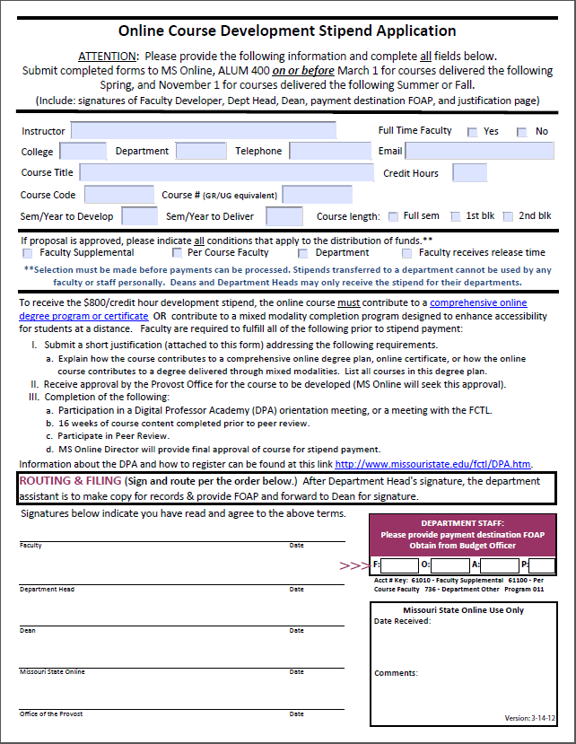
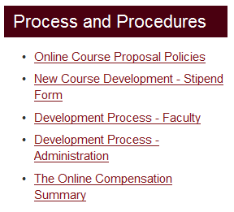
1. Submit Development Stipend Application Form*
Find Course Development information and forms at:
http://outreach.missouristate.edu/onlinecourseproposalform.htm
(NOTE: Form is available approximately 6 weeks prior to submission deadlines)
Fill-able online
Insert Destination FOAP
Route in order of signature lines
Courses must be submitted on or before:
March 1 for courses taught the following Spring
November 1 for courses taught the following Summer/Fall.
* This process only applies to courses requesting the Development Stipend. Deans and Department Heads may only receive the stipend for their departments. Stipends transferred to a department cannot be used by any faculty or staff personally.
Notes:
INCLUSION of the Destination FOAP (account number) can aid in reducing the processing time by anywhere from 2-3 weeks.

Slide 37
2. MS Online Tracks & Processes Forms
MS Online office will:
Send notice of stipend application receipt to Faculty, Deans, Department Heads, Admin Assistants.
Seeks Provost approval to develop for stipend
Send approval/denial notice to all involved (Faculty, Dean, Dept Head, Admin Assistant, College Budget Officer for departmental tracking)
Notes:
We are trying to increase visibility and confidence in the development payment process for faculty and department administrative assistants. This will also assist the provost office in approving PAFs.
NOTE: Even though courses are not approved for the stipend, they can still be developed and faculty should be encouraged to meet with the FCTL for to maximize student learning and best practices.

Slide 38
3. Development Process for Faculty to Receive Stipend*
The following are required for payment:
Attend one of the DPA orientations or meet with the FCTL.
Complete 16 weeks of course content prior to Peer Review.
Participate in DPA Peer Review.
There are 3 annual Peer Review sessions, starting 2 weeks prior to end of each semester. Visit http://www.missouristate.edu/fctl/DPA.htm for Digital Professor Academy (DPA) program and registration information.
Completion certificates are issued by the DPA at the end of the semester following Peer Review. (If you are unable to complete the review during your development semester, you will need to participate in the next scheduled review).
Developers must submit their certificate to MS Online to receive payment.
Director of Online provides final approval for payment.
Notes:
We are trying to increase visibility and confidence in the development payment process for faculty and department administrative assistants. This will also assist the provost office in approving PAFs.
NOTE: Even though courses are not approved for the stipend, they can still be developed and faculty should be encouraged to meet with the FCTL for to maximize student learning and best practices.

Slide 39
4. Payment Process
Course completion certificate must be on file with MS Online.
MS Online sends notice to Provost Office to release funds for certified courses.
Once funds are released/transferred, MS Online will notify the college and departments via email to initiate the payment PAF.

Slide 40
Contact Information
Gary Rader, Director
MS Online, 6-7619
garyrader@missouristate.edu

Slide 41
Take a few minutes to share a story of a teacher, mentor who influenced you to become an academic….

Slide 42
Shared Governance at MSU
Dr. Christopher Herr
Faculty Senate Chair

Slide 43
Focus Groups
Instructors/Clinical Faculty
Tenure-Track Faculty
PSU 400
PSU 3112

Slide 44
Support for Tenure-Promotion Process
Julie Masterson & Chris Craig

Slide 45
General Schedule
During fall semester, we’ll be having a series of workshops with each college to help you optimally prepare
Your first evaluation will occur in the spring... materials are due February 11, 2013.

Slide 46
Most Important Advice
Know YOUR DEPARTMENT’s plan
Pay careful attention to your annual review.
Each year, it should specifically indicate
1. progress toward tenure/promotion is satisfactory
2. progress toward tenure/promotion is questionable, identifying areas for improvement, providing specific suggestions
3. progress toward tenure/promotion is unsatisfactory
Heed advice and document how you have addressed feedback.

Slide 47
Faculty Research Grants
Proposal due November 2, 2012
Workshop on preparing proposal offered in September
The past chair and committee members indicate that this is one of those rare competitions that involve more money than requests, so…
APPLY
… with a STRONG PROPOSAL

Slide 48
Office of Sponsored Research & Programs

Slide 49
What We Do
Assist with finding funding opportunities, proposal preparation and submission
Award negotiation and acceptance
Post-award services such as:
Requesting project extensions
Negotiating budget re-allocations and changes to the project scope of work
Ensuring that projects are completed to the satisfaction of our sponsors

Slide 50
Finding Funding Opportunities
Search for funding on your own, or ask for assistance, using the following search engines:
COS (Community of Science) Funding Opportunities
OSRP Blog
Grants.gov
FedBizOpps.gov
GrantsNet

Slide 51
Writing Your Proposal
Assistance is available from our staff:
A thorough review of the RFP to produce a condensed version of exactly what items you will need to submit a completed proposal.
Assembly of proposal package (electronic or hard copy).
Review of proposal and budget to ensure compliance with Sponsor and University.
Submission of electronic proposal or mailing of hard copy.

Slide 52
University Support Available
The University is committed to assist those that seek external funding:
Travel Fund- up to $1,000 in travel expenses reimbursed.
Course Reassignment Fund- Up to $3,000 plus fringe.
Equipment Match Fund – Used for proposals that require match.

Slide 53
Contact Us
Office of Sponsored Research & Programs
Carrington Hall, Room 407
Phone: 417-836-5972
Email: sponsoredresearch@missouristate.edu
URL: srp.missouristate.edu
* We are available by appointment and will tailor training by individual, department, or college.

Slide 54
Faculty Writing Retreats
Dr. Keri Franklin, Provost Fellow
Writing Retreat Website

Slide 55
Morning Wrap-Up:
Resources to Support Teaching
FCTL, NF Workshop Series
Attend Showcase tomorrow!
Resources to Support Research
OSR, Internal Grants, Dean’s Summer Stipends, Writing groups, NF Workshop Series
Opportunities for Service

Slide 56
Personnel Review 2017-18
Top 3 Accomplishments | Contributing Factors
Teaching
Research
Service

Slide 57
Remaining Events
Lunch with Your Dean, 12:00-1:30
Room 312C- CHHS
Room 314A- CHPA
Room 314C-COE
Room 314B- CNAS
Room 315A- COAL
Reception with President & Mrs. Smart, 6:00

