Slide 1
Reconsidering Undergraduate Education
September 14, 2010

Slide 2
Overview of Presentation
Why are we looking at undergraduate education?
What resources are available and how can they guide us?
What will the process look like?
Discussion

Slide 3
Forces of Change
Long Range Planning Process – initiated by Pres. Nietzel
Academic Priorities Work Group
SWOT Analysis
HLC 2005 Review
Recent Experiences in General Education Revision
3 draft reports developed over Summer 2010
Presentations to Steering Committee, AC and AAA
Presentation to BOG at Retreat

Slide 4
Strategic Direction 1 (Recommended by APWG) Enhancing the quality of student learning Goal General Education Reform
Tactics
1. Establish university wide presidential committee on general education
2. Identify the purposes of general education
3. Establish learning outcomes for general education, including public affairs
4. Determine best practices in meeting learning objectives
5. Make recommendations for implementation options
6. Develop and implement assessment plan for general education

Slide 5
Resources
Derek Bok’s Our Underachieving Colleges
Inspiration
Research
AACU Grant Program
Content and Design that Matches Public Affairs, Senate Learning outcomes, Higher Learning Commission Concerns
Materials and Training
AASCU “Red Balloon” Project
Collaboration designed to create models of undergraduate education

Slide 6
This is not a course review
Focus on examining purposes of undergraduate education we wish to achieve at MSU
What knowledge, skills and competencies do our graduates need?
What methods of teaching are most effective in achieving the outcomes desired?

Slide 7
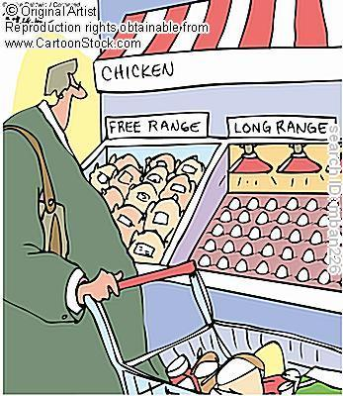
Timeline
2011-2016 Long Range Plan
Minimum 2-3 year active process
2010-2011 is Preparation/Discussion

Slide 8
At least two stages of undergraduate program review and action:
Macro Level - Recommendations to President and BOG
Purposes/Content
Competencies
Assessment
Design - From SOAR to Graduation
Format of instruction
Pedagogy
Cocurricular
Implementation –
Recommendations to Proposals
MSU Curricular Process

Slide 9
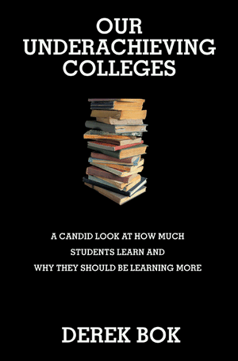
Derek Bok’s Our Underachieving Colleges
Introduction
A History of Higher Education
Religious Affiliation and Focus on Character
Science and the Liberal Arts
Vocational Education

Slide 10
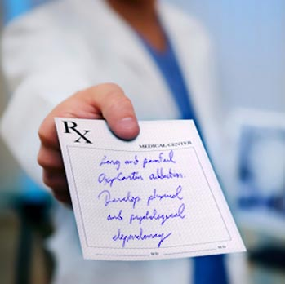
Historic and Ongoing Debates
Rigid prescriptions for coursework
No prescriptions – students must choose to learn
Development of concentrations (majors)
Distribution requirements

Slide 11
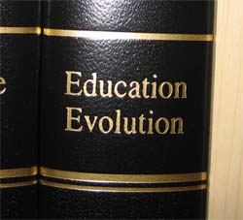
Institutional Evolution and Diversity
Private colleges
Land grants
Teachers colleges
Comprehensives
Community colleges
For profits

Slide 12
Critiques – From the Outside and Inside
External critiques largely miss the mark
Internal critiques sound like concerns raised by faculty at MSU
Science literacy
Quantitative skills
Communication skills
Critical thinking
Information literacy
Role of technology

Slide 13
Bok’s Concern and Guidance
Complacency and impediments should not stop us from examining:
What are we accomplishing?
What does research tell us can be achieved?
What do we want to achieve?
Guidance for processes for reform/revision in content and pedagogy

Slide 14
Bok’s Eight Purposes of Undergraduate Education: For Your Consideration

Slide 15
1: The Ability to Communicate
Writing
Oral Communication
Does our instruction improve student writing?
How much writing do our students do over the years?
Do some strategies work better than others?

Slide 16
The Dilemmas
General Education coursework in composition and communication are undervalued
Research on pedagogy in these fields is not as valued as traditional scholarly work
Difficulty of teaching composition
Instruction often relegated to “somebody else.”

Slide 17
2: Critical Thinking
Critical Thinking - A simple definition
An ability to recognize and define problems clearly, to identify the arguments and interests on all sides of an issue, to gather relevant facts and appreciate their relevance, to perceive as many plausible solutions as possible, and to exercise good judgment in choosing the best of these alternatives after considering the evidence and using inference, analogy and other forms of ordinary reasoning to test the cogency of the arguments(68)

Slide 18
Critical Thinking (continued)
Discussion of large body of evidence that critical thinking abilities can be improved and how to do it
Example: Legal Education and the Socratic method
Example: Blended course design with web based content followed by student blogs and targeted class discussion – Eric Nelson

Slide 19
Critical Thinking and Quantitative Reasoning
What mathematical, statistical and computer skills do students need to navigate the world they are likely to experience?
Arithmetic
Data
Computers
Modeling
Statistics
Chance
Reasoning
National Council on Education and the Disciplines

Slide 20
Critical Thinking and the Major
Body of knowledge
Standard methods of inquiry to obtain relevant information
Most useful methods of analysis to utilize knowledge to answer typical questions in the field
Opportunities to test ability to work in depth through a series of tasks of increasing complexity, culminating, ideally in some final project or inquiry

Slide 21
3: Moral Reasoning
Two aspects of ethical behavior:
Ability to think carefully about moral dilemmas, evaluate the arguments on all sides and decide the right thing to do.
Research suggests coursework can improve this

Slide 22
Moral Reasoning (continued)
2. Desire and self discipline to put one’s conclusions into practice
Role of empathy for others; value of community service, reflective opportunities
Academic Integrity – our own challenge and opportunity: 80% of “A” students acknowledge cheating

Slide 23
4: Preparing Citizens
Purpose – Develop active and informed participants in the process of democratic self government
Understanding of
Democracy
Political philosophy
Economics
US role in world affairs

Slide 24
5: Living with Diversity
The challenge is to determine how to help students learn to live together with understanding and mutual respect, while not appearing insensitive to the aggrieved, unfairly accusatory to the majority or rigidly doctrinaire to the larger society (75)

Slide 25
Living with Diversity
Interpersonal relations:
Skills of collaboration, persuasion and negotiation
Improving capacity for leadership:
Skills to listen perceptively and acquire insight into the feelings and motivations of others

Slide 26
6: Living in a More Global Society
Options – Four Elements to assist in Learning
1) Course in one country thoroughly and/or comparative analyses
2) Language
3) Study Away
4) International students
Continuing Challenge:
How do you measure intercultural competence?

Slide 27
7: A Breadth of Interests
Views on how to accomplish this purpose
Great books
Survey of major trends – western civilization, technology, etc
Modes of thought – science, art, history
Distribution requirements

Slide 28
8: Preparing for Work
Issues Facing Liberal Arts and Sciences Majors
Issues Facing Study in the Vocations

Slide 29
Bok’s Recommendations
Adopting a process of evaluation, experimentation and reform
Role of presidents provosts and deans - appealing to professional responsibility (dedication, intellectual capacity and creativity) of the faculty for the education of their students
Every institution has an equal opportunity to succeed (See Afterword) – with greater success likely for the less affluent

Slide 30
Bok’s Recommendations
Expand high impact instruction -
service learning, undergraduate research, etc.
Undertake assessment and pedagogical research
Make student evaluations more useful for faculty
Develop a more learner centered process of instruction
More focus on teaching in roles and rewards

Slide 31
Next steps
Appoint Provost Fellows – Danae Hudson, Michael Stout
Apply for AACU grant and await outcome (October 2010)
Appoint Committee, Prepare Charge and Timeline
Focus:
Purposes of undergraduate education
How to best achieve the purposes
How to assess learning outcomes

Slide 32
AACU Purposes/Content
Diversity, Democracy, and Global Emphases: Students will explore global interdependence and American pluralism, questions of identity and community, and personal and social responsibility.
Scientific Literacy (for ALL students, STEM majors and non-STEM majors): Learning experiences will emphasize scientific inquiry and scientific literacy across the curriculum, addressing real-world global dilemmas through research, application, and diverse perspectives.
Advanced Integrative Inquiry: Student work will focus on “big global questions” across disciplines. Students and faculty together will explore problems that require multiple perspectives and investigation for solutions that benefit the common good.

Slide 33
AACU Goals
The project builds upon innovative efforts to reframe general education courses and create coherent curricular designs that address complex global issues, and social responsibility across divisions and disciplines. Over the next two years, participants will:
articulate essential global learning outcomes for all students,
develop and share models of global general education curricula that can be adapted across all institutional types,
gain the knowledge, resources, and skills needed to effectively design and teach interdisciplinary, integrative courses that focus on real-world global issues, and
develop rubrics for assessing global learning outcomes that can be used by diverse institutions and across academic fields.

Slide 34
AACU Design
Sequential Progression from First to Final Undergraduate Years: Participants will implement a first to final year structure—keyed to expected student capabilities rather than specified course content—with integrative and applied work at milestone and culminating points across the curriculum, and flexible points of entry for transfer students.
High Impact Educational Practices: Institutions will weave widely tested, student-centered educational design practices into the general education curriculum (examples include first year seminars/experiences, learning communities, writing intensive courses, collaborative projects and assignments, undergraduate research, internships, study abroad and study away, and capstone projects).

Slide 35
AACU Design
Intellectual and Practical Skills and Ethical, Cross-Cultural Inquiry, Across the Curriculum: Starting when students enter the institution, the curriculum will help students make clear links between skills (such as analytical reasoning, inquiry and research, quantitative and information literacy, problem-solving, ethical reasoning, community-based learning, integrative learning) developed in general education and those developed in majors.
Capstones: Capstones are designed to integrate general education requirements and the major and to demonstrate that students can apply their learning to complex problems.

Slide 36
Participating Team Activities
Global Learning Inventory (Fall 2010-Spring 2011): Team members will identify locations on campus where global learning is robust. The inventory will form the basis for mapping global learning to strengthen its coherence and pervasiveness on campus..
Campus Action Plan (Spring 2011): Team members will develop an action plan for better aligning their global learning goals with general education designs.
Curriculum and Faculty Development Institute (Summer 2011): The centerpiece of the project will be a five-day institute in Summer 2011

Slide 37
The AACU Institute
The institute will feature:
seminars on integrative global learning topics such as sustainability and development, health and justice, migration and memory
curriculum design workshops
sessions on pedagogy, assessment, and student development
team time to accelerate campus-based change
consultations with experts drawn from previous Shared Futures projects and related AAC&U projects on general education, integrative learning, scientific literacy, personal and social responsibility, and assessment

Slide 38
AASCU’s Red Balloon Project
The goal of the Red Balloon Project is to collaboratively create models of undergraduate education that:
Will allow us to successfully educate, with fewer resources, an increasing number of students who are likely to be more culturally, linguistically, and racially more diverse than our current students.
Utilize educational technologies to better engage students in authentic learning experiences more aligned with the ways that knowledge is being generated, aggregated and disseminated in an age of networked knowledge.
Provide students with the knowledge, skills, and abilities they will need to become successful as participants in careers, as citizens in a democracy, and as leaders in the global society of the 21st century.

Slide 39
In conclusion
The proper way to evaluate a curriculum review, therefore, should be to ask not whether it has produced the one best curriculum – for no such thing exists, but whether it has arrived at a carefully considered result through a process that has strengthened the faculty’s commitment to undergraduate education and united them in a clearer understanding of their common purpose.

Slide 40
Discussion
Additional Discussion Forums
What’s On Your Mind – 9/15, Union Club 3:00
FCTL Events
College Strategies

