Slide 1
A&OER – Bookstore Perspective
Sherry Pollard
Director
UM Campus Stores
University of Missouri
Dale Sanders
Senior Associate Director
UM Campus Stores
University of Missouri

Slide 2
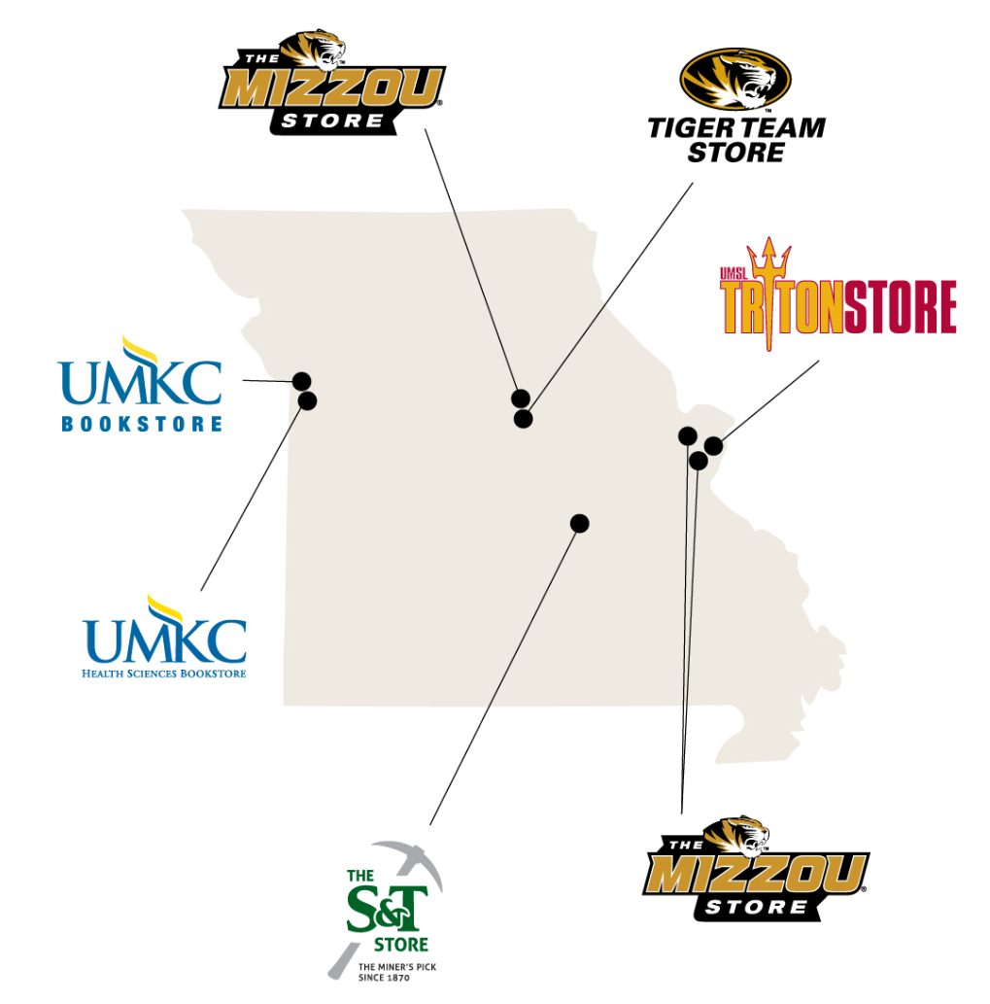
University Owned and Operated
5 University Stores
Shared Services Model
Marketing
IT
HR
Accounting
GM Buying
eCommerce
Course Materials

Slide 3
AutoAccess is currently the largest inclusive access program in the country.
Collaborative program between campus stores, faculty, publishers, and education technology teams.
All digital content is integrated into the LMS (Canvas or Blackboard).
Content is available to all students on the first day of class for prices that are “below competitive market rates”
Student choice remains (opt-out)

Slide 4
Publisher
12 participating publishers
Faculty
Day 1 Access
Canvas integration
Students
Cheapest Option
Confidence in content
Ease of communication
Low cost for students
Convenience
Textbooks and other eContent

Slide 5
Growth

Slide 6
Growth

Slide 7
Spring 2018 Data – UM System
Courses: 357
Sections: 858
Enrollment in AutoAccess: 40,200

Slide 8
Savings
Student Savings
Campus | Course | Enrollment | Prev Cost | Current Cost | Savings/ Student | Total Savings
MU | ITAL1200 | 15 | 325.65 | 29.95 | 295.70 | 4,435.50
MU | BIO_SC 2200 | 235 | 232.40 | 88.25 | 144.15 | 33,875.25
S&T | ENG_MGT | 52 | 205.95 | 58.99 | 146.96 | 7,41.92
UMKC | MATH 110 | 75 | 171.61 | 88.25 | 83.36 | 6,251.66
UMSL | PSYCH 2160 | 62 | 175.20 | 58.99 | 116.21 | 7,205.02

Slide 9
AutoAccess average price is $65.32, down from $150.38 on the prior adoption.
Spring 18 total student savings $2.5M from previous adoption.
Total student savings since Summer 14:
$9,766,425

Slide 10
Questions?

