Slide 1

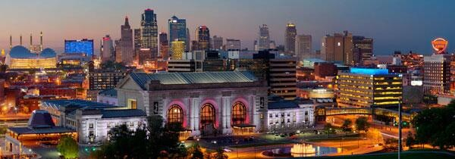

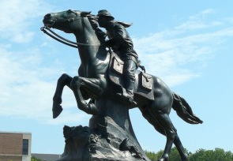

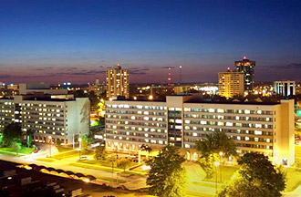


Higher Ed & Economic Development

Slide 2

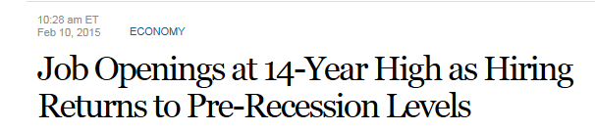
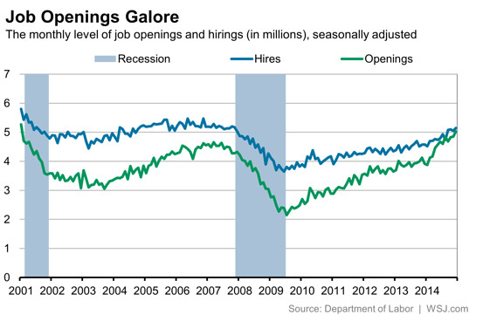

Slide 3
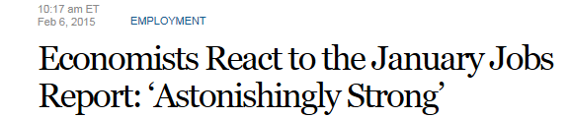
Before long, the U.S. economy is going to run into a problem that was unimaginable just six months ago:
we might run out of people to employ.”

Slide 4
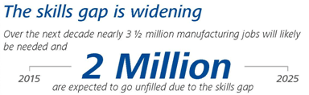
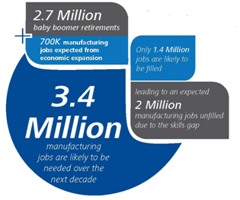




Slide 5

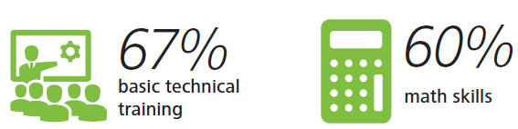



Slide 6
One of the most persistent challenges affecting both lagging and thriving state economies is the growing skills gap—the disparity between the skills companies need to drive growth and innovation versus the skills that actually exist within their organizations and in the labor market.
A sizable skills gap impacts other vital dimensions of the economy including exports and international trade, entrepreneurship, and technology, all critical drivers of national competitiveness and economic growth.
US Chamber Foundation, 2014
Notes:
http://www.uschamberfoundation.org/sites/default/files/legacy/foundation/Enterprising%20States%202014_0.pdf

Slide 7
“Education is the single most important factor in driving economic growth.”
CEO for Cities
“Technology has been a key driver of economic growth over the last two decades, fueling the innovation and entrepreneurship that are crucial to long-term economic development and prosperity.
Brookings Institute
Notes:
http://www.icic.org/connection/blog-entry/blog-what-i-heard-at-the-ceos-for-cities-conference

Slide 8

“In the past, workers with average skills, doing an average job, could earn an average lifestyle. Today, average is over. So many more employers have so much more access to so much more above average cheap foreign labor, cheap robotics, cheap software, cheap automation, and cheap genius. Therefore, everyone needs to find their extra – their unique contribution that makes them stand out in whatever is their field of employment.
Tyler Cowen, “Making It In America”

Slide 9

“New Economic Development Playbook”
Make attracting, developing, and retaining talented people in your communities your top ED priority.

Slide 10

Employment Data

Slide 11
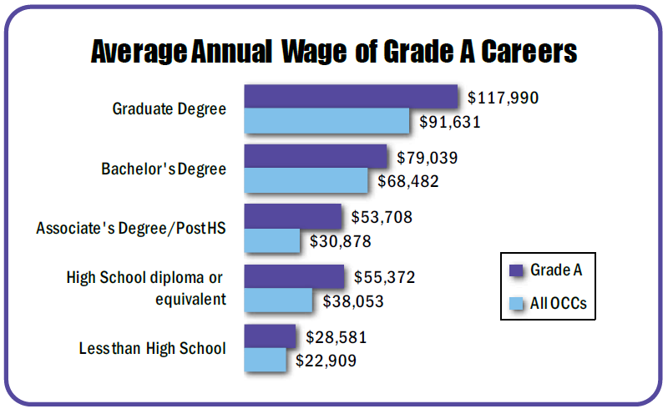
Notes:
http://www.missourieconomy.org/pdfs/career_grades.pdf

Slide 12
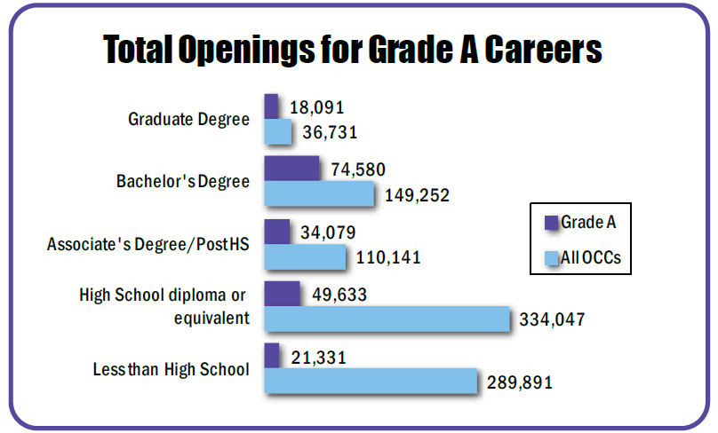
Notes:
http://www.missourieconomy.org/pdfs/career_grades.pdf

Slide 13
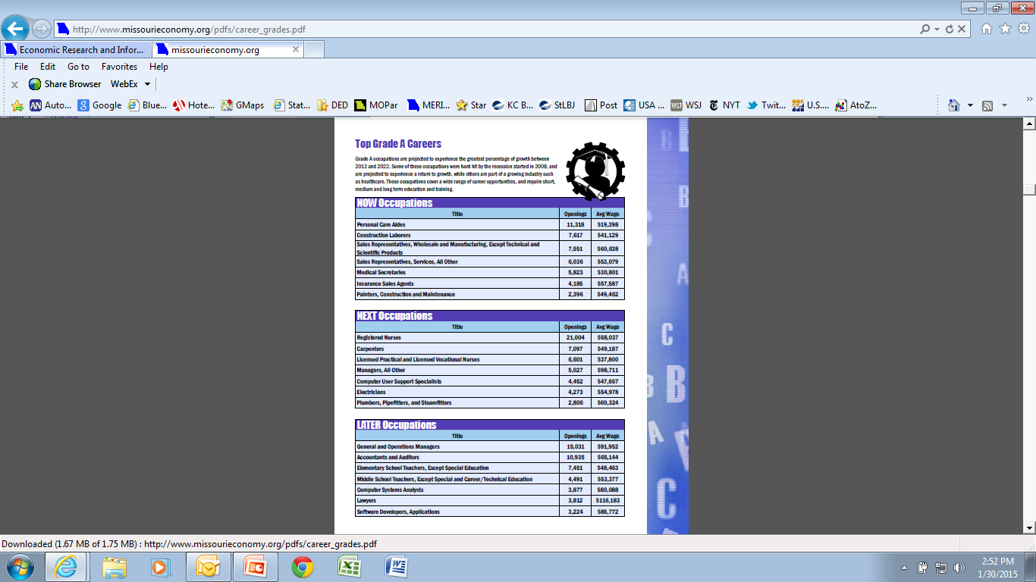

Slide 16
Employment Trends
Missouri is reaching peak employment again in 2015.
CY 2014: Largest 1 year job increase since 1997.

Slide 17
MO Employment Growth by 2022
New Jobs will be created….
2012 Employment 2022 Projected Employment Growth
2.84 Million 3.09 Million 255,000
But Replacement Jobs also needed….
New Job Openings + Replacement Jobs = Total Openings
255,000 665,000 920,000
2012-2022 Occupational Projections, MERIC . Occupations include payroll workers and the self-employed.

Slide 18
Projected Employment Growth by 2022
920,000 Total Job Openings
2012-2022 Occupational Projections, MERIC . 2013 median wage from Occupational Employment Statistics Program, MERIC.

Slide 19
Annual Demand for Mid-High Skill Jobs
56% of Job Openings need Middle-to-High Skills
51,300 Annual Openings for Middle-to-High Skill Workers
Can Unemployed Meet the Need?
143,000 Unemployed (+25 Older) in 2013
  77,000 (54%) have Some College or College Degrees
  Highest Rate of Unemployment in Construction
  Some Yes, but Others need New Skills…
2012-2022 Occupational Projections, MERIC . 2013 Unemployment information http://www.bls.gov/opub/gp/pdf/gp13_15.pdf. and 13_19.pdf

Slide 20
Missouri Labor Supply and Demand
5 to 1
In 2014 Too Few Jobseekers Chasing Opportunities in STEM, Business, and Healthcare
*Construction/Install./Maint. & Repair. Sources: Burning Glass Labor Insight, Online Job Ads Jan. 2014-Dec. 2014, Active Jobseekers, Dec. 2014, mo.jobs.gov.

Slide 21
Jobs and Education
Annual Job Openings
that Require Education after High School.
2012-2022 Occupational Projections, MERIC. Job openings include growth and replacement needs for an occupation.

Slide 22
STEM

Slide 23
What are Businesses Saying?
Business Roundtable of U.S. Company C.E.O.s
126 Employers Surveyed in Fall 2014
60% of Job Openings require basic STEM literacy
42% of Job Openings require advanced STEM knowledge
Biggest Gaps:
    Advanced Computer Skills
    Quantitative Knowledge Skill
Source: http://businessroundtable.org/sites/default/files/reports/BRT-SkillGap.pdf

Slide 24
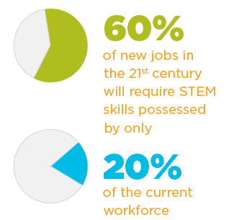
Source:
National Commission on Mathematics and Science for the Twenty-first
Century
Notes:
http://www.iteaconnect.org/mbrsonly/Library/SpecialInterest/ORLConferencePresentations/CLAYMIER%20-%20Elementary%20STEM%20presentation%20outline.pdf
https://www.teachforamerica.org/sites/default/files/131202_v08_rpak_stem_op_overview.pdf

Slide 25
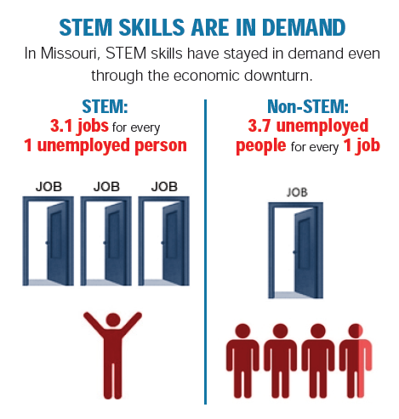
Source:
http://changetheequation.org/sites/default/files/vital-pdfs/MO-CTEq-vital-signs.pdf

Slide 26
Why STEM Education Matters
STEM is where the jobs are.
  STEM jobs will grow by 17 % over the next 10 years compared to 9.8% for non-stem.
STEM workers make higher salaries.
  26% more on average; Less likely to experience job loss.
Decline in STEM knowledge capital is reducing the basic scientific research that leads to growth.
Notes:
https://www.nms.org/Portals/0/Docs/Why%20Stem%20Education%20Matters.pdf

Slide 27
Why STEM Education Matters
United States is failing to produce enough skilled STEM workers.
  60% of the new jobs that will open in the 21st century will require skills possessed by only 20% of the current workforce.
  U.S. may be short as many as 3 million high-skills workers by 2018.
    2/3 of those jobs will require at least some post-secondary education.
  American universities, however, only award about 1/3 of the bachelor’s degrees in science and engineering as Asian universities.
Notes:
https://www.nms.org/Portals/0/Docs/Why%20Stem%20Education%20Matters.pdf

Slide 28
Top Missouri STEM Job Openings 2012-2022
Technologists and Engineers Top List
Notes:
2012-2022 STEM Occupational Projections, MERIC. http://www.missourieconomy.org/pdfs/stem_top_openings.pdf.

Slide 29
Degrees in STEM Fields Trending Up
In 2013 Missouri STEM Degrees make up:
16% of Bachelor’s Degrees
6% of Associate’s Degrees
60% of Job Openings require basic STEM literacy
42% of Job Openings require advanced STEM knowledge
Source: IPEDS completion survey data. Completions in Engineering, Computer Science, Sci./Eng. Technology, Bio., Life, and Physical Science.

Slide 30
Proposed Initiatives to produce more career-ready workers with good job prospects.
McKinsey Global Institute, “Game Changers: Opportunities for US Growth and Renewal”, July 2013
Expanding the number of apprenticeships and non-degree training programs that give workers marketable skills and credentials.
Concerted focus on improving learning and labor market outcomes (2 & 4 year degrees).
  Better and more transparent information about career pathways and outcomes so that students can choose the most appropriate and effective programs.
Increase in graduates with STEM degrees.
Focus on attracting and retaining talent from around the world.
Notes:
http://www.mckinsey.com/insights/americas/us_game_changers

Slide 31
MO Resources and Initiatives

Slide 32
Innovation Campuses
Purpose/Benefit:
  Increase the number of graduates in high-demand fields as identified by area employers.
  Reduce the time and costs for graduation.
Method: In HS junior year, students:
  Hired as interns by the high-growth employers.
  Take university and community college classes for credit.

Slide 33
Innovation Campuses
Campus Locations:
  Lees Summit (UCM), St. Joseph, Springfield, Jefferson City, St. Charles, Cape Girardeau, Rolla Kansas City, and Joplin.
  $9 million initial state grants (2012)
$1 million Grant (USA Funds, 2015) – Innovation Campus
  Northland Center for Advanced Professional Studies (NW MO State, North KC)
  UCM (Lees Summit)
  MoState (Springfield)
$1 million Grant (USA Funds, 2015) – Competency Ed.
  NW, Truman, UCM, MoState

Slide 34
Innovation Campus
2014 Legislation:
  50% tax credit for contributions to an Innovation Campus.
    ** Innovation Campus must repay the amount of the tax credit.
  Rules pending.

Slide 35
Workforce Training Resources
“Missouri Works”:
  Reimbursement of a portion of training for new jobs or upgrade of existing jobs.
    Primary companies with above average wages.
    New capital investment required.
  Needed improvements:
    Standardizing and improving the workforce services capacity of the Community Colleges.

Slide 36
ACT Work Keys /
National Career Readiness Certificate (NCRC)
Portable credential that demonstrates achievement and a certain level of workplace employability skills in:
  Applied Mathematics
  Locating Information, and
  Reading for Information
Measures "real world" skills that employers believe are critical to job success.

Slide 37
NCRC Benefits
Efficient matching of talent with work:
  Helps job seekers find better jobs.
    Especially seekers w/o degrees or certificates.
  Helps companies find skilled workers.
    Reduces their risk in hiring.
52,863 NCRCs issued in Missouri
  5,379 Veterans
2,158 Employers pledged to use NCRCs

Slide 38
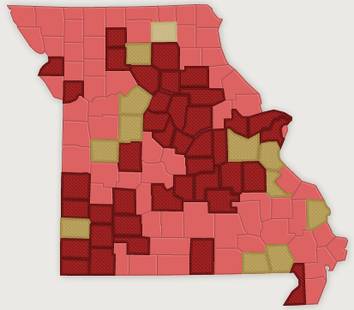

Certified Work Ready Communities
Spin-off of NCRC
Purpose:
  Documents the skills of the county’s workforce.
  Encourages companies to use NCRC in hiring.
52 counties participating
  12 Fully Certified

Slide 39
Recommendations (relative to NCRC)
Require NCRC as an exit exam for Community College graduates.
  Better markets skills.
Allow 3 semester hour credits at CCs for NCRC.
  Recommended by American Council on Education.
Provide for uniform pricing by CCs for NCRC job profiling.

Slide 40
Location of Higher Ed Facilities

Slide 41
Impact of Location of Higher Ed Facilities
Create the environment to attract and retain top talent, which will attract:
  High-growth companies.
  Top level entrepreneurs.
  Support professional services and financial resources.
This will cause:
  New technologies.
  Spin-off development and jobs.
  Improved state and local tax base.

Slide 42
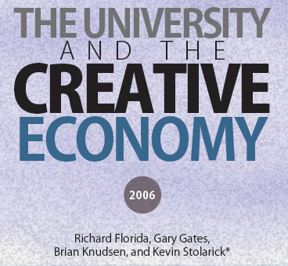
“Recent movement in the U.S. and around the world is to make universities “engines of innovation,” and to enhance their ability to commercialize their research.”
“3T’s” of University Economic Development:
  Technology: Cutting edge of technological innovation.
  Talent: attract faculty, researchers and students, while also acting as indirect magnets that encourage highly educated, talented and entrepreneurial people and firms to locate nearby.
  Tolerance: Help shape an environment open to new ideas and diversity.

Slide 43

“Live First, Work Second,” consultant Rebecca Ryan notes just how important lifestyle is to next generation workers:
75% surveyed said that finding a “cool city” was more important to them than finding a “good job.”
Notes:
http://nextgenerationconsulting.com/store/detail-live-first-work-second/

Slide 44

Innovation District Concept
Purpose:
  Attract/retain young tech/professional talent and tech/professional businesses and entrepreneurs.
Method:
  Mixed use development – residential, entertainment, office, arts, university, recreation (bikes, walking), public transit.
Notes:
http://www.inc.com/laura-montini/lessons-from-seattle-rtp-and-kendall-square-how-innovation-districts-are-born.html
http://www.cortexstl.com/who-we-are/

Slide 45


Examples – Innovation Districts
CORTEX, St. Louis (Wash U, SLU)
IDEA Commons, Springfield (MO State)
Kendall Square (MIT, Harvard)
South Lake Union, Seattle
Research Triangle Park, North Carolina

Slide 46
Innovation Districts – Brookings Report
“Innovation districts constitute the ultimate mash up of entrepreneurs and educational institutions, start-ups and schools, mixed-use development and medical innovations, bike-sharing and bankable investments—all connected by transit, powered by clean energy, wired for digital technology, and fueled by caffeine.”
http://www.brookings.edu/about/programs/metro/innovation-districts
Notes:
http://www.brookings.edu/about/programs/metro/innovation-districts

Slide 47
Higher Ed & Economic Development

