Slide 1
573.819.6705 CarolynParis1@gmail.com

Slide 2
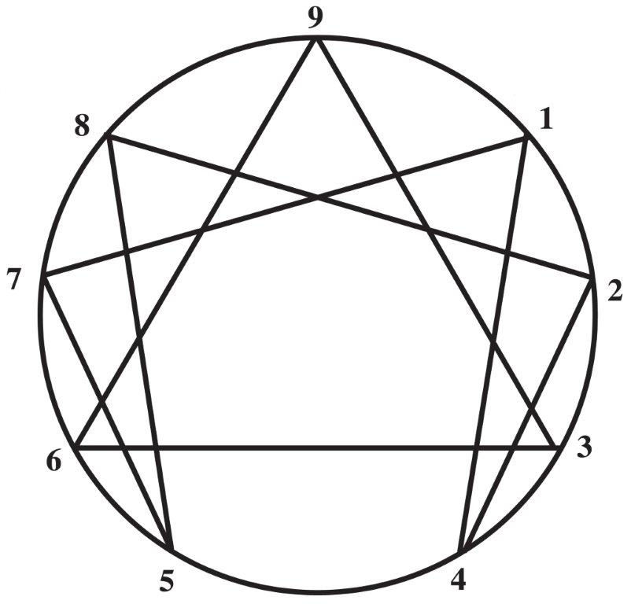
The Enneagram: Synergy thru Diversity
Notes:
The Enneagram is a powerful gateway to self-awareness and understanding of others.

Slide 3
History of the Enneagram
Ancient Roots
Predates modern psychology
Roots in Buddhism, Judaism and Eastern Orthodox Christianity
ENNEA is Greek for Nine GRAM means points
Notes:
Gurdjieff, a Russian teacher and contemporary of Freud
Clausdio Naranjo a Chilean psychologist brought the Enneagram into western psychology

Slide 4
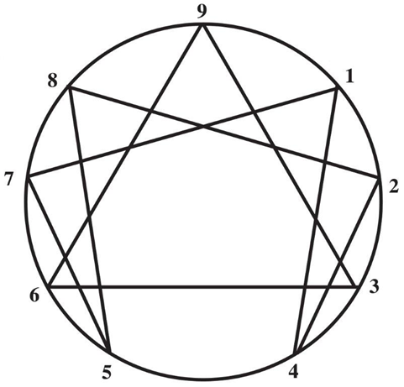
Why is this relevant?
When we honor Diversity we allow for Synergy.
Allowing and recognizing unique viewpoints expands the screen.
Honoring and recognizing our own gifts can allow others to experience that same kind of freedom and liberation.
Notes:
Self Story
Each viewpoint is right….but only partially.
Purpose and How it is used for Good. Natural to look at the shadow (good restaurant experience versus bad what do you talk about)

Slide 5
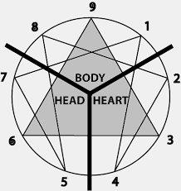
Three Centers of Intelligence
Notes:
Where Attention Goes
FOCUS of ATTENTION

Slide 6
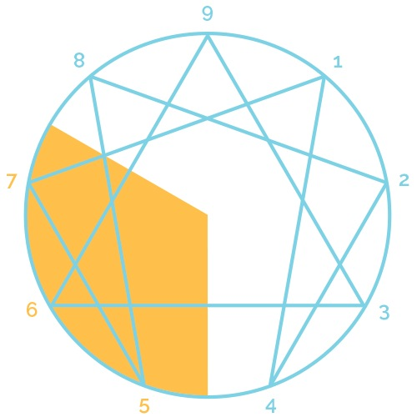
Head Triad
Tend to Filter the world through the Mental Faculties
*Gather Information
*Generate Ideas
*Mental Processing
*Rational Analysis
*Planning
Notes:
Mental Analysis, value facts, info & Ideas.
Share a common concern about safety & trust.
Productive Attributes Unproductive Attributes Objective Over Analysis Astute Insight Productive Planning

Slide 7
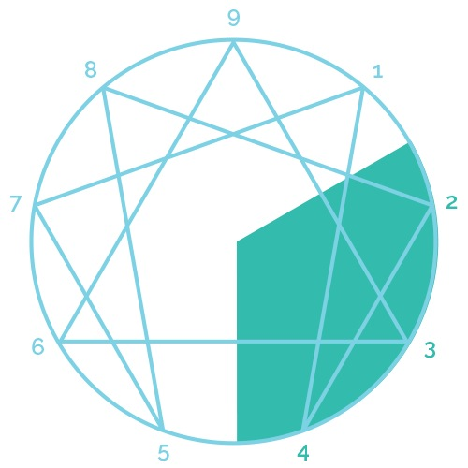
Heart Triad
Tend to filter the world through the lens of Emotional Intelligence
*Experience feelings
*Emotional relating
*Sensitivity to other
Notes:
Productive Attributes Empathy Authentic Relating Compassion
Very concerned about how others perceive them

Slide 8
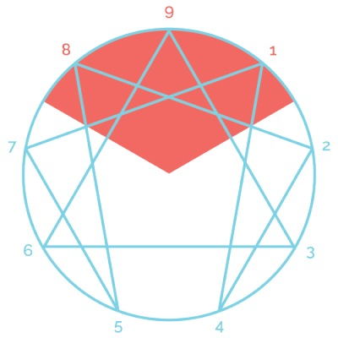
Body Triad
Tend to filter the world through an intelligence of Kinesthetic or physical sensations and gut instincts.
*Movement
*Physical sensations
*Action
*Control
Notes:
Productive Attributes Unproductive Attributes Effective Action Excessive Action Steadfastness Gut Knowing
Primarily trust their gut & instinct.

Slide 9
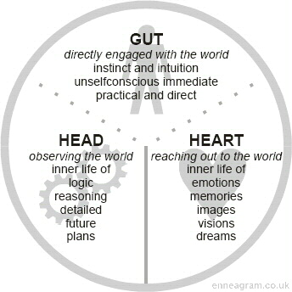
Notes:
Three very different ways of seeing the world with their FOCUS of ATTENTION

Slide 10
Type One: The Perfectionist
FOCUS OF ATTENTION:
What is Right/Wrong
GIFT: Discernment
Notes:
Strengths: * Areas for Development:
Concern for Improvement
Strive for Quality (High Standards) * Reactive
Organized *Critical
Perceptive
Honest

Slide 11
Type Two: The Helper
FOCUS OF ATTENTION:
Other’s Needs
GIFT: Empathy
Notes:
Strengths: Areas for Development:
Empathic *Accommodating
Supportive * Over focused on relationships especially challenging one
Motivating
Warm

Slide 12
Type Three: The Performer
FOCUS OF ATTENTION:
Approval for Tasks
GIFT: Efficiency & Adaptability
Notes:
Strengths: Areas for Development:
Leadership
Energetic *Competitive
Entrepreneurial
Confident
Results oriented

Slide 13
Type Four: The Individualist
FOCUS OF ATTENTION:
What’s Missing
GIFT: Uniqueness & Individuality
Notes:
Strengths: Areas for Development:
Inspiring * Intense
Creative
Introspective
Expressive

Slide 14
Type Five: The Observer
FOCUS OF ATTENTION:
Intrusion
What Other’s Expect
GIFT: Detachment
Notes:
Strengths: Areas for Development:
Analytical * Highly Private
Objective
Expert (scholarly)
Calm in Crisis

Slide 15
Type Six: The Loyal Skeptic
FOCUS OF ATTENTION:
Hazard
GIFT: Loyal Commitment
& Planning
Notes:
Strengths: Areas for Development:
Loyal *Worrying
Collaborative
Persevering
Anticipate problems
Fair

Slide 16
Type Seven: The Epicure
FOCUS OF ATTENTION:
Pleasant Options
GIFT: Optimism
Notes:
Strengths: Areas for Development:
Imagination * Impulsive
Enthusiastic
Engaging
Quick Thinking
Inventive

Slide 17
Type Eight: The Protector
FOCUS OF ATTENTION:
Power & Control
GIFT: Strength
Notes:
Strengths: Areas for Development:
Direct * Controlling
Strategic
Protective
Action oriented
Determined

Slide 18
Type Nine: The Mediator
FOCUS OF ATTENTION:
Maintaining Harmony
GIFT: Acceptance
Notes:
Diplomatic Conflict Avoidant
Easygoing
Accepting
Affable, Steady Going along to get along

Slide 19
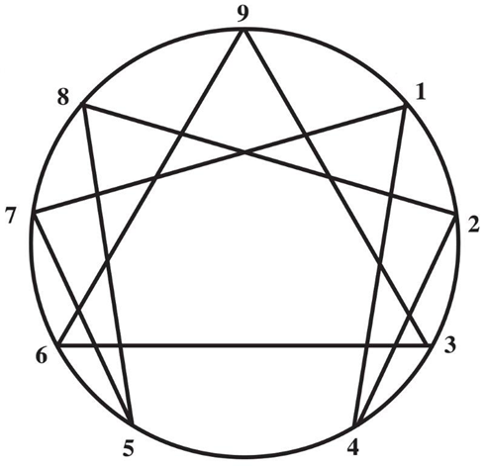
Awareness of Self and Others
Notes:
How do you use this typology to support Diversity and Synergy in your organization ………Awareness of Self & Others
RECALL: All About FOCUS of ATTENTION
6 Loyal Skeptic- Hazard…Anticipate Problems, Collaborative, Worry
#7 The Epicure- Pleasant Options….Imagination, Quick Thinking, Impulsive
Good Balance if they listen to each other.
#7 Sustain a Vision #6 Flourish take on demanding work #7 FOCUS #6 BELIEVE
5: The Observer- Intrusion, What Others Want
3: The Performer- Tasks, Doing, Moving Ahead
Performer jumps right in the middle of the project and moving taking action. Observer is being thought fill drilling down
Common to find Observer positioned as Analyst leaving Performer to handle the public relations.
5 Often produce Basic Concept & Theory, Amplified & Sold by Performer

Slide 20
573.819.6705 CarolynParis1@gmail.com

