Slide 1
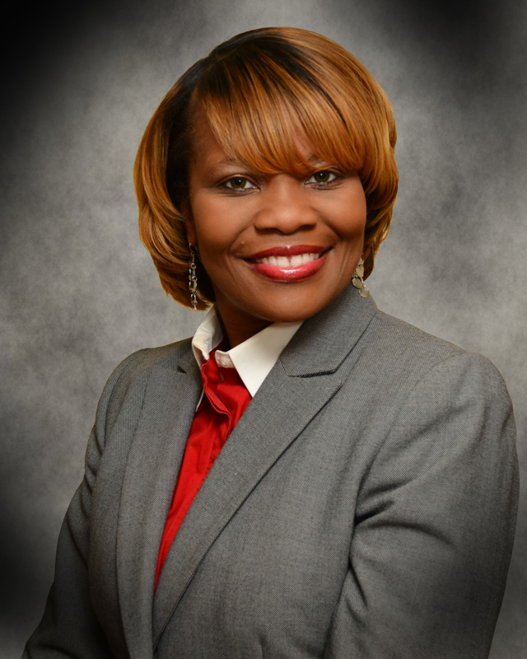
Statewide Collaborative Diversity Conference
“My Journey, My Purpose, My Perspective”
Presented By: Katina Lane-Fomby
Global Diversity and Inclusion Manager
March 18, 2016
Corporation

Slide 2
About Me………Personally
Born and raised in St. Louis, MO
Currently live in Minneapolis, MN
Previously lived in Memphis, TN and Fort Wayne, IN
I have two older sisters and four older brothers
Married, no children, no pets
Hobbies: I collect teapots and Gucci purses, and I love to travel, shop, and sing!
One interesting thing about me: I have 155 pairs of shoes!

Slide 3
About Me………My Educational Journey
Bachelor of Science – Business Administration
The University of Memphis (Memphis, TN)
(2003)
Master of Arts – Human Resources Management
Webster University (St. Louis, MO)
(2005)
Currently pursuing a Doctrine of Business Administration – Organizational Leadership
Walden University (Minneapolis, MN)

Slide 4
About Me………My Career Journey
1995-1997: Branch Manager – Enterprise Rent A Car
1997-2001: Senior Staffing Manager – Robert Half International
2001-2003: Inside Sales Manager – AmSouth Bank
2003-2005: Teacher – Lausanne Collegiate School
2005-2006: Assistant Human Resources Manager – Parker Hannifin
2006-2008: Senior Human Resources Generalist – Cummins, Inc.
2008-2011: Senior Human Resources Generalist – Reynolds, Inc. (Closure Systems International)
2011-2012: Human Resources Manager (Hartford City, IN) – 3M Corporation
2012-2014: Human Resources Manager (St. Paul & Eagan, MN) – 3M Corporation
2014-Present: Global Diversity and Inclusion Manager – 3M Corporation

Slide 5
My Personal Stories
LIFE
MY OUTLOOK ON LIFE
Notes:
Racial Discrimination – 2001 (Memphis, TN)
Old enough, qualified, you’re Black
3M – Indiana “You weren’t what we expected, are you old enough, are you qualified, colored HR lady
3M Eagan – diverse plant, learned different languages, cultures (attended three Hmong funerals, cultural celebrations)
-The importance of understanding culture and administering policies and procedures

Slide 6
Why I Chose Human Resources Management
I wanted to be an Employment Lawyer but I didn’t want to go to law school
It gave me the opportunity to develop others and myself
It gave me the opportunity to influence innumerable aspects of the organization, and to play a part in influencing strategic business decisions
I wanted to make a difference!
Our workforce and our entire economy are strongest when we embrace diversity to its fullest, and that means opening doors of opportunity to everyone and recognizing that the American Dream excludes no one. Thomas Perez
Notes:
A job as HR professional is one of most respected and of importance in an organization. We are in charge of some vital tasks such as identifying and hiring new talent for the company, & coordinating between the management and the employees.
Never give direct answers like “I love working with people” because hundreds of candidates before you have given the same answer. If you are really passionate about HR jobs, then it shouldn’t be a problem to cite examples where you put to use your abilities in a manner which is relatable to the desired skills for an HR job. A good way would be to identify work areas that an HR manager has to perform, and relate them with your interest.
a.
b. You will never know all there is to know about human resources, it is one of the most fluid and ever changing careers you can have. Employment law is always changing, as are federal requirements and regulations. It’s overwhelming at times at how much you need to know, but never will.
c. Sometimes in HR, I felt like I was on the menu, but I didn’t have a seat at the table.

Slide 7
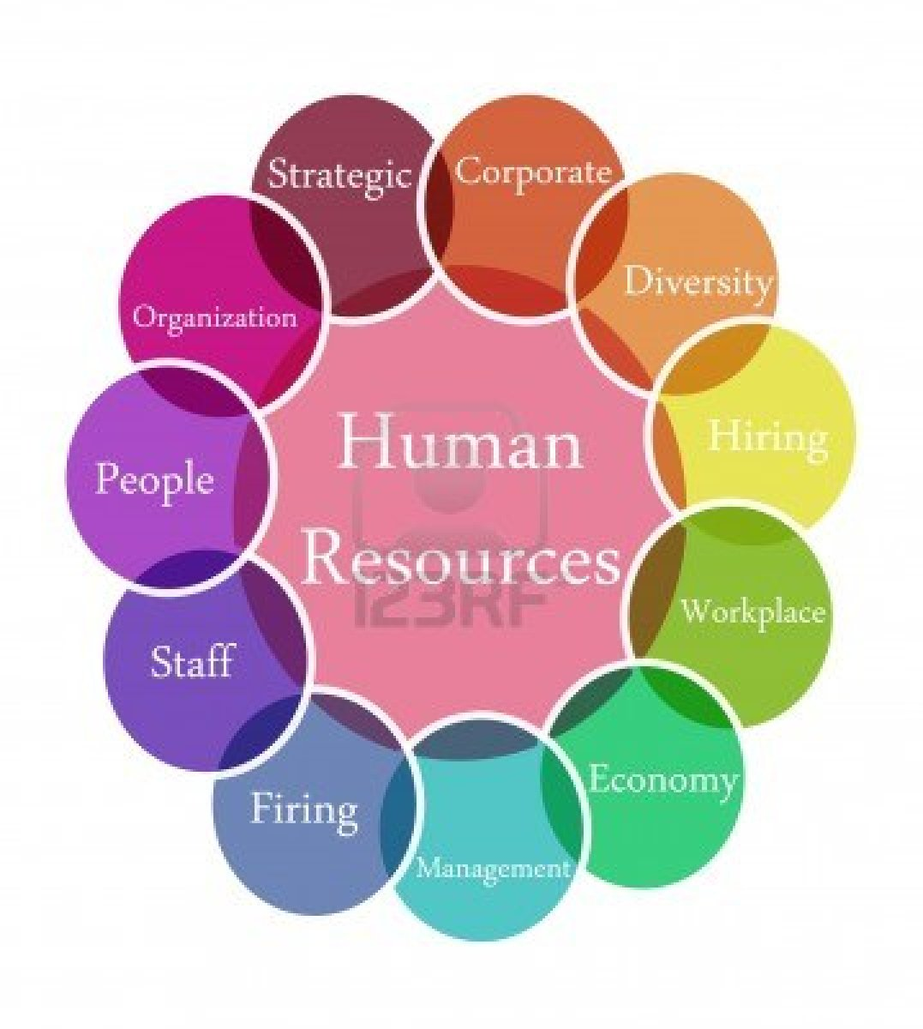
How has Diversity and
Inclusion Contributed to my Success?
Diversity and Inclusion has opened a window of opportunities for me personally and professionally.
Diversity and Inclusion has made me a more “well rounded” Human Resources Professional.
Diversity and Inclusion has allowed me to see the world through a broader lens.
Notes:
A. Workplace diversity affects the development of interpersonal relationships, how supervisors and managers interact with staff and how employees relate to each other. It also affects human resources functions, such as record keeping, training, recruiting and requirements for HR staff expertise. In many ways, workplace diversity increases HR responsibilities and holds the department accountable for functions mandated by law
Recruiting
Workplace diversity goals can require modifications to recruitment strategy or outreach to identify a diverse pool of qualified applicants. For example, recruiting from historically black colleges and universities may yield diverse candidates as will joining the Organization of Women Architects and Design Professionals to gain access to qualified women in a predominately male profession. In addition, posting requirements such as "equal opportunity employer" are HR functions that encourage diverse applicants to submit their resumes for consideration.
Training
Organizations look to HR staff to recommend diversity trainers or to supply in-house diversity training resources. The decision to mandate workplace diversity training is a strategic function of HR because it involves an assessment of the workplace climate and whether supervisors and managers would benefit from mandatory training or if informal activities are sufficient to support the company's workplace diversity philosophy.
Workforce Management
Diversity can help companies gain a competitive edge in global markets and when targeting business segments that require input from diverse perspectives. HR expertise is useful in evaluating where diverse candidates can be placed in the organization so they can make the most valuable contributions. For example, an organization concerned with developing state-of-the-art technology solutions might assign tech-savvy workers from Generation X or the Millennial generation to these projects, instead of a long-term worker from the Silent generation who relies on processing work using conventional methods.
B. Working in a diverse plant and being exposed to Hmong culture, Somali culture (language, family values, practices)
Make more informed and value added experience

Slide 8
What Motivates Me?
Coaching others and watching them succeed
Accomplishing tasks or projects that others have deemed unattainable
Meeting or exceeding project goals
My Motto:
Strive for Excellence, Not Perfection!
Notes:
a.
b. I like taking the road less travelled.
c. It gives me a sense of accomplishment and it's something that I can look back on and say "I achieved that"

Slide 9
A Glance at Diversity and Inclusion

Slide 10
Diversity and Inclusion Quotes
“We are all different, which is great because we are all unique. Without diversity life would be very boring.”
Catherine Pulsifer
“A lot of different flowers make a bouquet.”
Muslim Origin

Slide 11
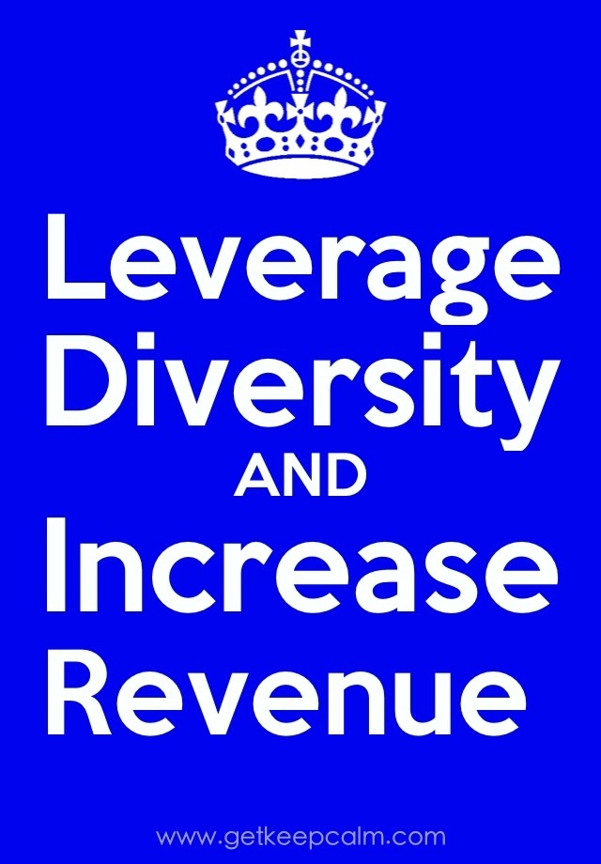
A Snapshot of Diversity

Slide 12
A Snapshot of Diversity
Source: https://www.glassdoor.com/Overview/Working-at-McKesson-EI_IE434.11,19.htm

Slide 13
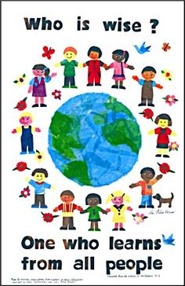
A Snapshot of Diversity

Slide 14
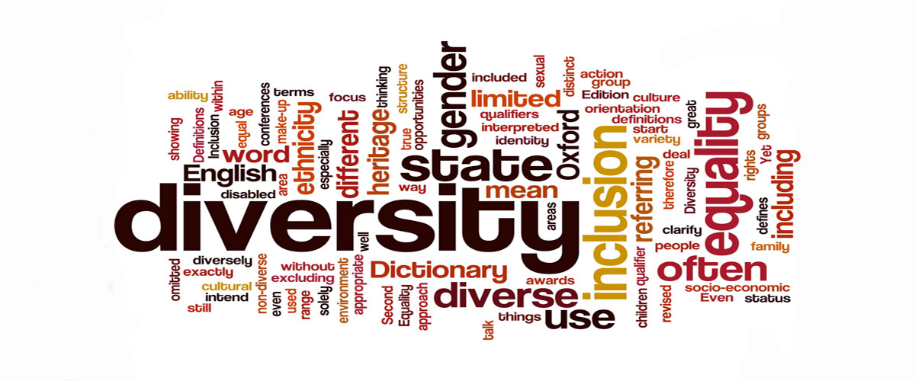
A Snapshot of Diversity

Slide 15
Questions

