Slide 1
How to Complete Master Promissory Note
Studentloans.gov

Slide 2
Step 1: Go to studentloans.gov and login
Log In using your FSA username and password.

Slide 3
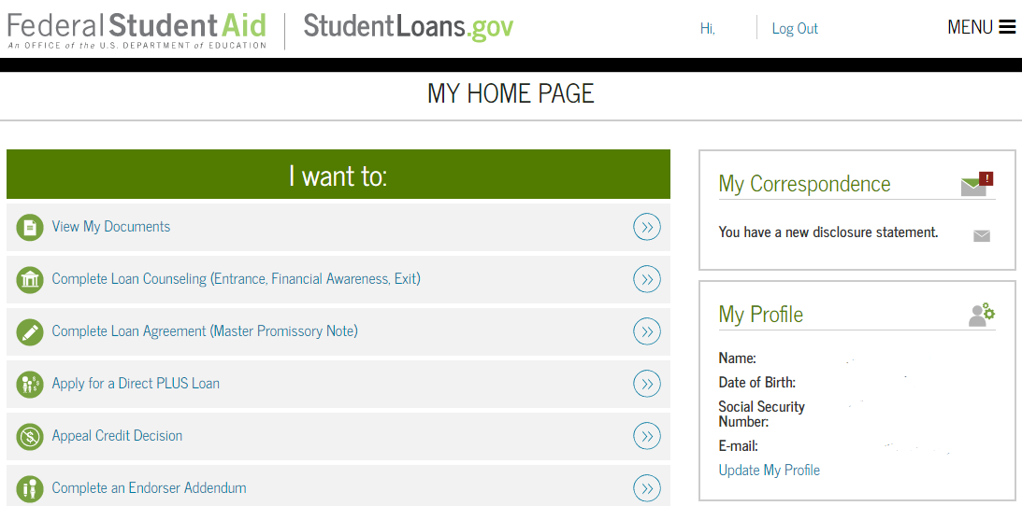
Step 2: Select the Complete Loan Agreement Link

Slide 4
Step 3: Select the type of Direct Loan MPN

Slide 5
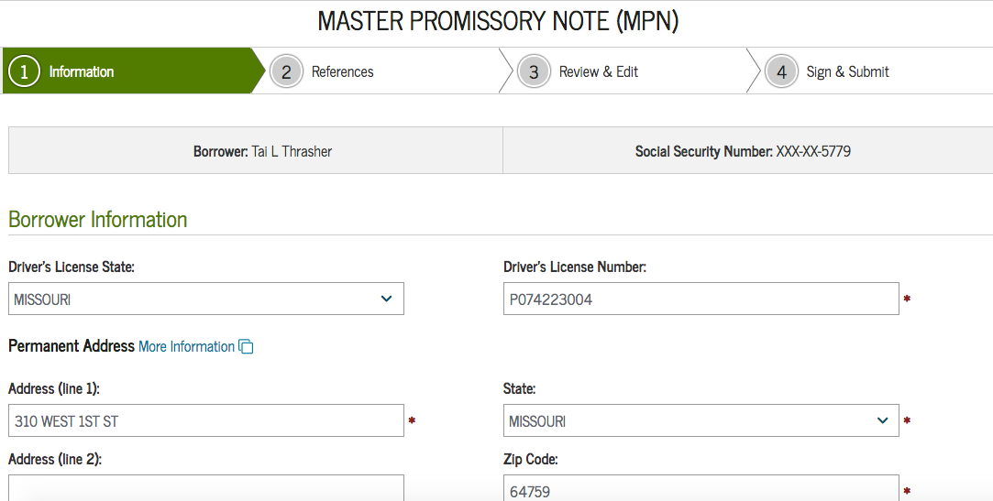
Step 4: Fill Out All Borrower Information

Slide 6
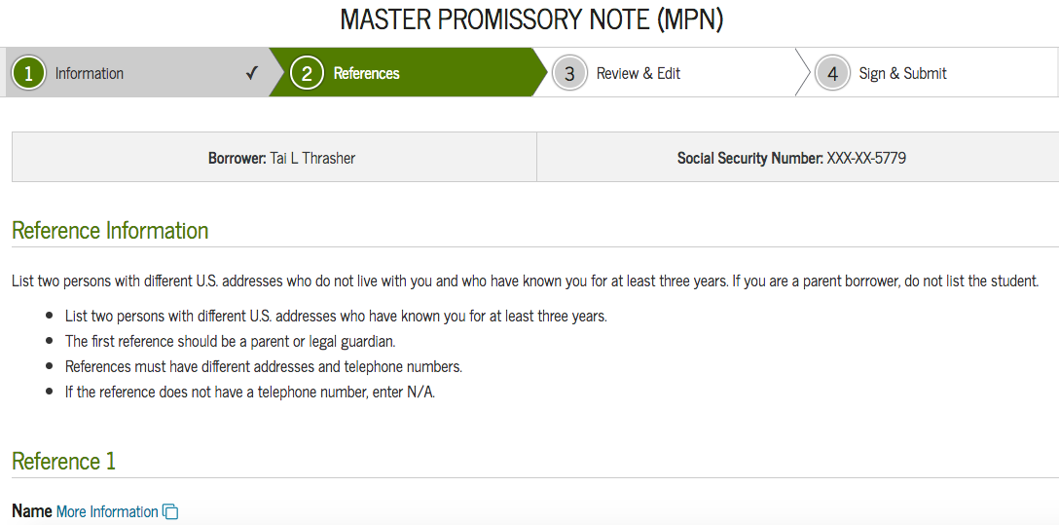
Step 5: References
It is recommended that your first reference be a parent/guardian who you live with, and the second reference be a close family member who doesn’t have the same permanent address as you.

Slide 7
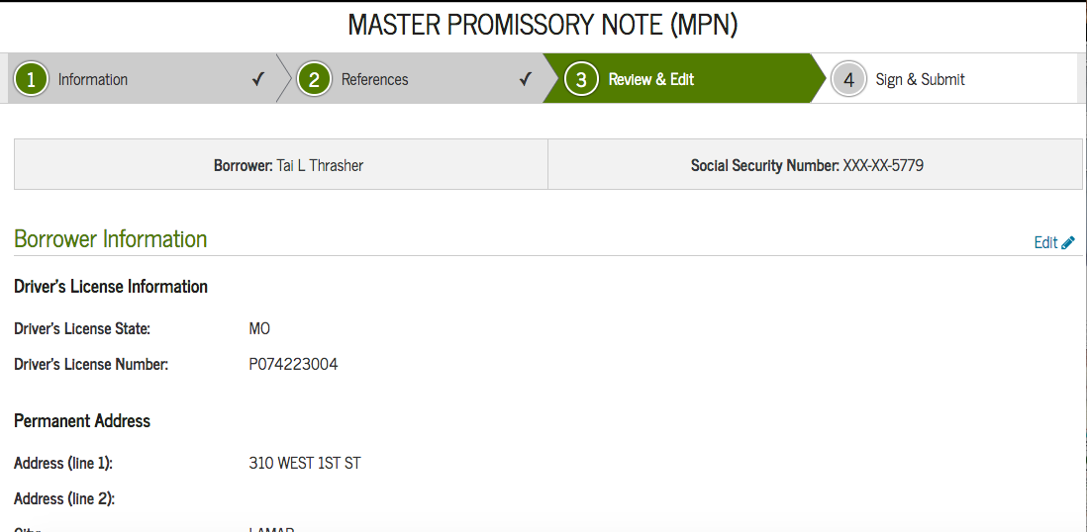
Step 6: Review And Edit If Needed

Slide 8
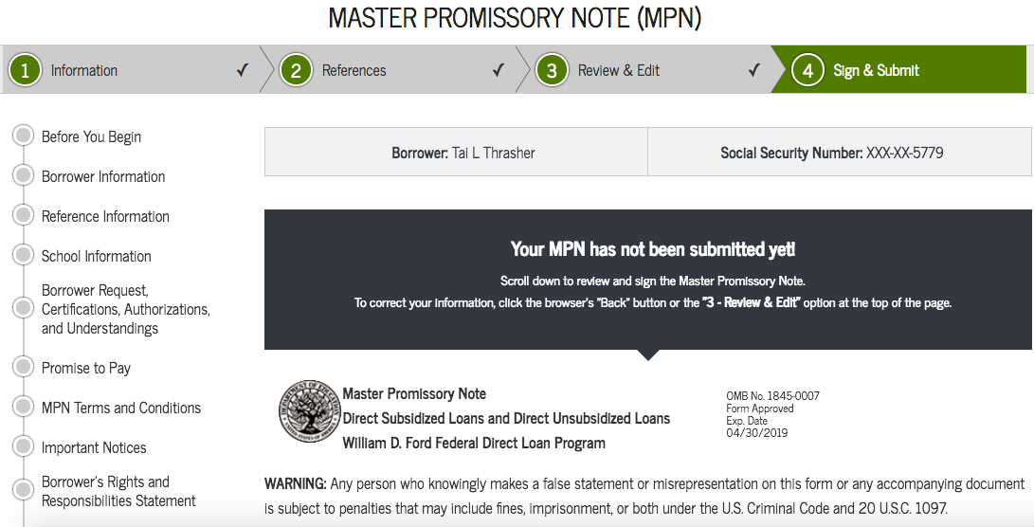
Step 7: Sign and Submit

Slide 9
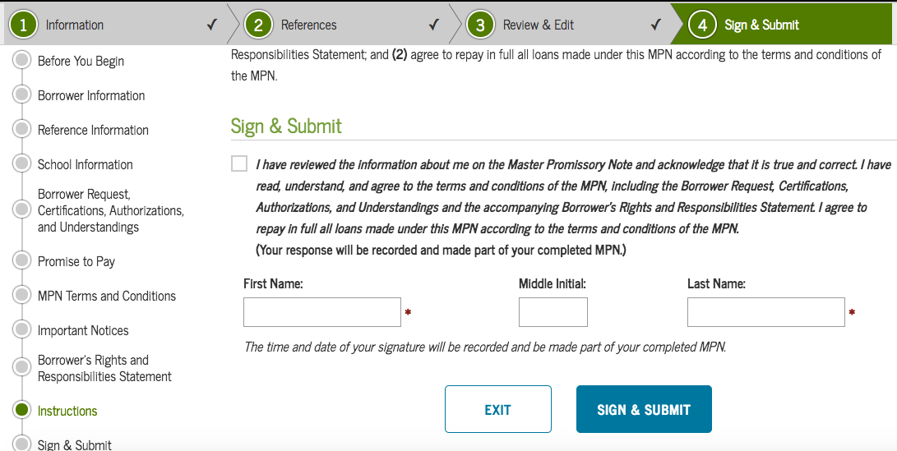
Step 8: Sign and Submit

Slide 10
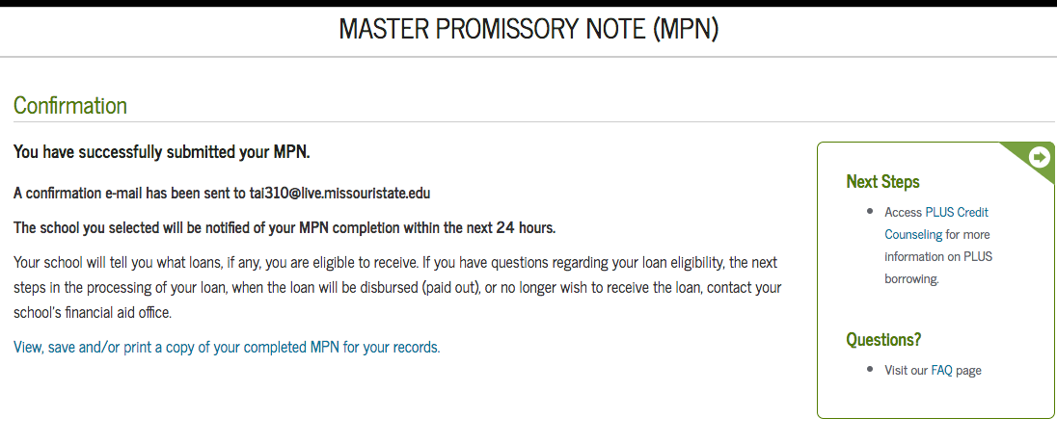
Step 9: Confirmation

