Slide 1
How to Complete Exit Counseling
Studentloans.gov

Slide 2
Step 1:
Go to studentloans.gov and log in

Slide 3
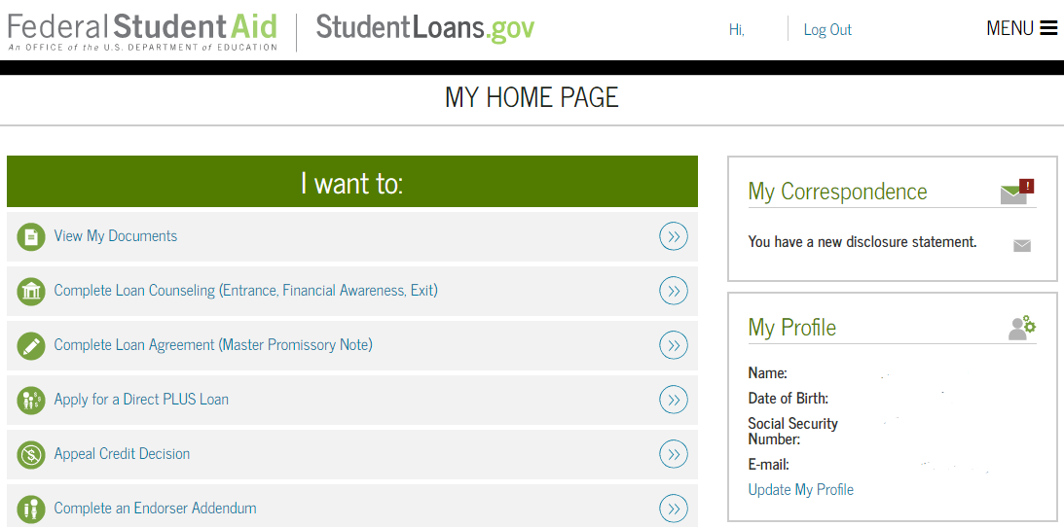
Step 2:
Select the complete counseling link

Slide 4
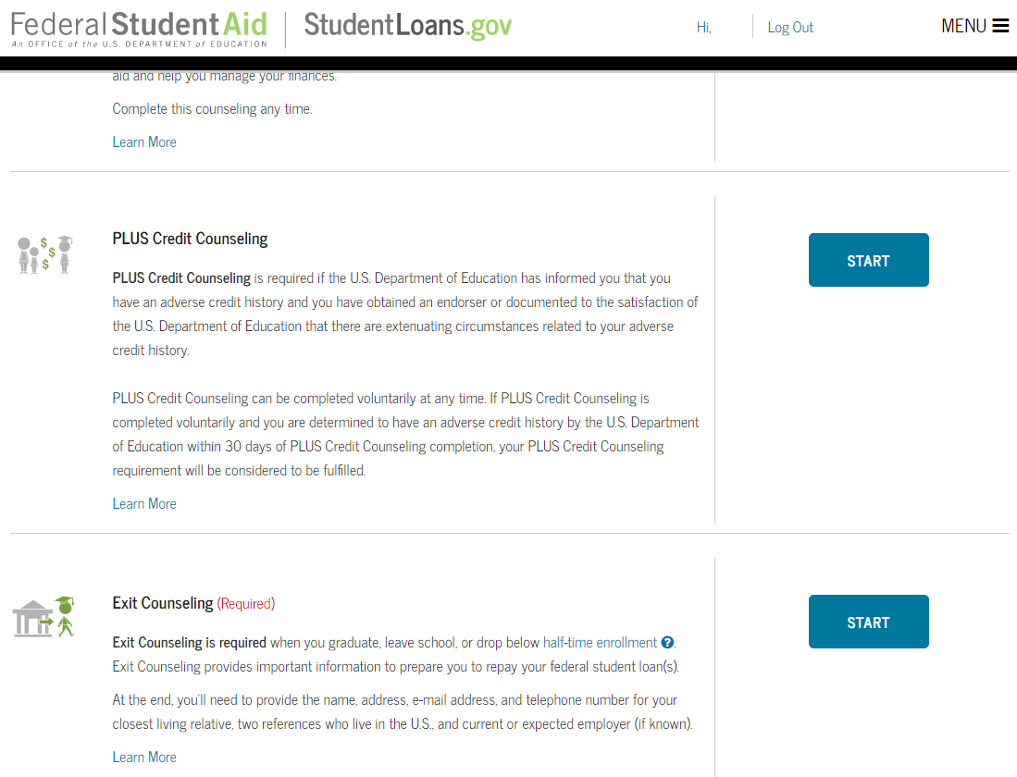
Step 3:
Select the start exit counseling button

Slide 5
Step 4:
Select your school (Missouri state university) to notify

Slide 6
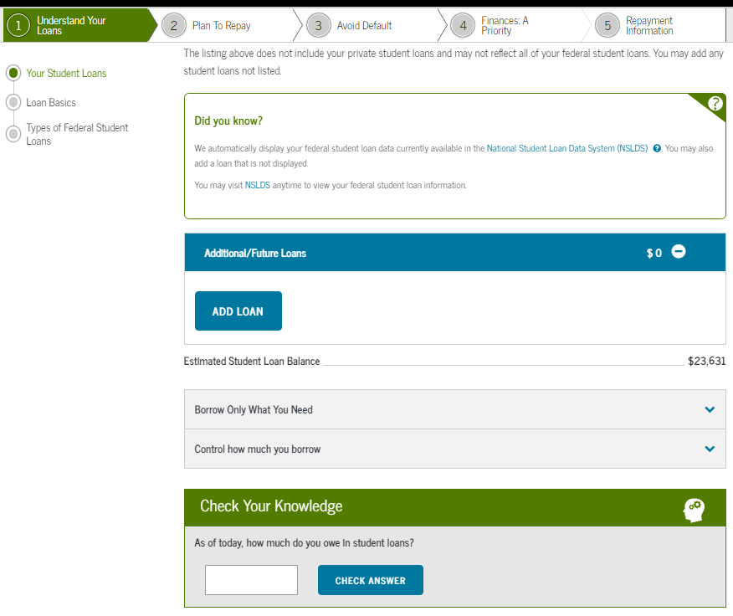
Step 5:
Understand your loans
To “Understand Your Loans” step displays a customized breakdown of the student’s loans and also covers basic loan terminology, the most effective ways to pay for school, and the different types of student loans.
The total amount of loans you must repay will be displayed. To add a loan not displayed, click “Add Loan”.
Answer all “Check Your Knowledge” questions correctly to continue to the next step.

Slide 7
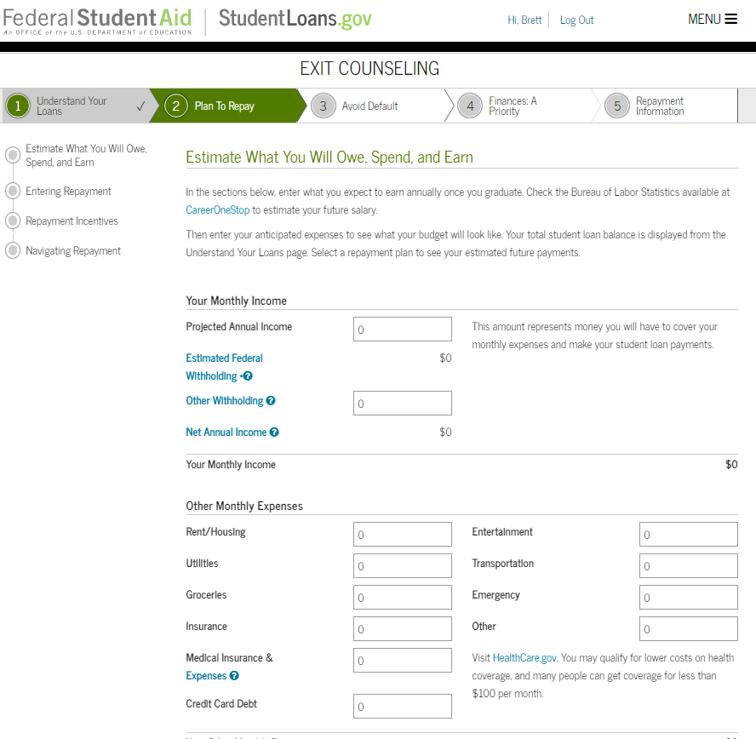
Step 6:
Understand your loans: Plan to repay
Complete all 3 tabs on the page: Your Monthly Loan Payment, Your Other Monthly Expenses, and Estimate Your Monthly Income.
Answer all “Check Your Knowledge” questions in purple correctly to continue to the next step.

Slide 8
Step 7:
Understand your loans: avoid default

Slide 9
Step 8:
Make finances a priority
The “Make Finances a Priority” step is designed to teach students about their income and taxes, how to protect their credit and identity, and how to develop a sound financial plan.
Answer all “Check Your Knowledge” questions correctly to continue to the next step.

Slide 10
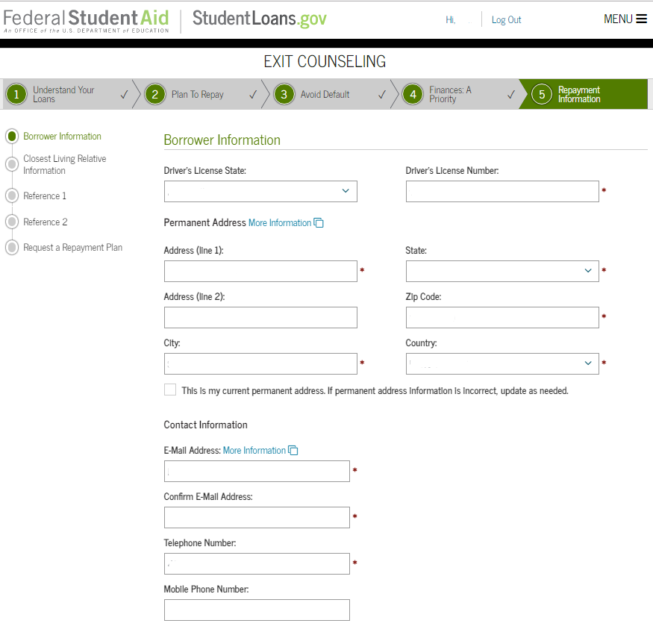
Step 9:
Understand your loans: Repayment Information
The “Repayment Information” step collects information about you, your references, and your preferred repayment plan.
Input your permanent address, personal contact information, your employer information, and contact information for your next of kin in for two references in the Reference Information section.

Slide 11
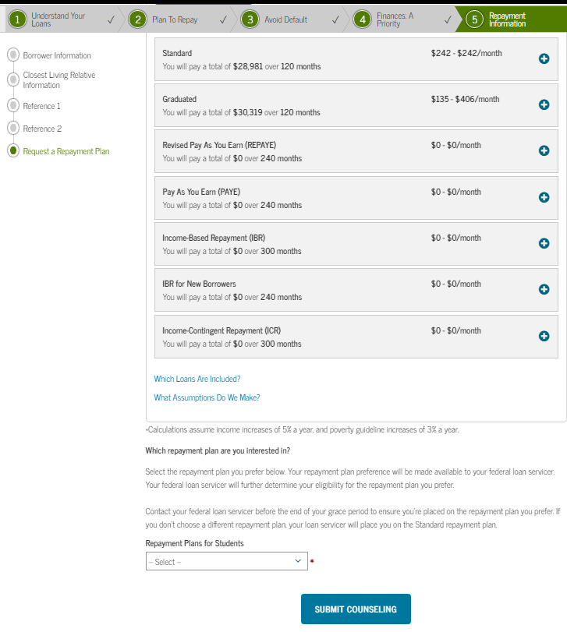
Step 10:
Understand your loans: Repayment information
Select a Repayment plan
Click “Submit Counseling” at the bottom of the page to submit the Exit Counseling session.

