Slide 1
How to Complete Entrance Counseling
Studentloans.gov

Slide 2
Step 1: Go to studentloans.gov and log in
Log In using your FSA username and password.

Slide 3
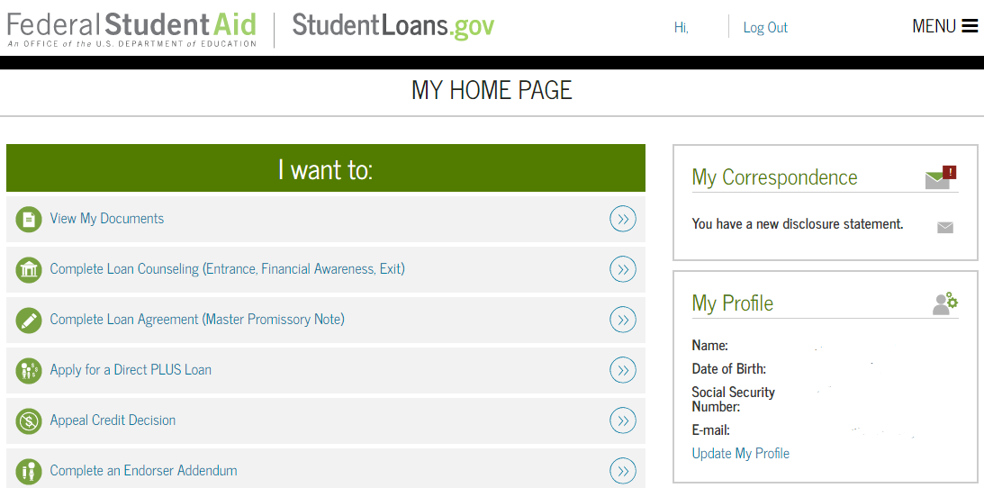
Step 2: Select the Complete Counseling Link

Slide 4
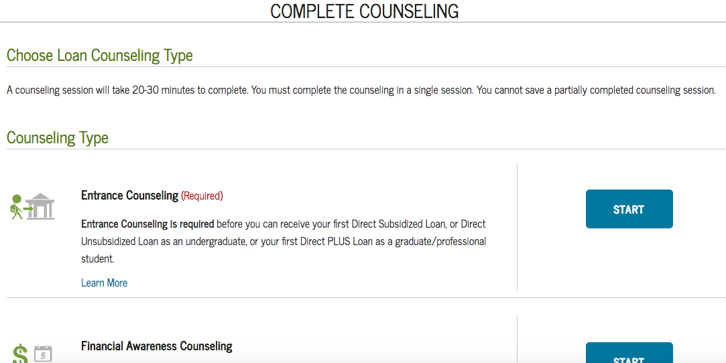
Step 3: Select the Start Entrance Counseling button

Slide 5
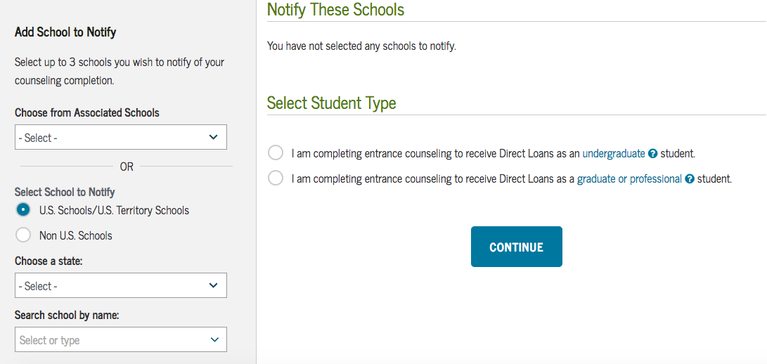
Step 4: Select Your School (Missouri State University) to Notify

Slide 6
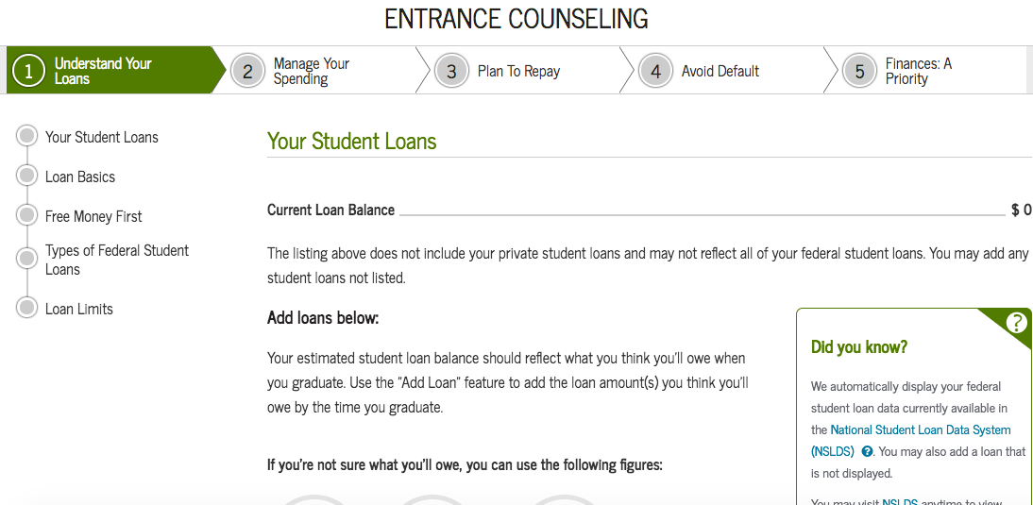
Step 5: Understand Your Loans
To “Understand Your Loans” step displays a customized breakdown of the your loans. It also covers basic loan terminology, the most effective ways to pay for school, and the different types of student loans.
The total amount of loans you must repay will be displayed. To add a loan not displayed, click “Add Loan”.
Answer all “Check Your Knowledge” questions correctly to continue to the next step.

Slide 7
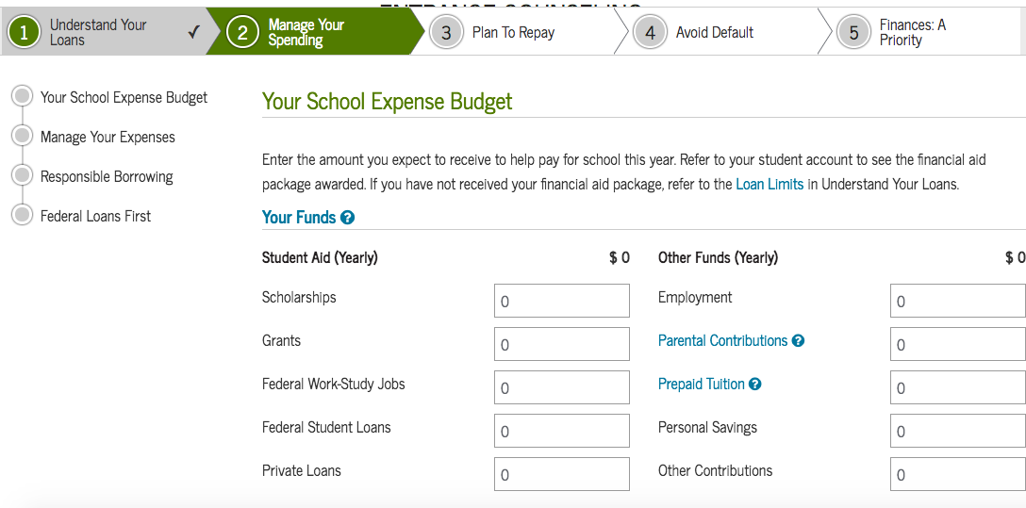
Step 6: Manage Your Spending
Complete both steps on the page: Your Expenses This Year and Your Funds This Year. Estimate what your funds will be based on scholarships, loans, and grants that you have. Include income from your job as well (if you have one). Estimate what expenses you will have based on your rent, tuition, groceries, and any other expenses you might have.
Answer all “Check Your Knowledge” questions correctly to continue to the next step.

Slide 8
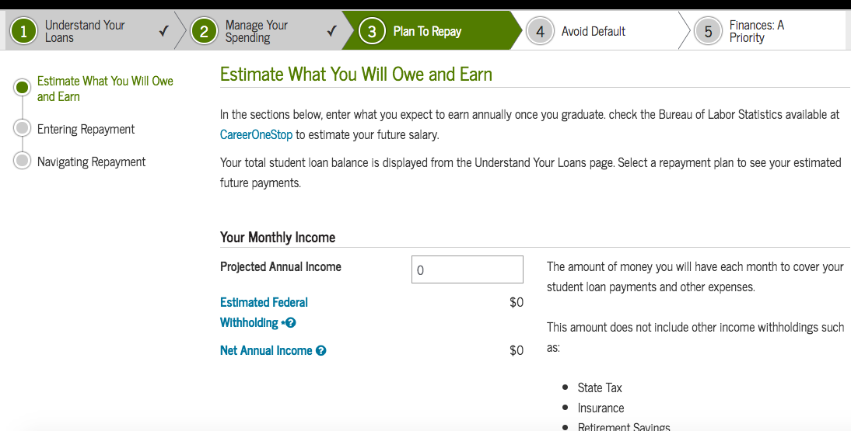
Step 7: Plan To Repay
The “Plan to Repay” step shows you what you could potentially own and earn when repaying your student loans. Make sure you complete both steps: Your Monthly Loan Payment and Your Monthly Income.
Answer all “Check Your Knowledge” questions correctly to continue to the next step.

Slide 9
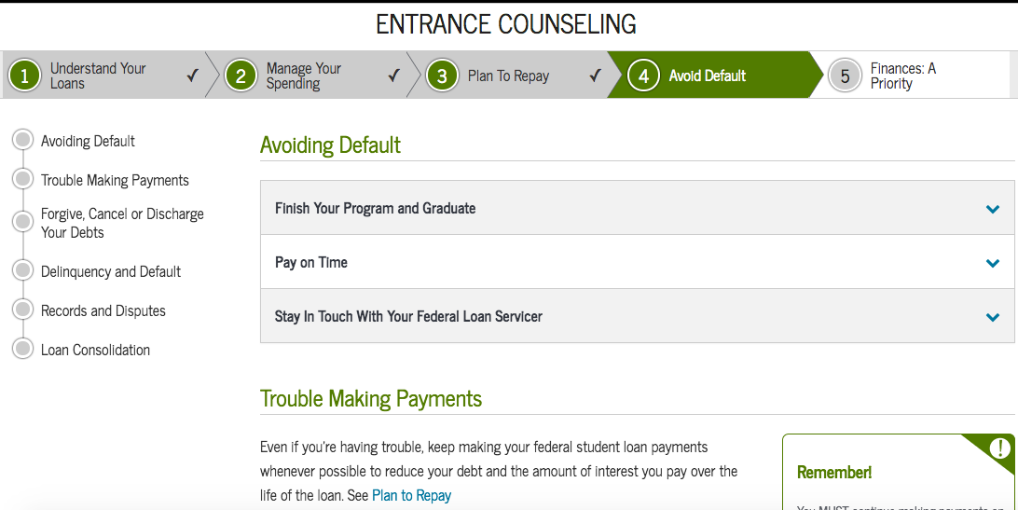
Step 8: Avoid Default
The “Avoid Default” step is designed to teach you how to avoid default after you have graduated and begin repaying your loans. Read this section thoroughly, so you can be sure to stay on top of your monthly payments and avoid the punishments associated with defaulting on your student loans.
Answer all “Check Your Knowledge” questions correctly to continue to the next step.

Slide 10
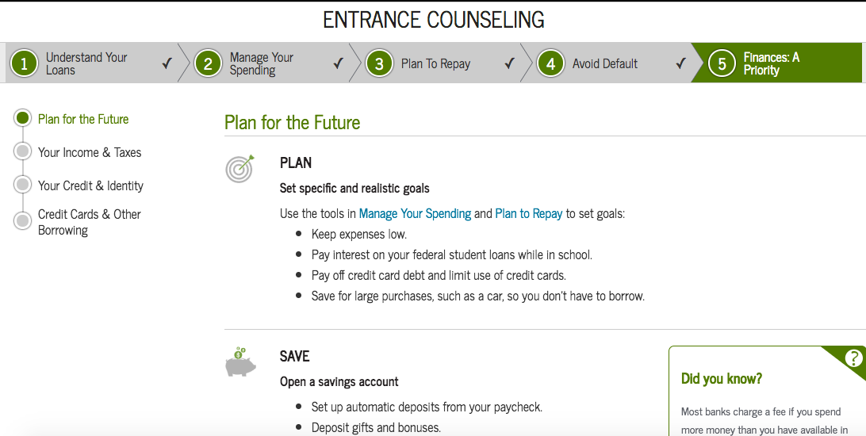
Step 9: Finances: A Priority
The “Make Finances a Priority” step contains information to help you plan, save, and spend wisely for your future. This is very useful information, so make sure you read over this page.

Slide 11
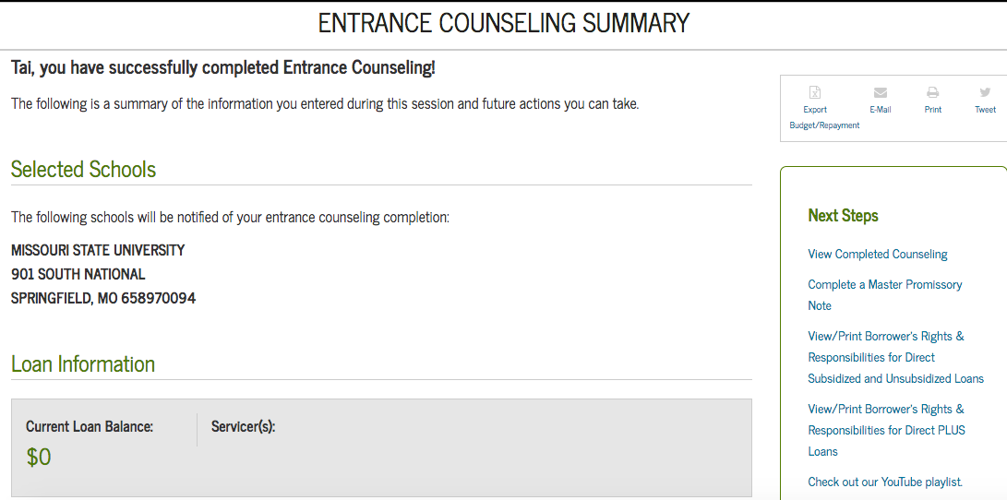
Step 10: Entrance Counseling Summary
Missouri State will be notified within 24-48 hours once your counseling session has been completed. You must sign the Master Promissory Note as well.

